Slide 1
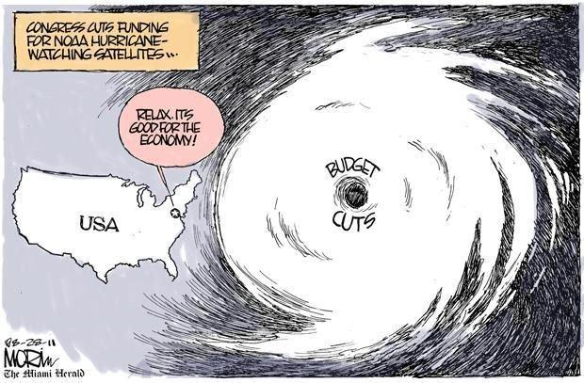

Slide 2
 | 2010 | 2011 | 2012 | 2013 | 2014 | 2015
Program/System
Flight Segment
Ground Segment
System Design Review complete
Mission PDR Part I complete
Launch Readiness Oct. 2015
Mission PDR Part II
Mission CDR
Spacecraft
S/C PDR complete
S/C SDR complete
S/C CDR
Instruments
ABI Delta CDR complete
ABI Delivery
SEISS Delivery
All instruments have passed CDR
EXIS Delivery
SUVI Delivery
GLM Delivery
Core GS PDR complete
RBU/NSOF/WCDAS installation
Antenna System PDR completed
Antenna System CDR
GS Project PDR complete
WCDAS complete
ESPDS CDR
RBU complete
100 % delivery of baseline product algorithms
CLASS CDR
NSOF complete
GS CDR
Development Integration and Testing

Slide 3
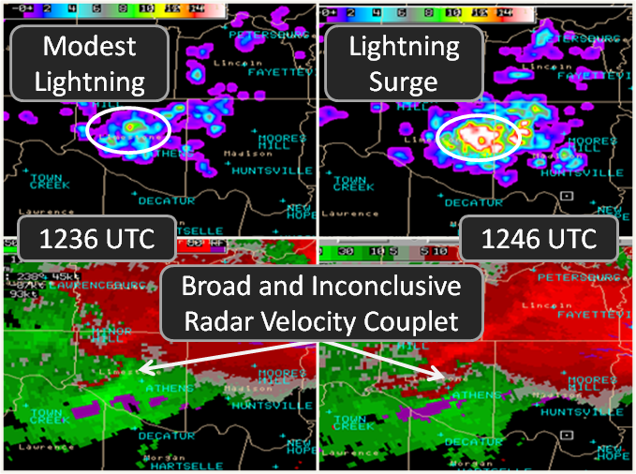
Geostationary Lightning Mapper (GLM)
National Average for Tornado warning lead-time is only 13 minutes
Courtesy of Chris Schultz – University of Alabama, Huntsville
Notes:
GLM Characteristics
Staring CCD imager (1372x1300 pixels)
- Single band 777.4 nm
- 2 ms frame rate
- 7.7 Mbps downlink data rate
Near uniform spatial resolution to 52 deg N lat
- 8 km nadir to 14 km at edge
70-90% flash detection
Product Availability (event, group, flash)
- < 20 sec total latency
- satellite rebroadcast and internet

Slide 4
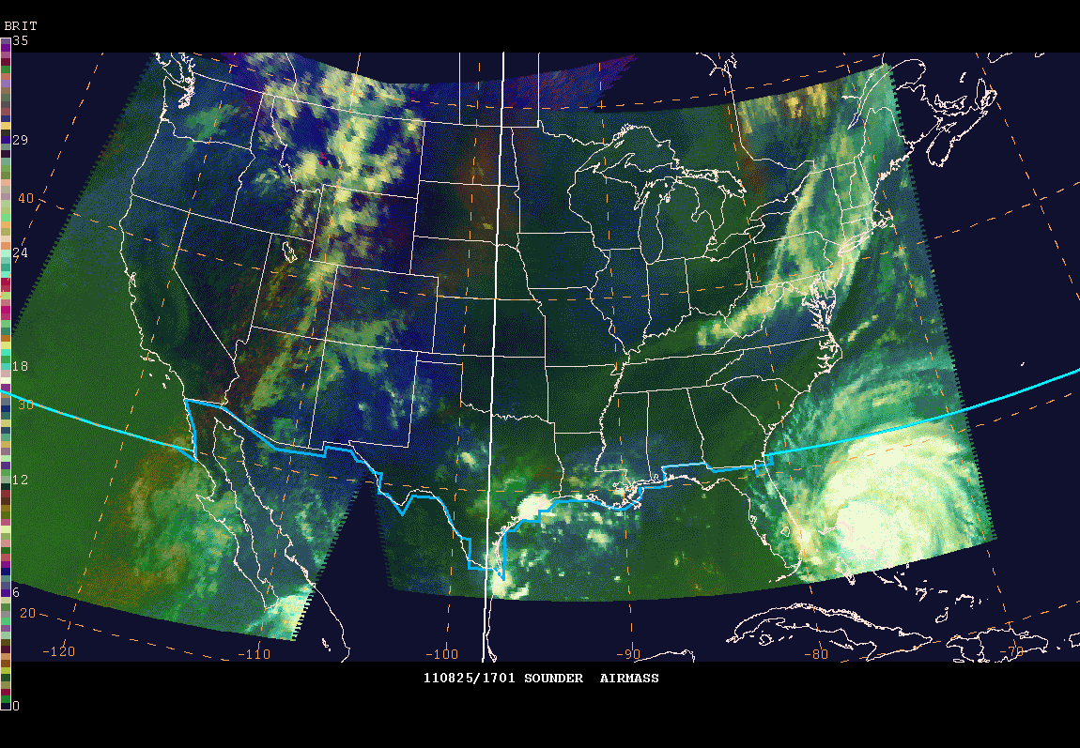
Future Capability: RGB Air Mass Product
Hurricane Irene
As the hurricane is approaching Cape Lookout, NC, the RGB product shows evidence of synoptic-scale dry air on the south-southeast side of the circulation. Synoptic –scale dry air is present to the northwest on the periphery of the storm. This dry air is caught in the southwest inflow channel, effectively cutting off convective development by introducing stably stratified air.
From CIRA and NASA SPoRT and Michael Folmer (CICS Satellite Champion at HPC/OHC/SAB)

Slide 5
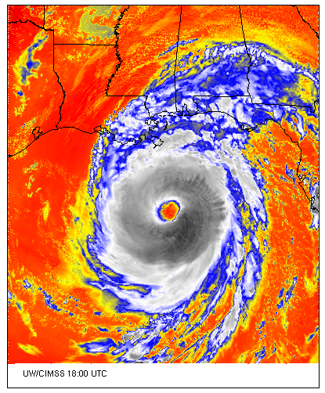
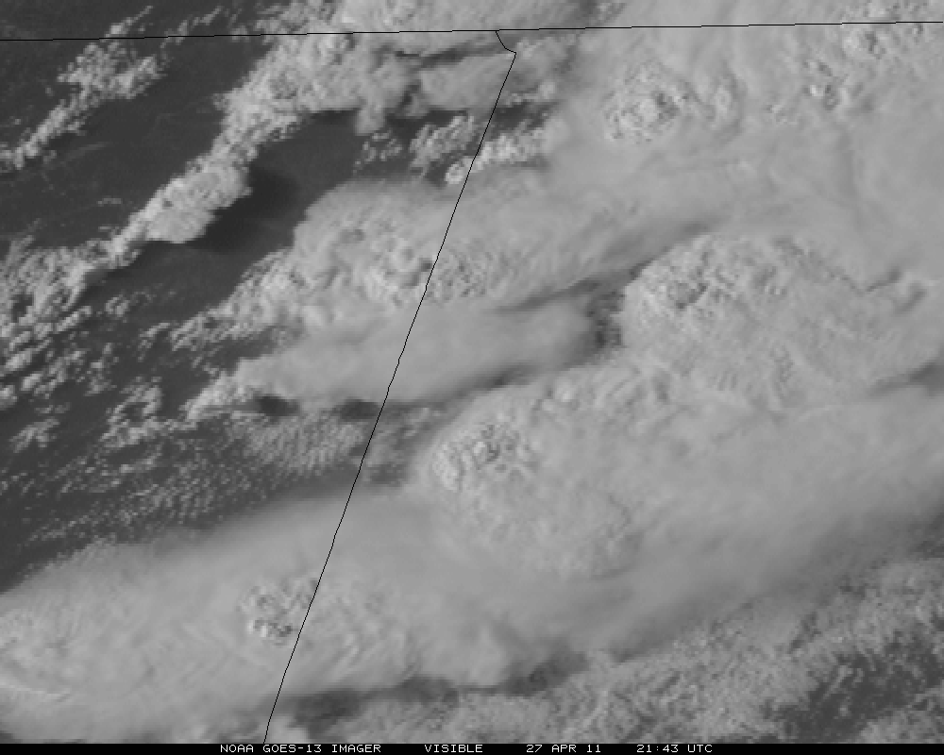
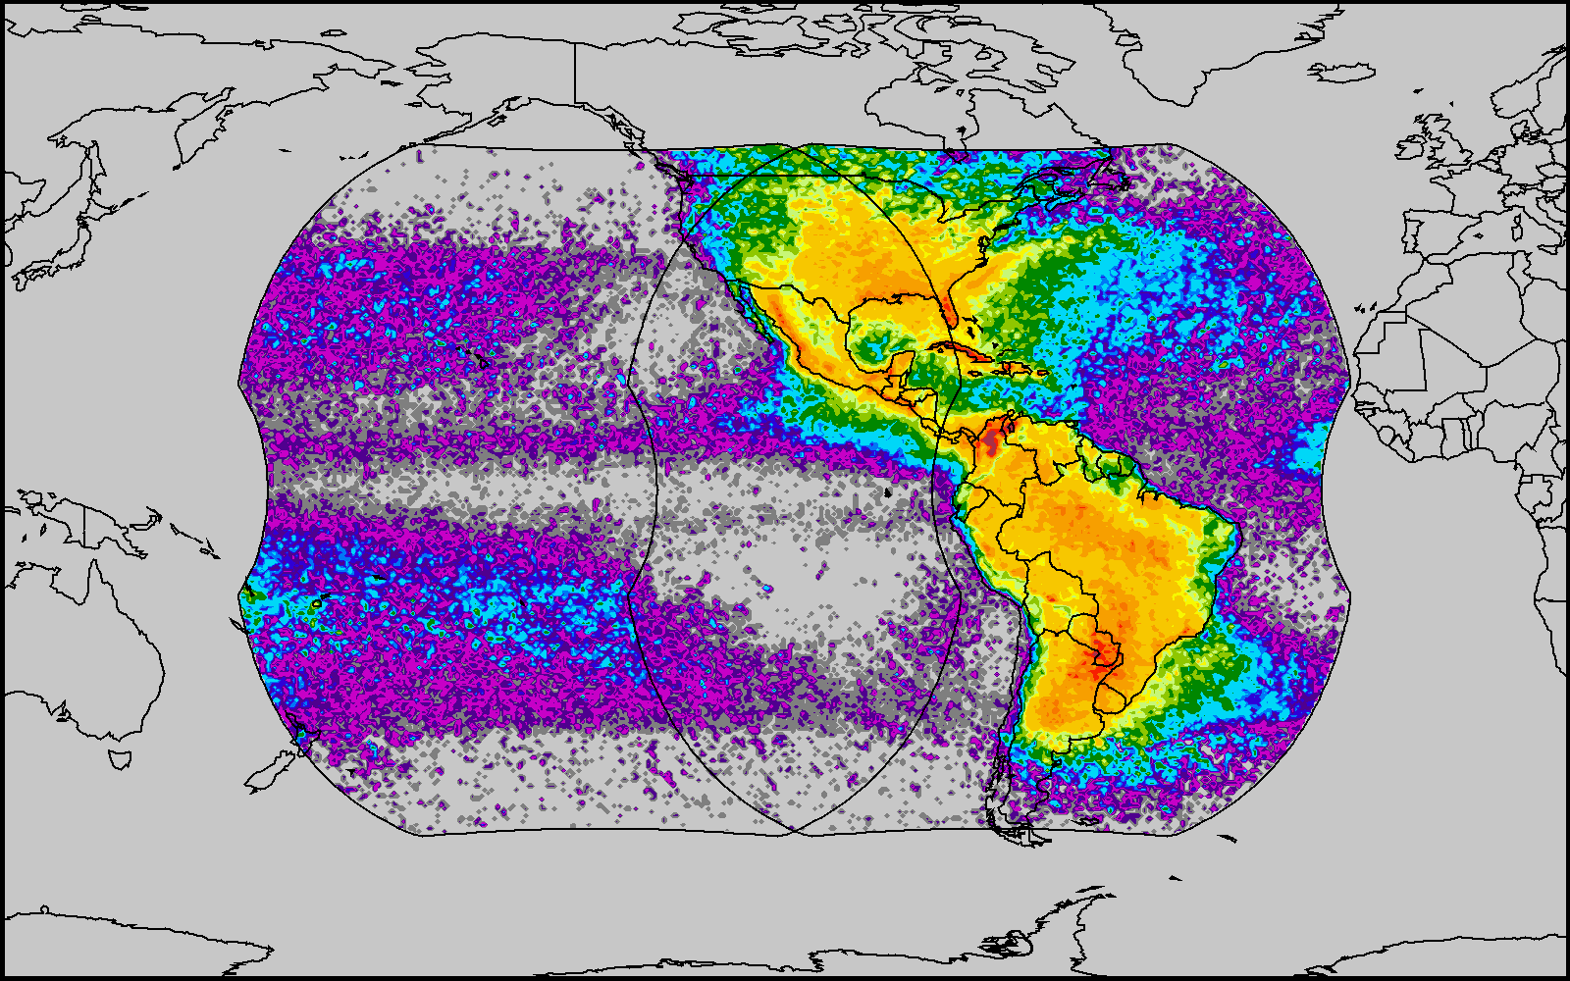
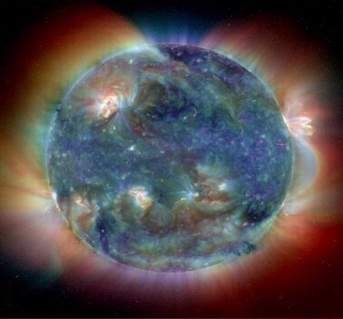
7th GOES Users’ Conference
20-21 October 2011 The Wynfrey Hotel Birmingham, AL
To be held in conjunction with the 15-20 October 2011
36th National Weather Association Annual Meeting: http://www.nwas.org/meetings/nwa2011
The Wynfrey Hotel
http://directreadout.noaa.gov/GUC_VII/index.htm

Slide 6
Thank you!
Any ???
For more information visit www.goes-r.gov
http://www.facebook.com/GOESRsatellite

