Slide 1
Evapotranspiration and Drought Monitoring Using
GOES-R Products for NIDIS
Co-PI: Christopher Hain (UMD/ESSIC)
Co-PI: Xiwu Zhan (NESDIS/STAR)
Co-Is: Martha Anderson (USDA)
John Mecikalski (UAH)
Collaborators: Mark Svoboda (NDMC)
Brian Wardlow (NDMC)
Yunyue Yu (NESDIS/STAR)
Istvan Laszlo (NESDIS/STAR)
Felix Kogan (NESDIS/STAR)

Slide 2
Evapotranspiration and Drought Monitoring Using GOES-R Products for NIDIS
Purpose: Use a thermal infrared-based surface energy balance modeling system (ALEXI) to demonstrate the utility of GOES-R products for routine mapping of evapotranspiration and drought (ALEXI Evaporative Stress Index [ESI]).
Strengths of ALEXI in ET and Drought Monitoring
Diagnostic LSMs based on TIR remote sensing like ALEXI, require no information regarding antecedent precipitation or soil moisture storage capacity – the current surface moisture status is deduced directly from the remotely sensed radiometric temperature signal.
Vegetation-based indices (such as NDVI and VHI) are relatively slow response variables to moisture deficits, showing decline only after damage has been done, while ALEXI is able to determine potential vegetation stress and provide early warning preceding detectable degradation in vegetation indices.
Project Objectives:
Implement ALEXI at 3-km resolution over Europe and/or Africa using LSA SAF SEVIRI products, building a climatological database from 2007 to present.
Evaluate ALEXI surface flux estimates in comparison with ground-base observations.
Generate 3-km ALEXI Evaporative Stress Index maps over the 2007 to present period.
Evaluate ESI in comparison with standard drought indices and historical drought records.
Prepare ALEXI system to ingest GOES-R product as they become available.

Slide 3
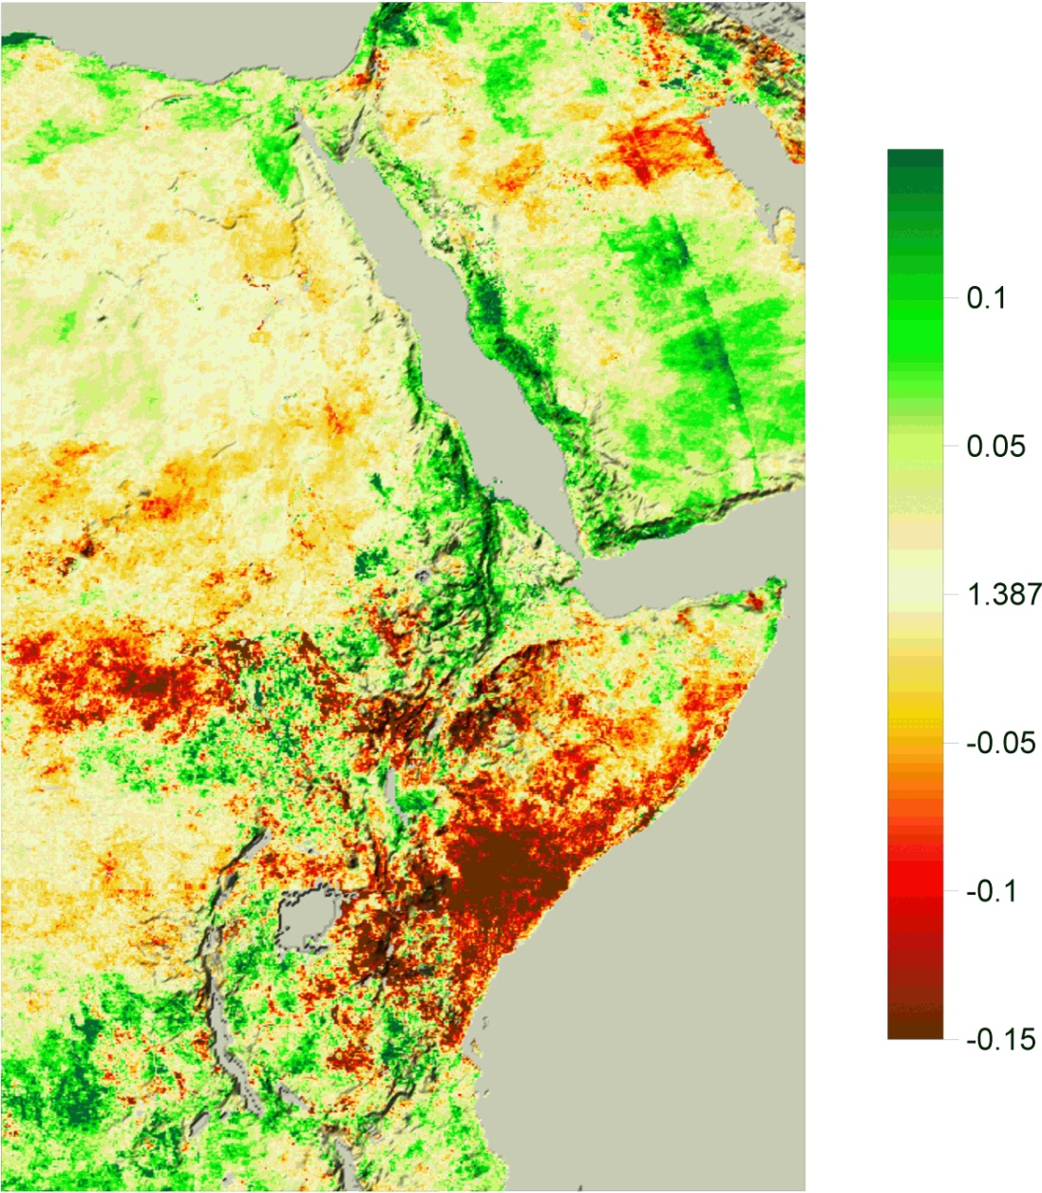
Initial Implementation over Africa (Horn of Africa Drought 2011)
FEWS-NET Food Insecurity Phase
ALEXI ESI Anomalies
[Red shading denotes ET deficits]

