Slide 1
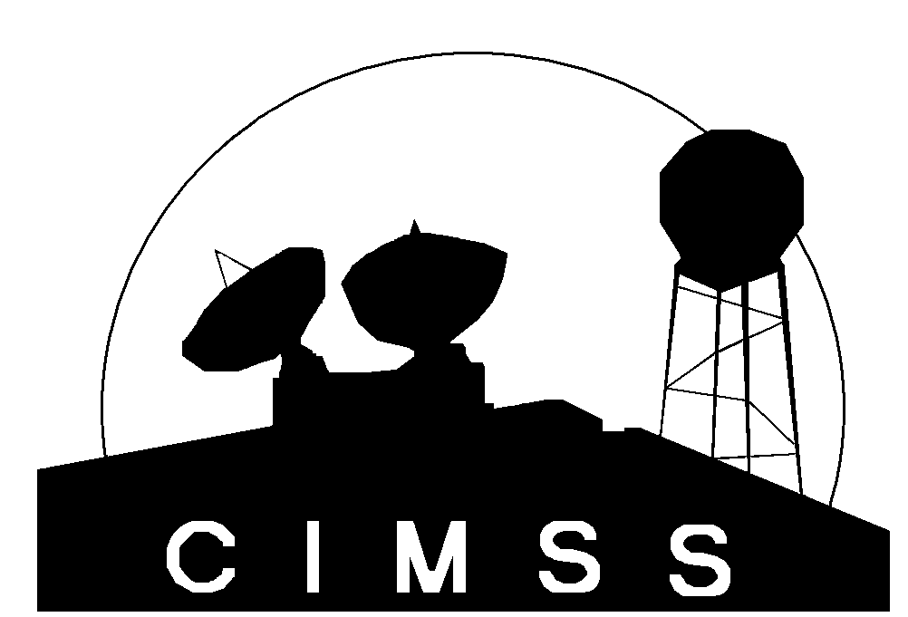
McIDAS-V Support for GOES-R Risk Reduction Projects
Tom Rink, Tom Achtor
McIDAS-V developers will work with selected GOES-RRR projects to
Visualize all data used in project development and evaluation
Develop analysis tools to support evaluation

Slide 2
McIDAS-V Support for GOES-R Risk Reduction Projects
Task 1 – Support for CIMSS Nowcasting Project
Develop enhancements to trajectory display
Support validation of trajectories vs. model fields
Seek an isentropic coordinate display (years 2-3)
Task 2 – Survey and Indentify additional projects
Survey all RRR projects for analysis and visualization needs; report on this survey
Create collaboration with specific RRR team(s) and develop enhancements in McIDAS-V to support their project.

