Slide 1
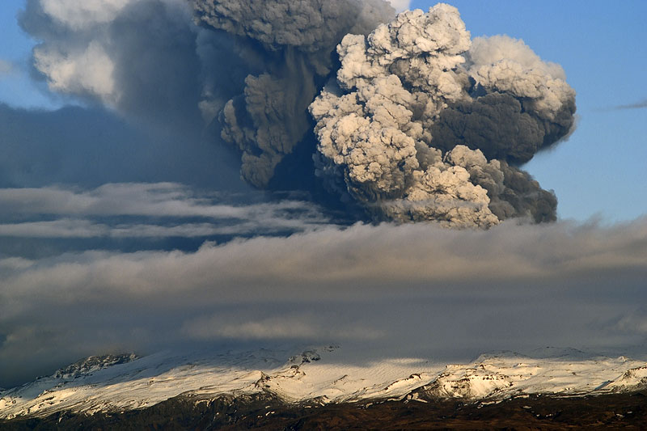
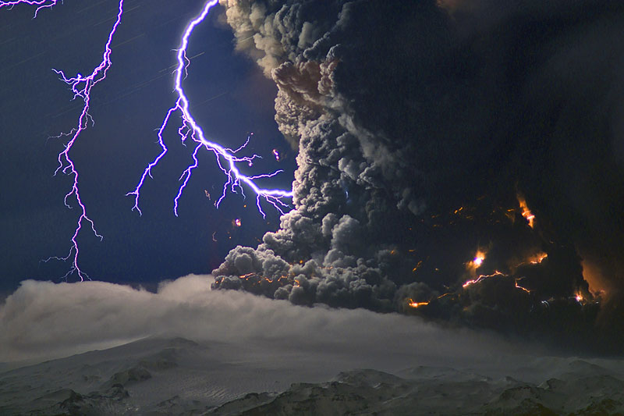
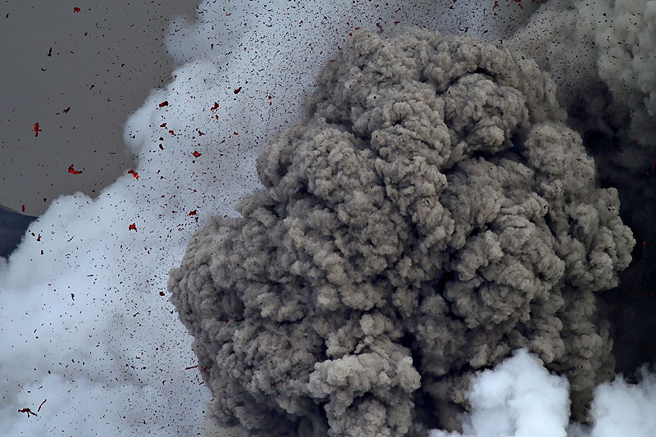
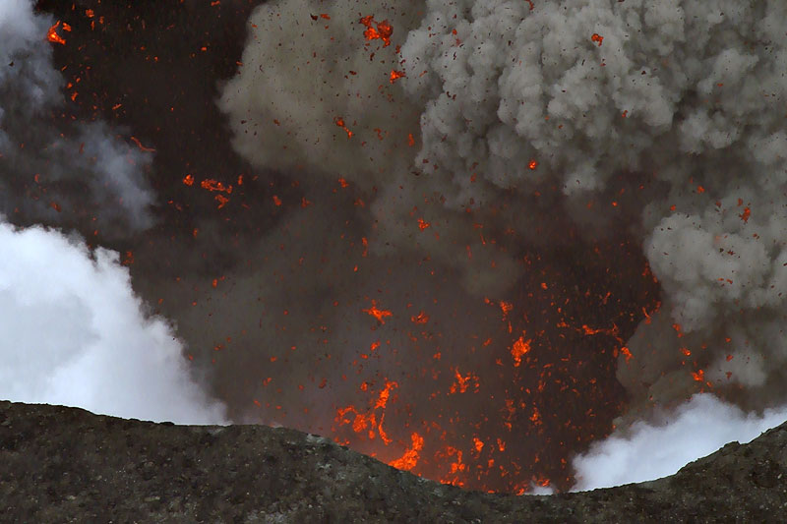
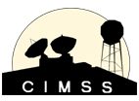
Development of a GOES-R Automated Volcanic Cloud Alert System
Marco Fulle - www.stromboli.net
Michael Pavolonis (NOAA/NESDIS/STAR)
Justin Sieglaff (UW-CIMSS)
Ron Thomas, Paul Krehbiel, William Rison (NMT)
Tony Hall (NOAA/NWS Anchorage VAAC)
Greg Gallina (NOAA/NESDIS Washington VAAC)

Slide 2
Development of a GOES-R Automated Volcanic Cloud Alert System
Multi-spectral imagery is important for tracking volcanic clouds but the information is qualitative and requires a properly trained human to interpret.
The GOES-R volcanic ash and SO₂ products developed by the AWG provide important quantitative information but are not designed to issue alerts to forecasters when a volcanic cloud is sampled by the ABI.
Alerts are critical for insuring that the full capabilities of GOES-R are used to help address the 5 minute volcanic ash warning capability required by the aviation industry.
The goal of this project is to develop a GOES-R automated alert system that can detect nearly all types of volcanic clouds
Ash dominated in portion of cloud observed by passive GOES-R measurements
SO₂ dominated in portion of cloud observed by passive GOES-R measurements.
Ice topped volcanic clouds
Notes:
In general, VAAC’s can only manually analyze satellite imagery and products once per hour over a limited spatial region. The GOES-R ABI will provide coverage of the full disk at least every 15 minutes. Thus, if we are just making imagery and derived products, we are not using the full capabilities of GOES-R for volcanic cloud detection.

Slide 3
Development of a GOES-R Automated Volcanic Cloud Alert System
Using robust spectral predictors (e.g. Pavolonis, 2010), a naïve Bayes classifier is used to determine the probability that a particular cloud object is an ash cloud (same procedure will be used to detect SO₂ clouds).
Temporal trends in cloud properties will be used to determine the probability that an ice topped cloud was produced by a volcanic eruption.
GLM detected lightning will be used to supplement the alerts (ground-based networks will be used as a proxy for the GLM) and gain insight into cloud microphysics.
Automated alerts (to VAAC’s and other interested users) can then be issued for clouds that exceed a user define probability that are near volcanoes of interest.
***The very high accuracy of the volcanic cloud detection scheme developed will be much better suited for data assimilation and model verification work than traditional detection methods and collaborations with modeling groups are underway (e.g. Schmehl et al., 2011).
Notes:
-Logistic regression
-Ice topped volcanic clouds often do not exhibit any unique spectral signatures that can be readily observed in imagery (they look like t-storms)
-the system will prevent multiple alerts for the same cloud from being issued, if desired

Slide 4
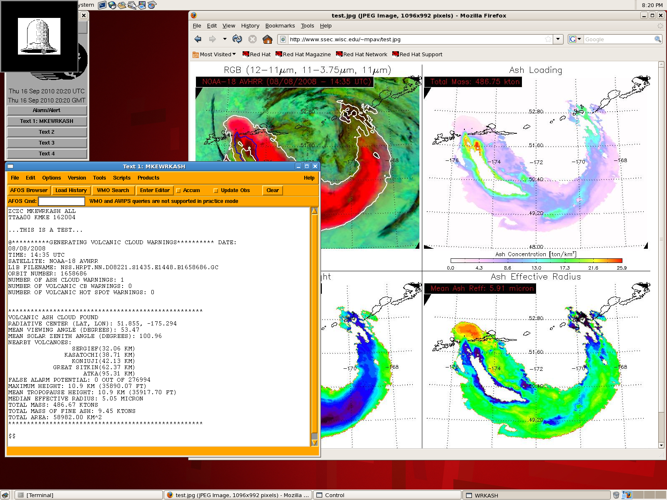
Results of ash detection are contoured on top of imagery and shown in tandem with baseline GOES-R ash products (ash height, loading, and effective radius)
Text report containing quantitative information on cloud location, detection uncertainty, cloud properties, and background environment
Notes:
-Poster includes more information on algorithm, including ice topped clouds.
-Utilizing the full capabilities of the ABI and GLM, the automated alert tool will allow the VAAC’s to produce more timely and accurate volcanic cloud advisories and may improve dispersion model forecasts.

