Slide 1
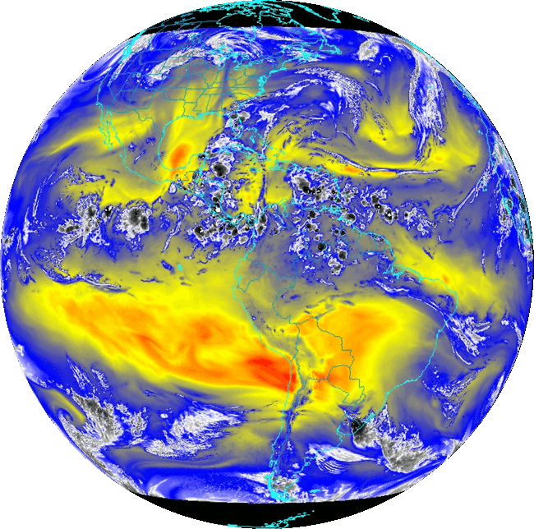
GOES-R Algorithm Working Group (AWG) Program Status
Jaime Daniels
Program Manager (Acting) GOES-R Algorithm Working Group (AWG)
NOAA/NESDIS, Center for Satellite Applications and Research
September 21, 2011

Slide 2
Outline
AWG Role
Level-2 Product Algorithm and Validation Scope
AWG Meetings and Reviews
Progress and Current Efforts
Looking Ahead

Slide 3
GOES-R Algorithm Working Group
Mission:
To select, develop, test, validate, and demonstrate Level-2+ algorithms that meet the GOES-R F&PS requirements and provide them to the GOES-R Ground Segment.
Provide sustained life cycle validation and Level-2 product enhancements
End-to-End Capabilities
Instrument Trade Studies
Proxy Dataset Development
Algorithm Development and Testing
Product Demonstration Systems
Development of Cal/Val Tools
Integrated Cal/Val Enterprise System
Radiance and Product Validation
Algorithm and application improvements
User Readiness and Education

Slide 4
AWG Teams
AWG Product Application Teams | Team Lead
Imagery | Tim Schmit
Soundings | Tim Schmit
Winds | Jaime Daniels
Clouds | Andrew Heidinger
Aviation | Ken Pryor, Wayne Feltz
Hydrology | Robert Kuligowski
Land | Bob Yu
Cryosphere | Jeff Key
Radiation Budget | Istvan Lazslo
Lightning | Bill Koshak
SST | Alexander Ignatov
Ocean Dynamics | Eileen Maturi
Aerosols/Air Quality/Atmos. Chemistry | Shobha Kondragunta
AWG Specialty Teams | Team Lead
Proxy Data | Fuzhong Weng
Cal/Val (Sensor) | Changyong Cao
Algorithm Integration | Walter Wolf
Notes:
Put in backup slides

Slide 5
AWG GOES-R L2 Algorithm Development Activities Reduce Risk
Allowed for early assessments of product quality
Early accuracy and precision analysis performed
Opportunity to refine L2 product requirements
Government-side (AWG) implementation of ATBDs (ie.,software) that allows for L2+ product verification prior to GS vendor implementation
AWG employs use of proxy data (simulated or real data from satellite instruments currently in orbit)
Proxy data run through L2 algorithms developed for GOES-R and L2 product are generated
Correlative measurements from other observing systems (surface-based, satellite-based, etc) used to characterize and quantify L2 product performance
Testing results enable algorithm verification of Product Measurement Accuracy and Product Measurement Precision specifications; reported in ATBDs

Slide 6
AWG Algorithm Development Scope Baseline Level-2 Products
Cloud and Moisture Imagery (KPP) |  | Lightning Det: Events, Groups, Flashes*
Aerosol Detection (including Smoke & Dust) |  | Legacy Vertical Moisture Profile
Aerosol Optical Depth |  | Legacy Vertical Temperature Profile
Volcanic Ash: Detection & Height |  | Derived Stability Indices
Clear Sky Masks |  | Total Precipitable Water
Cloud Optical Depth |  | Fire / Hot Spot Characterization
Cloud Particle Size Distribution |  | Rainfall Rate/QPE
Cloud Top Phase |  | Sea Surface Temperature (skin)
Cloud Top Height |  | Downward Shortwave Rad.: Surface
Cloud Top Pressure |  | Reflected Shortwave Rad.: TOA
Cloud Top Temperature |  | Hurricane Intensity
Land Surface (Skin) Temperature |  | Snow Cover
Derived Motion Winds
ABI | GLM
 | * Included in GRB

Slide 7
AWG Algorithm Development Scope Day-2 Capabilities…
Aerosol Particle Size | Absorbed Shortwave Radiation: Surface
Aircraft Icing Threat | Downward Longwave Radiation: Surface
Visibility | Flood / Standing Water
Total Ozone | Ice Cover
Cloud Type | Snow Depth (over Plains)
Cloud Ice Water Path | Surface Albedo
Cloud Layers / Heights | Surface Emissivty
Cloud Liquid Water | Vegetation Fraction: Green
SO₂ Detection | Vegetation Index
Low Cloud and Fog | Ocean Currents
Upward Longwave Radiation: Surface | Ocean Currents: Offshore
Convective Initiation | Sea and Lake Ice: Age
Enhanced-V / Overshooting Top | Sea and Lake Ice: Concentration
Tropopause Folding Turbulence Prediction | Sea and Lake Ice: Motion
Upward Longwave Radiation: TOA | Probability of Rainfall
 | Rainfall Potential
ABI

Slide 8
AWG Level-2 Product Validation Scope
Development of Level-2 product validation tools needed post-launch for:
Routine monitoring of L2 product performance (accuracy, precision)
“Deep-dive” assessments and analysis of products (problem resolution)
Continued quantification of product performance
Through pre-launch Level-2 product demonstrations and validation studies
Using available ABI proxy data and reference/”ground truth” measurements

Slide 9
AWG Meetings & Reviews 2011
Validation Workshop (May 10-11, 2011)
Each AWG team presented its ongoing and planned efforts that involve the development of tools/capabilities and use of pertinent data sources for GOES-R Level-2 baseline product validation activities.
Each AWG team highlighted their ongoing and planned validation activities for their baseline L2 products
Validation strategies
Routine validation tools
“Deep-Dive” validation tools
Ideas for the further enhancement and utility of validation tools
Share information and capabilities that will be relevant to post-launch cal/val activities
http://www.star.nesdis.noaa.gov/goesr/vtools_ws_May2011.php

Slide 10
AWG Meetings & Reviews 2011
AWG Annual Meeting (June 14-16, 2011)
Reviewed the progress of the AWG over the past year and discuss/review objectives of the coming year
Informed the GOES-R Program Office and the AWG Technical Advisory Committee (TAC) on the status of the AWG and receive guidance.
Product application teams presentations
Option-2 product algorithm development
Present some feedback on Algorithm Development Executive Board’s (ADEB) independent peer review report of the Option-2 products
Validation focus for the Baseline products
Highlighted collective AWG assets and capabilities
Proxy datasets
Product Processing Framework
Product validation tools
End-to-end capabilities/tools to support instrument waiver process
http://www.star.nesdis.noaa.gov/goesr/AWG_Meetings.php

Slide 11
Sample of AWG Technical Advisory Committee (TAC) Recommendations
“Due to greatly improved capabilities of the GOES-R system (total lightning, volcanic ash, aircraft icing, fog, turbulence, etc.) and large investment, the GOES-R should be put in to operational services as soon as possible. This best would allow the Nation to reap the benefits of GOES-R.”
“Successful delivery of Baseline products to the GOES-R Program Office has been a result of outstanding scientific technical and managerial work. All involved deserve the highest commendation.”
“Activities on track. TAC sees no show stoppers. Good Progress has been made on baseline (100% ATBDs) and option 2 (80% ATBDs). More detailed work remains.”
“Much high quality work related to the generation of Option 2 products has been presented at 2011 GOES-R AWG review. The Low Cloud and Fog and SO2 Detection products for example are needed for aviation safety and the Convective Initiation product is of clear assistance in severe weather prediction. It is important that the benefits to be accrued from the Option 2 products are not lost to the community.”

Slide 12
AWG Meetings & Reviews 2011
Algorithm Development Executive Board (ADEB) Meeting (August 2-4, 2011)
Provided a thorough, independent assessment of the GOES-R AWG Option-2 Level-2 product algorithms
Provide an independent assessment of processes followed by the AWG in the course of their algorithm development activities
Supported by a team of Independent Peer Reviewers (IPR) who performed a technical review of the Option-2 Product ATBDs
Preparing a final report for the GOES-R Program summarizing their findings with respect to state and readiness of the Option-2 product algorithms

Slide 13
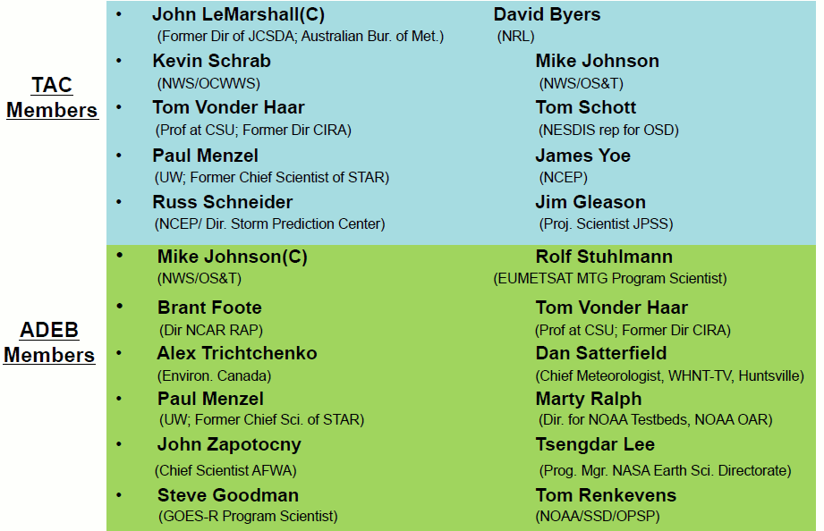
Advisory Committee Members

Slide 14
Progress and Current Efforts

Slide 15
AWG Deliverables & Status
Algorithm Packages (APs)
Algorithm Theoretical Basis Documents (ATBD)
Instrument proxy datasets
Product output datasets (for reproducibilty)
Algorithm Interfaces and Ancillary Data Description (AIADD) document
Schedule of Deliveries to the GOES-R Program
September 2008: As-Is ATBDs
September 2009: 80% APs for Baseline Products
November 2010: 100% APs for Baseline Products
80% APs for Option 2 Products
September 2011: 100% APs for Option 2 Products; 80% Visibility AP
September 2012: 100% APs for Visibility, Rainfall Potential, and Rainfall Probability Routine Validation Tool Documentation

Slide 16
From ATBDs to Level-2 Product Software
L2 product ATBDs
Implement in Software (Harris)
L2 product source code
Test datasets (proxy instrument inputs; L2 product outputs)
L2 product datasets
Technical Interchange Meetings
Harris/
AER
AWG
GSP
AWG is currently working closely with Harris/AER and the GOES-R Ground Segment Project (GSP) and Harris/AER in support of Harris’ implementation of GOES-R Level-2 product algorithms
Process is critical for proper implementation of the L2 product algorithms
Process is key for Harris to meet the reproducibility requirement (GSFPS-2758)
Good progress is being made!

Slide 17
Level-2 Product Algorithm Clarification Resolution Activity
52 new questions added in May
97 questions answered and closed in May
Net decrease of 45 open questions in May
100% Algorithm Package Delivery
Illustrates the identification and resolution of Level-2 algorithm clarification questions since the 100% Algorithm Package delivery
Slide courtesy of Harris/AER

Slide 18
Product Application Team Progress Option-2 Product Algorithms…
Teams have developed, tested, and delivered Versions 4 & 5 of their Option-2 product algorithms to the AIT
Teams have worked to enhance their validation datasets, where possible, in response to an ADEB recommendation to “pursue more complete datasets”
Completed their Algorithm Readiness Reviews (ARR)
Completed their 100% Algorithm Theoretical Basis Documents (ATBD)

Slide 19
Product Application Team Progress Baseline Product Algorithms…
Teams have been interacting with GSP and Harris/AER and responding to specific algorithm questions
Teams involved in a number of baseline product validation activities
Development of their routine and “deep-dive” validation tools
Continuing to validate their baseline products and enhance their validation datasets, where possible, in response to an ADEB recommendation to “Continue to pursue more complete data sets even after 100% delivery”.
Some teams have established routine near real-time product processing, when possible, using available proxy data
Identification of case study situations where algorithms are not performing well
Algorithm enhancements (beyond the 100% delivered algorithm)

Slide 20
AWG Cal/Val Tool Development Two Categories of Validation Tools...
“Routine” Calibration/Validation Tools
“Deep-dive” Calibration/Validation Tools
 | “Routine” Validation Tools | “Deep Dive” Validation Tools
 | Bulk/overview analysis | Detailed/point analysis
 | Executed soon after product generation | Not executed in real-time. May need to wait for other datasets
 | Run routinely | Run when more detailed analysis of product performance is needed
 | Run within OSPO and STAR | Run within STAR
 | Automated | Automated and/or Interactive components

Slide 21
AIT Progress
Algorithm Framework Deltas (bug fixes)
Completed Code Unit Test (CUT) reviews (Option-2 product algorithms)
Completed integration of new option-2 product algorithm code updates (Version 4 & 5) into framework
Generation and redelivery of some baseline product test data sets
Correct problems uncovered as a result of interchanges with Harris/AER
Completed generation of baseline products over longer time period (4 month runs that span all seasons)
Coordinating validation tool software developed by teams and is working toward designing an integrated validation system
Coordinating AWG team responses with GSP and Harris/AER

Slide 22
Proxy Team Progress

Slide 23
AWG Capabilities in Support of the End-to-End Waiver Analysis Process

Slide 24
Looking ahead

Slide 25
Looking Ahead
Near-term AWG deliverables
100% Option-2 L2 Algorithm Packages; 80% Visibility Algorithm Package (9/30/2011)
100% Option-2 L2 Algorithm Packages for Visibility, Rainfall Potential, and Rainfall Probability (9/30/2012)
Routine L2 product routine validation tool documentation (9/30/2012)
Continue to support the baseline Level-2 product algorithm implementation activity being done by the Harris Team

Slide 26
Looking Ahead
Continue Level-2 product validation preparation activities
Continue validation tool development & documentation
Pursue more complete validation datasets
Generate products from available proxy/simulated data
routine near real-time processing (outlier studies and analysis)
manual processing (case studies)
Continue to validate and characterize product performance
Continue Level-2 Algorithm Enhancements (beyond 100% algorithm delivery)
Carefully manage L2 algorithm deltas
Support GOES-R Program in Planning for Launch
Development of a Level-2 Product Calibration/Validation Plan
Development of an algorithm transition plan

Slide 27
Looking Ahead
Support User Readiness and Evolving User Needs through AWG involvement in
GOES-R Proving Grounds activities
GOES-R3 activities
JCSDA activities (NWP readiness)
Initiate Planning for AWG Activity in FY12

Slide 28
Backups

