Slide 1
IDEA-like GOES-R Air Quality Proving Ground data distribution system
Hai Zhang
University of Maryland Baltimore County (UMBC)

Slide 2
IDEA-like GOES-R air quality proving ground data distribution system
Objectives
Prepare near-real-time GOES-R air quality data distribution system for air quality community
Collaborate with GOES-R Air Quality Proving Ground (AQPG) team on user training and preparation for GOES-R air quality data
Techniques
Collaborate with GOES-R AQPG , build GOES-R proxy dataset – case studies and near-real-time data from model simulation and ABI aerosol retrieval algorithm
Revise IDEA system to use the GOES-R ABI proxy dataset.
Develop a new aerosol type component in the system.
Apply synthetic natural color imagery.
Air quality index (AQI) map from AOD
Test the system using proxy dataset. Analyze system ability to handle high data volume from GOES-R.
Demonstrate the system to the air quality end users. Acquire user feedbacks and improve system further.

Slide 3
Aerosol retrieval algorithm
Objectives
Test Multi-Angle Implementation of Atmospheric Correction (MAIAC) algorithm performance in geostationary satellite geometry
Improve the ability of GOES-R aerosol retrieval algorithm over bright surfaces
Techniques
Use geostationary satellite dataset
SEVIRI data
Simulated GOES-R proxy data
Can apply multichannel aerosol retrieval in the geostationary satellite geometry.
Two methods will be explored:
MAIAC
When apply MAIAC on SEVIRI data, use 1.6 μm channel for 2.1 μm channel.
Assume 1.6 μm channel is not affected by aerosol, retrieve BRDF (Bidirectional Reflectance Distribution Function) for that channel.
Assume 0.6 μm channels have the same BRDF shape as 1.6 μm channel and retrieve BRDF in that channel through time series analysis.
Retrieve AOD.
Apply modification on surface types where the BRDF shapes are not the same in the three channel
Use daily average AOD and TOA reflectance time sequence to retrieve surface BRDF
BRDF shapes are not necessarily the same for the three channels
Daily average AOD are obtained from MAIAC in good retrieval geometry
Retrieve BRDF separately for each channel
The algorithm will be tested and results will be compared against AERONET retrievals.
Case studies such as Sahara dust storm and European pollution

Slide 4
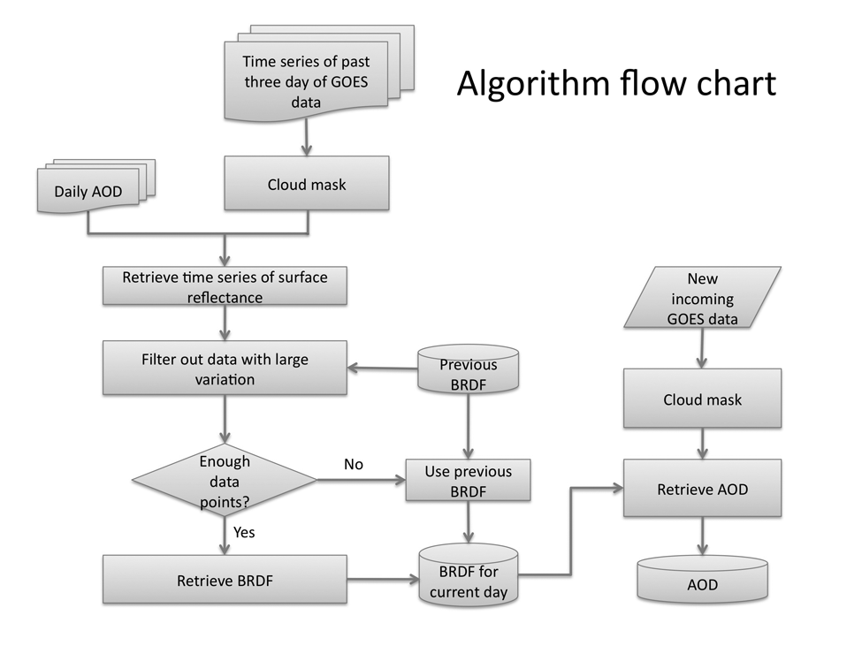
Poster: Improved aerosol optical depth retrieval algorithm for current GOES
Current GOES only have one visible channel available for aerosol retrieval
In the new algorithm, we retrieve surface BRDF using daily average AOD and GOES channel 1 TOA reflectance
Three day time series are used for BRDF retrieval
Daily average AOD is obtained from MODIS in the eastern US and MAIAC for GOES in the western US
The AOD retrieval results are more accurate than GASP and MAIAC for GOES.

