Slide 1
Integrated GOES-R GLM/ABI approaches for the detection and forecasting of convectively induced turbulence (CIT) Lawrence Carey¹, Wayne Feltz², Kristopher Bedka³, and Walter Petersen⁴ 1 – UAHuntsville, Huntsville, AL; 2 – CIMSS, University of Wisconsin-Madison, Madison, WI ; 3 – SSAI at the NASA LaRC, Hampton, VA; 4 – NASA GSFC/WFF, Wallops , VA
Rapidly developing convection is a known source of CIT
Satellite derived cloud top infrared (IR) cooling rate, overshooting tops (OT)/enhanced-V and total lightning flash rate trends are strong inferences of convective updraft intensity and growth rate
hazardous regions along data sparse flight routes (e.g., oceans).
Turbulence occurrence mined using eddy dissipation rate (EDR) from NCAR turbulence algorithm on commercial aircraft nav data.
Work leverages available VHF-based total lightning during turbulence encounters over Northern Alabama, Washington DC, Oklahoma, and Florida Lightning Mapping Array (LMA) domains.
Explore GLM proxy over the oceans (LF/VLF networks).

Slide 2
Develop database of LMA, GOES, EDR and other observations (radar, TRMM, NLDN, WTLN, GLD360) [Feltz, Carey]
Identify varied (weak, moderate, severe) sample of EDR measured CIT events over LMAs in a variety of environments and convective types.
Process LMA for total lightning flash occurrence and rates [Carey] and GOES for convective cooling rate, cloud type transitions, and OT occurrence and other GOES IR properties [Feltz]
Process and assess regional/global VLF/LF lightning networks as GLM total lightning proxy for use outside LMA domain, over oceans.
Establish temporal and spatial relationships between total lightning occurrence and LMA flash properties/trends, cloud top cooling, OT occurrence and EDR-CIT events [Carey, Bedka, Feltz]
Leverage ongoing LMA→GLM proxy and object tracking work
Utilize environmental (sounding, model), TRMM, ground Doppler/polarimetric radars, field campaign radar-LMA networks and other data (e.g., DC3, SEVIRI during CHUVA) to better understand and validate results [Carey, Petersen]

Slide 3
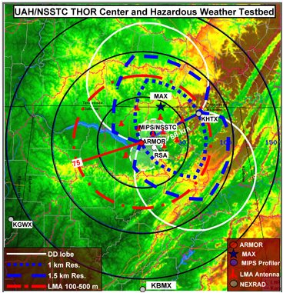
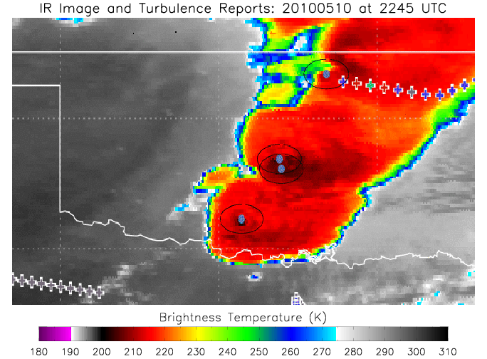
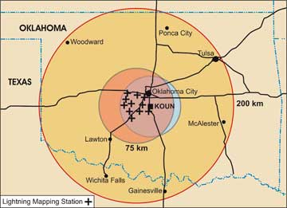
NASA NALMA and UAHuntsville radar network
GOES IR Tb, OT’s and EDR turbulence reports (blue: light, green: mod, red: severe) in MCS over OK (5/10/2010). Inset: NSSL OK LMA
GLM Flash Proxy and Tracking:
NALMA, WTLN, NLDN flash rates in a severe supercell over Northern Alabama (3/12/2010)

