Slide 1
GOES-R Ocean Dynamics:
Ocean Surface Currents From SST
Kinematic and Dynamic Approaches
Eileen Maturi, Andy Harris: NOAA/NESDIS/STAR
Ted Strub, Alexander Kurapov: CIOSS/Oregon State University
tstrub:@coas.oregonstate.edu
http://cioss.coas.oregonstate.edu/CIOSS/
GOES-R Science Week:
2011 Risk Reduction Annual Meeting

Slide 2
Ocean Surface Currents from SST
Kinematic Approach Dynamic Approach
“Derived Motion” Model Data Assimilation
Quick application wherever sequential images are available. No dynamics – Derived from GOES cloud-motion wind procedures (Emery et al., 1986). Can be fooled by “non-advective” propagation. Clouds obscure SST > 50%. AVHRR (2-4 images per day). GOES: more images to “see between clouds”; coarse spatial resolution and noisy SST GOES-R: Improved resolution and SST accuracy. Error estimates using model SST fields for proxy GOES-R data. | Dynamically consistent surface velocity, SST. Plus deeper currents, temperature and salinity (oxygen, bio-optics, ecosystem parameters). Requires time to set up a new model domain; DA can substitute for poor IC, BC, forcing. Besides the velocity fields, the model supplies diffusivities, error estimates used in trajectory models for spills. Producing 2-day forecasts off Oregon using NWP surface forcing, expanding to entire West Coast. NOAA Office of Response and Restoration (Seattle) is testing use of the fields in the operational GNOME trajectory model (used in Gulf DWH spill).

Slide 3
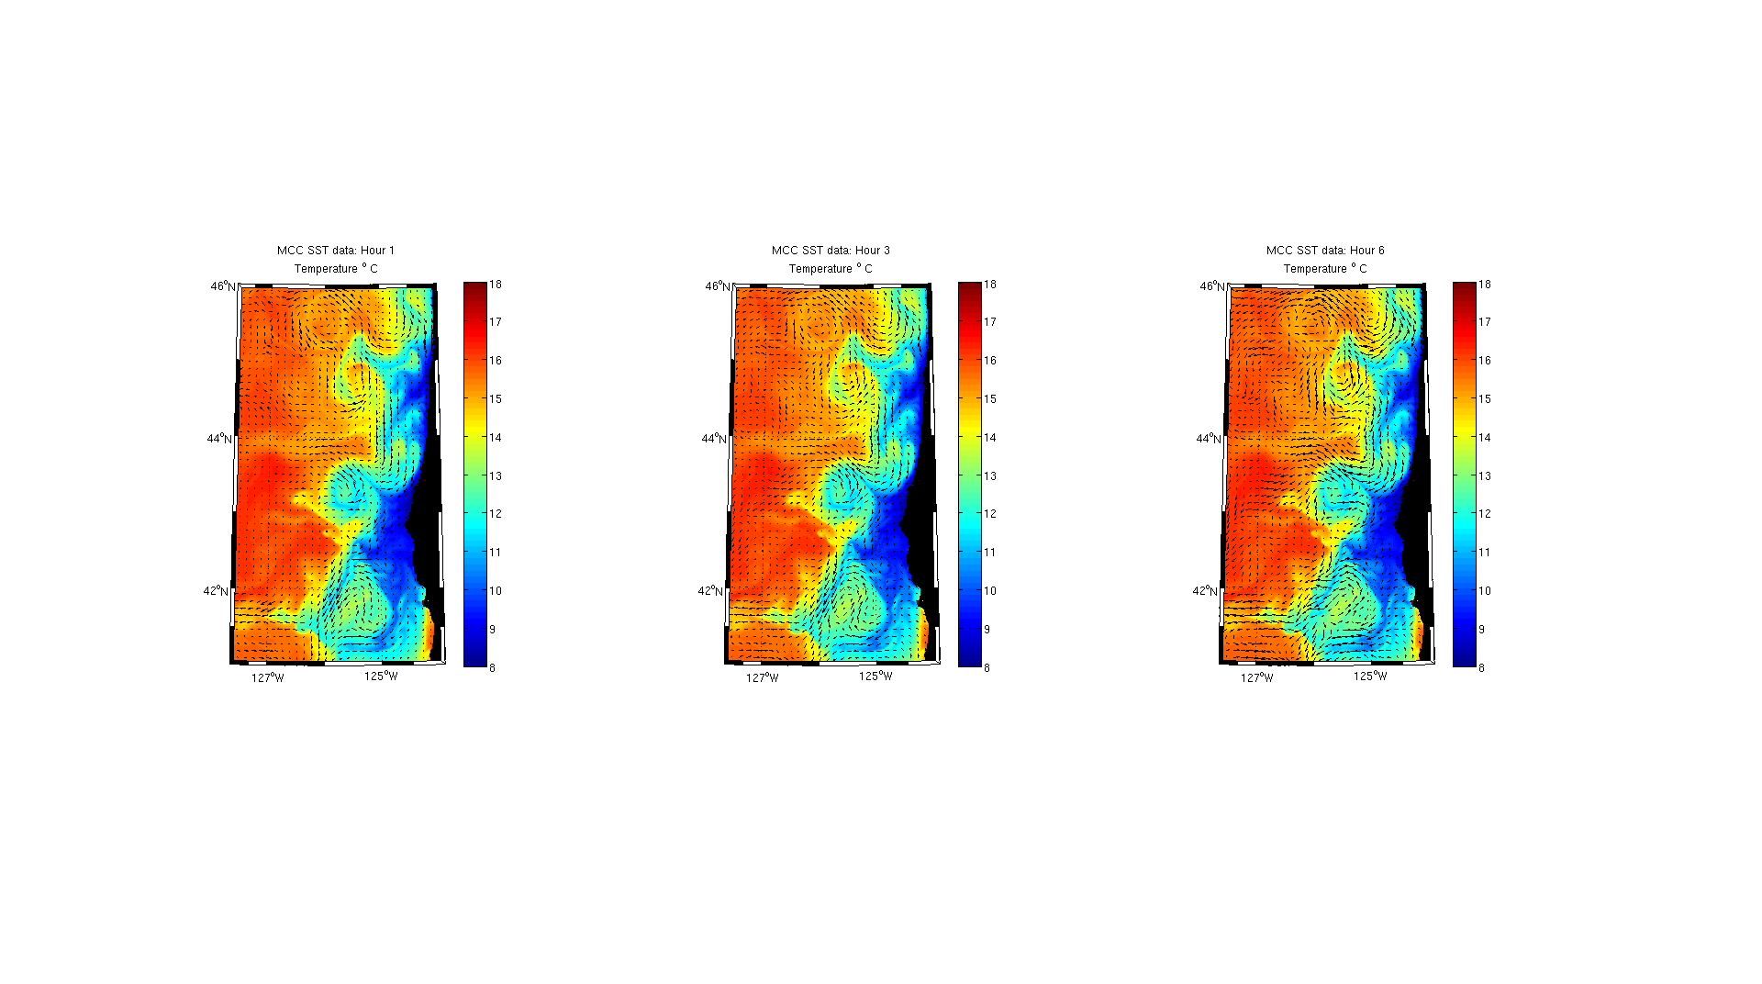
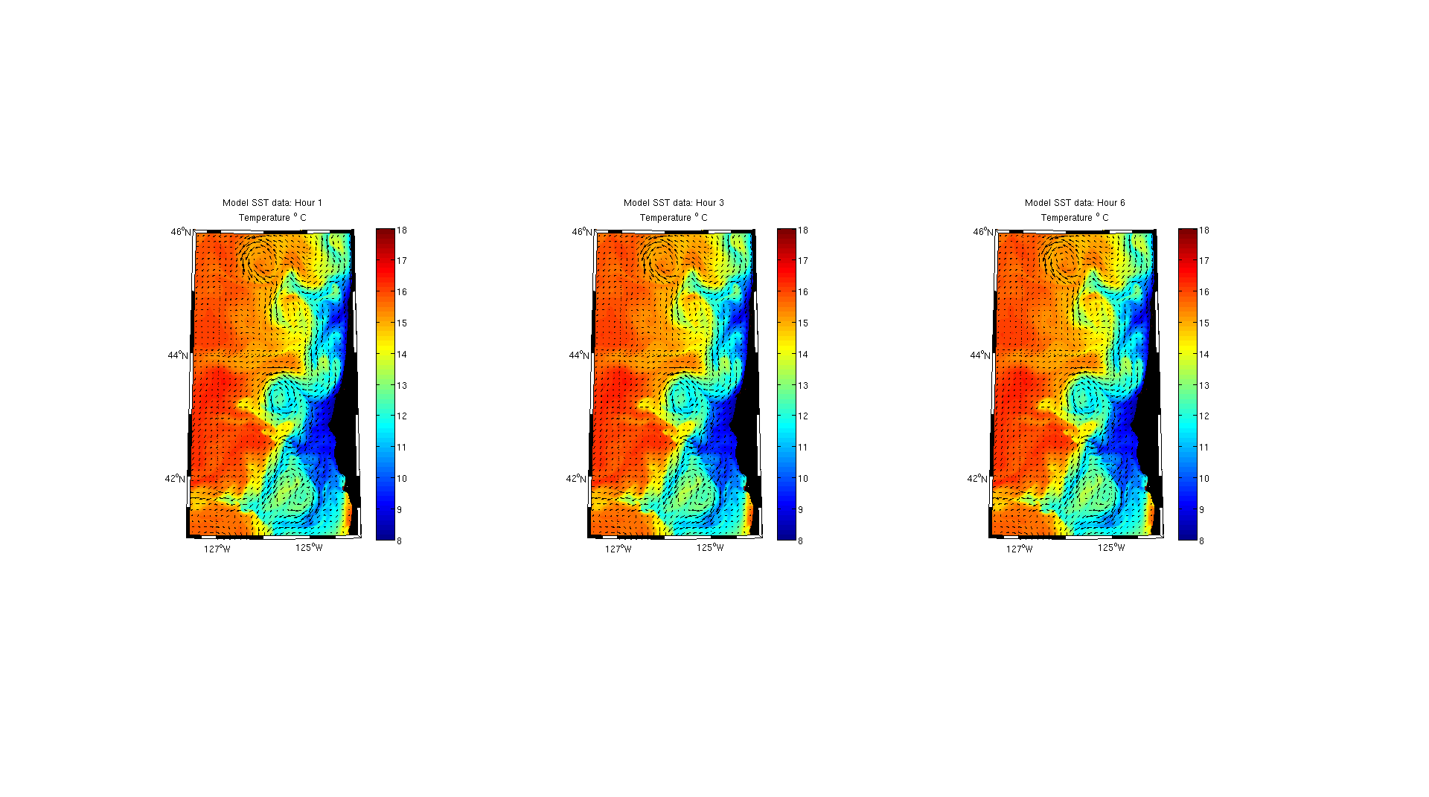
MCC and Model-derived surface velocity fields
for 6 hour separations, no clouds
MCC
Model
Latitude
Longitude

Slide 4
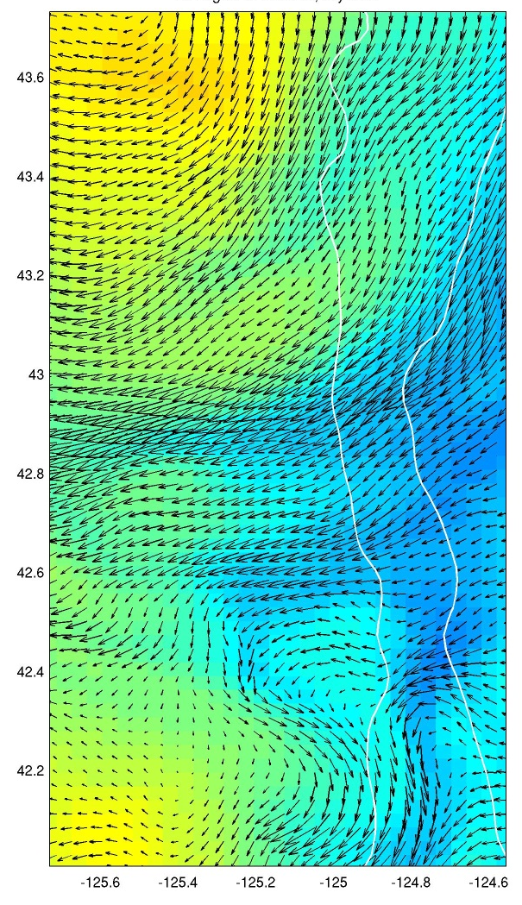
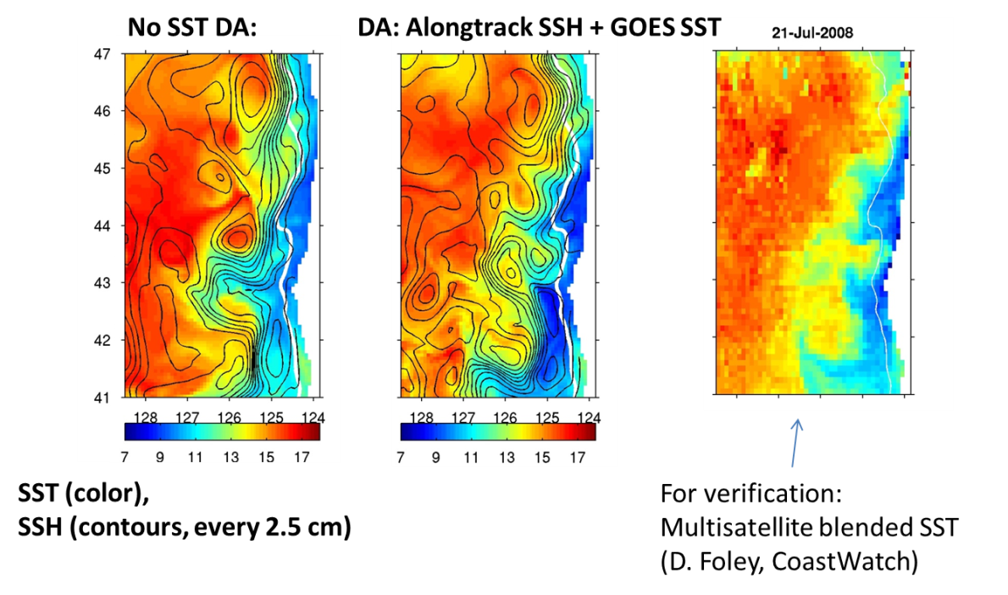
Assimilation of GOES-R SST into Coastal Ocean Circulation NOWCAST/FORECAST Models
Alexander Kurapov, P. Ted Strub, P. Yu, S. Erofeeva, J. Osborne (CIOSS, Oregon State University)
NOAA collaborators: E. Maturi, A. Harris, L. Miller (NOAA/NESDIS/STAR),
D. Foley (NESDIS/CoastWatch), A. MacFadyen (NOS/ORR), F. Aikman (NOS/OCS/MMAP)
Model SST and surface currents:
SST and surface velocities are dynamically coupled
Assimilation of GOES SST in a high-resolution coastal ocean model => improved forecasts of SST fronts, surface currents [users: fisheries, search&rescue, environmental hazard response, navigation, etc.]
SST and SSH model fields:
(left) before GOES SST assim.
(center) after assim.

Slide 5
Ocean Surface Currents
Kinematic Approach Dynamic Approach
“Derived Motion” Model Data Assimilation
Quick application wherever sequential images are available. No dynamics – Derived from GOES cloud-motion wind procedures (Emery et al., 1986). Can be fooled by “non-advective” propagation. Clouds obscure SST > 50%. AVHRR (2-4 images per day). GOES: more images to “see between clouds”; coarse spatial resolution and noisy SST GOES-R: Improved resolution and SST accuracy. Error estimates using model SST fields for proxy GOES-R data. | Dynamically consistent surface velocity, SST. Plus deeper currents, temperature and salinity (oxygen, bio-optics, ecosystem parameters). Requires time to set up a new model domain; DA can substitute for poor IC, BC, forcing. Besides the velocity fields, the model supplies diffusivities, error estimates used in trajectory models for spills. Producing 2-day forecasts off Oregon using NWP surface forcing, expanding to entire West Coast. NOAA Office of Response and Restoration (Seattle) is testing use of the fields in the operational GNOME trajectory model (used in Gulf DWH spill).

Slide 6
“Optical Flow Techniques” may offer improved error characteristics and alternate constraints

