Slide 1
The GOES-R GLM Lightning Jump Algorithm (LJA): Research to Operational Algorithm Lawrence D. Carey¹, Christopher J. Schultz¹, Walter A. Petersen², Daniel Cecil¹, Monte Bateman³, Steven Goodman⁴, Geoffrey Stano⁵, Valliappa Lakshmanan⁶ 1 – UAHuntsville, Huntsville, AL; 2– NASA GSFC/WFF Wallops , VA; 3 – USRA (NASA MSFC); 4 – NOAA NESDIS; 5 – ENSCO (NASA MSFC); 6 – OU CIMMS/NOAA NSSL
Prior R3 (Schultz et al. 2009 MWR, Gatlin and Goodman 2010 JTECH, Schultz et al. 2011 WF) explored the feasibility of thunderstorm cell-oriented lightning-trending or “jump” algorithms for application to operational severe weather warning decision support
Objective - To refine, adapt and demonstrate the LJA for transition to GOES-R algorithm readiness and to establish a path to operations
Year 1 Plans – reducing risk in algorithm automation, cell tracking, GLM proxy and data fusion. Demonstrating in PG.

Slide 2
Develop LJA as an automated objective system for operations (Schultz, Carey, Petersen, Goodman)
Fully automate and optimize LJA (rules, thresholds) to GLM proxy and multi-sensor object tracking improvements
Objective environmental definition and modification of LJA to improve performance skill scores and mitigate known LJA biases with low topped convection (cool season, tropical)
Explore fusion of LJA with radar and multi-sensor GOES-R (ABI) products
Improve cell (object)-oriented tracking (Cecil, Lakshmanan, Schultz, Carey)
Optimize current WDSS-II/K-means cell tracking algorithm to reduce tracking ambiguity for LJA
Multi-sensor (GLM proxy, ABI proxy, radar), multi-parameter (e.g. GLM flash initiation density, flash [or group, event] extent density) object tracking
Refine and develop large GLM “Level II” proxy database for R3 (Bateman, Stano, Carey)
Must use representative proxy lightning (e.g., GLM resolution, 8 km)
GLM is new GOES-R instrument – legacy LIS is LEO so no flash trends
Use statistical-physical methods to transform VHF-based LMA (possibly LF/VLF ) to optical lightning proxy using LIS as the “Rosetta Stone”.
Demonstrate automated LJA algorithm in NOAA Proving Ground (Carey, Stano, Schultz)
Active participation in National Lightning Jump Field Test coordinated by NOAA NWS (planning already underway for Spring 2012)

Slide 3
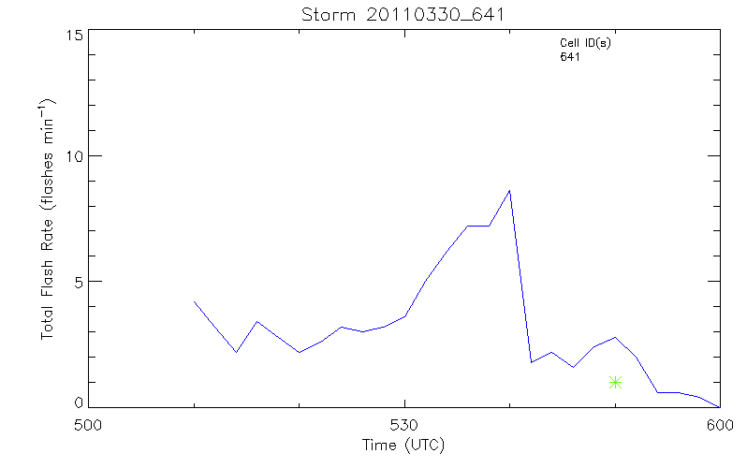
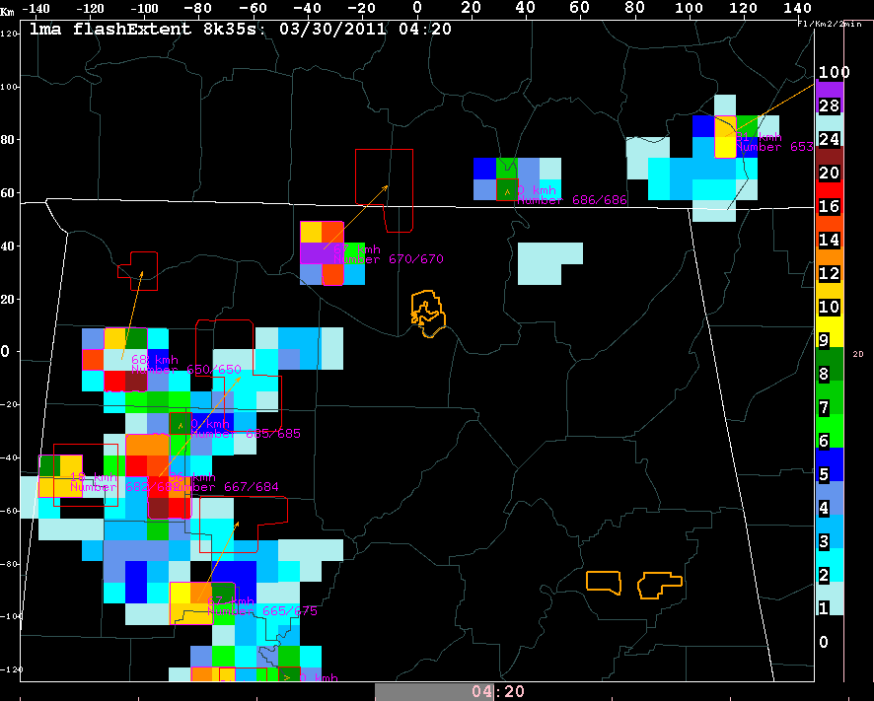
Thunderstorm Tracking
Lightning Jump Algorithm
GLM Lightning Proxy
The LJA is a 3-pronged system
Tracking on GLM flash proxy
Little legacy research
Will be useful for tracking with combinations of data types (ABI, radar) and in radar denied areas.
Representative GLM flash proxies are critical for development and testing of LJA
LJA requires optimization to the details of tracking on GLM proxy (or multi-parameter, multi-sensor fields)
Flash rate, lighting jump prior to severe
8 km x 8 km LMA Flash Extent Density and lightning “cell” tracks

