Slide 1
Assimilation of GOES-R ABI Aerosol Optical Depth (AOD) in a Regional Air Quality Model to Improve Surface PM2.5 Forecasts
S. Kondragunta, NOAA/NESDIS/STAR
Q. Zhao, IMSG

Slide 2
Objective
In preparation for GOES-R products, build a GOES AOD assimilation system in Gridpoint Statistical Interpolation (GSI) framework.
Transition the assimilation system to NCEP operations
NMMB-AQ
ICON
MET+AQ
MET+AQ
Analysis
Adjust AQ With
AOD Analysis
NMMB-AQ: North American Mesoscale Model B – Air Quality
ICON: Initial Concentrations
MET: Meteorological Fields
AQ: Air Quality
BCON: Boundary Conditions
EPA: Environmental Protection Agency
NEI: National Emissions Inventory
AOD: Aerosol Optical Depth
BCON
MET+AQ
MET+AQ
Forecasts
MET+AOD
Analysis
EPA NEI
AOD
Retrievals
Calculate
AOD from AQ
MET+AOD
Forecasts
GSI-AQ
MET
Observations

Slide 3
FY11 Accomplishments
Completed code development to convert GOES AOD data into BUFR format. BUFR encoder/decoder work for GOES-11, GOES-12, and GOES-13.
Code easily adaptable for other satellites.
Developed post-processing code to handle multiple Community Multiscale Air Quality (CMAQ) model output files.
Completed GSI code development
A branch was created in NCEP GSI subversion repository where developed code is committed
GSI GOES AOD product read module
CMAQ aerosol property module. Uses CRTM to compute AOD from CMAQ model aerosol fields
Code to convert C-grid met variables to A-grid
Code to compute CMAQ first guess fields
Tested compiling and running GSI with CMAQ NEMSIO data file and GOES AOD BUFR dataset as inputs

Slide 4
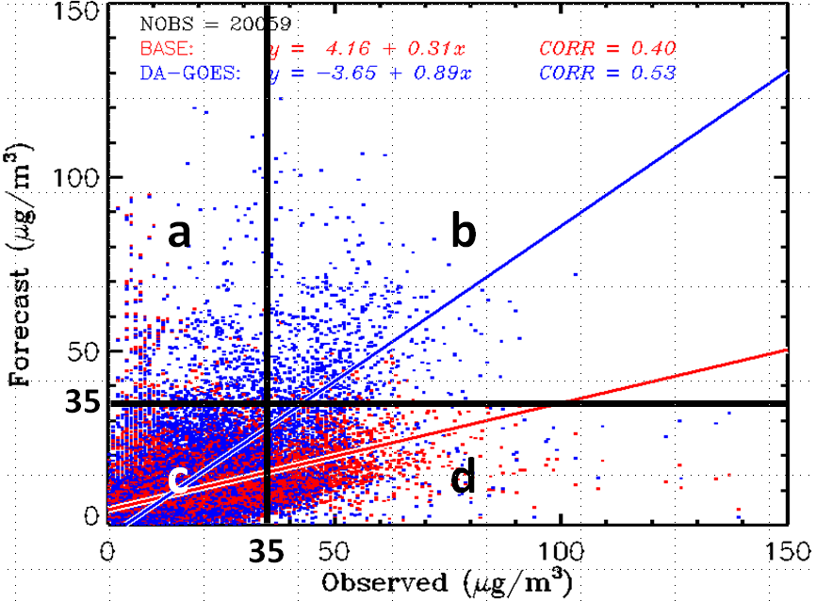
Categorical Evaluation for CMAQ Data Assimilation Experiments
Accuracy (A)
Bias (B)
False Alarm Rate (F)
False Alarm Ratio (FAR)
Critical Success Index (CSI)
Hit rate (H) or Probability of Detection (POD)

Slide 5
FY12 Tasks
Complete GSI development (delayed due to STAR contract vehicle issues)
Generate CMAQ model AOD background error (BE) statistics
Generate GOES AOD observation error (OE) statistics
Integrate CMAQ AOD BE and GOES AOD OE covariance matrices into GSI system through cost function construction
Conduct data assimilation experiments with GSI and analyze the results
GOES AOD data
GOES-R proxy data
Complete a manuscript on GOES AOD assimilation work (in preparation)

