Slide 1
A Blended, Multi-Platform Tropical Cyclone Rapid Intensification Index
Leads:
John Knaff, NESDIS/STAR/RAMMB
Chris Velden and Chris Rozoff, CIMSS/UW
John Kaplan, OAR/AOML Hurricane Research Division
Other Participants:
Mark DeMaria, NESDIS/STAR/RAMMB
Jonathan Vigh, NCAR MMM Division
Andrea Schumacher, CIRA/CSU

Slide 2
Project Summary
Explore the utility of multi-sensor, multi-platform information to forecast tropical cyclone rapid intensification
Long range lightning detection (proxy for GLM)
LEO passive microwave observations of convective organization
Convective asymmetries and modes from GOES IR (proxy for ABI)
SST, OHC (satellite based products)
GFS observations and forecast of environment
Develop experimental versions of the operational Rapid Intensification Index (RII)
Use new predictors from lightning, microwave , IR observations
Use different statistical techniques (Discriminant analysis, Logistic regression, & Naïve Bayes classifier)
Leverage other funded projects.

Slide 3
Justification
Improved forecasts of tropical cyclone rapid intensification is a high priority NWS and NOAA goal (i.e., one of the justifications of HFIP)
Several datasets with potential to improve rapid intensification are not fully utilized
A diversity of statistical methods has yet to be used for the rapid intensification problem

Slide 4
Methodology
Combine the talents and expertise at CIRA/RAMMB, CIMSS and AOML/HRD
Better use of satellite data
GOES, Microwave, lightning
Develop complimentary statistical techniques to estimate the probability of RI
LDA, Logistic Regression, Bayesian
Test the concept of consensus RI forecasting
Demonstrate real-time capabilities that can combine lightning, MI and GOES predictors.

Slide 5
6. FY11 Milestones
CIRA/RAMMB will provide to AOML and CIMSS
July 2011: Storm relative IR predictors and lightning Atlantic and E./C. Pacific
Summer 2011:Further testing of lightning-based correction models developed for Atlantic & E. Pacific
Coordinate effort among the groups for potential real-time testing in 2011.
CIMSS data provided to AOML and CIRA
August 2011: Develop improved 37 GHz MW predictors. (refined center finding and ring identification plus RGB (polarized Tb and PCTs.)
October 2011:provide storm relative 19, 37 (corrected) and 85-92 GHz MI predictors for the Atlantic to AOML/HRD (1995 – 2009).
November 2011: provide storm relative 19 and 85-92 GHz MI predictors for the Eastern Pacific to AOML/HRD (1995 – 2009).
December 2011: Initial code developed for real-time testing (at CIMSS) of 37 GHz predictors in RI prediction schemes and ensemble-mean forecasts.
Notes:
Provide a list of milestones for FY10 and FY11. You can use separate slides for each year if needed.

Slide 6
6. FY11 Milestones (Cont.)
Summer 2011: AOML will develop experimental versions of RII that use MI predictors Atlantic and E./C. Pacific
ALL
Develop a set of statistical techniques that make use of the same
Developmental datasets for consensus forecasting tests
Develop a data repository for real-time testing in 2011/2012 for possible Proving Ground testing.

Slide 7
Results (MW predictors)
Start with operational RII (LDA version)
Produces forecasts at 00, 06, 12 and 18 UTC
19, 37, and 85 GHz MW imagery database created for 1995-2009 (T_{b}; V and H pol. and PCT) from multiple sensors
SSM/I, TRMM-TMI, AMSU-B, AMSR-E, and WINDSAT
Automated center location methods leveraged from other projects
MW predictor selections evaluated using a logistic regression model (Rozoff and Kossin 2011; WAF)
the predictors also being tested in logistic regression, Bayesian, and LDA versions

Slide 8
Results (MW predictors)
Automated Center Finding
Example
Using ARCHER (Automated Regional Center Hurricane Eye Retrieval)
Wimmers and Velden (2010)
An objective ring detection scheme has been recently implemented that improves earlier results
Caption: Horizontally polarized T_{b} (37 GHz) and objective ring [TMI; Danielle (2004)]

Slide 9
Results (37-GHz MW predictors)
Improvements to the logistic RI model for the Atlantic (Rozoff and Kossin 2011; WAF) by incorporating improved microwave predictors. The forecasts are made at satellite passage times for all storms and also only for storms containing an intensity of at least 45 kt. Here, N = 2720 for all storms and N = 2050 for storms at least 45 kt in intensity. The skill scores are determined from independent testing over 1998 – 2008. These results include SSMI, WINDSAT, TMI, and AMSRE.

Slide 10
Results (TPW and IR PCs)
Start with operational RII
Leverages Joint Hurricane Testbed research and testing
Leverages TPW historical and operational datasets
RSS TPW (SSM/I)
NESDIS Blended (SSM/I, SSM/IS, AMSU)
Identified two new potential predictors
one TPW-based
one IR PC-based

Slide 11
Results (TPW and IR PCs)
TPW Predictor Description
Example
Percentage of TPW pixels <45 mm
radius=0-500 km
90 deg quad centered up-shear of the vertical wind shear vector (200-850 hPa)

Slide 12
Results (TPW and IR PCs)
Principle components (PCs) for direction relative imagery calculated from CIRA IR image archive (1995-2010)
IR brightness temperatures are analyzed on a cylindrical grid
Standard EOF analysis was performed and first nine PCs were examined
PC #2 (wave # 1 asymmetry) found to precede RI

Slide 14
Results (TPW and IR PCs)
Atlantic
East Pacific
Comparison of the skill of the current operational RII (Kaplan et al. 2010) against that of the new experimental version that uses TPW and IR PCs for the independent 2008-2010 sample (leveraged from JHT work at AOML)
Notes:
In the Atlantic predictors are scaled differently between the two experimental versions. These use operational inputs.

Slide 15
Results (TPW, IR PCs, & MW)
Atlantic
East Pacific
Results used MW data at operational times, use linear discriminant analysis and are comparable to the logistic regression model output vmax > 25. MW improves all forecasts at all thresholds.
Notes:
In the Atlantic predictors are scaled differently between the two experimental versions.

Slide 16
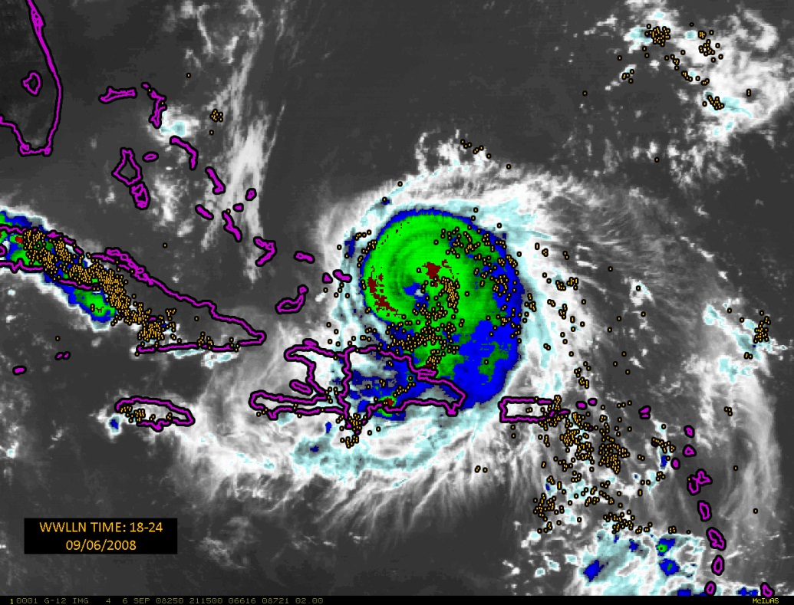
Lightning and Rapid Intensity Change
WWLLN data is GLM proxy
Large data sample (2005-2010 cases) for algorithm development
Experimental Rapid Intensity Change algorithms

Slide 17
Results (Lightning)
Increased lightning in the rainband region of the storm tends to precede RI
Increased lightning in the TC core often indicates peaking in intensity
Experimental rapid intensification scheme with lightning tested in 2010 and 2011 NHC proving ground
2011 version includes new rapid weakening index
Paper submitted to MWR

Slide 18
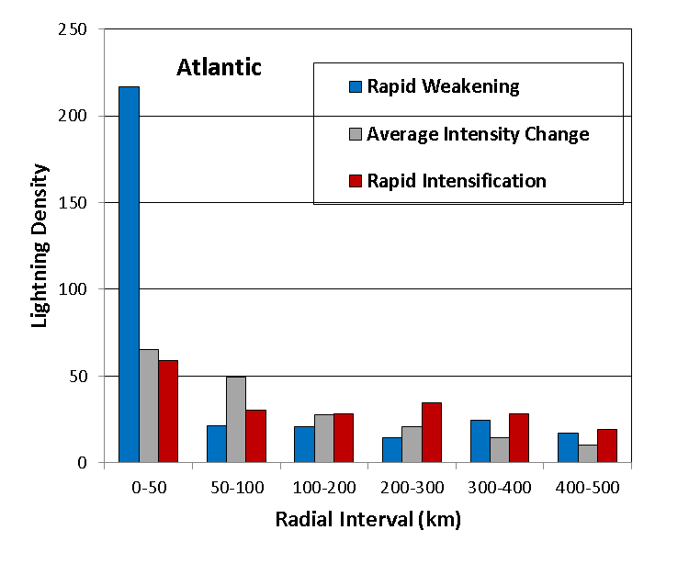
Lightning Density versus Radius Stratified by Intensity Change in the next 24 hr

Slide 19
Forecast improvements due to lightning input during 2010 Proving Ground at NHC
Notes:
Percent improvement by using lightning information (WWLLN). Independent results from 2010.

Slide 20
Plans (TPW, MW, IR PCs, & Lightning)
RII with TPW and IR PCs run in Joint Hurricane Testbed in 2011
NHC will make operational transition decision before 2012 season
New JHT project in 2012-2013 to transition MW version of RII
Will be added to TPW - IR PC version
Lightning data tests will continue in NHC Proving Ground
Could be added to TPW, IR PC, MW version
All versions will use ensemble approach
LDA, Logistic Regression, Bayesian

Slide 21
Questions?

