Slide 1
GOES-R Space Weather L2+ Algorithms
GOES-R3 Review
William F. Denig, Chief
Solar & Terrestrial Physics Division
NOAA/NESDIS/NGDC
+1 303 497-6323
William.Denig@noaa.gov

Slide 2
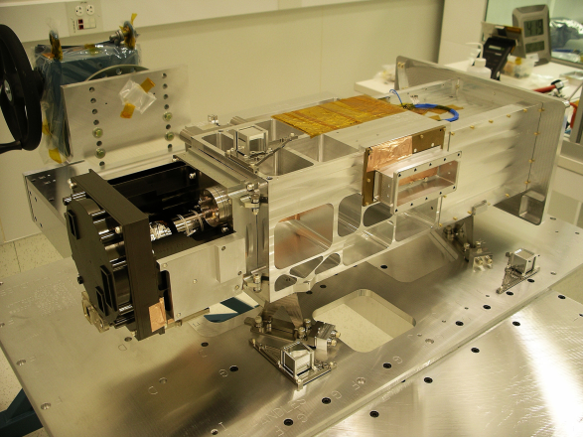
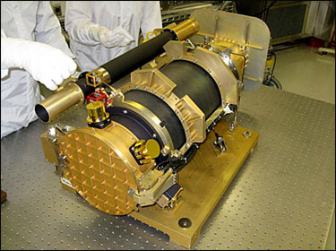
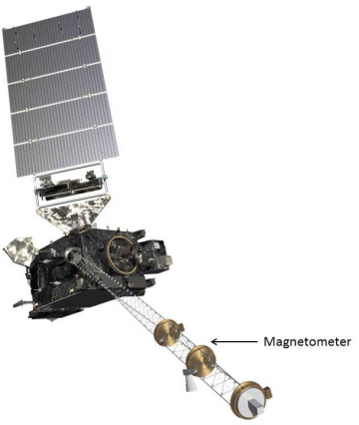
GOES-R Space Weather
SWx Instrument Overview (H/W & L1b)
EUV and X-Ray Irradiance Sensors (EXIS)
• Extreme Ultraviolet Sensor (EUVS)
• X-Ray Sensor (XRS)
• EUVS/XRS Electrical Box (EXEB)
• Sun Positioning Sensor (SPS)
Sensor Manufacturer: LASP
Solar UltraViolet Imager (SUVI)
Sensor Manufacturer: LMATC
Magnetometer (MAG)
Sensor Procurement: LM
Space Environment
In-Situ Sensor (SEISS)
Magnetospheric Particle Sensor Low (MPS-LO)
Magnetospheric Particle Sensor High (MPS-HI)
Solar & Galactic Proton Sensor (SGPS)
Energetic Heavy Ion Sensor (EHIS)
Sensor Manufacturer: ATC

Slide 3
GOES-R Space Weather
Space Weather L2+ Product Overview
Product Set 1
Complete
Product Set 2
Complete
Product Set 3
In Process
XRS.04: One-minute averages for both long and short channels
EUVS.03: One-minute averages of broad spectral bands
SEISS.16: One-minute averages - all MPS channels
SEISS.17: Five-minute averages - all MPS and SGPS channels
SEISS.18: Convert differential proton flux values to integral flux values
MAG.07: MAG data in alternate geophysical coordinate systems
MAG.08: One-minute averages
MAG.09: Comparison to quiet fields
SUVI.07: Composite (wide dynamic range) images
SUVI.09 and .10: Fixed and running difference images
XRS.05: Calculate the ratio of the short over long channels
XRS.09: Daily Background
XRS.07: Event Detection with one-minute data
EUVS.03D: Daily averages of broad spectral bands
EUVS.04: Event Detection
SEISS.19: Density & temperature moments & level of spacecraft charging
MAG.10: Magnetopause crossing detection
SUVI.12: Coronal Hole Images
SUVI.19: Thematic Map
XRS.10: Flare Location
EUVS.05: Multi-wavelength proxy
SEISS.20: Event detection based on flux values
MAG.12: Sudden Impulse (SI) detection
SUVI.13: Bright Region Data
SUVI.14: Flare Location (XFL) reports
SUVI.15: Coronal Hole Boundaries
SUVI.17: EUV Narrow Band Irradiance
Legacy Product
New Product
28 Level 2+ Space Weather Products in three product sets
19 are operational legacy, 9 are new or have experimental heritage

Slide 4
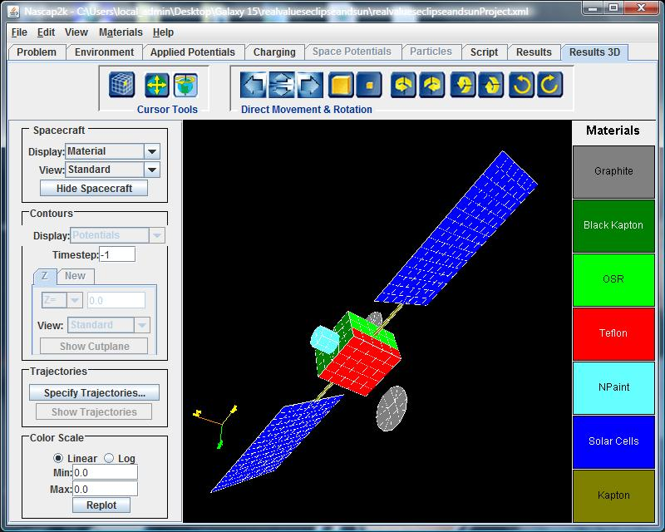
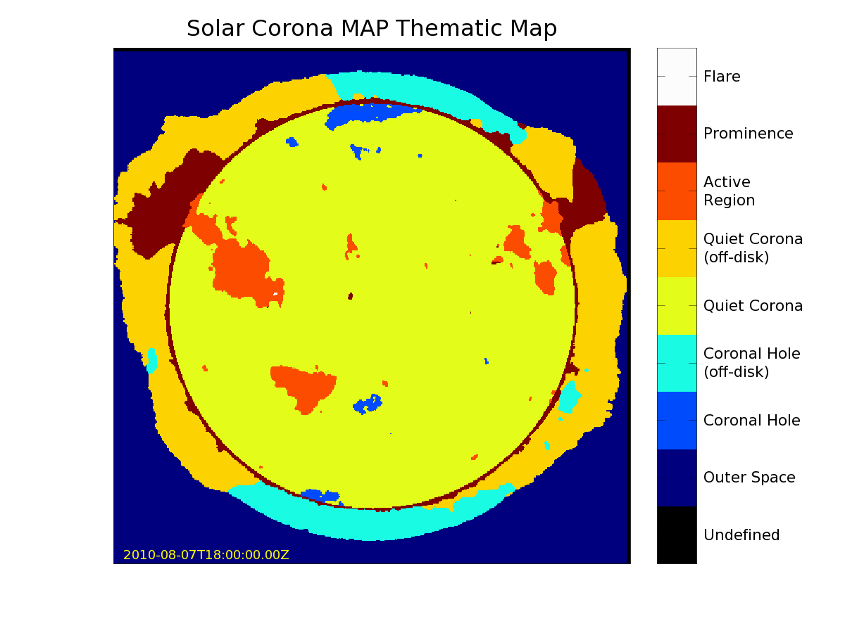
GOES-R Space Weather
Space Weather Product Set 2 - Examples
SUVI.19
SEISS.19
Thematic maps will be used to identify distinct solar regions including flares, prominences, coronal holes, active regions and corona. This technology will be used for the GOES-R proving ground.
Determination of the local environment used to model spacecraft potentials and assess Electro-Static Discharge (ESD) risks. Image below is the NASCAP run of Galaxy-15 for the 05-April-10 geomagnetic storm¹.
Proxy data from the NASA Solar Dynamics Observatory’s Atmospheric Imaging Assembly.
Proxy data from GOES NOP.
¹Published by Ferguson, Denig, and Rodriguez, AIAA, 2010

Slide 5
GOES-R Space Weather
Product L1b/L2+ Interdependencies
MAG
SEISS
EUVS
Level 1b Products
XRS
SUVI
GOES-RRR 23 Sep 2011
Level 2+ Products

Slide 6
GOES-R Space Weather
Selected New Products – Under Development
XRS-10: Flare Location
Purpose: Automate the location of solar flares using the XRS instrument to aid in evaluation of impacts on earth-based and satellite systems
Usage: SWPC solar flare forecast aid
Current Status: In research
SEISS.20: Event Detection
Purpose: Adapt current SEP Event Detection algorithm to SEISS SGPS protons, define enhanced event detection using new SEISS measurements with dosimeters (MPS-HI) and heavy ions, especially iron (EHIS)
Usage: SWPC proton event warnings and NGDC satellite anomaly assessments
Current Status: In research
MAG-12: Sudden Impulse Detection
Purpose: Automate the detection of impulsive magnetospheric events and provide shock wave impacts
Usage: SWPC geomagnetic storm and variation specifications and forecasts
Current Status: On hold until scientist is hired
SUVI.15: Coronal Hole Boundaries
Purpose: Automate the identification and location of coronal hole boundaries on solar images
Usage: SWPC coronal hole maps
Current Status: Scientist just hired

Slide 7
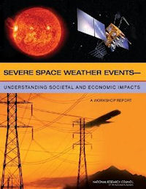
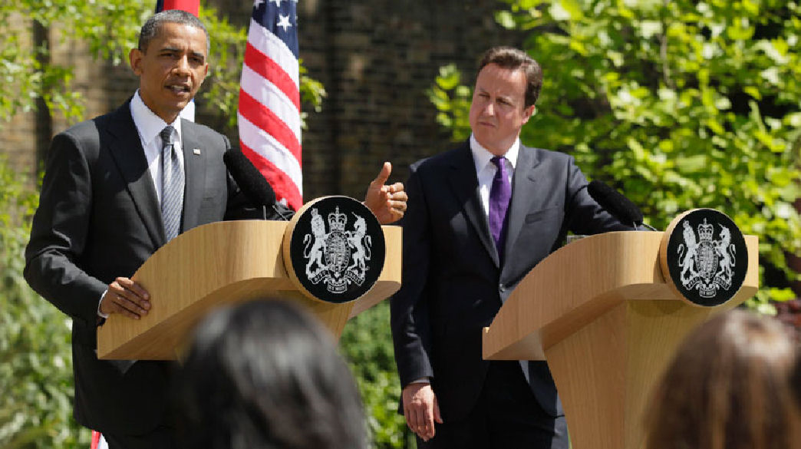
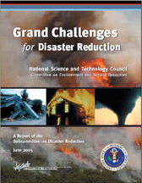
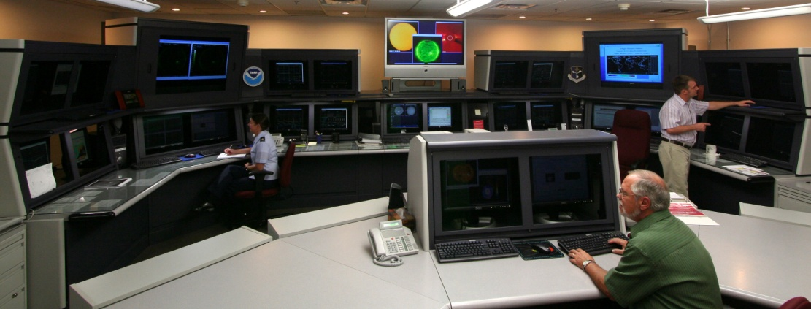
GOES-R Space Weather
Space Weather (SWx) Impacts
NRC estimate of the economic impact of a severe space weather event exceeds $1T in the first year – full recovery could take 4 to 10 years. (2008)
President Obama/Prime Minister Cameron
At the World Meteorological Congress the U.S. and U.K. agreed to work together with other international partners to implement a fully operational global space weather warning system. (2011)
Space weather presents a variety of hazards to technical systems and human life depending on the types, strengths, timings and locations of the disturbances. (2009)
The NOAA Space Weather Prediction Center provides 24x7 monitoring.
The U.K. Met Office pledges to establish a second 24x7 SWx forecast office.
GOES data are critical to SWx operations

Slide 8
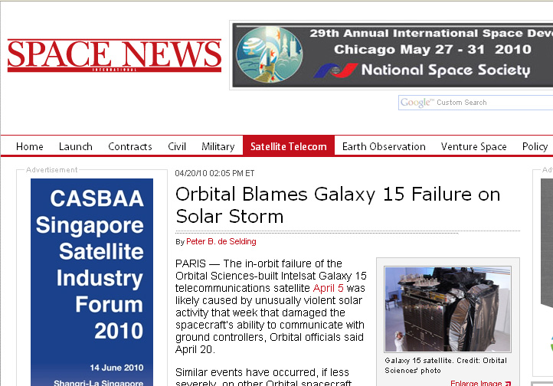
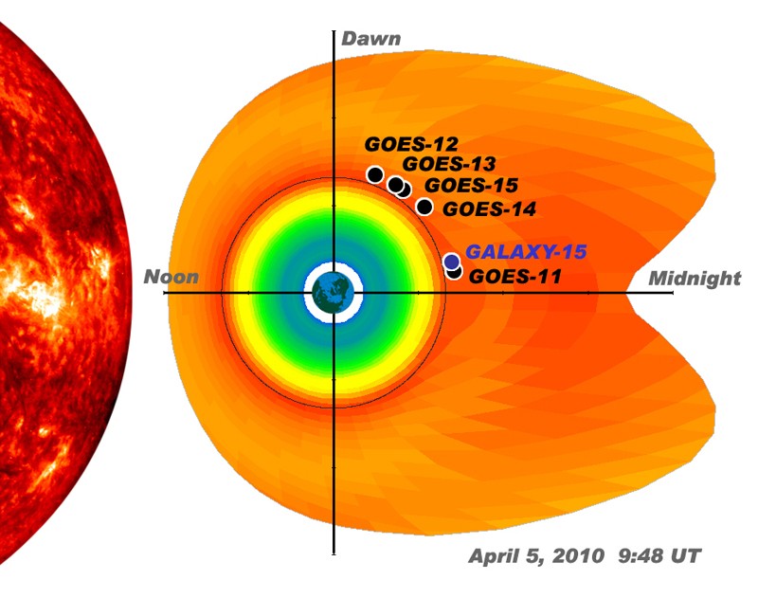
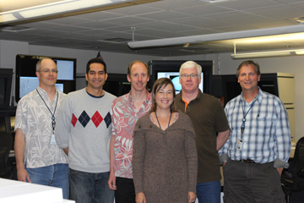
GOES-R Space Weather
Real World Example – Galaxy 15
In April 2010 the Galaxy 15 satellite suffered an anomaly during an interval of heightened space weather. NOAA’s environmental assessment for this period concluded that Galaxy 15 satellite was at increased risk of ESD. While not officially attributing the failure to space weather the satellite builder acknowledged that ESD was the root cause. The availability of GOES data was critical to NOAA’s environmental assessment.
ESD – ElectroStatic Discharge

Slide 9
GOES-R Space Weather
GOES-R Space Weather Team
Name Organization Fuctional Area
Mary Shouldis CIRES Management
Juan Rodriguez CIRES SEISS
Alysha Reinard CIRES EXIS
Jonathan Darnel (incoming) CIRES SUVI
CIRES New Hire CIRES MAG
Leslie Mayer CIRES MAG/SEISS
Jim Vickroy CIRES SUVI
Dave Bouwer Space Env. Tech. EUVS
Steve Mueller Univ. Colorado EUVS
Bill Denig NGDC Federal Oversight
Janet Green NGDC SEISS Advisory
Rob Redmon NGDC MAG Advisory
Dan Wilkinson NGDC Archive
Federal New Hire (pending) NGDC SUVI Advisory
Steven Hill SWPC SUVI Advisory
Terry Onsager SWPC SEISS Advisory
Rodney Viereck SWPC XRS/EUVS Advisory
Howard Singer SWPC MAG Advisory
Christopher Balch SWPC Lead Forecaster
Core Team
GOES-R Team is also assisting in GOES-R Cal/Val Activities

Slide 10
GOES-R Space Weather
Overall Status
GOES R Risk Reduction Activities are researching and developing operational algorithms for existing and new space weather products
User requirements for improved GOES-R space weather products have presented challenges requiring new approaches and algorithms for processing and interpreting the sensor data
Phases 1 and 2 are complete with completion of 20 of 28 algorithm requirements met to date
The GOES R³ activities will allow SWPC and NGDC to meet these challenges and greatly improve the functionality and overall utility of the GOES R space weather sensor suite
The Risk Reduction team is gearing up to take on calibration and validation activities needed for the space weather sensors

Slide 11
GOES-R Space Weather
Functional Re-alignment – SWPC & NGDC
SWPC Focus Areas
RT Operational Support
Space Situational Awareness
Forecasting
Model Transition
Model Science
Product Development
Instrument Requirements
Display Systems
Customer Requirements
Stakeholders
NGDC Focus Areas
Satellite Data Services
Scientific Data Stewardship
Cal/Val Observation Systems¹
Post Launch Testing¹
Algorithm Research¹
Post-Event Analysis¹
Instrument Science/Research¹
Instrument Performance¹
POES Processing¹
¹Functional Realignment from SWPC to NGDC (Ongoing)

Slide 12
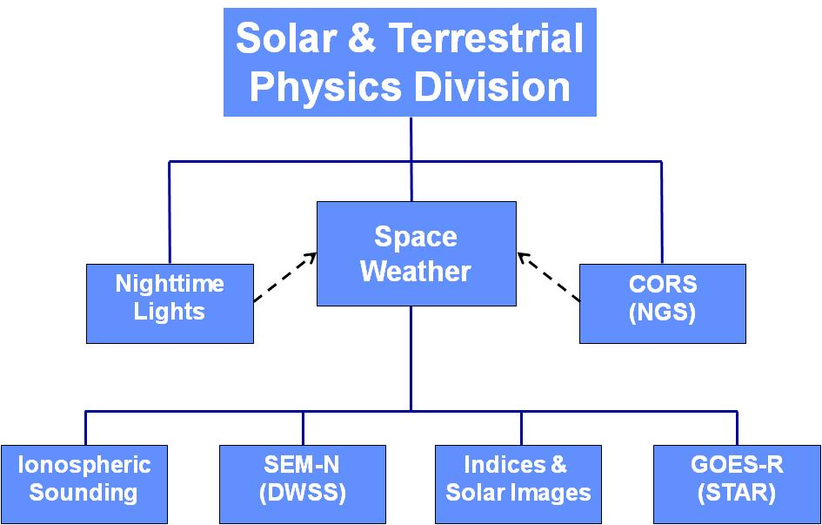
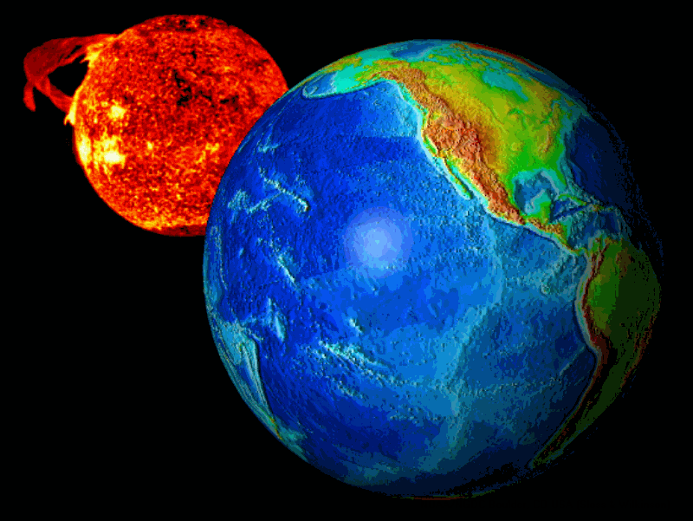
GOES-R Space Weather
NGDC Solar & Terrestrial Physics Division
Space Weather – “The conditions on the sun and in the solar wind, magnetosphere, ionosphere and thermosphere that can influence the performance and reliability of space-borne and ground-based technological systems and endanger human life or health.” (National Space Weather Program)
The Solar & Terrestrial Physics Division within the National Geophysical Data Center (NGDC) provides the archive, access and assessment (AAA) functions for the NOAA Space Weather program.
NGDC is also the organizational host for the World Data Center (WDC) for Geophysics, Boulder. The purpose of the WDCs is to collect, archive and distribute geophysical data and related products to world-wide users.
NOAA's
National
Geophysical
Data
Center

Slide 13
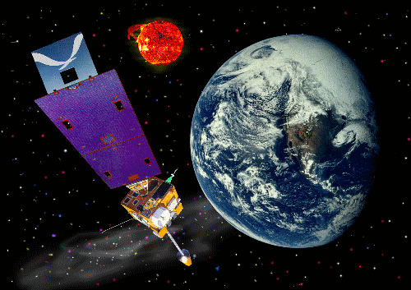
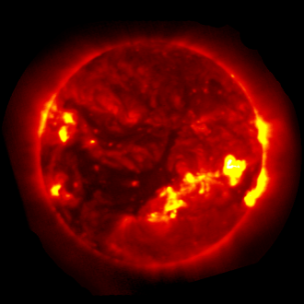
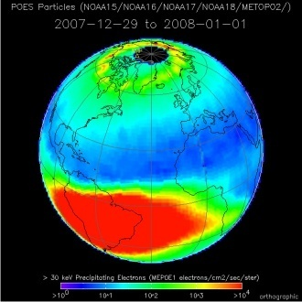
GOES-R Space Weather
NGDC/STP – Stewarding NOAA SWx Data
GOES Space Environment Monitor
Geosynchronous Orbit, since 1974
Elements: In Situ Magnetic Fields Whole Sun X-ray Flux Energetic Particles
GOES Solar X-ray Imager – GOES 12-15
Geosynchronous Orbit, since 2003
X-ray Images taken every minute
All Data Are Online (once operational)
POES/MetOp Energetic Particle Detector
Polar Low Earth Orbit
Energetic Particles Archived Since 1979
All Data Are Online
NGDC manages the CLASS Boulder node
CLASS – Comprehensive Large Array-data Stewardship System

Slide 14
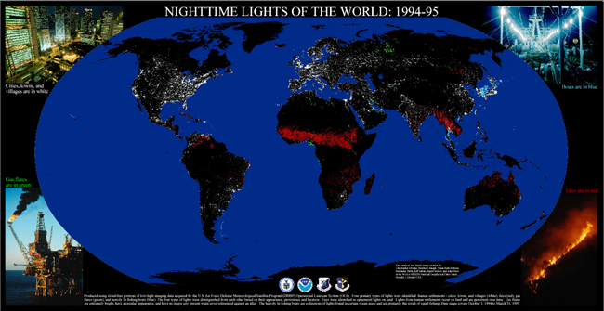
GOES-R Space Weather
NGDC/STP – DMSP Nighttime Lights
Since 1992 STP has been the principal archive for DMSP. The Earth Observation Group is responsible for the NOAA Nighttime Lights earth imagery dataset and derived products.

Slide 15
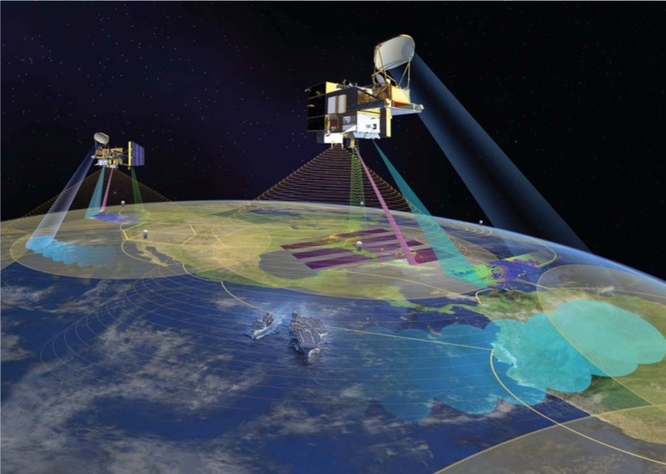
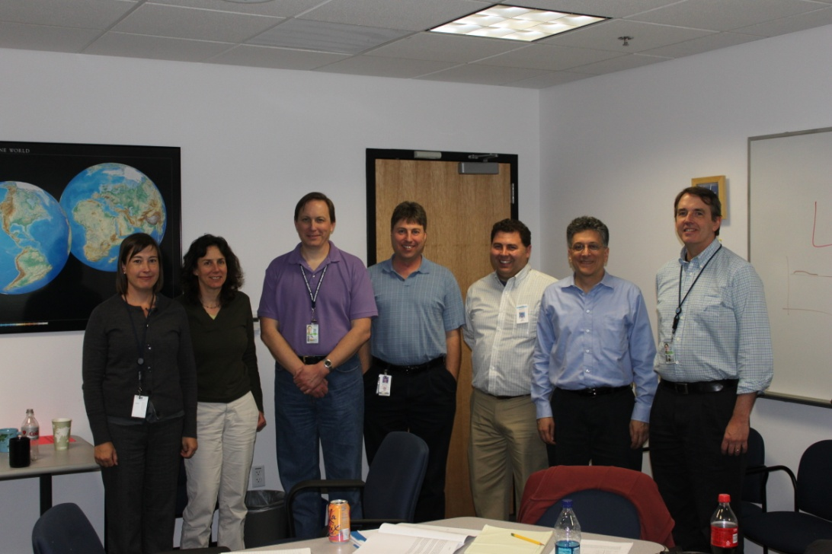
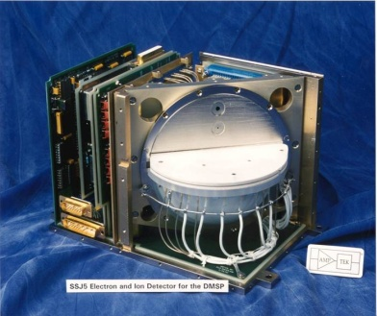
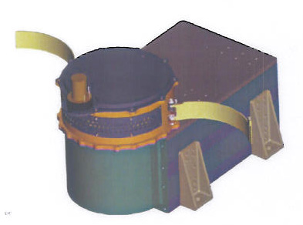
GOES-R Space Weather
NGDC/STP – SEM-N Algorithm Development
STP is developing algorithms for the Space Environment Monitor – Next (SEM-N) for the Defense Weather Satellite System. NGDC is coordinating internal efforts with support provided by AFRL and the JHU-APL. SEM-N is fully integrated with the Algorithm Development Language (ADL)
Image courtesy of NGST

Slide 16
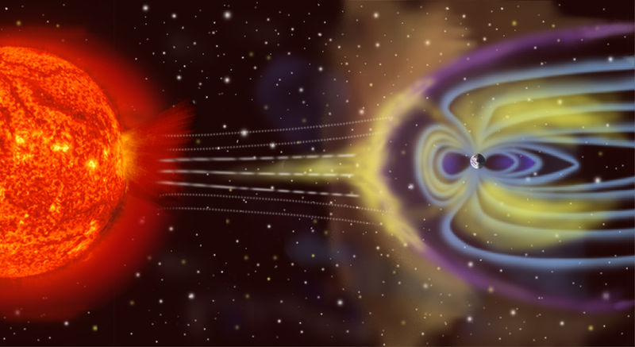
GOES-R Space Weather
Solar-Terrestrial Interactions
Image not to scale
Movie
Notes:
Points to make:
The earth is constantly bombarded by charged particles flowing outward from the sun (solar wind).
The pressure of the solar wind compresses the earth magnetic fields on the dayside and stretches them out on the nightside creating the magnetosphere.
The solar wind varies greatly in dynamic pressure (density & speed) – solar, coronal mass ejections release enormous amounts of high energy particles at high speeds which can greatly affect “space weather” at the earth.
The accompanying movie provides a more accurate depiction of the relative scale sizes for the sun and earth.
The earth is constantly bombarded by the streaming charged particles of the solar wind. The earth’s magnetic field effectively blocks these particles and causes them to deflect, for the most part, around the earth. The pressure of the solar wind on the sunward side of the earth compresses the dayside magnetic field and elongates the field on the nightside. Embedded within the high-beta plasma of the solar wind is the highly dynamic interplanetary magnetic field (IMF). Depending on the orientation of the IMF with respect to the earth’s geomagnetic field there can be either strong coupling between the IMF and the terrestrial field or weaker coupling.
This cartoon illustrates the configuration of the earth’s outer magnetic field under the influence of the solar wind. Prior to the mid 1960’s there was vigorous debate concerning whether the earth’s magnetic topology was open or closed; that is, if the geomagnetic field did or did not, respectively, merge with the IMF. The currently accepted notion is that the earth’s magnetic topology is open and that the IMF and geomagnetic fields merge on the dayside and reconnect within the tail region. The physics which govern these processes are complex and modeling their interaction is only possible using non-linear plasma theory. On the dayside there is anecdotal evidence for magnetic field merging from satellites near the space-earth interface typically referred to as the magnetopause. The evidence for magnetic merging within the lower atmosphere can be seen in the motion of discrete auroral structures that form within the auroral zone near noon and then move poleward. Similarly on the nightside the stretched magnetic field lines reconnect and tend to snap back to a more dipolar configuration which causes transient currents to flow within the auroral zones resulting in ground-based magnetic perturbations.

Slide 17
GOES-R Space Weather
SWx L2+ Algorithms
QUESTIONS?

