Slide 1
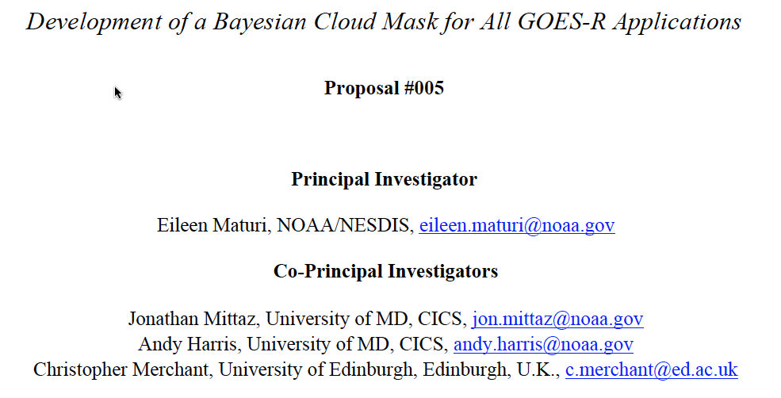
Purpose of project: Reduction of project risks related to quality of cloud
detection / masking for multiple applications over land and sea. Will provide a
Bayesian clear sky probability that can be used by multiple GOES-R applications.
Concept: Extension of Bayesian detection methodology (currently successful
for GOES SST) to exploit GOES-RRR channel suite, and extending to land
Approach: Prototyping on SEVIRI, bootstrapping from existing SEVIRI cloud
masks
2011 GOES-R Science Week -Risk Reduction Annual Meeting – 21-23 September –NSSTC-Huntsville, Alabama

Slide 2
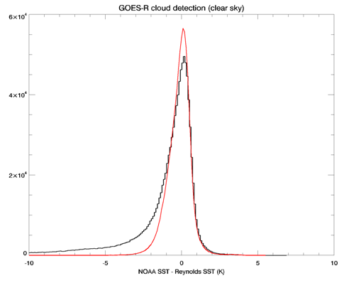
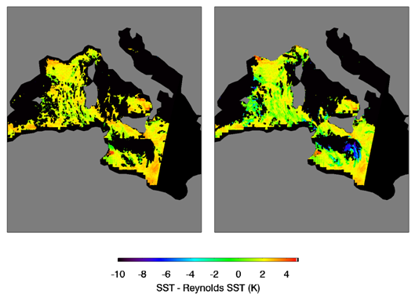
Perceived strengths of Bayesian alternative cloud detection:
Increased maintainability from generalized nature of approach combined
with use of in-house maintained NWP and CRTM capability
Bayesian method is resilient to channel updates (e.g. proxy-to-GOES-R) and/or failures
Apparent improved detection rates and decreased false detection rates compared
to threshold-based methods (including current GOES-R cloud mask)
Figure Left panel shows histograms of SEVIRI-retrieved SST minus Reynolds Daily-OI SST. The black line shows the distribution obtained using the current GOES-R cloud mask while the red line is the result of applying our Bayesian scheme. The right hand side shows a comparison of part of the SEVIRI minus Daily-OI SST. The Bayesian mask has been applied to the left-hand image while the result for the current GOES-R mask is shown on the right.
2011 GOES-R Science Week -Risk Reduction Annual Meeting – 21-23 September –NSSTC-Huntsville, Alabama
Notes:
Current GOES-R cloud mask misses a lot of cloudy pixels where the Bayesian cloud mask does not. The current GOES-R cloud mask flags clear pixels as cloudy. The Bayesian cloud mask gets more clear pixels.
We see that in the graph because our peak is higher than their peak.
Blue- current GOES-R cloud mask
Red- Bayesian Cloud mask
The cold tail indicates that they are flagging cloudy pixels as clear. They are also flagging some clear pixels as cloudy.

Slide 3
Year 1 milestones and progress:
Project kick-off telecon in July 2011
Establish common version control of software between partners (ongoing)
Obtain precursor cloud masks (complete)
Exploit precursor cloud masks for Bayesian probability distributions (PDFs)
Specify NWP/CRTM simulation capability for reflectance and emissivity
Implement simulation and PDFs in software
Major Year 2 and 3 milestones
Univ. Edinburgh
Refine land PDFs iteratively
Assess performance against CALIPSO/SEVIRI data base
Compare cloud mask impacts on selected retrievals
Documented, integrated software transferred to NOAA
NOAA
Update NOAA software with Univ. Edinburgh updates from Year 1
Derive Ocean PDFs using combination of Geo-SST SEVIRI cloud masks and CALIPSO data
Refine Ocean PDFs iteratively
Assess performance against CALIPSO/SEVIRI data base
Compare cloud mask impacts on selected retrievals
Combine with final Land cloud mask software
Document and run final tests
2011 GOES-R Science Week -Risk Reduction Annual Meeting – 21-23 September –NSSTC-Huntsville, Alabama

