Slide 1
Ensemble Simulation of GOES-R Proxy Radiance Data from CONUS Storm-Scale Ensemble Forecasts, Product Demonstration and Assessment at the Hazardous Weather Testbed GOES-R Proving Ground
Principal Investigator: Prof. Ming Xue, Center for Analysis and Prediction of Storms (CAPS ) and School of Meteorology, University of Oklahoma
Co-PIs: Drs. Keith Brewster and Fanyou Kong, CAPS, University of Oklahoma
Co-PI: Jason Otkin, Cooperative Institute for Meteorological Satellite Studies (CIMSS), University of Wisconsin-Madison
Co-PI: Dr. Louis Grasso, Cooperative Institute Research in the Atmospheric (CIRA), Colorado State University
Collaborators Co-I: Steve Weiss, Storm Prediction Center, NWS/NOAA, Norman OK
Co-I: Dr. Fuzhong Weng, NOAA/NESDIS
Co-I: Jack Kain and David Turner, National Severe Storm Laboratory

Slide 2
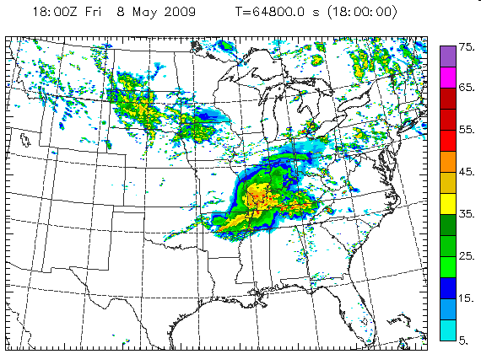
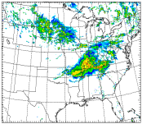
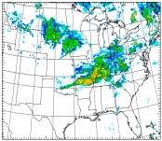
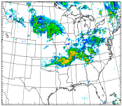
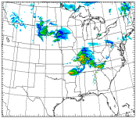
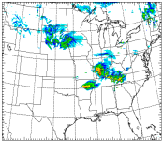
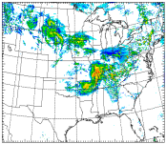
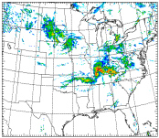
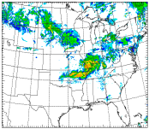
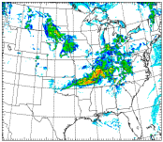
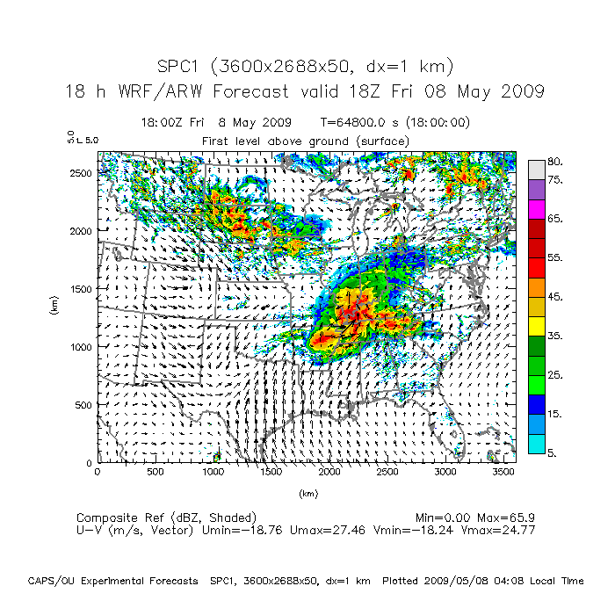
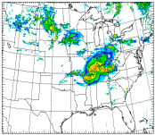
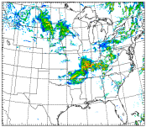
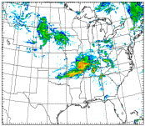
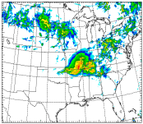
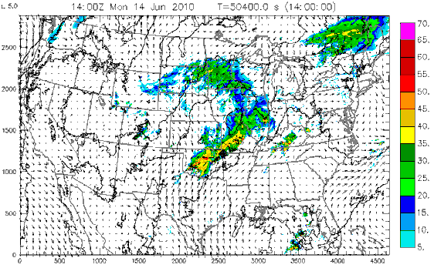
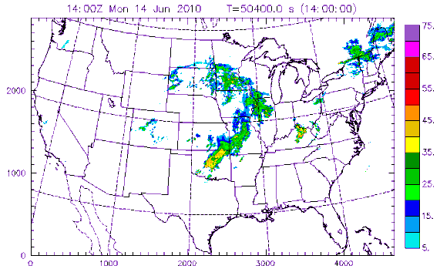
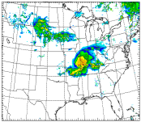
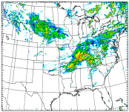
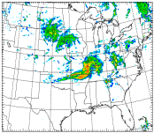
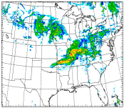
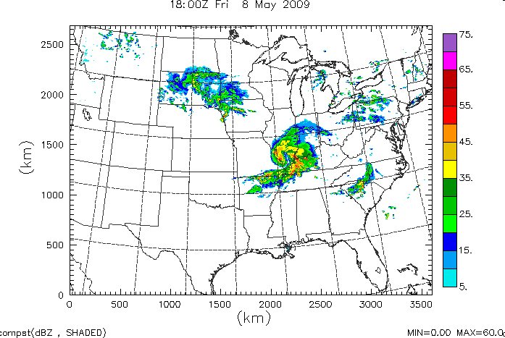
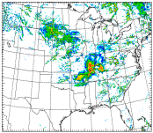
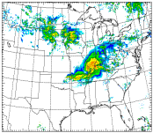
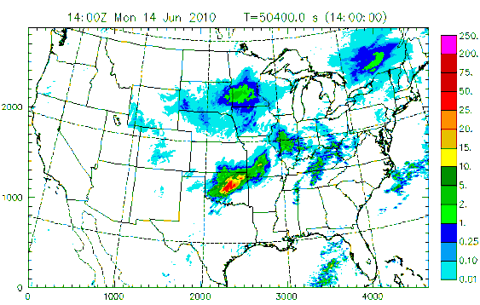
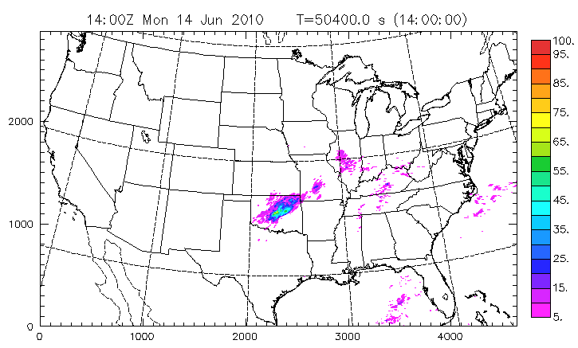











Realtime Convection-Permitting Ensemble and Convection-Resolving Deterministic Forecasts of CAPS for the Hazardous Weather Testbed (HWT) Spring Experiments
CAPS 2011 SSEF:
51 4-km, one 1 km, 36h CONUS forecasts
8 microphysics, 4 PBL, 2 LSM schemes, assimilating WSR-88D data
ARPS – CN
ARW – C0
NMM – CN
NMM – C0
ARPS – CN
ARPS – C0
June 14, 2010 – OKC Flooding Case, 14 h fcst
18 hr Forecast - 1 km “Radar”
1 km model forecast reflectivity
Observed reflectivity
Observed Radar Reflectivity
Max=125mm
Max=71%
20 members from 2008
Support Probabilistic Forecasts
PM ensemble hourly precip
probability of hourly
precipitation >0.5 inch
Notes:
2

Slide 3
Proposed Work
Ensemble Simulation of GOES-R Proxy Radiance Data from CONUS Storm-Scale Ensemble Forecasts, Product Demonstration and Assessment at the Hazardous Weather Testbed GOES-R Proving Ground
Ensemble of ABI imagery using NESDIS CRTM, CIMSS and CIRA simulation packages, from CAPS’s Storm-Scale ensemble in realtime.
Probabilistic products in terms of satellite observables.
Adapt the simulation packages to work with various microphysics schemes, including two-moment schemes
Simulations for at least 5 bands (6.185, 7.35, 6.95, 10.35 and 12.3 mm), comparison with GOES observations
Require ~3000-4000 CPU cores using three packages for ~ 30 members, need to run on NICS
Send the products to HWT/GOES-R Proving Ground for realtime assessment during Spring Experiments

Slide 4
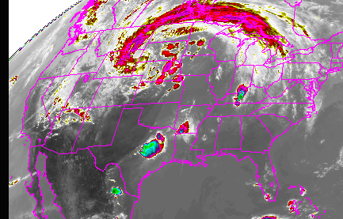
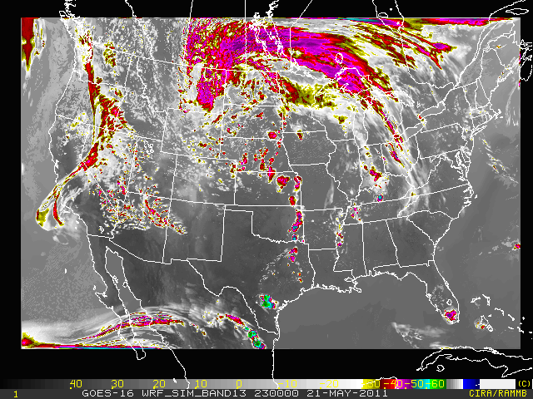
Preliminary Testing Results
2245 UTC on 21 May 2011
Simulated ABI 8.5 μm brightness T (K) at 0100 UTC, 28 April 2011 for 4 CAPS 4-km ensemble members
2300 UTC on 21 May 2011
By Jason Otkin, CIMSS
Top: observed Bottom: synthetic
GOES-R at 10.35 μm from 2011
NSSL realtime 4-km WRF forecast
By Louie Grasso, CIRA
Notes:
GOES-R at 10.35 μm image is generated using data from the real-time NSSL 4 km wrf-arw runs (right).
Note the difference in map projection.

