Slide 1
Storm Tracking and Lightning Cell Clustering using GLM for Data Assimilation and Forecast Applications
Principal Investigators:
Kristin Kuhlman and Don MacGorman
Collaborators:
Valliappa Lakshmanan, Ted Mansell, Travis Smith, and Kiel Ortega

Slide 2
Segmotion/K-means
Identifies segments (or storm cells/clusters) of image & estimates motion
Extracts properties of each cell
Size of cell (# of pixels)
Pull data from all grids, including radar, lightning, and derived properties such as maximum expected size of hail (MESH)
Moves grid based on motion field
Tracking: Lightning vs. Reflectivity vs. Hybrid
Want a relatively stable area, without drops or mismatches
Past track given by centroid of area, if loses section or adds will change centroid location and can account for difference in track
Notes:
Can tune for need (may be different getting max lightning, or VIL, or circulation tracks)

Slide 3
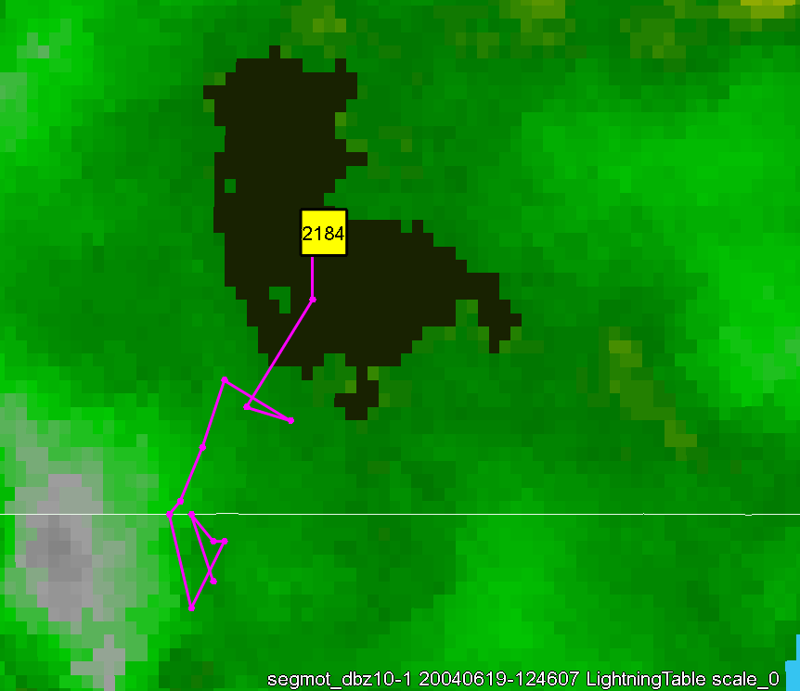
Comparison between methods
Evaluating Track Duration (length), Linearity, and cell size
Better tracks are expected to be longer, more linear, and are consistent (less variability in cell properties)
Both Lightning Density and Refl. @ -10 C provide consistent tracks for storm clusters / cells (and perform better than tracks on Composite Reflectivity )
At smallest scales: Lightning Density provides longer, more linear tracks than Ref.
Reverses at larger scales. Regions lightning tend to not be as consistent across large storm complexes.

Slide 4
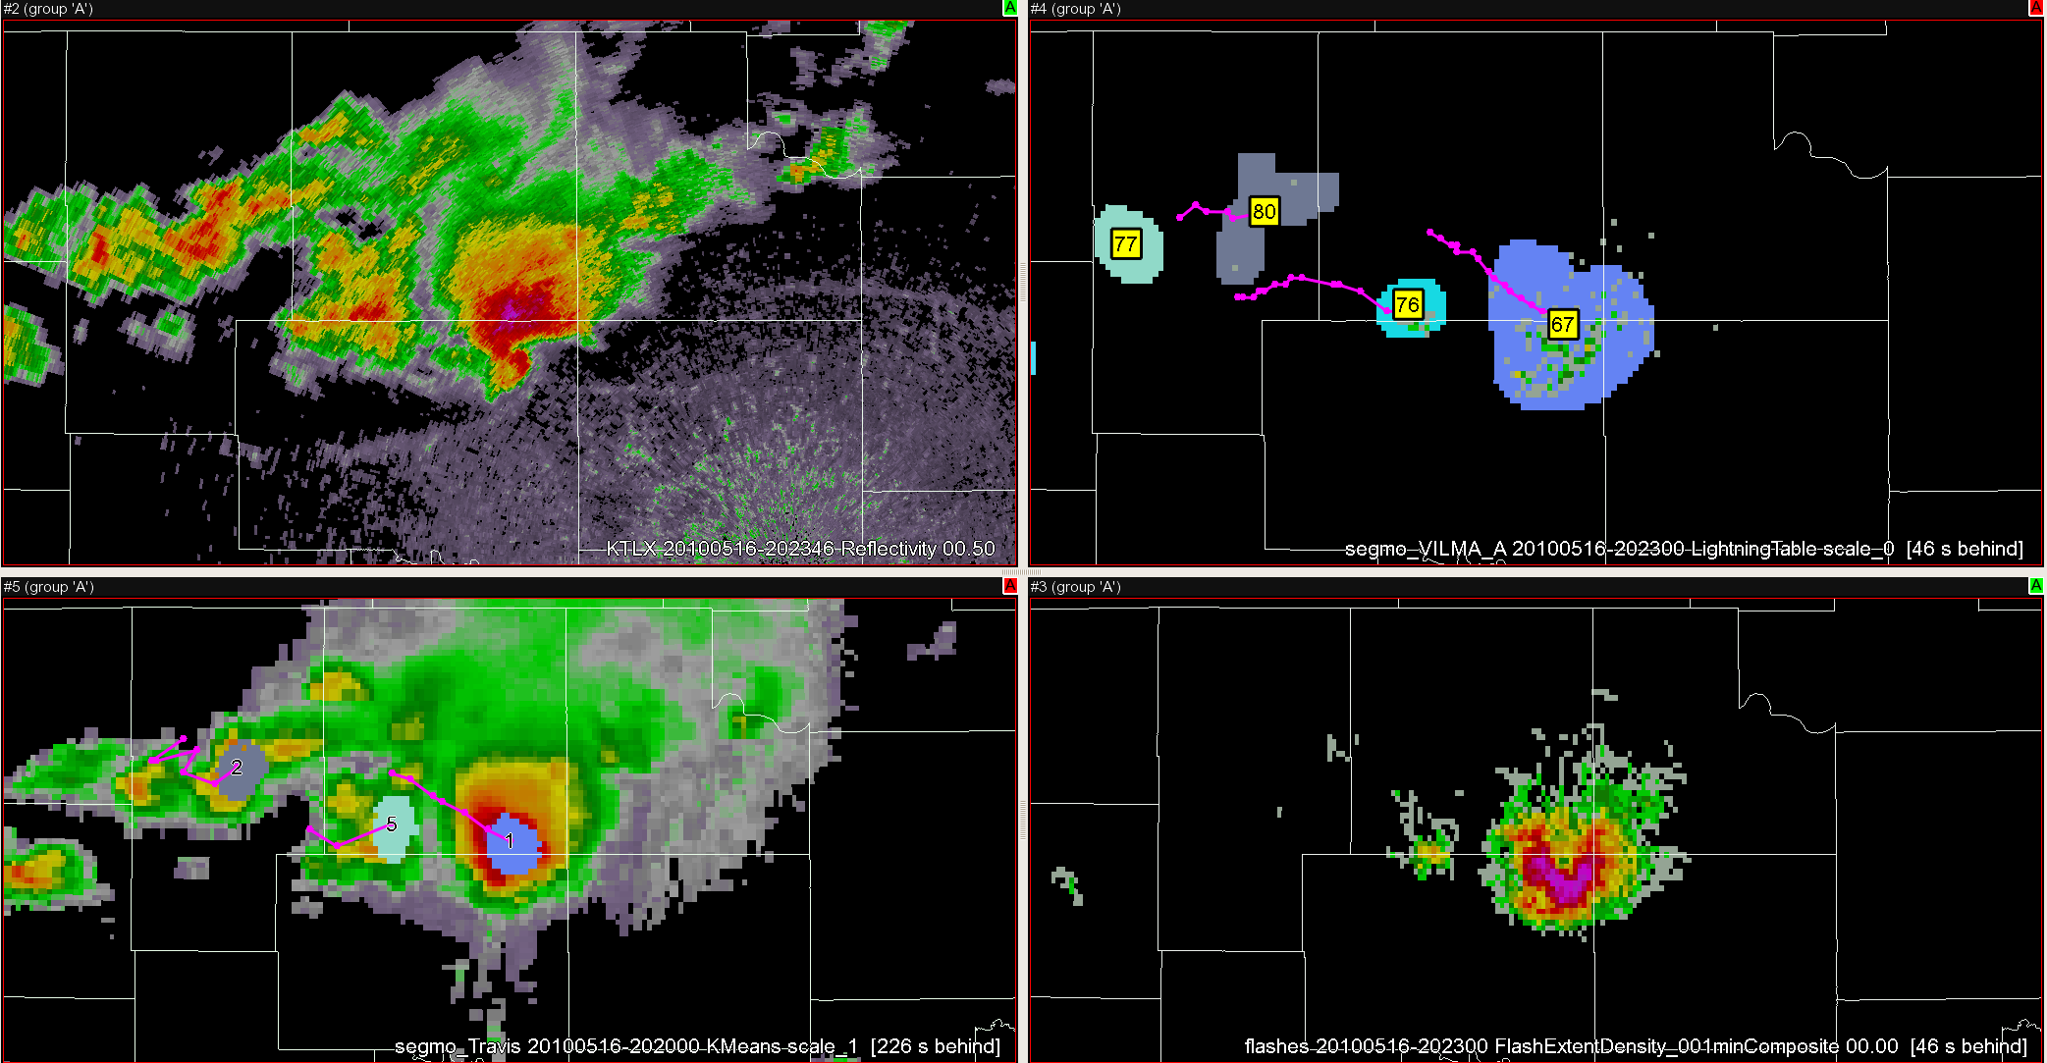
Questions:
For assimilation: # of flash initiations, # of flashes traversing a grid cell, or some measure of the summed density/duration of flashes at a particular grid cell?
Are the answers to these questions different for different types of storms or at different resolutions/spatial scales?
How does this translate to pGLM and ultimately GLM?

Slide 5
