Slide 1
SOLAR ENERGY APPLICATIONS
Istvan Laszlo, NOAA/NESDIS/STAR
Hongqing Liu, DELL GS
Vladimir Kondratovich, ERT
2011 GOES-R Risk Reduction Annual Review, 21-23 Sep 2011, Huntsville, AL

Slide 2
THE “GOES SOLAR RADIATION PRODUCTS IN SUPPORT OF RENEWABLE ENERGY” PROJECT
Team:
NOAA/STAR: I. Laszlo (PI), H. Liu (co-I), V. Kondratovich; A. Heidinger, M. Goldberg, F. Weng;
NOAA/OAR/ESRL: E. Dutton;
US Department of Energy (DOE)/National Renewable Energy Laboratory (NREL): B. Walter, T. Stoffel, M. Sengupta
Notes:
2

Slide 3
SOLAR RESOURCE DATA NEED
Solar power has been growing at an annual rate of 40% in recent years. By 2025 it could grow to 10% of U.S. power needs.
Sunlight is the fuel for solar power generation technologies. Need to know quality and future availability of the fuel for accurate analysis of system performance.
Variability of sunlight is probably the single greatest uncertainty in a plant’s predicted performance [1].
Solar resource data is used for
Site selection
Predicting annual plant output
Analysis of temporal performance and operating strategy.
Solar resource data needed:
direct normal irradiance (DNI)
diffuse horizontal irradiance (DHI)
global horizontal irradiance (GHI=DNI*cos(SZA)+DHI)
Neither current operational nor future GOES-R solar product contain all components as output.
[1] Stoffel et al., Concentrating solar power – Best practices handbook for the collection and use of solar resource data, NREL/TP-550-47465, Sep 2010

Slide 4
THE “GOES SOLAR RADIATION PRODUCTS IN SUPPORT OF RENEWABLE ENERGY” PROJECT
Objective:
Modify/improve and test the geostationary solar radiation budget algorithms such that they meet the requirements of solar energy (SE) applications.
Tasks:
increase spatial resolution of GSIP & GOES-R products (GPSDI,R3);
add direct normal and diffuse radiation as products (R3);
add tailored products (R3);
create and evaluate climatology of GOES-based solar radiation data for renewable energy (R3)
Explore “pseudo” forecast of SE
Notes:
4

Slide 5
ACCOMPLISHMENTS
Task | Status
Create climatology of SE parameters from 50-km GSIP-CONUS | Initial assessment of SE climatology Corrected data (1998-2010) for known problems (gaps , clear/cloudy biases) Re-evaluated insolation Started re-calculating and evaluating SE parameters
Revise current GSIP-v2 algorithm for SE | Increased spatial resolution from 14 km to 4 km Added capability for calculating direct and diffuse fluxes Deriving SE parameters
Revise GOES-R/ABI SW radiation budget algorithm for SE | Added capability for calculating direct and diffuse fluxes Initial assessment of direct and diffuse fluxes Expanded data base and performed detailed evaluation
Explore a pseudo forecast capability of insolation for GOES-R | Not (yet) performed
Note: Due to contracting/hiring issues the project start was delayed by almost a year

Slide 6
GSIP-CONUS climatology FOR SE

Slide 7
GAP FILLING (1) GSIP-CONUS
For climatology data without gaps are needed
Time interpolation, TI
uses cell values one hour before and/or one hour after
Space interpolation, SI
uses “good” neighboring cells
“+” cells have higher correlation with and smaller bias from the true value than “x” cells. Both are used with “+” cells having higher rank (priority).
x | + | x
+ | c | +
x | + | x

Slide 8
GAP FILLING (2) GSIP-CONUS
Decision tree selects the possible interpolation scheme with highest rank.
Interpolations are iterated on a day worth of data until the last gap is filled or until the limit of iterations is reached (5).
Rank | Method | R | residual | Comment
5 | TI (2 neighbors) | 0.96 | 8.3% | SZA-adjusted average
4 | SI (+) | 0.96 | 7.2% | Average
3 | SI (x) | 0.92 | 10.6% | Average
2 | TI (neighbor at h-1) | 0.90 | 12% | SZA-adjusted
1 | TI (neighbor at h+1) | 0.90 | 12% | SZA-adjusted
0 | Bad cell | - | - | Discarded

Slide 9
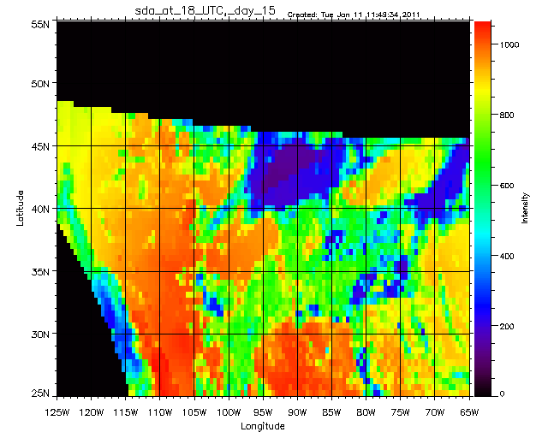
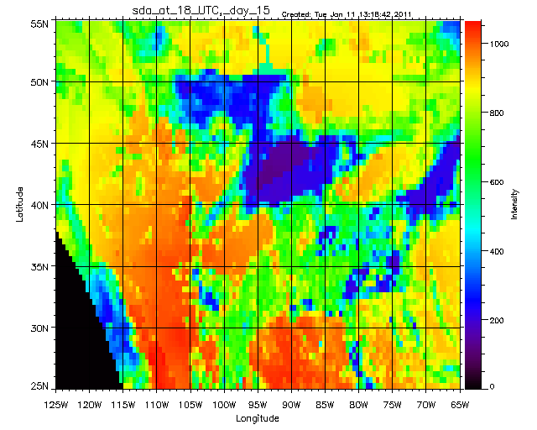
GSIP-CONUS DATA ENHANCEMENTS Gap filling - example (1)
Temporal Interpolation (TI)
Original image
Gap-filled image

Slide 10
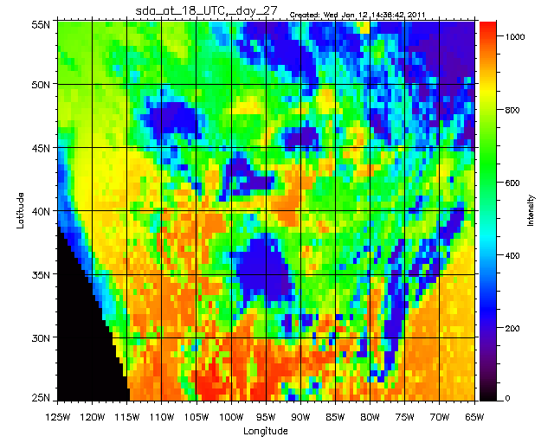
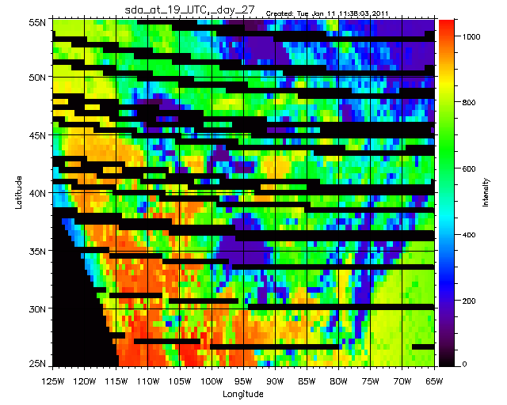
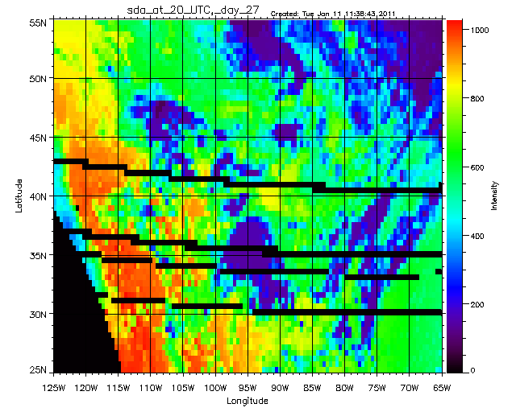
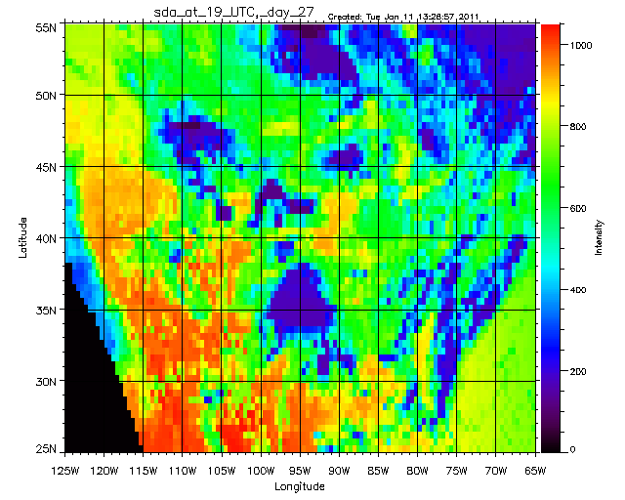
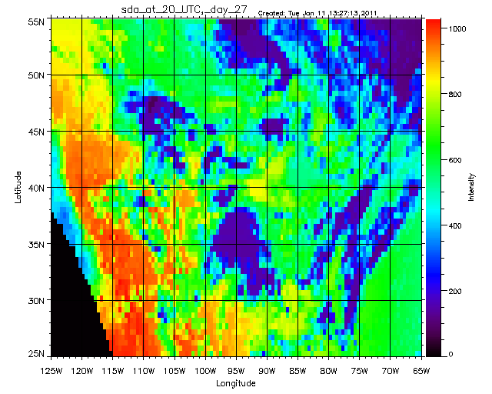
GSIP-CONUS DATA ENHANCEMENTS Gap filling - example (2)
More complicated case: later image is also “damaged” – TI are SI are combined.
Time
Gap-filled central image
Gap-filled right image

Slide 11
GSIP-CONUS DATA EVALUATION
Gap-filled data are adjusted
Applied seasonally-dependent empirical adjustments to clear and overcast GSIP fluxes
Adjustments were derived from one year of data per satellite
Adjustment also considered uncertainty in SURFRAD (~ 11 Wm⁻²)
Adjusted fluxes are compared with data from SURFRAD (7 sites)
Spatial/temporal representation of ground measurements and that of satellite retrievals differ
Applied a similarity filter (SF) ≤ 0.5
SF = {([(1 – CF)² + (CF – R)² ]/2)}^{-1/2}
CF: GSIP clear fraction
R: ratio of direct to total downwelling flux from ground

Slide 12
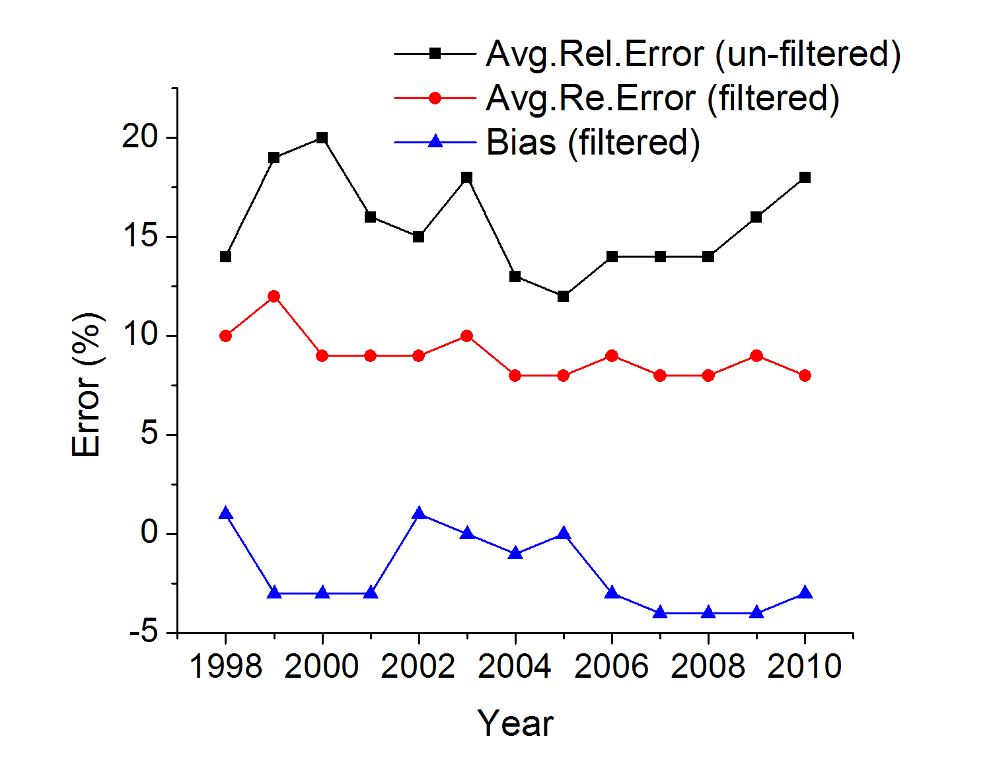
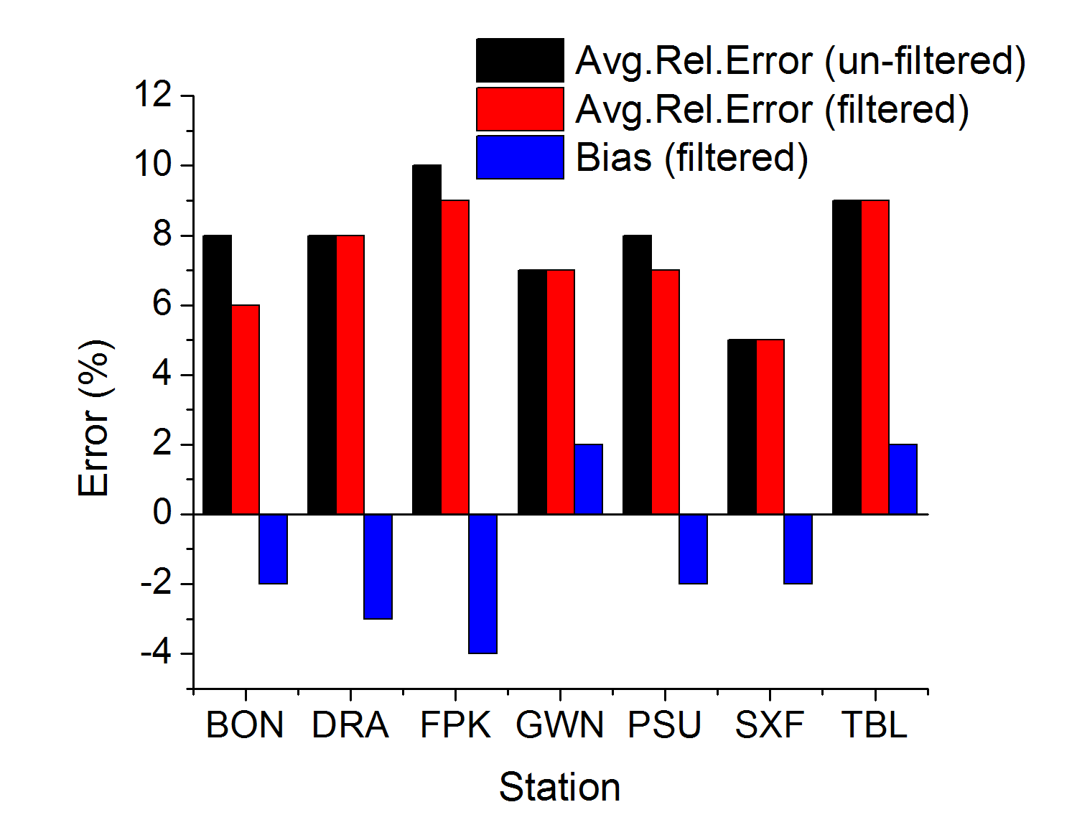
GSIP-CONUS DATA EVALUATION
Avg.Rel.Error= (Σ|Fgi – Fsi|)/ΣFsi Bias = (Σ(Fgi – Fsi))/ΣFsi
F: GHI; g: GSIP; s: SURFRAD
Hourly averages of GHI
Monthly averages of GHI

Slide 13
SE PARAMETERS GSIP-CONUS Data
Parameter | Validation
Average insolation (Amount of solar radiation incident on the surface of the earth) | Validated
Midday insolation (Average insolation available within 1.5 hours of Local Solar Noon) | Ongoing
Clear sky insolation (Average insolation during clear sky days (cloud amount < 10%) | Ongoing
Clear sky days (Number of clear sky days (cloud amount < 10%) | Ongoing
Diffuse radiation on horizontal surface (Amount of solar radiation incident on the surface of the earth under all-sky conditions with direct radiation from the Sun's beam blocked ) | Planned
Direct normal radiation (Amount of solar radiation at the Earth's surface on a flat surface perpendicular to the Sun's beam with surrounding sky radiation blocked) | Planned

Slide 14
GSIP-V2 SE EXAMPLES

Slide 15
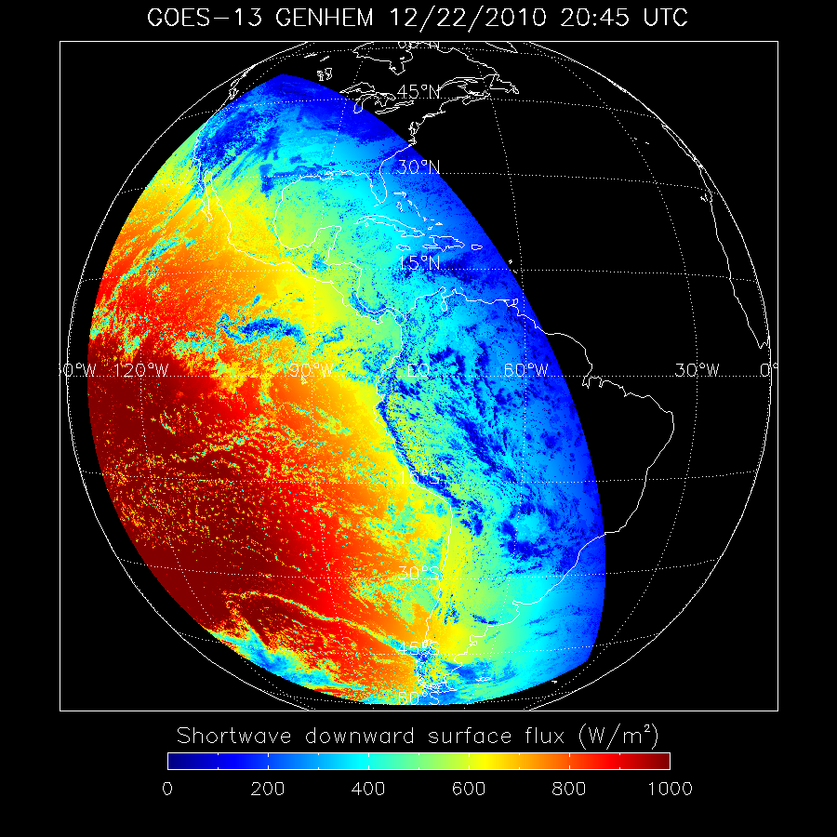
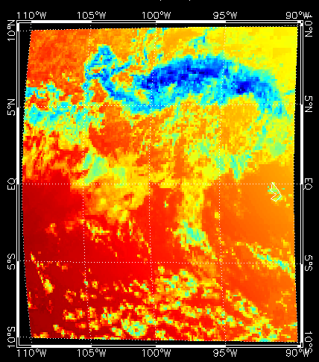
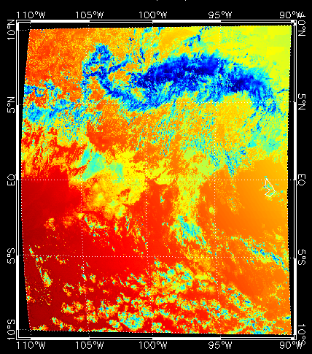
INCREASED SPATIAL RESOLUTION GSIP-v2 Examples (1)
14 km
4 km

Slide 16
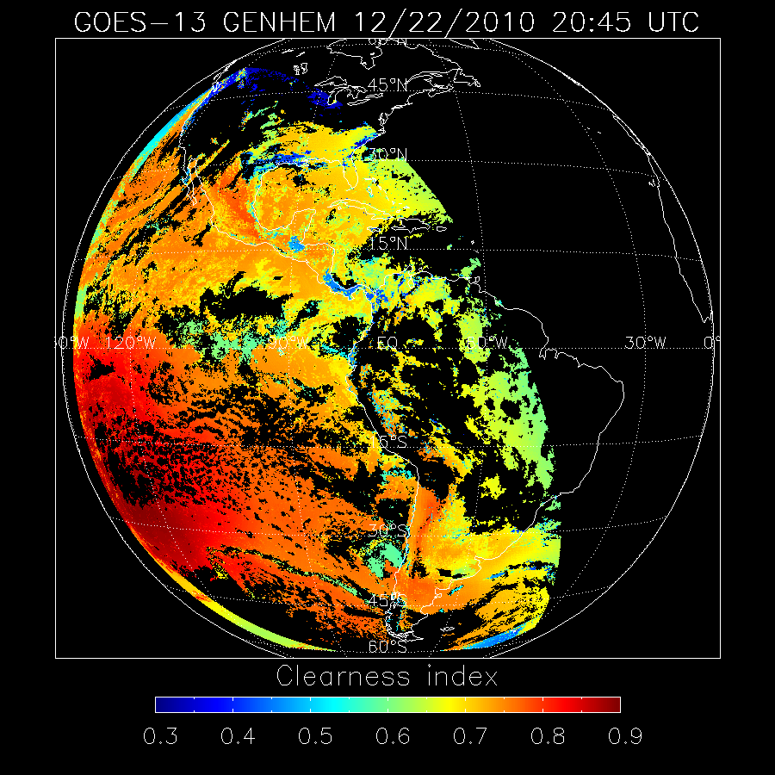
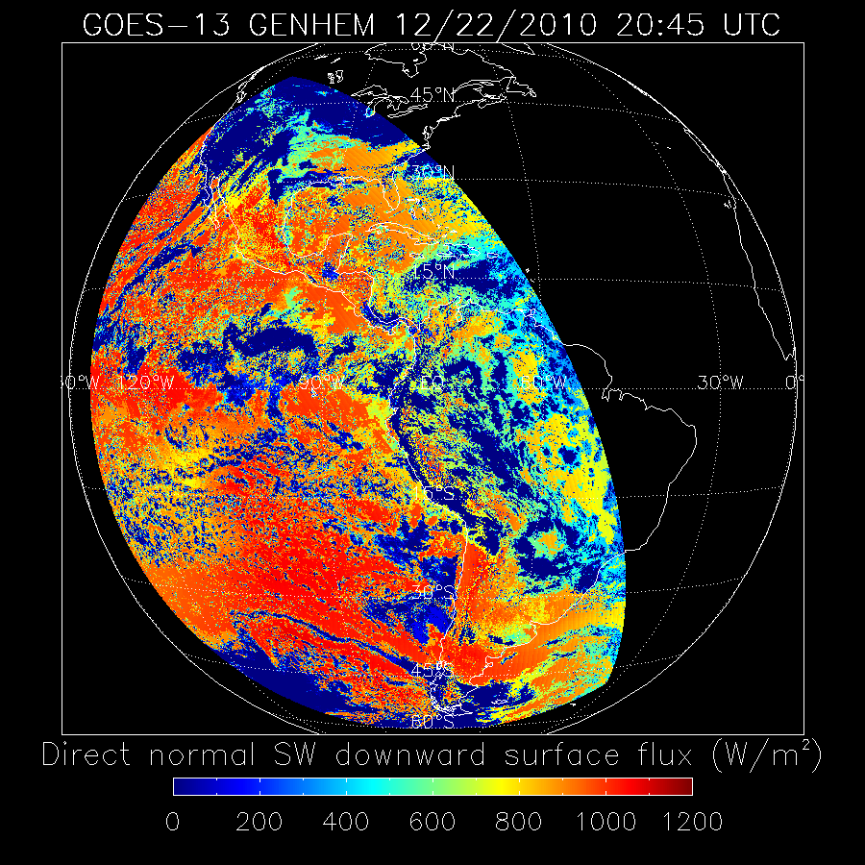
SE PARAMETERS GSIP-v2 Examples

Slide 17
GOES-R ABI FLUX EVALUATION

Slide 18
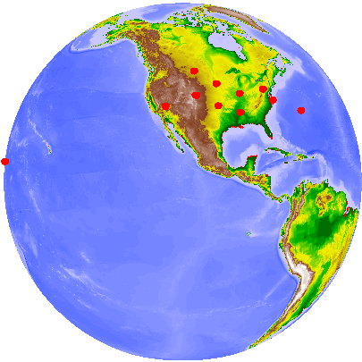
VALIDATION SITES AND TIMES
Sites: 12 stations within current GOES domain:
BON, DRA, FPK, GWN, PSU, SXF, TBL (SURFRAD)
COV (COVE)
E13 (ARM)
BER, BOU, KWA (CMDL)
Time Period:
2000.03 – 2009.12 (Terra);
2002.07 – 2009.12 (Aqua) for SURFRAD and COVE stations;
2000.03 – 2006.06 (Terra);
2002.07 – 2005.02 (Aqua) for ARM and CMDL stations.
Retrieval spatial scale: 5 km (from MODIS data/products)
Ground data temporal scale: 15-min average
FPK
SXF
PSU
DRA
BOU
BON
COV
E13
BER
TBL
GWN
KWA

Slide 19
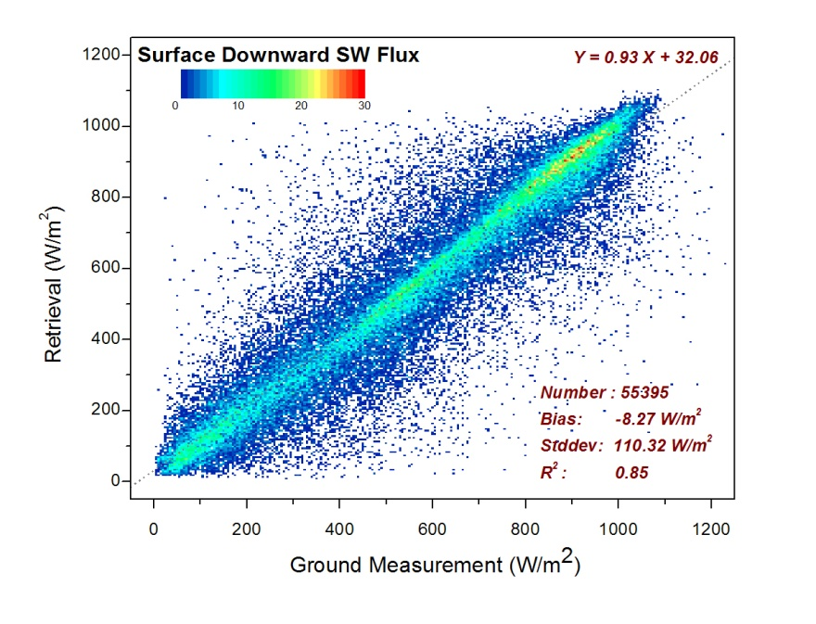
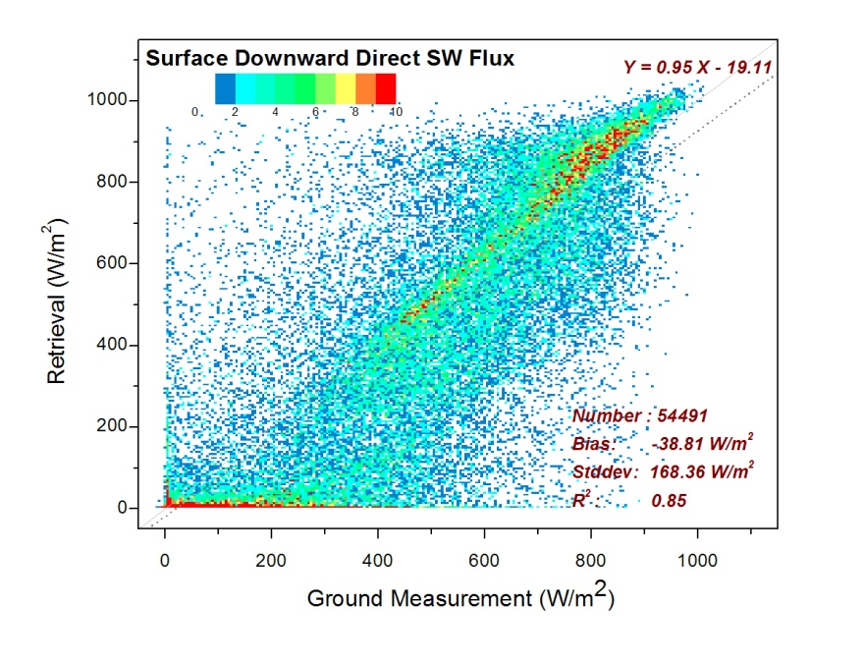
VALIDATION – ALL SKY
Validation of retrieved DSR and DIR against ground measurements.
Not a good way

Slide 20
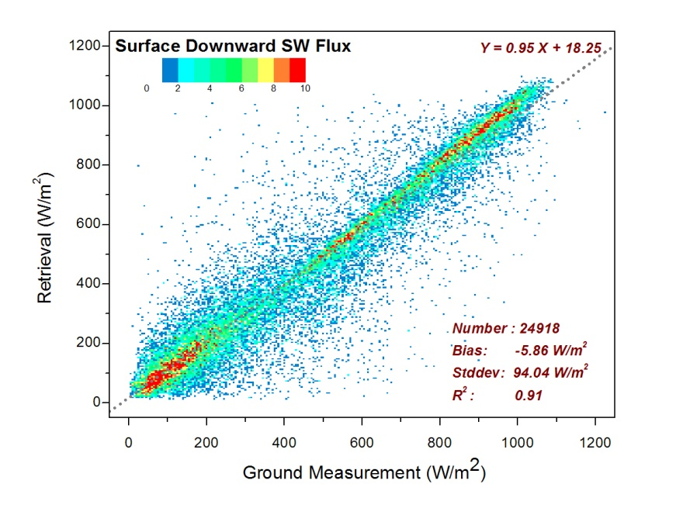
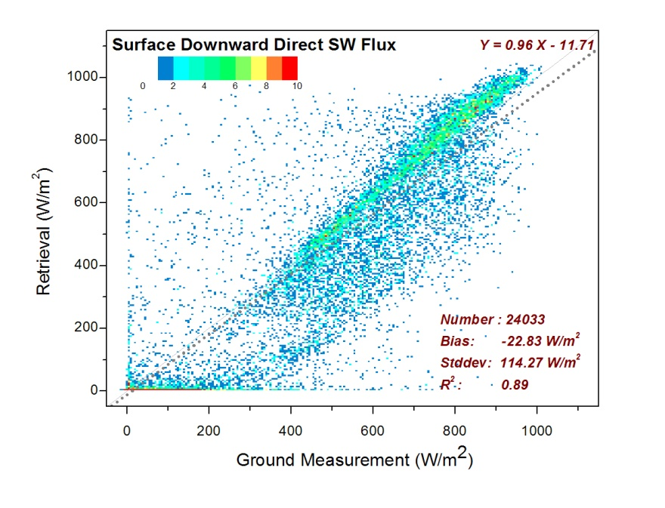
VALIDATION – ALL SKY
Same cloud fraction from both satellite and ground.
Still not a good way

Slide 21
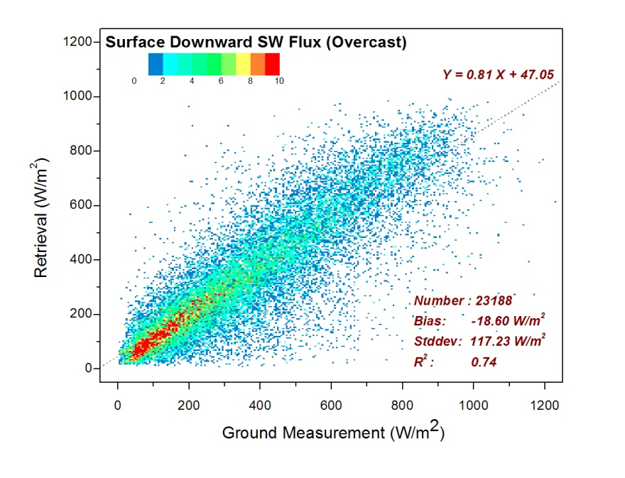
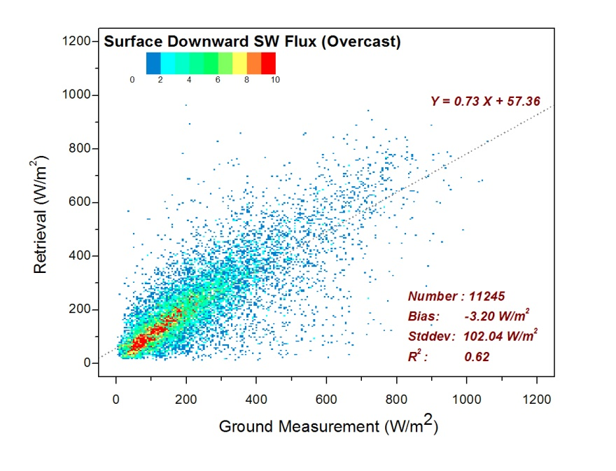
VALIDATION - OVERCAST
Validation of DSR against ground measurement:
Left: 100% cloudy sky is identified by satellite
Right: both satellite and ground report 100% cloudy sky

Slide 22
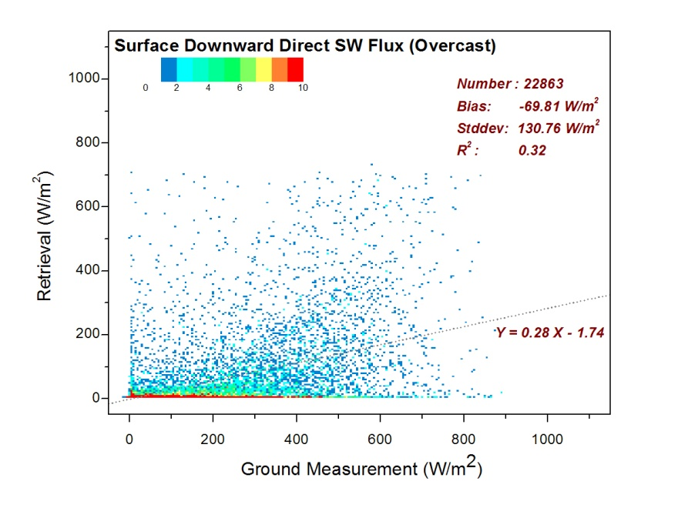
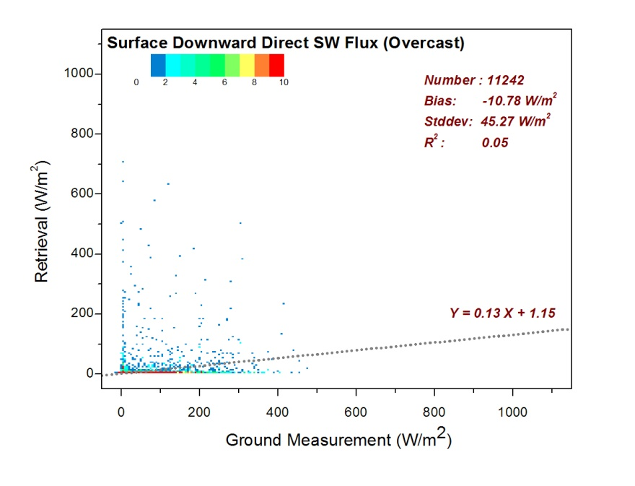
VALIDATION – OVERCAST
Validation of DIR against ground measurement:
Left: 100% cloudy sky is identified by satellite
Right: both satellite and ground report 100% cloudy sky

Slide 23
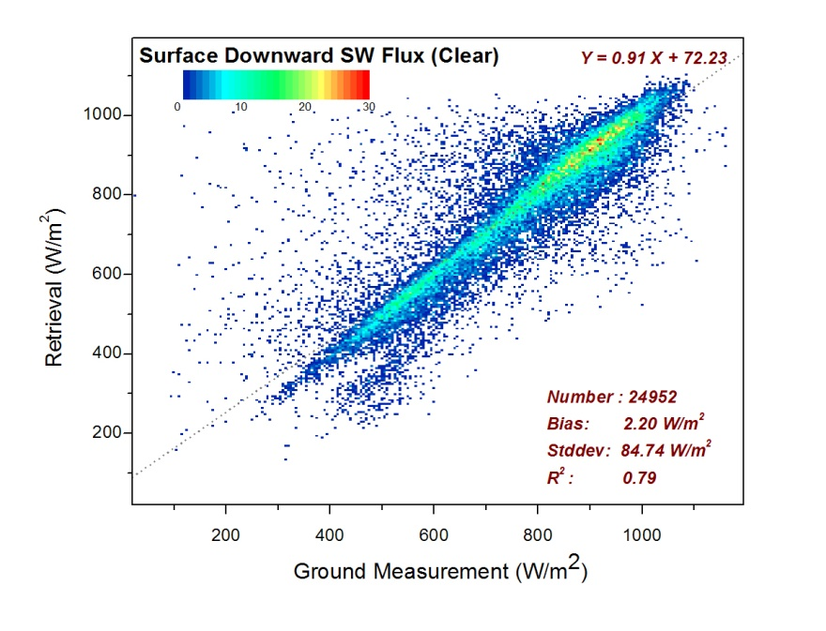
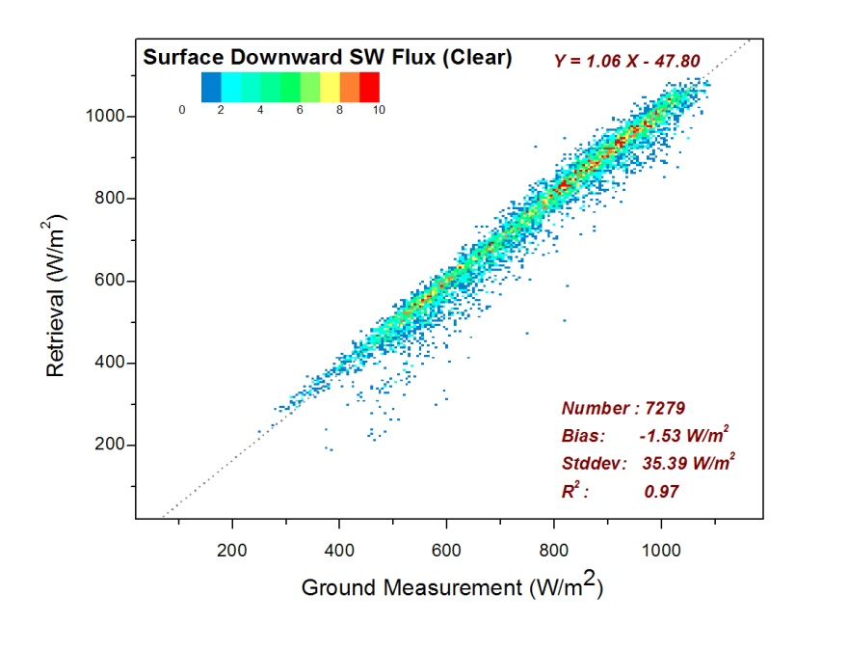
VALIDATION – CLEAR SKY
Validation of DSR against ground measurement:
Left: 100% clear sky is identified by satellite
Right: both satellite and ground report 100% clear sky

Slide 24
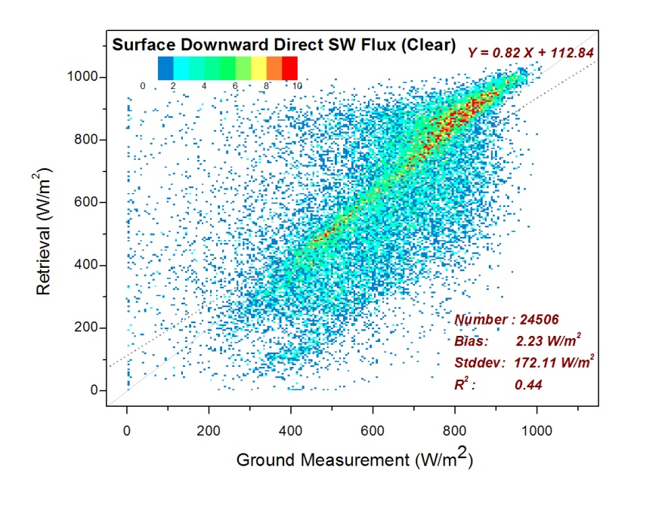
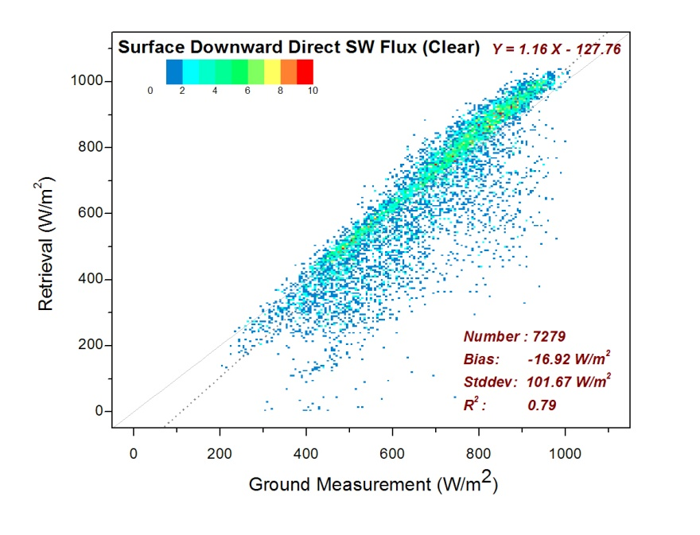
VALIDATION – CLEAR SKY
Validation of DIR against ground measurement:
Left: 100% clear sky is identified by satellite
Right: both satellite and ground report 100% clear sky

Slide 25
SUMMARY AND PLANS
Enhanced and started characterization of 13-year GSIP-CONUS data; will finish evaluation and will make data available over the Internet
Ready to start routine experimental runs of 4-km SE parameters (GHI and DNI) from GSIP-v2; will evaluate, and pursue transition to operations
Characterized performance of GOES-R ABI algorithm for SE applications:
good DSR (=GHI) retrievals – PV systems can use data
large errors of DIR (=DNI*cos(SZA)) – need to improve for CSP systems
Note: satellite data may not be actually this bad – need to design a better way to compare with ground data

