Slide 1
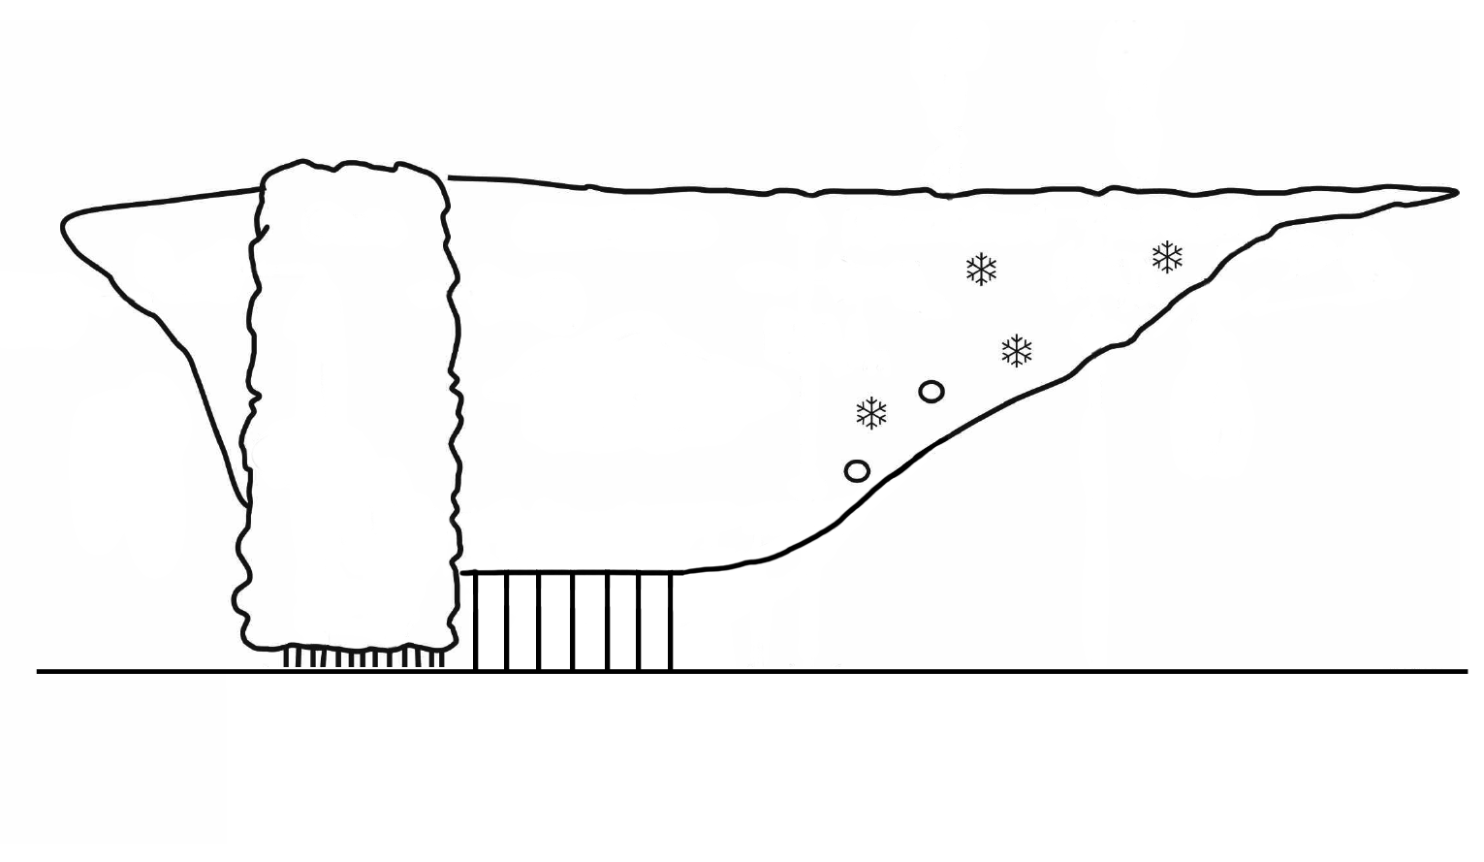
Improving GOES-R Cloud and Precipitation Products Associated with DCSs using NEXRAD Radar Network over Continental USA
PI: Xiquan Dong (NEXRAD&GOES➔Classification), Uni. of North Dakota
Co-PI: Zhanqing Li (MODIS➔Cloud Properties), University of Maryland
Collaborator: Bob Kuligowski (SCaMPR➔Precipitation), NOAA NESDIS
Cold Cloud Shield (GOES)
NEXRAD
GOES
Thick Anvil
Tran. Anvil
Thick Anvil
Convective
Stratiform
Thin Anvil
E_{ce}
C_{T}
E_{se}
E_{se}
E_{ce}
C_{cu}
C_{su}
E_{cd}
E_{sd}
Anvil Clouds
Rain Core
Anvil Clouds
Feng et al. (2011) JGR

Slide 2
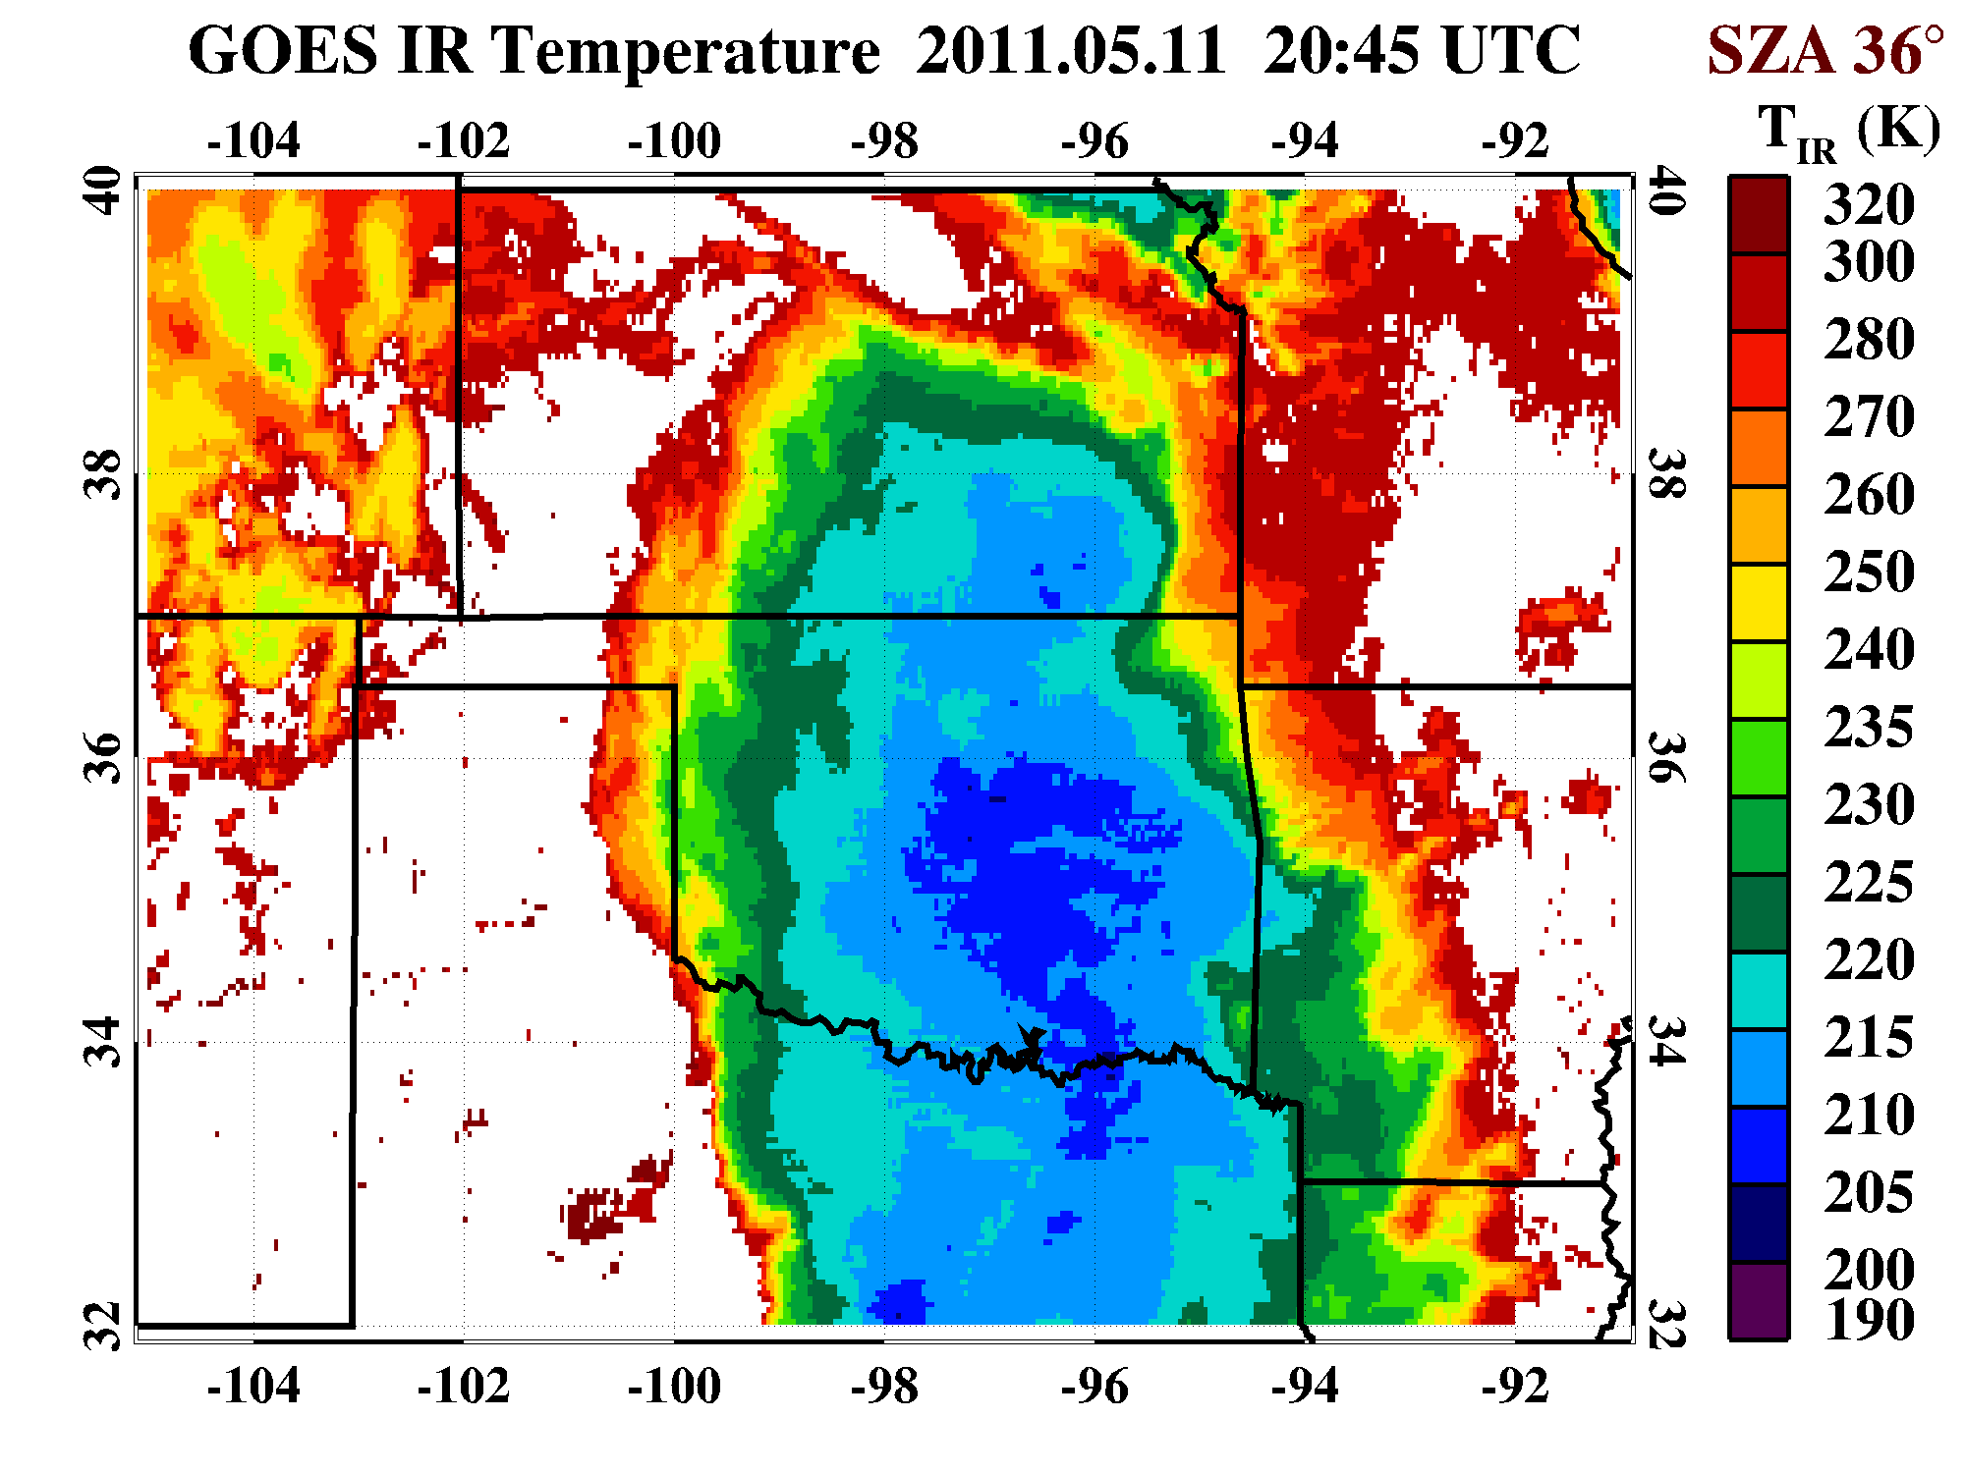
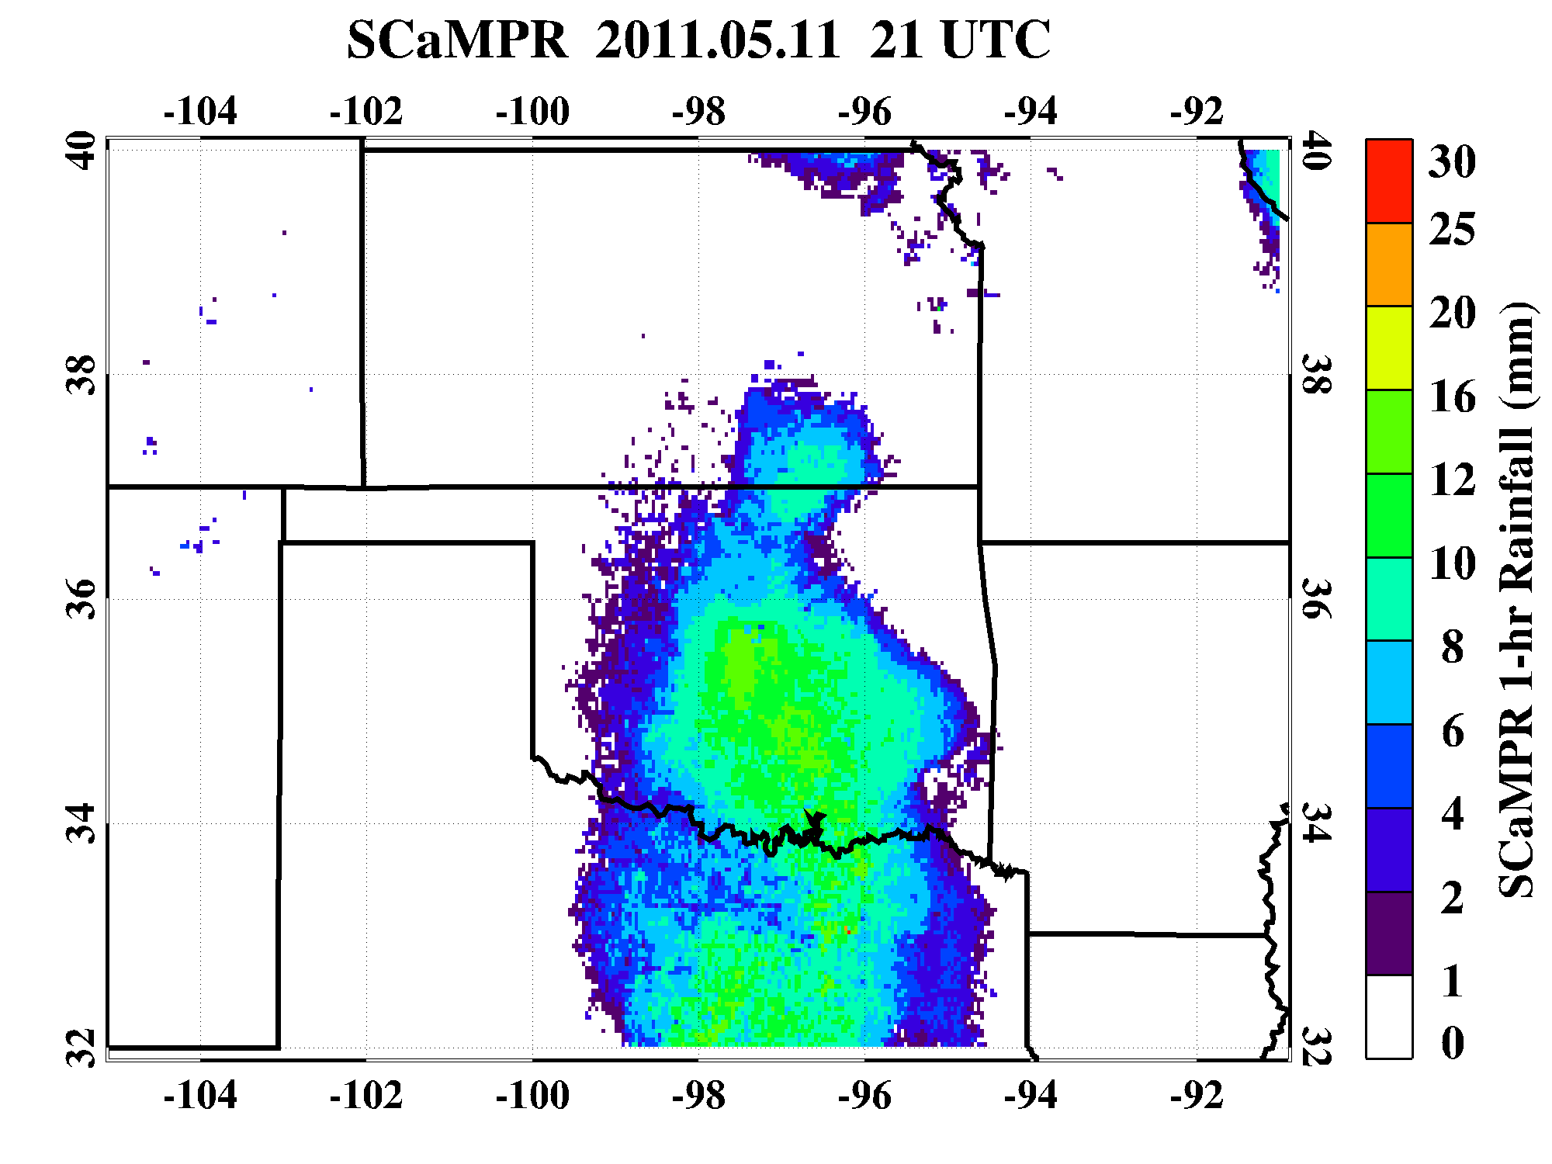
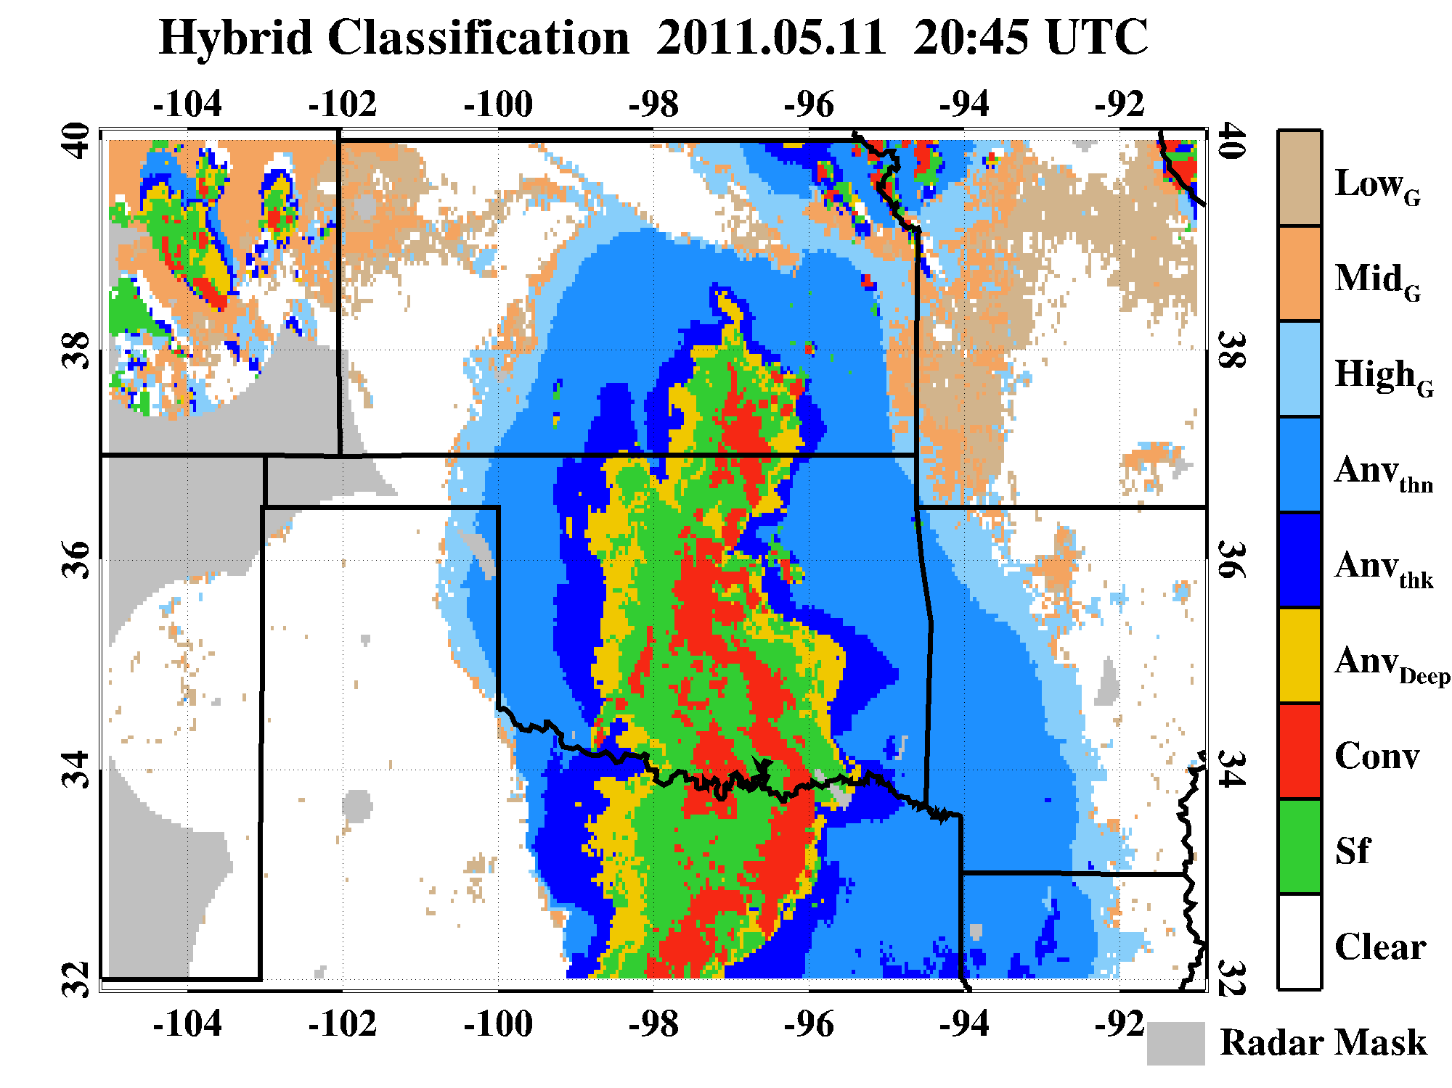
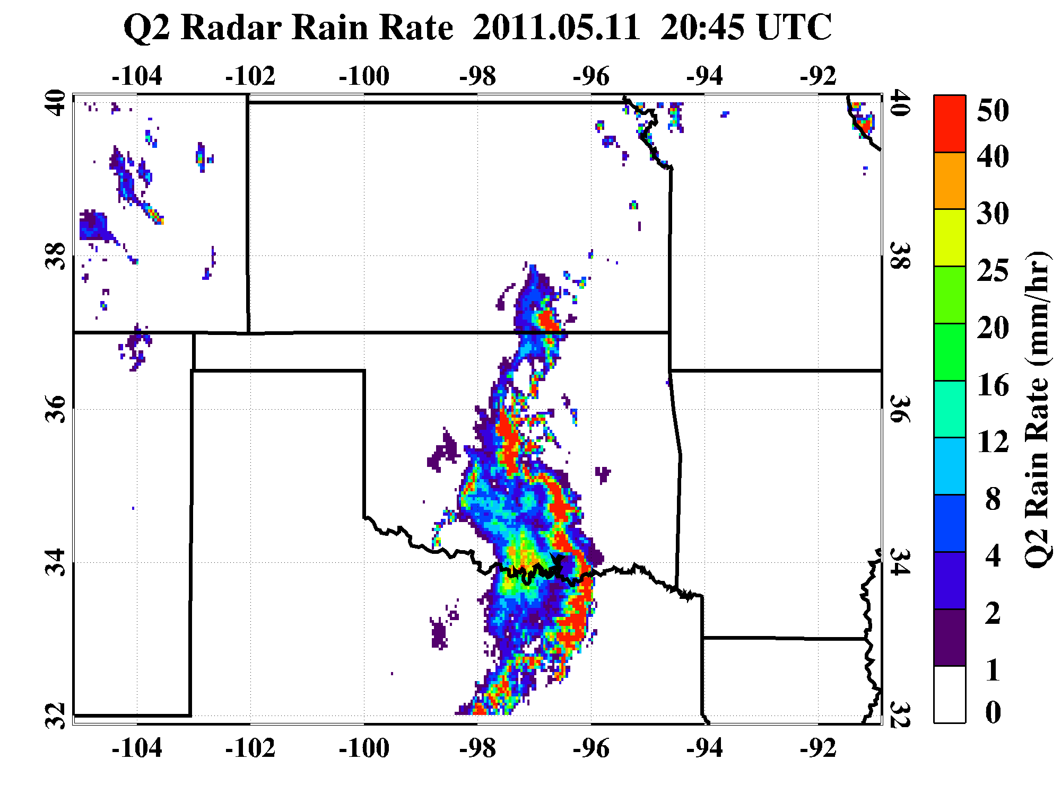
Classify Rainfall from DCS Components
IR Temperature
SCaMPR Rainfall
Classification
Q2 Rainfall
RC
AC
AC
What are the % of rainfall from rain core and anvils in SCaMPR and Q2?

Slide 3
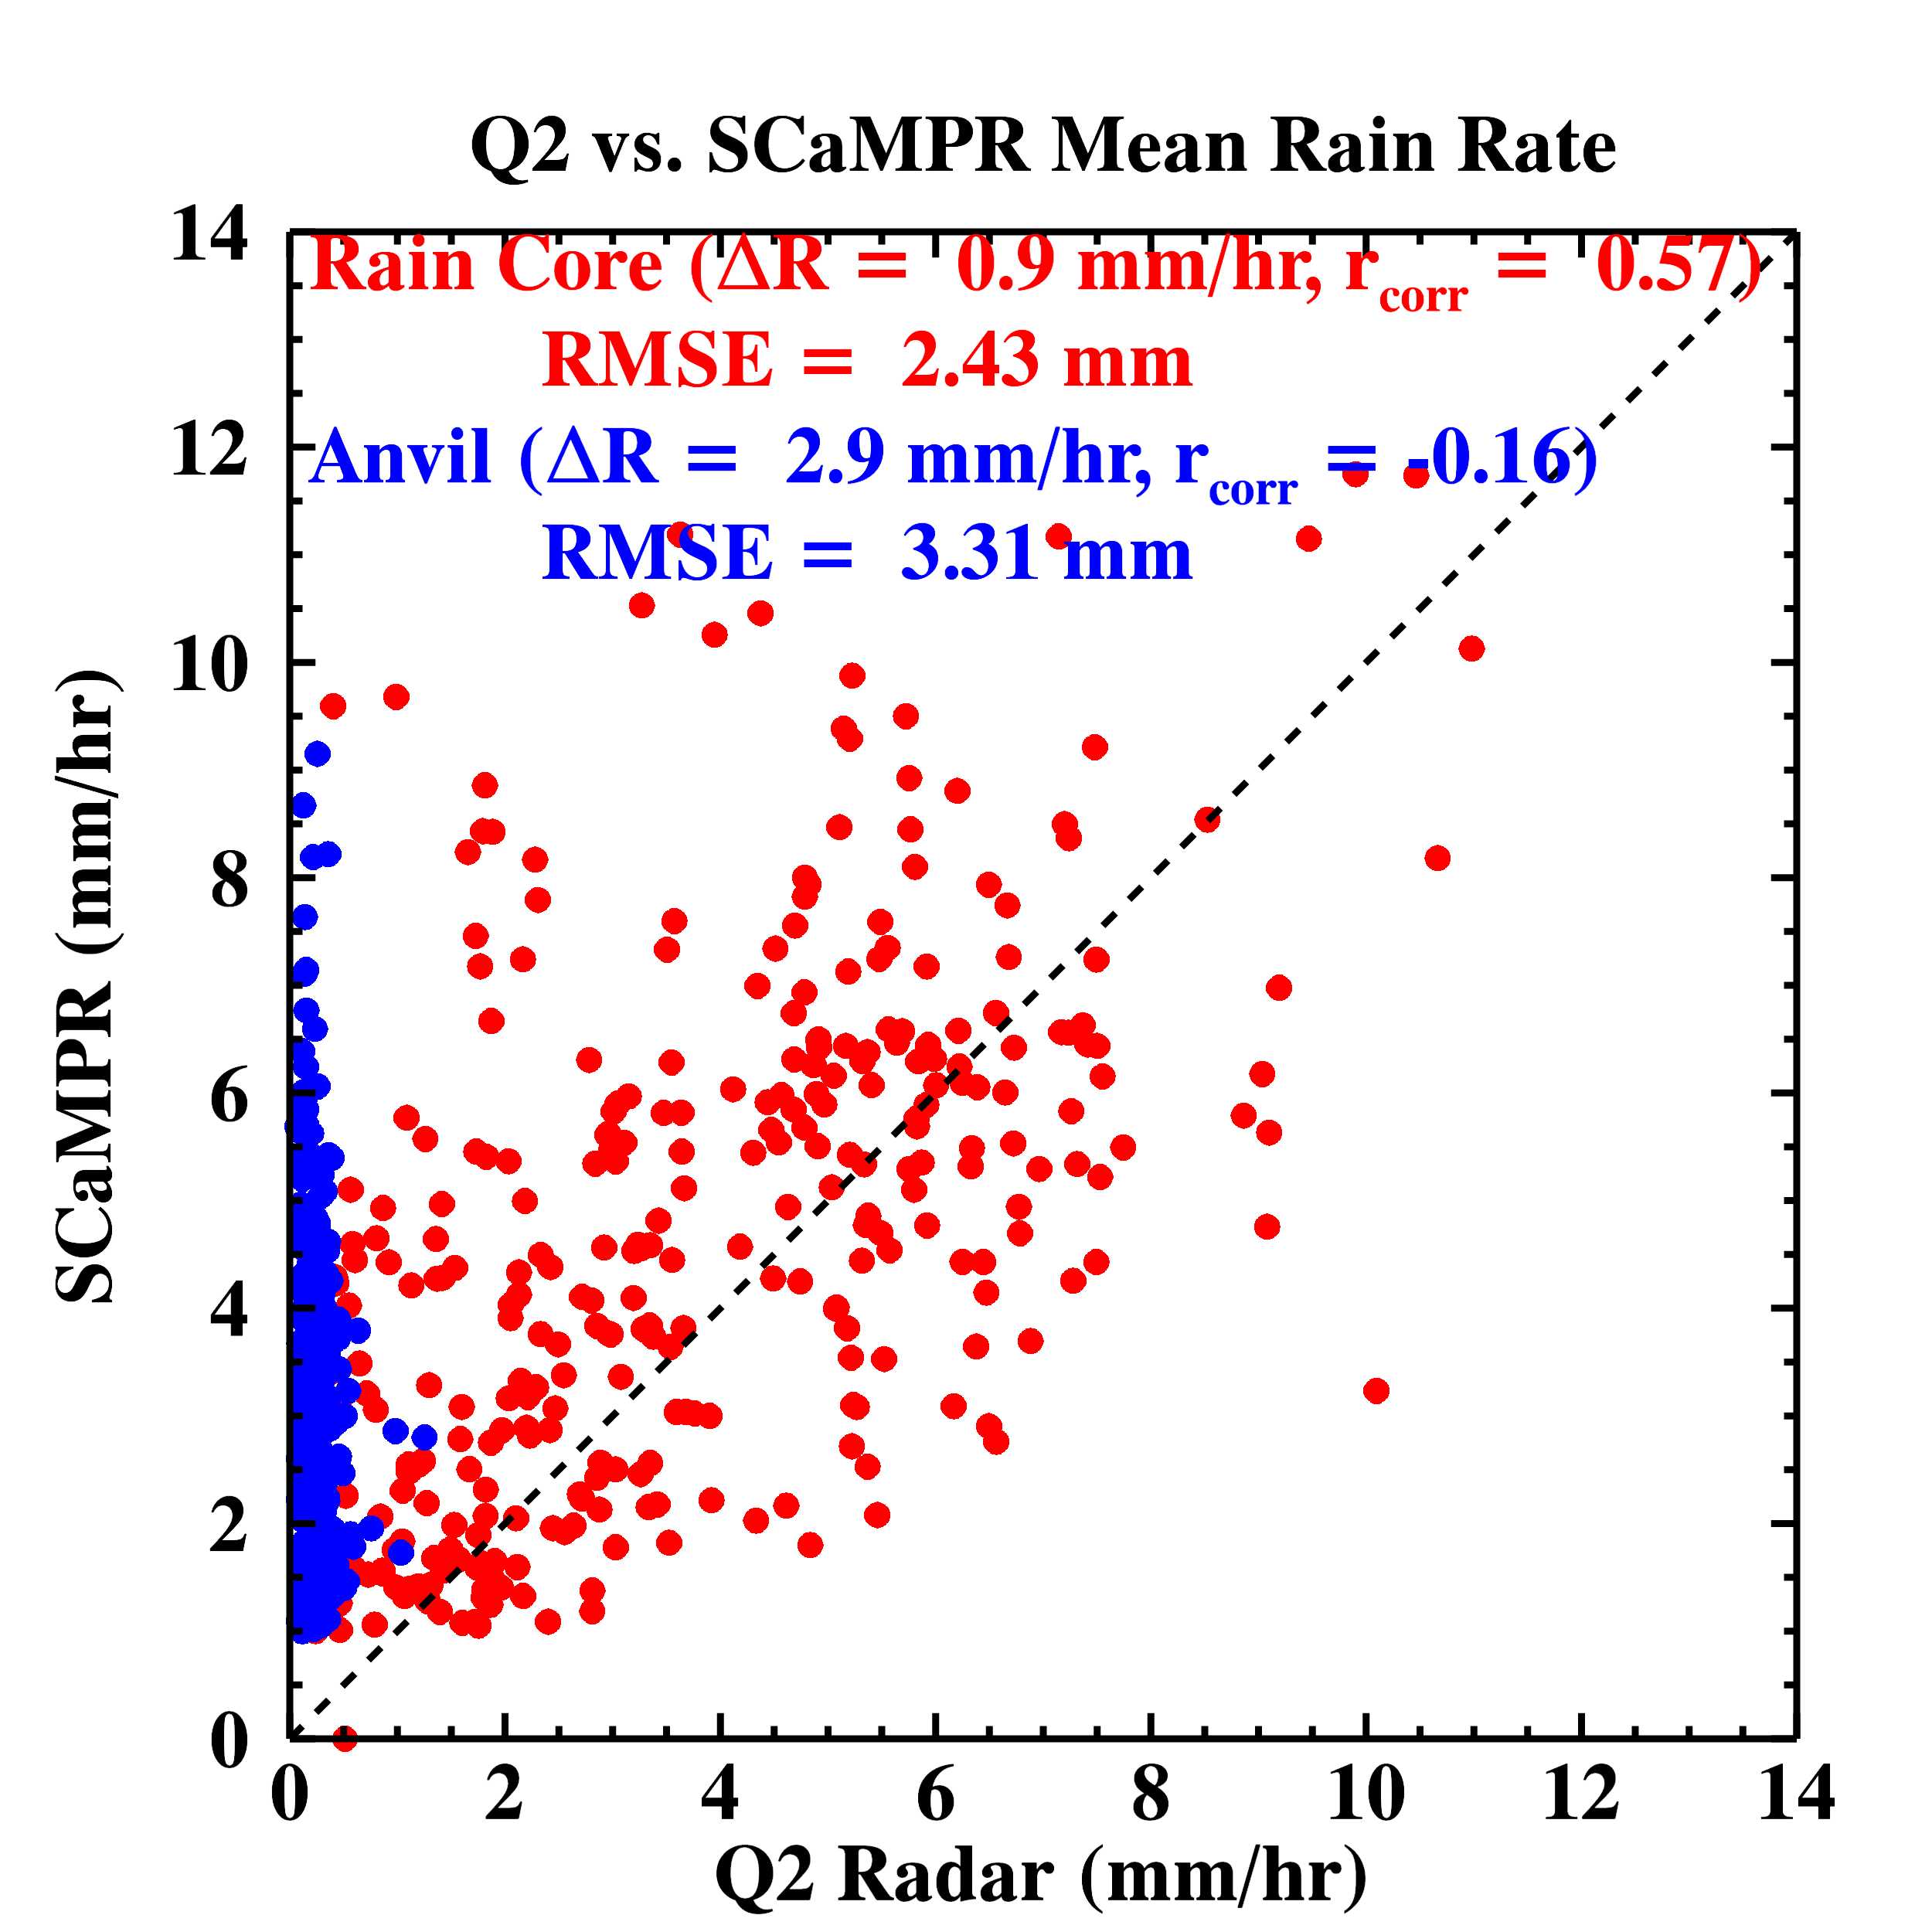
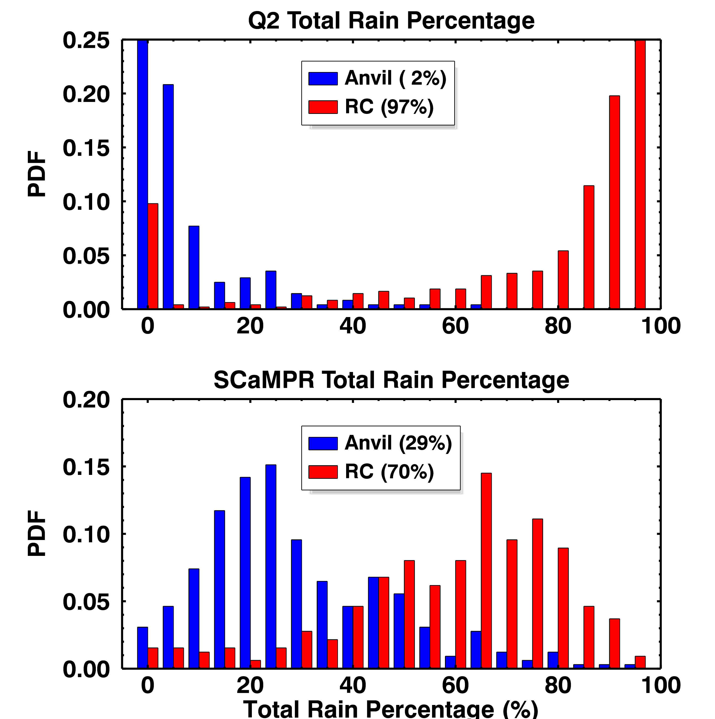
Rainfall Comparison
True Value
Rainfall in anvil: SCaMPR (29%) vs. Q2 (2%)
Rainfall in rain core: SCaMPR (70%) vs. Q2 (97%)
Overall: SCaMPR overestimated precipitation compared to Q2, in particular over Anvil region .

Slide 4
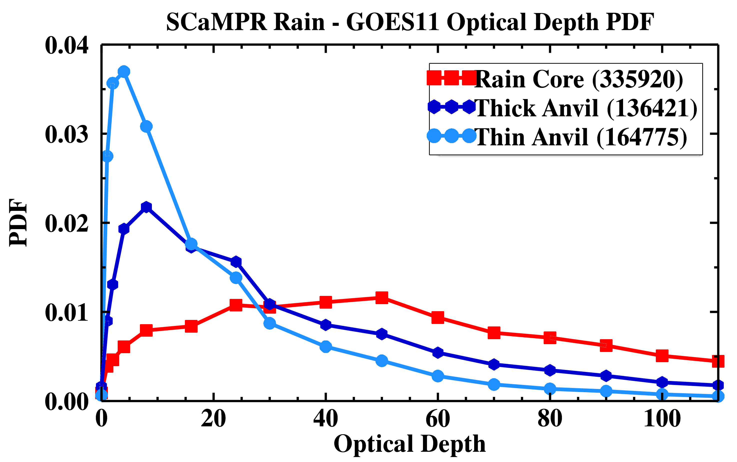
How to Improve SCaMPR Precipitation?
Daytime optical depth shows significant difference between both types of anvil clouds and rain core
Optical depths in anvil region may be used to improve the SCaMPR precipitation retrieval (filter out non raining areas)
Step 1:
Improving SCaMPR method by distinguishing anvil clouds from rain cores using more available channels (MODIS proxy data), Radar, and Aircraft data during MC³E experiment over ARM SGP (15 convective+anvil cases during Apr-June 2011)
Step 2:
Extending the modified SCaMPR method to continental USA and comparing with NEXRAD Q2 precipitation product. (For more details, See Zhe Feng’s poster)

