Slide 1
Project V: Training National and International Training Development, Delivery, and Distribution Presenter: Bernie Connell
Participants: B. Connell, D. Bikos, J. Braun, M. Davison,
T. Mostek, K.-A. Caesar, V. Castro, and L. Veeck
GOES-R meeting 23 September 2011
Proposal Period: 1 July 2011 – 30 June 2012

Slide 2
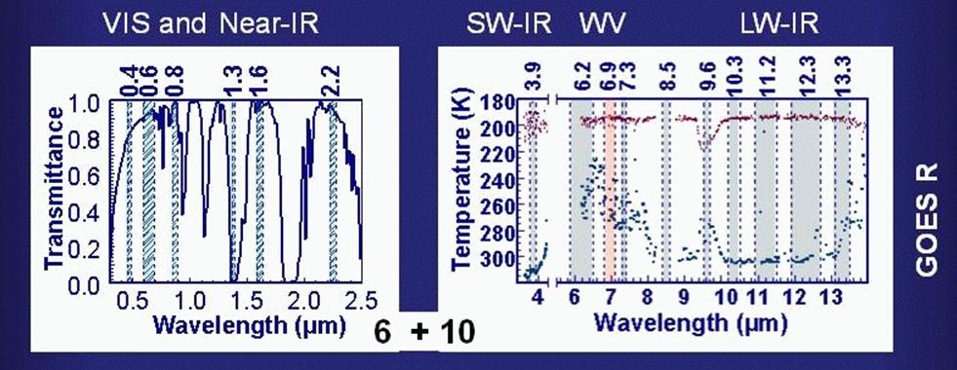
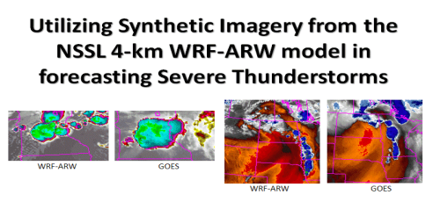
Effective training ..
Leverages on successes of existing national (VISIT/SHyMet, COMET, and SPoRT) and international (WMO VLab) programs
Adapts content for:
emerging research and technologies
feedback from users
Existing GOES-R Teletraining and Modules
http://rammb.cira.colostate.edu/research/goes-r/risk_reduction/training.asp
Notes:
The first point includes many things including the basic structure to develop, deliver, and distribute training.

Slide 3
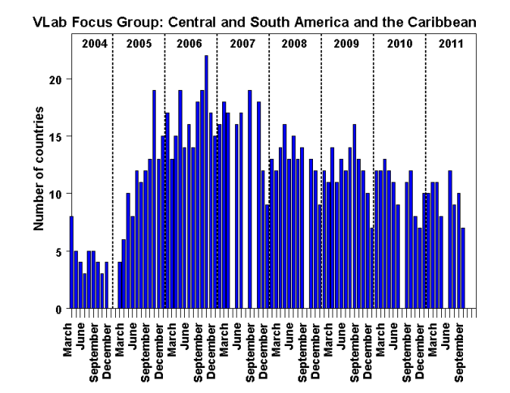
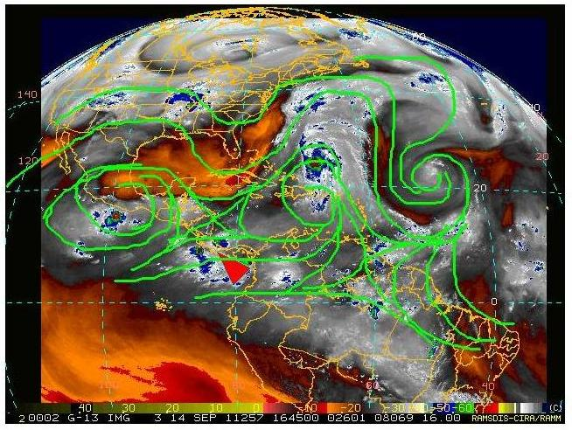
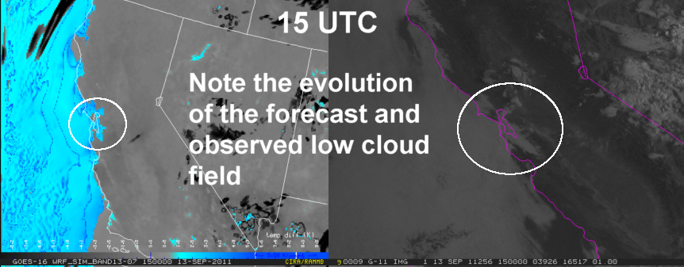
GOES-R image and products examples
UPDATES…
Activity on the international scene:
Conduct WMO VLab Focus Group of the Americas and Caribbean monthly sessions
What motivates participation?
Attend CALMet International conference 3-8 Oct 2011
WMO VLab Management Group – guidelines for user readiness for new satellites.
How to better integrate and organize training material on web pages?
Existing GOES-R Modules
Modules with embedded GOES-R content
VISIT Blog
RAMMB PG Blog
Notes:
Existing GOES-R Teletraining and Modules
http://rammb.cira.colostate.edu/research/goes-r/risk_reduction/training.asp

