Slide 1
Breakout Session
Thematic Areas
How can R3 contribute to connecting user needs with GOES-R capabilities in the following areas?
High-Impact Weather (Johnson)
Observations & Techniques (Schrab)
Applications, Testbeds & Training (Weiss)

Slide 2
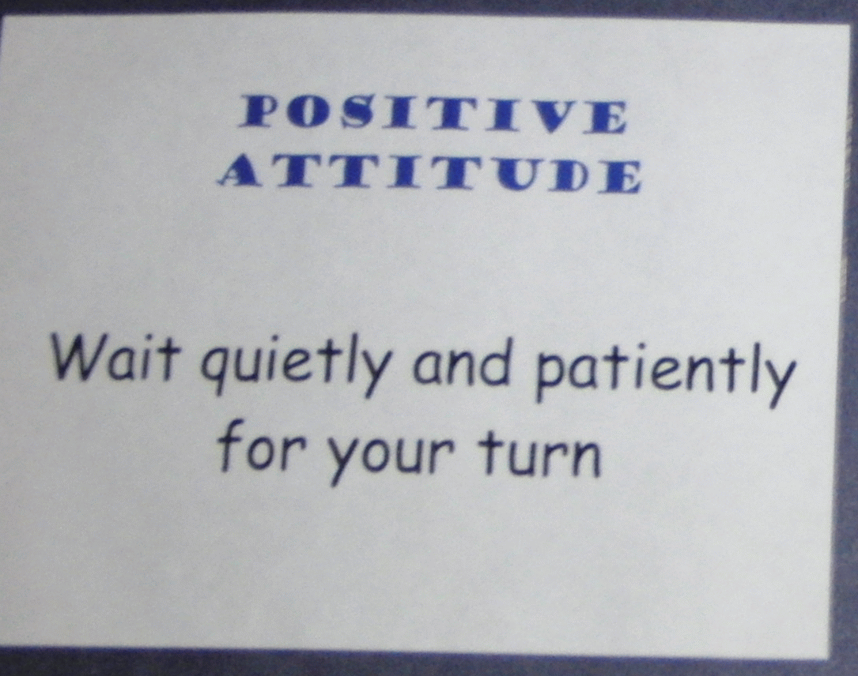
Etiquette of Engagement
Source: Proving Ground successful breakouts
Share relevant information and
experiences.
Everyone’s input is equally valued.
Discussions and criticisms will
focus on interests, not people.
No idea is bad.
Share “air time.”
Respect each speaker.
Only one conversation at a time…
All members are expected to participate in all phases of the process.
Signal when we are going off-track.
Off-target discussions are limited to five minutes and then put
in the “parking lot”.

Slide 3
Breakout Questions
1) What were the significant outcomes of the Day 1 projects briefed? What are the recommended next steps for these projects to help connect GOES-R capabilities to User Needs? Were attempts to fuse GOES-R data with other data or models successful?
2) How do the updates from the various groups/programs (NWS, JPSS, AWG, Proving Ground, GOES-R Program Office) impact strategies to connect GOES-R capabilities to user needs? Are there new strategies emerging that new-start PIs should consider? (new start projects are listed in appendix to the agenda)
3) TBD by your group – the question we should have asked

Slide 4
Breakout Group 1 Capture Template
Discussion Item:
Recommendation:
Possible Action(s):

Slide 5
Breakout Group 1 Capture Template
Discussion Item:
Recommendation:
Possible Action(s):

Slide 6
Breakout Group 1 Capture Template
Discussion Item:
Recommendation:
Possible Action(s):

Slide 7
Breakout Group 2 Capture Template
Discussion Item:
Recommendation:
Possible Action(s):

Slide 8
Breakout Group 2 Capture Template
Discussion Item:
Recommendation:
Possible Action(s):

Slide 9
Breakout Group 2 Capture Template
Discussion Item:
Recommendation:
Possible Action(s):

Slide 10
Breakout Group 3 Capture Template
Discussion Item:
Recommendation:
Possible Action(s):

Slide 11
Breakout Group 3 Capture Template
Discussion Item:
Recommendation:
Possible Action(s):

Slide 12
Breakout Group 3 Capture Template
Discussion Item:
Recommendation:
Possible Action(s):

