Slide 1
Breakout Session
Thematic Areas
How can R3 contribute to connecting user needs with GOES-R capabilities in the following areas?
High-Impact Weather (Johnson)
Observations & Techniques (Schrab)
Applications, Testbeds & Training (Weiss)

Slide 2
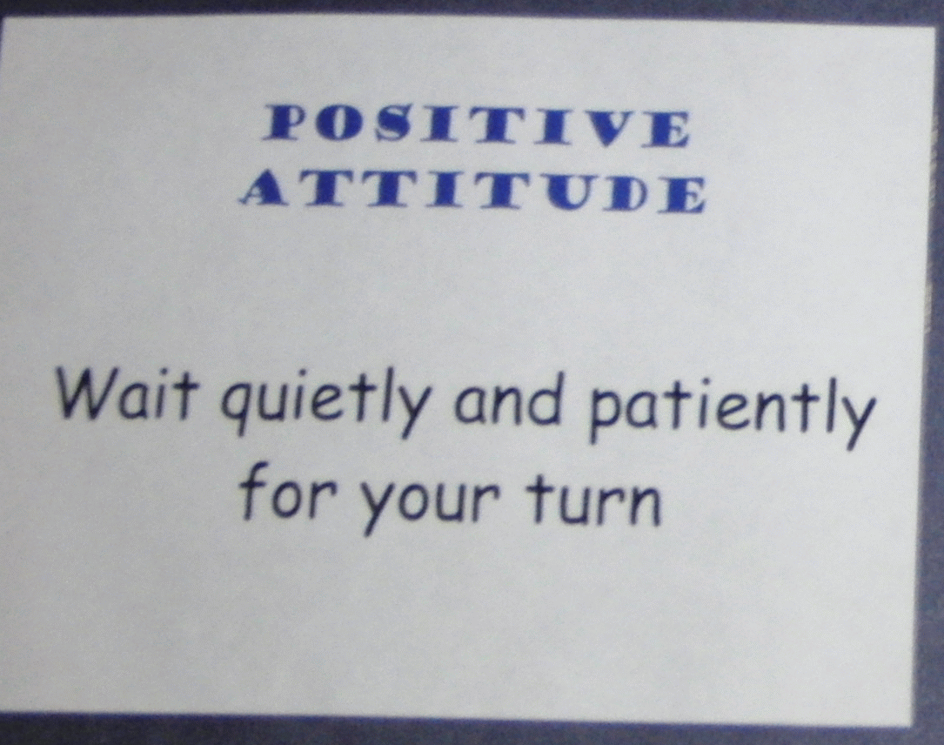
Etiquette of Engagement
Source: Proving Ground successful breakouts
Share relevant information and
experiences.
Everyone’s input is equally valued.
Discussions and criticisms will
focus on interests, not people.
No idea is bad.
Share “air time.”
Respect each speaker.
Only one conversation at a time…
All members are expected to participate in all phases of the process.
Signal when we are going off-track.
Off-target discussions are limited to five minutes and then put
in the “parking lot”.

Slide 3
Breakout Questions
1) What were the significant outcomes of the Day 1 projects briefed? What are the recommended next steps for these projects to help connect GOES-R capabilities to User Needs? Were attempts to fuse GOES-R data with other data or models successful?
2) How do the updates from the various groups/programs (NWS, JPSS, AWG, Proving Ground, GOES-R Program Office) impact strategies to connect GOES-R capabilities to user needs? Are there new strategies emerging that new-start PIs should consider? (new start projects are listed in appendix to the agenda)
3) TBD by your group – the question we should have asked

Slide 4
Breakout Group 1 Capture Template
Discussion Item: TC rapid intensity forecasting
Recommendation: Improve sounding input thru joint GOES/JPSS
Comment: very good link to ops
Possible Action(s): transition MW and TPW to ops NOW

Slide 5
Breakout Group 1 Capture Template
Discussion Item: Storm Intensification – Improved CI algorithm with GOES
Application most useful where there is no RADAR (open ocean)
Link to Ops: FAA heavily involved in validation (NEXGEN)
Recommendation: tie into NASA areas of interest looking for opportunities to validate
Make link to operations more clear – to define future funding
Possible Action(s): Use AWG products

Slide 6
Breakout Group 1 Capture Template
Discussion Item: GPM Rainfall
Adding lightning improved bias
Link to new start
Recommendation: link to ops – suspect greatest need is over water. 2nd need in high elevations where radar not adequate.
Links to Pacific Region Test Bed and OPC
Possible Action(s): look at using ground-based lightning data

Slide 7
Breakout Group 2 Capture Template
Discussion Item: Aviation - Vol Ash: integrate product into WRF-CHEM model
Using all useful sats
Recommendation: explore use of JPSS and AQUA/MODIS
Possible Action(s):

Slide 8
Breakout Group 2 Capture Template
Discussion Item: Auto Vol Ash Alert System. Aviation needs 5-minute warning. Dispatchers want 24 hour warning. Nice link to ops (VAACs). System is not limited to GOES-R – any instrument could be used
Remote users need this as well, e.g., regional observatories
Recommendation: link up w/JPSS.
Possible Action(s):

Slide 9
Breakout Group 2 Capture Template
Discussion Item: Storm Tracking and lightning cell clustering using GLM data.
Recommendation: need presentation of all related research matrix “PSDI, GIMPAP, JCSDA, SPSRB”
Possible Action(s):

Slide 10
Breakout Group 3 Capture Template
Discussion Items: Integrated GLM/ABI approaches for detect of CI
Recommendation: need presentation of all related research to describe comprehensive path to Ops
Possible Action(s): link up w/Ops (GLM/ABI)

Slide 11
Breakout Group 3 Capture Template
Discussion Item: GLM lightning jump R2O
Good links to Ops
High value exploratory
Recommendation:
Possible Action(s):

Slide 12
Breakout Group 3 Capture Template
Discussion Item: WRF Lightning Forecast Algorithm
Running in 3 models. SPC principal sponsor
OPC and fire wx also interested.
Recommendation: link w/ other GLM projects
Possible Action(s):

