Slide 1
The Utility of GOES-R and LEO Soundings for Hurricane Data Assimilation and Forecasting
Jun Li@, Timothy J. Schmit#, Hui Liu&, Jinlong Li@, and Jing Zheng@
@Cooperative Institute for Meteorological Satellite Studies, University of Wisconsin-Madison, Madison, WI
#Advanced Satellite Products Branch, Satellite Applications and Research, NESDIS/NOAA, Madison, WI
&National Center for Atmospheric Research, Boulder, CO
GOES-R Risk Reduction Annual Meeting, 21 – 23 September 2011, Huntsville, Alabama
1. Project Objectives:
To improve the short-range hurricane forecasting by assimilating the high spectral resolution advanced IR soundings (AIRS, IASI, CrIS) in regional numerical weather prediction (NWP) models.
To combine GOES-R and advanced IR soundings for hurricane track and intensity forecasting. AIRS/IASI/CrIS and MODIS/GOES Sounder are used to emulate the LEO and GEO observations.
2. Progress:
The MODIS total preciptable water (TPW) is used as proxy for GOES-R ABI. Positive impact is found on both track and intensity analysis when MODIS TPW is assimilated.
Single field-of-view (SFOV) temperature and moisture profiles (12 ~ 14 km at nadir) from AIRS radiance measurements with CIMSS hyperspectral IR Sounding Retrieval algorithm (CHISR) have been used in assimilation experiments for hurricane track and intensity forecasts. Both WRF/DART and WRF/3DVAR are used for Hurricane and typhoon assimilation. Positive impact is found on cyclone intensity and track forecast, both temperature and water vapor profiles are important for hurricane forecast.

Slide 2
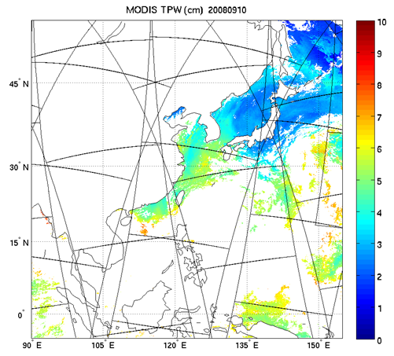
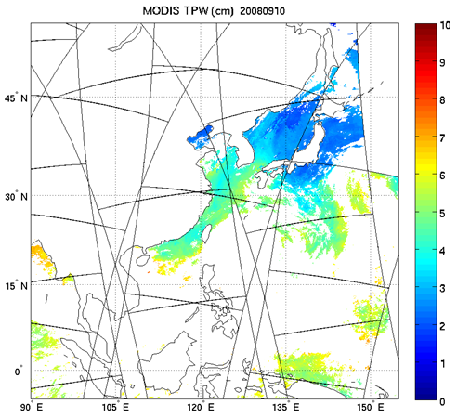
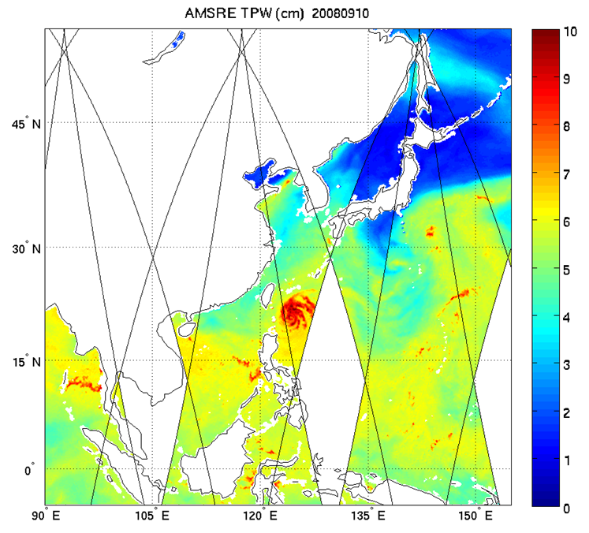
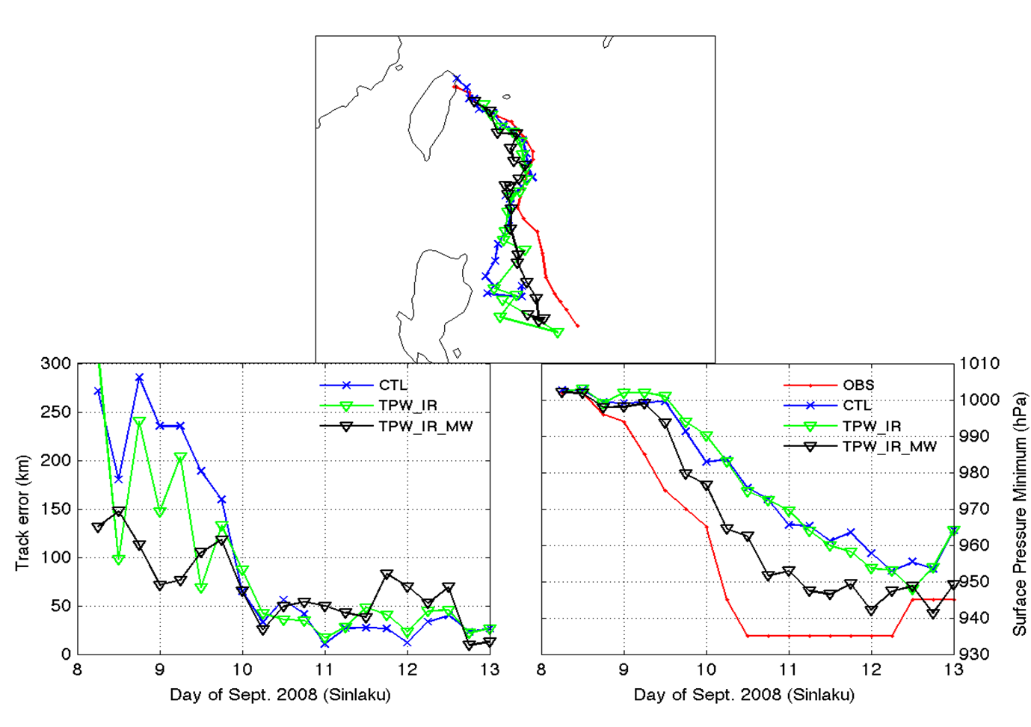
Terra MODIS TPW over ocean
(10 September 2008)
Aqua MODIS TPW over ocean
(10 September 2008)
AMSR-E TPW
(10 September 2008)
Control (CTL): Radiosondes, cloud winds (AMVs from JMA) extracted from NCEP/GFS dataset, aircraft data, station and ship surface pressure data, JTWC advisory TC positions, 6-hourly analysis cycle.
TPW-IR: Add MODIS IR TPW data (both Terra and Aqua).
TPW-IR-MW: Add MODIS and AMSR TPW data.
Assimilations with WRF/DART started Sep. 1, 2008. WRF 9 km moving nest grid with feedback to 27 km grid in the forecasts.
ABI water vapor product should be better than MODIS because:
ABI has more water vapor absorption bands;
MODIS TPW is from regression, ABI TPW is from physical retrieval;
ABI has three layer precipitable water;
ABI has high temporal resolution.

Slide 3
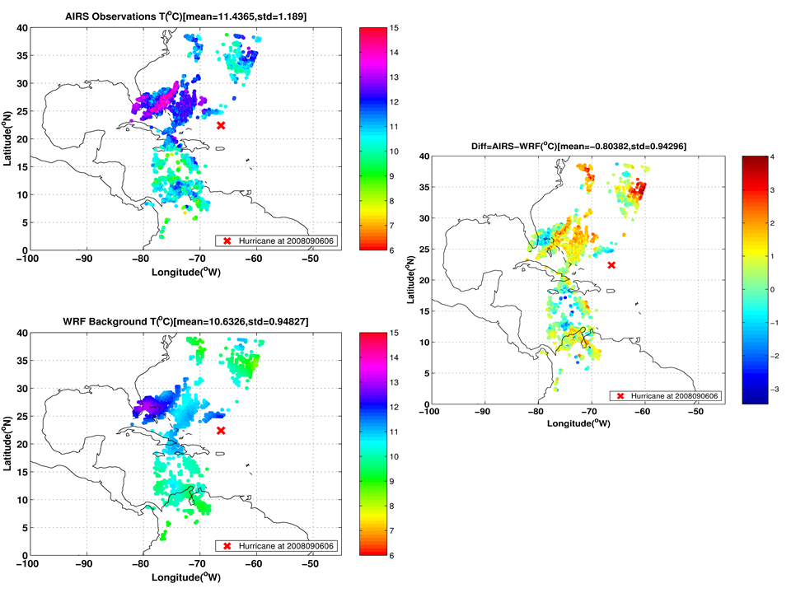
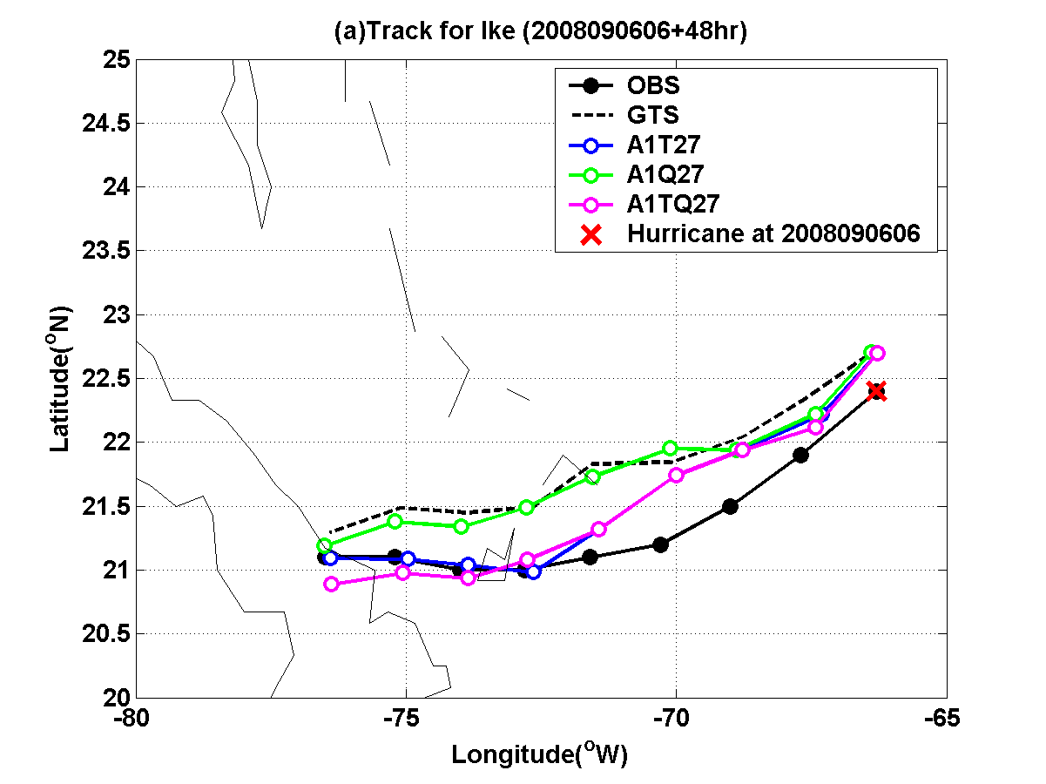
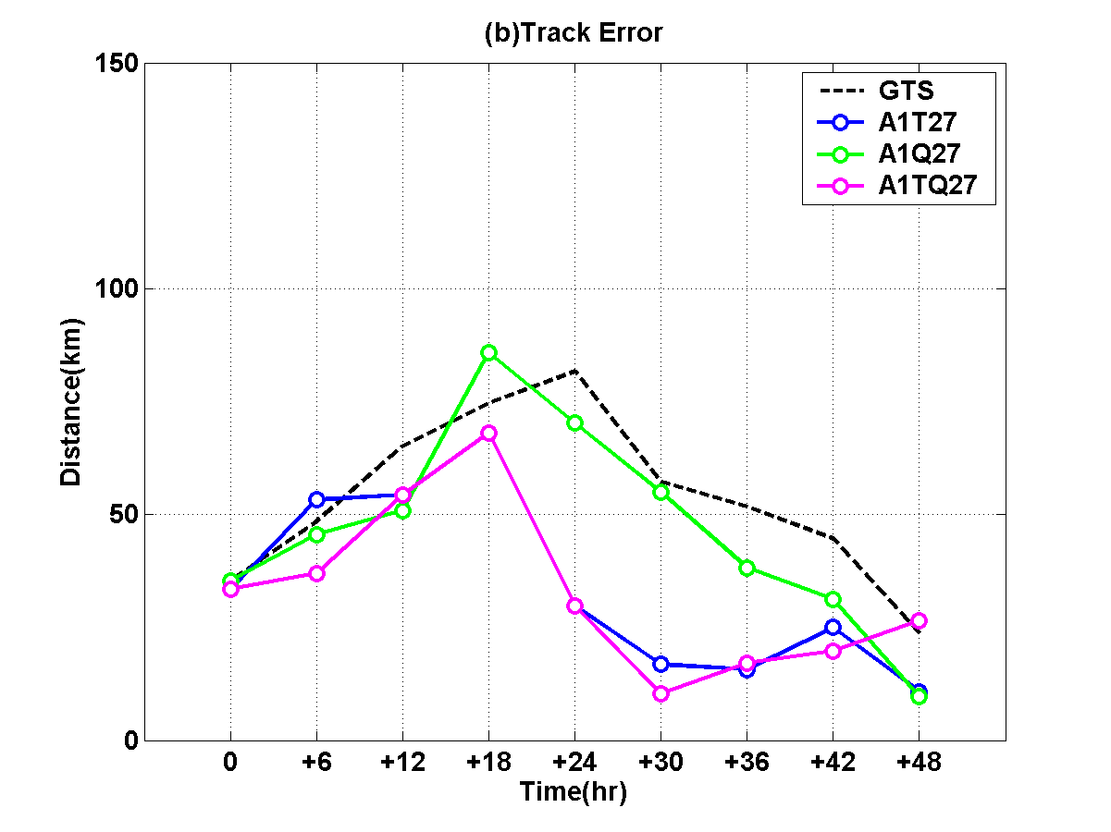
AIRS 700 hPa T (upper left);
WRF 700 hPa T (lower left);
Difference between AIRS and WRF
3. Future work:
Assimilate the GOES Sounder high temporal resolution precipitable water (PW) between 300 and 700 hPa;
Combined AIRS and MODIS/GOES Sounder for hurricane forecast in order to prepare the application of combined GOES-R/JPSS atmospheric profiles in high impact weather applications;
Continue to collaborate with CIRA (Zupanski) on using GOES-R for hurricane (e.g., using SEVIRI/AIRS data).
AIRS run with WRF/3DVAR uses clear-skies from 3 granules g066/067/068, assimilate T/q profiles between 200 - 700hPa in the experiments for next 48 hour Hurricane Ike (2008) track forecast
GTS: Conventional and other Sat data
A1T27: GTS+AIRS 200 – 700 hPa T
A1Q27: GTS+AIRS 200 – 700 hPa Q
A1TQ27: GTS+AIRS 200 – 700 hPa TQ

