Slide 1
MC3E Forecast Briefing
12 April 2011

Slide 2
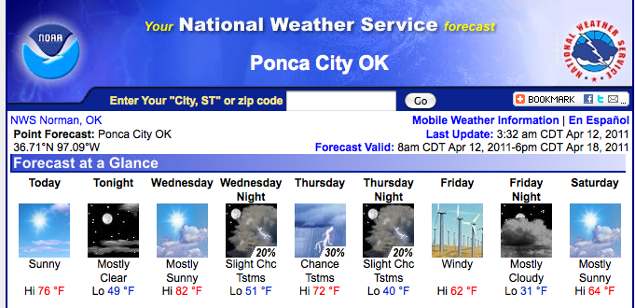
Overview
Day 0: Nada
Day 1: Maybe into Day 2
Day 2: Maybe
Day 3-6: Possible weekend alert?

Slide 3
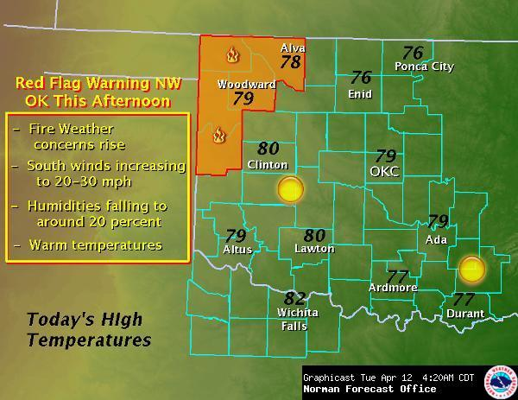
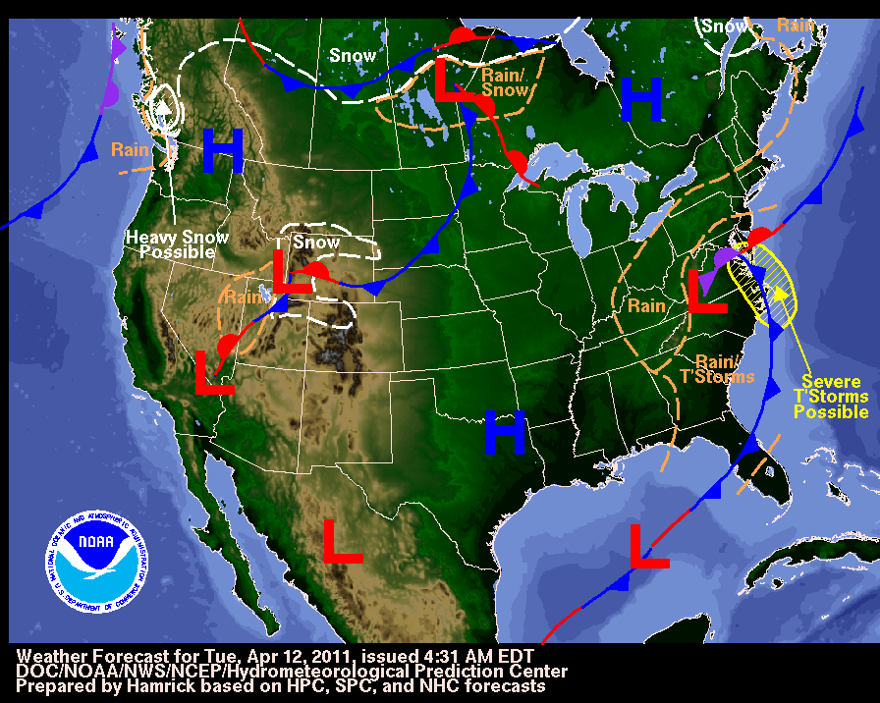
Day 0: Tuesday

Slide 4
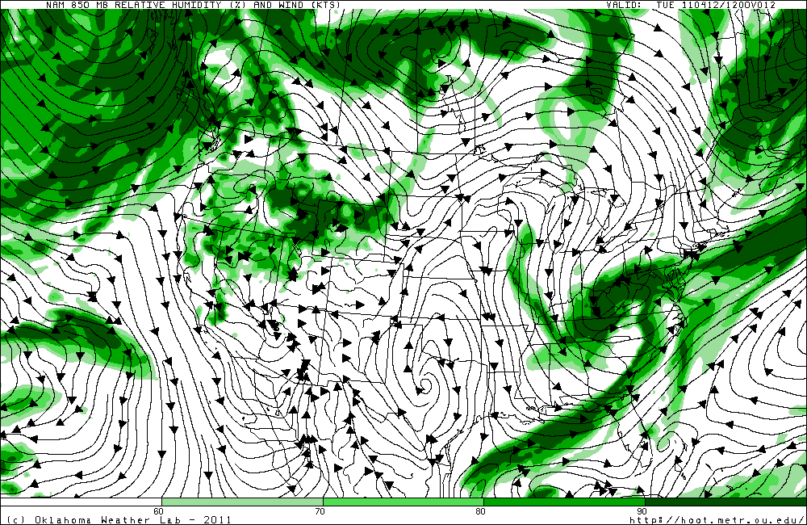
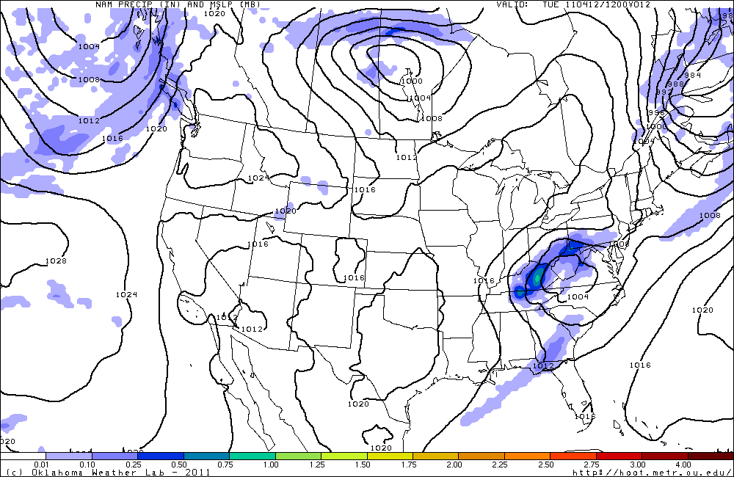
Day 0: Tuesday

Slide 5
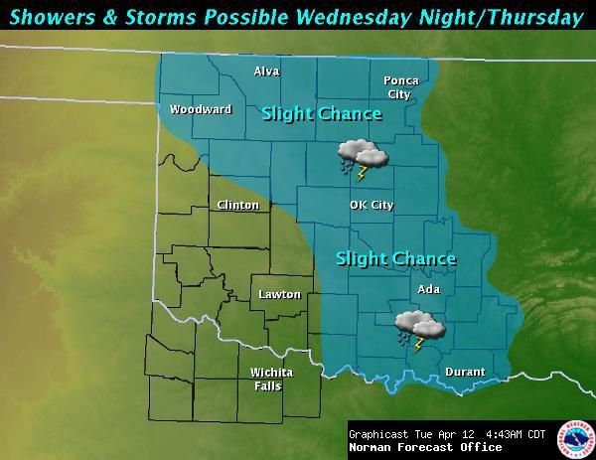
Day 1/2: Wednesday/Thursday
300

Slide 6
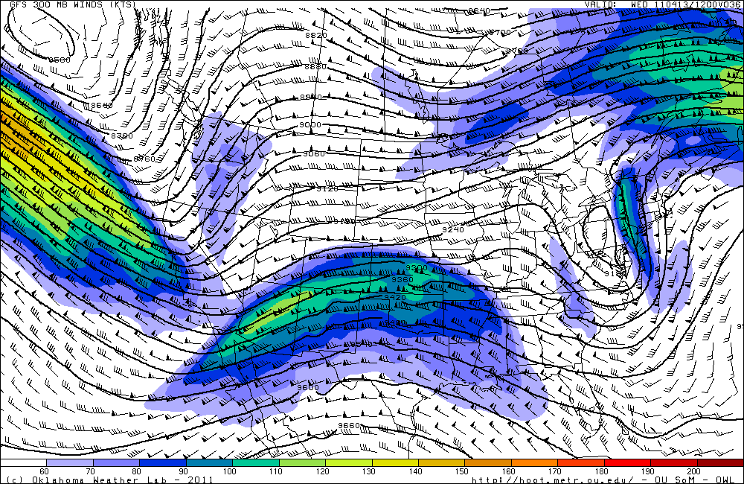
Day 1: Wednesday
300

Slide 7
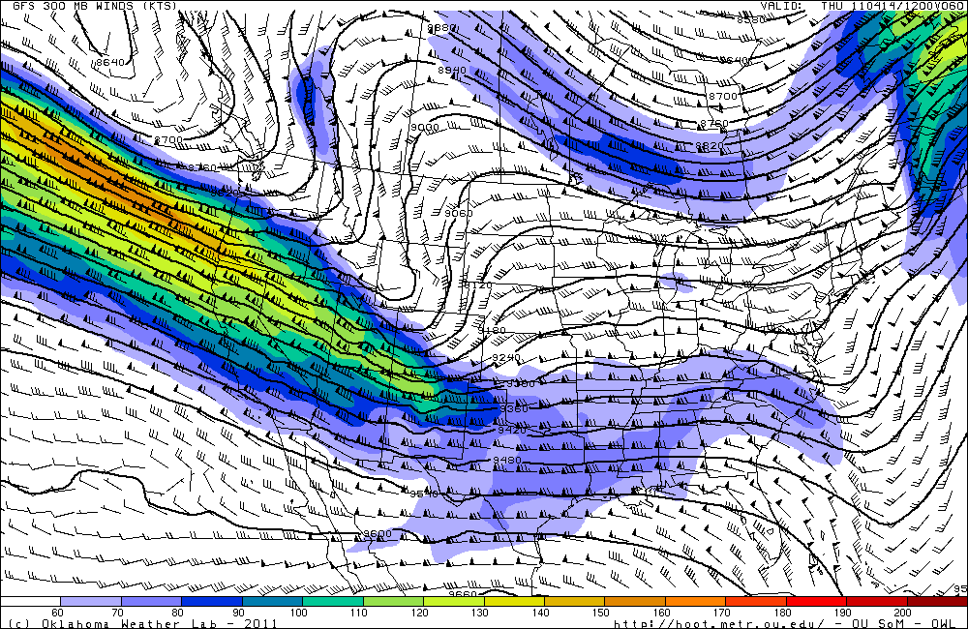
Day 2: Thursday

Slide 8
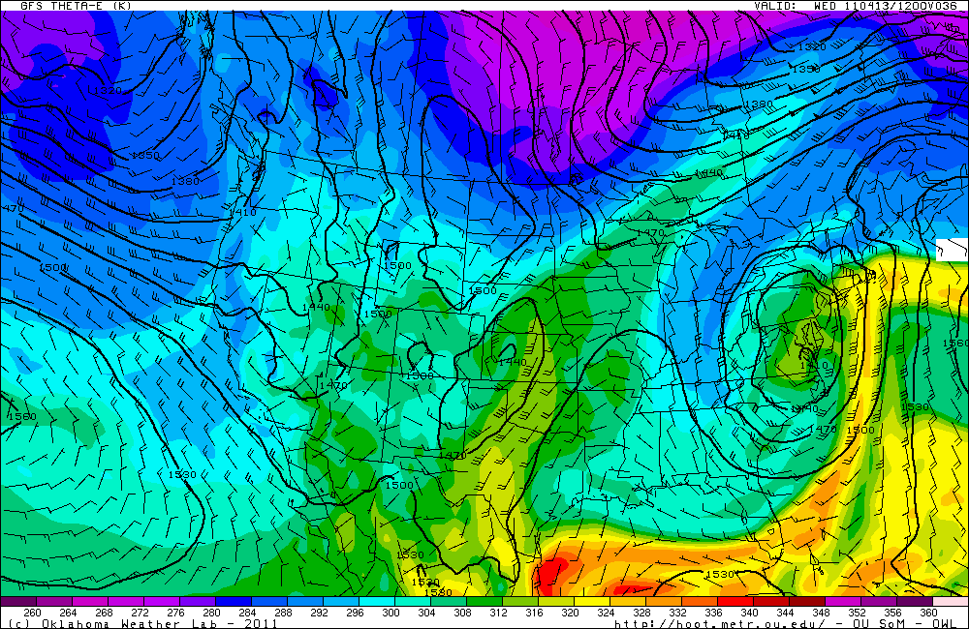
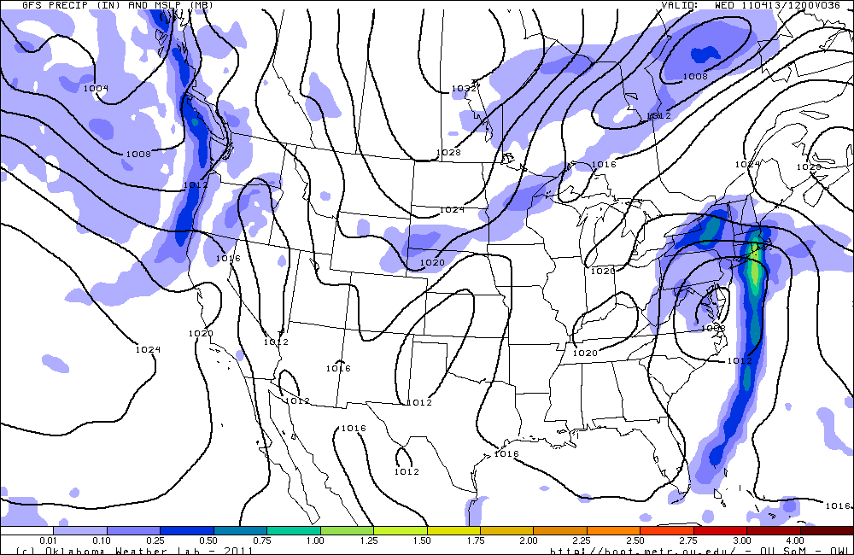
850 show time evolution of front

Slide 9
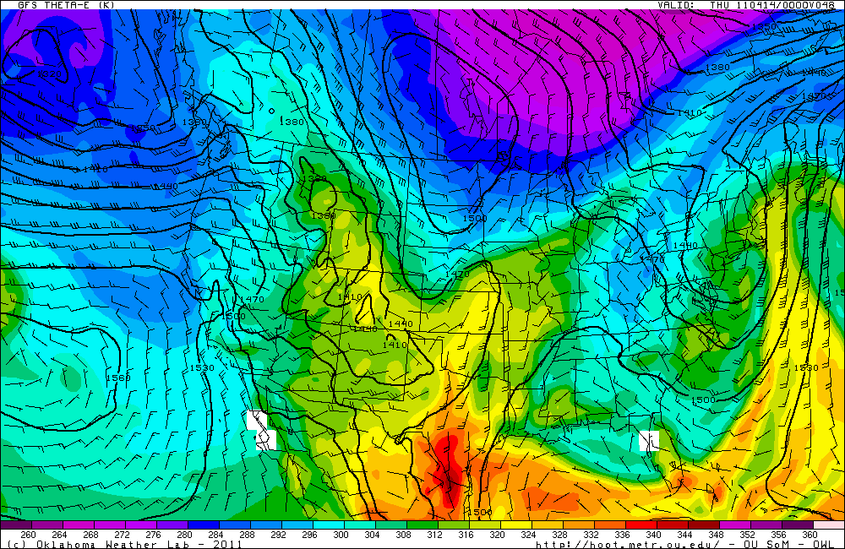
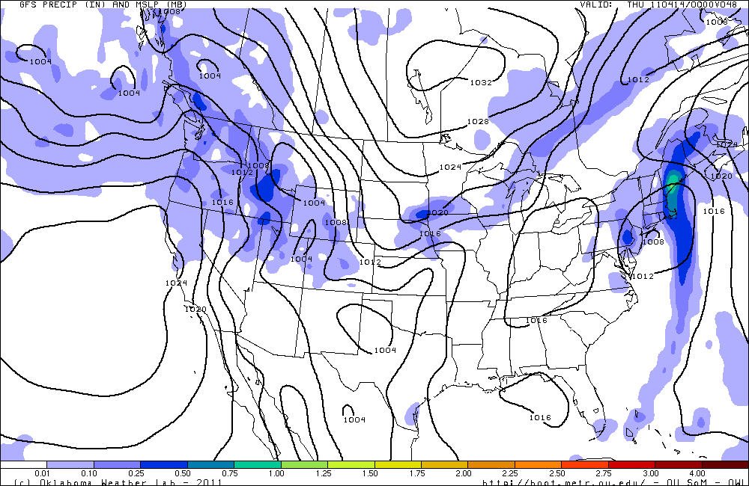

Slide 10
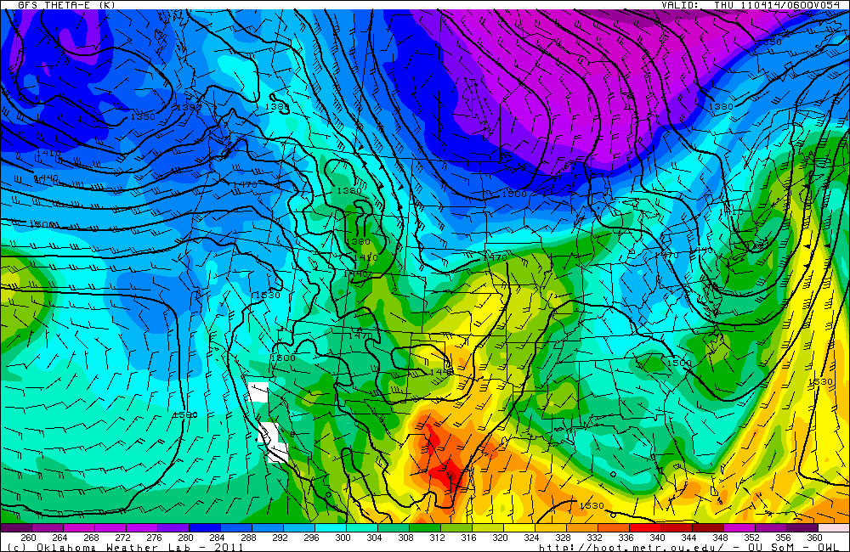
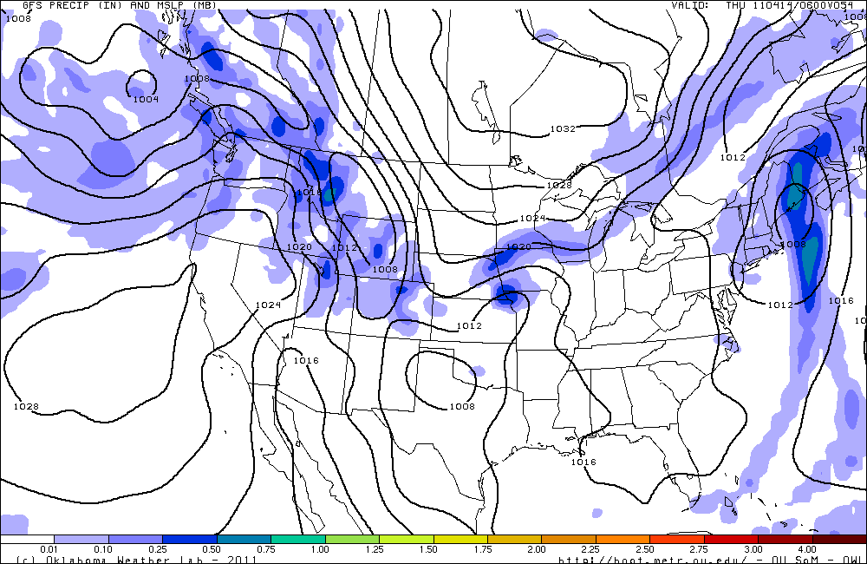
1am Thursday
GFS-Start of precip
NAM-No precip

Slide 11
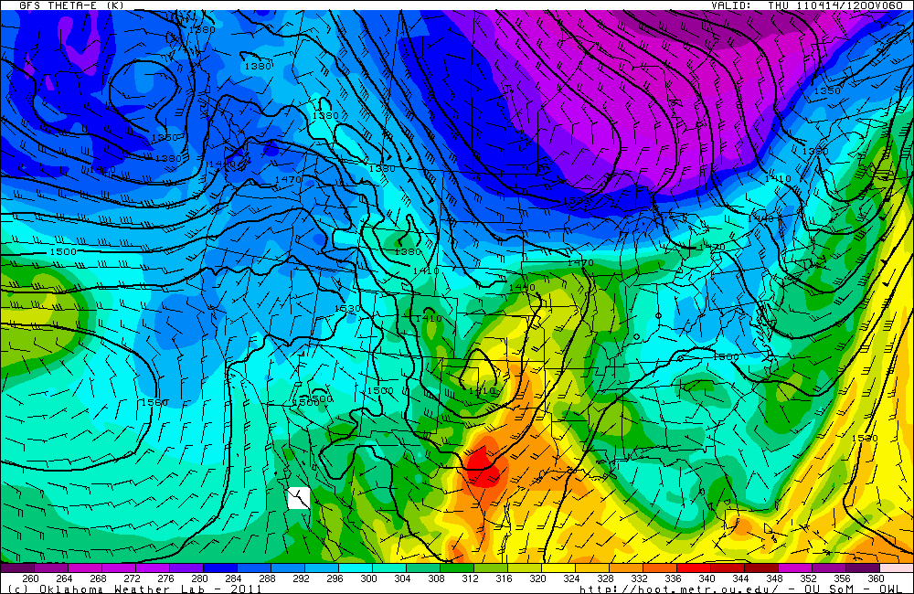
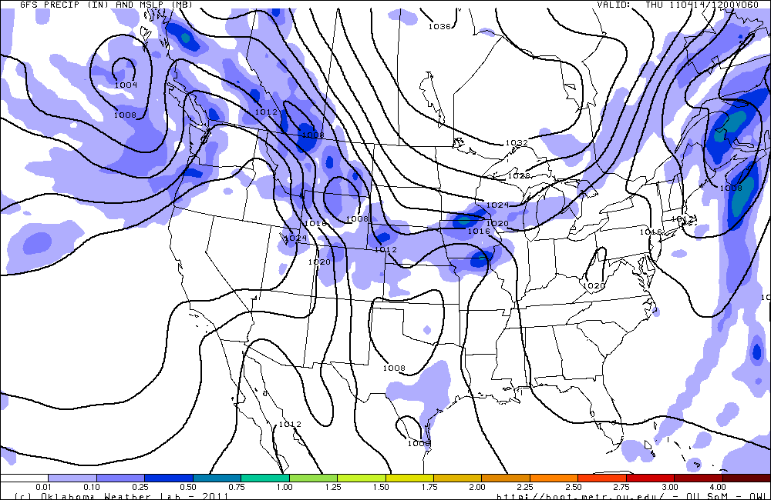

Slide 12
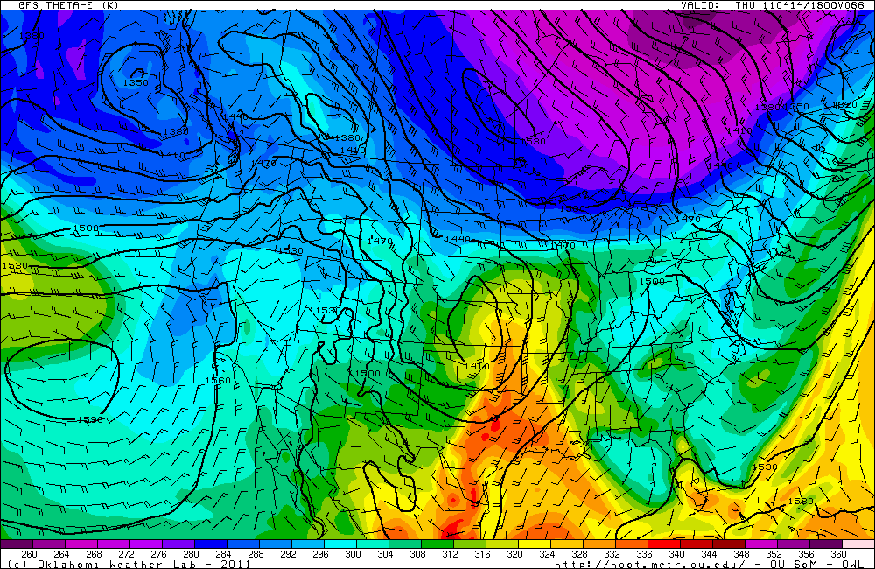
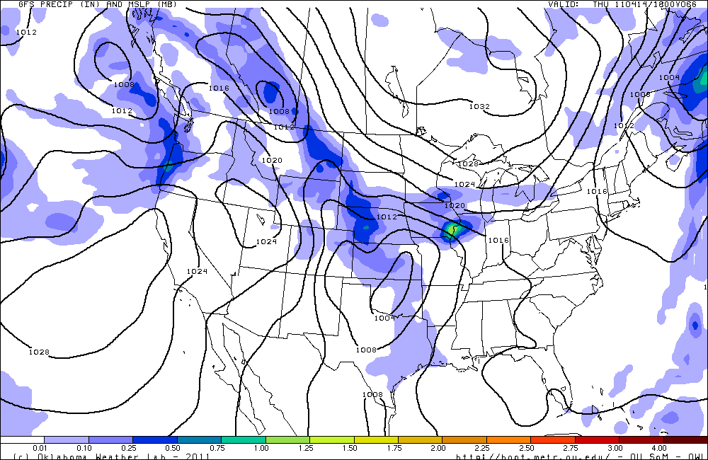

Slide 13
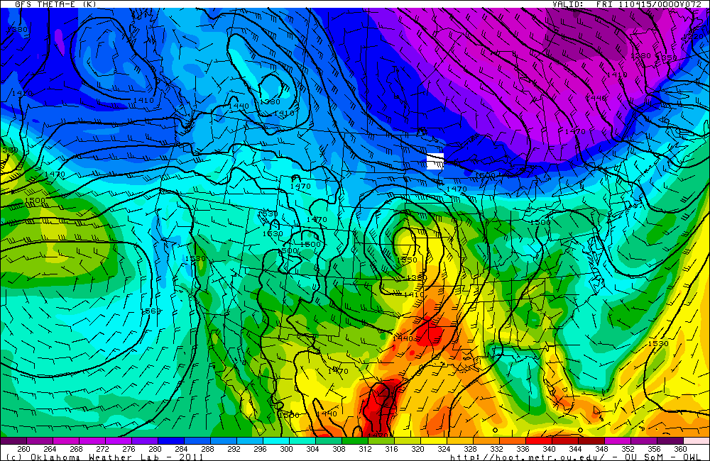
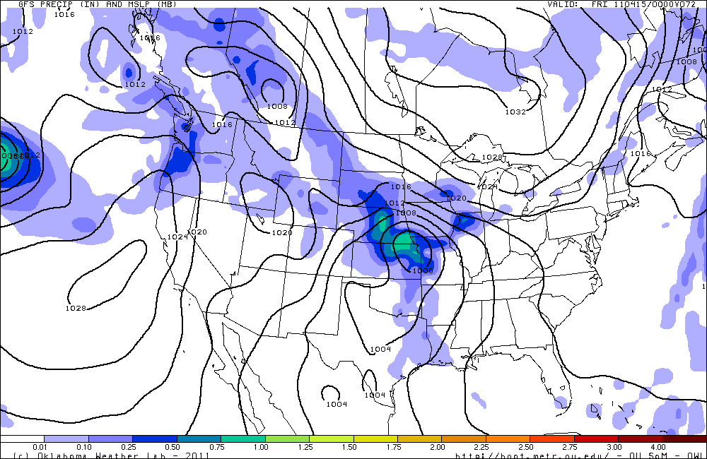

Slide 14
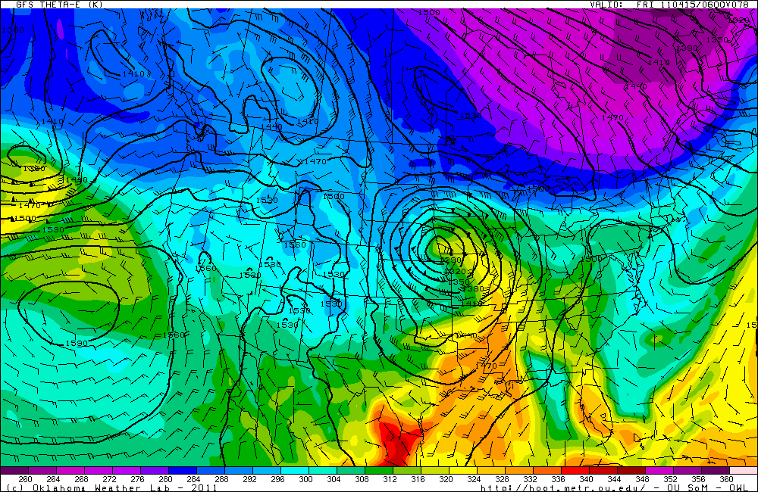
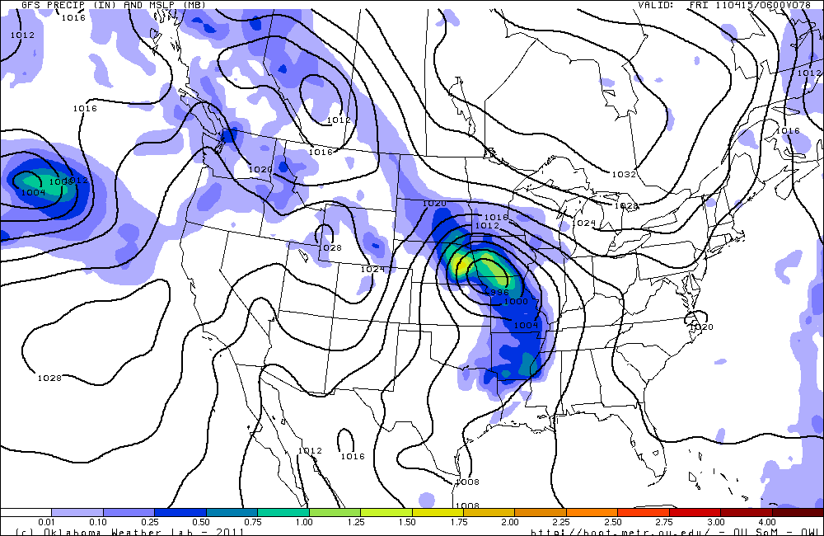

Slide 15
Thursday ops?
Possible start times of event
12 UTC Thursday
Duration
12 hours
Geographic area
Mainly N and E of PNC
Precip motion
030 at 20 kt
Type of precipitation
Very light stratiform precip initially, convection initiation east along front after 20 UTC

Slide 16
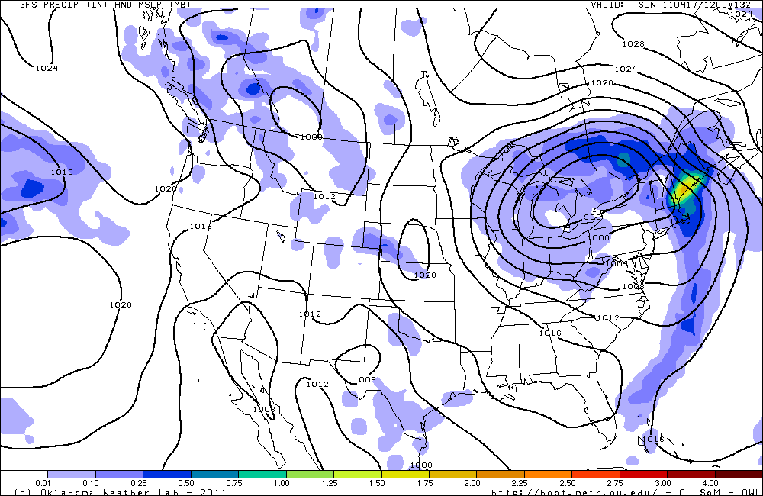
Day 3-7
GFS outlook for Sunday

Slide 17
Next event: Tuesday

Slide 18
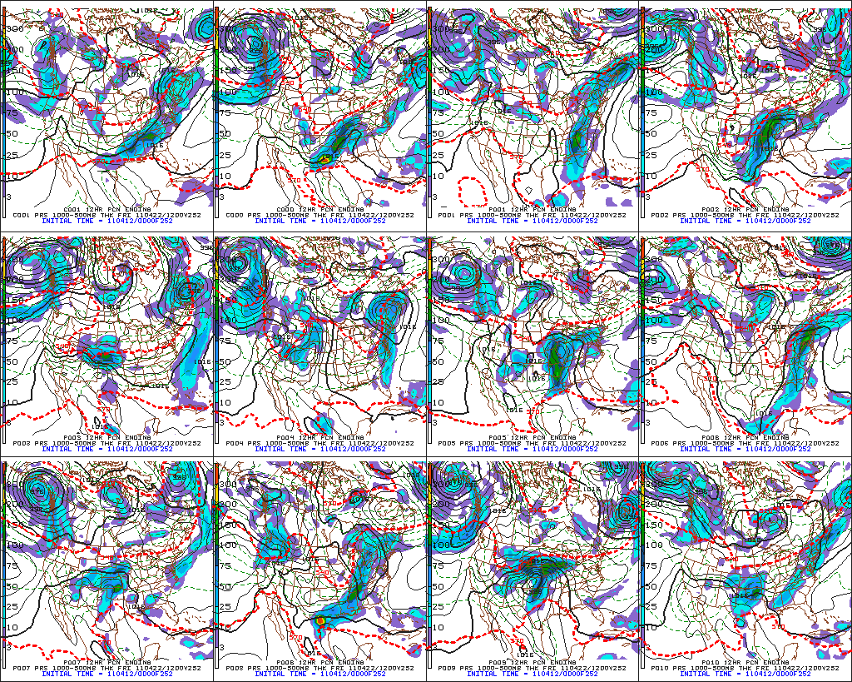
Action on transit flight?

