Slide 1
Applications of GOES-R Data to the Warn-on-Forecast Project
Thomas Jones
September 15, 2011
GOES-R Science Week Meeting: Huntsville, AL

Slide 2
Warn-on-Forecast
Goals of the WoF Project
Explore the use of current and future data sets to improve short-term (< 3 hour) forecasts
Assimilate these data into meso and storm-scale NWP models
Compare and contrast different datasets and assimilation techniques to determine those which prove most useful in a real-time, operational warning environment
Applications for satellite data in WoF data assimilation
Provide information on the near-storm environment
Provide information on the location and properties of clouds
These data can be used to deduce convective initiation and subsequent evolution of the convection
Assimilating this information into regional NWP models should lead to an improvement of short-term forecast of convective events.

Slide 3
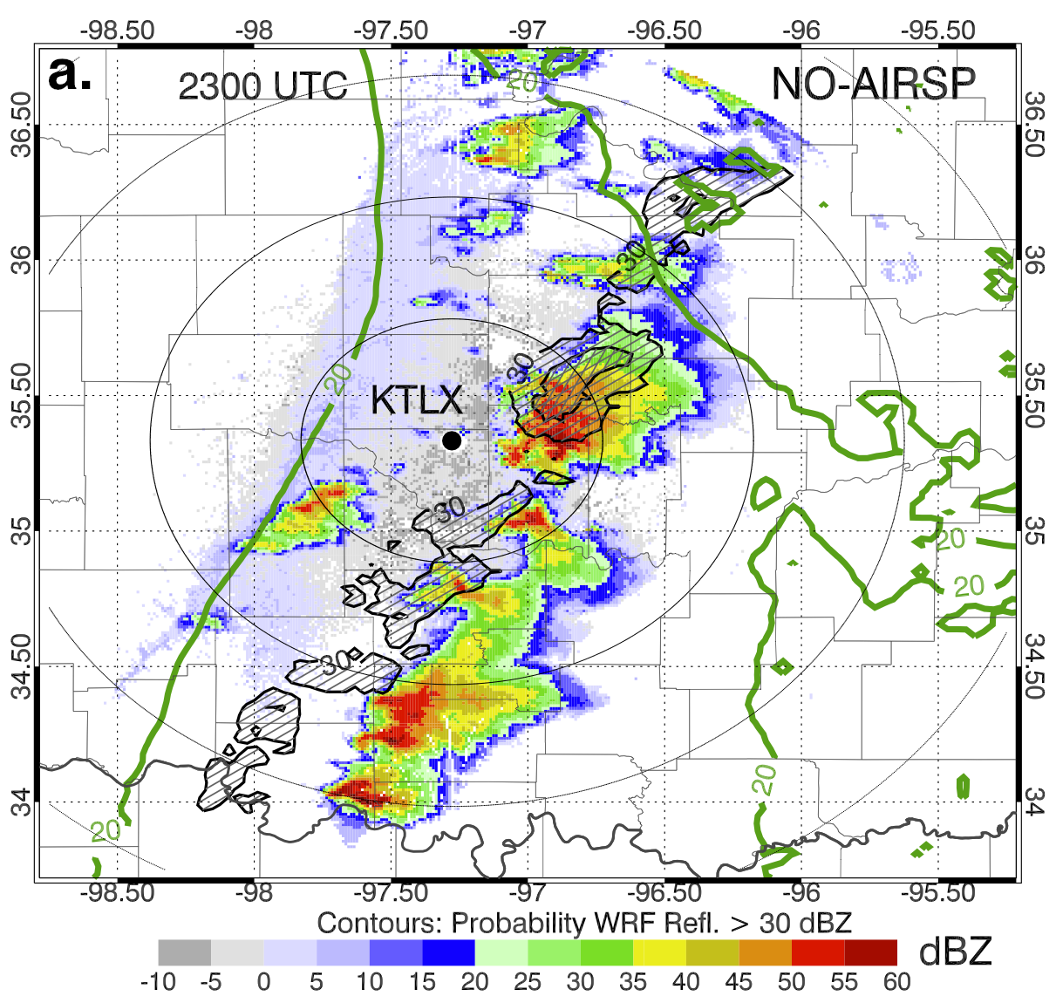
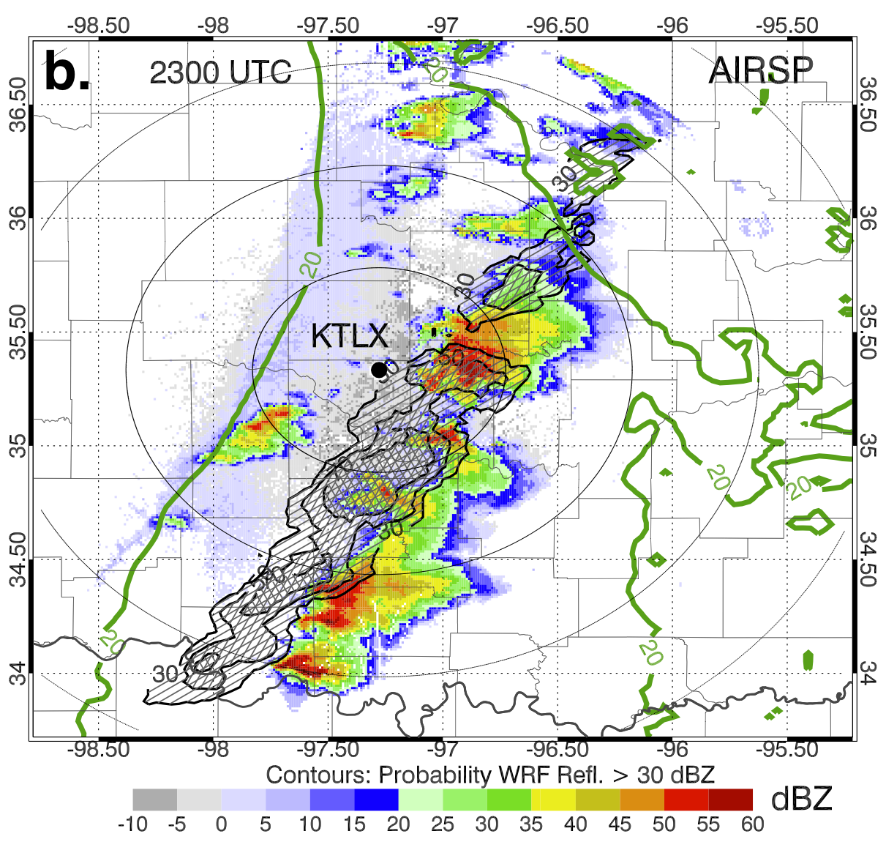
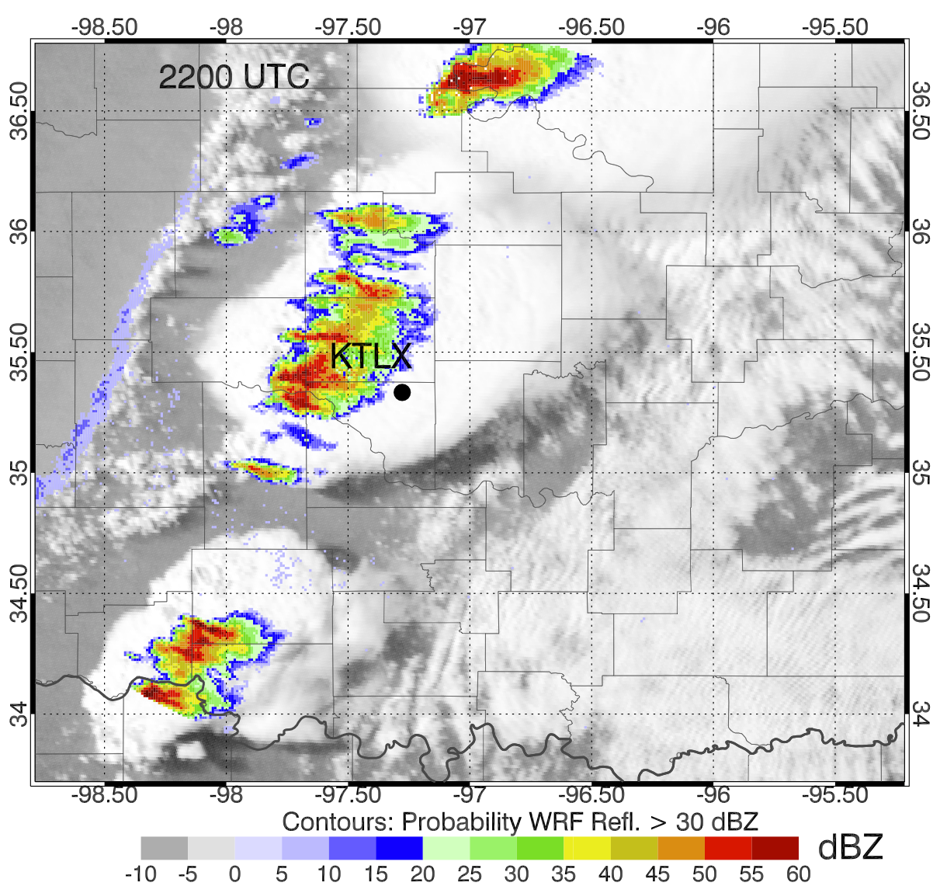
Warn-on-Forecast
Current Projects:
Use hyperspectral sounder data (AIRS)
To improve 0-3 hour forecasts of a severe
weather event (May 10, 2010).
Temperature and dewpoint profiles
improve mid-tropospheric characterization
of the atmosphere
Increases forecast convection compared to
not assimilating these data.
Future Projects:
Assimilate satellite derived cloud products
Examples include:
Cloud top pressure and temperature
Cloud coverage
Cloud liquid and ice water contents
All products to be retrieved from GOES-R ABI radiances
Testing of satellite-derived cloud products will utilize MODIS (and similar) data as will as OSSE experiments to prepare for GOES-R coming online in 2015-16.
Increases forecast convection
Better match to WSR-88D
GOES Cloud Cover

