Slide 1
Improved Understanding and Diagnosis of Tropical Cyclone Structure and Structure Changes
GOAL: Develop new tools that enhance the current capabilities to diagnose tropical cyclone (TC) structure and location using GOES-R advanced baseline imagery (ABI) and GOES lightning mapper (GLM) proxies.
John Knaff (PI,StAR) and Chris Rozoff (PI,CIMSS)
Jim Kossin (NCDC) and Chris Landsea (NHC)
Presented by M. DeMaria (co-Investigator, StAR)

Slide 2
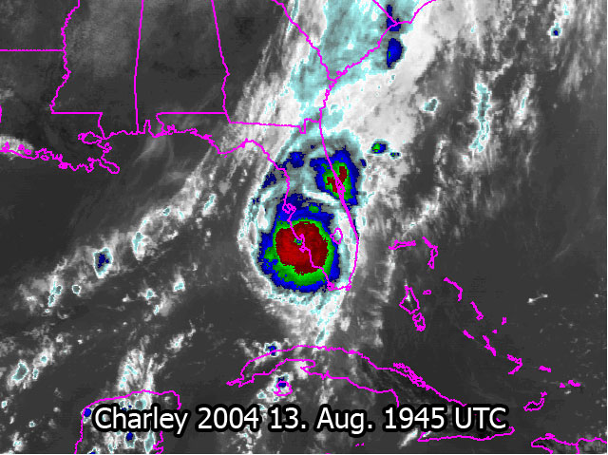
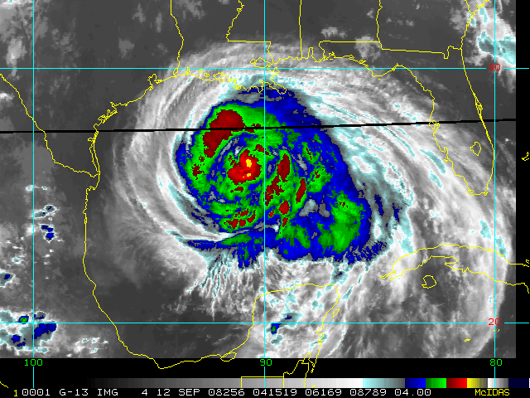
Storm Structure Affects Impacts
Hurricane Charley 2004 Hurricane Ike 2008
Small category 4 Large category 2

Slide 3
Research Summary
Use multi-spectral satellite and lighting data to improve center and wind structure estimation
Quantify factors responsible for TC size variation, especially variations in moisture
Guide algorithm development with high resolution WRF simulations
Microphysics sensitivity
Compare synthetic and real imagery
Statistical-dynamical models for size forecasting

