Slide 1
Investigating the Effects of Detector-Averaged SRFs
Mat Gunshor
CIMSS / SSEC / UW-Madison
Tim Schmit
NOAA/NESDIS/STAR/ASPB

Slide 2
Project Description
ABI will have hundreds(?) of detectors that are averaged into one SRF
Goal: Determine effects of using detector-averaged SRFs on today’s GOES imagery and products.
Current Sounder has 4 detectors per band
Use RTM and convolution with multiple atmosphere types.

Slide 3
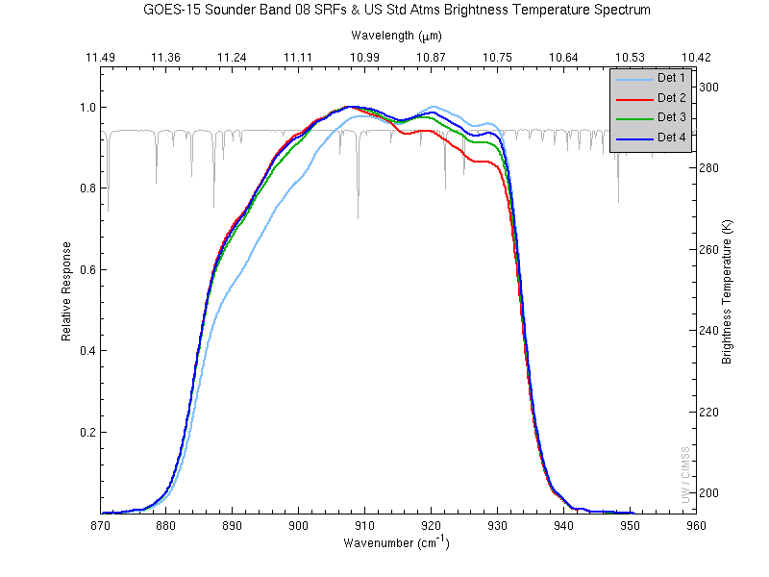
Example of SRF detector variability, current GOES-15 Sounder

Slide 4
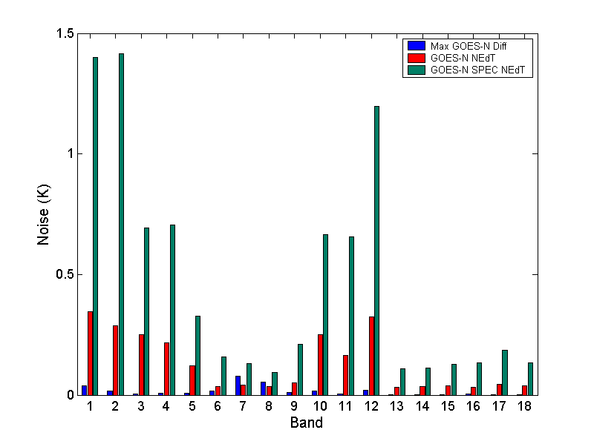
Detector Level Differences Compared to Noise (GOES-13, prelaunch data)
Note for bands 7 and 8 the max detector-to-detector difference is greater than the noise.

