Slide 1
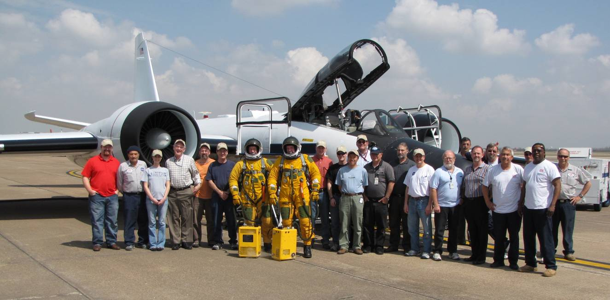






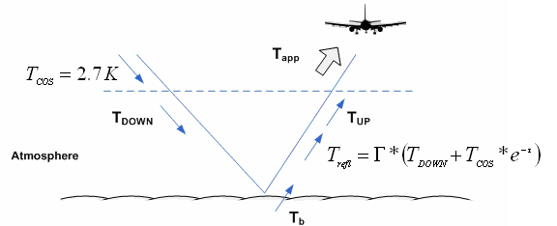
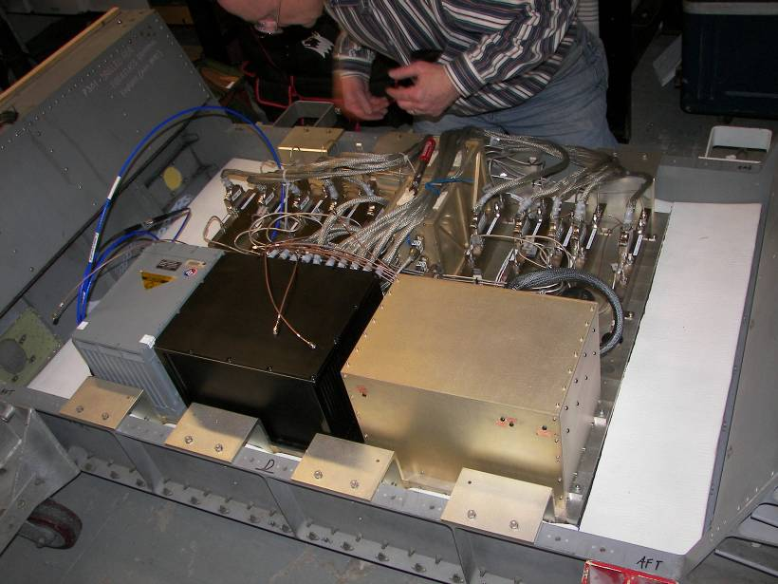
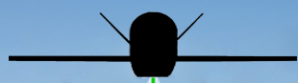
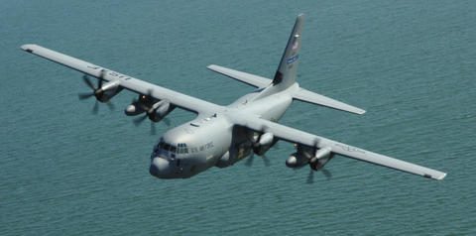
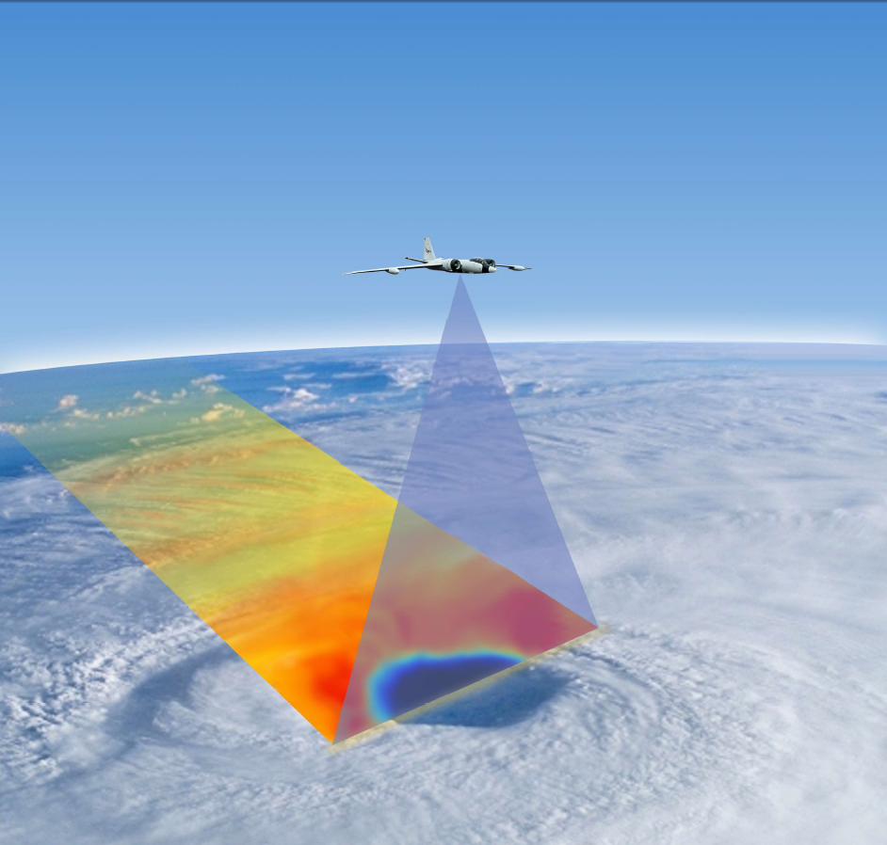

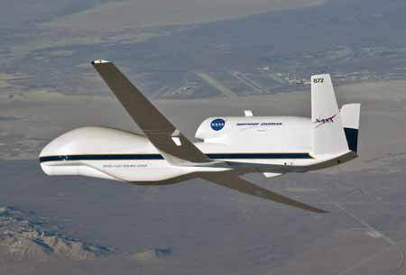
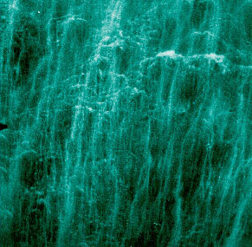


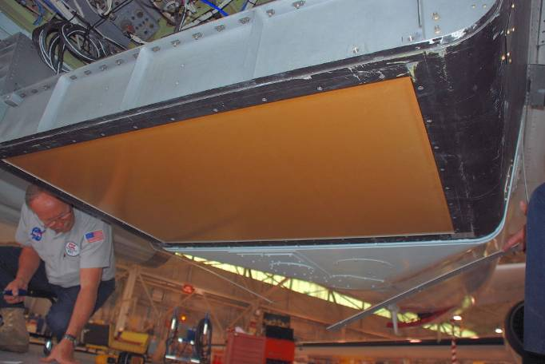
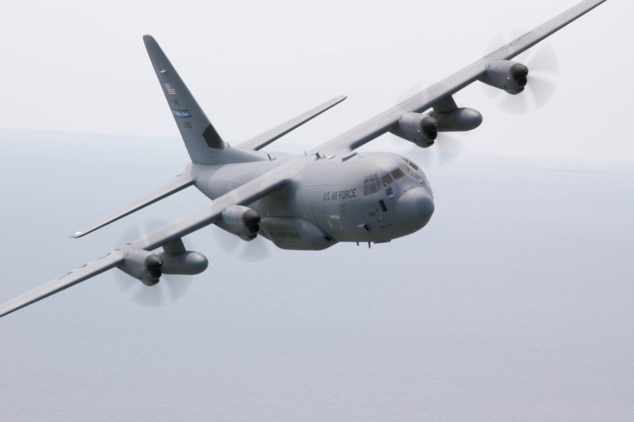
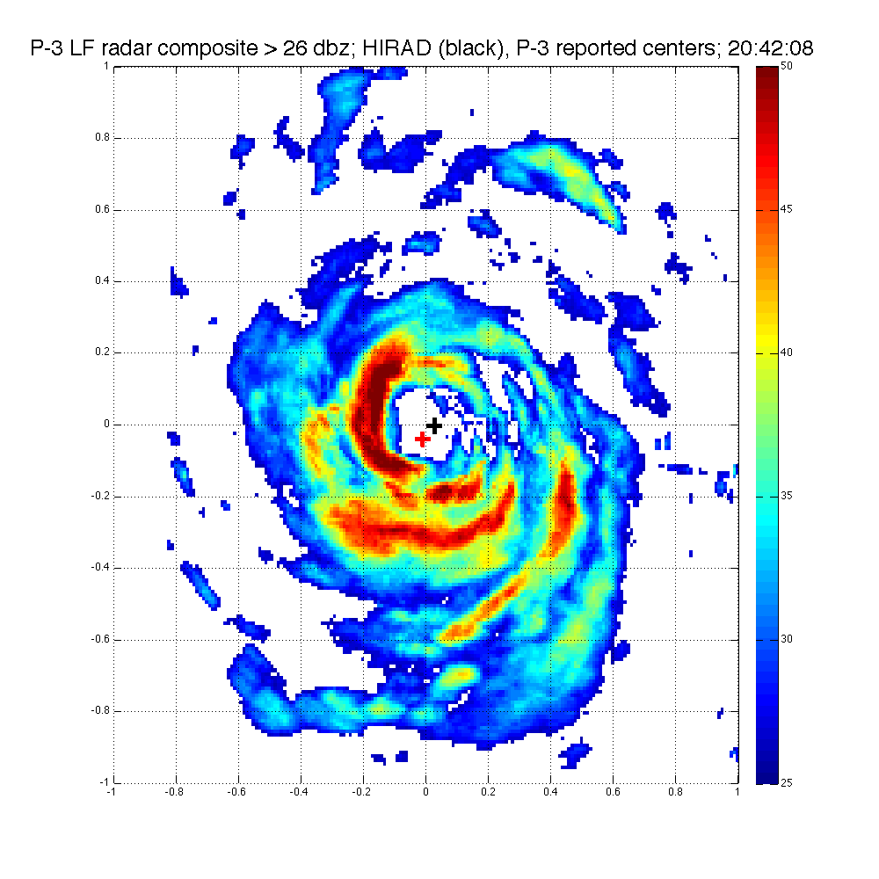
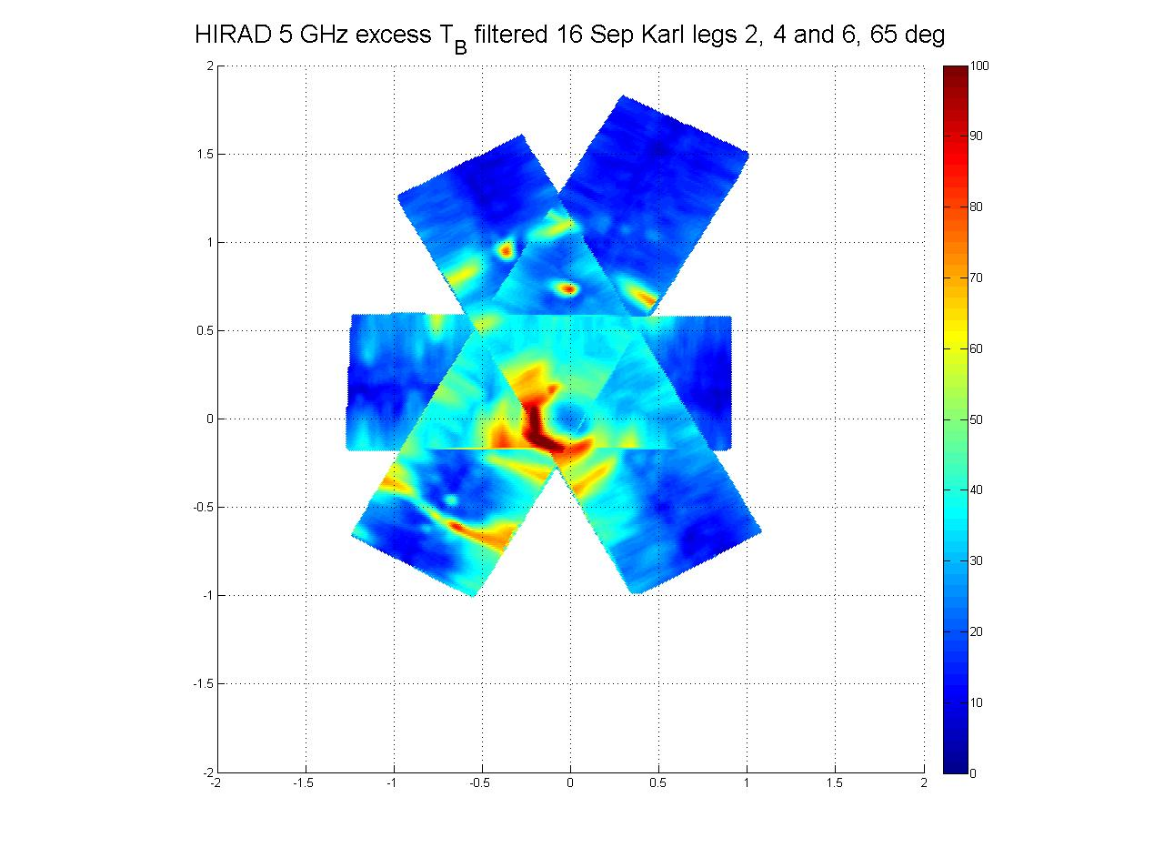
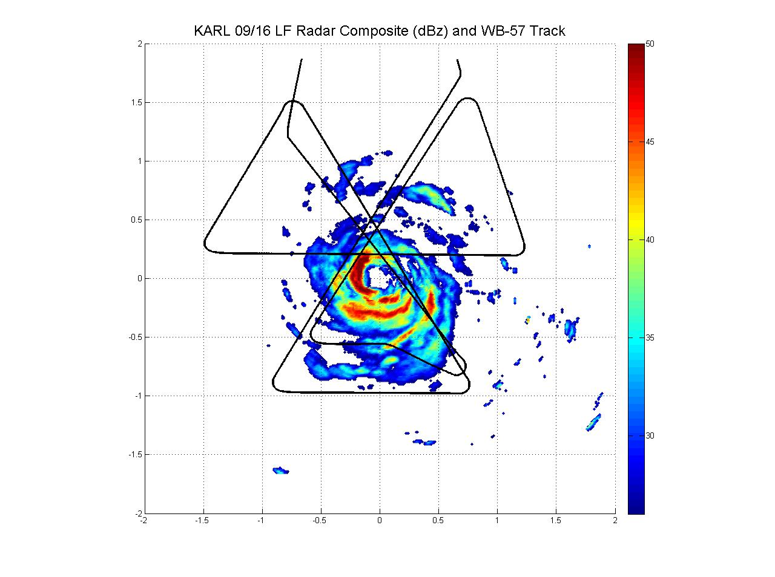
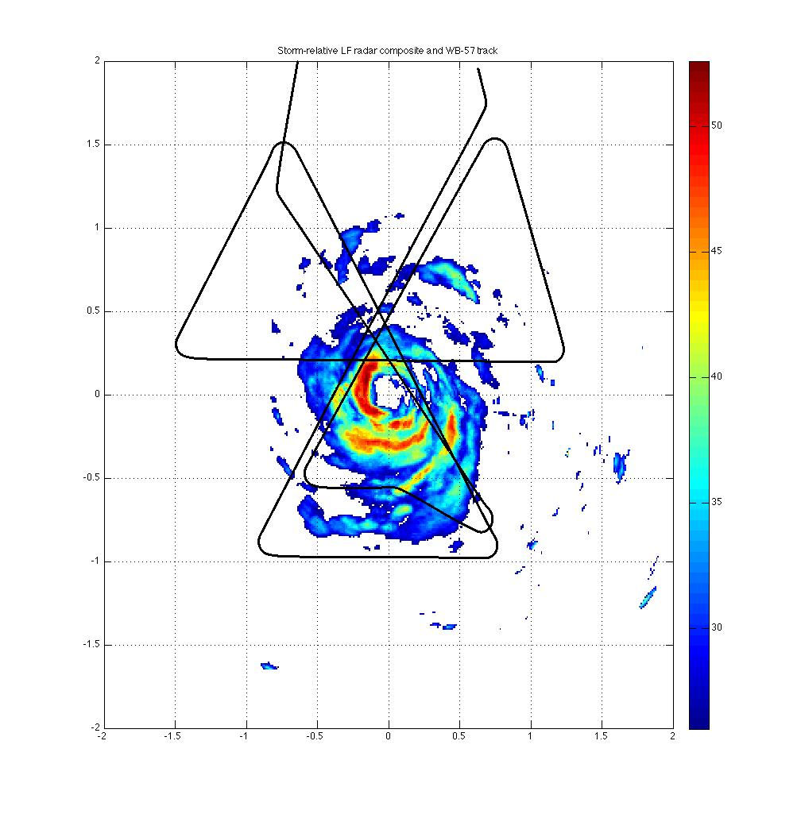
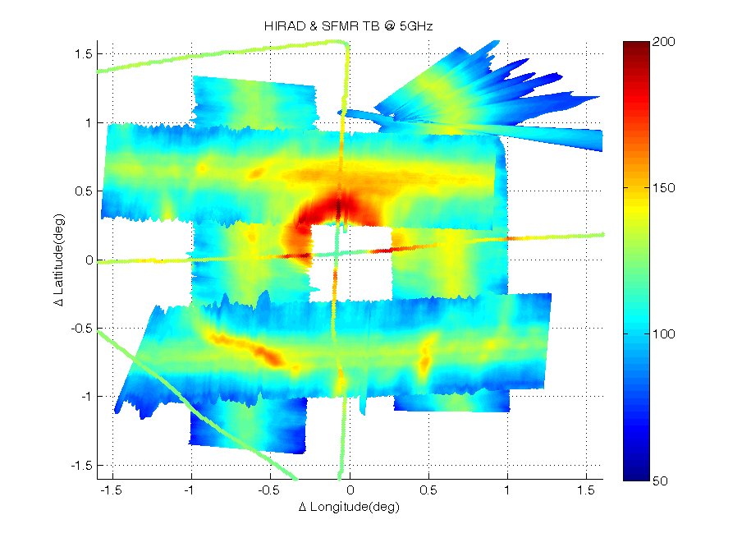
Observations of C-Band Brightness Temperature from the Hurricane Imaging Radiometer (HIRAD) on-board the NASA WB-57 during GRIP in Hurricanes Earl And Karl (2010)
Timothy Miller, Mark James, J. Brent Roberts,
Sayak Biswas and Courtney Buckley
NASA Marshall Space Flight Center
Eric Uhlhorn
Atlantic Oceanographic and Meteorological
Laboratory (AOML)
Peter Black
SAIC, Inc at NRL/
Marine Meteorology Division
W. Linwood Jones and Cathy May
Central Florida Remote Sensing Laboratory
University of Central Florida
Christopher S. Ruf
Space Physics Research Laboratory,
University of Michigan
Hurricane Imaging RADiometer (HIRAD)
HIRAD Physical Principles
HIRAD Technology Investment Roadmap
HIRAD Passive Microwave C-Band Radiometer :
Version 1: H-pol at 4, 5, 6 & 6.6 GHz freq for wind speed and rain rate
Version 2: H- & V-pol continuum of C-band freq for Ocean Surface Vector Wind (OSVW) & rain rate
Performance Characteristics (Version 1):
Earth Incidence angle: 0- 60°,
Spatial Resolution: 2-5 km,
Swath: ~70 km for 20 km altitude
Observational Goals (Version 1):
WS: 10 to >85 m/s; RR: 2 to > 100 mm/hr
HIRAD advances:
Expands Stepped Frequency Microwave Radiometer (SFMR) coverage from nadir to wide swath
Eliminates SFMR max wind under-sampling with wide-swath sampling of entire eyewall (instantaneously)
Uses synthetic thinned array and RFI mitigation technology of Lightweight Rain Radiometer (NASA Instrument Incubator)
HIRAD
Version 1
GRIP (2010) HIRAD
Swath Geometry
Technology Transfer: Operational Tropical Cyclone Reconnaissance
Similar to NASA HS3 Global Hawk
  configuration for 2012-2014
HIRAD
Version 2
HIRAD measures ‘emissivity’ over a range of incidence angles and frequencies from ocean surface foam (a function of wind speed) and intervening rain.
At C-band microwave frequencies (4-6.6 GHz), emissivity from wind-driven foam is invariant with frequency while rainfall emissivity is a strong function of frequency.
These physical characteristics allow two geophysical variables (wind speed and rain rate) to be derived from emissivity measurements at 4-6 discrete C-band frequencies, an ‘over-determined’, ‘least-squares’ problem solvable with conventional mathematical techniques.
Surface wind speed and rain rate retrievals are derived from empirical correlation of HIRAD measured emissivity at operating incidence angles with co-located GPS dropsonde surface wind observations and accepted functional relations for rain attenuation vs frequency.
Operational use of SFMR for Ocean Surface Wind Speed and Rain Rate since 2002 & since 1980 NASA LaRC AFE/RADSCAT flights
(AF WC-130J, NOAA WP-3D)
HIRAD first flight- 2010: NASA GRIP- Genesis and Rapid Intensification Project (WB-57)
Next up: NASA Hurricane and Severe Storm Sentinel (HS3) mission 2012-14 (Global Hawk)
Improved Hurricane Ocean Surface Vector Winds and Rain Rate
Karl 16 Sept 2010
Version 2: A fully polarimetric continuum of frequencies will be measured from which 6 will be sampled that will result in wind direction retrievals as well as more accurate wind speeds (fields of OSVW)
This approach will eliminate wind and rain retrieval ambiguities in gale-force wind regimes.
P-3 composite center time ~20:44 UTC
Radar; + HIRAD; + Wind Centers
60
60
0
-60
Storm track
Storm Track
Earl and Karl Storm Tracks: HIRAD WB-57 Flight Locations
Earl Flight: 1-2 Sept 2010
0
Hurricane Earl
HIRAD Tb@ 4GHz
HIRAD Tb@ 5GHz
-60
Tb (K)
Model Tb@ 4GHz
Partial outer concentric eyewall
HIRAD flight
WS (kt)
Model Tb@ 5GHz
WP-3D LF radar reflectivity dBZ
HIRAD 5 GHz excess Tb (K)
Sept
50
SFMR Wind +50 (m/s)
180
Outer principal rainband
30
30
(kt)
(mm/hr)
RR (mm/hr)
SFMR Rain +50 (mm/hr)
Good agreement between HIRAD
  and WP-3D LF radar centers
WP-3D wind centers consistently south
  of LF radar and HIRAD centers as seen
  in radar composite image to right
Aug
10
10
“Model” data are Tb’s computed from SFMR wind & rain fields
120
WB-57 flight track
HIRAD 4- and
5-GHz observed
Tb values agree
with SFMR Tb
values
Key features of radar and HIRAD comparison (right):
  1) Eyewall dBZ and HIRAD Tb maxima are located in left-front quadrant. This, together with open eyewall in right-rear quadrant, suggest easterly environmental shear.
  2) Partial outer concentric eyewall is suggested equally well in radar and HIRAD images, as is outer principal rainband.
60
HIRAD flights
SFMR
0
-60
Best day
HIRAD obs from
WB-57 at 20-km;
SFMR obs from
WP-3D at 3 km
HIRAD GRIP Calibration Challenges
Rain rate and wind speed retrievals to be based on three calibrated frequencies:
  5 GHz T_{b} (Microwave Brightness Temps) have been successfully produced
  Calibration of other 2 channels is in progress; completion within 3 months
HIRAD calibration issues and mitigation for HS3:
  Calibration uses internal reference blackbody targets and noise diodes
  Calibration algorithm depends on reference T_{b}: uncorrected instrument temperature dependence found during GRIP flights (+/-25º C)
  Temperature correction algorithm being developed for GRIP (requires additional instrument characterization testing)
  Thermal control subsystem has been upgraded for HS3 to minimize instrument temperature fluctuations
Hurricane Karl
SFMR
-120
120
60
0
-60
-120
Sept

