Slide 1

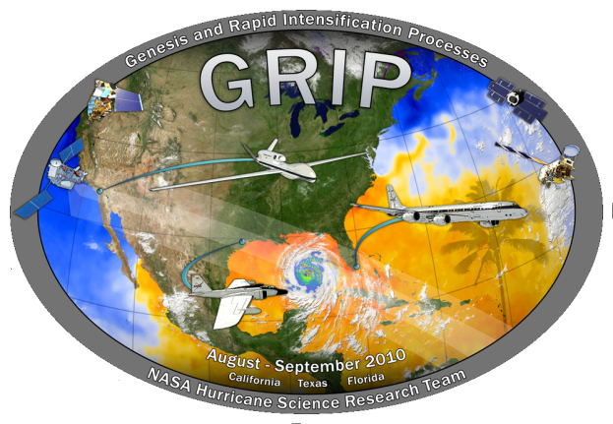

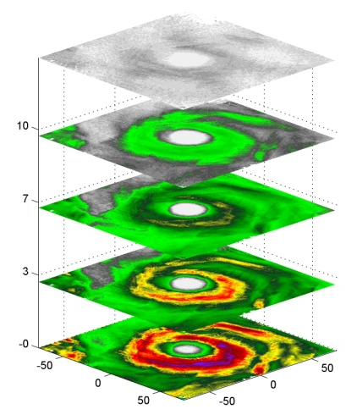
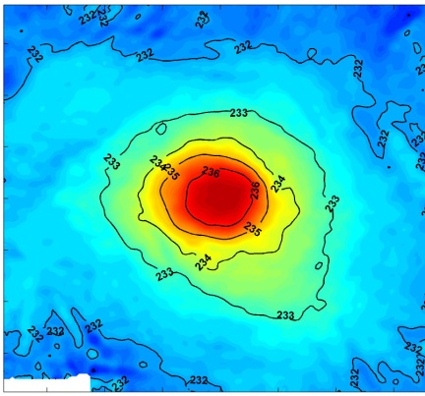
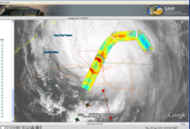
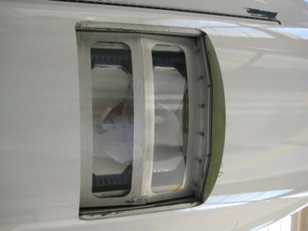
HAMSR Observations During GRIP
Shannon Brown, Bjorn Lambrigtsen, Richard Denning, Boon Lim, Jordan Tanabe, Alan Tanner
Jet Propulsion Laboratory, California Institute of Technology
Karl
HAMSR
Karl
Earl

Slide 2
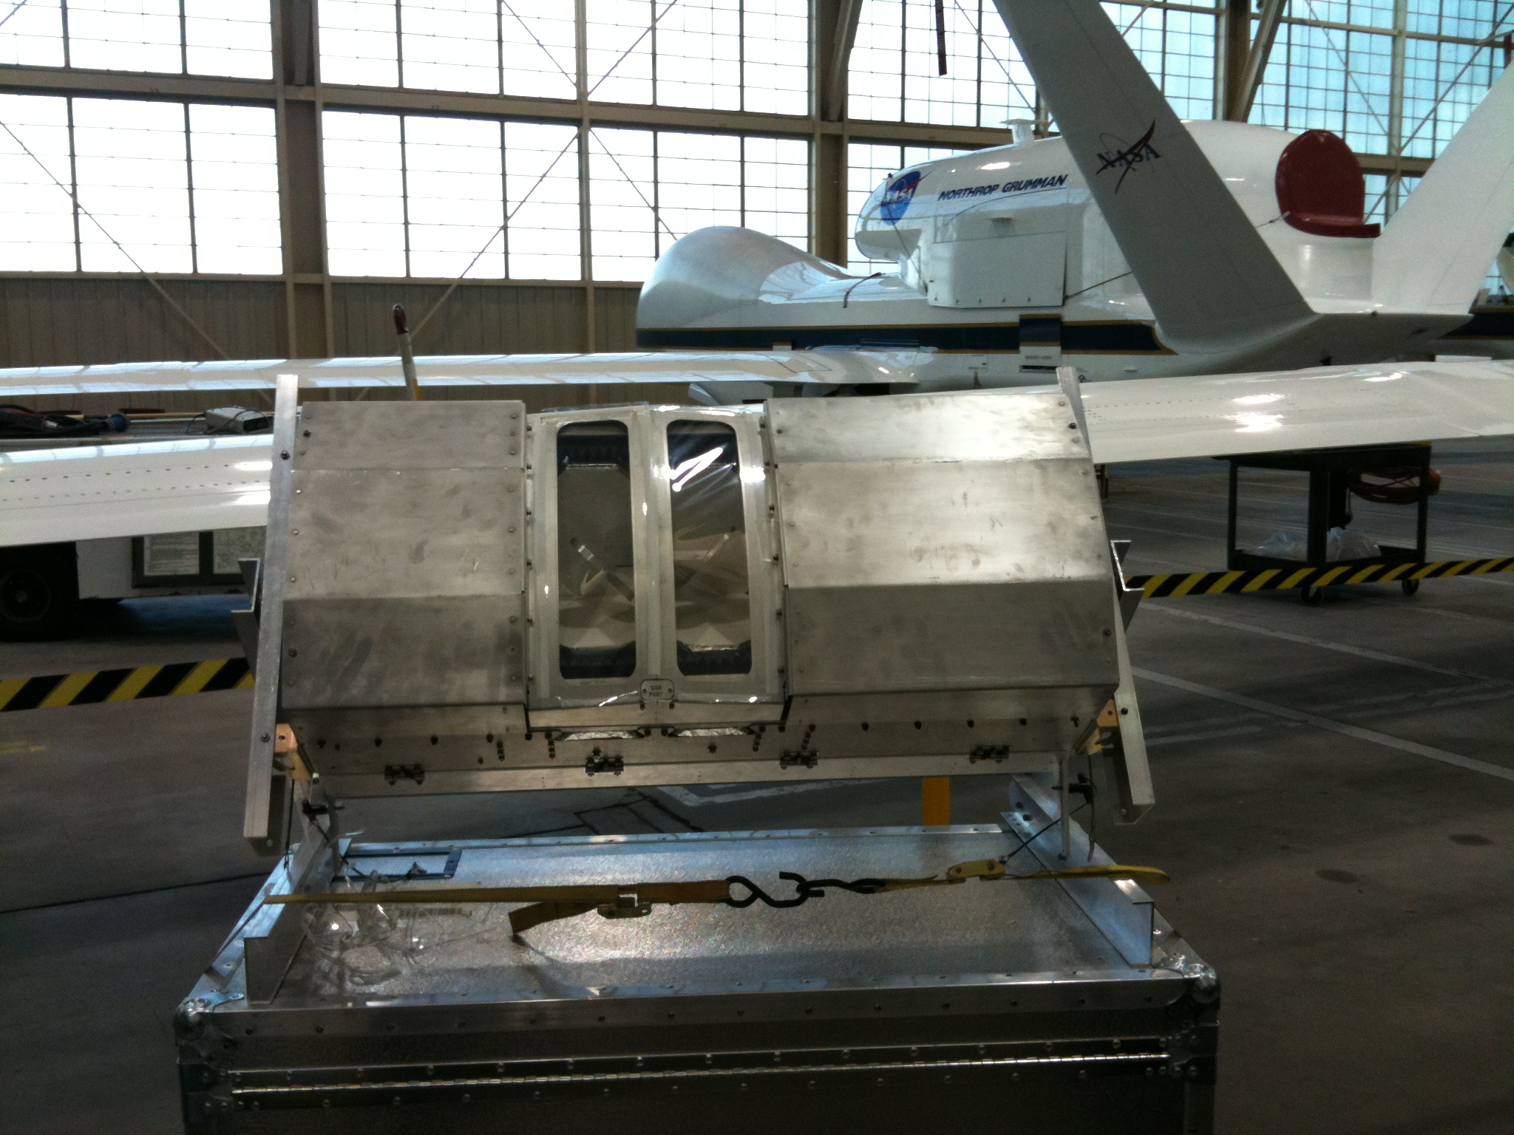


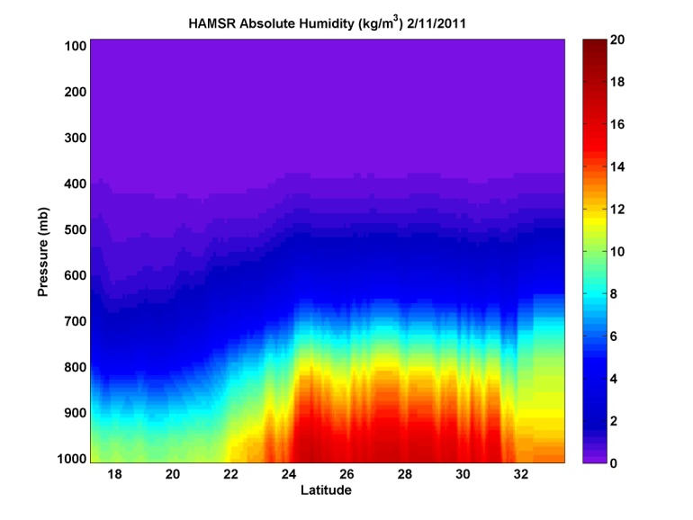
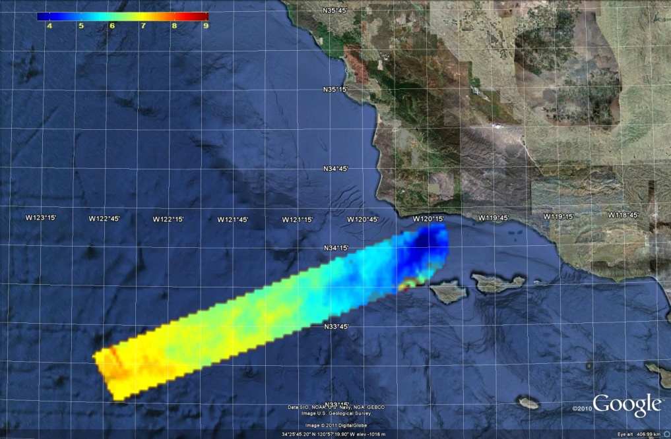
JPL High Altitude MMIC Sounding Radiometer (HAMSR)
JPL High Altitude MMIC Sounding Radiometer (HAMSR)
  Microwave radiometer for 3-D all-weather temperature and water vapor sounding, similar to AMSU
  25 sounding channels in three bands:
  50-60 GHz, 118 GHz, 183 GHz
Cross track scanning
  + 60º off nadir
  65 km swath
  1.9 km resolution
Hurricane Field Campaigns
  CAMEX-4 (2001)
  TCSP (2005)
  NAMMA (2006)
  GRIP (2010)
  HS3 (2011-2014)
6
8
10
13 mm
HAMSR PWV

Slide 3
HAMSR GRIP Status
  HAMSR L1b data (calibrated TB’s) distributed through 3 servers
    GRIP archive server (MSFC)
    HAMSR data server (JPL)
    Hurricane portal (JPL)
  Validation and finalization of L2 product
    T(z), q(z), L(z) for non-precipitating FOVs
    Z(z) for precipitating FOVs
  Derived products & analyses
    Warm core anomaly & intensity vs. time
    Convective structure vs. intensity
Notes:
Plenty of work to do…

Slide 4
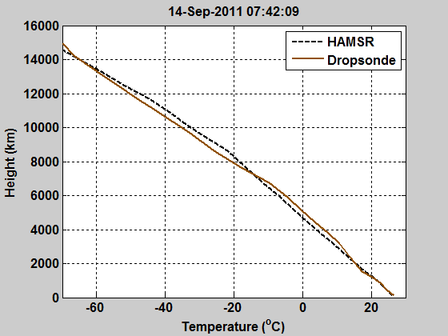
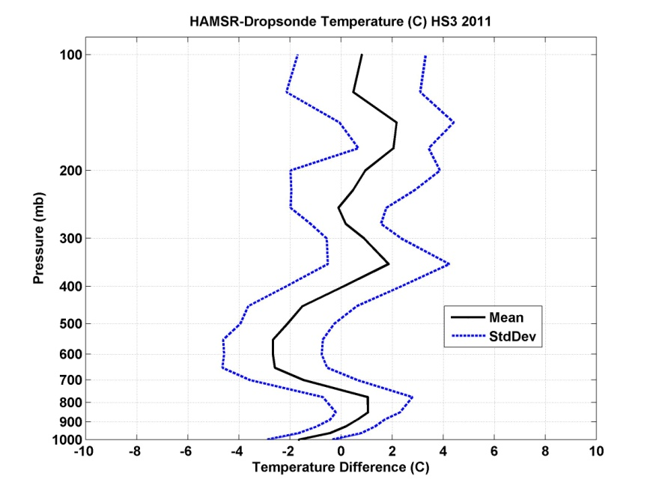
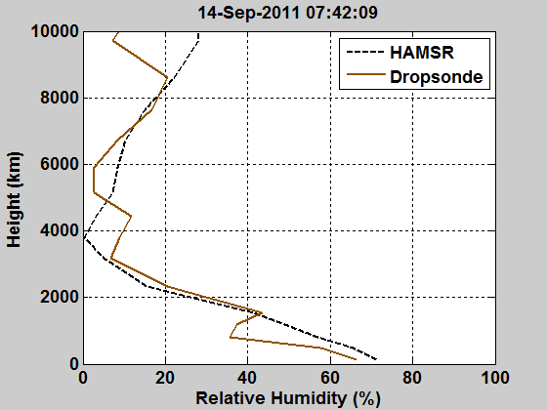
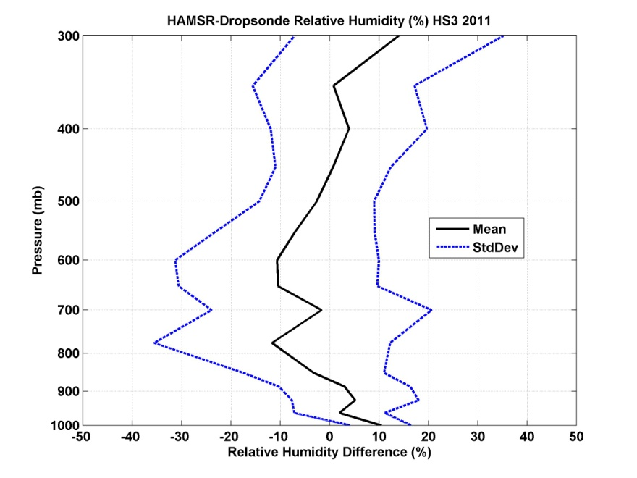
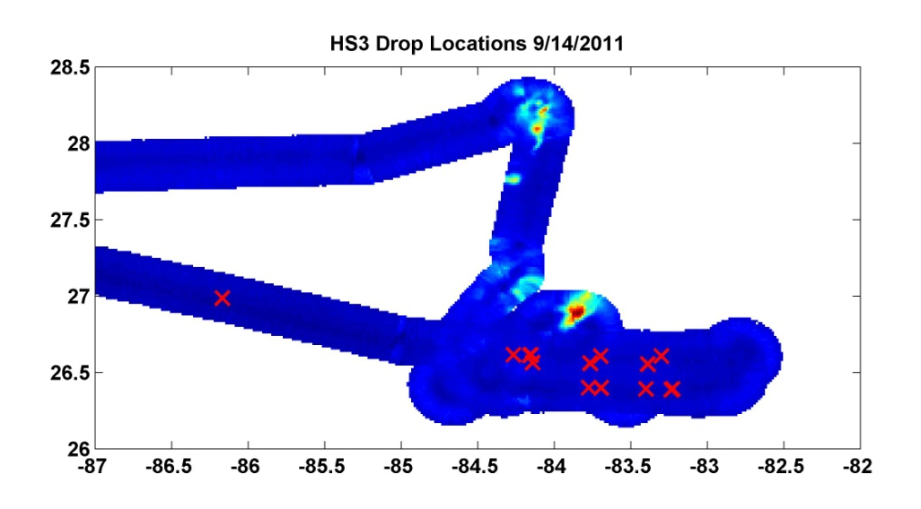
T(z) and q(z) Retrieval Validation
Temperature (K)
Non-linear, iterative optimal estimation based algorithm used to simultaneously retrieve the temperature, water vapor and cloud liquid water profiles (similar to 1-D var) (Brown et al. 2007)
  Flexible algorithm that is adaptable to any channel set or observation geometry
  Validated for non-precipitating conditions (clear and cloudy) over ocean through dropsonde comparisons during WISPAR and HS3 campaigns in 2011
  Dropsonde profiles smoothed vertically to match HAMSR vertical resolution
mean: -0.1K
σ = 1.9 K
Temperature
Relative Humidity (%)
Retrieval | Height Averaged RMS Error
Temperature | 2K
Relative Humidity | 17%
mean: -0.5%
σ=16.5%
Relative Humidity

Slide 5
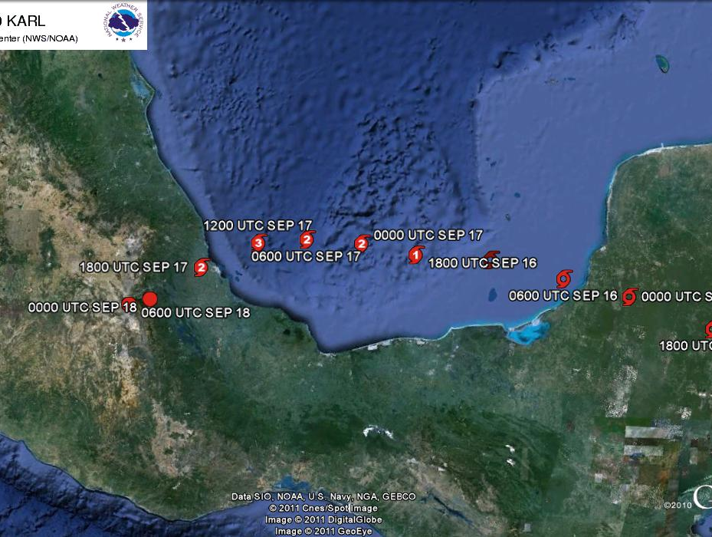
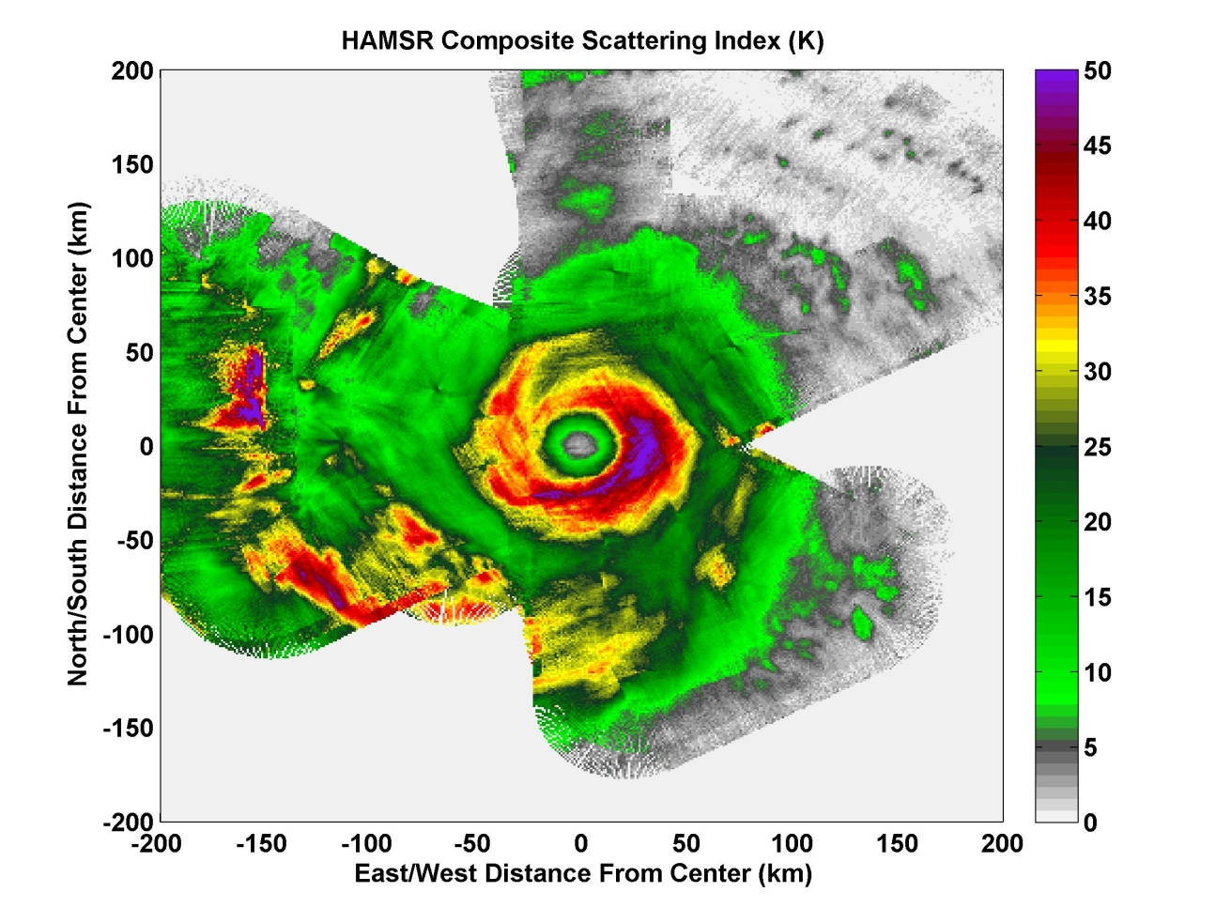

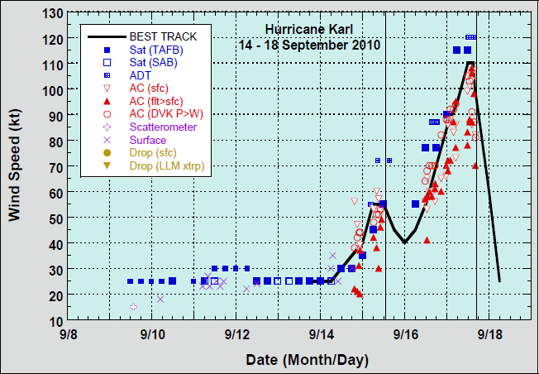
Hurricane Karl 2010
N
20 eye overpasses
14 hours over storm
Unique observations of the evolution of the inner core thermodynamic structure
NHC storm report

Slide 6
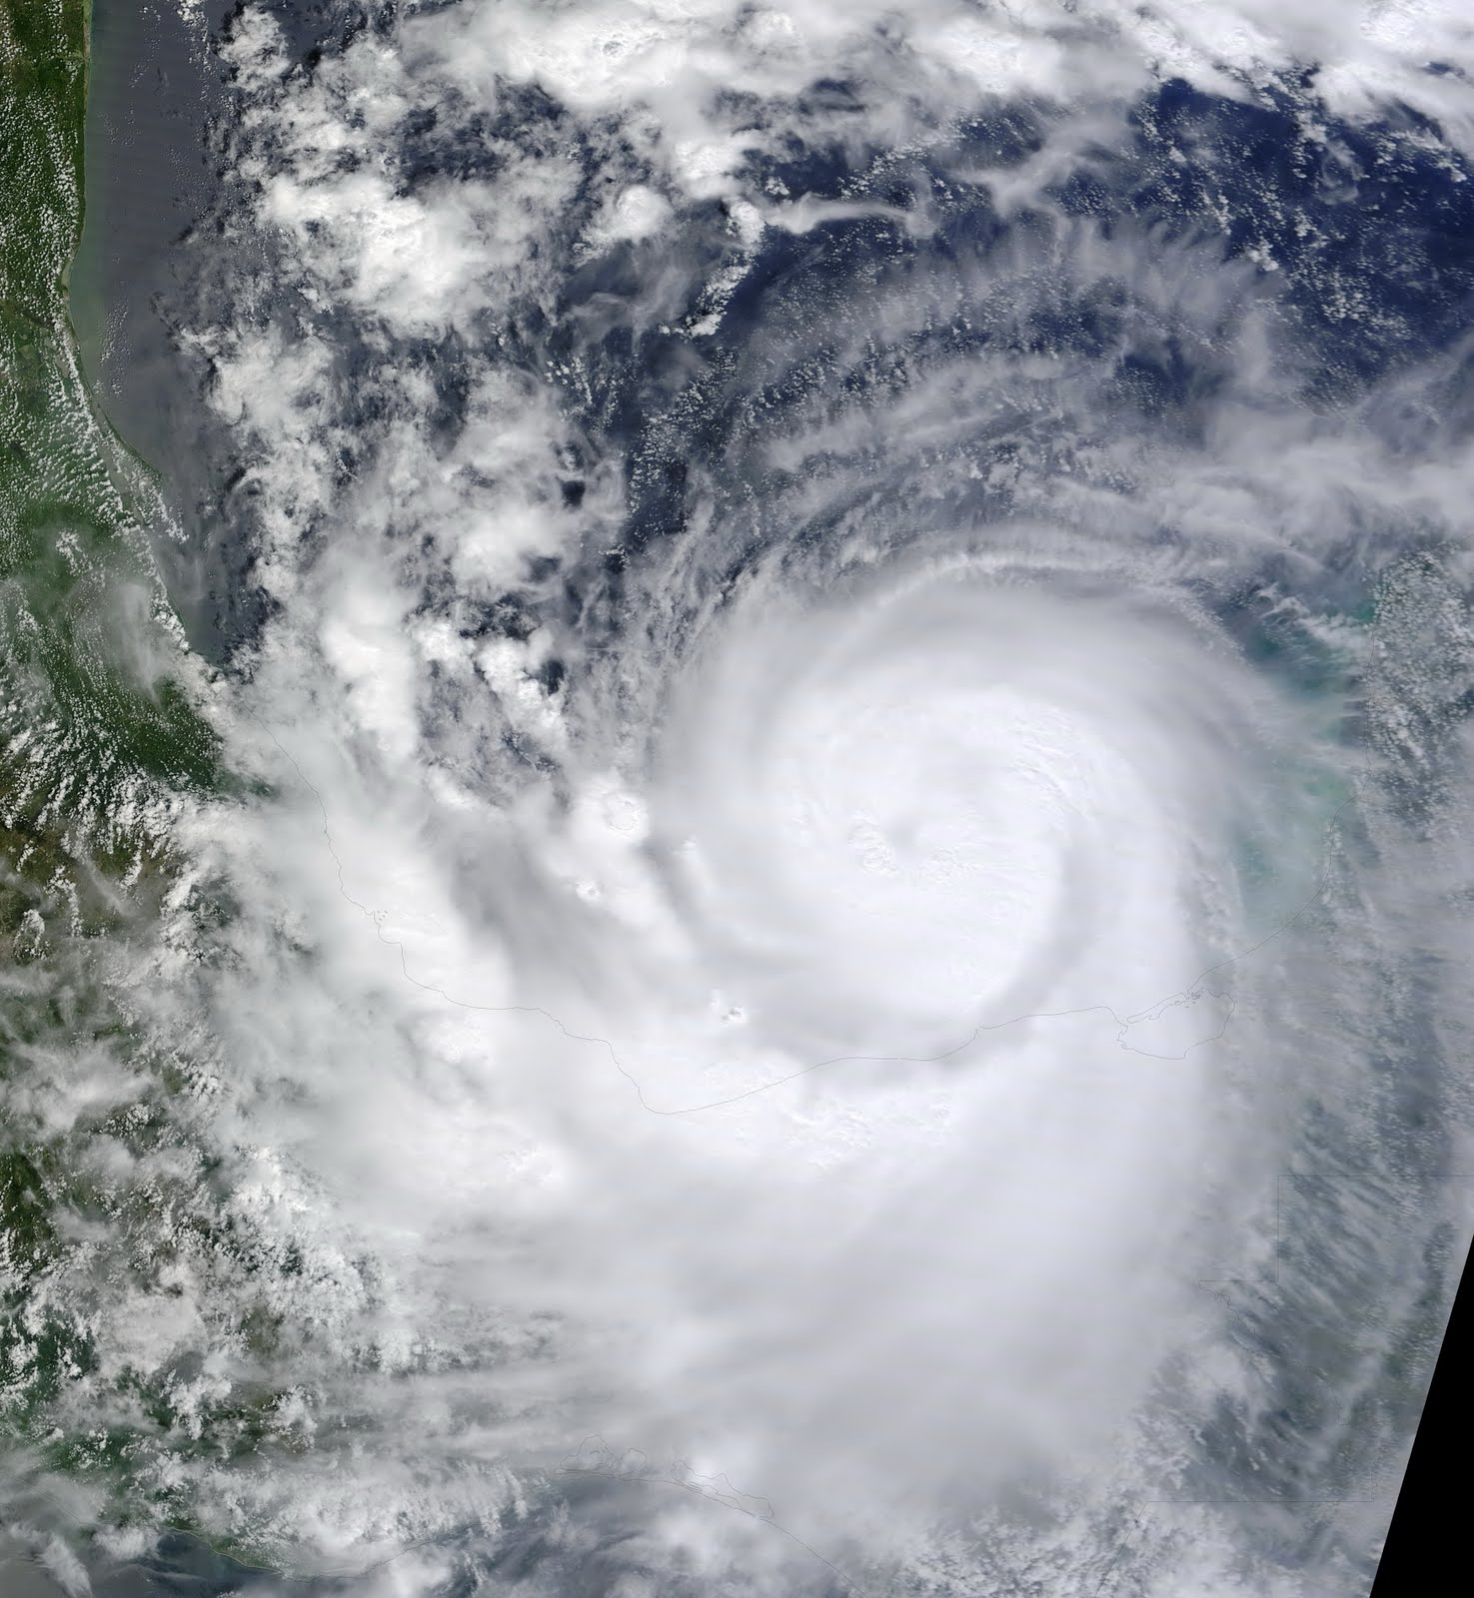
Hurricane Karl
9/16/2010 20 UTC to 9/17/2010 8 UTC
Horizontal structure of warm core
Vertical thermodynamic structure in the eye
Time evolution of the thermodynamic structure in the eye
Relationship between temperature anomaly at various vertical levels and intensity

Slide 7

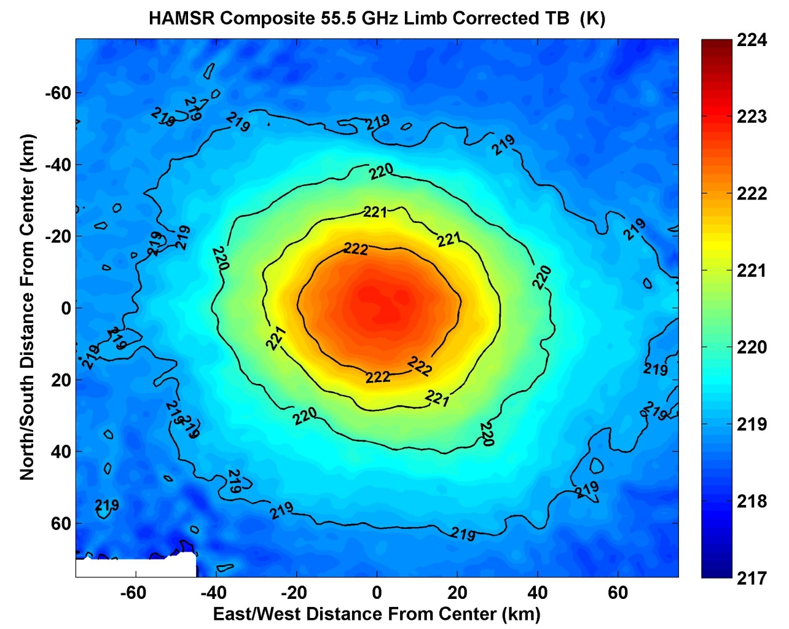
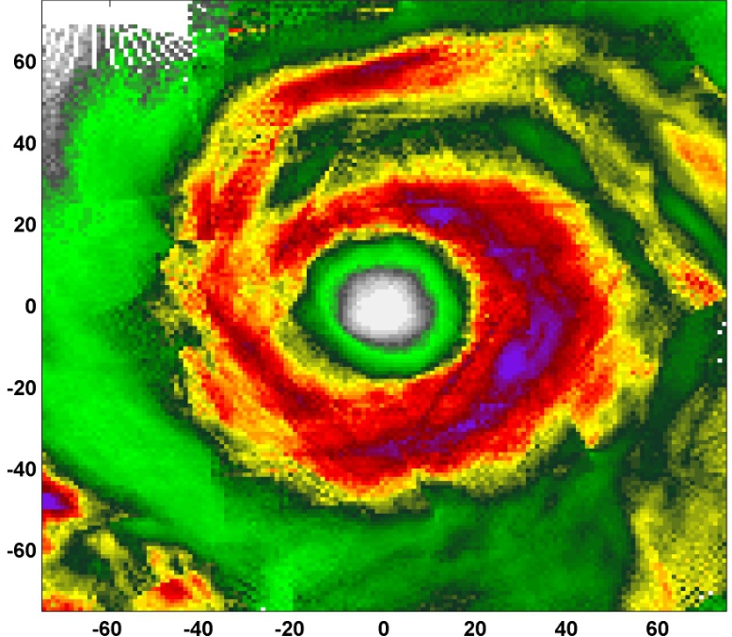
54.94 TB [250mb peak]
55.5 TB [150mb peak]
Precipitation Structure
Composite images of limb corrected brightness temperature at 54.94 [250mb peak] and 55.5 GHz [150 mb peak] show most significant warming within a 30km radius of storm center
~6K peak warming at 250mb and ~3K peak warming at 150mb

Slide 8
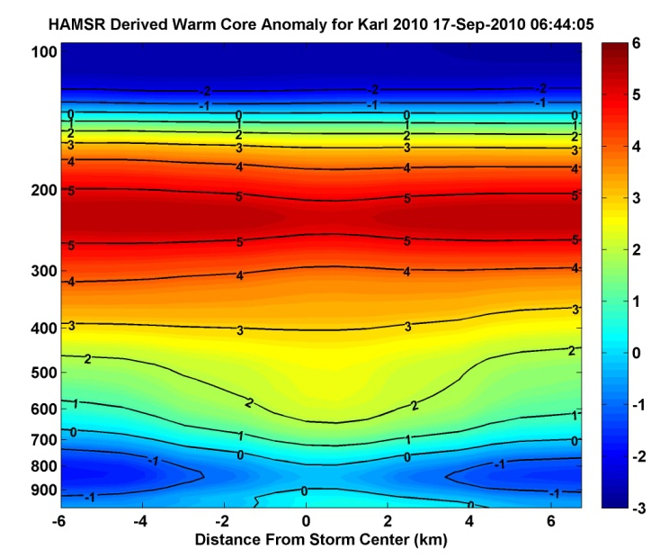
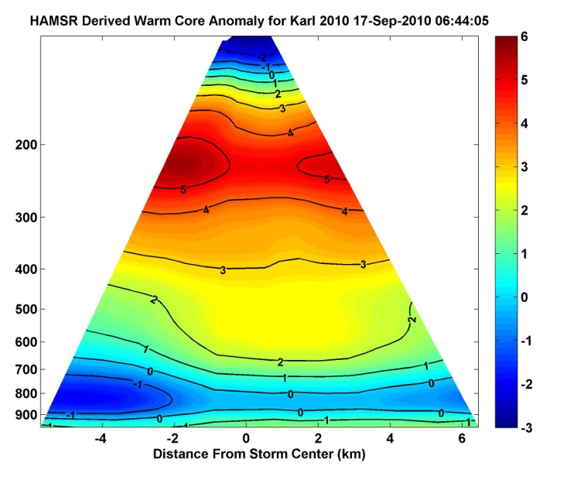
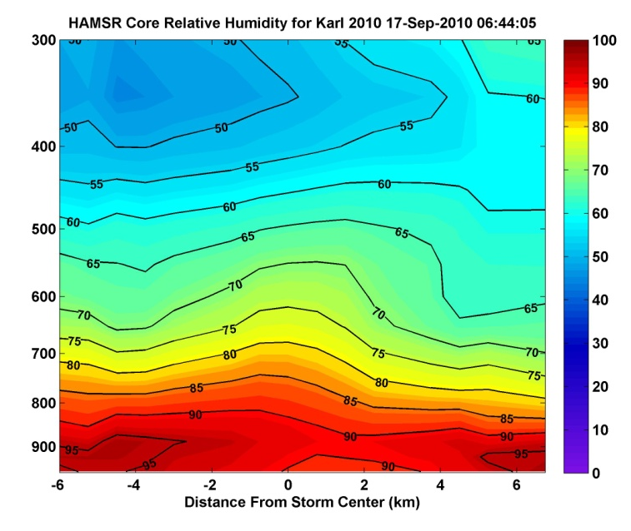
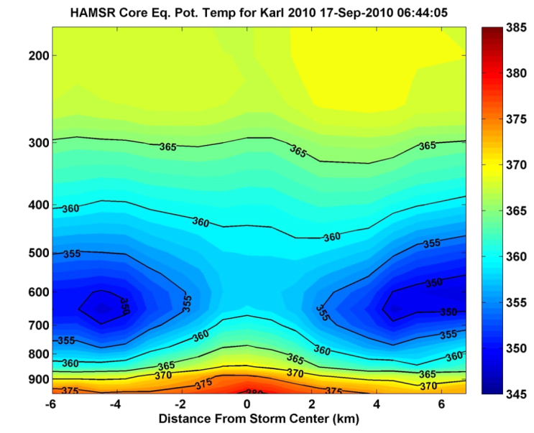
Warm core anomaly computed relative to average profile 225-250 km from the storm center
- Peak warming of ~6C at 250 mb level (12km)
The top of inversion layer is observed around 700 mb
Nearly saturated air is observed below the inversion layer with drier air aloft
Shows general agreement with previous observations and models
Temperature Anomaly (K)
Temperature Anomaly (K)
W
E
S
N
Relative Humidity (%)
Equivalent Pot. Temp (K)
S
N
S
N
N
W
Inner Core Vertical Thermodynamic Structure
E
S

Slide 9
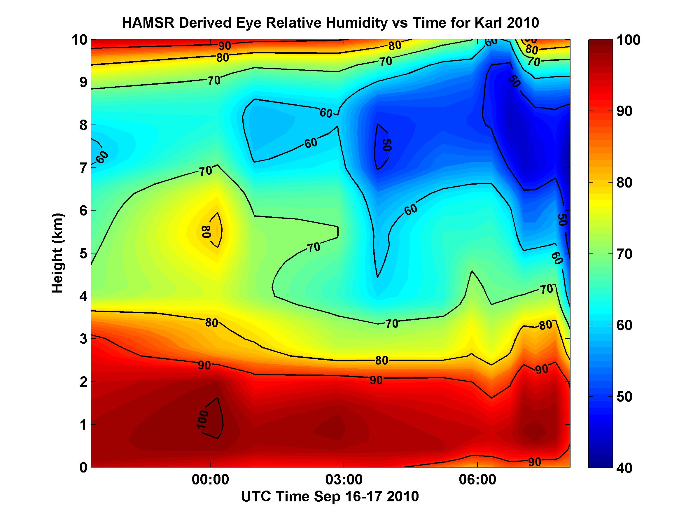
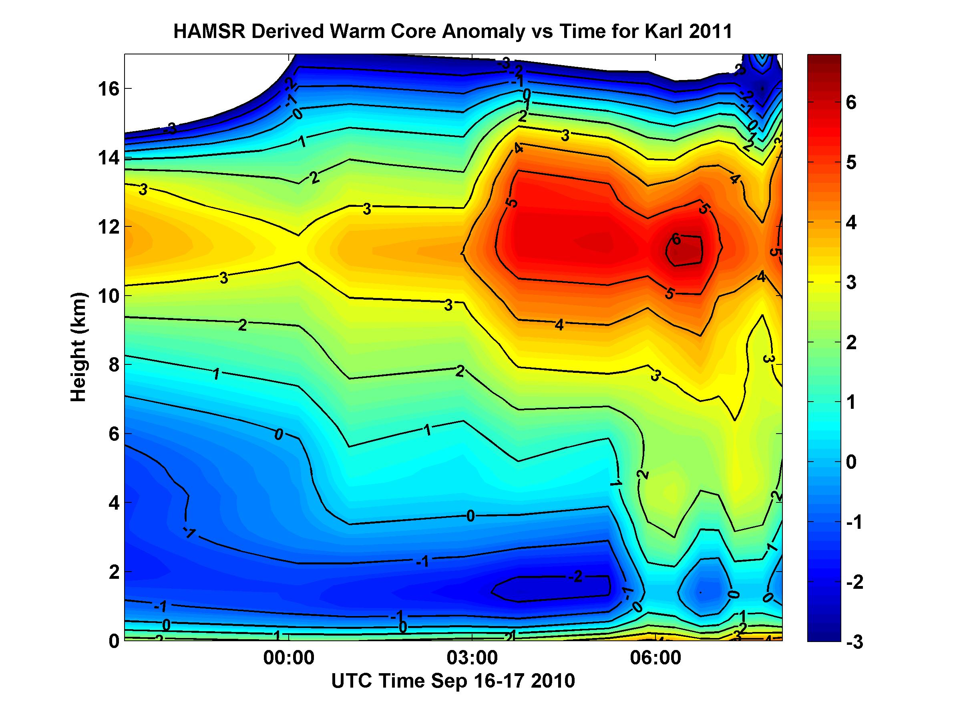
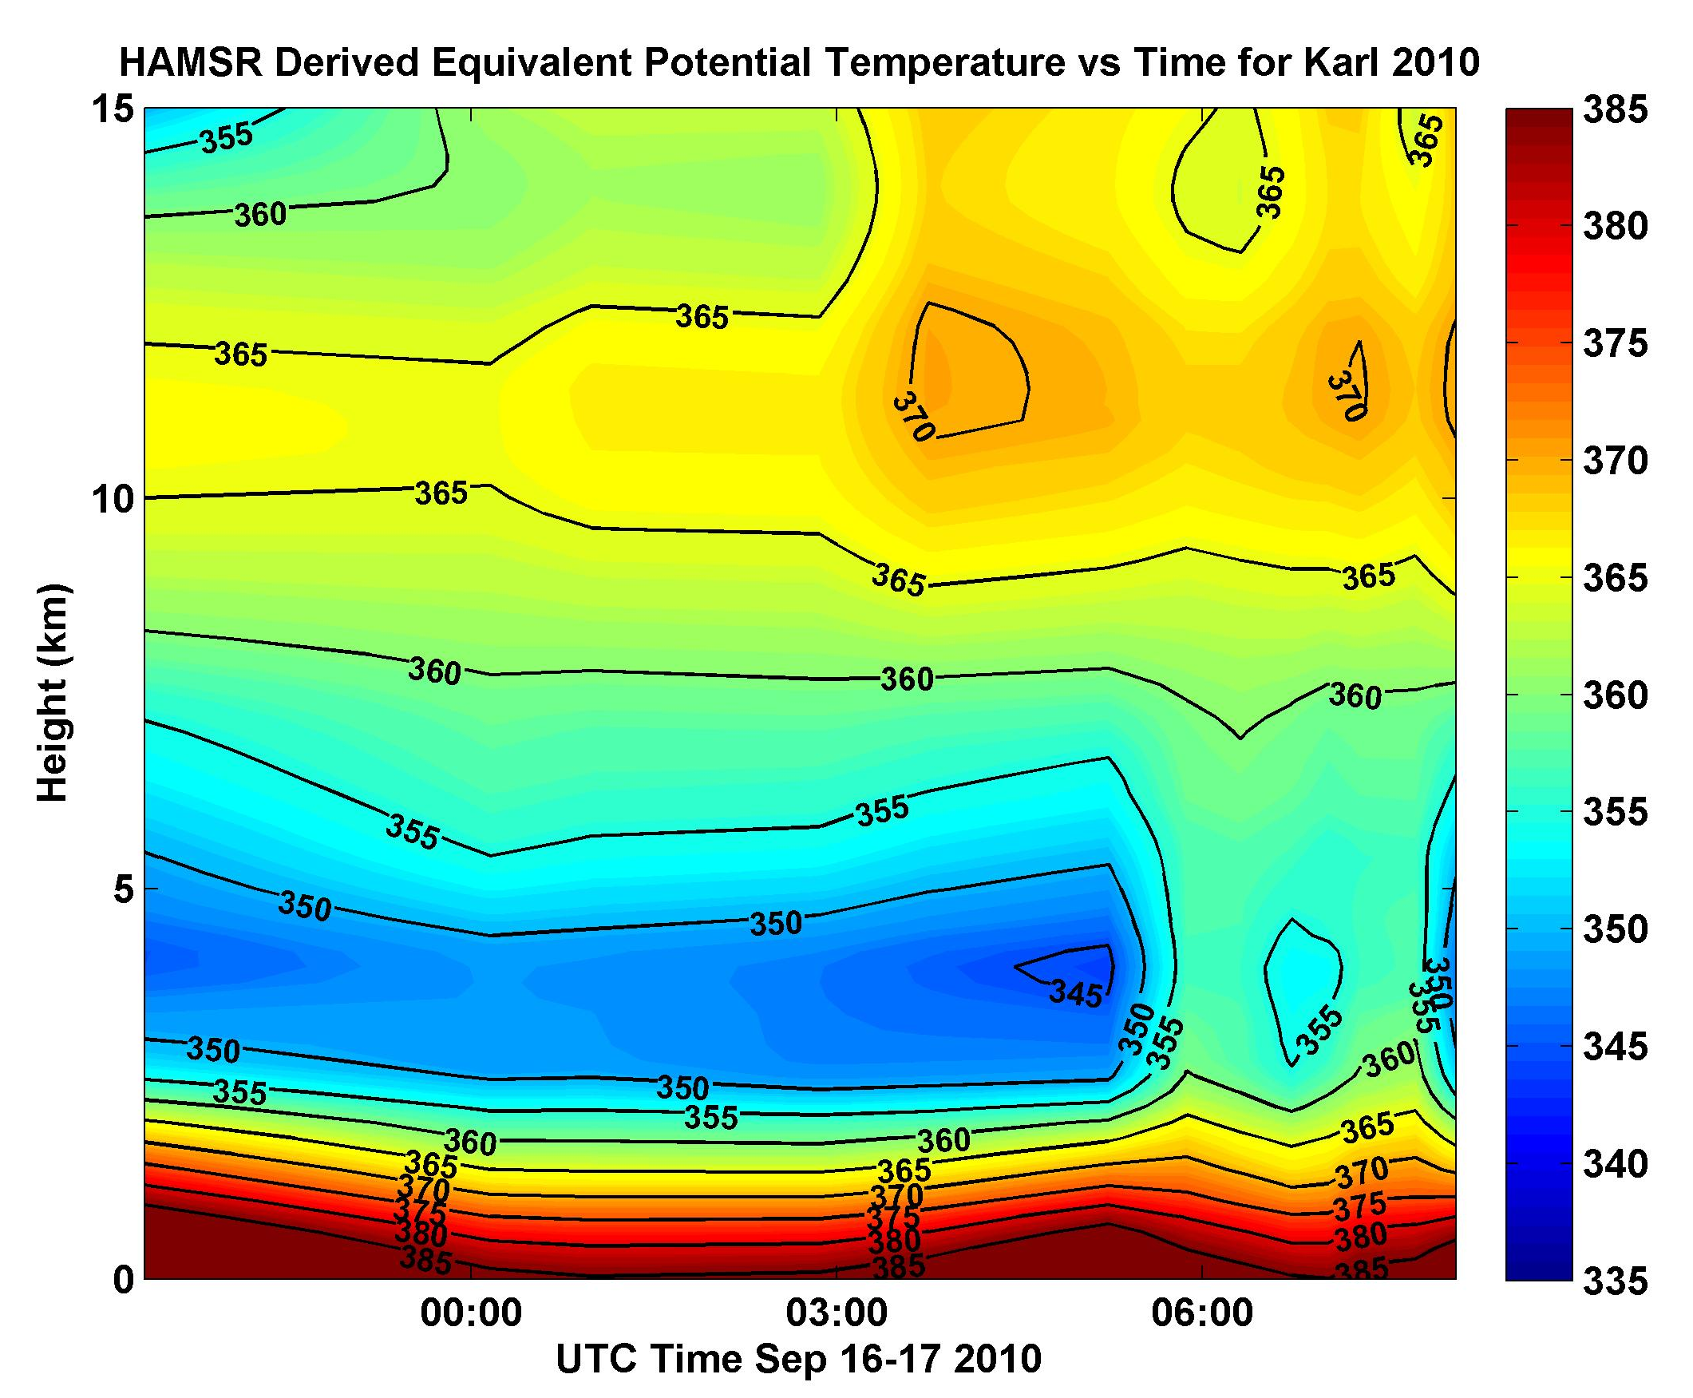
Time Evolution of the Inner Core Vertical Thermodynamic Structure
RH (z) vs Time
T(z) vs Time
θ_{Ε} vs Time
Warm anomaly propagated to lower levels as the storm intensified with the peak warm anomaly increasing by ~2-3C
Decreasing RH in upper troposphere while air below the inversion layer remained near saturation

Slide 10
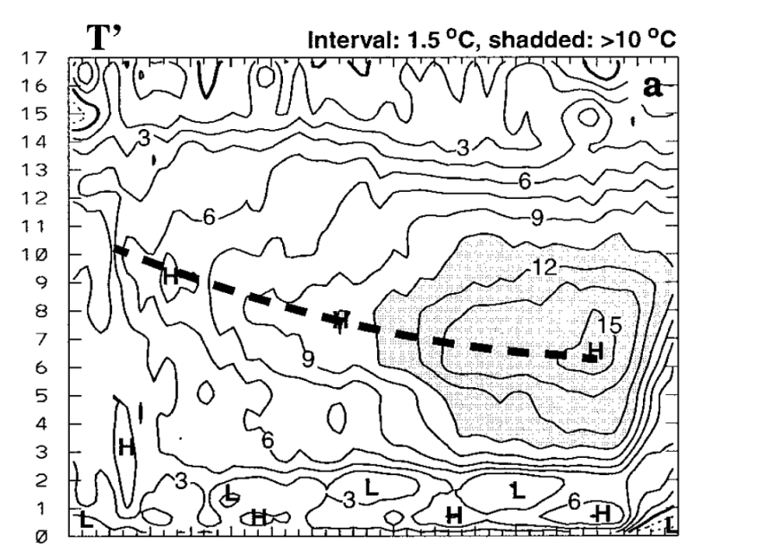

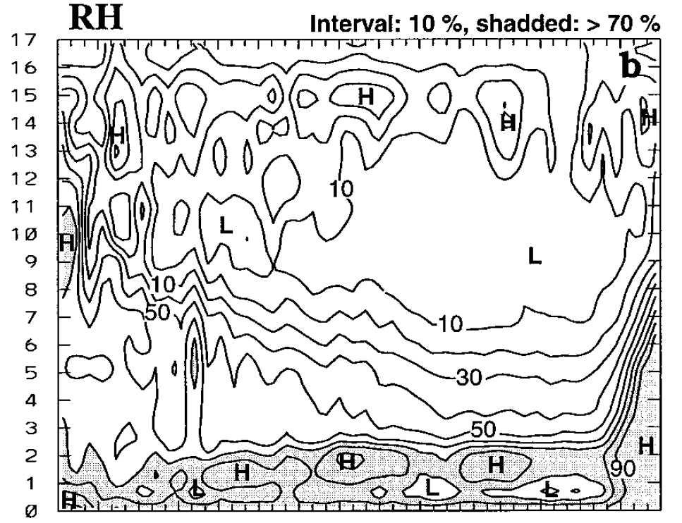
Inner Core Evolution Model vs. Obs.
6km MM5 Simulation of
Hurricane Andrew
Liu et al., 1999 (II)
Temperature Anomaly
45 hrs
11 hrs
Relative Humidity

Slide 11
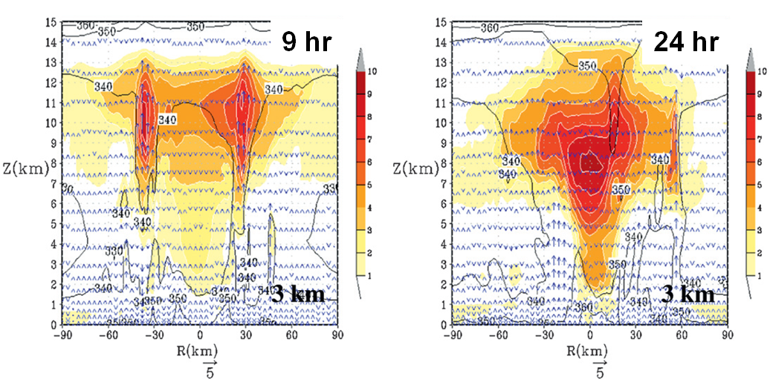
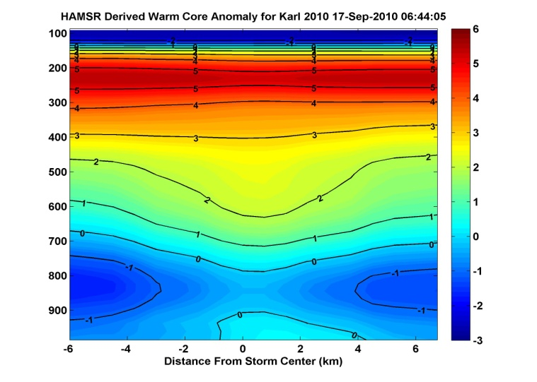
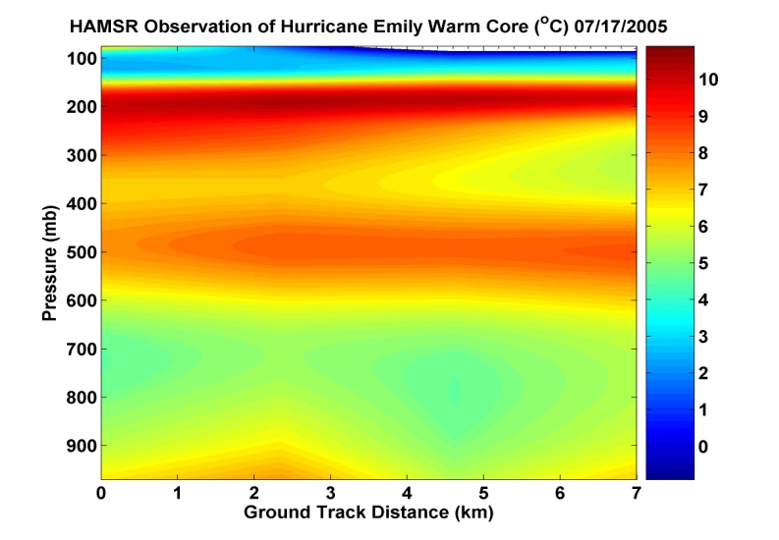
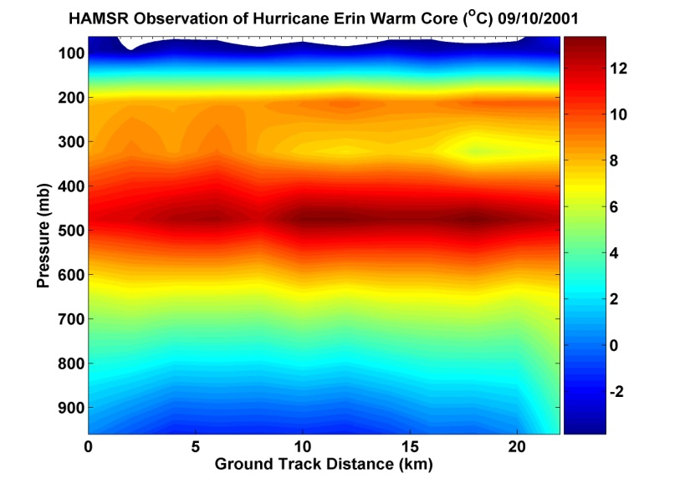
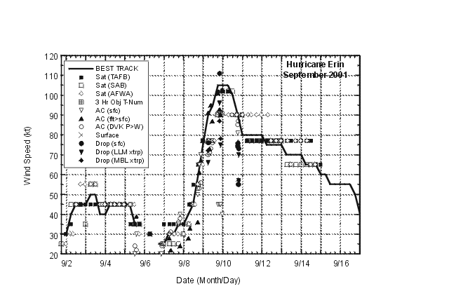
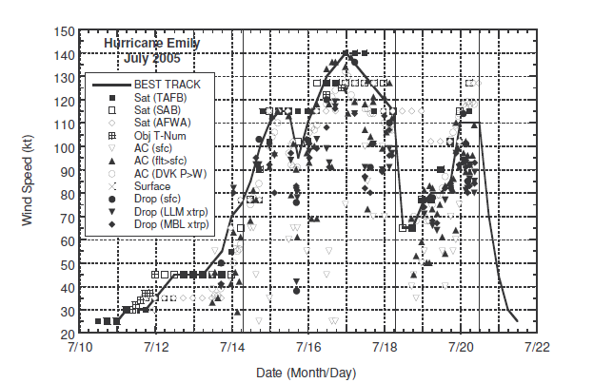
(HWRFX model)
Gopalakrishnan et al., 2011
Karl 9/17/2010 6UTC
Emily 9/17/2005 7 UTC
Erin 9/10/2001 18 UTC
6K
11K
13K
HAMSR
GRIP
HAMSR
TCSP
HAMSR
CAMEX-4

Slide 12
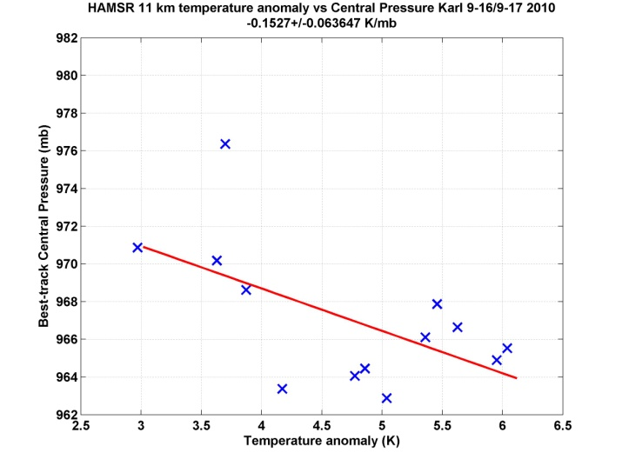
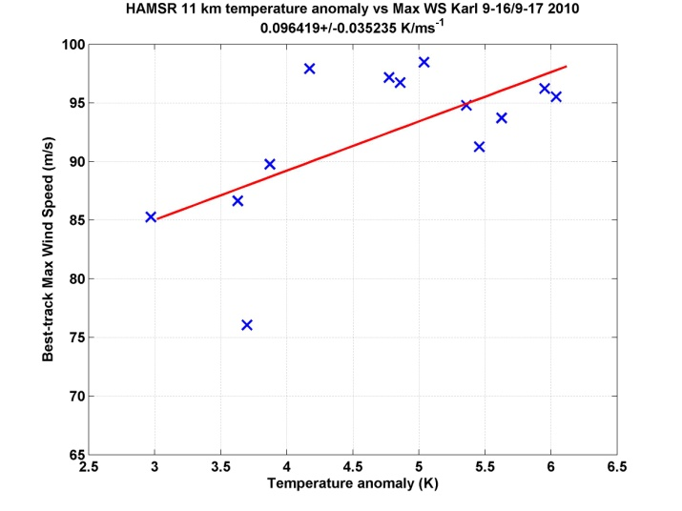
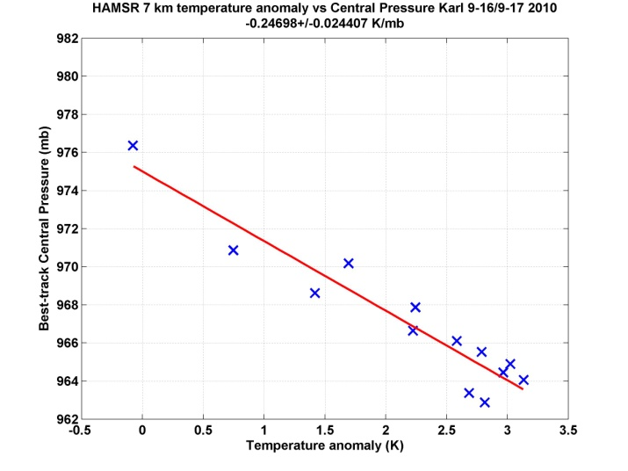
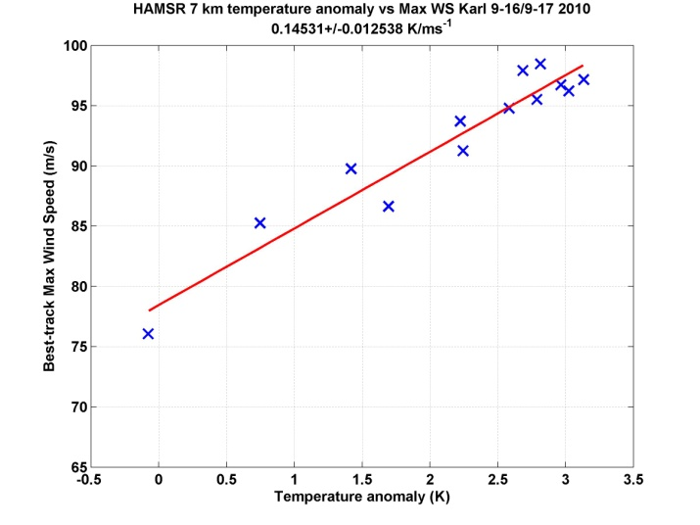
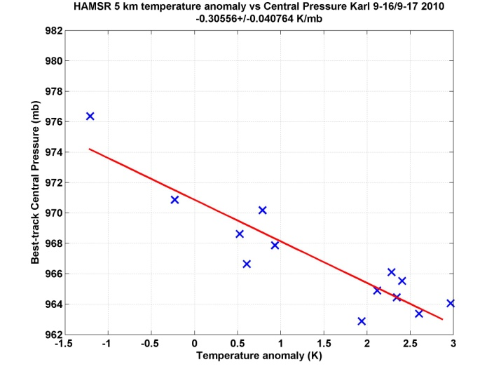
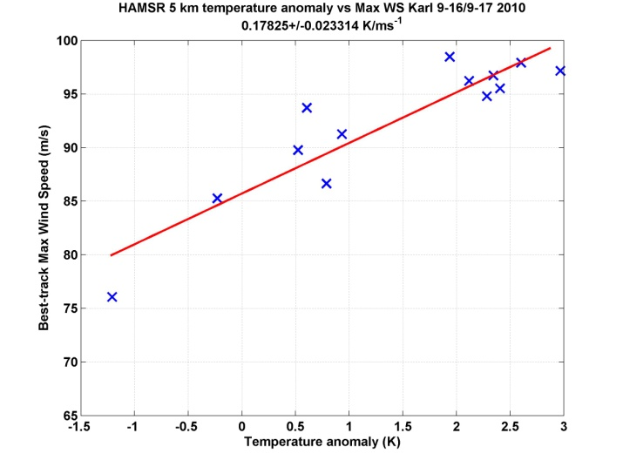
T. anom. vs min pres.
T. anom. vs max WS
11 km
Correlation between warm core anomaly at different levels to minimum pressure and maximum sustained winds from NHC best track
Sensitivity to WS between +0.1 to +0.2 K/ms⁻¹
Sensitivity to p between -0. 15 to -0.3 K/mb
Strongest correlation and higher sensitivity observed in mid-troposphere
11 km
7 km
7 km
5 km
5 km

Slide 13

Summary
Validation of Level 2 product nearing completion
  HAMSR retrievals show good overall agreement with dropsondes
Observations of evolution of inner core thermodynamic structure show mean advection of the warm anomaly lower in the troposphere during intensification coupled with a general increase in anomaly magnitude
  Consistent with previous modeling studies for inner core evolution (Liu et al., 1999, Gopalakrishnan et al., 2011)
Strongest relationship found between warm anomaly and intensity in the mid- to lower troposphere above the inversion (5-7 km) during intensification

Slide 14
Backup

Slide 15
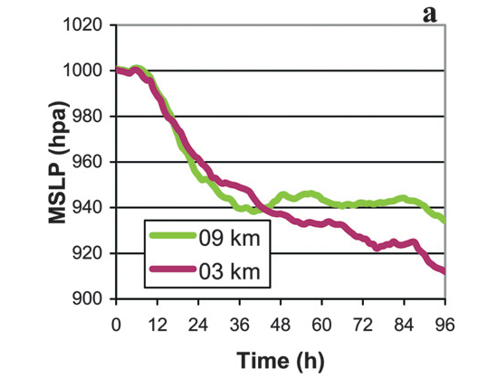
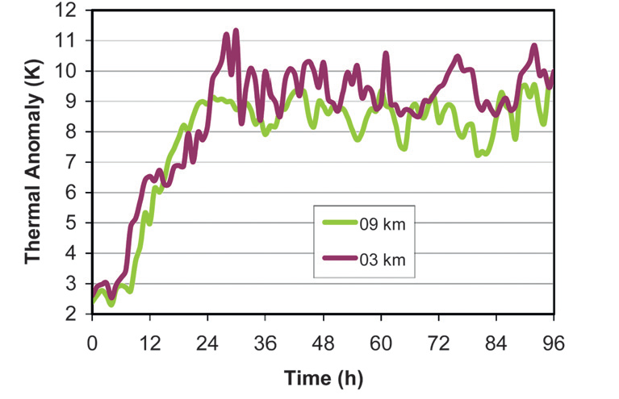
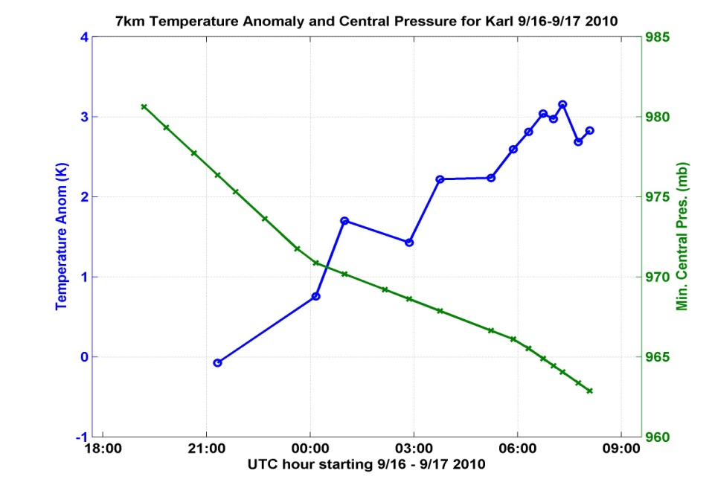
Hurricane Karl 2010
Gopalakrishnan et al., 2011
~0.15 K/mb
Temperature Anomaly @ 7km
Minimum Central Pressure (NHC)

Slide 16
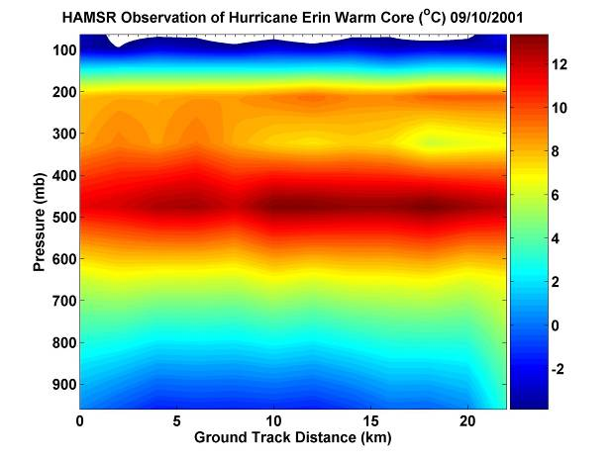

Monitoring Hurricane Intensity with HAMSR
Investigations using AMSU data have shown strong correlation between 200mb temperature anomaly and hurricane intensity
Comparisons of AMSU warm core temperature anomaly to maximum wind speed (left) and central pressure (right) [from Kidder et al. 2000]
HAMSR warm-core in Hurricane Erin
High-resolution observations from HAMSR can be used to predict hurricane intensity and improve algorithms for satellite sensors
  Eye-wall contamination is a large error source for satellite sensors

Slide 17
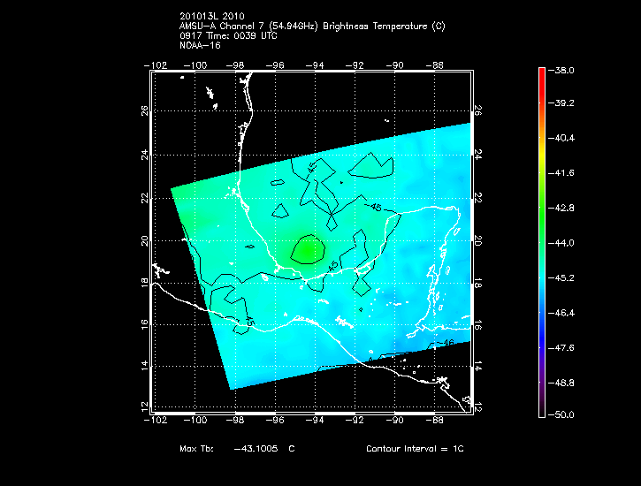
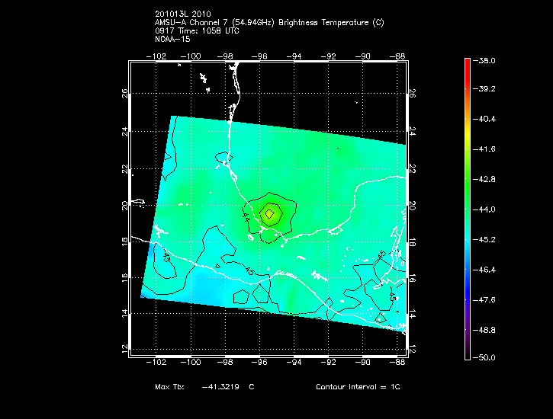
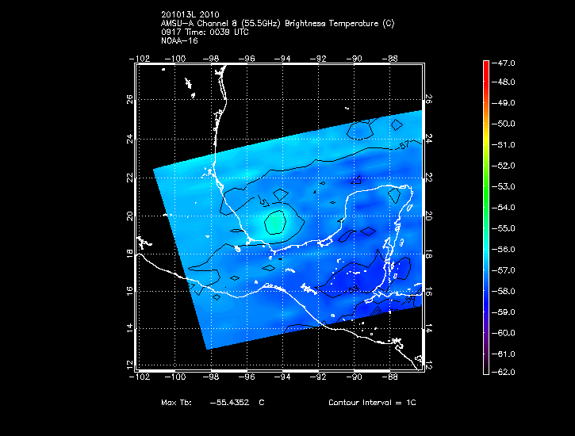
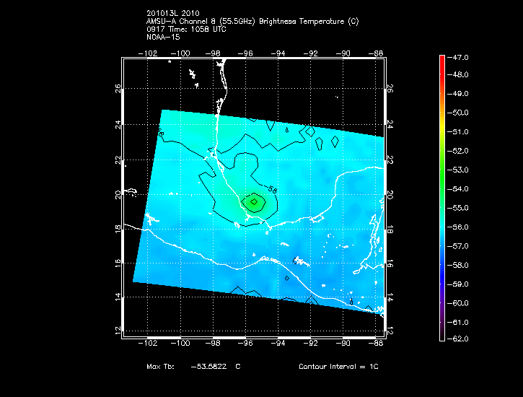
54.94 GHz 9/17 00:39 UTC
54.94 GHz 9/17 10:58 UTC
55.5 GHz 9/17 00:39 UTC
55.5 GHz 9/17 10:58 UTC
AMSU Images from Univ. of Wisc-CIMSS

Slide 18
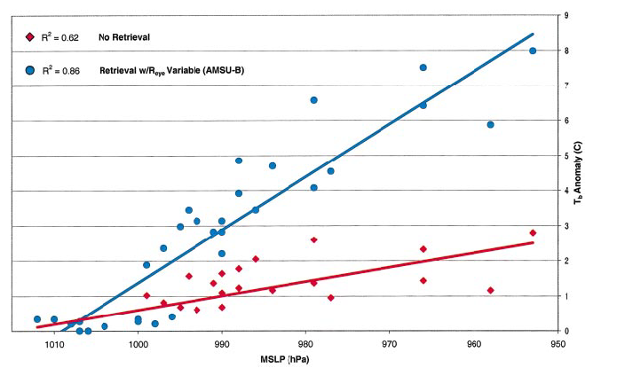
AMSU TB Anomaly and Intensity
Brueske et al. 2003

Slide 19
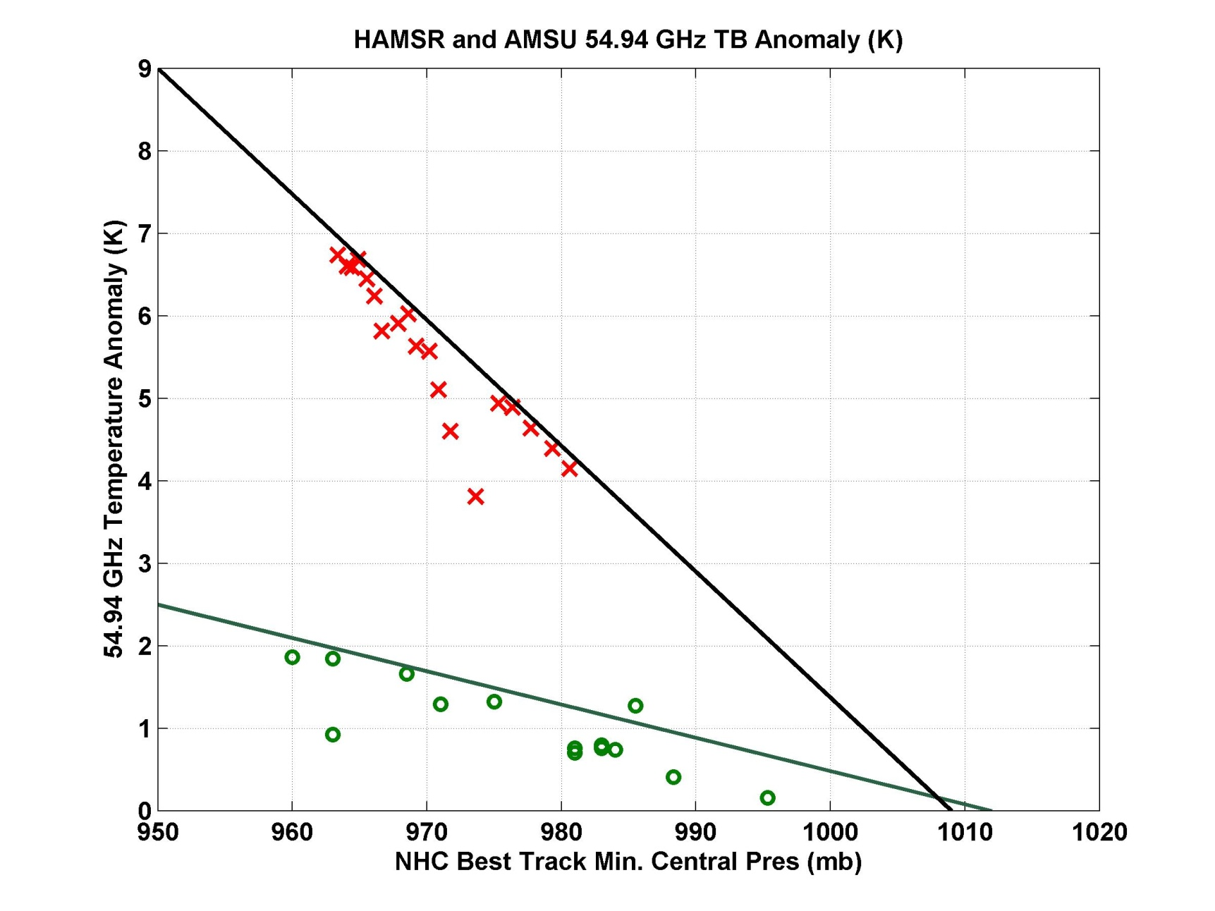
Comparison of HAMSR and AMSU
Brueske et al. 2003
Fit for retrieved warm anomaly from AMSU from Brueske et al. 2003
HAMSR 54.94 GHz TB
Fit for uncorrected AMSU from Brueske et al. 2003
AMSU 54.94 GHz TB

Slide 20


HS3 Dropsonde Summary Comparison
Precipitable Water Vapor (mm)
Absolute Humidity (g/m³)
50 dropsonde comparisons during HS3 over a wide variety of atmospheric conditions
Dropsonde profiles smoothed vertically to match HAMSR vertical resolution
mean: 0.8 mm
σ = 4.4 mm
Temperature (K)
Relative Humidity (%)
mean: -0.5 %
σ = 16.5 %
mean: -0.1K
σ = 2 K

Slide 21


54.94 TB [250mb peak]
55.5 TB [150mb peak]
Precipitation Structure
Composite images of limb corrected brightness temperature at 54.94 [250mb peak] and 55.5 GHz [150 mb peak] show most significant warming within a 30km radius of storm center
~6K peak warming at 250mb and ~3K peak warming at 150mb
Merrill, 1995

Slide 22


2/4/2011 21 UTC
Comparison between 2km HAMSR and 3km WRF PWV Fields
3km WRF PWV

