Slide 1
Cooperative Institute For Alaska Research (CIFAR)
Tom Heinrichs, University of Alaska Fairbanks
John Walsh, CIFAR Director
GOES-R Science Week, Huntsville, Sept. 22, 2011

Slide 2
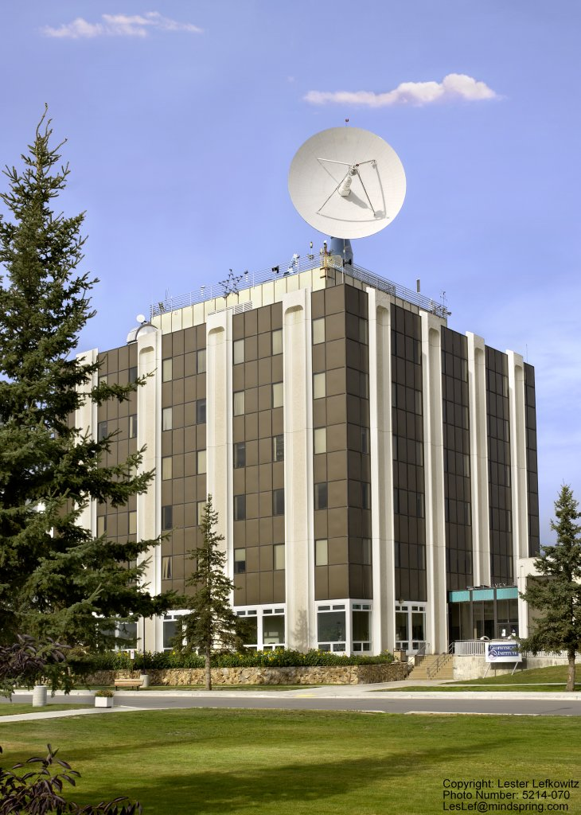
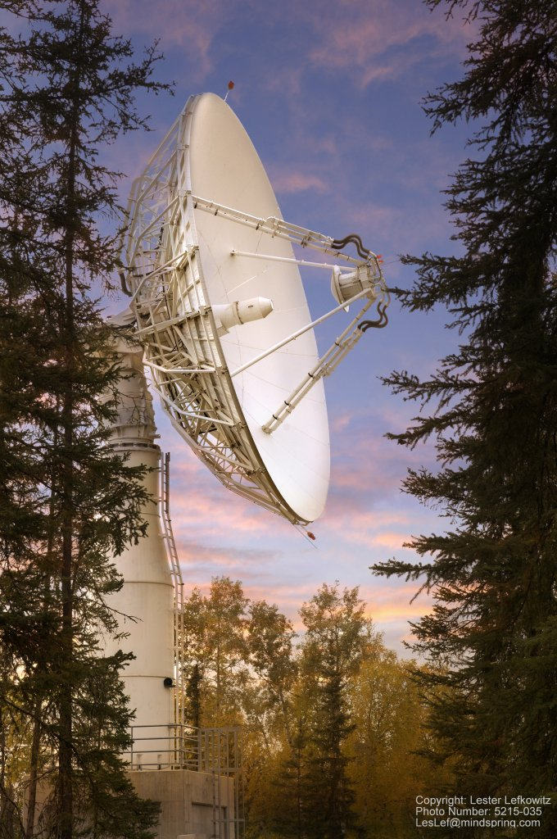
NOAA / NESDIS Fairbanks Command & Data Acquisition Station
UAF L-, S- and X-band reception

Slide 3
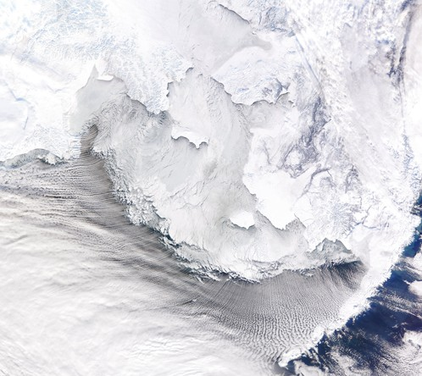
CIFAR's research themes are
ecosystem studies and forecasting;
coastal hazards; and
climate change and variability
All can be benefit from satellite services.

Slide 4
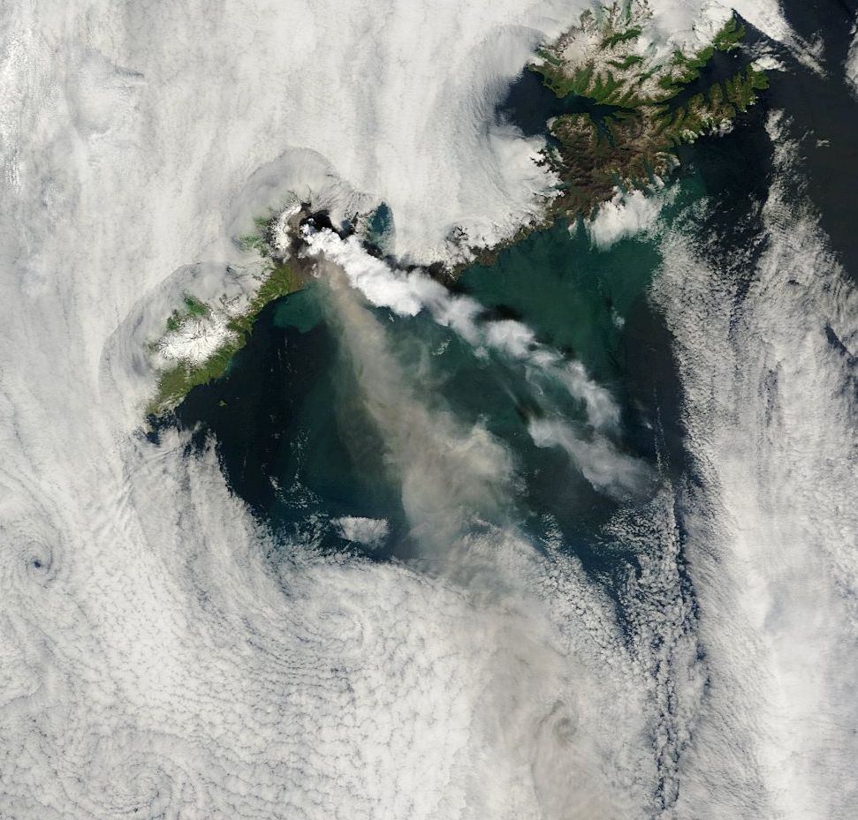
Thank you
Okmok Volcano July 13, 2008 (MODIS from UAF-GINA)

