Slide 1
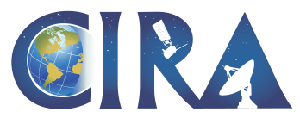
GOES-R Risk Reduction Annual Meeting 2011
Christian Kummerow
CIRA Director
22 September 2011

Slide 2
CIRA Product Development Interest
Tropical cyclone genesis
Severe weather forecasting
Data Assimilation for maximum data use
Solar energy forecasts
Data fusion for cloud properties
Precipitation, orographically forced precipitation
Snow & snow melt

Slide 3
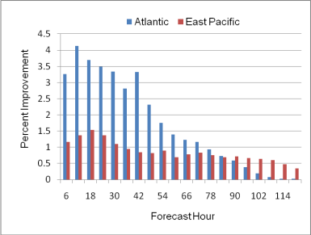
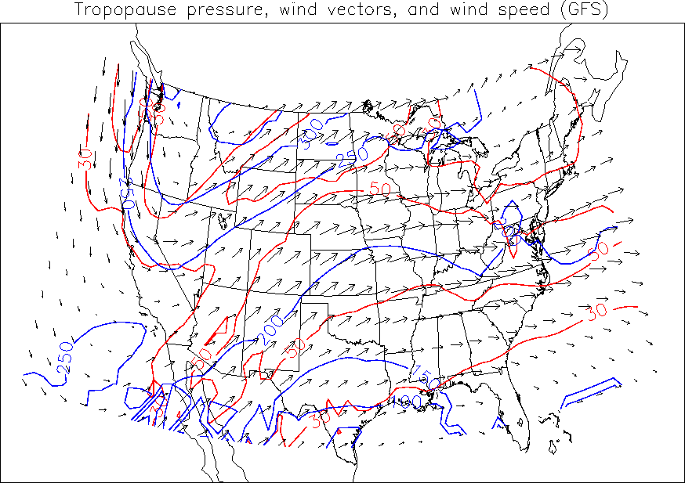
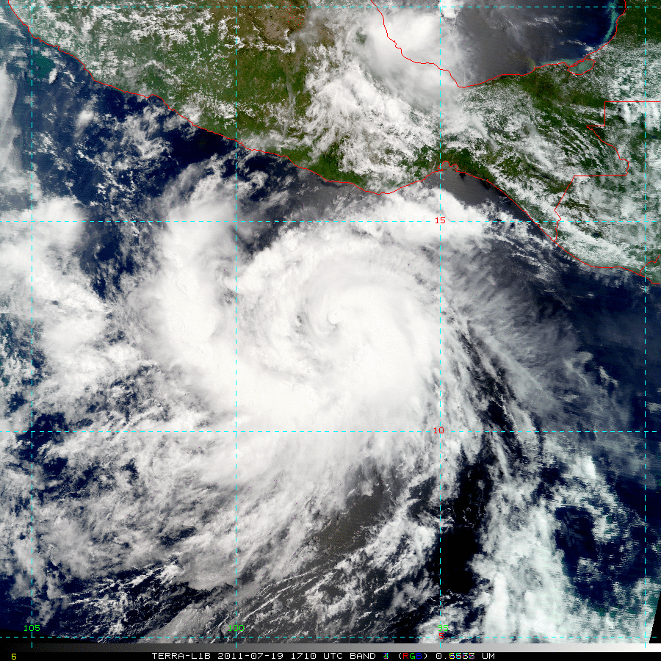
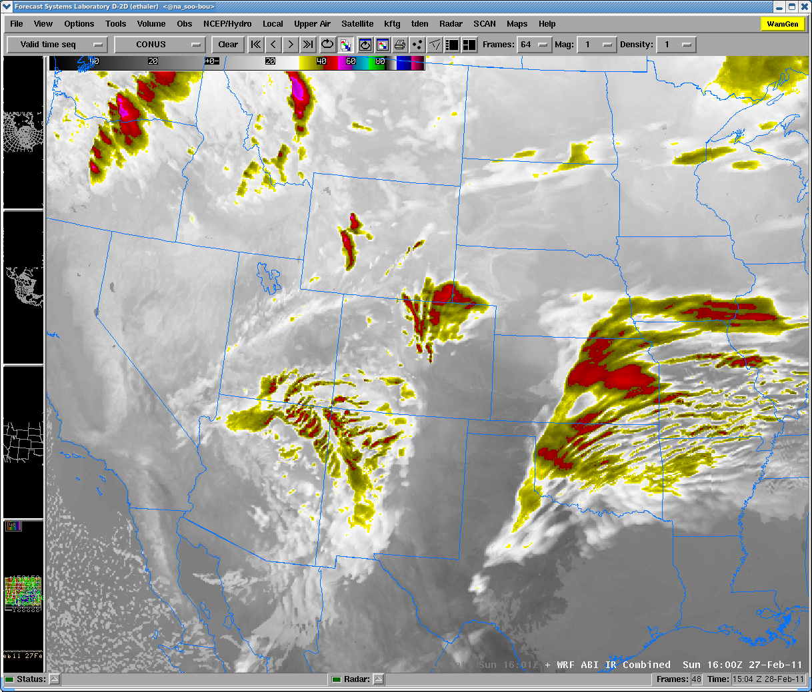
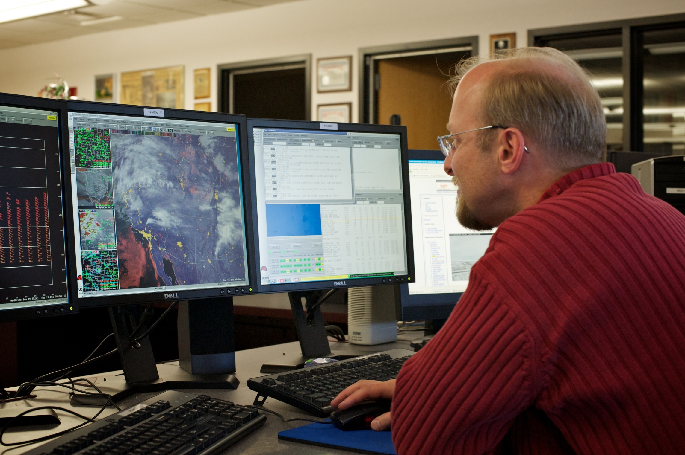
Future Satellites/Sensors
Operational Satellites
Time line
Year 1-3
Risk Reduction Research
Fundamental
Research
Algorithm Working Groups
GOES Improved
Measurements and
Product Assurance Plan (GIMPAP)
Year 4-5
Proving Ground Testbed
TC Dora (2011)
ABI Natural Color
Imagery
Product
Implementation
Program
WRF-based Synthetic ABI 10.35µm Imagery (02/27/2011)
Year 6-7
Product System
Development and
Implementation
(PSDI) Program
WFO Boulder Forecaster Chad Gimmestad Studying GeoColor
Notes:
General note: CIRA has received many years of GIMPAP , GOES-R Risk Reduction (GOES-R3), Algorithm Working Group (AWG), and Proving Ground (PG) grants.
These grants were essential for CIRA to be in a position to conduct many different types of research, publish and present the research results,
and for transitioning CIRA products into operation.
Slide 2 comments: The simplified schematic on this slide depicts the sequential nature of GOES-R (in blue) and GOES (green) projects, starting from research/development projects which lead to projects with more of an operational focus (like GIMPAP, GOES-R AWG, Proving Ground) and then to operational product implementation (like PSDI).

Slide 4
Example: CIRA GOES-R Synthetic Imagery Projects 2005-2011
Timeline
2005
GOES-R Risk Reduction Project:
CIRA produces their first synthetic GOES-R ABI imagery (ABI bands 7-16)
for a severe weather event over Kansas which occurred in 2003
2006
First Algorithm Working Group project: Simulated ABI Fire Proxy Datasets
Case 1: Multiple fire hotspots with differing characteristics were inserted into the Kansas data set .
Case 2: Simulated ABI agricultural fire proxy datasets located in Central America were created based on real GOES observational data.
2007
– 2011
Additional AWG Fire Proxy Dataset projects:
Base on real fire events, 5 additional fire proxy datasets of varying locations and different types of fires were produced over a five-year time span: California wildfires, British Columbia forest fires, Arkansas agricultural fires, etc..
2012 ?
Future Product Implementation Program:
Synthetic forecast model data will most likely be displayed at WFOs and National Centers as part of the AWIPS II product palette.
Notes:
This slide depicts a sample timeline how CIRA GOES-R ABI synthetic imagery projects were funded sequentially (2005 through 2011) .

Slide 5
5-year CIRA GOES-R Synthetic Imagery Project
Timeline
GOES-R Risk Reduction Project:
CIRA produces their first synthetic GOES-R ABI imagery (ABI bands 7-16)
for a severe weather event over Kansas which occurred in 2003
Risk reduction research on simulated GOES-R ABI datasets including the production of simulated ABI datasets for different type of weather and fire events.
First Algorithm Working Group project: Simulated ABI Fire Proxy Datasets
Case 1: Multiple fire hotspots with differing characteristics were inserted into the Kansas data set .
Case 2: Simulated ABI agricultural fire proxy datasets located in Central America were created based on real GOES observational data.
2005
- 2011
Additional AWG Fire Proxy Dataset projects:
Base on real fire events, 5 additional fire proxy datasets of varying locations and different types of fires were produced over a five-year time span: California wildfires, British Columbia forest fires, Arkansas agricultural fires, etc..
2012 ?
Future Product Implementation Program:
Synthetic forecast model data will most likely be displayed at WFOs and National Centers as part of the AWIPS II product palette.
Notes:
A more comprehensive 5-year plan covering GOES-R Risk Reduction research, creation of AWG datasets, all the way to the operational implementation would allow the CIRA principle investigators to involve graduate students from beginning to end.

Slide 6
Evolution of STAR
Satellite Operational Algorithm Readiness (SOAR)
Collaborative Computing Environment (CCE)
Satellite Algorithm Test Bed (SATB)
Oper. Product R&D
(Alg. Working Groups)
Exp. Product R&D
(Risk Reduction)
Proving Grounds & Testbeds
R&D Coupled to End-User Needs
Common environment for rapid R2O transition
A paradigm for multi-sensor fusion product development
→ SOAR must ‘fly above’ any single satellite program and provide an environment for integrated product development.
Notes:
SOAR is a concept being proposed by Al Powell that defines an idealized paradigm for research to operations. It contains all the elements of risk reduction, product development, and demonstration within an environment that facilitates rapid hand-offs between the different elements. The algorithms developed in SOAR do not have to be sensor/program specific. This cohesive program speaks to the need for a more connected funding mechanism that enables more dedicated, long-term staffing (as opposed to piecemeal) to see a program through its entire course.

Slide 7
Thematic Approach (Example)
Stovepipe Linear Model
Parallel Model
GOES Satellite Program
Solar Energy Forecasting
GIMPAP
NOAA Models
Satellite Resources
Partners
Solar Energy Forecasting
HRRR, LAPS, GFS, etc.
GOES, GOES-R, JPSS,
International
NREL, Industry
1-2 year project
Ongoing program, sustained student involvement
GOES Product
Satellite/Model Fusion Products
NSOF Operations
Operational Transitions to Vested Users
A big-picture approach provides broader connection between NOAA resources, provides latitude to define research approach optimally, and ties research to end-user throughout the development process.
Notes:
The traditional GIMPAP and Risk Reduction programs have been extremely successful and we realize that NOAA cannot change the way it receives its funding. There may be opportunities to realize even greater impacts from NOAA’s satellite assets if the programs are planned along thematic lines.

