Slide 1
GLM Proxy Data Generation: Methods for Stroke/Pulse Level Inter-comparison of Ground-based Lightning Reference Networks
Prepared by
Ken Cummins
Huntsville, AL Sept. 2011

Slide 2
Context
Requirement
Ground-base lightning observations are needed to help create GLM proxy datasets over large continental and oceanic regions
Observations will be provided by a variety of existing and emerging VLF/LF “LLS” datasets
Approaches
“bulk statistical analysis of datasets at the cell flash-rate level
Detailed stroke/pulse inter-comparisons to understand what is seen uniquely and in-common by various data sources
Issue
LLS performance for CG strokes and cloud pulses must be characterized before it can be intelligently applied in quantitative proxy datasets
Location accuracy
Detection efficiency
Type classification (CLD/CG)
Sub-context: CHUVA LLS inter-comparisons
Note: Need help from modeling and independent validation where there are no comparison datasets

Slide 3
Presentation Scope
Description of the inter-comparison tool
Case Study – Japan
Case Study – GLD360
GLD “show and tell”
Next Steps

Slide 4
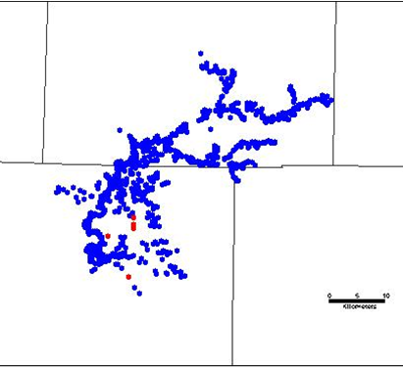
What can you detect?
VHF vs. VLF/LF Cloud Flash Detection
The pulses detected by a moderate baseline (~200-300 km) LF/VLF cloud detection system (red dots) generally cluster near the initial breakdown region shown in the 2-D flash depiction using a VHF mapping system (blue dots).
“Reasons” (2/3 - truths)
VHF emitted during breakdown (spark) and leader processes
Lower frequencies easily generated by “longer” (time duration and/or channel-length) processes
Channels must be “substantially vertical” for large EM fields to propagate 100’s of km => significant vertical orientation and depth of charge structure

Slide 5
What can you detect?
VHF vs. VLF/LF Cloud Flash Detection
Disadvantage of LF/VLF:
Limited description of the spatial extent of a cloud flash (or the charged regions of a mature thunderstorm)
Benefits:
Ability to provide reasonable storm onset information
Quantifiable flash-rate information
EM signals propagate well through mountainous terrain (no line-of-sight constraint).
EM signals will be better-correlated with optical emissions observed from space.

Slide 6
Inter- comparison Tool
Coded in Matlab
Stand-alone executables can run on Unix, Linux, and Windows
Can specify datasets and related parameters in a “cfg” file using a text editor…

Slide 7
Tool “Outputs”
Analysis “Sheets”
Sheet 1:
Requires date, time, lat, lon, and (optionally) type (CG/CLD pulse)
Sheet 2:
Requires peak current estimates
Sheet 3:
Requires quality-related parameters
location error estimate
# sensors reporting the stroke/pulse

Slide 8
Sheet 1 – Japan Case

Slide 9
Sheet 2 – Japan Case

Slide 10
Sheet 3 – Japan Case

Slide 11
Sheet 1 – GLD360 vs. NLDN (real-time operation)

Slide 12
Sheet 1 – GLD360 vs. NLDN (Vaisala’s upcoming algorithm release)

Slide 13
Sheet 2 – GLD360 vs. NLDN (Vaisala’s upcoming algorithm release)

Slide 14
Sheet 1 – GLD360 vs. NLDN (“bad day” operation – 2 local sensors down)

Slide 15
Closing Comments/movies
GLD Interpretation
Real-time data have
large location errors/scatter
Many duplicate solutions for the same events
Poor Ip estimates (not shown)
Future product generator has
3-5 km median LA
~50%/30% stroke DE over U.S. (good/bad days) => ~80%/60% flash DE)
Sees many events not reported by the NLDN (low-current strokes and cloud pulses?)
Good Ip estimates (>90% correct polarity

Slide 16
Future Directions
Tool
Spatial map of correlated and uncorrelated datasets
Spatial DE map accumulated over many days
Temporal DE curve
Detailed flash analysis
Flash DE
Relative counts of flashes:
CLD, CG, and CG w/ CLD
Analysis
Extensive GLD/NLDN comparisons
Land-only
Land-to-sea
Other network inter-comparisons (directed or carried out by NASA/UAH)
Employ performance values in proxy generator/products
“up-scale” LLS-based data
Help understand cell-based datasets and results

Slide 17
Hurricane Irene August 25-29, 2011
NLDN + IR
GLD360 + IR

Slide 18
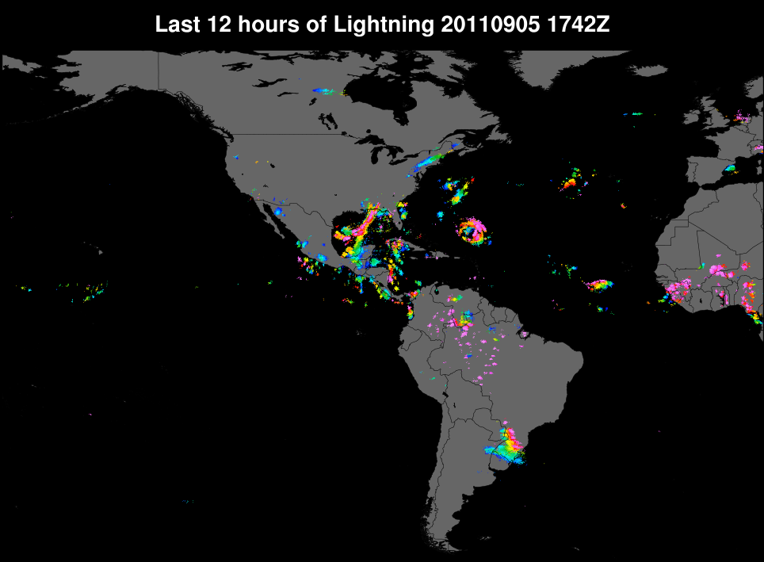
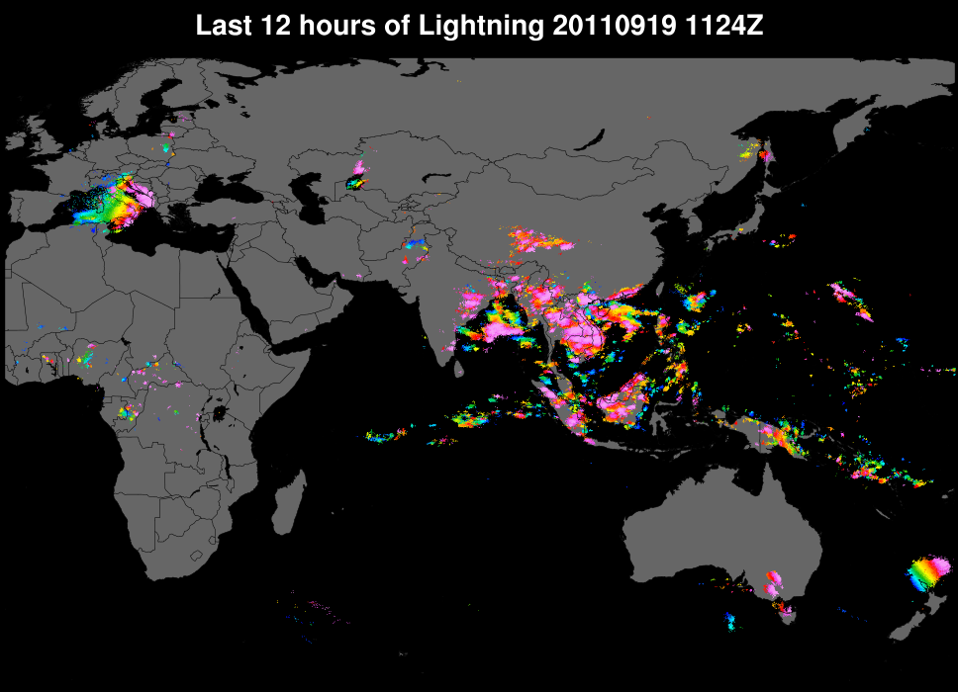
Recent Data (U-of-AZ display)
Western Hemisphere
(Hurricane Katia)
Eastern Hemisphere

