Slide 1
Geostationary lightning monitoring with the Meteosat Third Generation Lightning Imager (MTG LI)
Jochen Grandell, Marcel Dobber and Rolf Stuhlmann
GLM Science Team
19-21 September 2012
(through Webex)

Slide 2
Topics of Presentation
Quick introduction to Meteosat Third Generation (MTG)
MTG LI instrument status update
Lightning Imager Science Team (LIST)
Examples of LIST studies supporting LI L1/L2 processor development
  EUMETSAT contribution to the CHUVA campaign (LINET measurements)
  LIProxy – tool for proxy data development and LI simulation
Summary

Slide 3
Topics of Presentation
Quick introduction to Meteosat Third Generation (MTG)
MTG LI instrument status update
Lightning Imager Science Team (LIST)
Examples of LIST studies supporting LI L1/L2 processor development
  EUMETSAT contribution to the CHUVA campaign (LINET measurements)
  LIProxy – tool for proxy data development and LI simulation
Summary

Slide 4
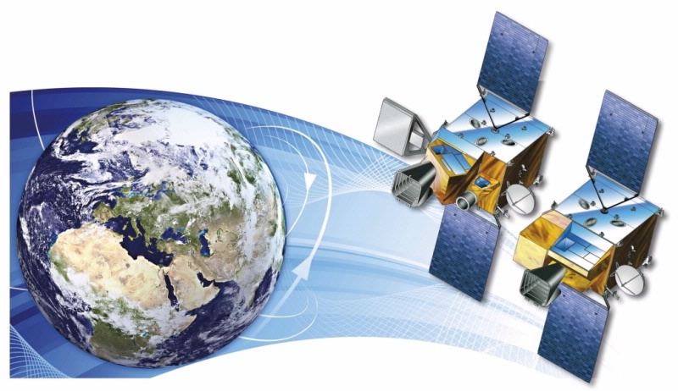


Short Introduction to the MTG Programme
MTG-I; 4 satellites
MTG-S; 2 satellites
Courtesy of

Slide 5
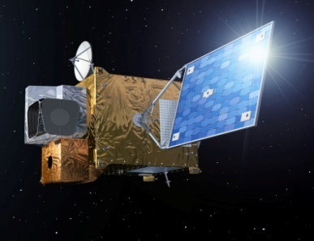
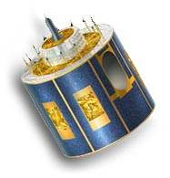
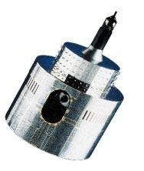
MTG to Secure Continuity and Evolution of EUMETSAT Services
1977
2002
2017 and 2019
MOP/MTP
MSG
MOP/MTP
MSG
MTG-I and MTG-S
Observation missions:
- Flex.Comb. Imager: 16 channels
- Infra-Red Sounder
Lightning Imager
UVN
3-axis stabilised satellites
Twin Sat configuration
Class 3-ton
Observation missions:
- SEVIRI: 12 channels
GERB
Spinning satellite
Class 2-ton
Observation mission:
MVIRI: 3 channels
Spinning satellite
Class 800 kg
Implementation of the EUMETSAT Mandate
for the Geostationary Programme
Atmospheric Chemistry Mission (UVN-S4):
via GMES Sentinel 4

Slide 6
MTG-I and MTG-S Configuration
Satellite Class:
+ / - 3 tons at launch
2700 W

Slide 7
Conclusion on MTG Missions
MTG Mission are well defined
to ensure continuation and improvement of existing services
to enable new services expected for 2017 – 2037
breakthrough expected in precipitation forecast exploiting MTG information for regional NWP and NWC

Slide 8
Topics of Presentation
Quick introduction to Meteosat Third Generation (MTG)
MTG LI instrument status update
Lightning Imager Science Team (LIST)
Examples of LIST studies supporting LI L1/L2 processor development
  EUMETSAT contribution to the CHUVA campaign (LINET measurements)
  LIProxy – tool for proxy data development and LI simulation
Summary

Slide 9
Lightning Imager (LI) Status Update
The MTG satellite PDR (Preliminary Design Review) was held in May 2012. The LI instrument was not part of this review, only MTG::LI interface requirement documents were reviewed.
LI industrial consortium consolidated via ITT, concluded by April 2012.
LI instrument prime contractor is Selex Galileo in Italy.
LI mission prime activities are still to be allocated. This includes the 0-1b data processing software. These activities will most likely be allocated to either Thales (MTG prime contractor) or to Selex Galileo (TBC).
Phase B2 was kicked off begin July 2012.
Selex Galileo are preparing for SRR (System Requirements Review) around end October 2012.
LI instrument PDR (Preliminary Design Review) not before October 2013.

Slide 10
Lightning Imager (LI) main characteristics
LI main characteristics:
Coverage about equal to visible disc (instantaneous view).
Continuous measurements of triggered events / lightning triggered events.
Continuous measurements of background images, typically one every minute.
Data rate <30 Mbps; Mass < 110Kg; Power < 320W.
Ground pixel size required < 10 km at 45 degrees latitude
Measurements at 777.4 nm with 1.5-2.0 nm spectral bandpass filter.

Slide 11
Challenge for processing: “False Events” (noise)
Noise can be (instrument) internal or external depending on the mechanism
“Internal” noise:
    Electronic noise
    Thermo-mechanical noise
    Stray light noise
    Ghost noise?
“External” noise:
    Cloud radiation (background in general)
    Sun glint
    Particles flux
    Jitter (spacecraft motion)
Rough order of severity (based on GLM analysis):
Spacecraft motion, Photon/electronics noise, Sun glint, Radiation

Slide 12
Looking at jitter, when only amplitude is considered
Assumption of a homogeneous energy distribution in the pixel
In real life the pixel is integrating over a scene where the jitter movement could be catching a high intensity edge (or not)
Energy
Energy
Jitter amplitude
Integrated energy over pixel #2
Integrated energy over pixel #2
Integrated energy over pixel #1
Jitter amplitude across to neighboring pixel
Integrated energy over pixel #1
Jitter amplitude across to neighboring pixel
Jitter details (amplitude/frequency)
still not known

Slide 13
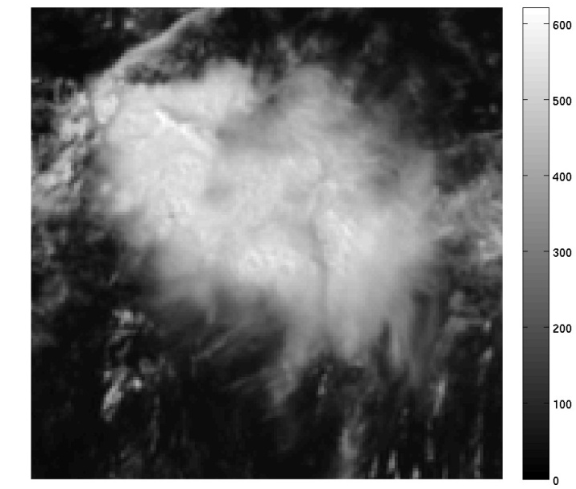


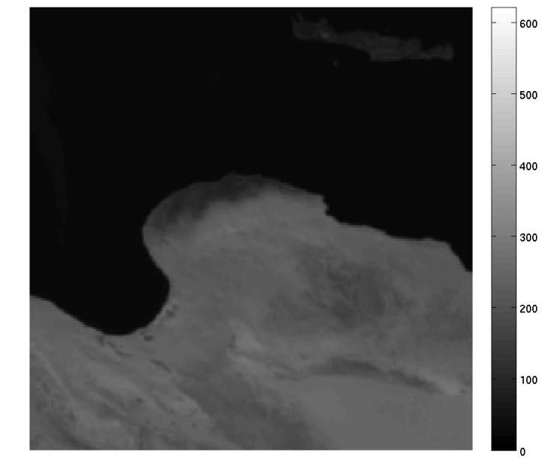

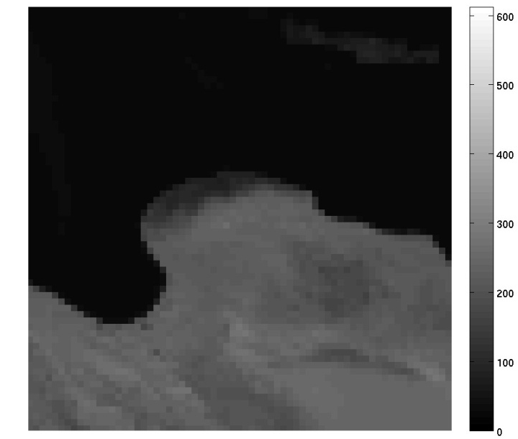
Effect of resolution
3 km x 3 km 6 km x 6 km 9 km x 9 km

Slide 14
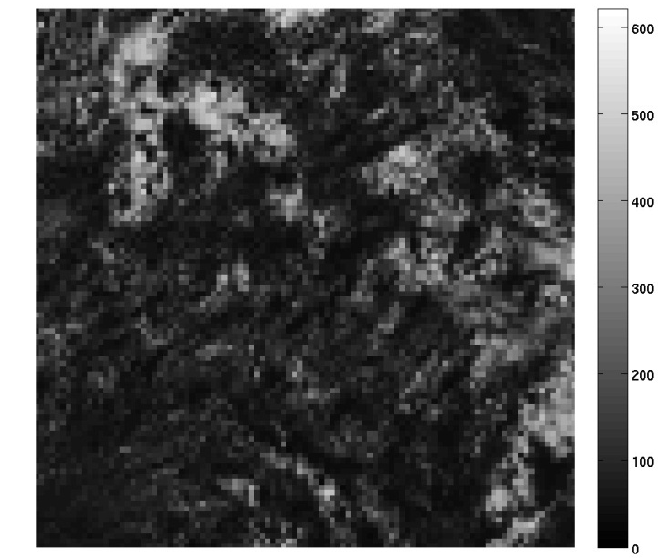
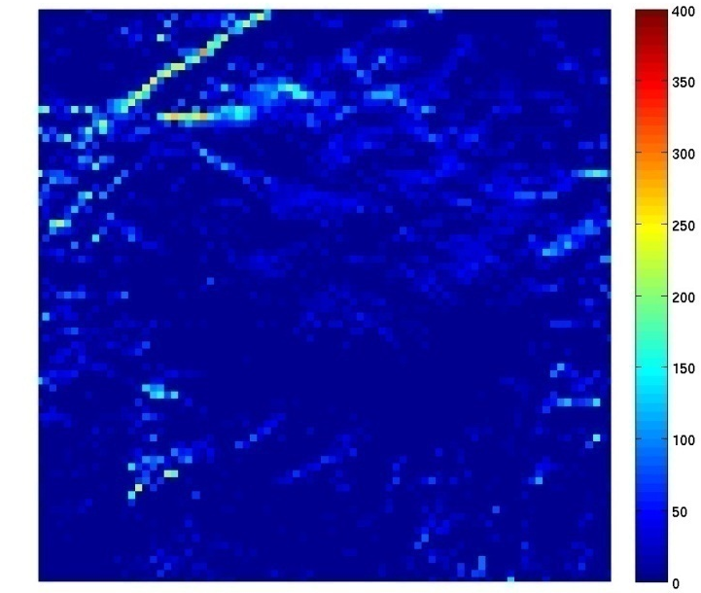
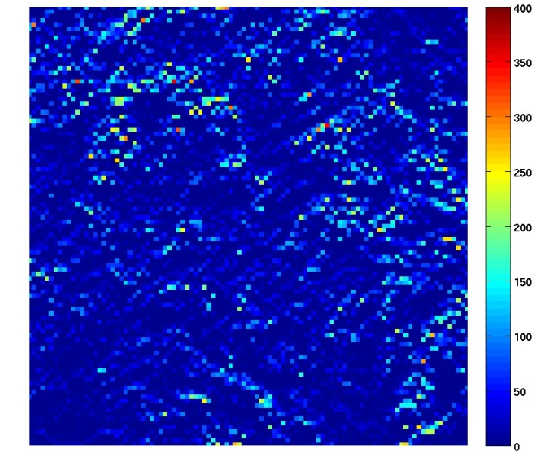
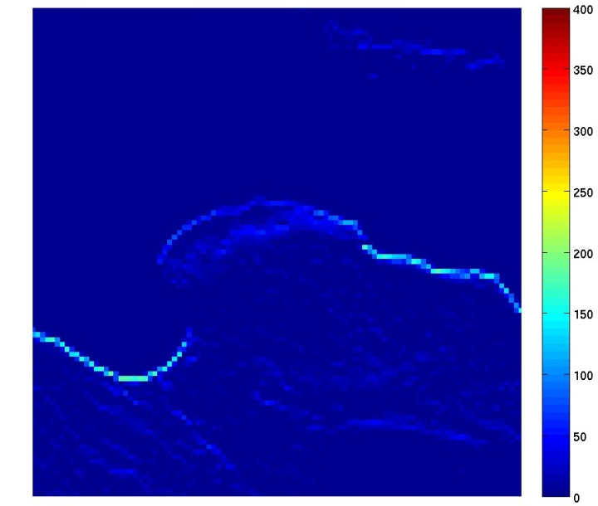
Close-up of jitter cases – full 6 km pixel movement (corresponding to 168 µm !! – illustration only)
Cloud #1 Cloud #1 Coastline
µJ/m2/sr
µJ/m2/sr

Slide 15
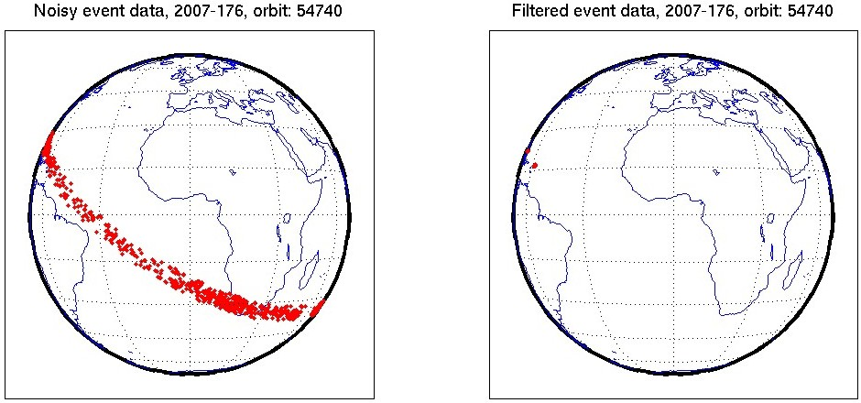
Investigation of noisy LIS data
Geolocated events but with all filters switched off
(created by Dennis Buechler/Doug Mach)
Effect of filtering
=>
L2 events where all filters have been applied

Slide 16
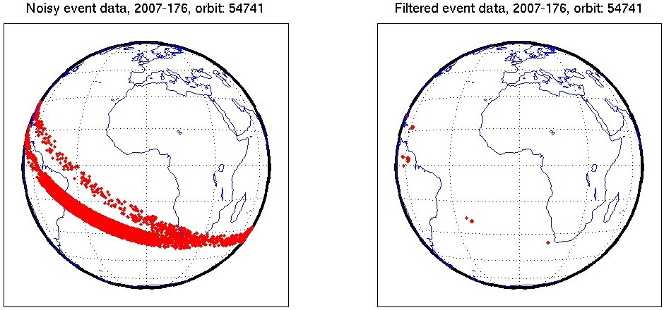
Investigation of noisy LIS data
Geolocated events but with all filters switched off
(created by Dennis Buechler/Doug Mach)
Effect of filtering
=>
L2 events where all filters have been applied

Slide 17
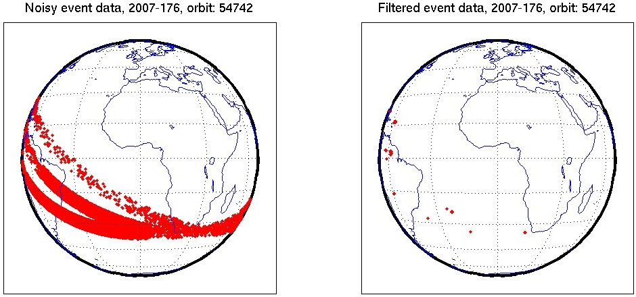
Investigation of noisy LIS data
Geolocated events but with all filters switched off
(created by Dennis Buechler/Doug Mach)
Effect of filtering
=>
L2 events where all filters have been applied

Slide 18
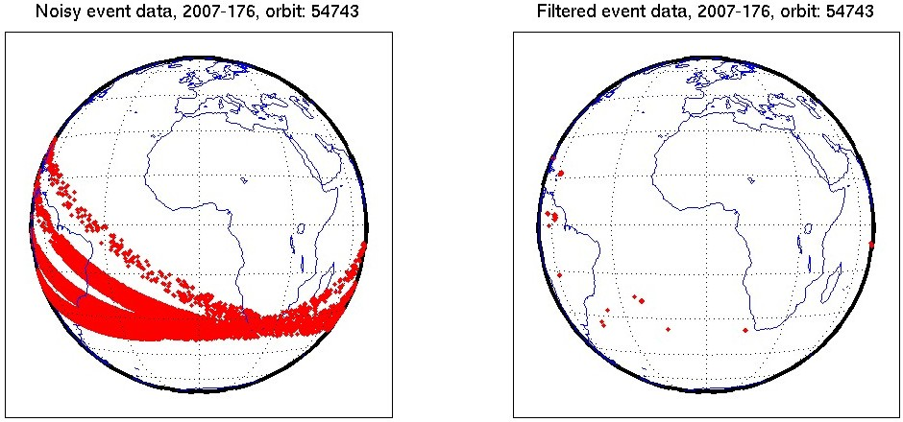
Investigation of noisy LIS data
Geolocated events but with all filters switched off
(created by Dennis Buechler/Doug Mach)
Effect of filtering
=>
L2 events where all filters have been applied

Slide 19
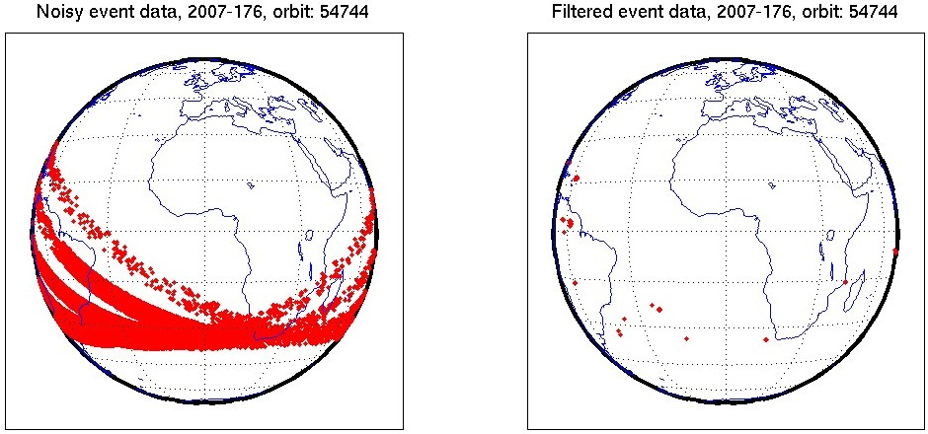
Investigation of noisy LIS data
Geolocated events but with all filters switched off
(created by Dennis Buechler/Doug Mach)
Effect of filtering
=>
L2 events where all filters have been applied

Slide 20
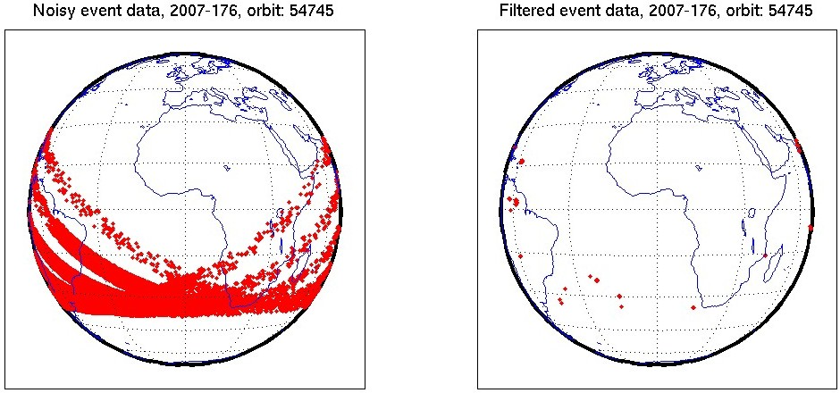
Investigation of noisy LIS data
Geolocated events but with all filters switched off
(created by Dennis Buechler/Doug Mach)
Effect of filtering
=>
L2 events where all filters have been applied

Slide 21
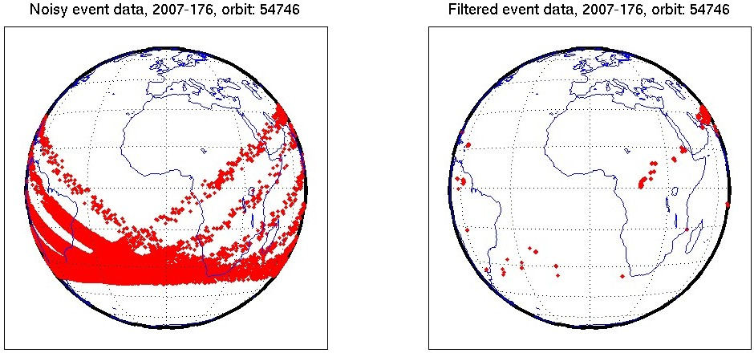
Investigation of noisy LIS data
Geolocated events but with all filters switched off
(created by Dennis Buechler/Doug Mach)
Effect of filtering
=>
L2 events where all filters have been applied

Slide 22
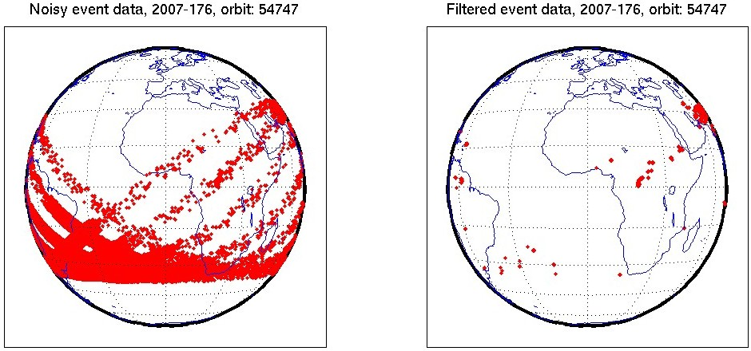
Investigation of noisy LIS data
Geolocated events but with all filters switched off
(created by Dennis Buechler/Doug Mach)
Effect of filtering
=>
L2 events where all filters have been applied

Slide 23
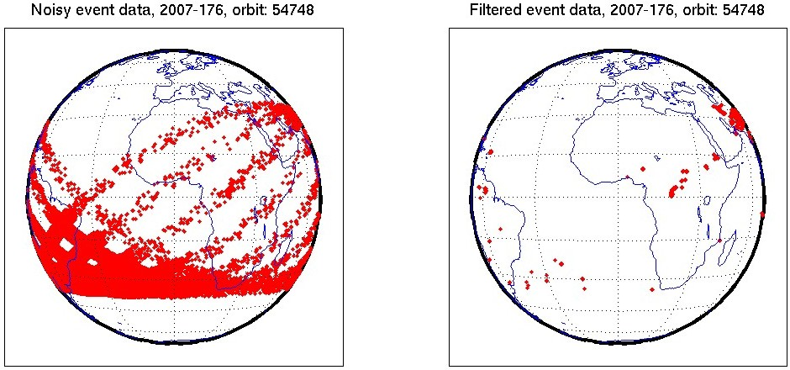
Investigation of noisy LIS data
Geolocated events but with all filters switched off
(created by Dennis Buechler/Doug Mach)
Effect of filtering
=>
L2 events where all filters have been applied

Slide 24
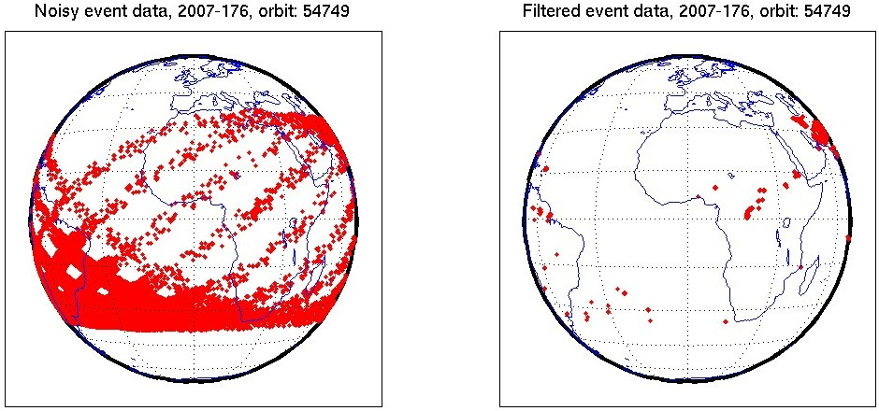
Investigation of noisy LIS data
Geolocated events but with all filters switched off
(created by Dennis Buechler/Doug Mach)
Effect of filtering
=>
L2 events where all filters have been applied

Slide 25
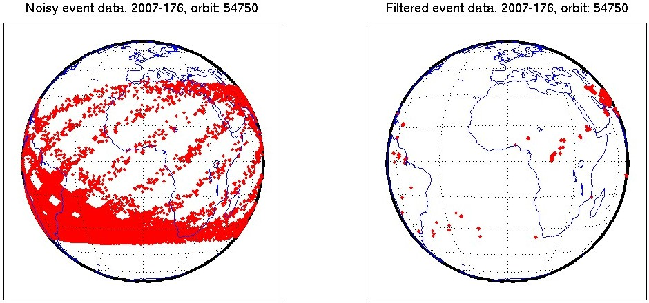
Investigation of noisy LIS data
Geolocated events but with all filters switched off
(created by Dennis Buechler/Doug Mach)
Effect of filtering
=>
L2 events where all filters have been applied

Slide 26
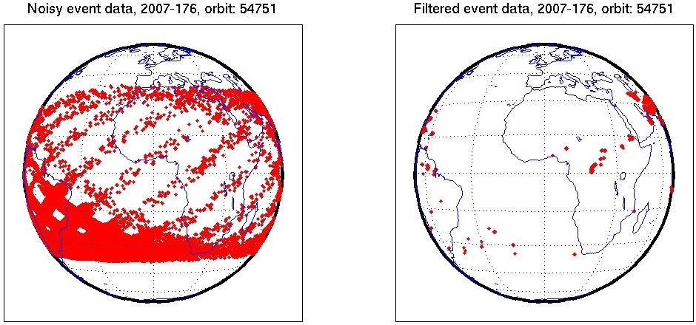
Investigation of noisy LIS data
Geolocated events but with all filters switched off
(created by Dennis Buechler/Doug Mach)
Effect of filtering
=>
L2 events where all filters have been applied

Slide 27
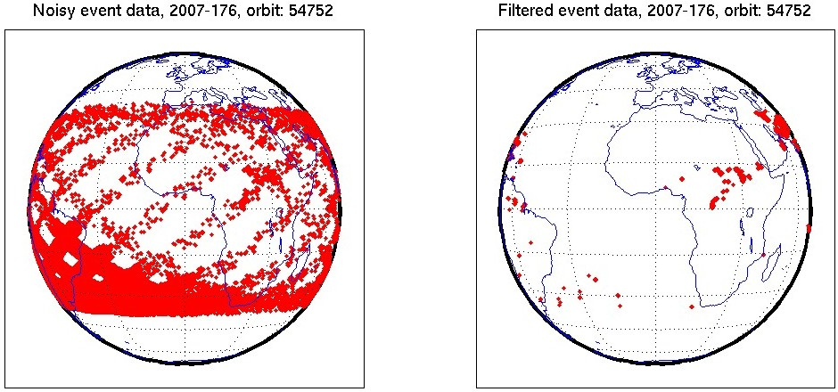
Investigation of noisy LIS data
Geolocated events but with all filters switched off
(created by Dennis Buechler/Doug Mach)
Effect of filtering
=>
L2 events where all filters have been applied

Slide 28
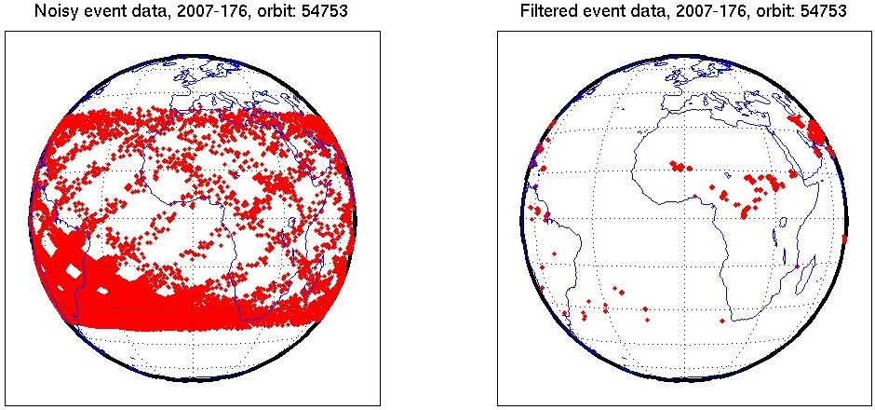
Investigation of noisy LIS data
Geolocated events but with all filters switched off
(created by Dennis Buechler/Doug Mach)
Effect of filtering
=>
L2 events where all filters have been applied

Slide 29
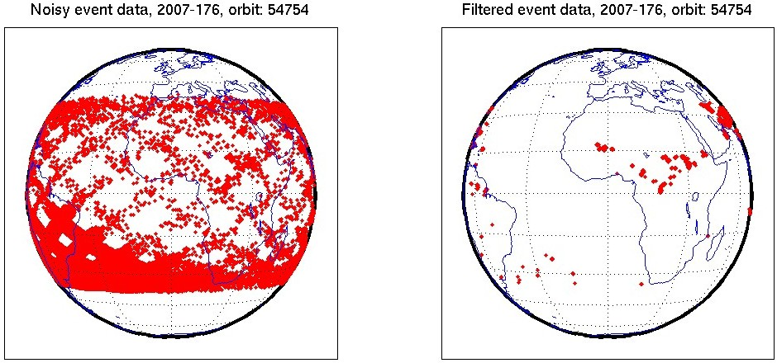
Investigation of noisy LIS data
Geolocated events but with all filters switched off
(created by Dennis Buechler/Doug Mach)
Effect of filtering
=>
L2 events where all filters have been applied

Slide 30

Investigation of noisy LIS data
Geolocated events but with all filters switched off
(created by Dennis Buechler/Doug Mach)
Effect of filtering
=>
L2 events where all filters have been applied

Slide 31
Topics of Presentation
Quick introduction to Meteosat Third Generation (MTG)
MTG LI instrument status update
Lightning Imager Science Team (LIST)
Examples of LIST studies supporting LI L1/L2 processor development
  EUMETSAT contribution to the CHUVA campaign (LINET measurements)
  LIProxy – tool for proxy data development and LI simulation
Summary

Slide 32
MTG Lightning Imager Science Team (LIST)
In order to support activities for establishing a scientific baseline for the operational Lightning Imager (LI) L2 processor, a MTG LI Science Team was set up in 2009.
The main objectives of this (external) team is to:
  Assist EUMETSAT with the implementation of the MTG LI L2 scientific baseline processor.
  Prepare an Algorithm Theoretical Basis Document (ATBD). It includes also a description of the proxy dataset, to be used for algorithm development and processor development.
The ATBD V1 was subject for review at the Preliminary Design Review (PDR) concluding the MTG system Phase B activities in May-June 2011

Slide 33
MTG Lightning Imager Science Team (LIST)
The MTG LI Science Team, led by EUMETSAT, currently consists of the following members:
  Graeme Anderson (MetOffice – United Kingdom)
  Daniele Biron (USAM – Italy)
  Eric Defer (LERMA – France)
  Ullrich Finke (U. Hannover – Germany)
  Hartmut Höller (DLR – Germany)
  Philippe Lopez (ECMWF)
  Douglas Mach (NASA – USA)
  Antti Mäkelä (FMI – Finland)
  Dieter Poelman (RMI – Belgium)
  Serge Soula (Laboratoire d'Aerologie – France)
In addition, invited experts are contributing to individual meetings.

Slide 34
Topics of Presentation
Quick introduction to Meteosat Third Generation (MTG)
MTG LI instrument status update
Lightning Imager Science Team (LIST)
Examples of LIST studies supporting LI L1/L2 processor development
  EUMETSAT contribution to the CHUVA campaign (LINET measurements)
  LIProxy – tool for proxy data development and LI simulation
Summary

Slide 35
LIST study: EUMETSAT contribution to the CHUVA field campaign
A study was initiated to provide the EUMETSAT contribution (LINET measurements) to the CHUVA Field Campaign which took place in the Sao Paulo area in Brazil from December 2011 to April 2012.
The aim of the study was:
    to generate a very comprehensive data set of lightning observations (surface based VHF/LF/VLF observations, surface & space based optical observations from the polar orbit and MSG SEVIRI imagery)
    to enhance the generation of geostationary lightning imager proxy data,
    to support the development of verification and validation strategies for these novel instruments (MTG-LI and GOES-R GLM),
    to enable development of strategies for a complementary use of surface based VLF lightning location systems and space-based optical systems such as MTG-LI, and
    to foster the user readiness for the future MTG-LI mission.

Slide 36
LIST study: EUMETSAT contribution to the CHUVA field campaign
Within the study the portable LINET system, owned and operated by DLR, was deployed in Brazil.
    Measurements were taken continuously from December 2011 to April 2012 and could also be monitored in real-time via a link provided by Nowcast on the web.
A second part of the study (Oct 2012 - April 2013) will concentrate on the creation of an enhanced proxy data method, based on LINET data as in input source and the findings of the data comparisons especially between LINET and LMA
    This LINET-based proxy data V2 will be available after the study closure (April 2013), with a coverage of almost all of Europe.
    A Real-time processing of the LINET proxy data is also being planned => user readiness application

Slide 37
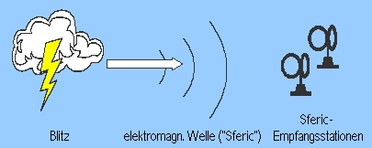
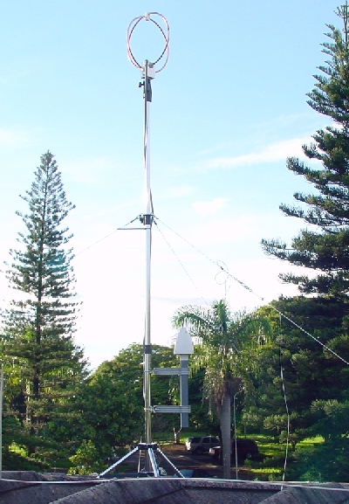
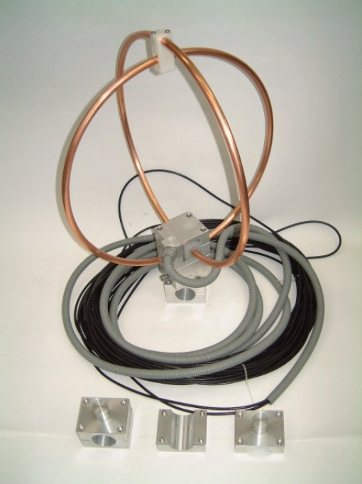
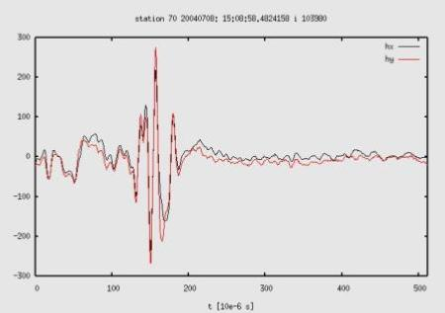
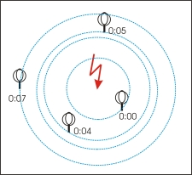
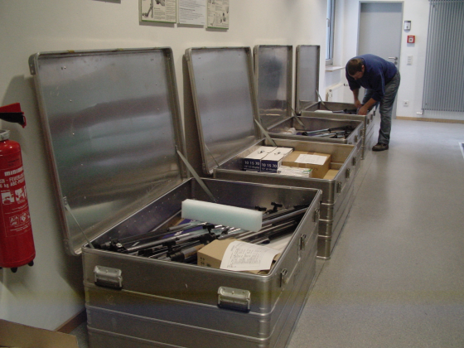
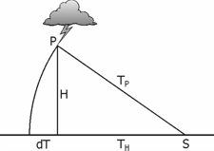
LINET (Lightning Detection Network in VLF/LF)
System Characteristics
  Measurement of magnetic field
  TOA Method for lightning location
  IC - CG discrimination
  Height of IC events

Slide 38
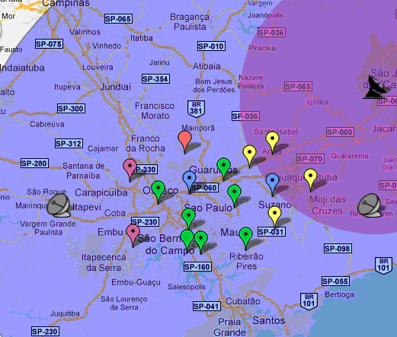
LMA and LINET Sites
XPOL and operational radars
LMA and LINET
LMA and LINET configuration, XPOL and operational radars

Slide 39
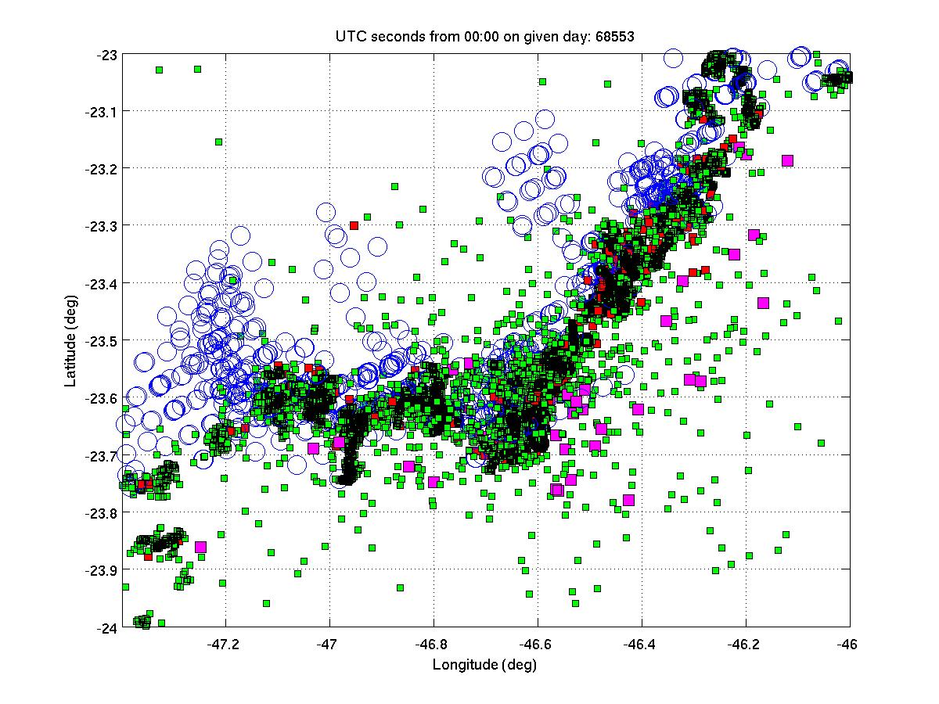
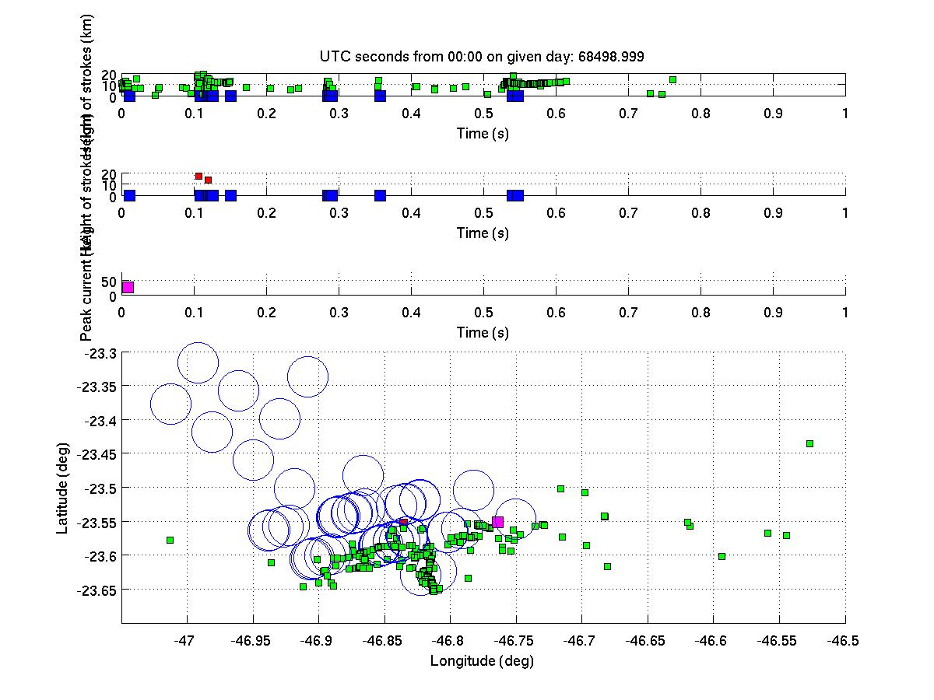
Example: Full LIS overpass on 10 Feb 2012 (60 seconds of data)
60 seconds contains already loads of data – need to look much closer
LIS event (~5 km footprint)
LIS event (in the temporal axis view)
STARNET stroke
LMA source (part of channel formation)
LINET stroke

Slide 40
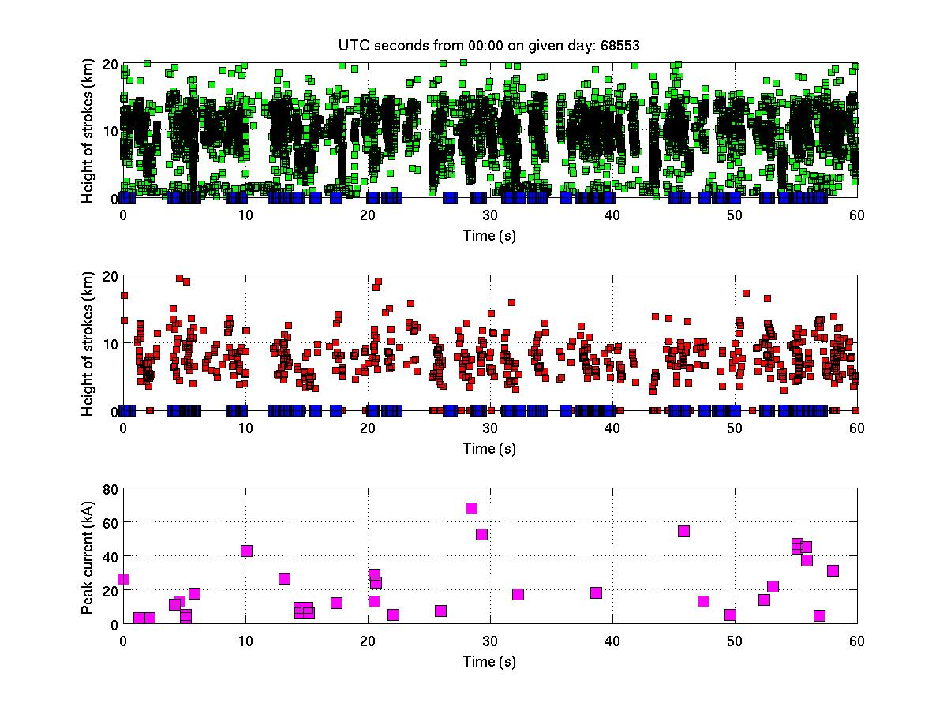
Example: Full LIS overpass on 10 Feb 2012 (60 seconds of data)
In temporal view (X-axis shows time of LIS overpass):
LIS event (in the temporal axis view)
STARNET stroke
LMA source (part of channel formation)
LINET stroke

Slide 41
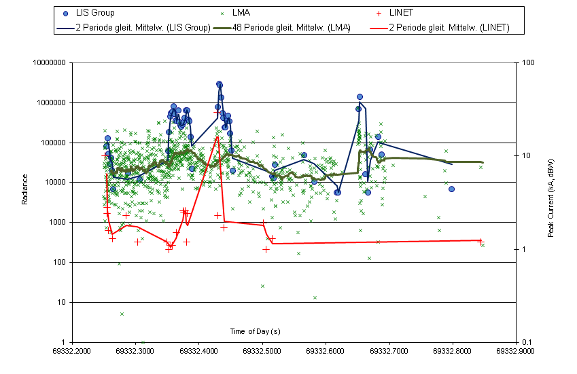
Case Studies
8 Feb 2012
  LIS flash 137 group radiance, LINET peak current (absolute value) and LMA source power on 8 Feb 2012

Slide 42
Conclusions
Preliminary Summary
CHUVA lightning campaign was very successful with respect to the objectives
7 months (Oct 2011 – April 2012) of lightning data available for analysis complemented by XPOL radar data
4-6 good cases with LIS overpasses of the inner network area (more than 20 cases in a wider area)
As found in a previous study done by DLR (funded by EUMETSAT), LINET strokes and LIS groups are well correlating
XPOL radar helps in interpretation of 3D cloud structure important for scattering of light

Slide 43
Topics of Presentation
Quick introduction to Meteosat Third Generation (MTG)
MTG LI instrument status update
Lightning Imager Science Team (LIST)
Examples of LIST studies supporting LI L1/L2 processor development
  EUMETSAT contribution to the CHUVA campaign (LINET measurements)
  LIProxy – tool for proxy data development and LI simulation
Summary

Slide 44
LIST study: LIProxy tool for generating MTG-LI proxy data
LIproxy is a Matlab-based computational tool that simulates the expected LI operational data
    The development of the tool was started in 2010 as a LIST activity.
    First version of the tool was created by Prof. Ulli Finke, and later further developed by CNMCA (Italian Meteorological Service) on EUMETSAT contracts
The tool simulates lightning pulses with “photons” which are a tool-internal unit to describe the pulse.
The location/density of the pulses can be generated based on conceptual models or from external data such as ground-based networks (ATDnet or LINET) – this also allows realistic storm conditions to be simulated
Event detection is then based on given parameters for threshold, saturation,...

Slide 45
LIST study: LIProxy tool for generating MTG-LI proxy data
Recent updates to the tool include:
    Introduction of modules for noise simulation in LIProxy tool in order to enable the use of LIProxy for the full chain (L1b+L2) processor development
        Random noise (simple statistical noise to investigate saturation)
        1st version of spacecraft motion generated noise
    Fully reworked GUI
Currently ongoing work:
    Implementing a background module for SEVIRI images
    Noise modules for particle noise and Sun glint
Future plans:
    Implementation of an “instrument model” once the LI design is available

Slide 46
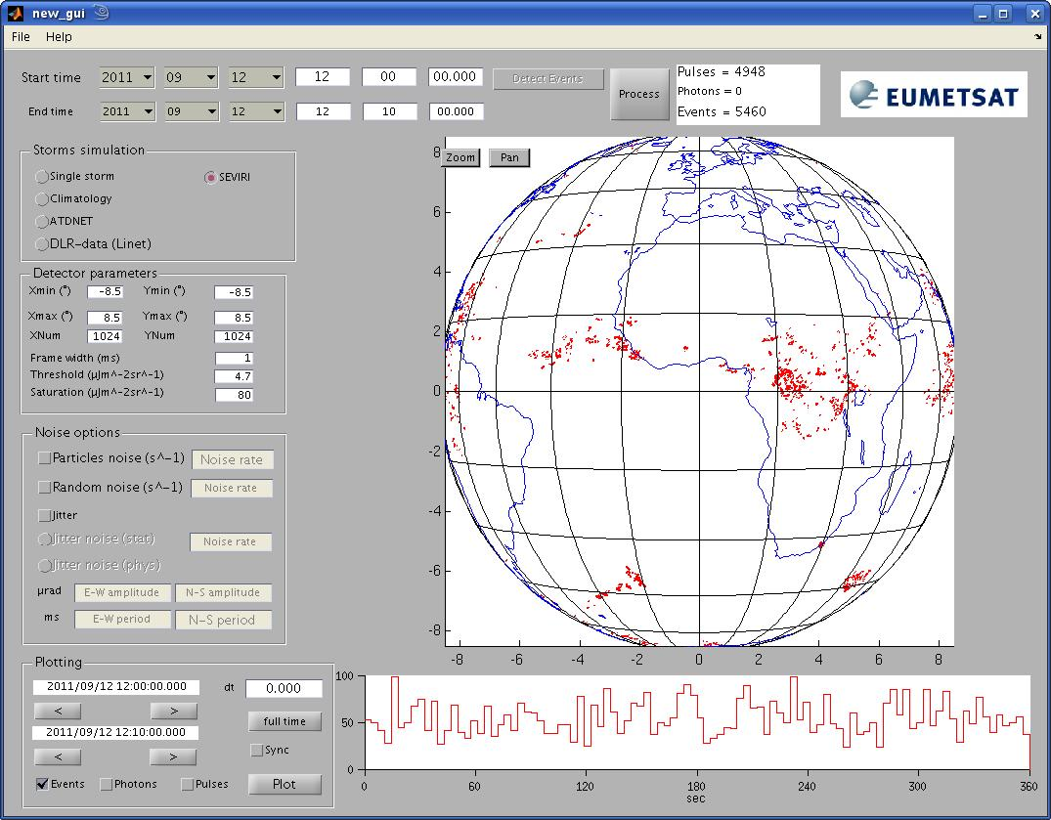

Slide 47
Topics of Presentation
Quick introduction to Meteosat Third Generation (MTG)
MTG LI instrument status update
Lightning Imager Science Team (LIST)
Examples of LIST studies supporting LI L1/L2 processor development
  EUMETSAT contribution to the CHUVA campaign (LINET measurements)
  LIProxy – tool for proxy data development and LI simulation
Summary

Slide 48
Summary
Meteosat Third Generation (MTG) will secure continuity and evolution of EUMETSAT geostationary services from 2017 onwards
    One of the new instruments on MTG is the Lightning Imager (LI) providing continuous lightning observation (CG+CC) over almost the full disk (at 0 deg).
Instrument prime was selected (Selex Galileo), with kickoff in July 2012 – System Requirements Review in to take place in 2012.
MTG Lightning Imager Science Team (LIST) supporting activities for defining a baseline L2 ATBD and prototype processor development
    Main achievements so far: ATBD V1, Proxy data, LIProxy tool, support to CHUVA campaign, …
EUM/MTG/VWG/11/0504
September 2011
EUMETSAT Conference, Oslo
EUM/MTG/VWG/11/0515
September 2011
GLM Science Team, Huntsville

Slide 49
Thank you!
EUM/MTG/VWG/11/0504
September 2011
EUMETSAT Conference, Oslo
EUM/MTG/VWG/11/0515
September 2011
GLM Science Team, Huntsville

