Slide 1

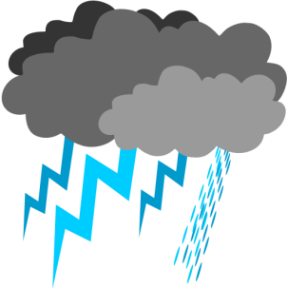






LANCE AMSR2
Amy Lin
Research Scientist
alin@itsc.uah.edu
Presented at the GHRC User Working Group Meeting
September 25-26, 2014
Notes:
GHRC AMSR SIPS (Science Investigator-Led Processing System)
SIPS—Science Investigator-Led Processing System

Slide 2
Advanced Microwave Scanning Radiometer (AMSR) Science Investigator-led Processing System (SIPS)
Advanced Microwave Scanning Radiometers, developed by the Japan Aerospace Exploration Agency (JAXA; formerly NASDA), are designed to detect water in all its state phases
In 1997 NASA established the framework for the Science Investigator-led Processing Systems (SIPS) in order to
  enable generation of high quality climate data products
  by personnel directly associated with the instrument science team
  who work in close cooperation with the DAACs
AMSR SIPS at GHRC was established in 1998 to generate standard products from the AMSR-E instrument on Aqua. Near-real time processing for LANCE was added in 2010.
AMSR-E | 04 May 2002 | NASA Aqua
AMSR | 12 Dec 2002 | JAXA ADEOS-II
AMSR2 | 17 May 2012 | JAXA GCOM-W
Notes:
The AMSR-E SIPS is one of the first instantiations of this concept.
ADEOS-II, aka Midori. The mission ended in October 2003 after the satellite's solar panels failed.^{[5]}
Environmental parameters measured by include precipitation, oceanic water vapor, cloud water, near-surface ocean wind speed, sea surface temperature, soil moisture, snow cover, and sea ice
GCOM-W1 was launched on May 17, 2012 via a H-IIA rocket, and it flies in a sun-synchronous orbit as part of the "A-train" satellite constellation. It successfully began collecting data on July 4, 2012. Its planned lifespan of 5 years means that the satellite is set to operate until 2017, although JAXA hopes that it will last longer.^{[3]}
----- Meeting Notes (9/18/14 13:12) -----
Add bullet about AMSR-E SIPS at GHRC (e.g., from Helen's history slide)

Slide 3


Land, Atmosphere Near real-time Capability for EOS (LANCE)
Is part of NASA’s Earth Observing System Data and Information System (EOSDIS)
  https://earthdata.nasa.gov/data/near-real-time-data/about-lance
Initiated and sponsored by NASA in 2009 to ensure the availability of NASA satellite data products to those partners who have grown to rely on those data for their decision support systems
Provides Near-Real-Time (NRT) EOS data products within 3 hours of satellite observation with high availability
LANCE Data contributed to the successful forecast of hurricane Sandy
Notes:
Best effort basis: EOS data products depend on some ancillary data which might not be available at the time for NRT,
so the latest available ones will be used instead of waiting for the “right” ancillary data.
LANCE AMSR-E on Aqua : http://lance.nsstc.nasa.gov/
Numerical weather and climate prediction
Forecasting and monitoring of natural hazards, ecological/invasive species, disaster relief, agriculture, air quality
Providing help with disaster relief and homeland security

Slide 4
LANCE Platforms and Instruments
Instrument | Satellite | Product Categories | Latency (min)
AIRS | Aqua | Radiances, Temperature and Moisture Profiles, Precipitation, Dust, Clouds and Trace Gases | 75 - 140
MLS | Aura | Ozone, Temperature, Carbon Monoxide, Water Vapor, Nitric Acid, Nitrous Oxide, Sulfur Dioxide | 75 - 140
MODIS | Terra & Aqua | Radiances, Cloud/Aerosols, Water Vapor, Fire, Snow Cover, Sea Ice, Land Surface Reflectance, Land Surface Temperature | 60 - 125
OMI | Aura | Ozone, Sulfur Dioxide, Aerosols, Cloud Top Pressure | 100 - 160
AMSR-E | Aqua | Brightness Temperatures, Soil Moisture, Rain Rate, Ocean Products, Snow Water Equivalent, Sea Ice | 80 - 135
AMSR2 | GCOM-W1 (雫) | Expected to be the same as AMSR-E | < 180?
  AMSR-E: Advanced Microwave Scanning Radiometer for EOS
  AMSR2: Advanced Microwave Scanning Radiometer 2,
    a slightly modified and improved version of AMSR-E
Notes:
AIRS--Atmospheric Infrared Sounder (Aqua)
MLS--Microwave Limb Sounder (Aura)
MODIS--Moderate Resolution Imaging Spectroradiometer (Terra and Aqua)
OMI-- Ozone Monitoring Instrument (Aura)
AMSR-E: Advanced Microwave Scanning Radiometer for EOS (Earth Observation System)
AMSR2: Advanced Microwave Scanning Radiometer 2
Brochure: https://earthdata.nasa.gov/sites/default/files/field/document/LANCE_Trifold_for_Distribution.pdf

Slide 5
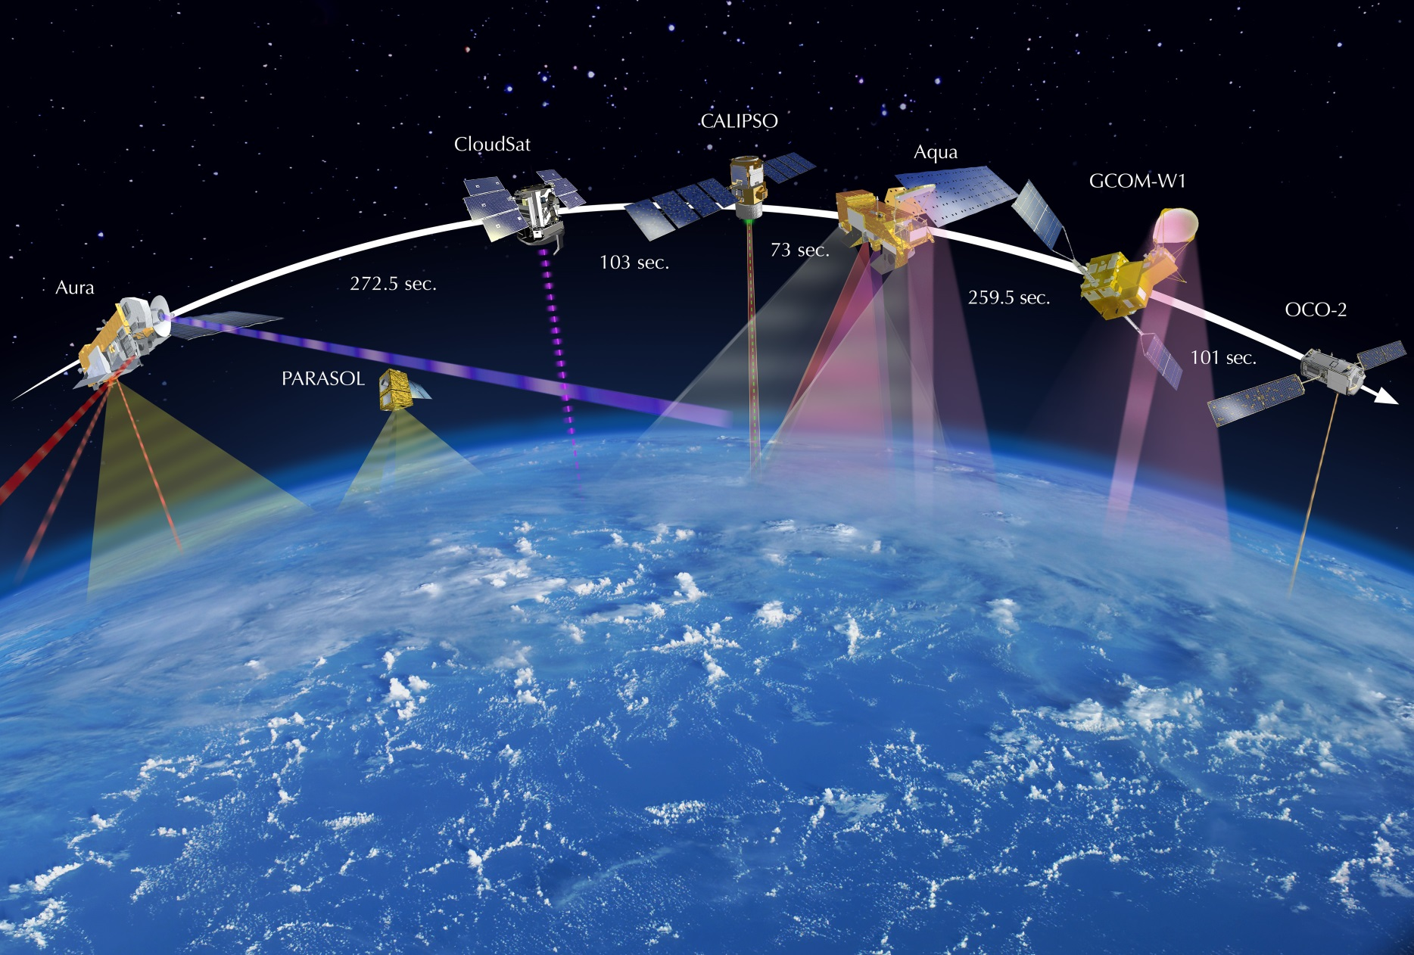
AMSR-E
AMSR2
GCOM-W1 carrying AMSR2 joined the international A-Train , an Earth observation satellite constellation run by NASA, on July 2, 2012
Notes:
The A-train (from Afternoon Train) is a satellite constellation of six Earth observation satellites of varied nationality in sun-synchronous orbit at an altitude of 705 kilometers above the Earth.^{[1]}
The orbit, at an inclination of 98.14°, crosses the equator each day at around 1:30 pm solar time, giving the constellation its name; the "A" stands for "afternoon;"^{[2]} and crosses the equator again on the night side of the Earth, at around 1:30 am.
They are spaced a few minutes apart from each other so their collective observations may be used to build high-definition three-dimensional images of the Earth's atmosphere and surface.
Aura – NASA (USA) and Canadian Space Agency
CALIPSO – NASA (USA) and CNES (France)
PARASOL – French built and launched
Active
The train, as of July 2014,^{[3]} consists of six active satellites:
OCO-2, lead spacecraft in formation, replaces the failed OCO and was launched for NASA on July 2, 2014.
GCOM-W1 "SHIZUKU", follows OCO-2 by 11 minutes, launched by JAXA on May 18, 2012.
Aqua, runs 4 minutes behind GCOM-W1, launched for NASA on May 4, 2002.
CloudSat, a cooperative effort between NASA and the Canadian Space Agency, runs 2 minutes and 30 seconds behind Aqua, launched with CALIPSO on April 28, 2006.
CALIPSO, a joint effort of CNES and NASA, follows CloudSat by no more than 15 seconds, launched on April 28, 2006.
Aura, a multi-national satellite, lags Aqua by 15 minutes, crossing the equator 8 minutes behind due to different orbital track to allow for synergy with Aqua, launched for NASA on July 15, 2004.
Past
PARASOL, launched by CNES on December 18, 2004 and moved to another (lower) orbit on December 2, 2009.^{[4]}
Failed
OCO,^{[5]} destroyed by a launch vehicle failure on February 24, 2009,^{[6]} and was replaced by OCO-2.
Glory,^{[7]} failed during launch on a Taurus XL rocket on March 4, 2011, and would have flown between CALIPSO and Aura.

Slide 6
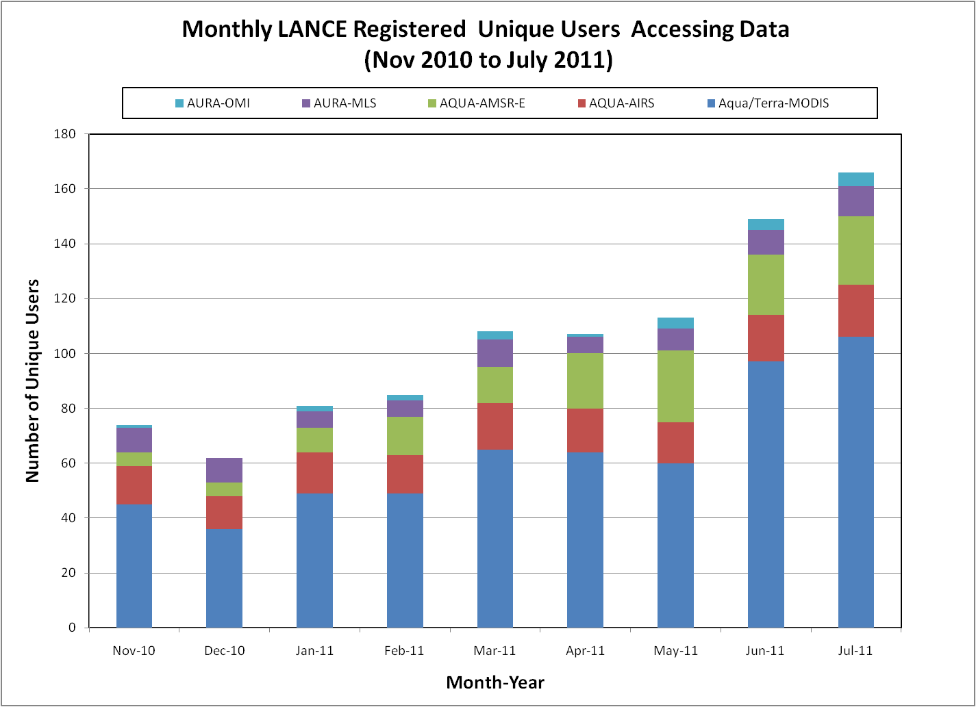
LANCE AMSR-E User Statistics
Notes:
We, AMSR SIPS has been working with standard AMSR-E data products since (?),
Increasing popularity of AMSR-E near real time data
At the time the instrument failed we had 77 registered users (point to 80 line for comparison), second only to number of LANCE MODIS users

Slide 7
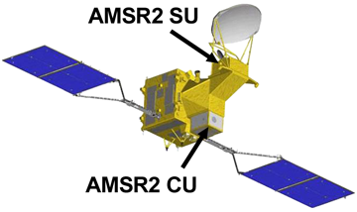


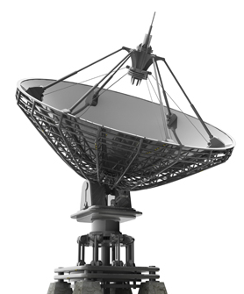
LANCE AMSR2 System Overview
LANCE AMSR2 Level 2 and Level 3 processing at AMSR SIPS (GHRC)
https://gcom-w1.jaxa.jp
Worldview
AMSR2 NRT L2, L3 daily Science data
JPG/PNG imagery
GIBS
gwen.nsstc.nasa.gov
lance.nsstc.nasa.gov
EOSDIS User Registration System (URS)
Data Ingest
& Processing
LANCE Web & FTP Server
JAXA GCOM-W1Data Providing Service
APID packets
L1R
gwen.itsc.uah.edu
lance.itsc.uah.edu
metadata
Registered Users
ECHO
Data Ingest
& Processing
LANCE Web
& FTP Server
KSAT Svalbard Ground Station
LANCE AMSR2 NRT data product in HDF-EOS5
Redundant processing strings on 2 independent networks in different buildings will greatly reduce the possibility of data being unavailable due to system outages
LANCE AMSR2 NRT data products will be available at AMSR SIPS on GHRC DAAC, for 7-14 days
Notes:
This LANCE AMSR2 system architecture is adapted from our earlier LANCE AMSR-E work, one of the major difference is the input data, before we used Level 0 NRT data from NOAA, now from JAXA (longer latency?)
GIBS: Global Imagery Browse Services for any web applications, such as GIS, Google map, Google Earth, OpenLayers ( WMS or KML map layer)
SIPS: Science Investigator-led Processing Systems
Two streams = complete redundancy (separate networks and separate buildings)
Worldview, a tool from NASA which allows user to interactively browse global satellite imagery within hours of it being acquired.
ECHO -- EOS Clearing House
A spatial and temporal metadata registry and order broker built by NASA’s ESDIS (Earth Science Data Information System), to enable the science community to more easily use and exchange NSAS’s data and services.
Objective: Enable broader use of NASA’s EOS data, allow users to more efficiently search and access data and services
GIBS– Global Imagery Browse Service, Integrate full resolution imagery in your own GIS application or mapping library by accessing the GIBS’ Web Map Tile Service (WMTS) and KML generation services. https://earthdata.nasa.gov/gibs
WorldView – interactively browse and download full resolution imagery for 100 visualized parameters in geographic and polar projections, https://earthdata.nasa.gov/worldview (use GIBS data?)

Slide 8

AMSR2 NRT L2 & L3 Data Products
AMSR2 Data | Description | Science Team
A2_RainOcean_NRT | Instantaneous Rainfall and rainfall vertical structure (GPROF2010V2) | Dr. Kummerow (Lead) Dr. Dave Randel, Mr. David Duncan (Colorado State University)
A2_Land_NRT A2_Land3_NRT | Surface soil moisture, vegetation water content, surface temperature | Dr. Eni G. Njoku (Lead) Dr. Thomas Jackson Dr. Steven Chan (NASA/JPL)
A2_DySno_NRT | Incremental L3 daily snow water equivalent | Dr. Marco Tedesco (Lead) Mr. Jeyaratnam Jeyavinoth (City College of New York)
A2_SI6_NRT A2_SI12_NRT A2_SI25_NRT | Incremental daily brightness temperature, sea ice product, for spatial resolution 6km, 12km, and 25km | Dr. Thorsten Markus (Lead) Dr. Josefino Comiso Dr. Don Cavalieri (NASA/GSFC)
Algorithm has been delivered
Notes:
Maybe note using preliminary AMSR2 algorithm, or modified AMSR-E algorithm
L1R (Input data)
Latency: 90~120min
Re-sampling brightness temperatures of 6, 10, 23, 36 GHz resolution, and original 89 GHz
1/2 orbit between the North Pole and the South Pole, ~29 granules daily
Data granules
Half orbit between the North Pole and the South Pole
Ascending: daytime observation
Descending: nighttime observation
Roughly 29 granules, ~1.5 GB daily

Slide 9
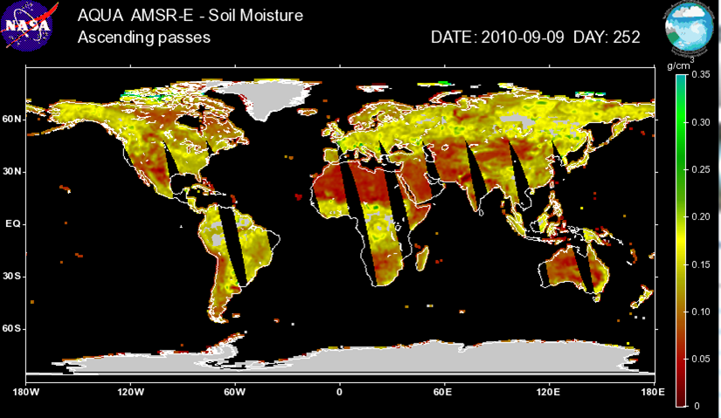
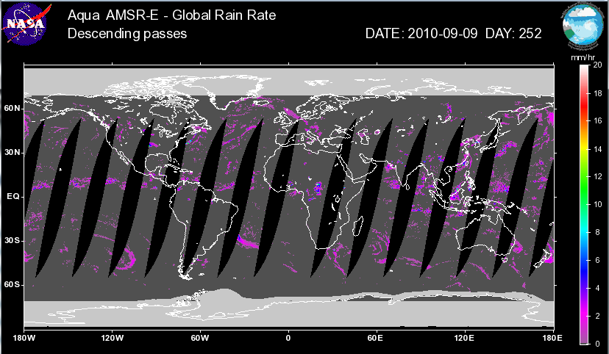
LANCE AMSR-E Imagery (Level 2)
Surface Soil Moisture from AE_Land_NRT
Global Rain Rate from AE_Rain_NRT
Notes:
AMSR-E provides global coverage of the Earth’s surface and atmosphere from its near-polar orbit aboard the Aqua satellite. This table lists the datasets and environmental parameters that can be measured by AMSR-E include precipitation, oceanic water vapor, cloud water, near-surface ocean wind speed, sea surface temperature, soil moisture, snow cover, and sea ice.
The AMSR-E data products are provided in both a Level-2, pixel-by-pixel, orbital swath projection and in a Level-3, global space and time averaged (i.e., daily composite) earth-oriented coordinate grid.

Slide 10
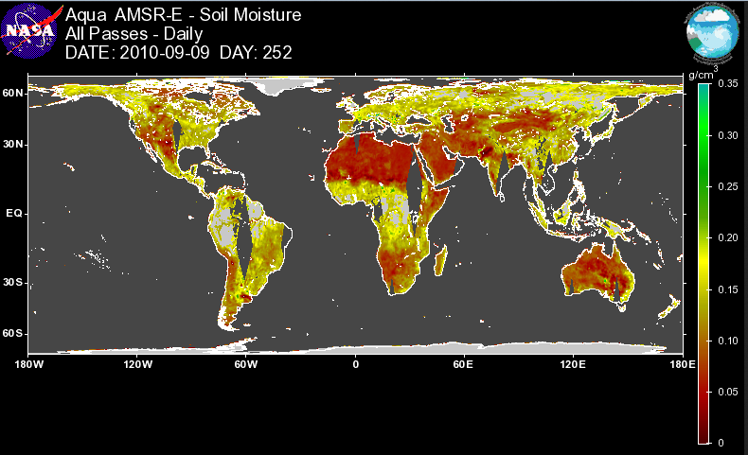
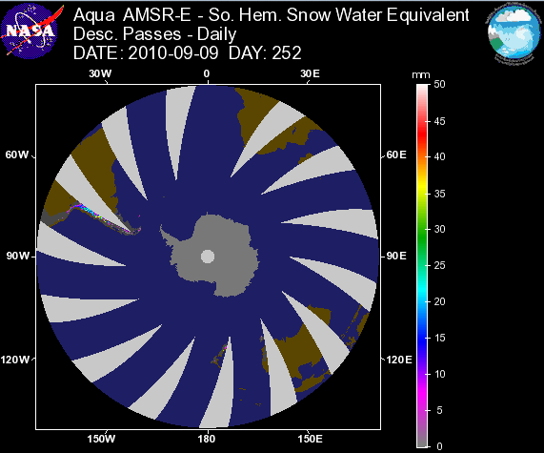
LANCE AMSR-E Imagery (Level 3)
Daily Soil Moisture from AE_Land3_NRT
Daily Snow Water Equivalent from AE_DySnow_NRT
Notes:
AMSR-E provides global coverage of the Earth’s surface and atmosphere from its near-polar orbit aboard the Aqua satellite. This table lists the datasets and environmental parameters that can be measured by AMSR-E include precipitation, oceanic water vapor, cloud water, near-surface ocean wind speed, sea surface temperature, soil moisture, snow cover, and sea ice.
The AMSR-E data products are provided in both a Level-2, pixel-by-pixel, orbital swath projection and in a Level-3, global space and time averaged (i.e., daily composite) earth-oriented coordinate grid.

Slide 11
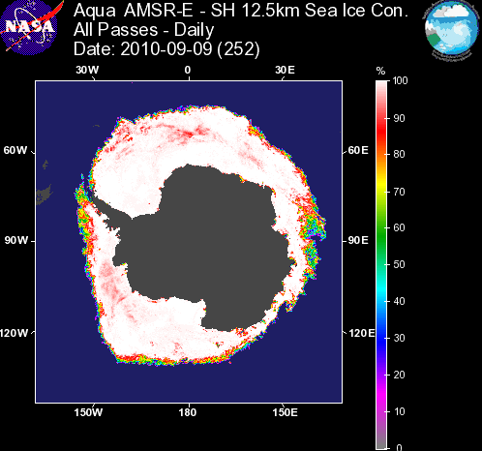
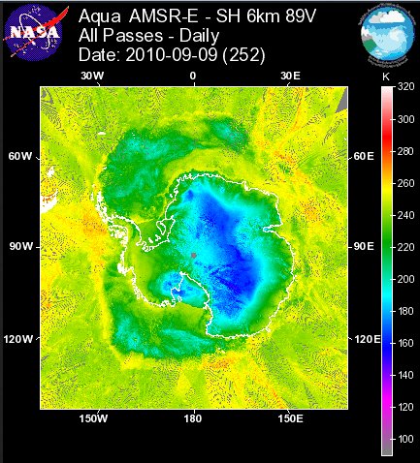
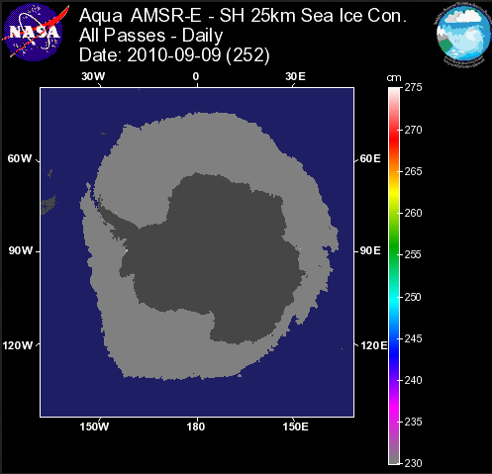
LANCE AMSR-E Imagery (Level 3)
Sea Ice Con. from AE_SI12_NRT
Brightness Temperature at 89V GHz from AE_SI6_NRT
Sea Ice Con. from AE_SI25_NRT
Notes:
AMSR-E provides global coverage of the Earth’s surface and atmosphere from its near-polar orbit aboard the Aqua satellite. This table lists the datasets and environmental parameters that can be measured by AMSR-E include precipitation, oceanic water vapor, cloud water, near-surface ocean wind speed, sea surface temperature, soil moisture, snow cover, and sea ice.
The AMSR-E data products are provided in both a Level-2, pixel-by-pixel, orbital swath projection and in a Level-3, global space and time averaged (i.e., daily composite) earth-oriented coordinate grid.

Slide 12
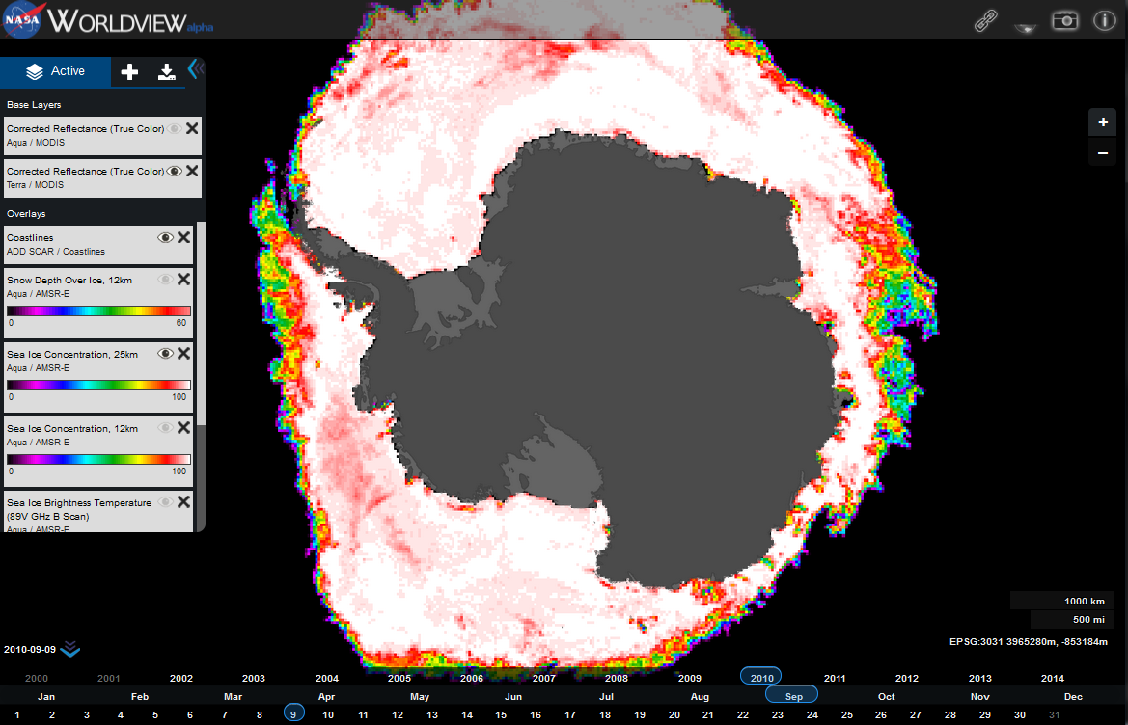
AMSR-E on Worldview

Slide 13
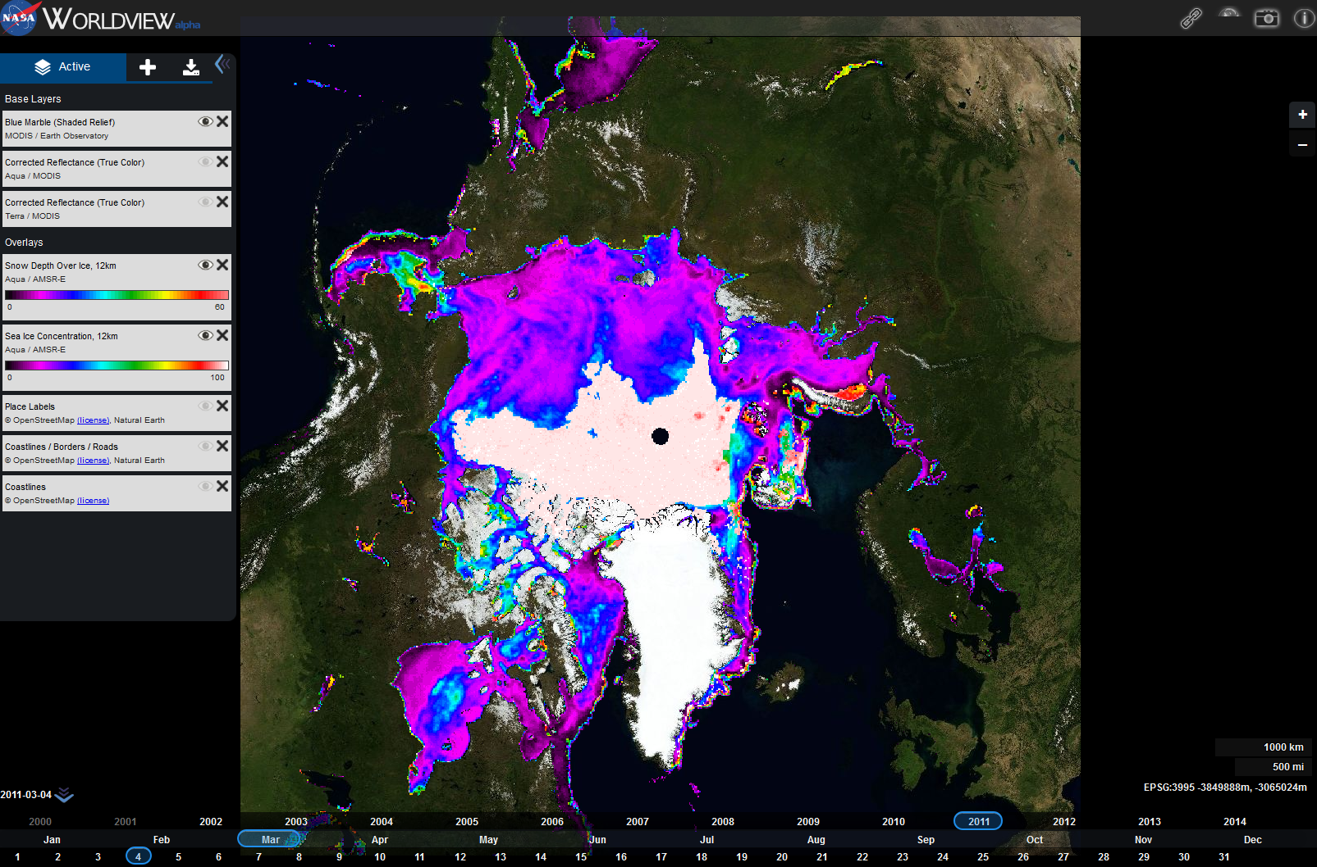
Sea Ice Concentration overlaid with Snow Depth over Ice (12 km)
URL: https://earthdata.nasa.gov/labs/worldview/

Slide 14
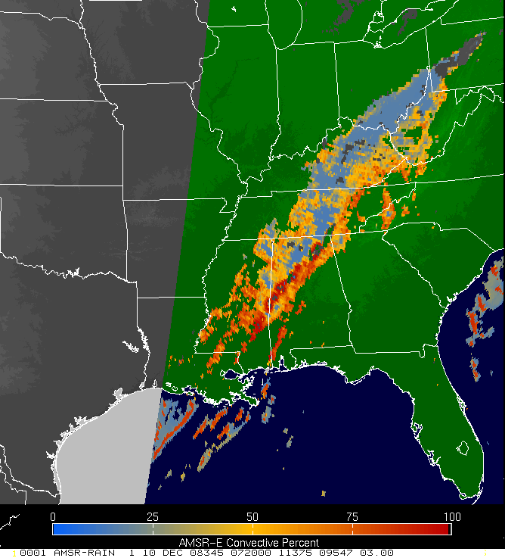
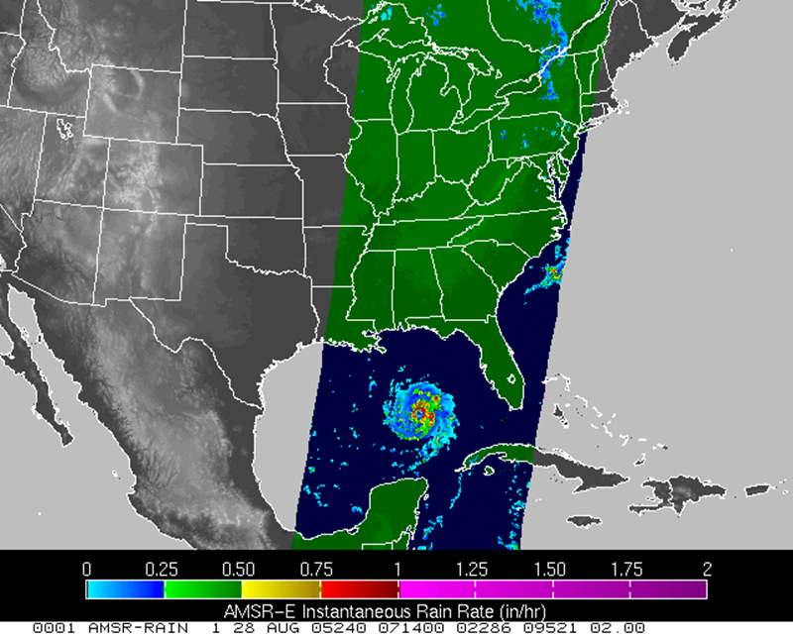
SPoRT generated AMSR-E Convective Percent of Storms from AMSR-E observation in the early hour of 12-10-2008 of the line of storms that swept through the southeast bringing heavy rains and several tornadoes
SPoRT generated AMSR-E Rain Rate of hurricane Katrina the day before making landfall on the gulf coasts
Notes:
Passive microwave data can be used to obvserve and monitor weather events outside the range of conventional ground-based radars.

Slide 15
AMSR-E Provenance
Michael McEniry
Research Associate
mmceniry@itsc.uah.edu

Slide 16
Data Stewardship Context
Make the preserved data / information available to all our stakeholder communities with traceability to support authenticity.

Slide 17
Importance of Provenance
Understand how a data product was generated
  Relationships among products, processes
  Corroborate scientific validity
Data preservation requirements from NASA Earth Science Data and Information Systems Project
  Data Preservation Specification document includes algorithm information, processing history, input data

Slide 18
Questions that Provenance can Help Answer
How was this product created?
Which algorithm version created this product?
This data file is incorrect. Was it corrected in a later edition?
This data file is incorrect. What changed in this processing run?

Slide 19
AMSR-E Sea Ice Use Case
Sea ice scientists saw problem with reprocessed products: Not enough arctic ice in January
Problem caused by reprocessing each calendar year independently
  Sea ice mask derived from previous 5 days’ output
  Use default (October) mask if previous output missing
New processing rules to prevent same mistake
  If mask is older than 5 days, then report error and stop
  Process sequentially from beginning of mission
Investigation required scattered information
  Documentation, software, tacit knowledge
Notes:
The AMSR-E Sea Ice algorithm team detected a problem when reviewing newly reprocessed sea ice products: There was less arctic ice than there should have been in the first few days of January.
The investigation identified the cause as the incorrect use of a mask file. Normally, the mask file is derived from the previous 5 days’ output files, using a default mask file if those are missing. The algorithm team provides updated default mask files for October 1.
To shorten the overall time required, the reprocessing work was divided across multiple processing systems, partitioned by calendar year. Because January’s sea ice products were being worked on before the preceding December’s sea ice products were available, the processing software used the October mask file.
This incident resulted in new processing rules:
1) If mask is older than 5 days, then report error and stop
2) Process sea ice products sequentially from beginning of mission
Tracking down the cause was complicated by the information being scattered among several sources (algorithm science documentation, processing scripts, tacit knowledge).

Slide 20
What if Provenance was Already Available?
Shorter investigation time
  Reduced scattering of information
  Reduced chance of missing information
Analysis tools
  Dependency visualization
  Version comparison
  Automated rule verification

Slide 21
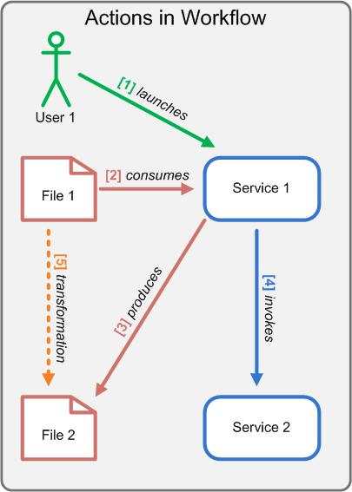
Approach in AMSR-E
Instrumentation library
  Minimal impact
  Logs "consumed", "invoked" and "produced" events
Aggregate scattered metadata
  Product creation
  Data contents
  Quality
  Science algorithm
Provenance browser
Notes:
Designed an instrumentation library for the current data processing system with minimal impact to its existing processing capability.
Written for perl-based processing systems and logs "consumed", "invoked" and "produced" events within the processing stream.
Aggregate relevant distributed metadata around the captured provenance
How the data product was created, what is in the data, and other key elements such as quality, science algorithm details, etc.
Designed a provenance browser for disseminating this information.

Slide 22
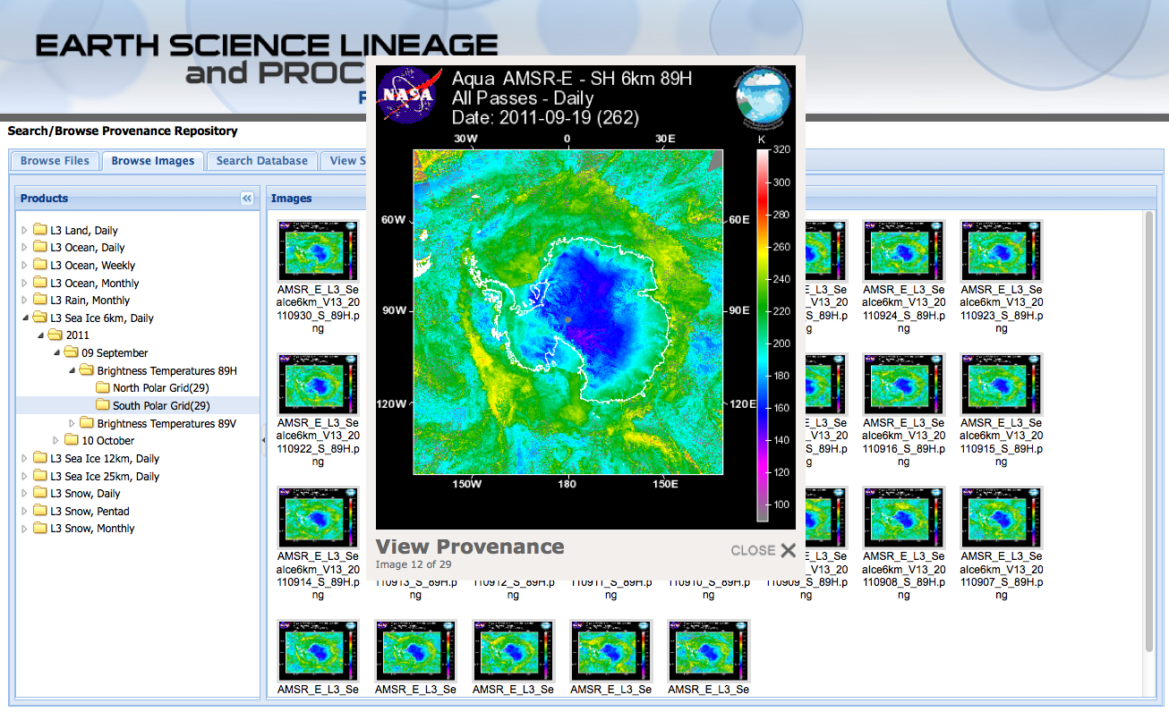
AMSR-E Provenance Browser
Users may explore the provenance repository by browsing the list of files; browsing imagery; searching for a specific file name; or viewing general processing information by product type.
Browse by Product Type
Browse by Product Images
Search by File Name
Explore Provenance
Notes:
Preview of browser – different ways to enter system

Slide 23
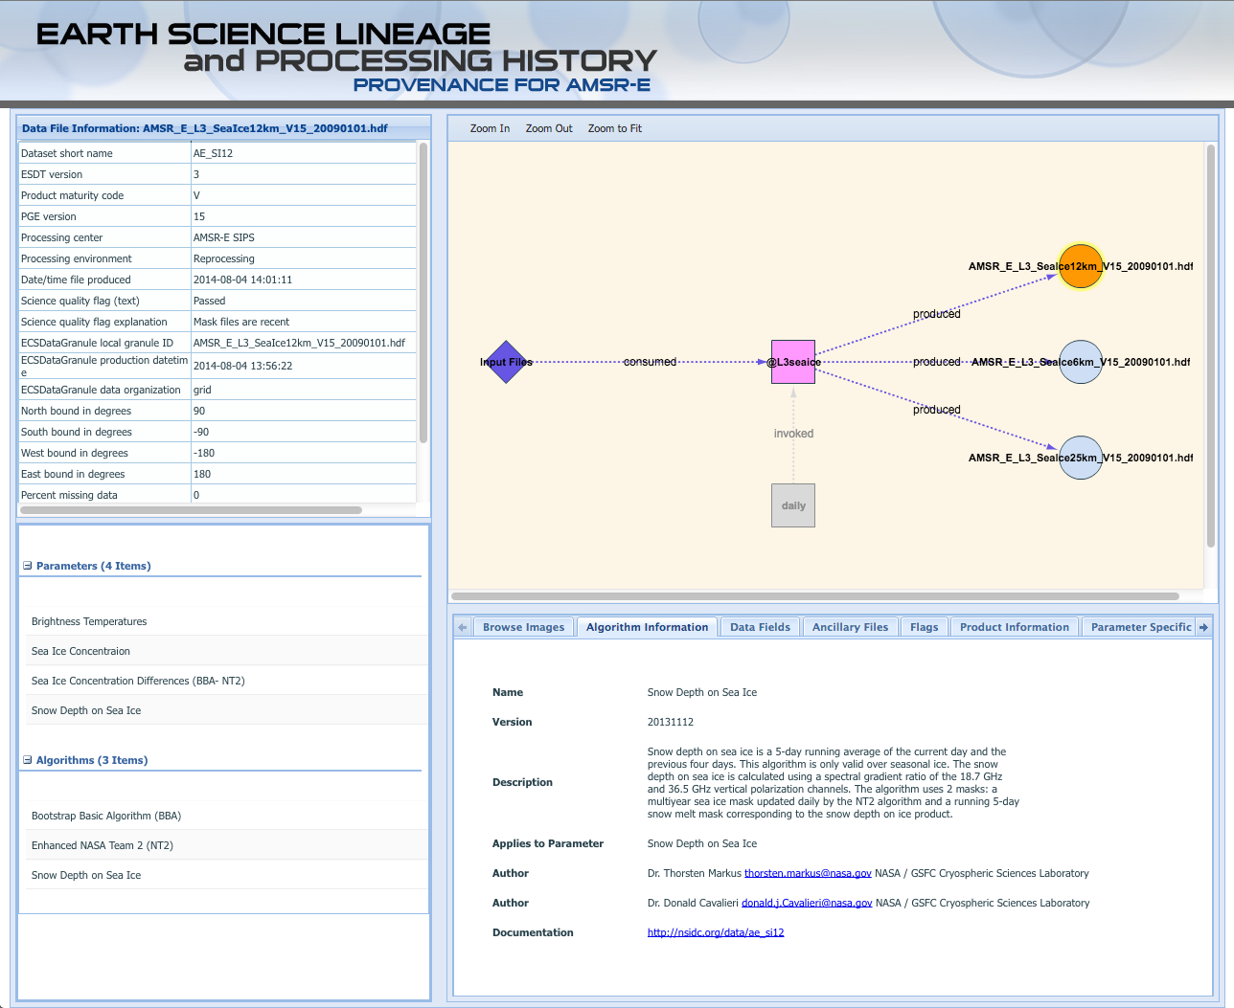
AMSR-E Provenance Browser
Granule Metadata
Processing Graph
Parameters and Algorithms
Algorithm Information
Notes:
Preview of browser – different types of info available

Slide 24
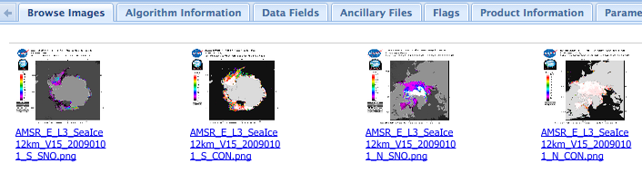
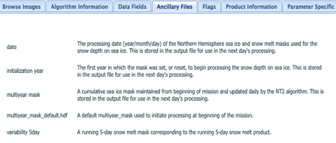
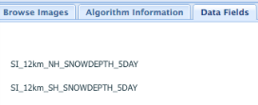
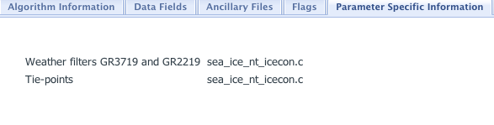
AMSR-E Provenance Browser
Parameter Selected
Algorithm Used
Notes:
The approach presented is required to retrofit existing/legacy data production system with minimal impact.
There are limitations on what can be done, especially if the system is heterogeneous and there is a lack of direct control over all the software components to allow instrumentation.
Hopefully, future data production systems will include both provenance collection and aggregation of contextual information at the beginning of the system design.
To date, the provenance browser has been very well received by different science teams.

Slide 25
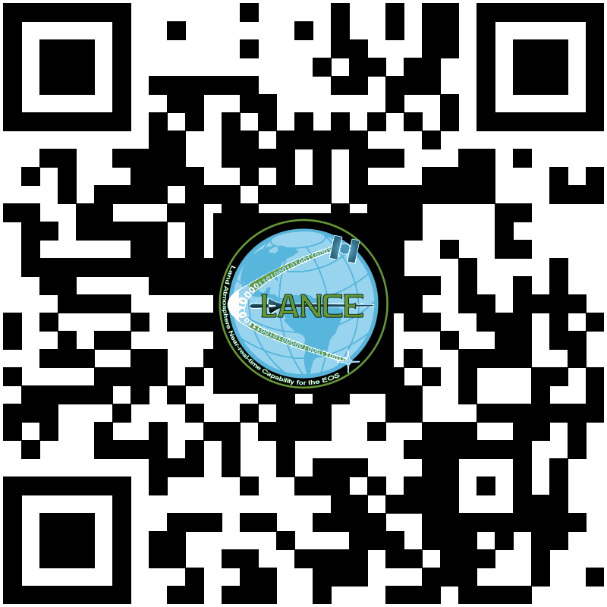
Discussion
THANK YOU
for your attention!
What real time applications do you have for AMSR2 data?
What data fields would you like to see available at GIBS/Worldview?
Do you have a need for data provenance information? How do you want to access that information?
  In-file metadata
  Separate metadata query
  Interactive browser
Please contact GHRC User Services for any help or questions
ghrcdaac@itsc.uah.edu

