Slide 1
Meteosat Third Generation Lightning Imager (MTG LI)
----
Status Update
Jochen Grandell, Marcel Dobber, Hartmut Höller and Rolf Stuhlmann
GLM Science Team
19-21 September 2012
(through Webex)

Slide 2
Topics of Presentation
Quick introduction to Meteosat Third Generation (MTG)
MTG LI instrument status update
Lightning Imager Science Team (LIST)
Examples of LIST studies supporting LI L1/L2 processor development
  EUMETSAT contribution to the CHUVA campaign (LINET measurements)
  LIProxy – tool for proxy data development and LI simulation
Summary

Slide 3
Topics of Presentation
Quick introduction to Meteosat Third Generation (MTG)
MTG LI instrument status update
Lightning Imager Science Team (LIST)
Examples of LIST studies supporting LI L1/L2 processor development
  EUMETSAT contribution to the CHUVA campaign (LINET measurements)
  LIProxy – tool for proxy data development and LI simulation
Summary

Slide 4
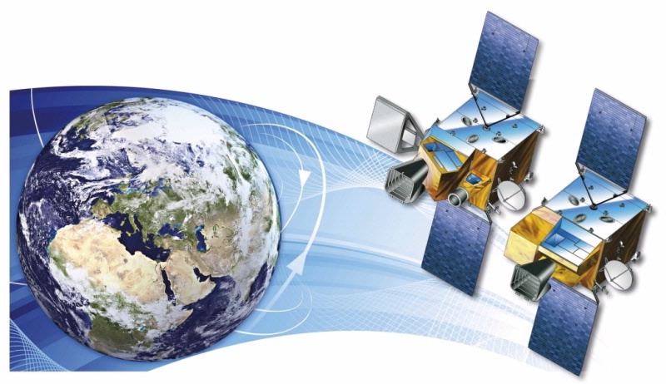


Short Introduction to the MTG Programme
MTG-I; 4 satellites
MTG-S; 2 satellites
Courtesy of

Slide 5
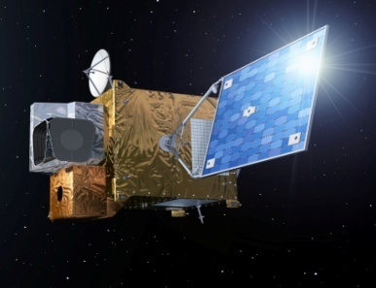
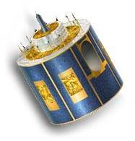
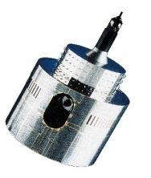
MTG to Secure Continuity and Evolution of EUMETSAT Services
1977
2002
2017 and 2019
MOP/MTP
MSG
MOP/MTP
MSG
MTG-I and MTG-S
Observation missions:
- Flex.Comb. Imager: 16 channels
- Infra-Red Sounder
Lightning Imager
UVN
3-axis stabilised satellites
Twin Sat configuration
Class 3.6-ton
Observation missions:
- SEVIRI: 12 channels
GERB
Spinning satellite
Class 2-ton
Observation mission:
MVIRI: 3 channels
Spinning satellite
Class 800 kg
Implementation of the EUMETSAT Mandate
for the Geostationary Programme
Atmospheric Chemistry Mission (UVN-S4):
via GMES Sentinel 4
(Ultraviolet Visible Near-infrared spectrometer)

Slide 6
MTG Space Segment Configuration
Twin Satellite Concept, based on 3-axis platforms
  4 Imaging Satellites (MTG-I) (20 years of operational services)
  2 Sounding Satellites (MTG-S) (15.5 years of operational services)
Payload complement of the MTG-I satellites
  • The Flexible Combined Imager (FCI)
  • The Lightning Imager (LI)
  • The Data Collection System (DCS) and Search and Rescue (GEOSAR)
Payload complement of the MTG-S satellites
  • The Infrared Sounder (IRS)
  • The Ultra-violet, Visible and Near-infrared Sounder (UVN)

Slide 7
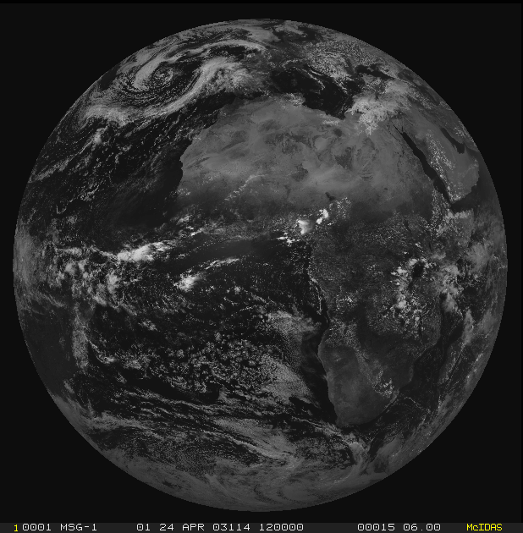
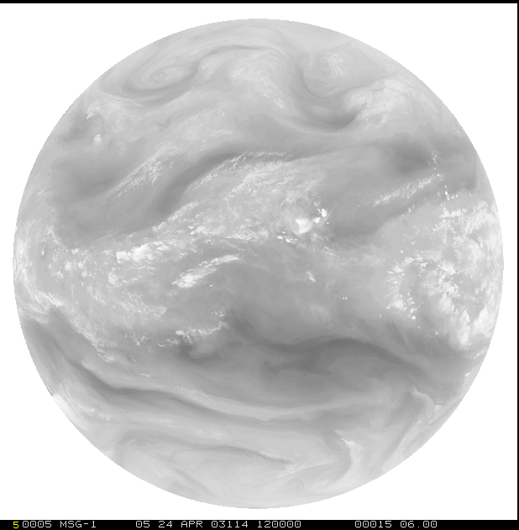
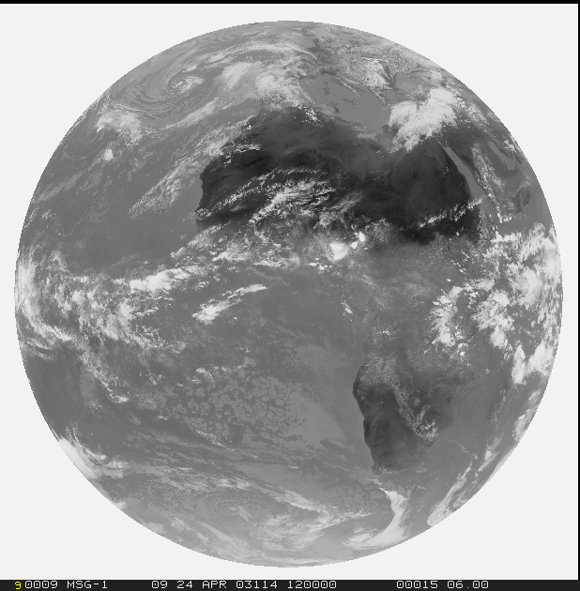
From MVIRI through SEVIRI to FCI on MTG
1977
1=VIS0.6
12=HRV
2=WV6.2
3=IR10.8

Slide 8
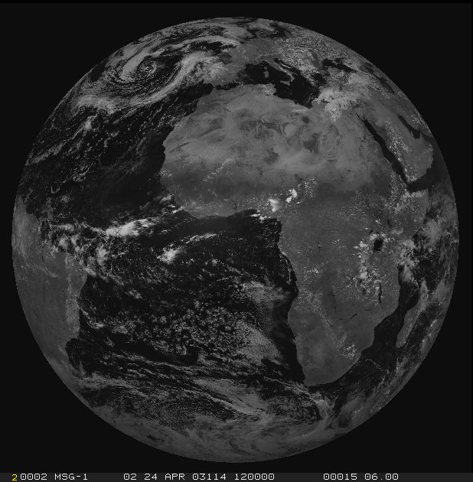
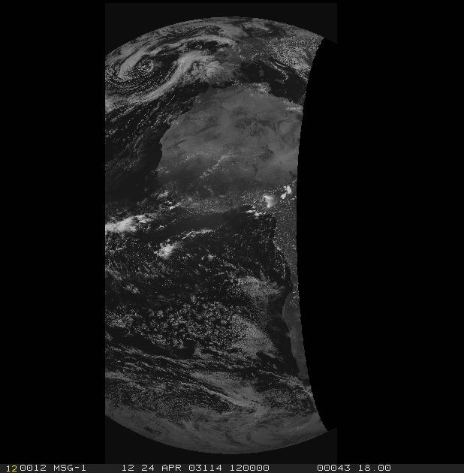
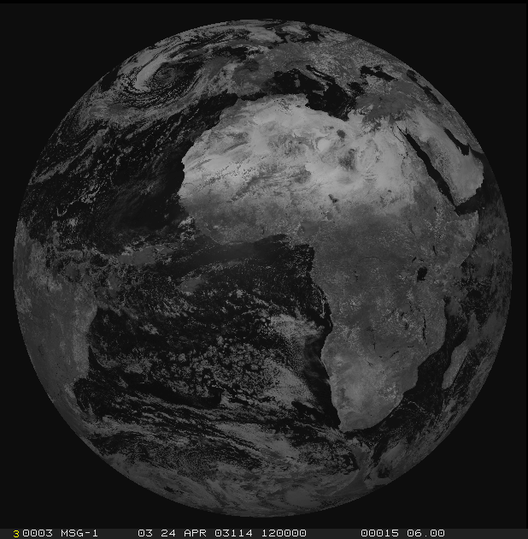
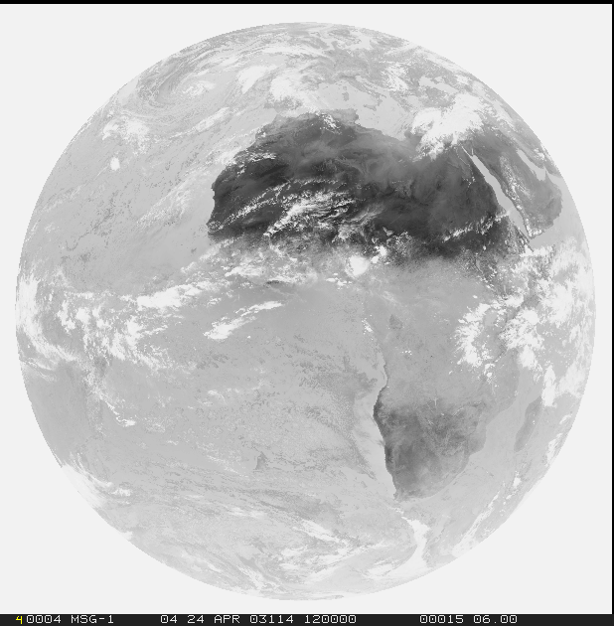
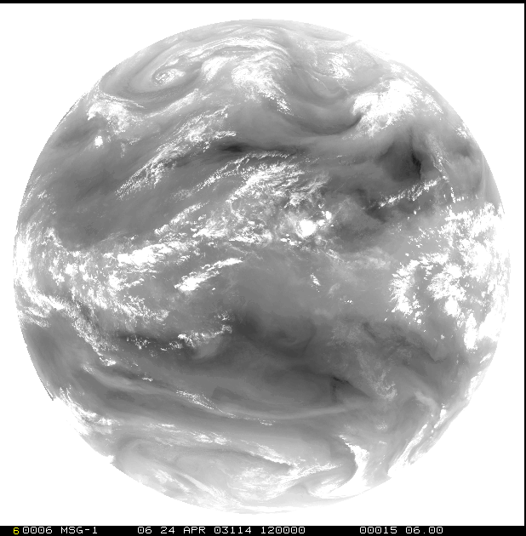
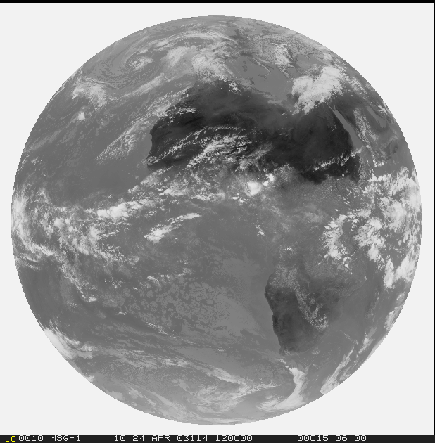
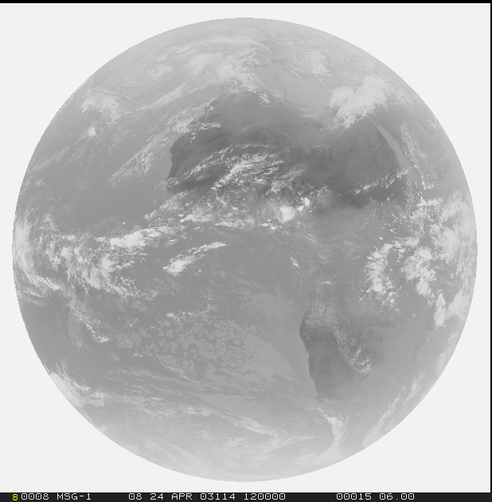
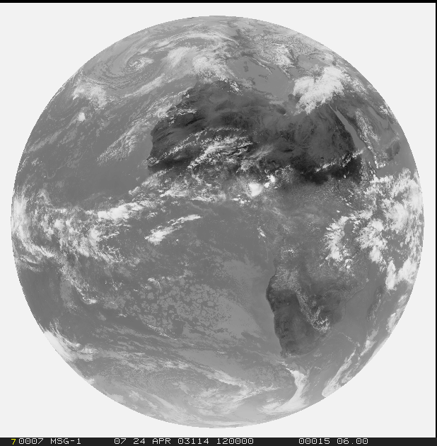
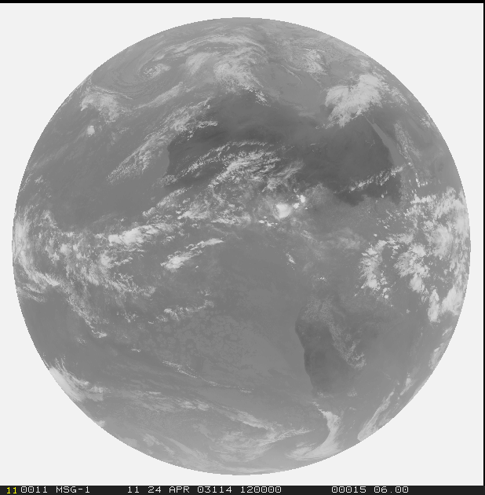
From MVIRI through SEVIRI to FCI on MTG
1977 -> 2002
1=VIS0.6
2=VIS0.8
12=HRV
3=NIR1.6
4=IR3.8
5=WV6.2
6=WV7.3
7=IR8.7
8=IR9.7
9=IR10.8
10=IR12.0
11=IR13.4

Slide 9
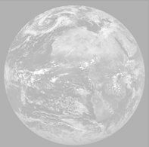
From MVIRI through SEVIRI to FCI on MTG
1977 -> 2002 -> 2018
1=VIS0.4
2=VIS0.5
3=VIS0.6
4=VIS0.8
5=NIR0.9
6=NIR1.3
FCI-FDSS:
8 solar channels at 1km
8 thermal channels at 2km
7=NIR1.6
8=NIR2.2
FCI-RSS:
2 solar/thermal
channels
at
0.5 km/1.0 km
9=IR3.8
10=WV6.2
11=WV7.3
12=IR8.7
13=IR9.7
14=IR10.5
15=IR12.3
16=IR13.3

Slide 10
Topics of Presentation
Quick introduction to Meteosat Third Generation (MTG)
MTG LI instrument status update
Lightning Imager Science Team (LIST)
Examples of LIST studies supporting LI L1/L2 processor development
  EUMETSAT contribution to the CHUVA campaign (LINET measurements)
  LIProxy – tool for proxy data development and LI simulation
Summary

Slide 11
Lightning Imager (LI) Status Update (1)
The MTG satellite PDR (Preliminary Design Review) was held in May 2012.
    The LI instrument was not part of this review, only MTG-LI interface requirement documents were reviewed.
LI industrial consortium consolidated via ITT, concluded by April 2012.
LI instrument prime contractor is Selex Galileo in Italy.
LI mission prime activities are still to be allocated.
    This includes the 0-1b data processing software.
    These activities will most likely be allocated to either Thales (MTG prime contractor) or to Selex Galileo (TBC).

Slide 12
Lightning Imager (LI) Status Update (2)
MTG LI Phase B2 has been kicked off:
      beginning of July 2012
Selex Galileo are preparing for SRR (System Requirements Review):
      end October 2012
LI instrument PDR (Preliminary Design Review)
      not before October 2013.

Slide 13
Lightning Imager (LI) main characteristics
LI main characteristics:
  Coverage about equal to visible disc (instantaneous view).
  Continuous measurements of triggered events / lightning triggered events.
  Continuous measurements of background images, typically one every minute.
  Data rate <30 Mbps; Mass < 110Kg; Power < 320W.
  Ground pixel size required < 10 km at 45 degrees latitude
  Measurements at 777.4 nm with 1.5-2.0 nm spectral bandpass filter.

Slide 14
Challenge for processing: “False Events” (noise)
Noise can be (instrument) internal or external depending on the mechanism
“Internal” noise:
    Electronic noise
    Thermo-mechanical noise
    Stray light noise
    Ghost noise?
“External” noise:
    Jitter (spacecraft motion)
    Cloud radiation (background in general)
    Sun glint
    Particles flux
Rough order of severity (based on GLM analysis):
Spacecraft motion, Photon/electronics noise, Sun glint, Radiation

Slide 15
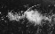
Effect of Microvibrations (“jitter”) on Lightning Detection
Assuming that this is what the
Lightning Imager is looking at...
Background
energy
Cloud
Distance
Darker (ocean)
background
Cloud
Darker (ocean)
background
EUM/MTG/VWG/11/0504
September 2011
EUMETSAT Conference, Oslo
EUM/MTG/VWG/11/0515
September 2011
GLM Science Team, Huntsville

Slide 16
Effect of Microvibrations (“jitter”) on Lightning Detection
What if the instrument (satellite) moves slightly between integration frames...?
Background
energy
Background removal
(Frame #2 – Frame #1)
But this is
not lightning!
Frame #1
Cloud
Frame #2
Distance
Distance
Darker (ocean)
background

Slide 17
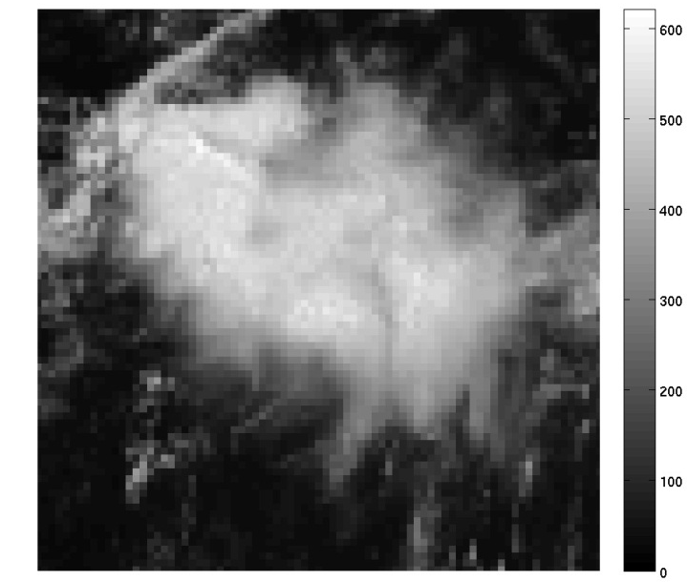
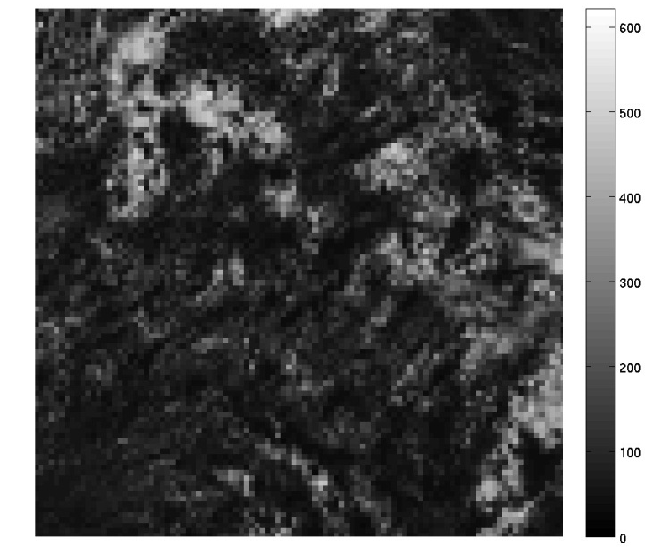
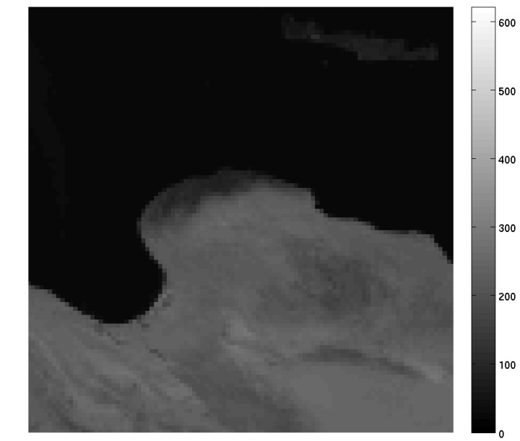
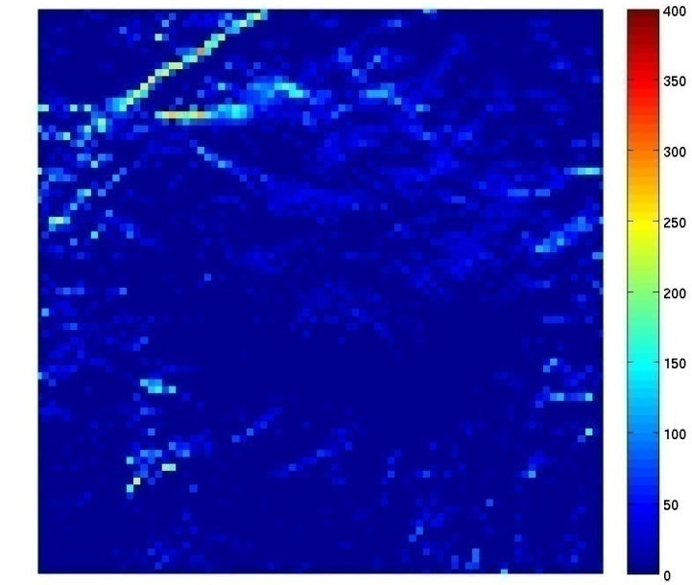
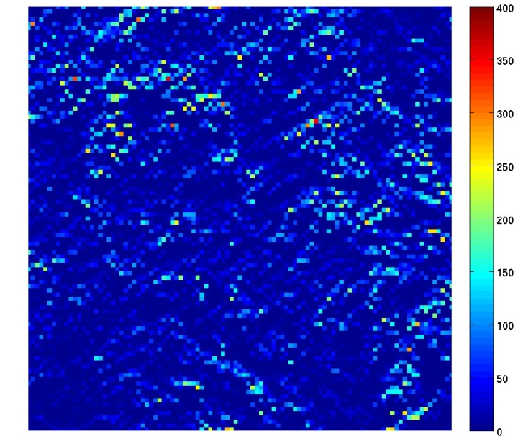
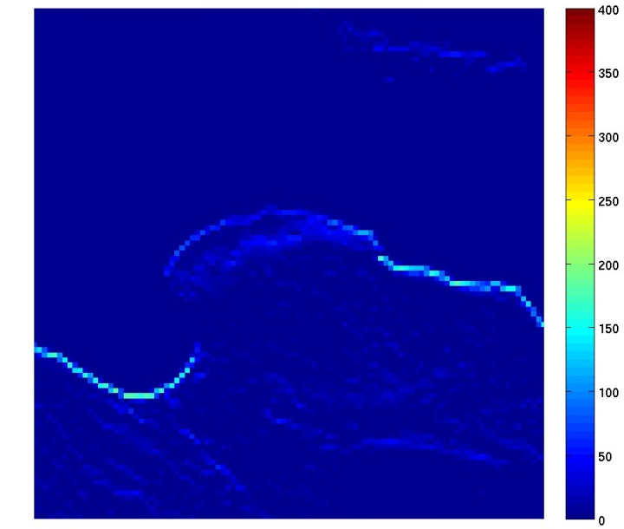
Close-up of jitter cases – full 6 km pixel movement (corresponding to 168 µrad !! – illustration only)
Cloud #1 Cloud #1 Coastline
µJ/m2/sr
µJ/m2/sr

Slide 18
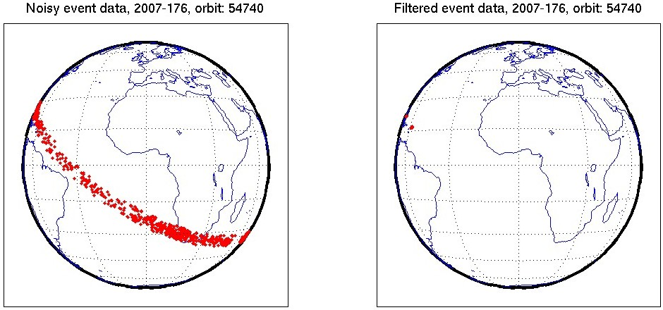
Investigation of noisy LIS data
Geolocated events but with all filters switched off
(data provided by Dennis Buechler/ Doug Mach)
Effect of filtering
=>
L2 events where all filters have been applied
Overall rejection rate for
this data set ~80%

Slide 19
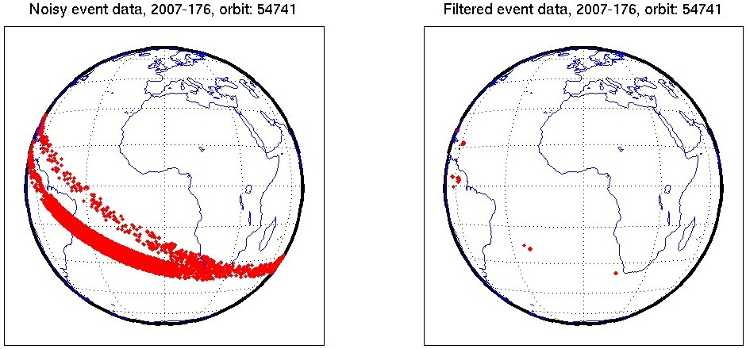
Investigation of noisy LIS data
Geolocated events but with all filters switched off
(data provided by Dennis Buechler/ Doug Mach)
Effect of filtering
=>
L2 events where all filters have been applied
Overall rejection rate for
this data set ~80%

Slide 20
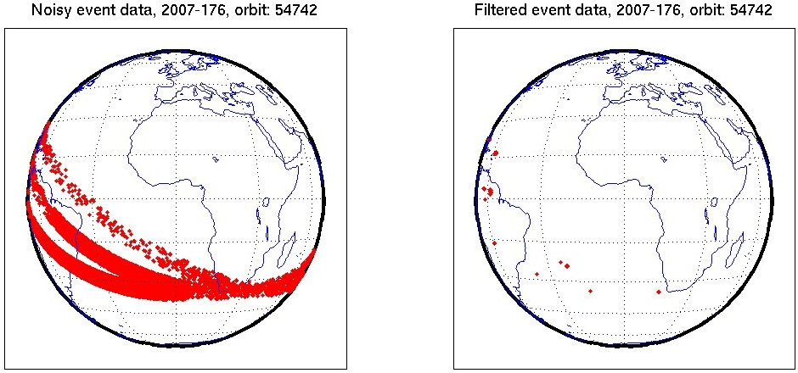
Investigation of noisy LIS data
Geolocated events but with all filters switched off
(data provided by Dennis Buechler/ Doug Mach)
Effect of filtering
=>
L2 events where all filters have been applied
Overall rejection rate for
this data set ~80%

Slide 21
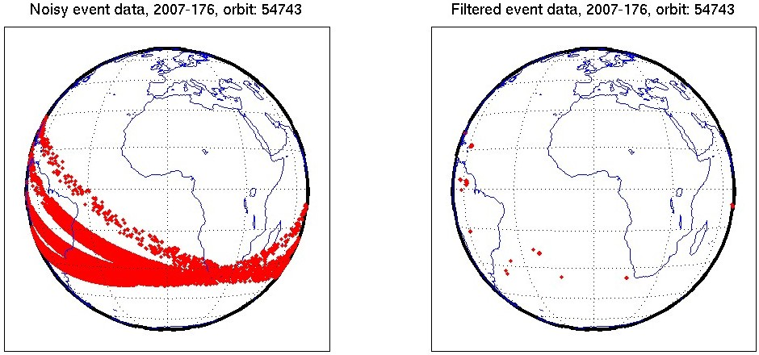
Investigation of noisy LIS data
Geolocated events but with all filters switched off
(data provided by Dennis Buechler/ Doug Mach)
Effect of filtering
=>
L2 events where all filters have been applied
Overall rejection rate for
this data set ~80%

Slide 22
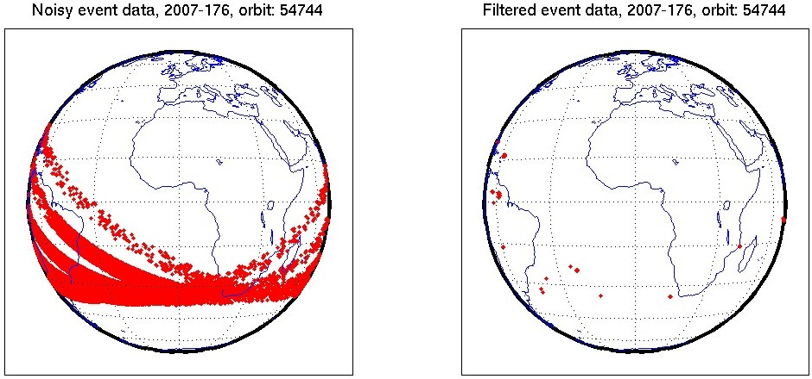
Investigation of noisy LIS data
Geolocated events but with all filters switched off
(data provided by Dennis Buechler/ Doug Mach)
Effect of filtering
=>
L2 events where all filters have been applied
Overall rejection rate for
this data set ~80%

Slide 23
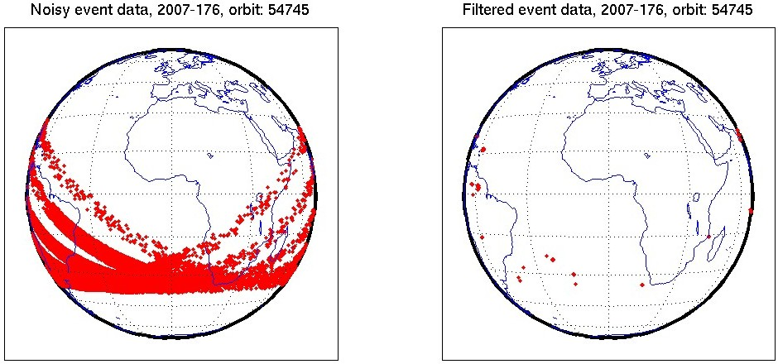
Investigation of noisy LIS data
Geolocated events but with all filters switched off
(data provided by Dennis Buechler/ Doug Mach)
Effect of filtering
=>
L2 events where all filters have been applied
Overall rejection rate for
this data set ~80%

Slide 24
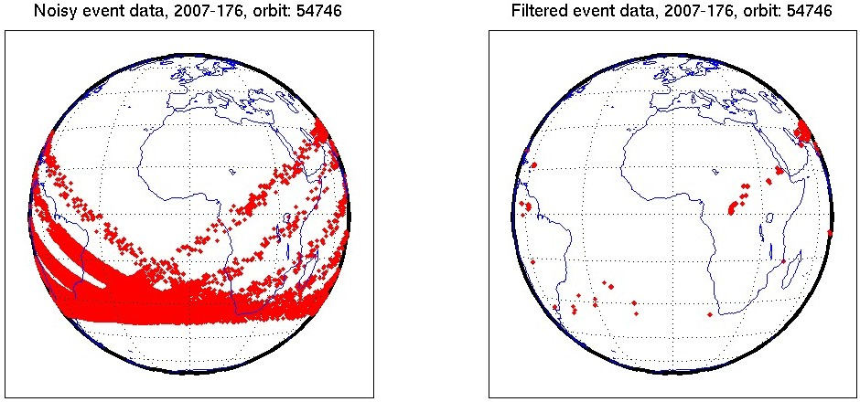
Investigation of noisy LIS data
Geolocated events but with all filters switched off
(data provided by Dennis Buechler/ Doug Mach)
Effect of filtering
=>
L2 events where all filters have been applied
Overall rejection rate for
this data set ~80%

Slide 25
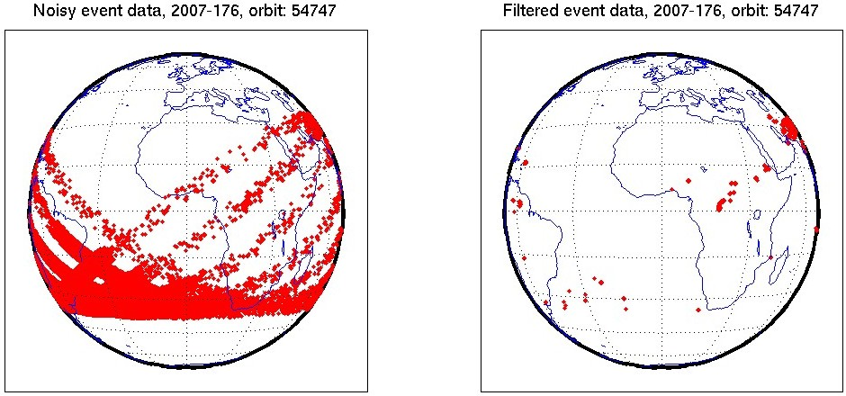
Investigation of noisy LIS data
Geolocated events but with all filters switched off
(data provided by Dennis Buechler/ Doug Mach)
Effect of filtering
=>
L2 events where all filters have been applied
Overall rejection rate for
this data set ~80%

Slide 26
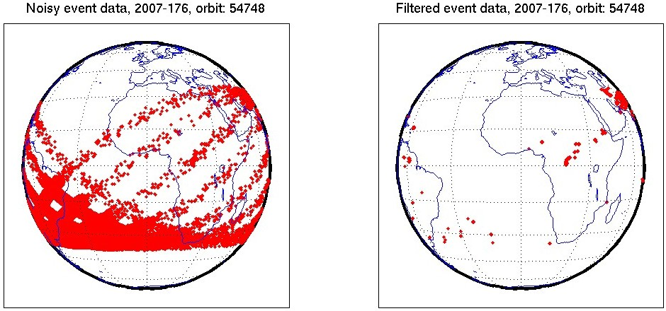
Investigation of noisy LIS data
Geolocated events but with all filters switched off
(data provided by Dennis Buechler/ Doug Mach)
Effect of filtering
=>
L2 events where all filters have been applied
Overall rejection rate for
this data set ~80%

Slide 27
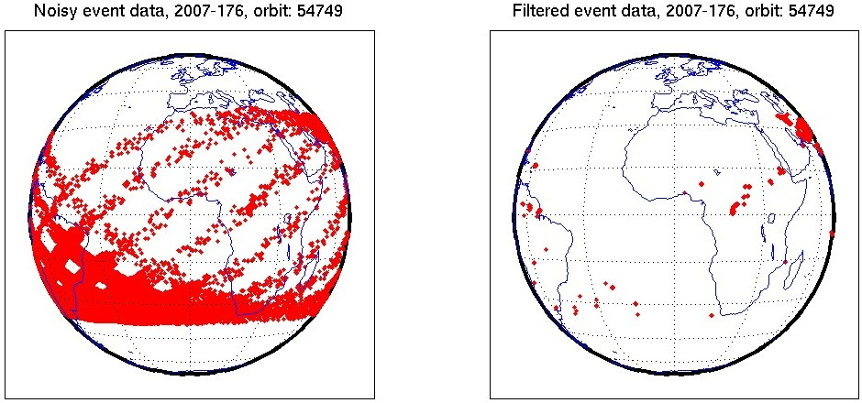
Investigation of noisy LIS data
Geolocated events but with all filters switched off
(data provided by Dennis Buechler/ Doug Mach)
Effect of filtering
=>
L2 events where all filters have been applied
Overall rejection rate for
this data set ~80%

Slide 28
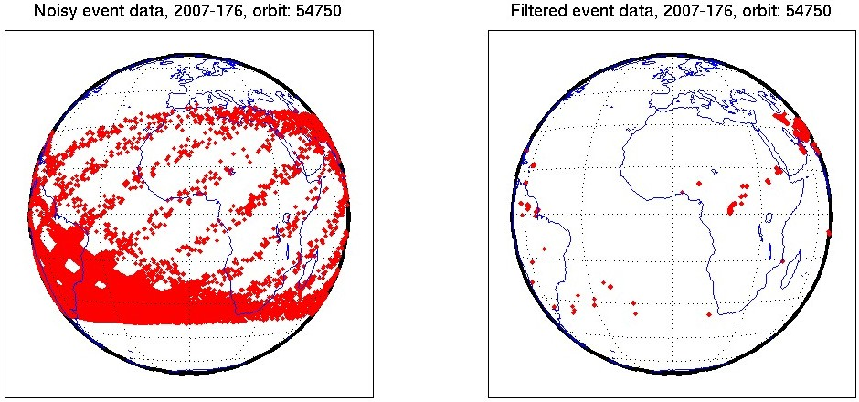
Investigation of noisy LIS data
Geolocated events but with all filters switched off
(data provided by Dennis Buechler/ Doug Mach)
Effect of filtering
=>
L2 events where all filters have been applied
Overall rejection rate for
this data set ~80%

Slide 29
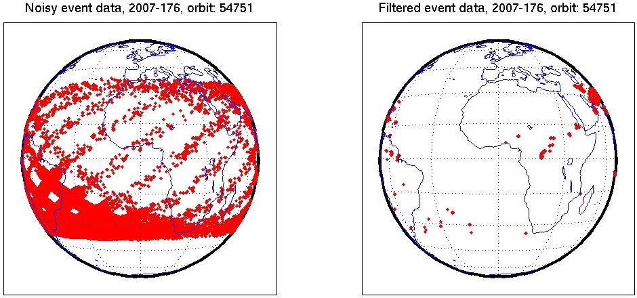
Investigation of noisy LIS data
Geolocated events but with all filters switched off
(data provided by Dennis Buechler/ Doug Mach)
Effect of filtering
=>
L2 events where all filters have been applied
Overall rejection rate for
this data set ~80%

Slide 30
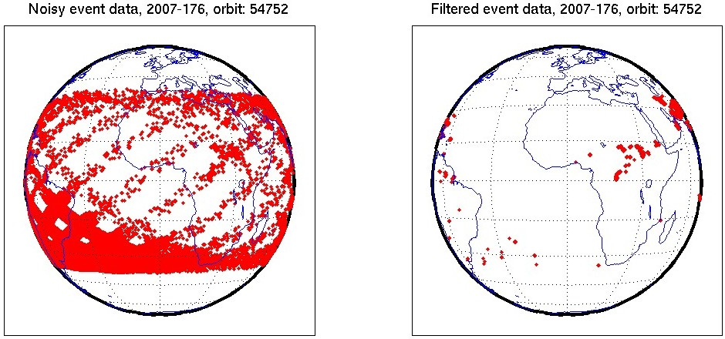
Investigation of noisy LIS data
Geolocated events but with all filters switched off
(data provided by Dennis Buechler/ Doug Mach)
Effect of filtering
=>
L2 events where all filters have been applied
Overall rejection rate for
this data set ~80%

Slide 31
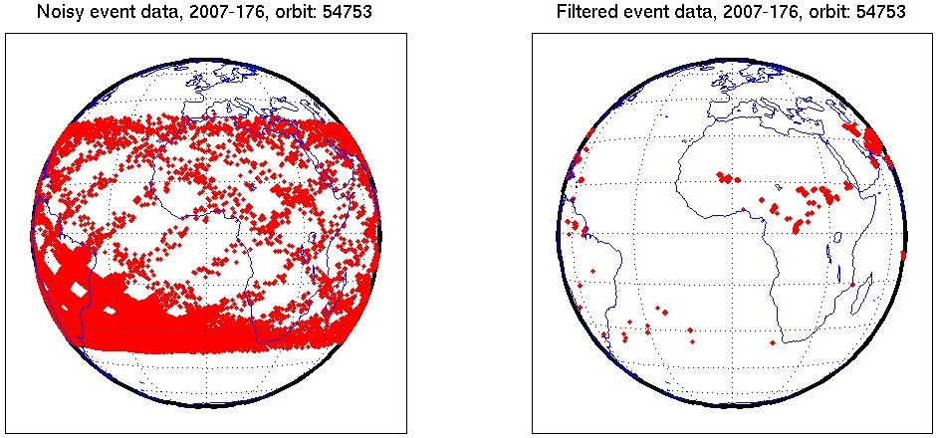
Investigation of noisy LIS data
Geolocated events but with all filters switched off
(data provided by Dennis Buechler/ Doug Mach)
Effect of filtering
=>
L2 events where all filters have been applied
Overall rejection rate for
this data set ~80%

Slide 32
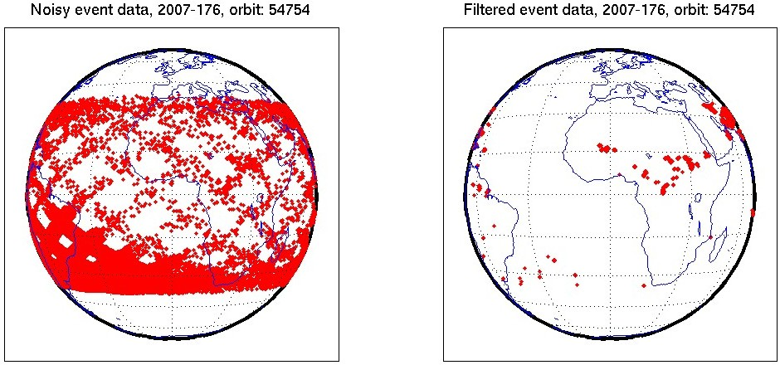
Investigation of noisy LIS data
Geolocated events but with all filters switched off
(data provided by Dennis Buechler/ Doug Mach)
Effect of filtering
=>
L2 events where all filters have been applied
Overall rejection rate for
this data set ~80%

Slide 33

Investigation of noisy LIS data
Geolocated events but with all filters switched off
(data provided by Dennis Buechler/ Doug Mach)
Effect of filtering
=>
L2 events where all filters have been applied
Overall rejection rate for
this data set ~80%

Slide 34
Topics of Presentation
Quick introduction to Meteosat Third Generation (MTG)
MTG LI instrument status update
Lightning Imager Science Team (LIST)
Examples of LIST studies supporting LI L1/L2 processor development
  EUMETSAT contribution to the CHUVA campaign (LINET measurements)
  LIProxy – tool for proxy data development and LI simulation
Summary

Slide 35
MTG Lightning Imager Science Team (LIST)
In order to support activities for establishing a scientific baseline for the operational Lightning Imager (LI) L2 processor, a MTG LI Science Team was set up in 2009.
The main objectives of this (external) team is to:
  Assist EUMETSAT with the implementation of the MTG LI L2 scientific baseline processor.
  Prepare an Algorithm Theoretical Basis Document (ATBD). It includes also a description of the proxy dataset, to be used for algorithm development and processor development.
The ATBD V1 was subject for review at the Preliminary Design Review (PDR) concluding the MTG system Phase B activities in May-June 2011
LIST continues to support EUMESTAT for L2 processor development and ATBD updates

Slide 36
MTG Lightning Imager Science Team (LIST)
The MTG LI Science Team, led by EUMETSAT, currently consists of the following members:
  Graeme Anderson (MetOffice – United Kingdom)
  Daniele Biron (USAM – Italy)
  Eric Defer (LERMA – France)
  Ullrich Finke (U. Hannover – Germany)
  Hartmut Höller (DLR – Germany)
  Philippe Lopez (ECMWF)
  Douglas Mach (NASA – USA)
  Antti Mäkelä (FMI – Finland)
  Dieter Poelman (RMI – Belgium)
  Serge Soula (Laboratoire d'Aerologie – France)
In addition, invited experts are contributing to individual meetings.

Slide 37
Topics of Presentation
Quick introduction to Meteosat Third Generation (MTG)
MTG LI instrument status update
Lightning Imager Science Team (LIST)
Examples of LIST studies supporting LI L1/L2 processor development
  EUMETSAT contribution to the CHUVA campaign (LINET measurements)
  LIProxy – tool for proxy data development and LI simulation
Summary

Slide 38
LIST study: EUMETSAT contribution to the CHUVA field campaign
A study was initiated to provide the EUMETSAT contribution (LINET measurements) to the CHUVA Field Campaign which took place (IOP) in the Sao Paulo area in Brazil from December 2011 to April 2012.
The aim of the study was:
    to generate a very comprehensive data set of lightning observations (surface based VHF/LF/VLF observations, surface & space based optical observations from the polar orbit and MSG SEVIRI imagery)
    to enhance the generation of geostationary lightning imager proxy data,
    to support the development of verification and validation strategies for these novel instruments (MTG-LI and GOES-R GLM),
    to enable development of strategies for a complementary use of surface based VLF lightning location systems and space-based optical systems such as MTG-LI, and
    to foster the user readiness for the future MTG-LI mission.

Slide 39
LIST study: EUMETSAT contribution to the CHUVA field campaign
Within the study the portable LINET system, owned and operated by DLR, was deployed in Brazil.
    Measurements were taken continuously from December 2011 to April 2012 and could also be monitored in real-time via a link provided by Nowcast on the web.
A second part of the study (Oct 2012 - April 2013) will concentrate on the creation of an enhanced proxy data method, based on LINET data as in input source and the findings of the data comparisons especially between LINET and LMA
    This LINET-based proxy data V2 will be available after the study closure (April 2013), with a coverage of almost all of Europe.
    A Real-time processing of the LINET proxy data is also being planned => user readiness application

Slide 40
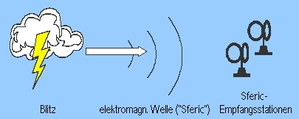
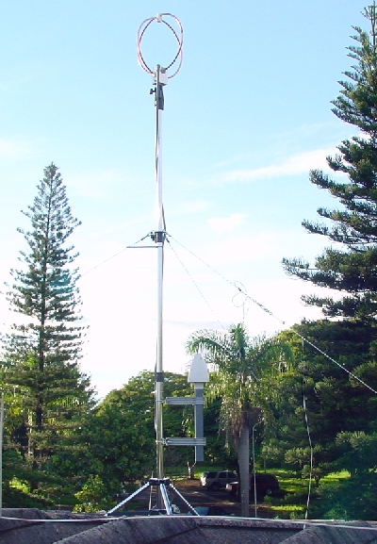
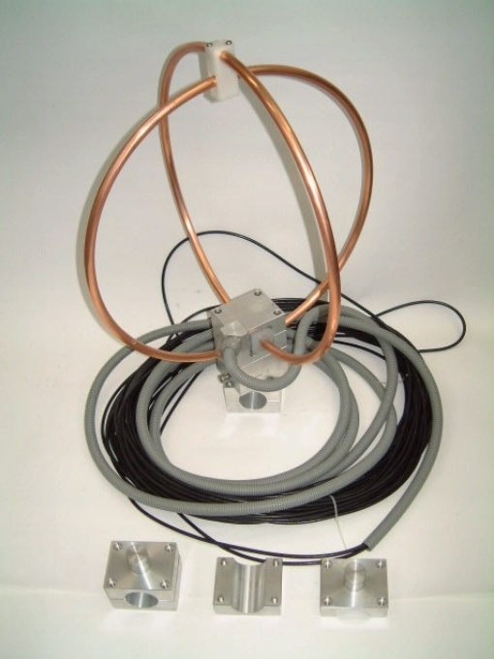
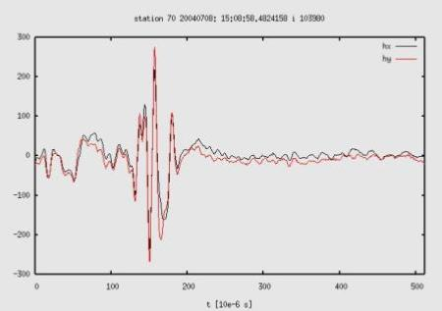
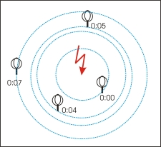
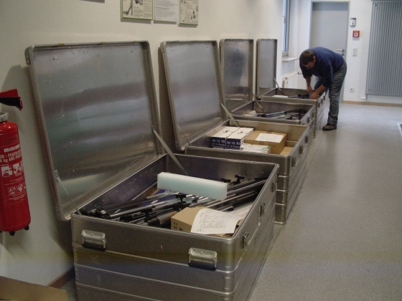
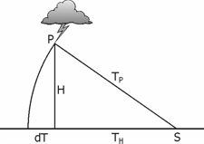
LINET (Lightning Detection Network in VLF/LF)
System Characteristics
  Measurement of magnetic field
  TOA Method for lightning location
  IC - CG discrimination
  Height of IC events

Slide 41
LINET sites in the CHUVA campaign (Sao Paulo area)
Baselines in the order of ~20-40 km

Slide 42
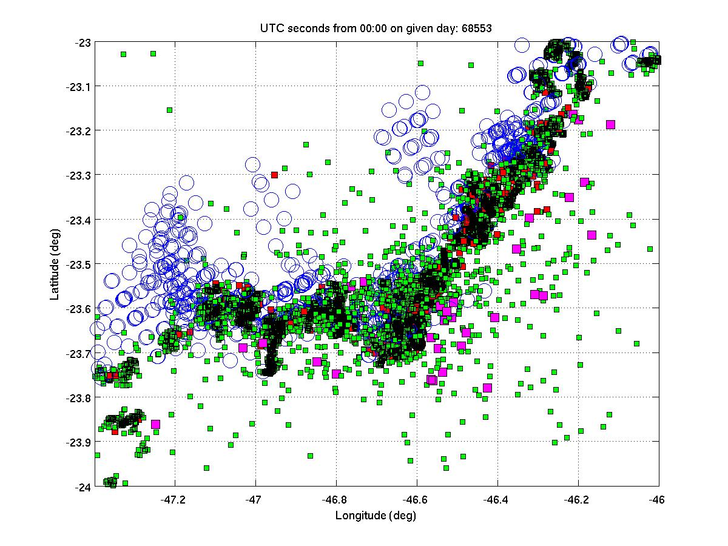
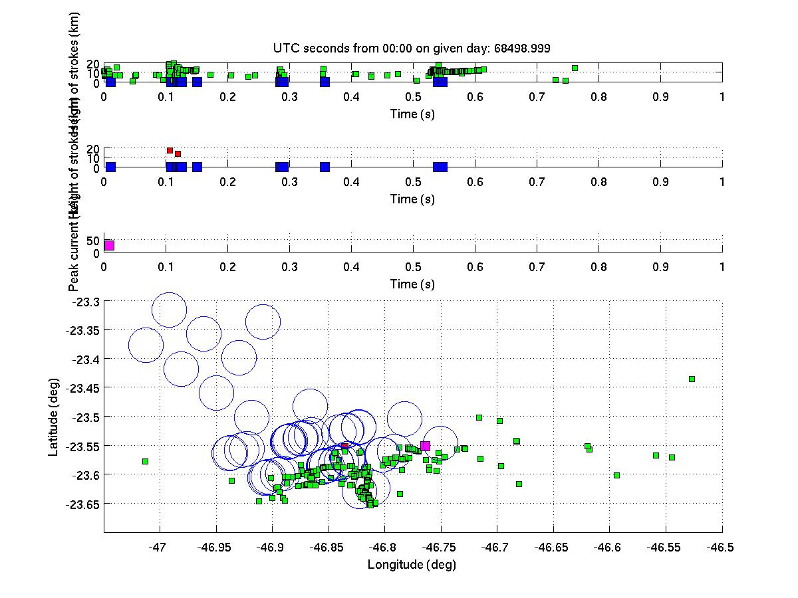
Example: Full LIS overpass on 10 Feb 2012 (60 seconds of data)
60 seconds contains already loads of data – need to look much closer
LIS event (~5 km footprint)
LIS event (in the temporal axis view)
STARNET stroke
LMA source (part of channel formation)
LINET stroke

Slide 43
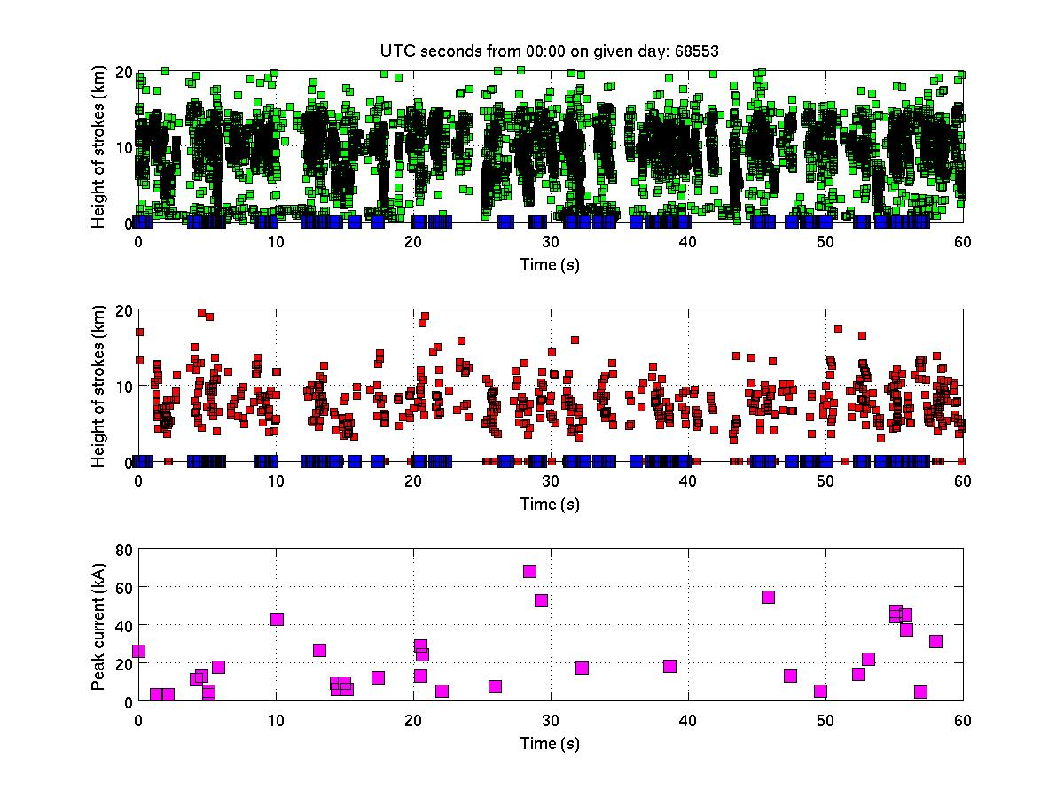
Example: Full LIS overpass on 10 Feb 2012 (60 seconds of data)
In temporal view (X-axis shows time of LIS overpass):
LIS event (in the temporal axis view)
STARNET stroke
LMA source (part of channel formation)
LINET stroke

Slide 44
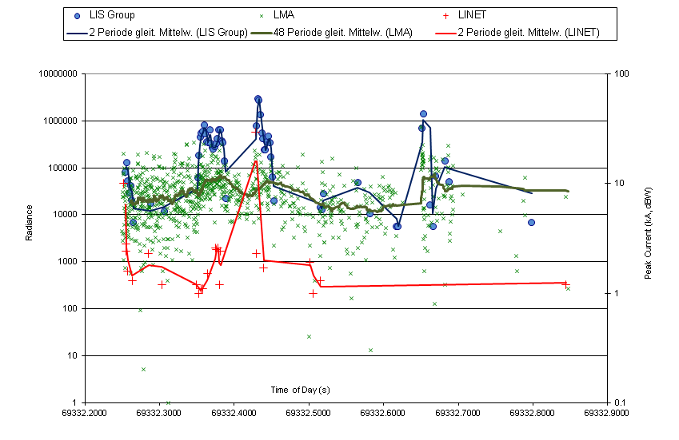
Case Studies
8 Feb 2012
  LIS group radiance, LINET peak current (absolute value) and LMA source power on 8 Feb 2012

Slide 45
Conclusions
Preliminary Summary
CHUVA lightning campaign was very successful with respect to the objectives
7 months (Oct 2011 – April 2012) of lightning data available for analysis complemented by XPOL radar data
4-6 good cases with LIS overpasses of the inner network area (more than 20 cases in a wider area)
As found in a previous study done by DLR (funded by EUMETSAT), LINET strokes and LIS groups are well correlating
XPOL radar helps in interpretation of 3D cloud structure important for scattering of light

Slide 46
Topics of Presentation
Quick introduction to Meteosat Third Generation (MTG)
MTG LI instrument status update
Lightning Imager Science Team (LIST)
Examples of LIST studies supporting LI L1/L2 processor development
  EUMETSAT contribution to the CHUVA campaign (LINET measurements)
  LIProxy – tool for proxy data development and LI simulation
Summary

Slide 47
LIST study: LIProxy tool for generating MTG-LI proxy data
LIproxy is a Matlab-based computational tool that simulates the expected LI operational data
    The development of the tool was started in 2010 as a LIST activity.
    First version of the tool was created by Prof. Ulli Finke, and later further developed by CNMCA (Italian Meteorological Service) on EUMETSAT contracts
The tool simulates lightning pulses with “photons” which are a tool-internal unit to describe the pulse.
The location/density of the pulses can be generated based on conceptual models or from external data such as ground-based networks (ATDnet or LINET) – this also allows realistic storm conditions to be simulated
Event detection is then based on given parameters for threshold, saturation,...

Slide 48
LIST study: LIProxy tool for generating MTG-LI proxy data
Recent updates to the tool include:
    Introduction of modules for noise simulation in LIProxy tool in order to enable the use of LIProxy for the full chain (L1b+L2) processor development
        Random noise (simple statistical noise to investigate saturation)
        1st version of spacecraft motion generated noise
    Fully reworked GUI
Currently ongoing work:
    Implementing a background module for SEVIRI images
    Noise modules for particle noise and Sun glint
Future plans:
    Implementation of an “instrument model” once the LI design is available

Slide 49


Slide 50
Topics of Presentation
Quick introduction to Meteosat Third Generation (MTG)
MTG LI instrument status update
Lightning Imager Science Team (LIST)
Examples of LIST studies supporting LI L1/L2 processor development
  EUMETSAT contribution to the CHUVA campaign (LINET measurements)
  LIProxy – tool for proxy data development and LI simulation
Summary

Slide 51
Summary
Meteosat Third Generation (MTG) will secure continuity and evolution of EUMETSAT geostationary services from 2018 onwards
    One of the new instruments on MTG is the Lightning Imager (LI) providing continuous lightning observation (CG+CC) over almost the full disk (at 0 deg).
Instrument prime was selected (Selex Galileo), with kickoff in July 2012 – System Requirements Review (SRR) to take place in October 2012.
MTG Lightning Imager Science Team (LIST) supporting activities for defining a baseline L2 ATBD and prototype processor development
    Main achievements so far: ATBD V1, Proxy data, LIProxy tool, support to CHUVA campaign, …

Slide 52
Thank you!
Further information and contact:
Jochen.Grandell@eumetsat.int

