Slide 1
Lightning NOx measurements during and after DC3
GLM Science Meeting, Huntsville, AL
September 19, 2012
Harold Peterson: USRA
Arastoo Biazar, Mike Newchurch, Wesley Cantrell: UAH

Slide 2
Motivation
Lightning NOx has been measured by:
Aircraft
Satellite
Laboratory
Chambers capturing rocket-triggered lightning
Models
What has yet to be done is a simple measurement near thunderstorms

Slide 3
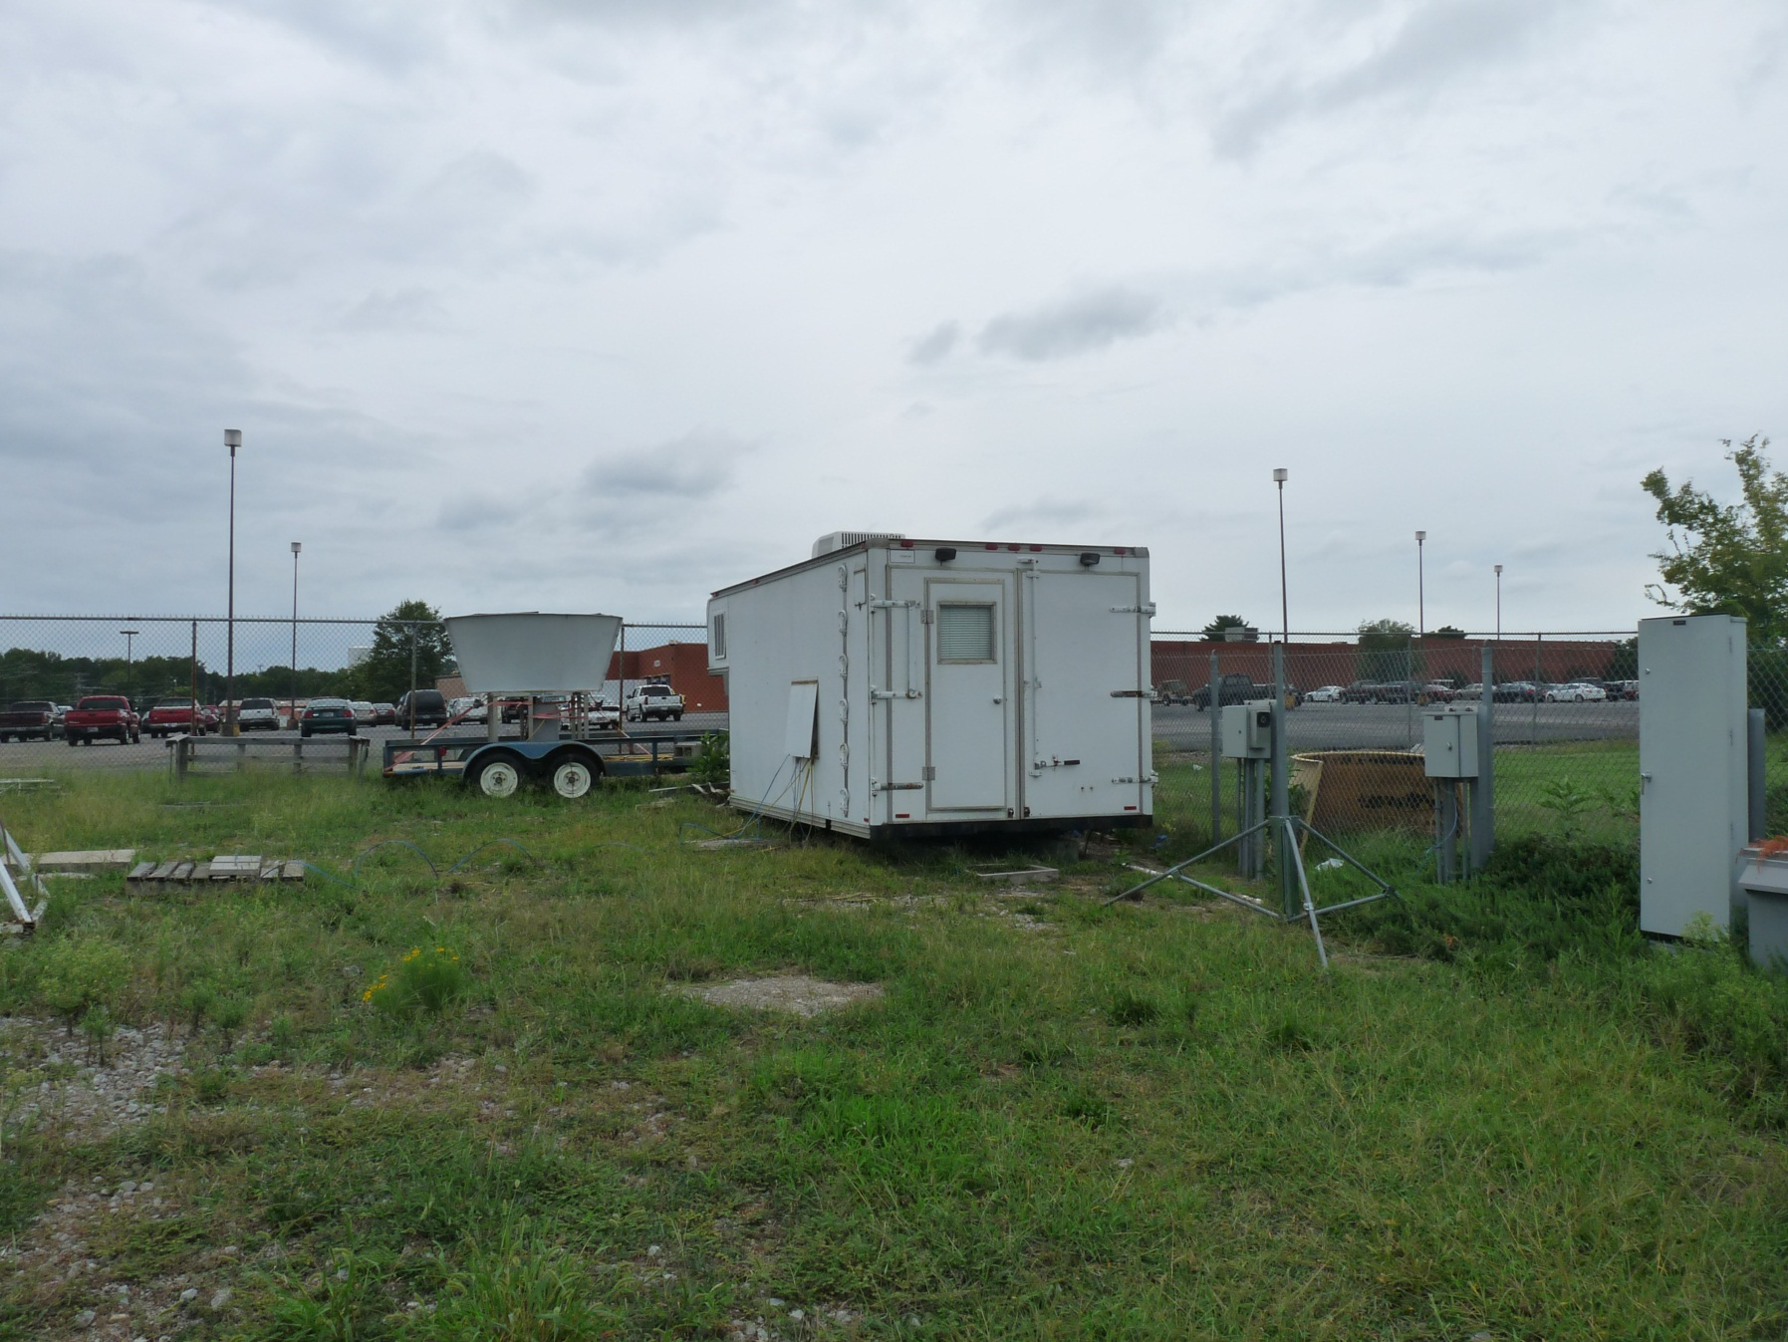
Experiment design

Slide 4
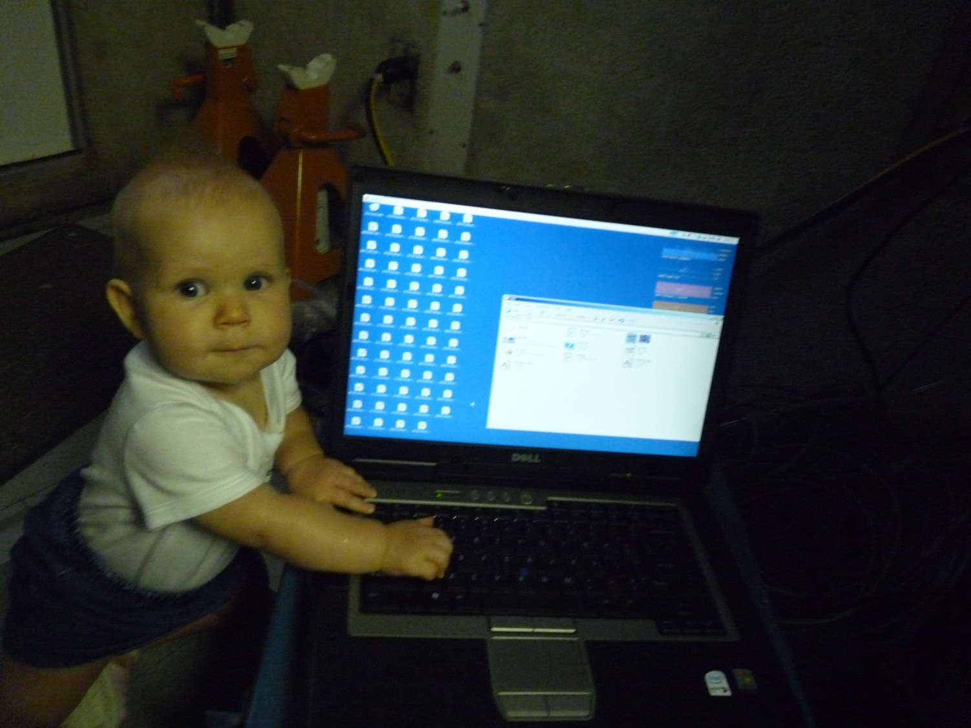
Experiment design
So simple a baby could do it? (Well, almost…)

Slide 5
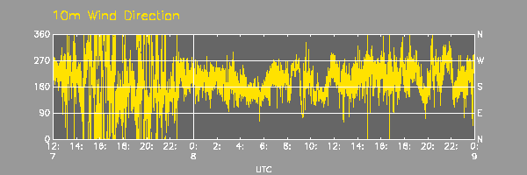
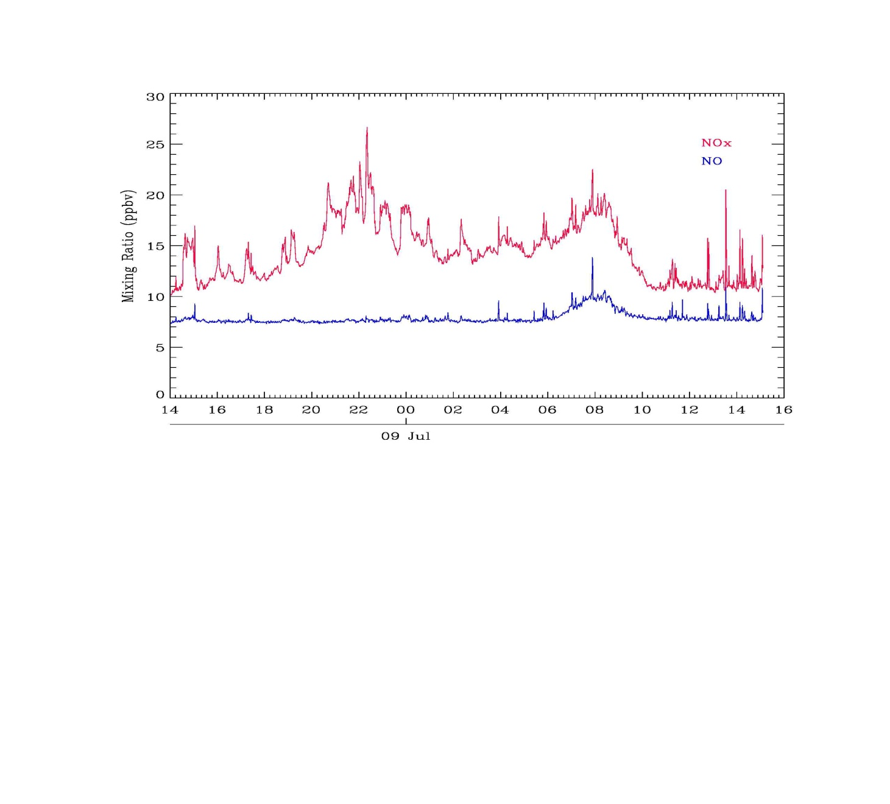
Detailed measurements
NLDN Lightning image is for 5:00-5:15 p.m. local time, with SW winds at the surface advecting in NOx (all NO2)

Slide 6
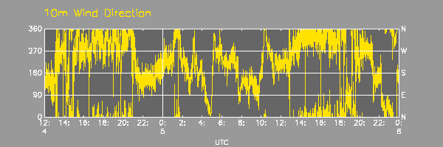
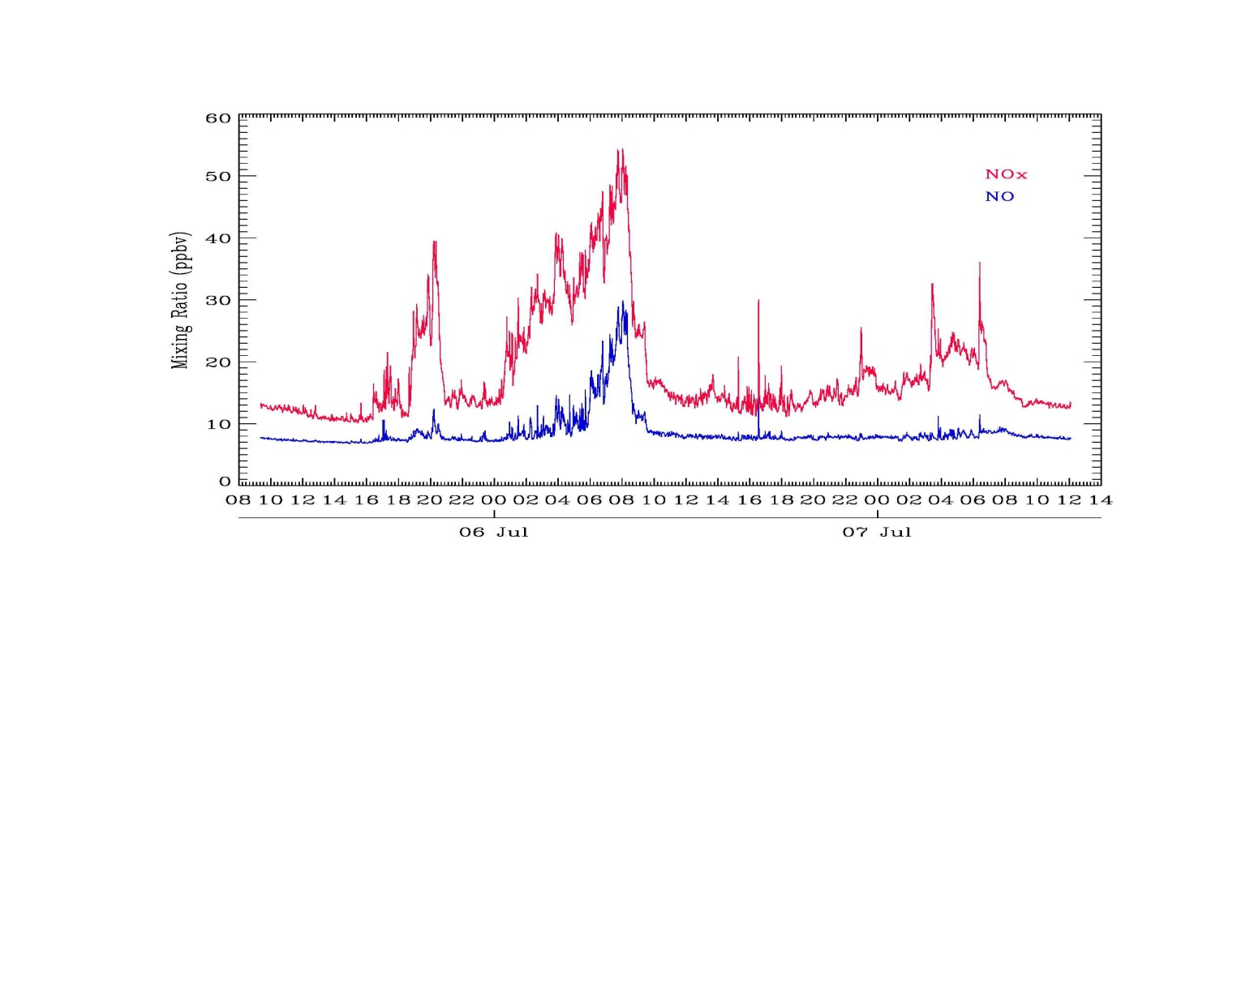
Detailed measurements
Lightning image on left is for 5:45-6:00 p.m. local time, with N to NE winds at site; slight time lag in CG lightning to NOx increase (mostly NO2)

Slide 7
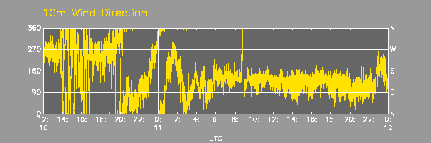
Detailed measurements
Lightning image is for 5:00-5:15 p.m. local time; SSE winds at the time of the increase in NOx (mostly NO2)

Slide 8
Conclusions
Lightning NOx has a signal that is unique from anthropogenic NOx
Lower amplitude (sometimes), longer duration, NO2 instead of NO
Larger than background NOx, so we know there is an additional source above and beyond concurrent anthropogenic NOx
No wildfires present in the area during the measurement period, so there are no other natural NOx sources

Slide 9
Conclusions
Consequence 1: Larger than normal peaks in NOx concentration may result from an anthropogenic event superimposed on a lightning event (compare July 6 and July 7 morning NOx)

Slide 10
Conclusions
Consequence 2 (TBD): Similar effects are predicted for lightning ozone

Slide 11
Acknowledgements
Thank you to Solomon Bairai and TVA for loaning us a calibrated NOx detector
NLDN lightning images are from the Global Hydrology Research Center
Wind direction maps are from Kevin Knupp’s berm instruments

