Slide 1
Nimbus
Dr. Matthew Goodman, DSO Program Manager
Briefing prepared for GLM Annual Science Meeting
National Space and Technology Center – September 19, 2011
Huntsville, AL
Approved for Public Release, Distribution Unlimited

Slide 2
The Agency

Slide 3
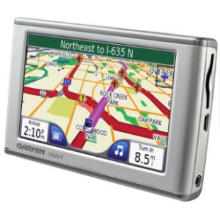
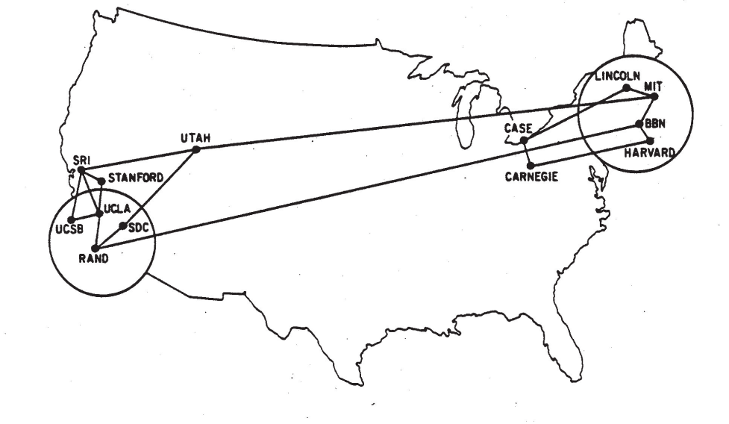
DARPA
The Soviet Union’s launch of Sputnik showed that a fundamental change was needed in America’s defense science and technology programs. DARPA was formed to meet this need and rejuvenated our defense technological capabilities.
Some of DARPA’s best (and least known) accomplishments:
1. Recommended the formation of NASA
3. GPS technology
2. The internet
ARPANET c.1970

Slide 4
Nimbus Background

Slide 5
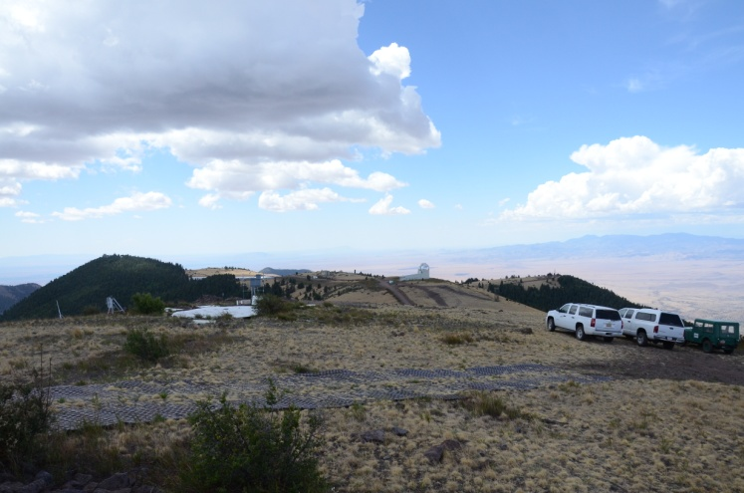
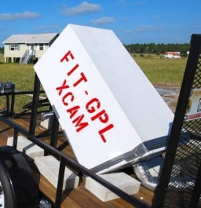
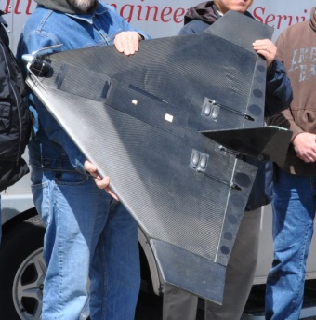
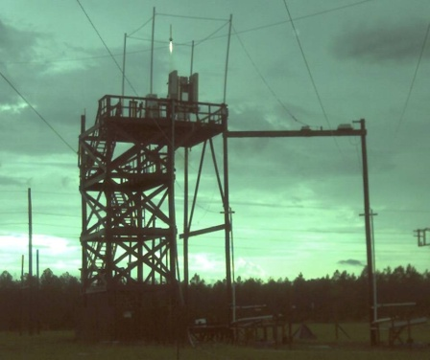
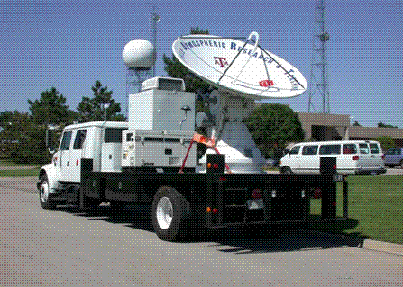
Summary
Nimbus is a fundamental science program focused on obtaining a comprehensive understanding of the lightning process, its associated emissions and its ionospheric components.
Why: Lightning is unpredictable and poses a significant danger to personnel, aircraft, electronic equipment, military assets and ordnance. Outdoor operations may be limited and more complicated when lightning is present within a predetermined radius.
How: Seven unique performer teams are measuring, observing and recording all parameters and physical processes associated with both natural and triggered lightning across the United States, from ground to space, DC to daylight, using a comprehensive suite of state-of-the-art instrumentation, equipment and facilities.

Slide 6
Scientific Goals
Broad Goals:
Develop scientific foundations for understanding the lightning discharge.
Develop experimentally validated, statistical models of the triggering of lightning.
Quantify the impact of triggered lightning on properties of natural lightning (including the emission of gamma rays, x-rays, UV, VNIR/SWIR, RF,VLF/ULF) and on the properties of ionospheric phenomena (elves, sprites, whistlers, etc.).
Specific Phase I Goals:
Operate at least 2 triggering facilities to obtain data about different types of thunderstorms in various geographical regions.
Measure and characterize critical parameters for lightning initiation, propagation and attachment.
Model, measure and characterize associated lightning phenomena (e.g., terrestrial gamma ray flashes, compact intracloud discharges, etc.).
Model, measure and characterize upward-going lightning (cloud to ionosphere).
Model, measure and characterize ionospheric phenomena (sprites, elves, whistlers, etc.) using ground observations.
Model, measure and characterize tropospheric lightning over large distances under different environmental conditions.

Slide 7
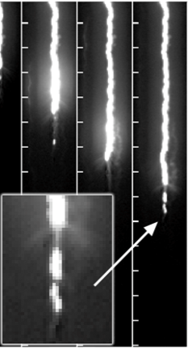
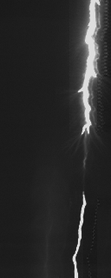
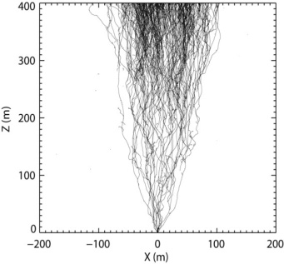
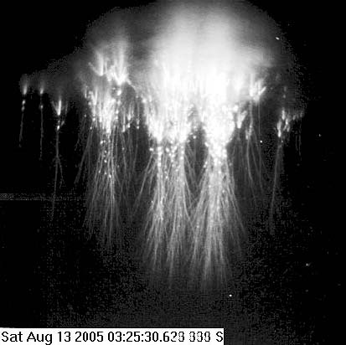
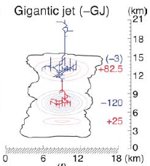
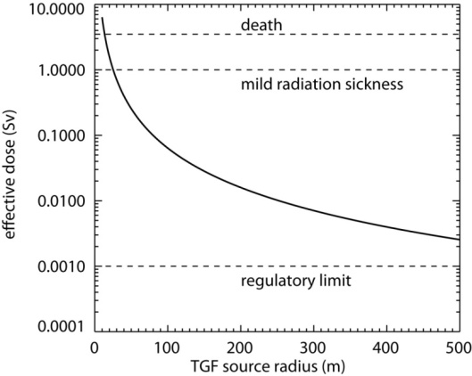
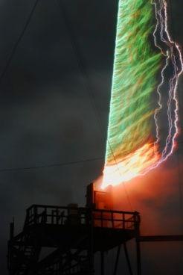
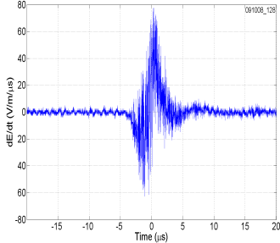
Research Thrust Areas
Initiation
Propagation
Attachment
Emissions
Ionospheric Effects
Compact Intracloud Discharges (CIDs)
Terrestrial Gamma-ray Flashes (TGFs)
Triggered Lightning
Microphysics
dE/dt

Slide 8
Significant Research Questions Abound
Initiation: What high energy processes (runaway electrons, x-rays, gamma rays) are involved in lightning initiation and how?
Propagation: Why and how do lightning leaders step?
Attachment: How do objects on the ground respond to the downward propagating stepped-leader, and what properties can enhance the probability of producing a successful upward streamer that will connect to the stepped-leader?
Emissions: By what physical mechanisms do lightning leaders emit x-rays and do the x-rays affect propagation?
TGFs: By what physical mechanisms are TGFs produced and are they hazardous to aircraft and humans in the aircraft?
CIDs: How are CIDS related to other phenomena (gigantic blue jets, TGFs, etc.)?
Ionospheric Effects: Do transient luminous events play a significant role in mesospheric physics, or in coupling the troposphere to the ionosphere?
Triggered Lightning: How exactly does rocket-and-wire (classical and altitude) triggering of lightning work?
Microphysics: What controls when a cloud ceases production of lightning flashes?

Slide 9
New Insights

Slide 10
Initiation
Video: Natural Lightning Strike
New theory suggests that when runaway electron avalanches exceed the relativistic threshold, the in-cloud electric field is forced to discharge.

Slide 11
Propagation
Video: Natural Lightning Strike
Experimental evidence has shown there are at least three classifications of negative leaders: stepped leaders, dart-stepped leaders, and "chaotic" dart leaders.

Slide 12
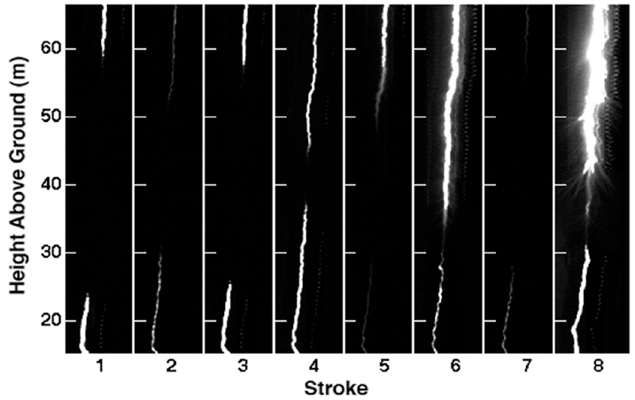
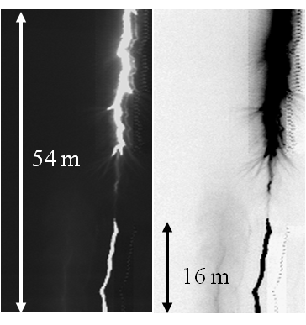
Attachment
Downward leader connecting to upward leader
Photoelectric radiometers have provided evidence that the attachment process produces a characteristic signal (regardless of whether the stroke was natural or triggered).

Slide 13
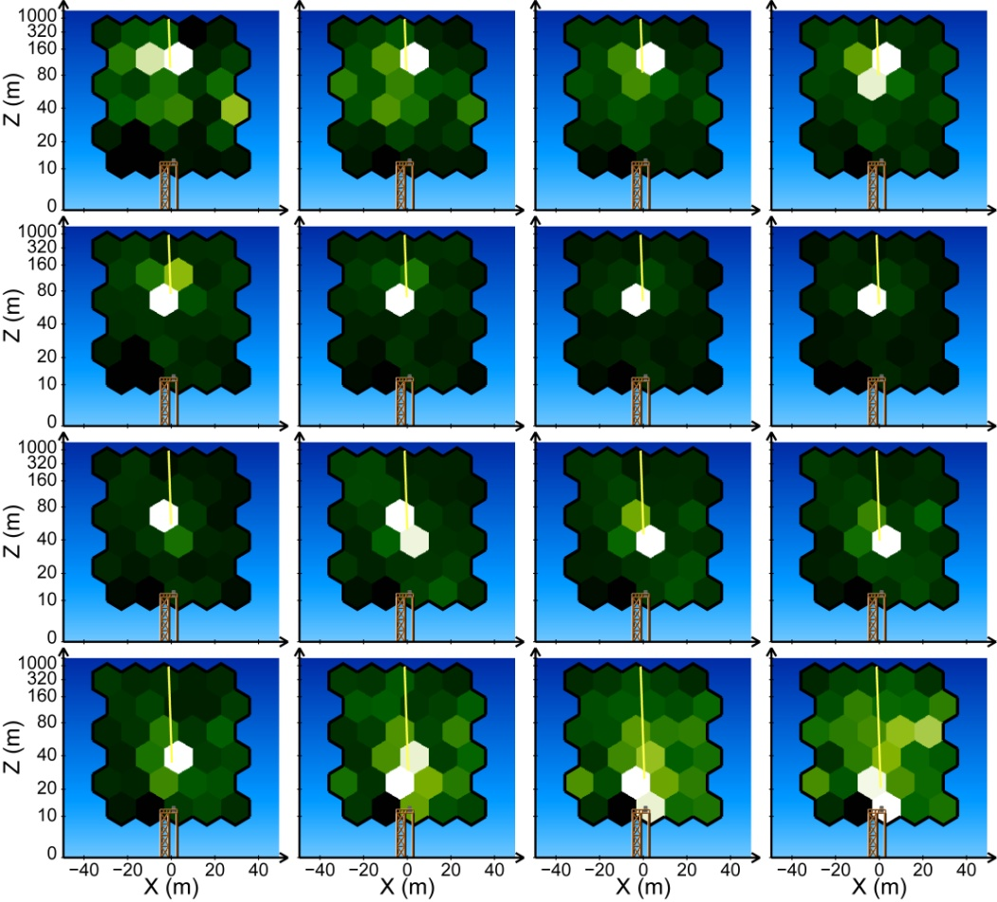
Emissions
Succesive 0.1-msec image of x-ray emissions from a 28 kA peak current lightning strike. The amount of x-ray energy increases dramatically with the return stroke current.
Measurements of energetic radiation (x-rays, gamma rays, electrons and neutrons) by thunderstorms and lightning is strong enough for the creation of phosphenes in humans.

Slide 14
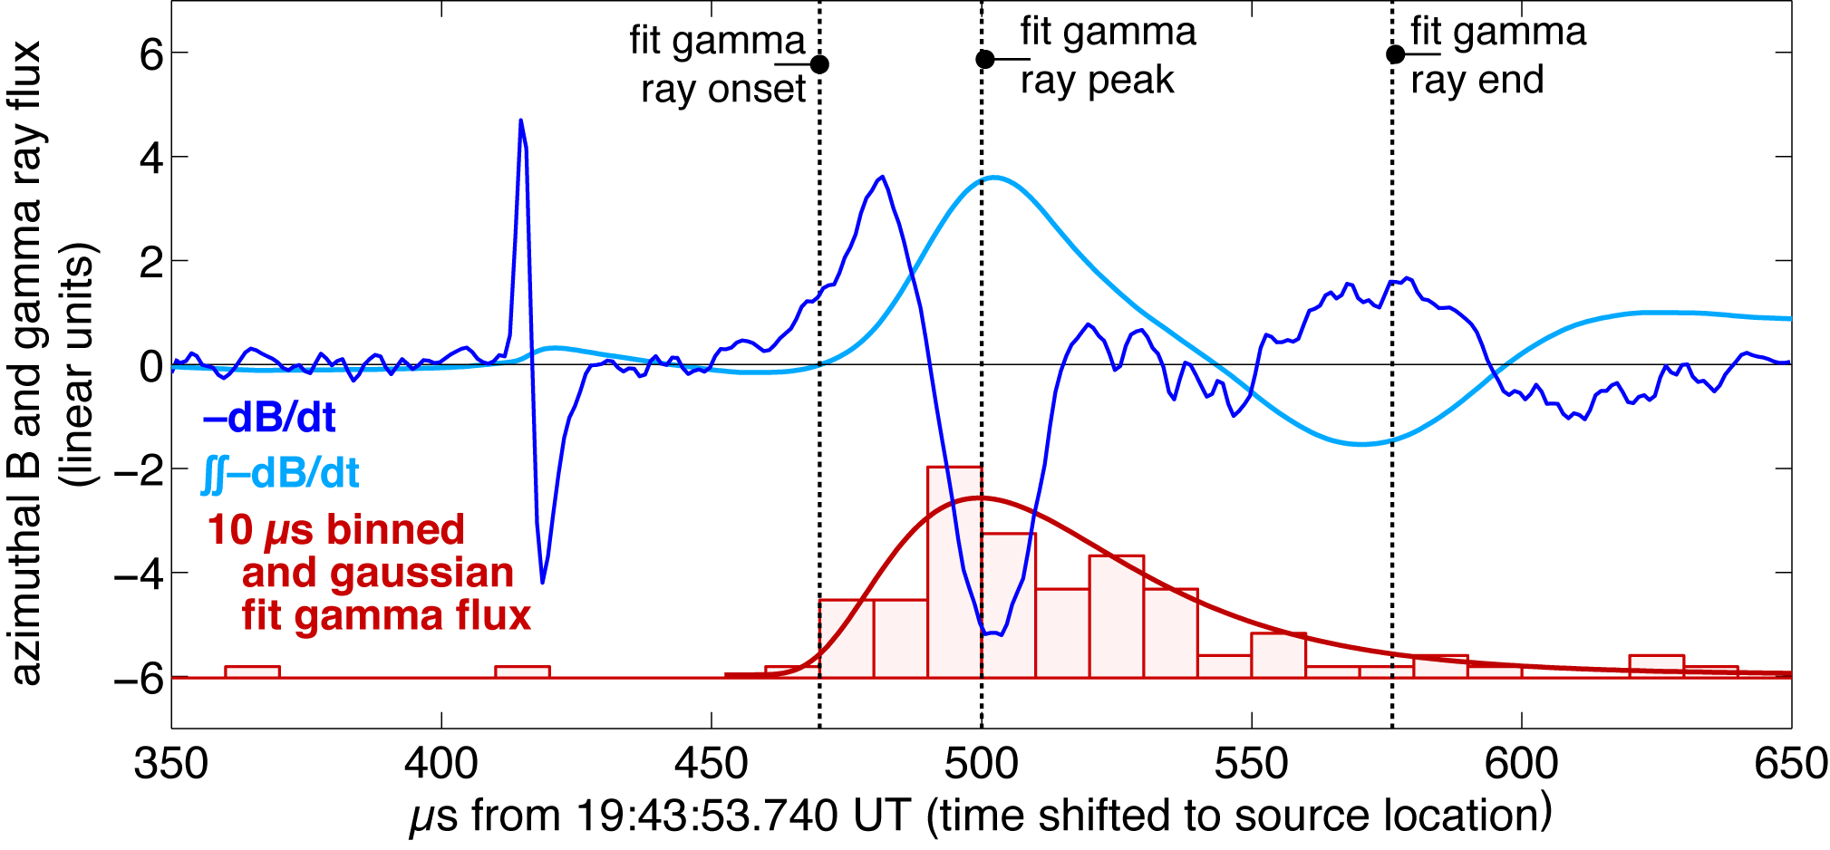
Terrestrial Gamma-ray Flashes (TGFs)
Evidence has revealed that source current is very closely aligned with gamma and x-ray production.

Slide 15
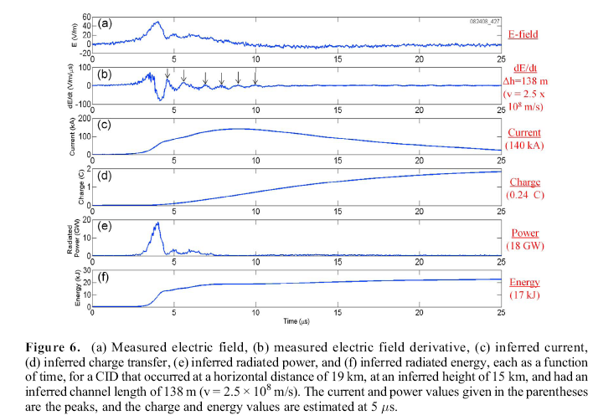
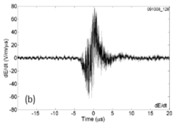
Compact Intracloud Discharges (CIDs)/Narrow Bipoloar Events (NBEs)
New evidence suggests that the VHF radiation associated with Narrow Bipolar Pulses is chaotic and randomly polarized.

Slide 16
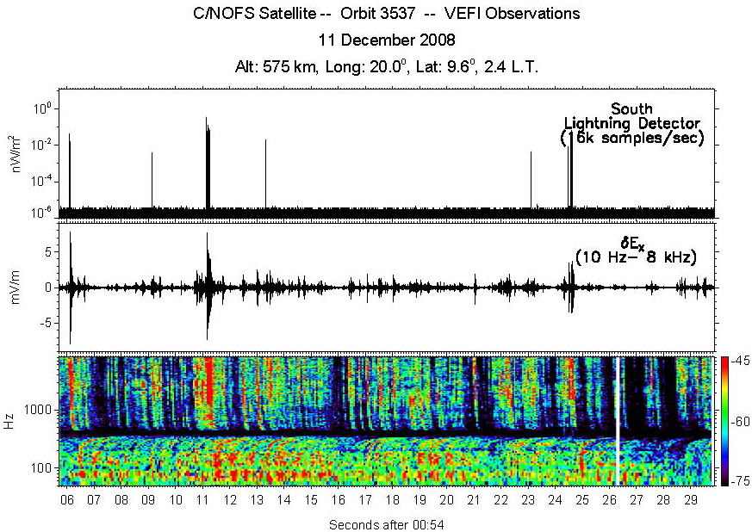
Ionospheric Interactions/Components
Figure 1. 24-second burst memory example at 575 km altitude
New evidence reveals that lightning often creates large electric field signals that are co-located with narrow, deep ionospheric density depletions in the equatorial ionosphere.

Slide 17
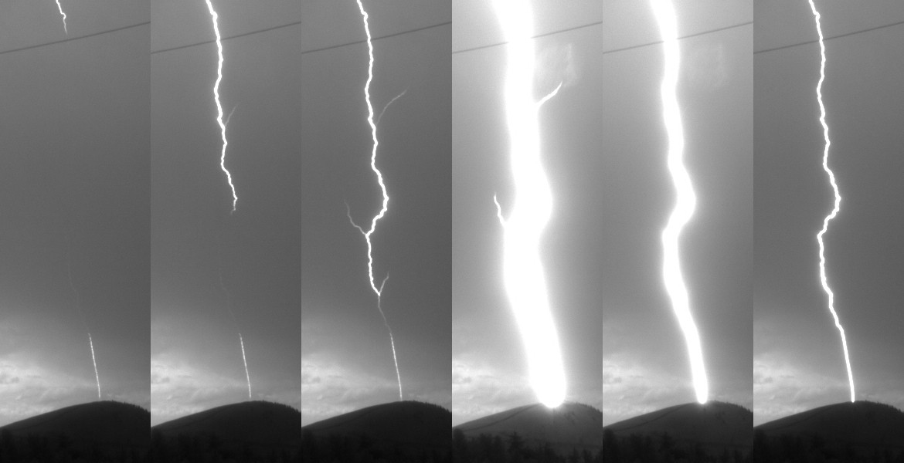
Triggered Lightning
Triggered Lightning with 16 Return Strokes – Real Time
New photographic evidence reveals that as the dart-leader travels down the main channel, it also travels back up channel branches, depositing charge which is then removed during the return stroke.
Triggered Lightning – High Speed Video

Slide 18
Microphysics
VHF mapping instruments have detected the structure of lightning flashes that create high altitude leaders (up to 35 km altitude), which may be precursors to Gigantic Blue Jets.

Slide 19
In Conclusion

Slide 20
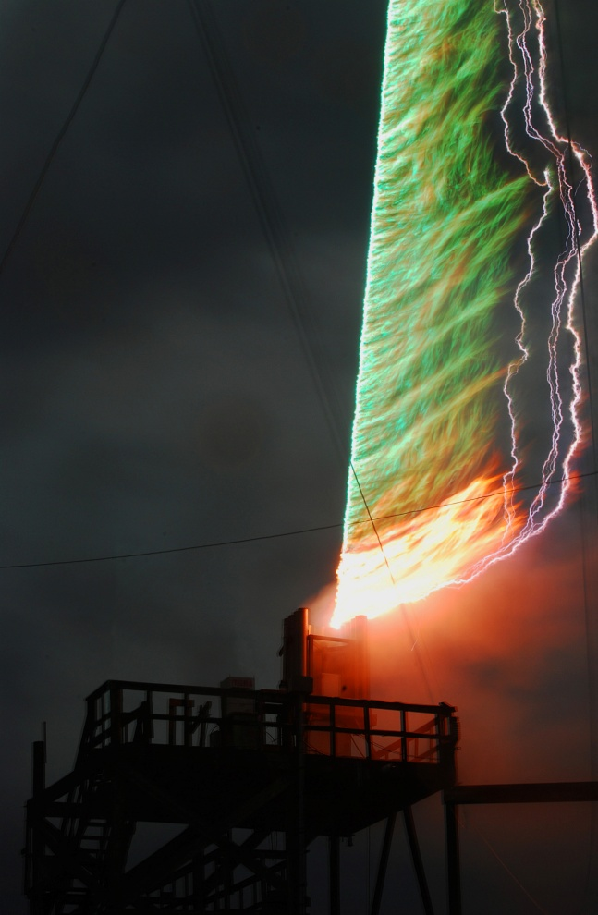
Success Defined
Achieving and/or exceeding each of the goals set forth in the Nimbus program will result in a revolutionary understanding of the lightning process.
Accurate lightning models = lightning prediction, mitigation, and protection
Understanding of the effects of lightning on the ionosphere = Protection of communications and space assets, and mitigation or elimination of interference

Slide 21
Approved for Public Release, Distribution Unlimited

