Slide 1
GOES-R Calibration & Validation Update
Bob Iacovazzi Jr.
GOES-R PSE Calibration Coordination Team Lead
GLM Science Meeting
September 20, 2012
Notes:
To-Do:

Slide 2
Outline
GOES-R program-level cal/val scope and overview
Cal/Val Updates
  ABI
  GLM
  Space Weather Instruments
  Ground Segment
Summary
Notes:
To-Do:

Slide 3
GOES-R Cal/Val Scope
Ensure instrument calibration requirements are met
Enhance data integrity by leveraging NIST SI-traceable calibration standards, and testing capabilities and procedures
Reduce risks associated with possible operational failure of on-board calibration systems
Prepare NOAA satellite calibration scientists and engineers for monitoring, analyzing and maintaining GOES-R series instrument calibration and product integrity
Support product validation to determine the degree to which GOES-R science data meets user needs
GOES-R Program commitment to cal/val enhances understanding of data quality, and encourages “Day-1” readiness and long-term user confidence.
Notes:
To-Do:

Slide 4
GOES-R Cal/Val Overview
Activity | Instr and L1b Dev |  |  |  | Sat and L1b I&T |  |  |  | PLT ACT |  | PLT SPOT |  |  |  | Ops
Instr and GS Design Review
Instr Cal and Cal Test Report Review
Product Dev and Implementation
Pre-launch System-Level Testing and Post-Launch Cal/Val Preparation
Cal/Val On-Orbit Checkout
Cal Parameter and Product Algorithm Anomaly Resolution and Updates
“Deep-Dive” Cal/Val Analysis Tools
Cal Trending Initialization & Long-term monitoring
Product Validation
LAUNCH
MCDR
Space Segment Development
Ground Segment Development
Long-term Cal/Val Readiness
Flight Oversight
CCT/CWG/OSPO Support
Instr. Vendor Responsible
GSP Oversight
CCT/CWG/AWG/OSPO Support
GS Vendor Responsible
PSE CCT/CWG/AWG Responsible
MOST/DOST Support
STAR/NGDC/MSFC Responsible
Flight/MOST Responsible
CCT/CWG/OSPO Support
Instr. Vendor Support
GSP/MOST/DOST Responsible
CCT/CWG/AWG/OSPO Support
GS Vendor Support
OSPO Responsible
STAR/NGDC/MSFC Support
Vendor Support as Requested
Notes:
To-Do:

Slide 5
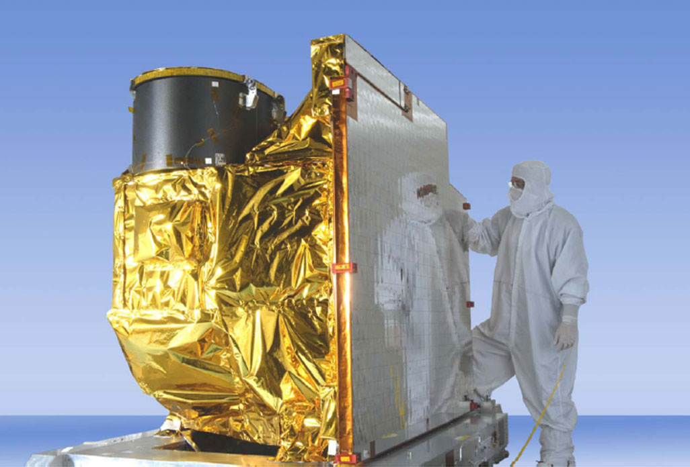
ABI Cal/Val Updates
Notes:
To-Do:

Slide 6
Test Activities: ABI Vendor (ITT Exelis)
Proto-Type Model (PTM)
  Formal testing period complete
  Retested on an as-needed basis to learn about instrument behavior
  PTM not used to verify performance specifications
Proto-Flight Model (PFM)
  Bench Testing
    Revealed a ghosting issue that has been resolved.
    Other tests show ABI meets requirements with few exceptions.
  Pre-Environmental Review set for 16-18 October
Notes:
To-Do:

Slide 7
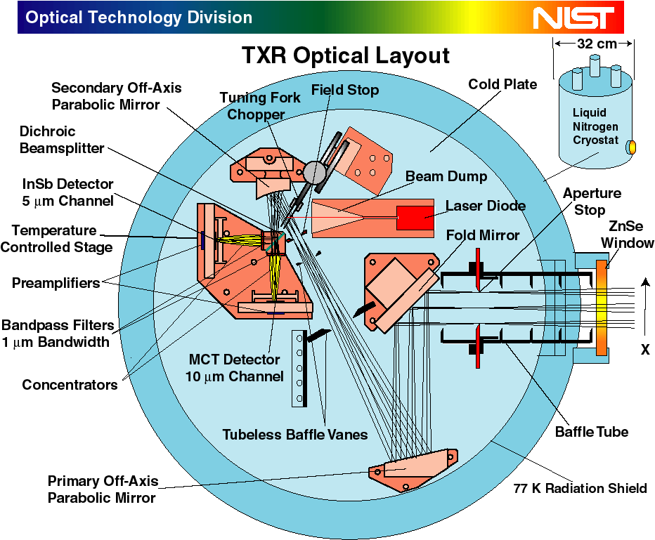
Test Activities: NIST
  Completed Testing
    Instrument-level testing using NIST Traveling Spectral Irradiance and Radiance Responsivity Calibrations using Uniform Sources (SIRCUS)
      Irradiance to radiance transformation validation
      Spectral response validation
    Small integration sphere characterization at the NIST FAcility for Spectroradiometric CALibrations 2 (FASCAL 2)
    External blackbody characterized using the NIST Thermal Transfer Radiometer (TXR)
    Exelis FEL lamp calibration process validation and spatial uniformity test
  Coming in FY ‘13
    Large integration sphere radiance scale validation using the NIST Visible Transfer Radiometer (VXR)
    Determination of witness filter spectral response
NIST SIRCUS
Notes:
1) For SIRCUS Testing – CWG has seen reports. K-value or cal-factor bias for irradiance test [could be an issue with the blocker used in the test that was performed by Exelis]. End-to-end response good except for 1.38 micron, where there is a water vapor issue. Looking to post reports on portal.
2) Planned completion schedule for the NIST testing of the witness filters is January 2013.
3) VXR deployment is to be late January or early February of 2013.

Slide 8
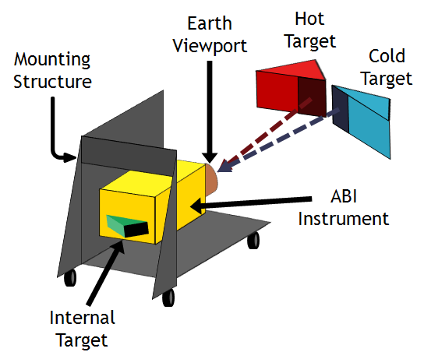
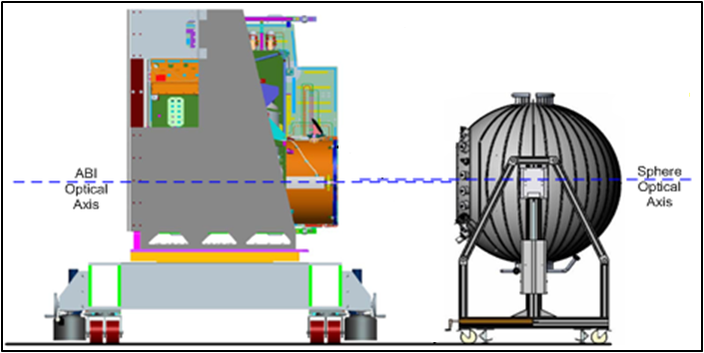
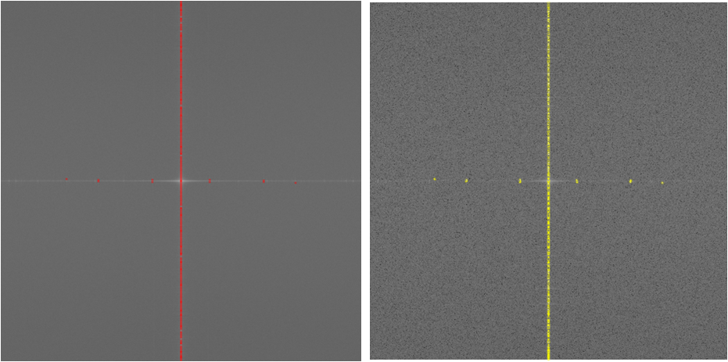
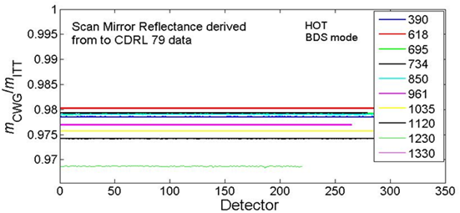
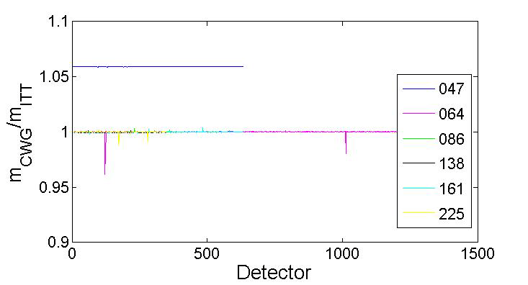
Test Activities: Government Witness and Analysis
Calibration Working Group (CWG) conducted detailed data analysis on pre-launch tests for proto-type model (PTM)
Reflective and emissive channel calibration
Coherent noise; irradiance calibration; and MTF-focus-registration
Exelis
CWG
Emissive (top) and Reflective (bottom) channel calibration test arrangement
Anomalies caused by not using actual scan mirror reflectance values
Anomalies caused by incorrectly reported sphere level
Coherent noise test results - exceedances for 2.25 µm channel
Emissive (left) and reflective (right) channel calibration test results - ratio of CWG to Exelis cal coefficient
Notes:
1) “Incorrectly reported sphere level” - ITT has a bad sphere setting. Output not really associated with pre-assumed setting valued.
2) Has the RCC bench been performed for PFM? This data going to be analyzed, but most tests take place during TVAC and later, after PER.

Slide 9
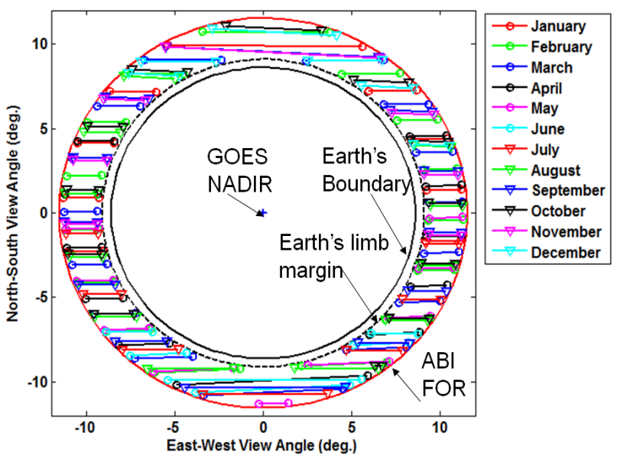
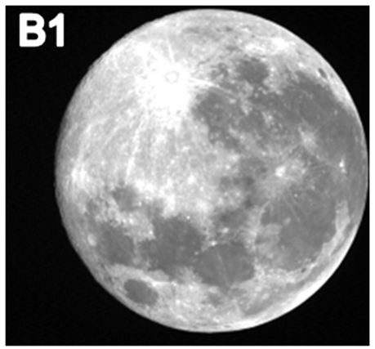
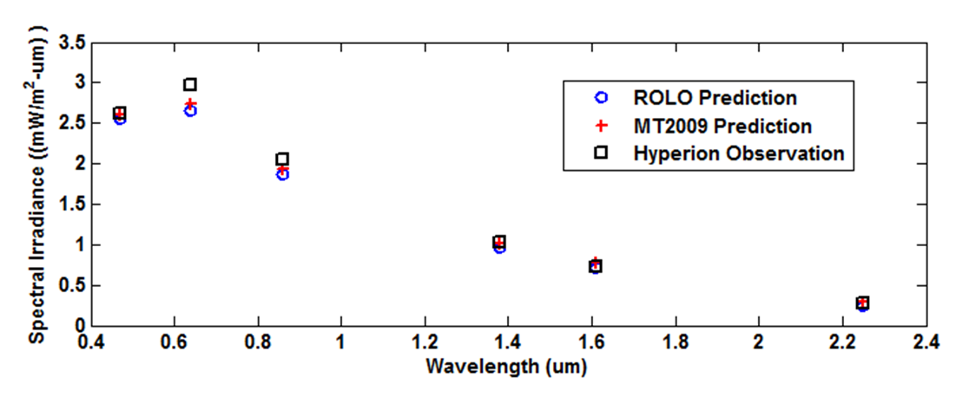
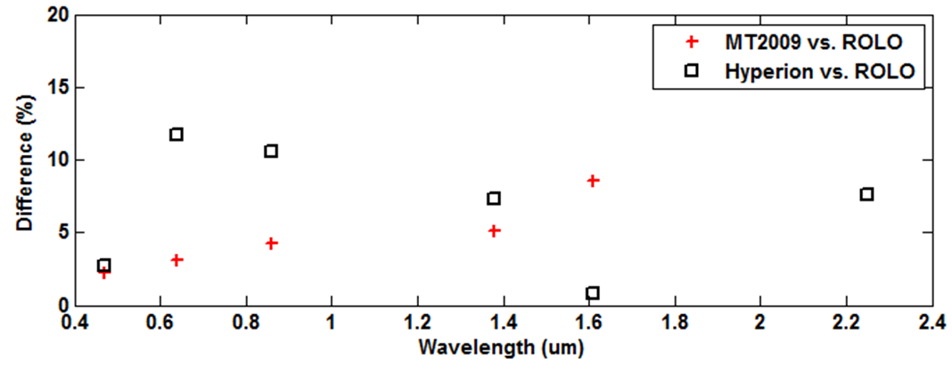
Post-Launch Cal/Val Support Readiness: Lunar cal method implementation
Synthetic ABI 0.47 µm channel lunar observation derived from Hyperion observations.
Prediction of lunar imaging windows of opportunity for GOES-EAST for year 2016, lunar phase < ±60°.
Simulated ABI Lunar irradiance inter-comparisons using Hyperion data and ROLO and Miller-Turner Lunar Models
NIST currently has a proposal out to improve the calibration of ROLO measurements
Notes:
To-Do:

Slide 10
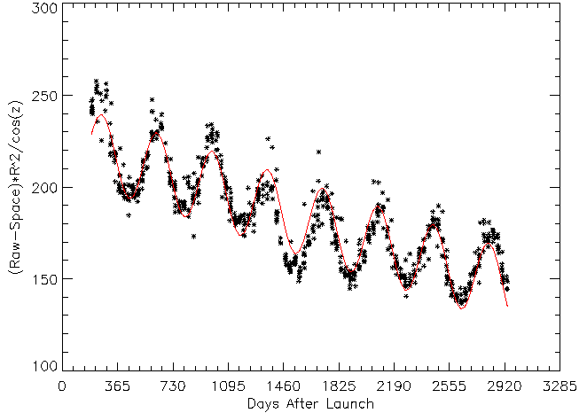
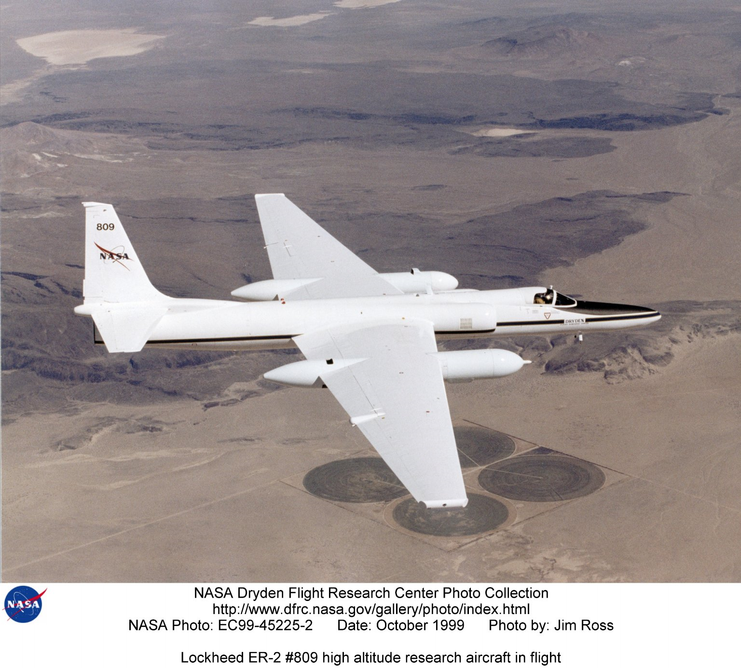
Post-Launch Cal/Val Support Readiness: Desert target BRDF determination
GOES-8 Imager noon-time visible channel measurements Grand Desert (32N, 115W)
(Wu et. al., NTIS Report ADA45999, 2005 )
ER-2 AVIRIS/MASTER Flight Acquisitions Completed:
White Sands Missile Range (WSMR) (May 23, 2011)
Sonora Desert (June 10, 2011)
Underflights of GOES-11/13, Metop-A, EOS-Aqua/Terra and NOAA-19
Measurements – corrected to nadir sun angle and average earth-sun distance – reveal seasonally-variant anomalies that could be reduced with knowledge of surface bi-directional reflectance distribution function (BRDF).
Sonoran Desert and WSMR BRDF data analyses to be performed starting 2013 by a UMD Graduate Student
Notes:
To-Do:

Slide 11
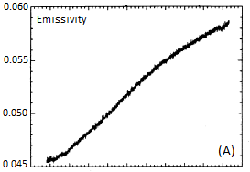
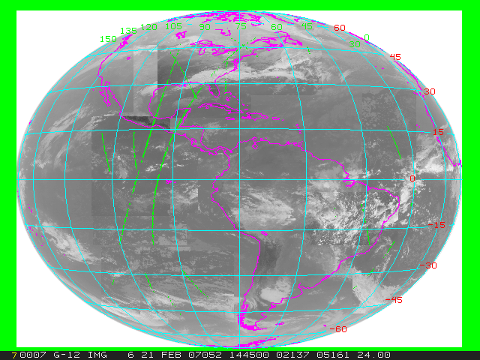
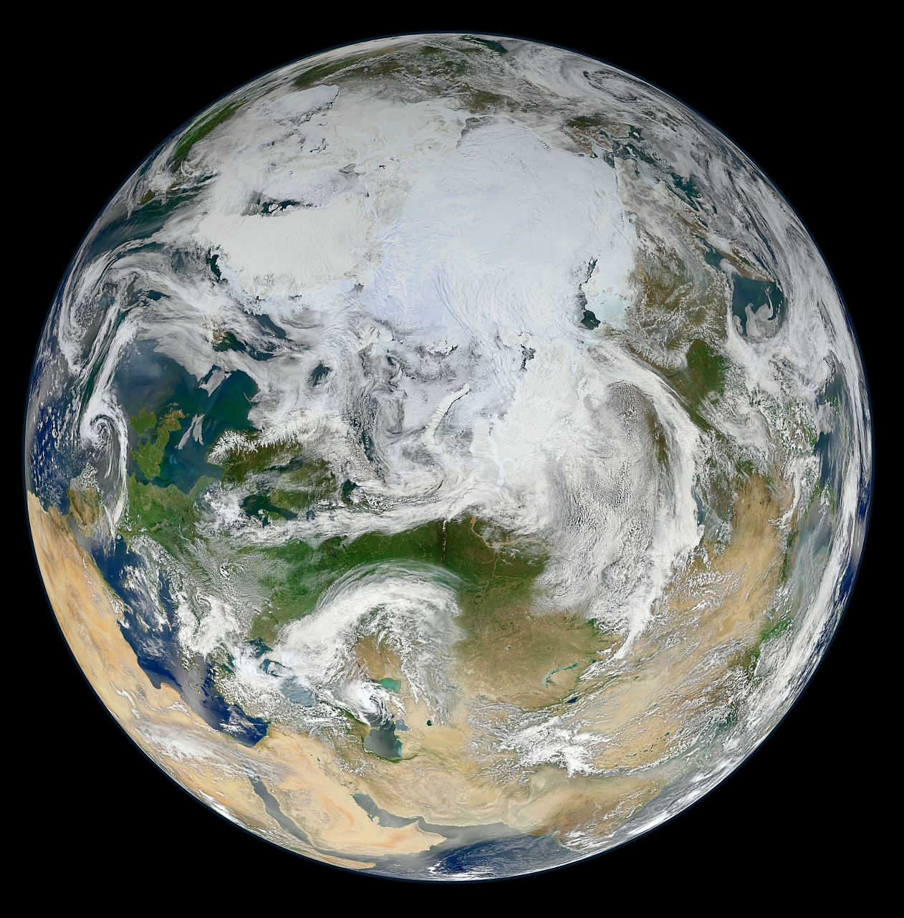
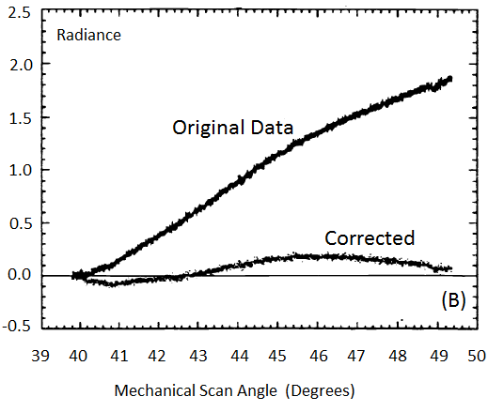
Post-Launch Cal/Val Support Readiness: Post-launch test (PLT) preparation
GOES-R PLTs being created based on GOES-R Cal/Val Plan Vol. 1: L1b Data
ABI scan angle dependent response test being developed
Success of NPP VIIRS and CrIS instrument supports ABI proxy data generation for testing, as well as providing a standard for cross-comparison after launch
GOES-10
Emssivity [unitless]
Radiance [mW/(m^2-sr-cm^-1)]
GOES-AIRS collocated pixels for 21 February 2007 used for infrared channel inter-comparisons. AIRS is a proxy instrument for JPSS CrIS.
Sample NPP VIIRS data projected over a “full-disk” view. (Image courtesy of NASA Ocean Color Team)
GOES-10 Ch. 4A (Top) Mirror emissivity vs. scan angle and (Bottom) Corrected and uncorrected Radiance vs. scan angle. (Beaucom et al., Proceedings of SPIE, 1999)
Notes:
To-Do:

Slide 12
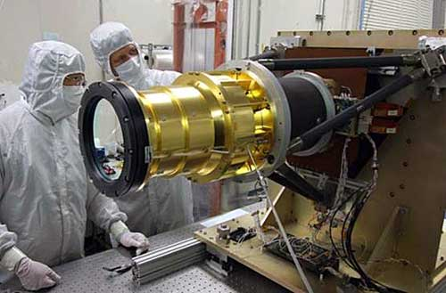
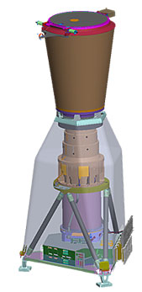
GLM Cal/Val Updates
Notes:
To-Do:

Slide 13
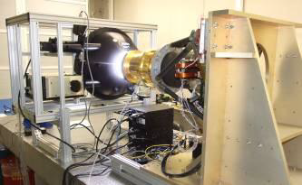
Test Activities: GLM Vendor (Lockheed-Martin ATC)
The GLM characterization and calibration activities consist of observatory-level checks designed to investigate the following:
static linearity response and uniformity;
transient response;
performance;
field of view;
spectral response;
effects of spacecraft motion and jitter; and
solar intrusion.
Notes:
To-Do:

Slide 14
Test Activities: Engineering Development Unit (EDU)
Testing philosophy: EDU testing is a proof-of-concept of testing procedures, and helps to define realistic algorithm parameters to support algorithm implementation.
Testing of EDU does not verify performance specifications.
Calibration Working Group (CWG) member Harold Peterson spent a week in Palo Alto this past July to observe EDU testing.
Current EDU testing helping to iron out testing procedures for FM1.
Notes:
To-Do:

Slide 15
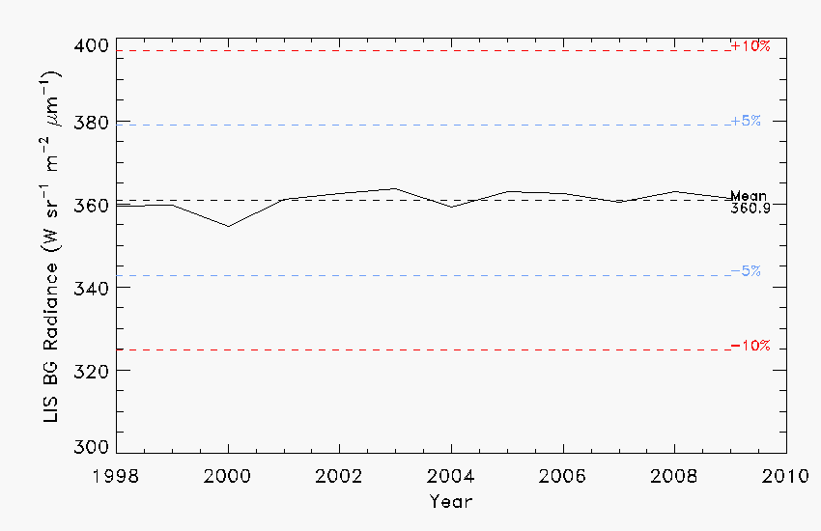
Post-Launch Cal/Val Support Readiness: Cal monitoring tool development
Paper was accepted by Atmospheric Research: "Assessing the performance of the Lightning Imaging Sensor (LIS) using Deep Convective Clouds" by Dennis E Buechler; Dennis Buechler; William J Koshak; Hugh J Christian; Steven J Goodman
Tropical Rainfall Measurement Mission Lightning Imaging Sensor (LIS)
Application of GLM Long-term Radiometric Performance tool to LIS.
Notes:
To-Do:

Slide 16
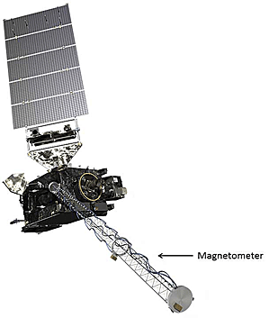
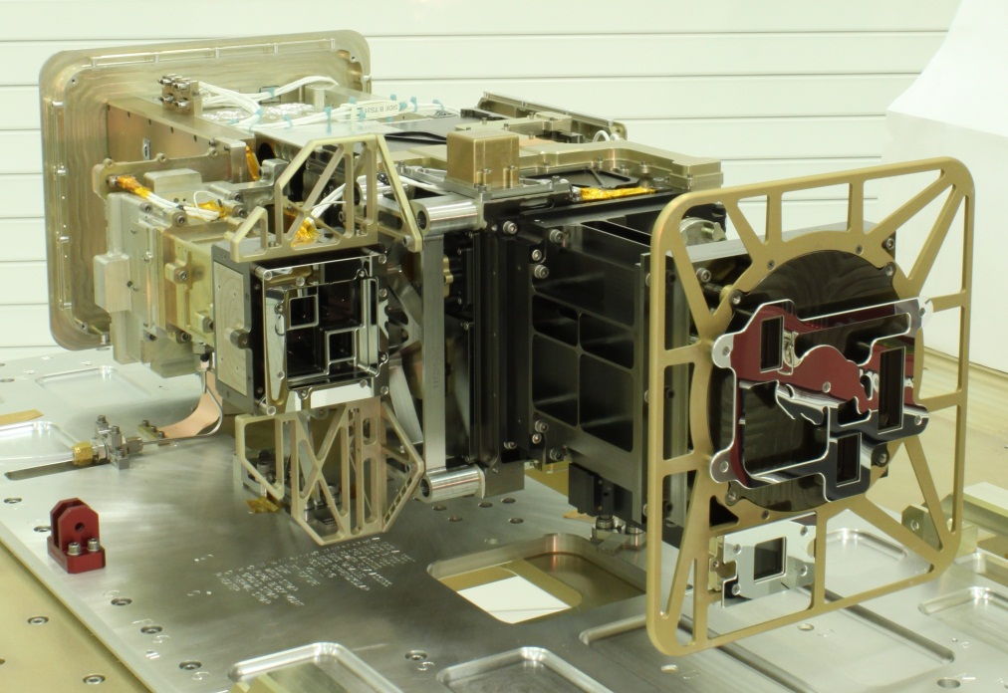
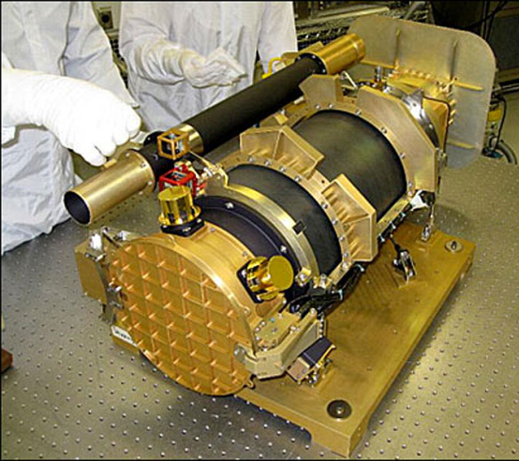
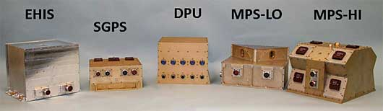
Cal/Val Updates
Space Weather Instruments
EXIS
SUVI
SEISS
Notes:
To-Do:

Slide 17
Test Activities: SEISS (Assurance Technology Corp)
SGPS:
Tested at Mass General Hospital Proton Therapy Center in May 2012.
Later vibration test revealed a mechanical issue that, after fixing, will require later re-calibration.
MPS-HI:
Tested at MIT van de Graaf electron accelerator in June (good data and no runs repeated) and NASA GSFC in July. Some unexpected variability between telescopes may warrant expanded testing of later units.
The sensor is currently in storage awaiting it’s final calibration run at GSFC. The low energy accelerator at GSFC was down for maintenance during calibration of MPS-HI in early August.
Notes:
To-Do:

Slide 18
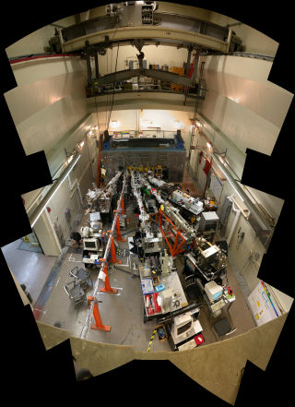
Test Activities: EXIS (Lab for Atmospheric and Space Physics)
Tested in July at NIST Synchrotron Ultraviolet Radiation Facility III (SURF-III).
Extensive data are still to be analyzed.
NIST staff continue to improve the SURF beam uniformity, stability, characterization accuracy, and ease of use.
LASP scientists and engineers have taken full advantage of the SURF improvements.
Calibration data has less scatter due to these improvements.
Calibration data supports more detailed system models.
The GOES-R team is performing an EXIS calibration that will increase the accuracy of solar data input to climate models.
NIST SURF-III Facility
Notes:
To-Do:

Slide 19
Test Activites: SUVI and MAG (Lockheed-Martin)
SUVI
Performance testing of instrument components supports analytical inference of system-level instrument performance.
  Mirror reflectance measured at LBNL.
  Transmission of SUVI filter witness samples will be measured by NIST to validate vendor model estimates.
  CCD calibration at vendor based on new NIST calibrated transfer detector.
  Vendor X-Ray test underestimates CCD charge spreading. Investigating repeating test at EUV.
MAG
No current testing.
Test will be performed using well characterized sources at vendor facilities.
Notes:
To-Do:

Slide 20
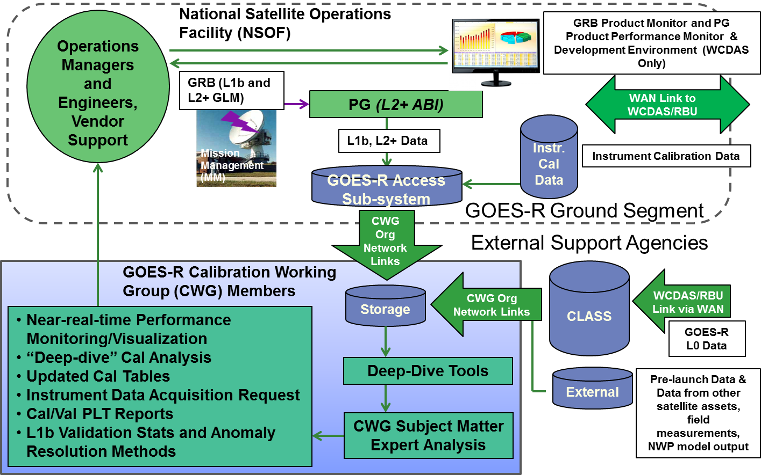
Ground Segment Cal/Val Updates
Notes:
To-Do:

Slide 21
L1b Dev and Implementation
Instr. Vendor L1b Dev
Key activities
  Evaluate L1b algorithm completeness to support upcoming development phases
  Identify specific issues to be resolved by the L1b algorithm developer
  Use TIMs to obtain technical data from L1b algorithm developer
  Develop product metadata definition and processing
  Address algorithm OPSCON issues specific to Harris GS design
  Track algorithm interdependencies with other algorithms/sensors and with spacecraft
L1b Alg and Test Data and RFA Responses
RFA and RFA Responses
Gov’t Instr Manager
Portal
L1b Alg and Test Data Analysis and RFA Responses
L1b Tiger Team Meetings
Gov’t Support Subject Exp.
Gov’t GS Managers
L1b Alg and Test Data and RFA Responses
RFA and RFA Responses
GS Vendor L1b Implement-ation
L1b Tiger Team Mandate Proactively identify and mitigate risks associated with implementing GFP L1b algorithms
Notes:
To-Do:

Slide 22
ABI Lunar Image Ground Processing Operational Concept Finalized
Mission Management predicts, schedules and collects ABI Mode 3 Lunar ‘meso’ images
Product Generation extracts the Lunar ‘meso’ data using scene pointing information in the science data, and then L1b Processing applies the ABI calibration to the data
Product Distribution packs the Lunar data into Instrument Calibration Data files
Operational Support Organization processes and trends the lunar data over mission
Notes:
To-Do:

Slide 23
Instrument Calibration Data
Instrument Calibration Data are needed to evaluate, monitor, and trend sensor performance, and to perform calibration anomaly resolution
Instrument Calibration Data contains:
  Raw sensor calibration data
  Engineering data and sensor parameters
  Derived sensor performance statistics
  Intermediate calibration products
  Final sensor calibration coefficients
Before launch, careful checks are made by the GOES-R CWG to ensure that Instrument Calibration Data meet post-launch ‘fitness-for-purpose”
Notes:
To-Do:

Slide 24
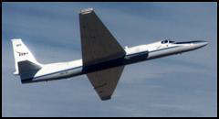
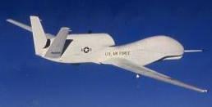
Validation Field Campaigns
Current Recommendations have been made by the Science Community to fly:
GLM Airborne Simulator
  Build an airborne detection system that will make high resolution optical measurements as a GLM simulator.
  Deploy on aircraft (e.g., ER2) to observe cloud-top lightning pulses.
MODIS Airborne Simulator (MAS)
An airborne scanning spectrometer that acquires high spatial resolution imagery of cloud and surface features from its vantage point on-board a NASA ER-2 high-altitude research aircraft.
Similar channels as GOES-R ABI
It is also recommended that GOES-R leverage upon JPSS underflights for the purpose of instrument post-launch validation.
Notes:
To-Do:

Slide 25
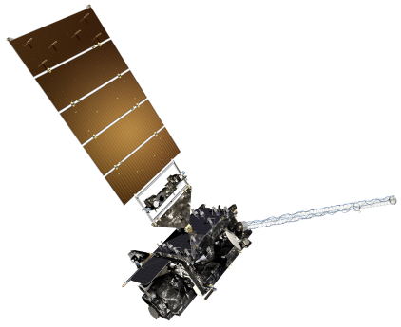
GOES-R Pre-Launch Milestones
 | 2010 | 2011 | 2012 | 2013 | 2014 | 2015
Program/System
Flight Segment
Ground Segment
System Design Review complete
Mission PDR Part I
Launch Readiness Oct. 2015
Mission PDR Part II
Mission CDR
Spacecraft
S/C PDR complete
S/C SDR complete
S/C CDR
ABI Delivery
Instruments
ABI Delta CDR complete
EXIS Delivery
GLM Delivery
All instruments have passed CDR
MAG Delivery
SEISS Delivery
SUVI Delivery
Core GS PDR completed
Core GS CDR
RBU/NSOF/WCDAS installation
Antenna System CDR
Antenna System PDR completed
GS Project PDR complete
WCDAS complete
ESPDS CDR
RBU complete
100 % delivery of baseline product algorithms
CLASS CDR
NSOF complete
GS Project CDR
Development Integration and Testing
Notes:
To-Do:

Slide 26
Summary
GOES-R is post-CDR, and all instruments and the ground segment are in the process of fabrication, assembly, integration, and test
GOES-R leveraging diverse complementary technical capabilities and resources for cal/val
There is a life cycle cal/val plan to support a successful GOES-R program
Notes:
To-Do:

Slide 27
Backup Slides
Notes:
To-Do:

Slide 28
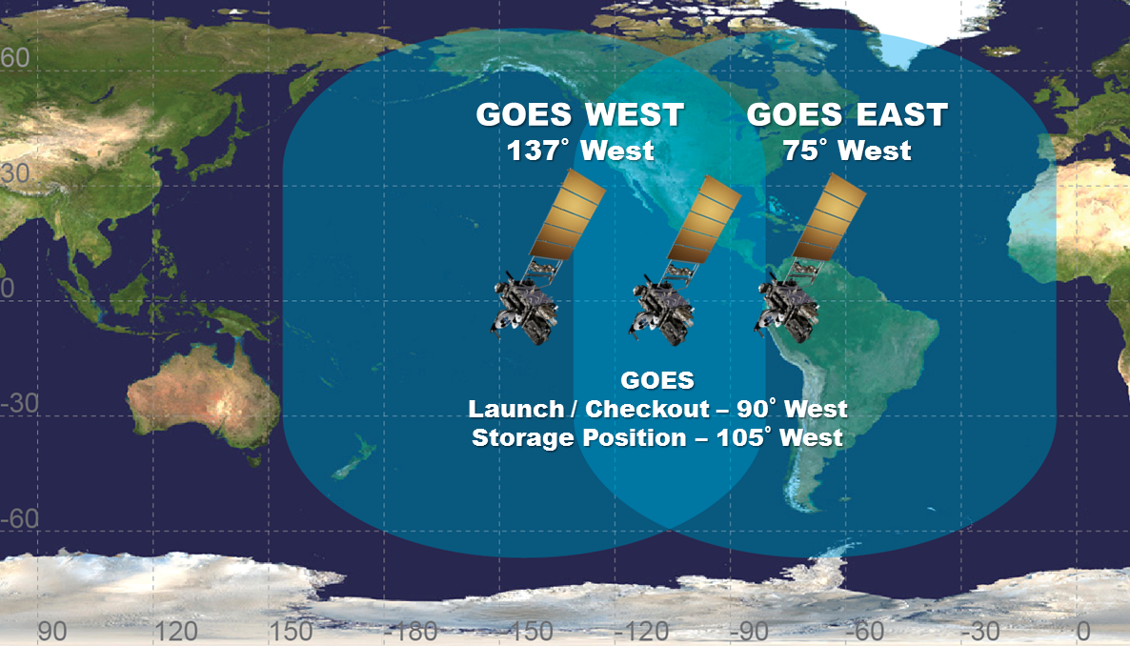
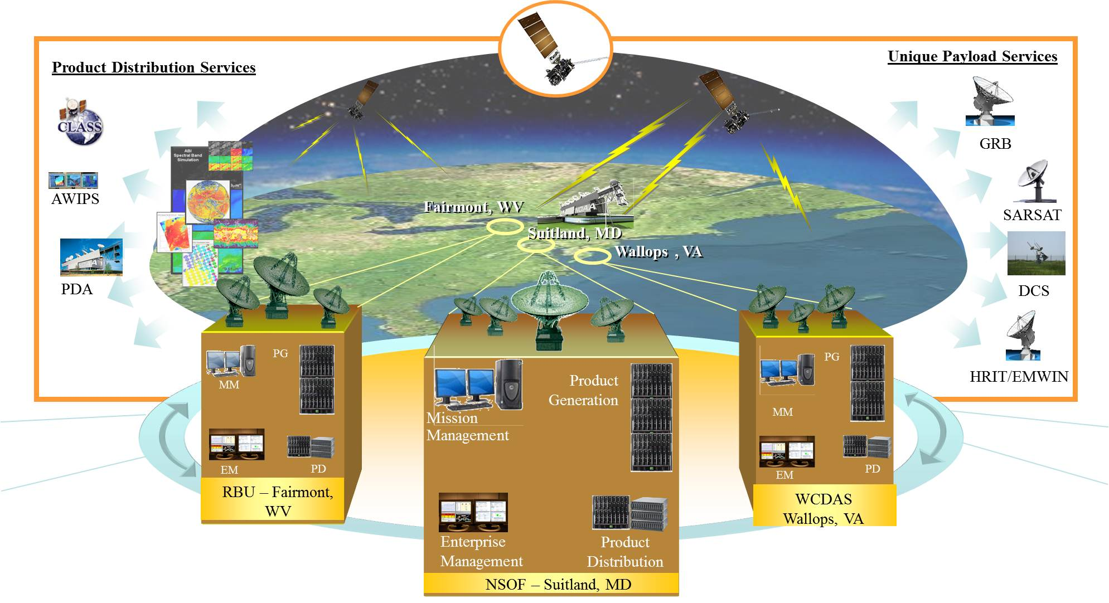
GOES Fleet and GOES-R Architecture
Notes:
To-Do:

Slide 29

GOES-R Satellite
Solar Array
Solar Ultraviolet Imager (SUVI)
Magnetometer
Extreme Ultraviolet and X-Ray Irradiance Sensor (EXIS)
Space Environment In-Situ Suite (SEISS)
Geostationary Lightning Mapper (GLM)
Advanced Baseline Imager (ABI)
Notes:
To-Do:

Slide 30
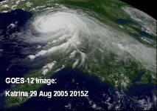
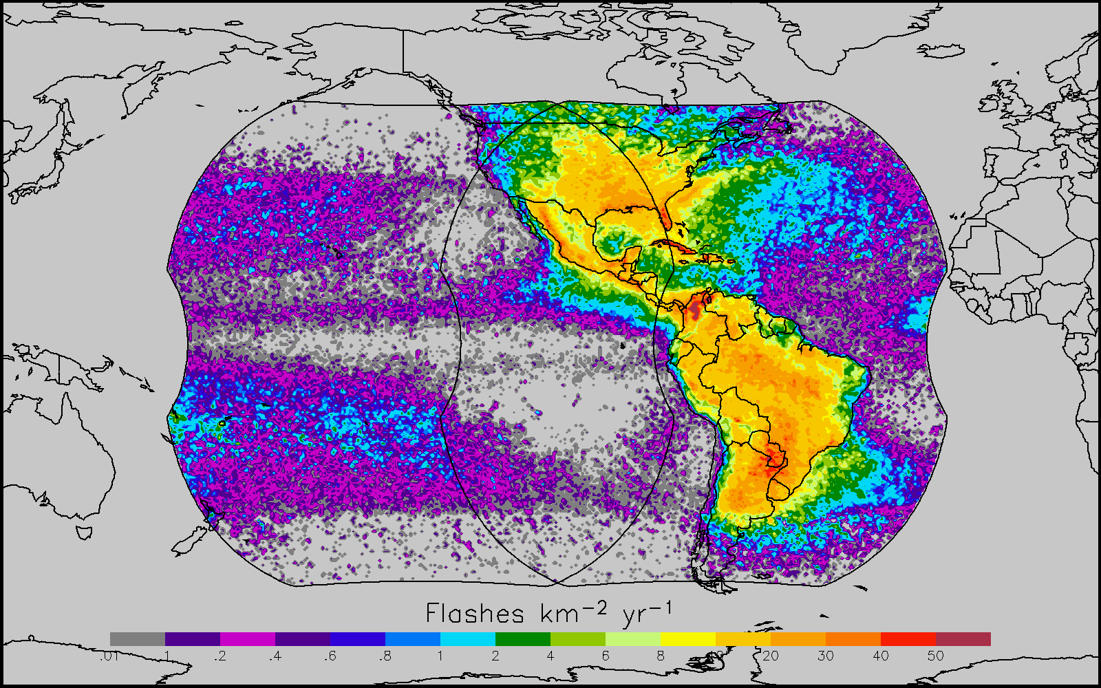
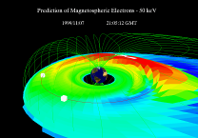
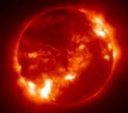
Instrument Overview
GOES-R supports NOAA mission to provide forecasts and warnings for the United States, its territories, and adjacent waters for the protection of life and property and the enhancement of the national economy.
GOES-R is the next generation of GOES satellites that will provide a major improvement in quality, quantity, and timeliness of data collected.
Earth Pointing
In-Situ
Sun Pointing
Spare
Visual & IR Imagery
Lightning Mapping
Space Weather Monitoring
Solar Imaging
Advanced Baseline Imager (ABI)
Geostationary Lightning Mapper (GLM)
Space Environment in-Situ Sensor Suite (SEISS)
Magnetometer
Solar Ultra-Violet Imager (SUVI)
Extreme UV/X-Ray Irradiance Sensors (EXIS)
New and improved capabilities for:
  increased lead times for severe weather warnings
  better storm tracking capabilities
  solar, space weather, and climate analyses
  advanced products for aviation, transportation, commerce
Notes:
To-Do:

Slide 31
GOES-R Data and Product Overview
GOES-R Products
GOES-R Raw Data Throughput
Radiances* | Cloud and Moisture Imagery (KPP)
Solar Imagery: X-ray* | Rainfall Rate / QPE
Energetic Heavy Ions* | Legacy Vertical Moisture Profile
Magnetospheric Electrons and Protons: Low Energy* | Legacy Vertical Temperature Profile
Magnetospheric Electrons and Protons: Medium and High Energy* | Derived Stability Indices
Solar and Galactic Protons* | Total Precipitable Water
Geomagnetic Field* | Clear Sky Masks
Solar Flux: EUV* | Downward Shortwave Rad.: Surface
Solar Flux: X-Ray* | Fire / Hot Spot Characterization
Lightning Det: Events, Groups, Flashes* | Land Surface (Skin) Temperature
Aerosol Detection (including Smoke & Dust) | Sea Surface Temperature (skin)
Aerosol Optical Depth | Reflected Shortwave Rad.: TOA
Volcanic Ash: Detection & Height | Snow Cover
Cloud Optical Depth | Derived Motion Winds
Cloud Particle Size Distribution | Hurricane Intensity
Cloud Top Phase | Cloud Top Pressure
Cloud Top Height | Cloud Top Temperature
ABI | GLM
SEISS | EXIS
SUVI | Magnetometer
 | * Included in GRB
Fill Packets
L1b
Space Wx
Mbps
GLM
ABI
ABI provides 3x spectral, 4x coverage, and 5x temporal resolution of current imager
GOES-R product requirements drive instrument performance requirements, which often are the same as, or more strict than, heritage GOES.
L2+ Products are remainder outside of oval
Notes:
To-Do:

Slide 32
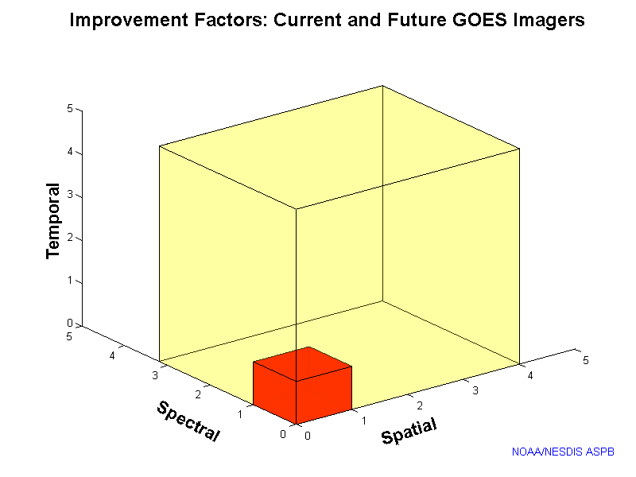
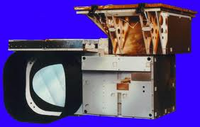
ABI Comparison to Current GOES Imager
ABI Current
Spectral Coverage 16 bands 5 bands
Spatial resolution
0.64 μm Visible 0.5 km 1 km
Other Visible/near-IR 1.0 km n/a
Bands (>2 μm) 2 km 4 km
Spatial coverage
Full disk 4 per hour every 3 hr
CONUS 12 per hour ~4 per hour
Mesoscale 30 sec (typical) n/a
ABI provides 3x spectral, 4x coverage, and 5x temporal resolution of current imager
Current
GOES
GOES-R ABI
GOES Imager
Notes:
To-Do:

Slide 33
Importance of Calibration & Validation (Cal/Val)
Calibration: The process to determine factors for converting and correcting raw detector measurements into science data units (e.g., radiance) with the specified level of accuracy.
  Calibration is applied to GOES-R raw instrument data to transform them into L1b measurements … the fundamental building blocks for all L2+ products.
Validation: The process of determining that the deliverable item satisfies its intended use in its intended environment.
  Validation provides user confidence that GOES-R data can be used for their intended purpose, .e.g weather forecasting or numerical weather prediction.
Notes:
To-Do:

Slide 34
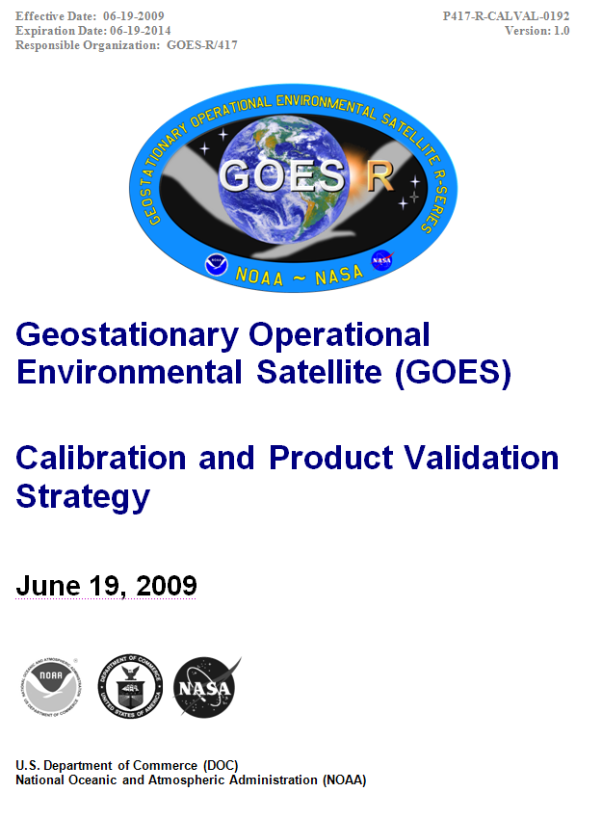
GOES-R Program Calibration and Product Validation Strategy
Describes:
Scope of effort
Organizational elements and working groups
Activities, and roles and responsibilities, for each mission phase
Resources
Schedules
Notes:
To-Do: Add screen shot of the revised Strategy with the revision date when we are done.

Slide 35
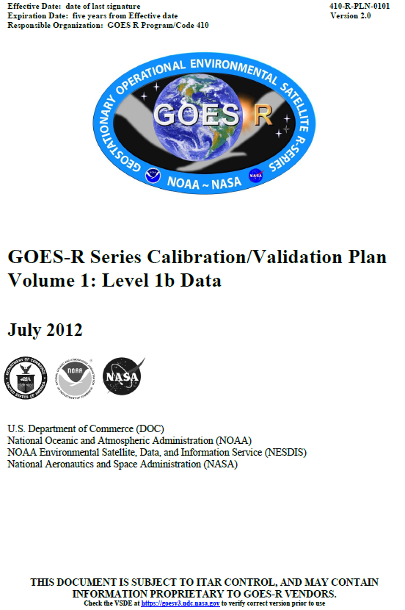
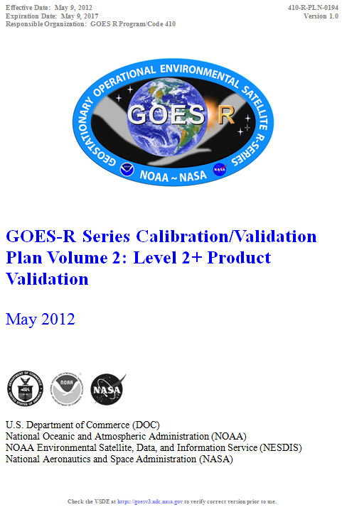
GOES-R Program Cal/Val Plans
Describe cal/val methods and processes as a function of mission phase
Notes:
To-Do:

Slide 36
GOES-R Cal/Val Collaborators
Collaborator | Main Responsibilities | Cal | L1b Prod Val | L2+ Prod Val
Flight Project | Oversee SC/Instr. Design, Fabr., Integ., and Test | ✓ | ✓
SC/Instr Vendors | SC/Instr. Design, Fabr., Integ., and Test | ✓ | ✓
Ground Segment (GS) Project | Oversee GS Design, Fabr., Integ., and Test | ✓ | ✓ | ✓
GS Vendor | GS Design, Fabr., Integ., and Test | ✓ | ✓ | ✓
Mission Ops Support Team | Gov’t SC/Instr/GS Test | ✓ | ✓ | ✓
Data Ops Support Team | Gov’t GS Test | ✓ | ✓ | ✓
Cal Coordination Team (CCT) | PSE Coordination Support to GOES-R Instr. Cal & L1b Val | ✓ | ✓
Cal Working Group (CWG) | PSE Technical Support to GOES-R Instr. Cal & L1b Val | ✓ | ✓
Algorithm Working Group (AWG) | L2+ Product Dev and V&V |  |  | ✓
NESDIS Office of Satellite and Product Operations (OSPO) | Ops Support to Cal/Val | ✓ | ✓ | ✓
Notes:
To-Do:

Slide 37
GOES-R Cal/Val Resources
Resource | Pre-Launch | Post-Launch Testing | Mission Operations
Data and Tools
Cal/Val, L0, L1b Data Archive/Storage | ✓ | ✓ | ✓
Models/Analysis Tools | ✓ | ✓ | ✓
GOES-R Portal and Web Sites | ✓ | ✓ | ✓
Facilities and Equipment
Vendor Offices, Manufacturing Centers, Test Labs/Equipment | ✓ | ✓
NIST Test Labs/Equipment | ✓
NASA Offices & Test Labs/Equipment | ✓ | ✓
NOAA Offices | ✓ | ✓ | ✓
Independent Test Facilities | ✓
Field Campaign Assets | ✓ | ✓ | ✓
Notes:
To-Do:

Slide 38
Instrument Calibration: ABI
Radiometric Characterization & Calibration | Spectral Response | Image Navigation & Registration | Spatial Resolution & Response
System linearity and dynamic range Signal-to-Noise, NEDN, and Coherent Noise Pixel-to-pixel, swath-to-swath, channel-to-channel-, image-to-image, and blackbody calibration-to-calibration repeatability Irradiance to radiance transfer (VNIR) External/Internal calibration target comparison (TIR) Polarization (VNIR) Channel-to-channel and within channel optical cross talk Electronic cross talk In-flight electronic calibration Blooming Quantization step size Hot, marginal and dead pixels | Spectral response envelope Spectral response uniformity over the focal plane detector array Out-of-band response Evaluation of spectral response function uncertainty Inference of possible spectral shifts Consistency between system-level and integrated component-level spectral response functions | Navigation (including star sensing) Frame-to-frame, within frame, swath-to-swath, and channel-to-channel registration | System modulation transfer function Spatial response uniformity (e.g., response vs. scan angle) Ringing from a sharp edge Near field scatter Far field scatter Ghosting Pointing knowledge
Notes:
To-Do:

Slide 39
On-Orbit Instrument Calibration
Instrument | On-Board Cal Devices | Vicarious Targets | Inter-Calibration with Other Satellite Assets
Advanced Baseline Imager (ABI) | IR Cal (NEDT[@300K]: 0.1K all but 13.3 μm, 0.3K for 13.3 μm) – Blackbody; VNIR Cal (5%) - Solar Diffuser; Self-Emission - Space View; Electronics Linearity - Electronic Stimulus | VNIR Cal - Moon, Stars, Deserts, Test Sites, Deep Convective Clouds (DCCs), Rayliegh Scattering, etc; MTF, B2B Reg - Moon | VNIR/IR Cal - GEO and LEO Imagers; Spectral Cal – Hyperspectral Imagers
Geostationary Lightning Mapper (GLM) | None | Response Cal - DCCs, Deserts, Sun-glint | Response Cal - GEO and LEO Imagers
Extreme Ultraviolet and X-Ray Irradiance Sensor (EXIS) | Response Linearity - Light Sources; Dark Measurements and Flatfields - Off-point Mechanism; Electronics Linearity - Electronic Stimulus | Response Flatfield - Sun | Response Cal – GEO Solar Sensors (e.g., SDO/EVE)
Solar Ultraviolet Imager (SUVI) | Aliveness - Light Source; Dark Measurements and Flatfields - Off-point Mechanism; Out-of-band Rejection - Glass/Analysis Filters; Electronics Linearity - Electronic Stimulus | Response Flatfield - Sun | Response Cal - EXIS and other GEO Solar Sensors (e.g., SDO/EVE)
Space Environment In-Situ Suite (SEISS) | Electronics Linearity - Electronic Stimulus | None | Response Cal – GEO Particle Sensors
Magnetometer (MAG) | Electronics Linearity - Electronic Stimulus | None | Response Cal - GEO Mag Sensors
Notes:
To-Do:

