Slide 1
GOES-R GLM Calibration
GLM Science Meeting 2011
Bob Iacovazzi Jr.
September 20, 2011

Slide 2
GOES-R Calibration Definition
Calibration:
The process to determine factors for converting and correcting raw detector measurements into science data units (e.g., radiance) with the specified level of accuracy. [Calibration requirements are found in MRD Sections 3.4.2.1-7]
GOES-R Program Acronym and Glossary

Slide 3
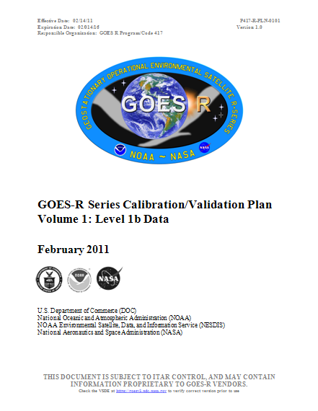
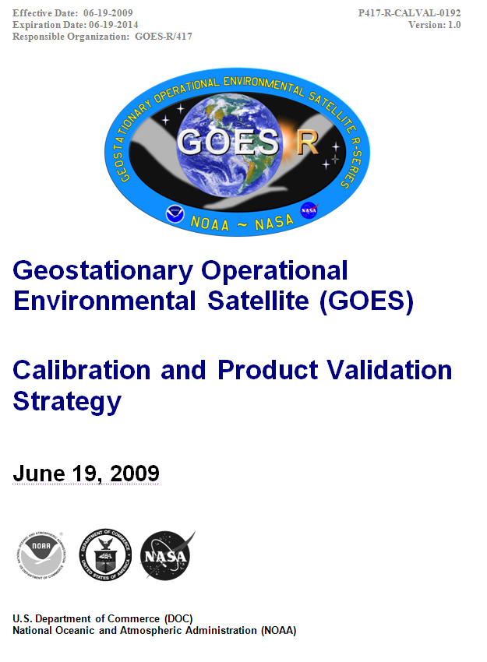
GOES-R Program Cal/Val Documents
Roles and
Responsibilities
Technical Details
Notes:
Cal/Val Plan & Strategy overarch all of the calibration phases.

Slide 4
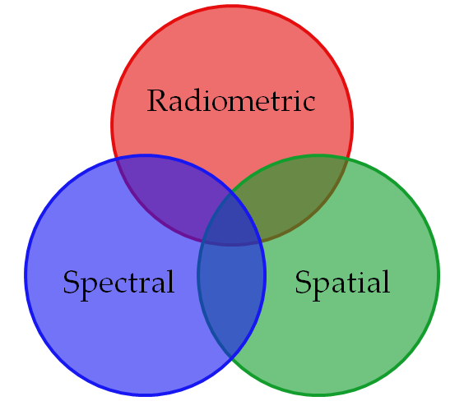
Calibration Support for GLM
Instrument, Spacecraft and Ground Segments Vendors
GOES-R Cal/Val Working (CWG) Group Members and Partners
Flight Project
Ground Segment Project
NOAA/NESDIS/STAR
MIT Lincoln Laboratory
Field Campaign Support (NASA, NOAA, JPL, etc.)
Marshall Space Flight Center/UAH

Slide 5
Calibration Coordination Team (CCT) Formed Under New PSE Leadership
Scope – A coordinating body to ensure efficient implementation of calibration activities throughout the GOES-R Program during all mission phases.
CCT members - Representatives of any group with responsibility to ensure L1b Product integrity, e.g.,
PSE & Program Science
Flight (Deputy Project Manager, Instrument Managers)
Ground (Deputy Project Manager)
Other CWG reps
Vendors (Instrument, Spacecraft and Ground)
MOST (MOM)
DOST (DOM)
AWG
DOST
AWG
MOST
PSE & Program Science
GOES-R Calibration Coordination Team
GS Vendor
Flight
Instr./SC Vendor
GSP
CCT provides a forum to clarify GOES-R cal/val activities and associated member roles and responsibilities
PSE lead has the final authority on cal/val topics
GOES-R Calibration Coordination Team membership diagram

Slide 6
Major GLM Cal-related Activities in Each Mission Phase
Pre-Launch
Schedule determined by Flight and Vendors
Instrument and Test Design and Review
Instrument Testing and Test Verification
L1b Algorithm Development, Implementation and Review
Post-Launch Testing (PLT)
Schedule determined by MOST and DOST
Science Test Design and Review
Science Tests Analysis and Verification
Cal Parameter Verification
Long-Term Monitoring Initialization
Performance Analysis/Anomaly Resolution
Mission Operational Lifetime
Schedule determined by Ops
Long-Term Instrument and L1b Product Monitoring
Cal Parameter Updates
Anomaly Resolution

Slide 7
Major GLM Cal-related Activities in Each Mission Phase
Pre-Launch
Schedule determined by Flight and Vendors
Instrument and Test Design and Review
Instrument Testing and Test Verification
L1b Algorithm Development, Implementation and Review
Post-Launch Testing (PLT)
Schedule determined by MOST and DOST
Science Test Design and Review
Science Tests Analysis and Verification
Cal Parameter Verification
Long-Term Monitoring Initialization
Performance Analysis/Anomaly Resolution
Mission Operational Lifetime
Schedule determined by Ops
Long-Term Instrument and L1b Product Monitoring
Cal Parameter Updates
Anomaly Resolution

Slide 8
Lockheed-Martin Pre-launch Calibration Overview
GLM is an imager and an event detector and must be radiometrically calibrated for background scenes (images) and for lightning events (optical pulses)
Calibration activities consist of six procedures:
Static radiometric response (Linearity and uniformity)
Transient radiometric response (instrument calibration)
Performance test (detection efficiency, false event rate, etc.)
Field of view
Spectral response
Spacecraft motion and jitter simulation

Slide 9
Lockheed-Martin Pre-launch Calibration Overview
Calibration is performed in a class 10K clean room at LMATC
Principal equipment includes
Large integrating sphere (NIST Certified)
Integrating sphere with co-aligned optical pulse emitter
Two precision rotary stages
Collimator
Tunable laser
GLM GSD including a dedicated lightning calibration computer system

Slide 10
Pre-Launch Design & Development Review
Lockheed-Martin
Reviews, TIMs, and TRRs
RFAs
Reports, Presentations
Flight / Instrument Vendor Interface
CDRLs, Reports
Development Plans, Procedures, Reports, Draft CDRLs, RFA Responses, Requested Items
Feedback, Comments,
Requests, Direction, RFAs
Feedback, Comments, RFAs
GOES-R Portal
GLM Instrument Manager
CDRLs, Reports
RFA Responses, Requested Items
Feedback, Comments, Requests, RFAs
Flight/CWG
Review

Slide 11
Pre-Launch Calibration Data Management
Cal Testing
Lockheed-Martin
Cal Analysis
Vendor Archive
2030 expiration
Cal Test Data Requests,
Discrepancy Notification
Cal Test Data, Results & Reports
All Instrument Test Data
Flight / Instrument Vendor Interface
Selected Cal Reports & Data for CDRLs
GLM Instrument Manager
GOES-R Portal
Cal Test Data Requests,
Discrepancy Notification
Cal Test Data,
Discrepancy Resolution
Cal Test Validation Reports
Cal Test Data, Documentation, Results
Flight/CWG
Verification
Cal/Val Long-term Stewardship

Slide 12
L1b Ground Processing Algorithm (GPA) Development and Implementation
Lockheed-Martin L1b GPA Development
Export: L1b GPA (CDRLs), Test IO , Description, and Implementation Certification Import: L1b GPA GS Vendor Implementation Results
Flight / Instrument Vendor Interface
TIMs (GLM
Instrument Manager Facilitating)
GOES-R Portal
CLASS
Import: GPA, Test IO, Cal Database, etc.
Export: L1b GPA Review
CWG
Ground / Ground Segment Vendor Interface
TIMs (GSP L1b IPT Chair facilitating)
Import: L1b GPA, Test Case IO
Export: L1b GPA Implementation Results
Harris L1b GPA Implementation

Slide 13
Major GLM Cal-related Activities in Each Mission Phase
Pre-Launch
Schedule determined by Flight and Vendors
Instrument and Test Design and Review
Instrument Testing and Test Verification
L1b Algorithm Development, Implementation and Review
Post-Launch Testing (PLT)
Schedule determined by MOST and DOST
Science Test Design and Review
Science Tests Analysis and Verification
Cal Parameter Verification
Long-Term Monitoring Initialization
Performance Analysis/Anomaly Resolution
Mission Operational Lifetime
Schedule determined by Ops
Long-Term Instrument and L1b Product Monitoring
Cal Parameter Updates
Anomaly Resolution

Slide 14
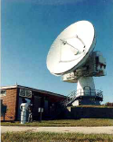
Postlaunch Instrument Calibration Data Flow
NOAA Satellite Operations Facility (NSOF)
L1b Data, GLM L2+ GRB
MM, PG, PD and DE
MLS
Wallops Command and Data Acquisition System (WCDAS)
L1Data, GLM L2+ GRB
2-Day Store
Fairmount, WV (RBU)
L0
Data
Instrument Calibration Data
GLM Background Images
Calibration-relevant instrument housekeeping & engineering data
L1b, L2+ Products,
Instr. Cal Data
Instrument Calibration Data
Via
Terrestrial Data Link
GAS
Cal L0 and Processing Data
Product Generation Operational Environment
Updated Calibration Parameter Tables
Ground Processing Algorithm
CWG
CLASS
L1b Calibrated
Data
L0 & Input Data
Instrument Radiometric, Spectral. Spatial Calibration Data Quality Assurance for GOES Series-R
Post Launch Verification
Long-term Instr. Monitoring
Deep-Dive Calibration Analysis and L1b Product Anomaly Resolution
Calibration Parameter Updates
Cal Parameter Tables and Algorithms (Wallops only)
Product Generation Development Environment
L0 Data
Experimental Ground Processing Algorithm
ExperimentalL1b Calibrated
Data
L0 & Input Data
CLASS

Slide 15
L1b Product Performance Monitoring and Anomaly Resolution
WCDAS/RBU-SOZ
L1b (GRB)
NSOF-SOZ
Instr. Telemetry
Mission Mgmt:
Instr. Temps, etc. H & S Monitor
Mission Mgmt: GRB Downlink & Monitor
Anomaly Resolution
SOZ-wide Access to Cal Terminals
L1b (GRB)
Mission Mgmt: GRB Uplink
Product Generation/ Distribution: Create L0, L0 to L1b processing and GRB generation.
2-day
MLS
CALVAL Workstation
Gov’t Tools
CAL (RDL)
L1b, CAL
GAS
L0
2-day
L0
External Org
Anomaly Resolution
5-Day RDR
Product Generation: Product Performance Monitor
Org GOES-R Terminals
DE in WCDAS SOZ
Anomaly Resolution
External Org Workstations
Automated Cal Data Acquisition
GOES-R Integrated Cal/Val
Instrument Performance Web Displays
CALVAL Workstation
Gov’t Tools
MLS
SOZ-wide Access to Cal Terminals
Org LS
Org Firewall
CLASS
CLASS

Slide 16
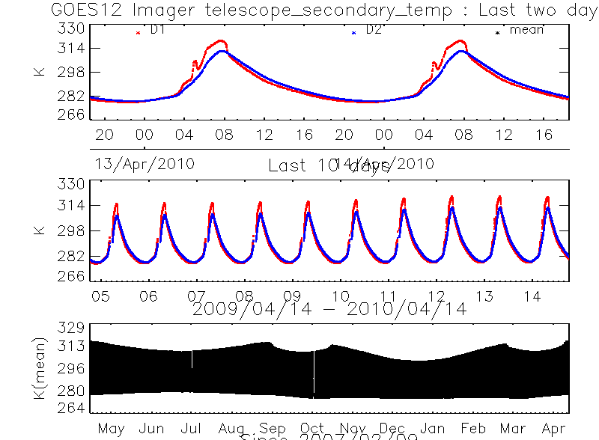
Post-Launch Calibration Evaluation
Instrument Performance Monitoring
Tracking of thermal stability of GLM components
Quick views of GLM background images, output every 2.5 minutes
Long-term Radiometric Trending
Comparison of GOES-E/W GLM background images
Ratio of GLM background image radiances with ABI and other instruments
GEO-LEO
GEO-GEO

Slide 17
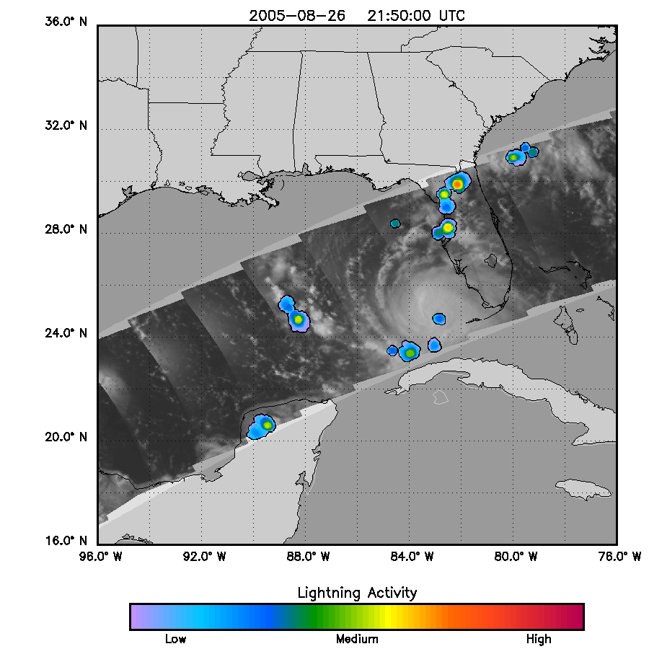
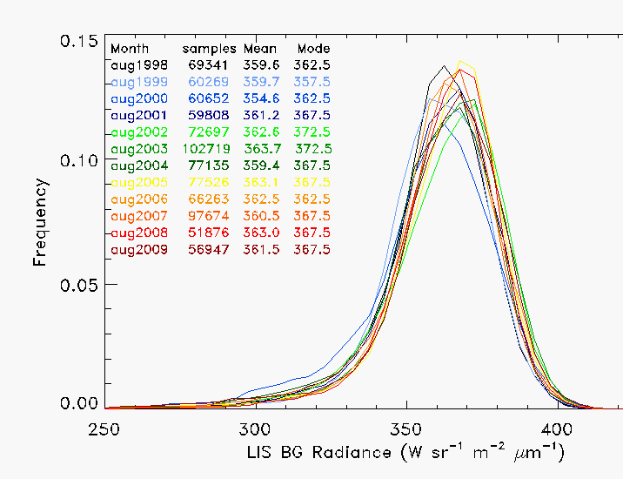
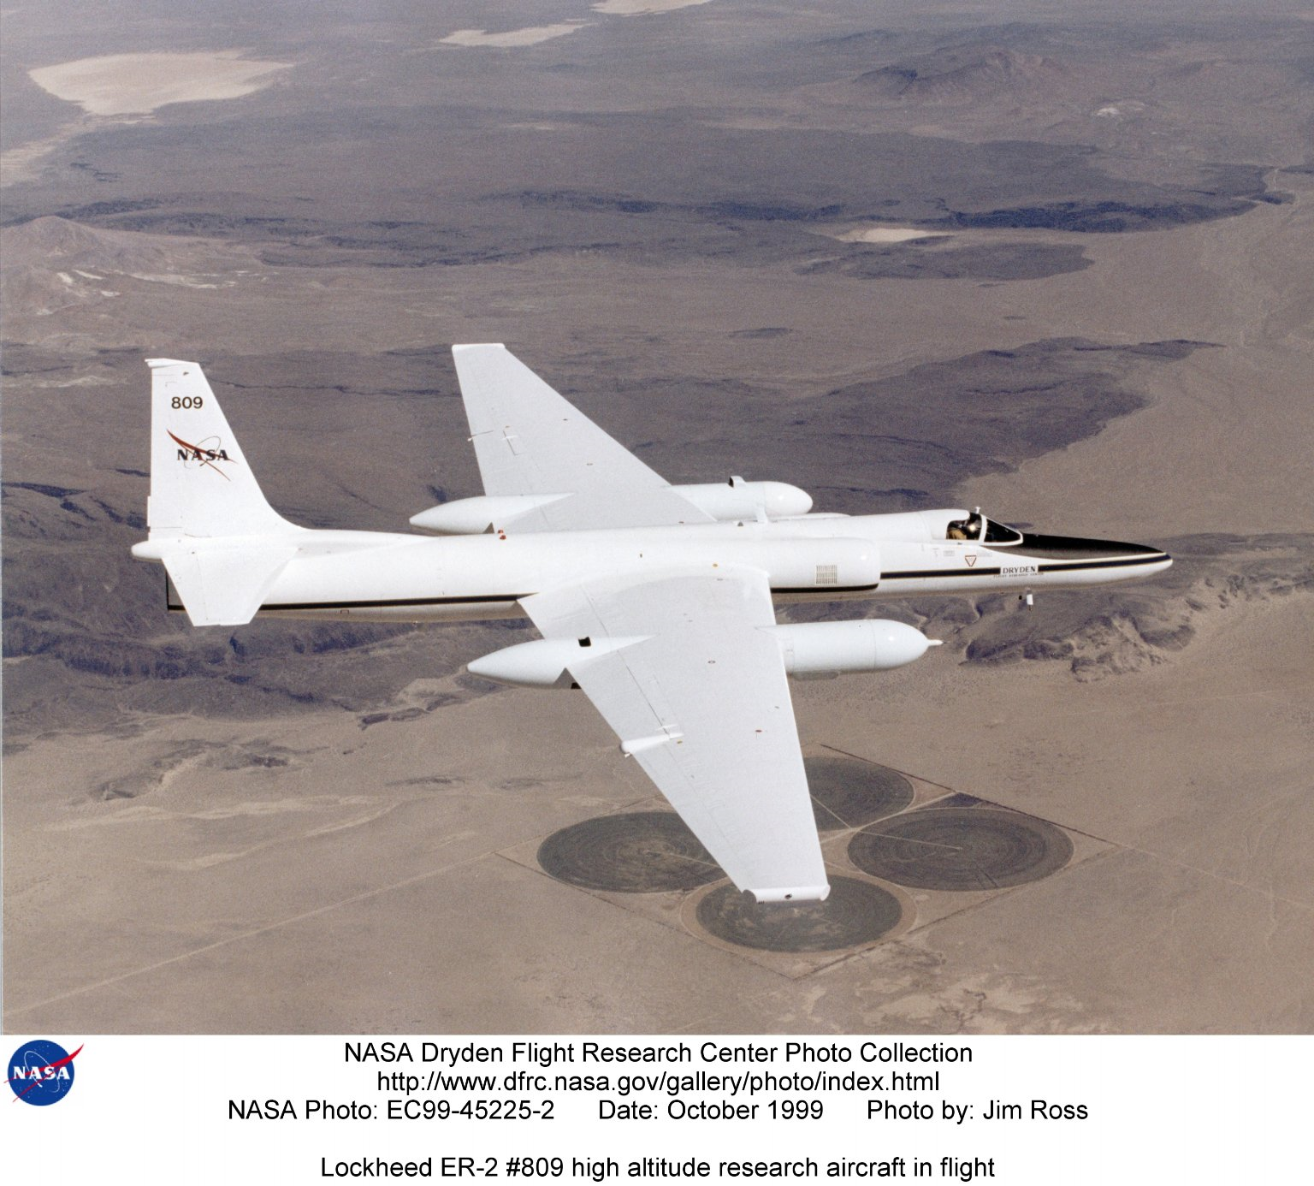
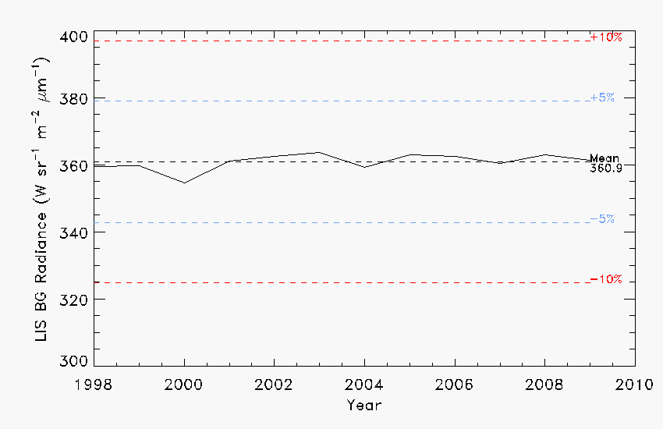
Post-Launch Calibration Evaluation
Long-term Radiometric Trending
Sonoran Desert and White Sands Site Characterization
Sonoran Desert has been used for GOES Imager long-term radiometric trending
White Sands is a possible new site for GOES-R
Characterization of BRDF to remove seasonal signal variation for vicarious calibration.
Several methods have applicability to determining lifetime GLM radiometric calibration drift:
Vicarious calibration using deep convective clouds (DCC), sun glint, and deserts
Radiance bias estimate using NWP and radiative transfer models
ER-2 AVIRIS/MASTER Flight Acquisitions Completed: WSMR (May 23, 2011), Sonoran Desert (June 10, 2011)

Slide 18
Summary
GLM calibration leveraging diverse complementary technical capabilities
Comprehensive GOES-R GLM Cal/Val Strategy and Plan developed to ensure product quality
Pre-launch Vendor implementation and Government review processes for GLM calibration testing and data, and ground processing algorithm
Post-launch
GLM calibration-relevant data capture and monitoring to support anomaly resolution
Long-term calibration trending

