Slide 1
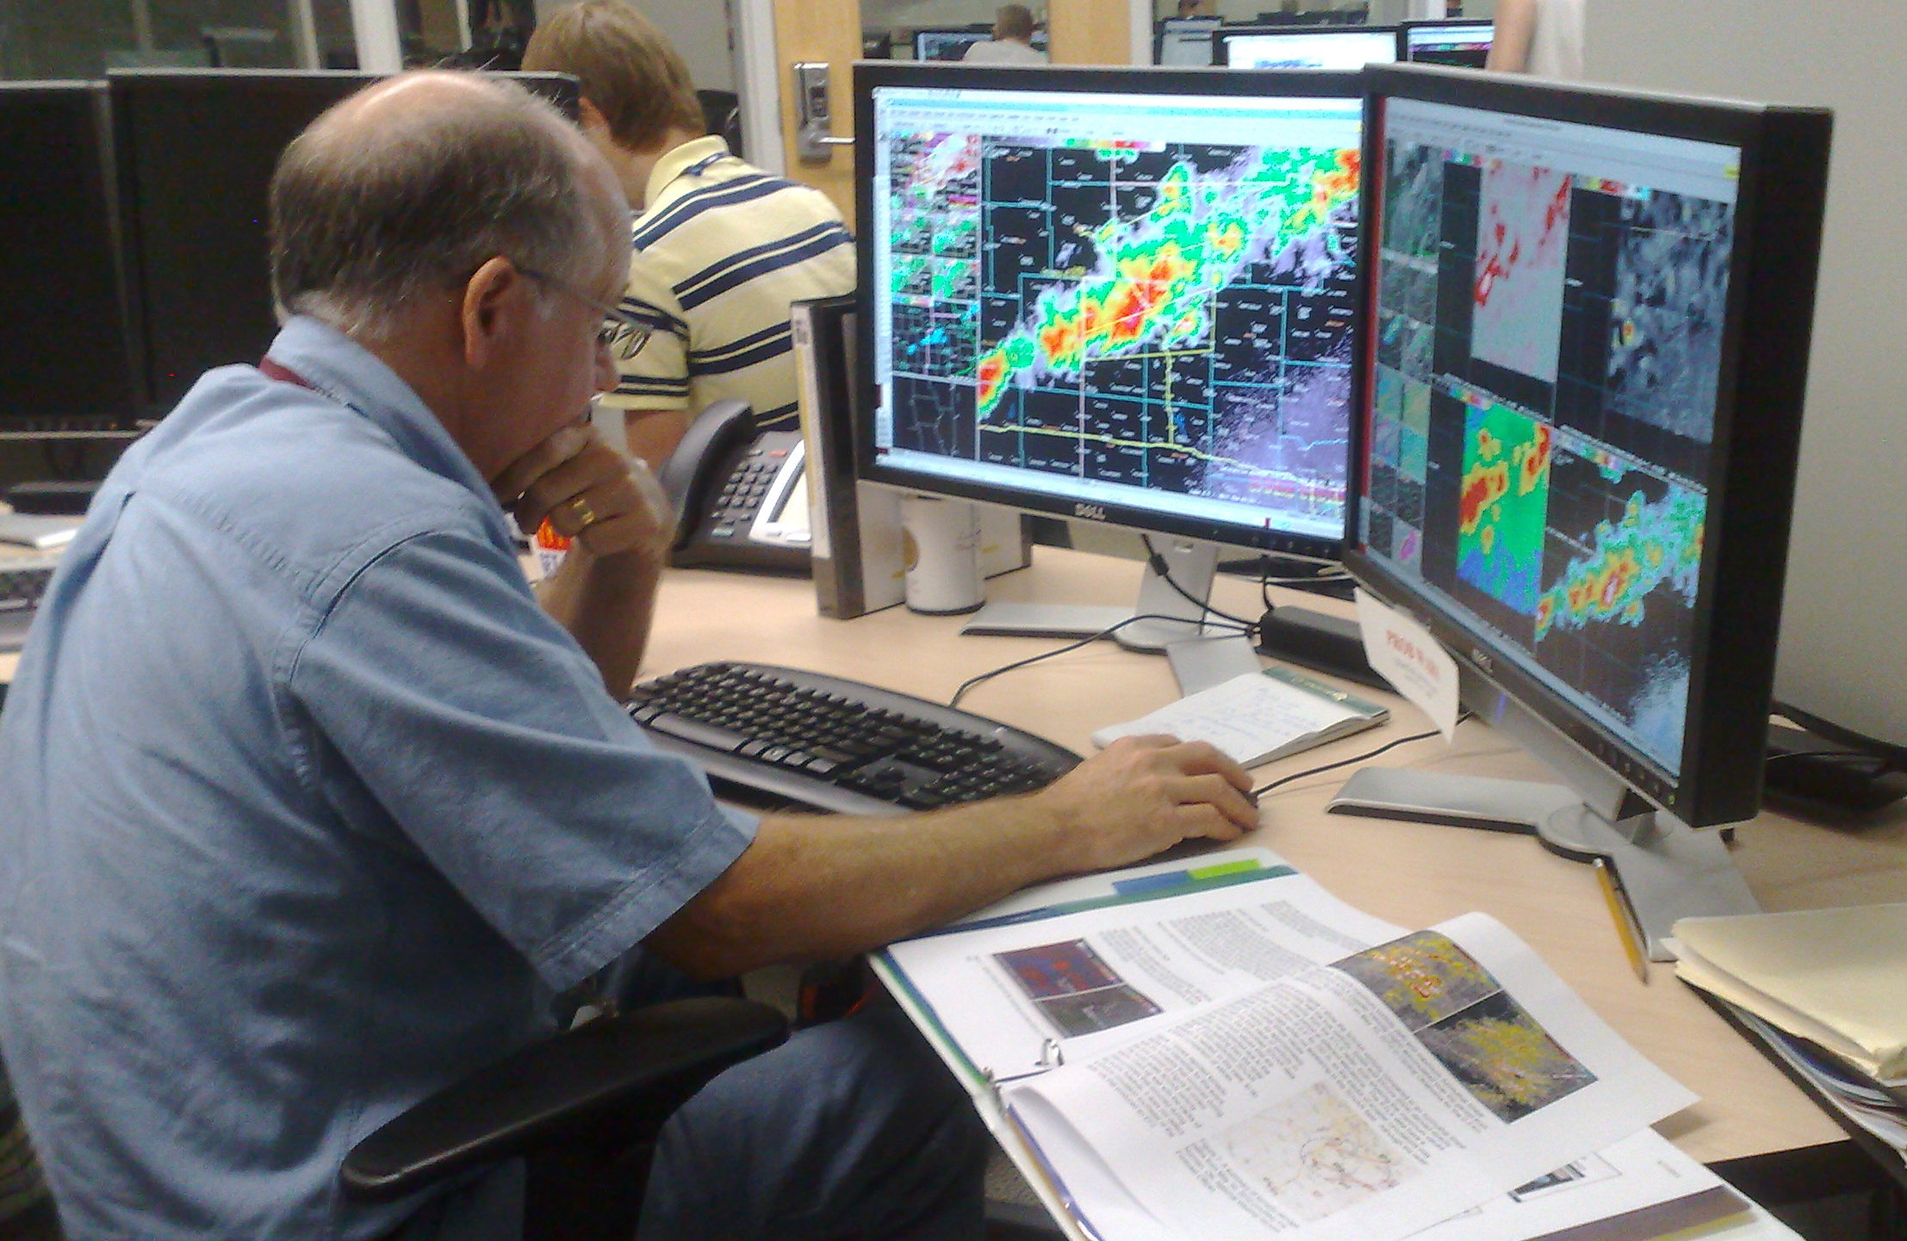
Use and Evaluation of Total Lightning Data in the GOES-R Proving Ground and Experimental Warning Program
Kristin Kuhlman (CIMMS/NSSL)
Geoffrey Stano (NASA/SPORT)
Chris Siewert (CIMMS/SPC)
Scott Rudlosky (NOAA/NESDIS)
Eric Bruning (TTU)
Greg Stumpf (CIMMS/MDL)
Travis Smith (CIMMS/NSSL)

Slide 2
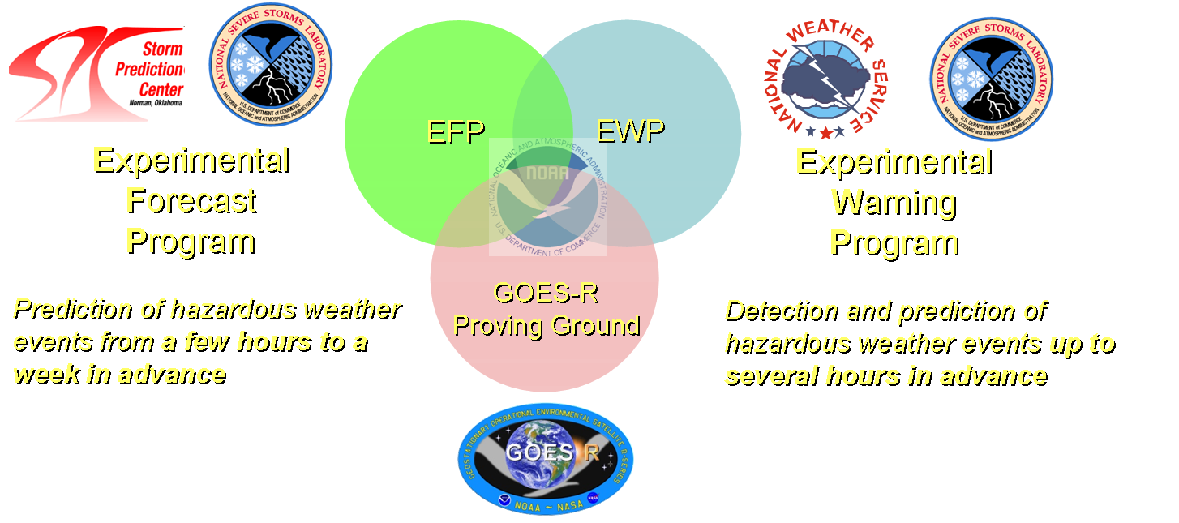
The Hazardous Weather Testbed and Experimental Warning Program
Mission: to improve the nation's hazardous weather warning services by bringing together forecasters, researchers, trainers, developers, and user groups to develop, test and evaluate new techniques, applications, observing platforms, and technologies.
Goal: Improve decision support for the prediction of high impact severe weather hazards at the WFO “warning scale” (0-2 hours).
Notes:
Feedback from experiments used for improvements
Immerse forecasters in a research environment
Provide researchers information about operational requirements

Slide 3
The Forecaster’s Operational Week:
The 2011 weekly shift schedule:
Mon 10a-6p Orientation and Training (includes 3 hr WES case)
Tue-Thu 10a-6p Early “forecast” shift
Tue-Thu 1p-9p Late “warning” shift
Fri 10a-1p Debriefing and optional seminars
Early forecast shift: Issue Target Area Forecast Discussion
GOES-R Nearcast and CI forecasts
High Resolution Model Evaluation
Late Warning Shift: Issue nowcasts/warnings using experimental data
GOES-R pGLM product evaluation
3D-Var product evaluation

Slide 4
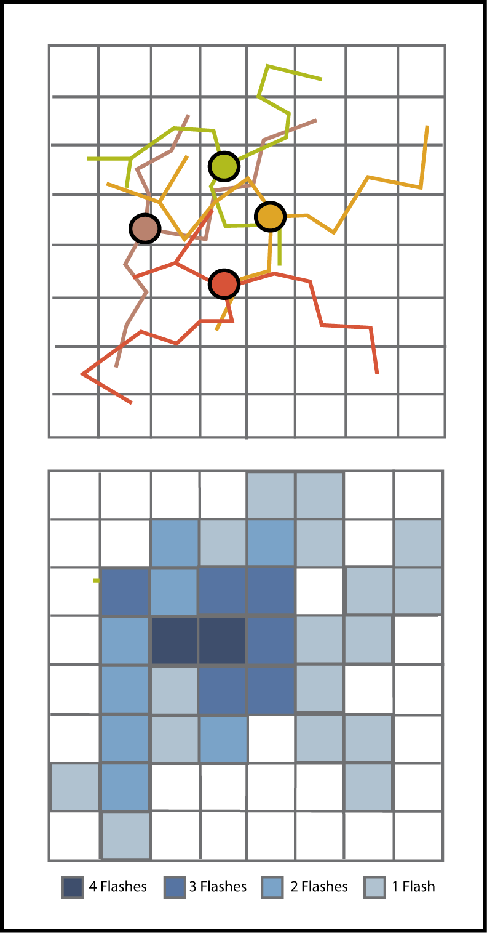
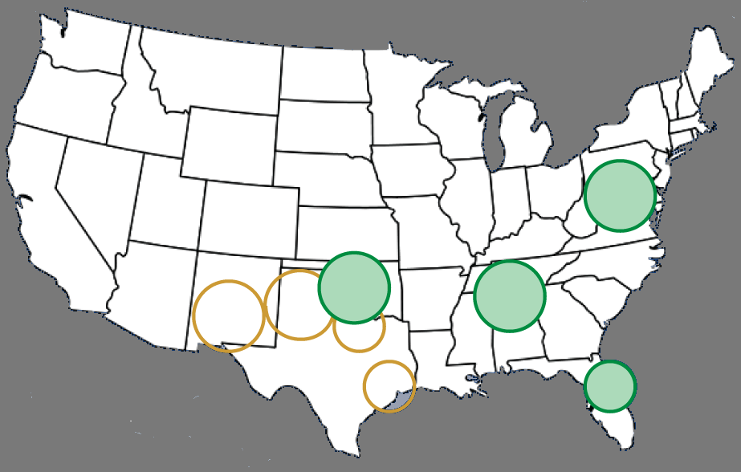
Creation of the PGLM product
Flash sorting – real-time - WDSSII
Flash Extent Density – Flash Footprint

Slide 5
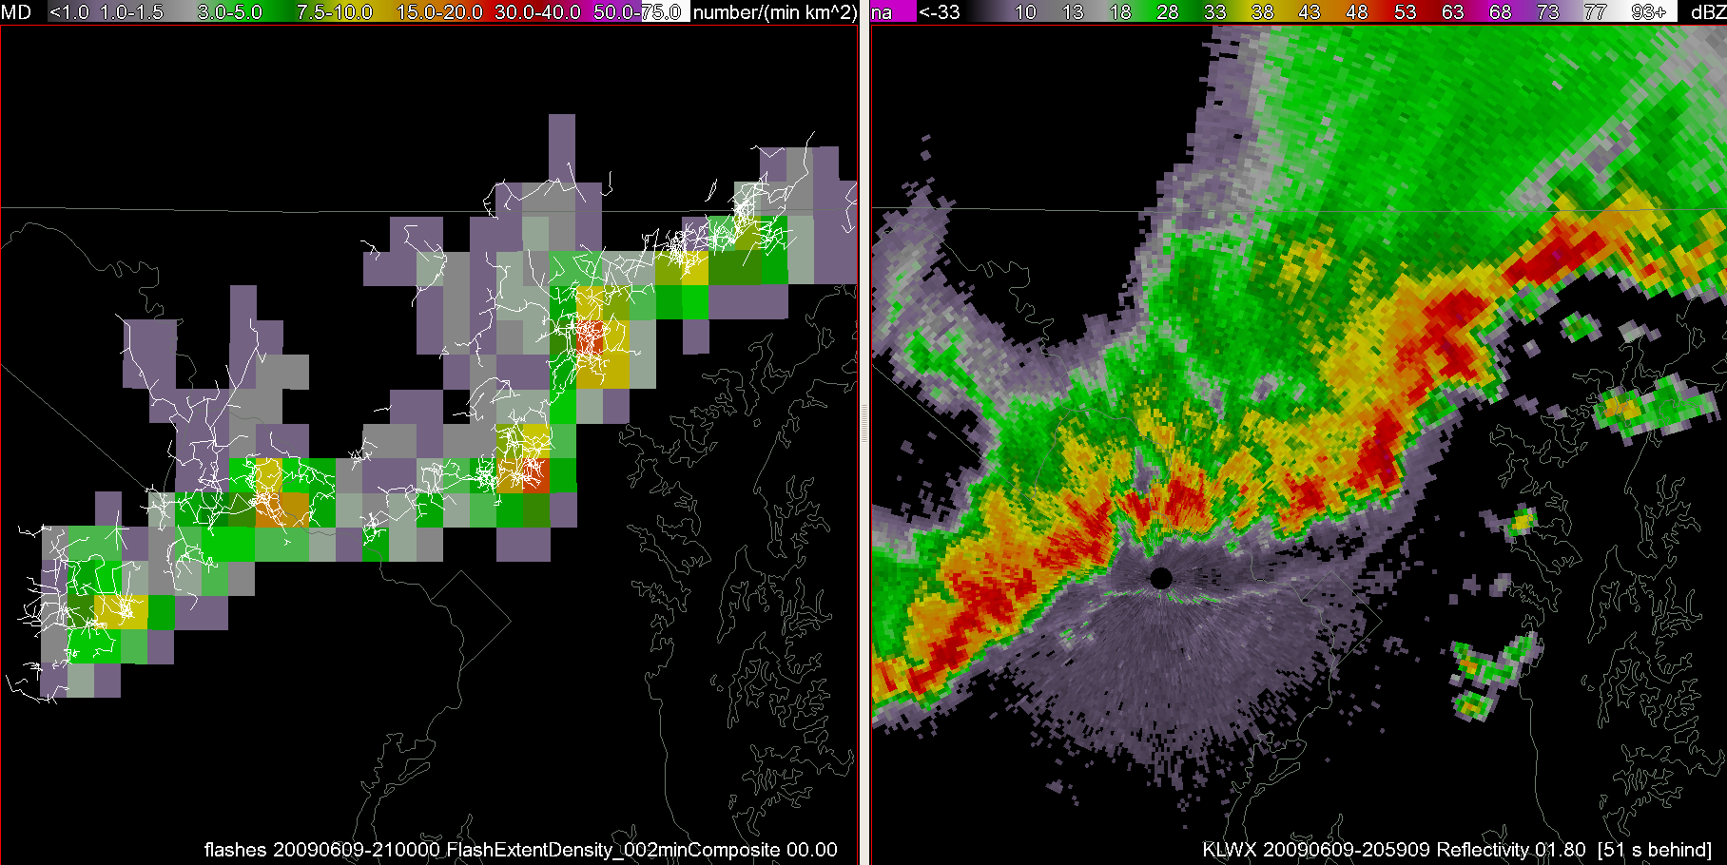
Creation of the PGLM product

Slide 6
Example Products
Notes:
60 min tracks of max & Sum
Not shown: 120 min tracks and flash initiation products

Slide 7
Cases from Spring/Summer 2011
19 May 2010 – archive event (OK - supercells)
11 May 2011 (OK – isolated cells & MCS)
12 May 2011 (OK – severe multicell)
17 May 2011 (DC – multicell storms)
19 May 2011 (OK – multicell storms & clusters)
23 May 2011 (OK – multicell, short-lived storms)
24 May 2011 (OK – supercells)
26 May 2011 (DC – developing squall line)
9 June 2011 (OK – multicell)

Slide 8
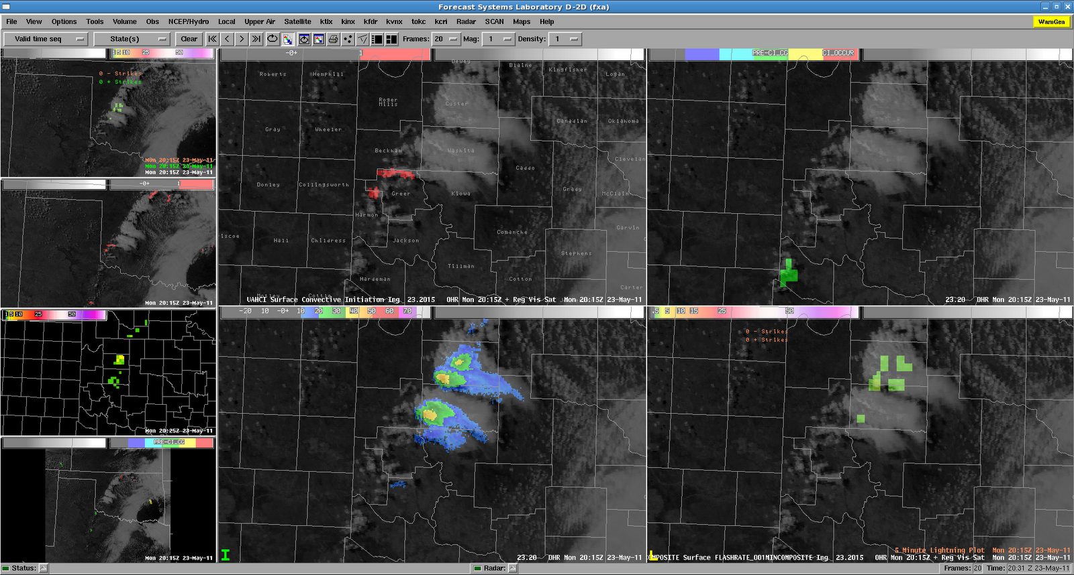
Real-time Product Integration: “Ultimate CI”
Interrogation preferences
Notes:
Ultimate CI: Starting from top left and moving (clockwise) we have the visible with SATCAST, visible with UWCI, visible with MRMS reflectivity at -10 C and finally visible with PGLM and NLDN lightning detections.

Slide 9
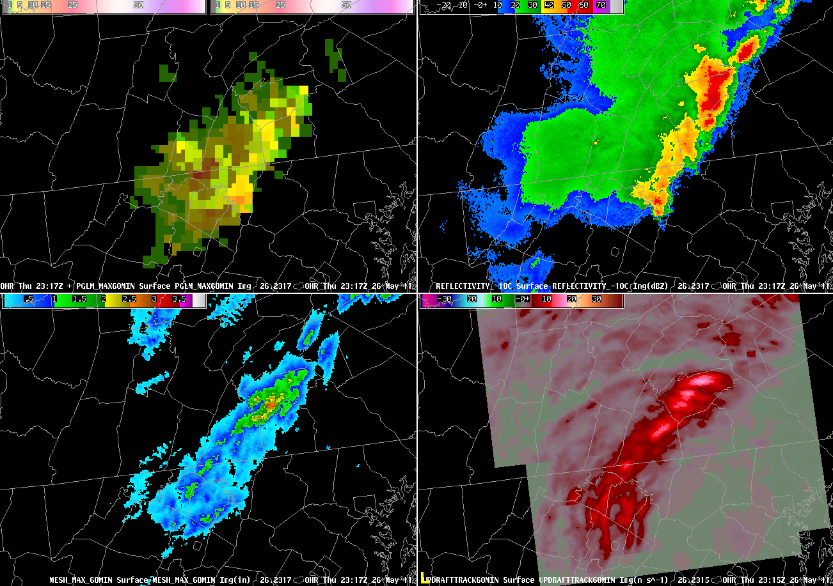
Real-time Product Integration: Storm Tracks
Interrogation preferences
Notes:
pGLM flash rate (bright) and 60 min Max Track (shadowed), reflectivity at -10 C, 60 min max MESH trackk, 60 min updraft track from 3D-Var.

Slide 10
11 May 2011: Flash Rate / CG comp
Notes:
The 1-minute PGLM flash extent density (and the corresponding NLDN cloud-to-ground lightning data) are tightly clustered with the the stronger convective regions, indicated by strong radar reflectivity. However, unlike the NLDN data, the PGLM flash extent density still showed that lightning flashes were extended anywhere from 8-32 km into the stratiform region. This shows the advantage of seeing the spatial extent of lightning activity available from total lightning observations.

Slide 11
Warning Decision: Lightning Jump
Notes:
This continued to rapidly increase through 2220 UTC when the PGLM flash extent density observe 82 flashes in a 1 minute interval for a single 8×8 km grid box. This was one of the largest lightning jumps of the day with an increase of 75 flashes per minute in a nine minute time span. With this major lightning jump, along with the forecaster’s interrogation of radar data, a new severe thunderstorm warning was issued at 2226 UTC. This warning was later verified with several severe hail reports

Slide 12
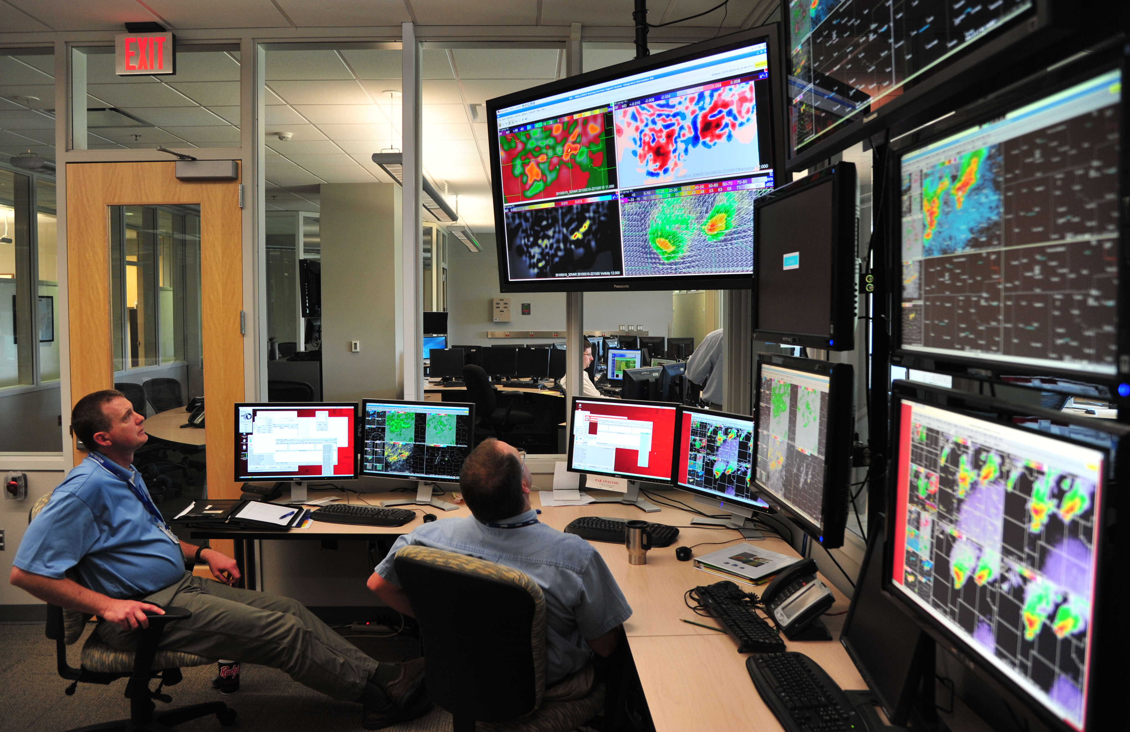
Forecaster Feedback
“The total lightning data is an excellent tool for monitoring convection, I see much promise for such data in the future, especially since CG strikes may be only a small fraction of the total lightning strikes within a given storm. “
“I utilized it as a situational awareness product and then kept a watch on my tried and true radar practices to issue the warning. The PGLM data gave me more confidence in my warning. Which is always something that is positive.”

Slide 13
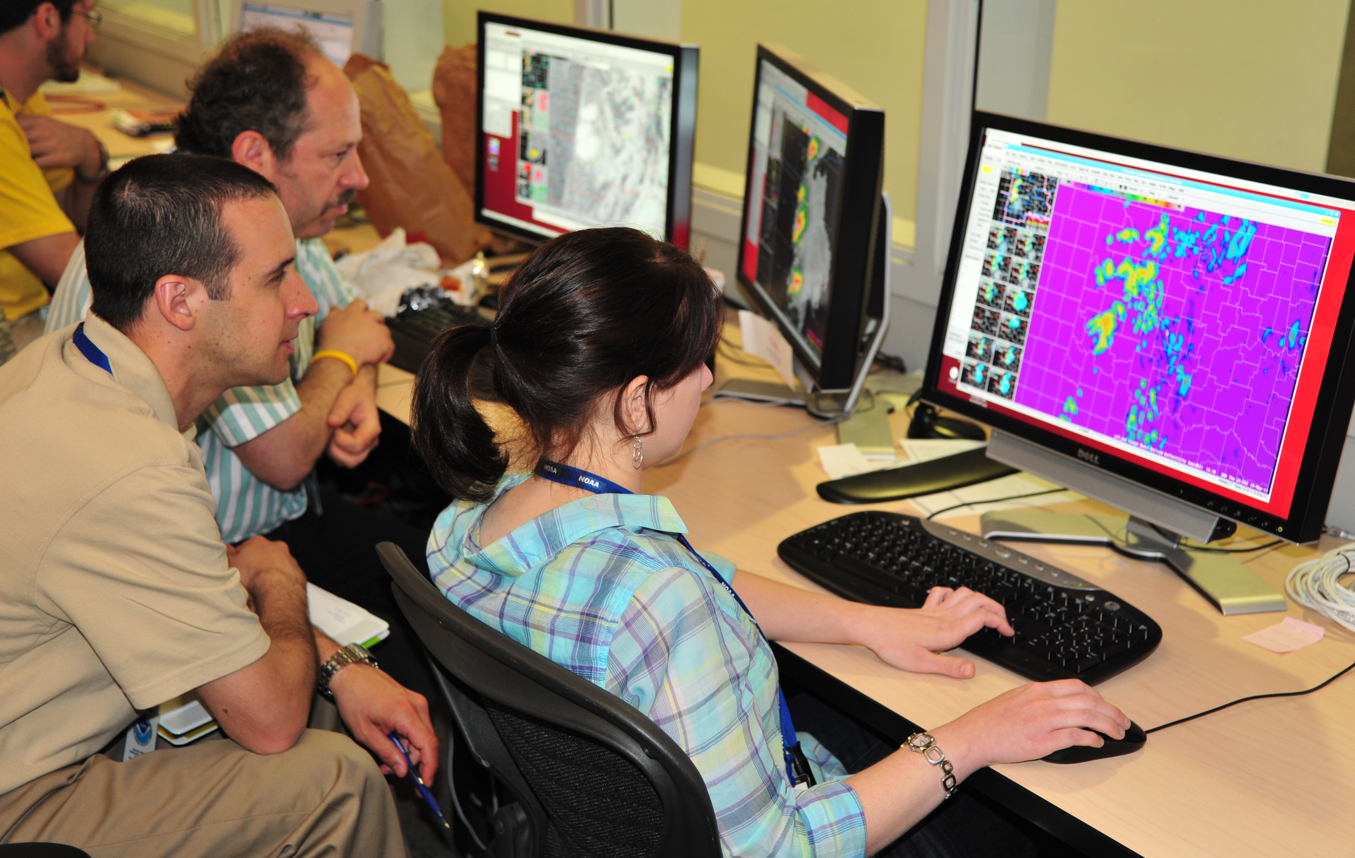
Forecaster Feedback
“Total lightning data preceded the CG network anywhere from 10-40 minutes. I was able to quickly determine when flash rate was significantly increasing, and then compare with satellite and updraft/downdraft parameters for a nice big picture.”
“Coming into the day, I wasn't quite sure when or where to or why to use the data, but after using it. I really think it has a lot of functionality and is useful in warning operations. I look forward to it as a product from the GOES-R.”

Slide 14
Forecaster Feedback
Lightning Safety
“We have a lot of users like golf courses and parks that we may not be paying attention to, especially for lightning safety in stratiform rain regions where people may think that it's just light rain… When I'm in warning operations, I get engaged in the base radar data and pay less attention to everything else. This may help a lot in those situations”
“Lightning danger for first and last flash and stratiform rain regions… Provides details on which anvils well downstream of main core are electrically active.”
Integration with other products:
“When we saw cell mergers there was a rapid increase in flash rate over a 5 minute time period and updraft intensity from the 3D-VAR analysis”
Aviation & Fire Wx – Increased operational efficiency
PGLM data can help fill the holes by radar and NLDN. There won’t be as much surprise by lightning starts
Reduced FAR for airport shutdown – (e.g., Demetriades, Holle, Hembury)

Slide 15
Changes & Additions for future testing
Some type of IC/CG ‘ratio’ or ‘fraction’ product
Trend display: both gridded and time series (storm tracking)
Color Scale
An additional DRT/WES case focused specifically on lightning applications: Aviation? Flooding? Lightning Safety? Fire or Winter Weather?
Development of “proxy” data from WTLN for increased real-time coverage for CONUS?
"Need more research on the forecasting applications of this data."
Notes:
What is an intense flash rate for a particular type of storm? Jump from 10 to 20 flashes per min? What about a jump from 40 to 80?

