Slide 1
MC3E Weather Briefing
Tuesday March 29, 2011

Slide 2
Welcome
Start of Campaign Operations: April 22nd
To support daily radiosonde decisions and aircraft operations.
Daily Forecasting. Plans Include:
Morning Mission Briefing @ 9 AM Local
Discussions with local NWS WFO @ 830 AM
Afternoon Mission Update @ 4 PM Local

Slide 3
Forecast Day 0 (Back to the future…)
-24 to 24 hours

Slide 4
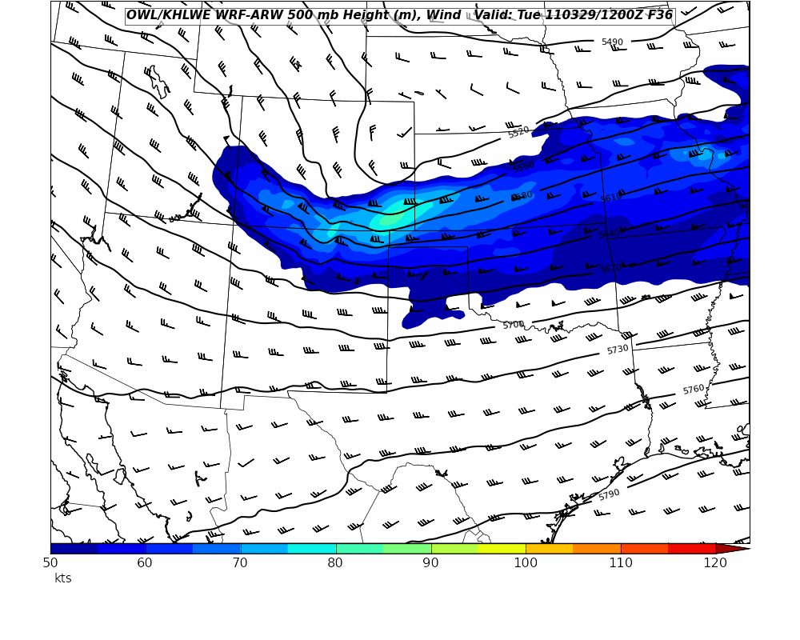
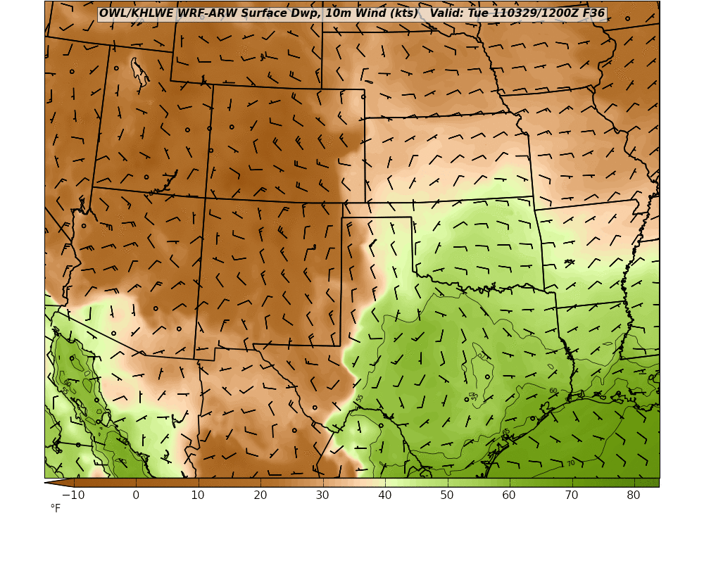
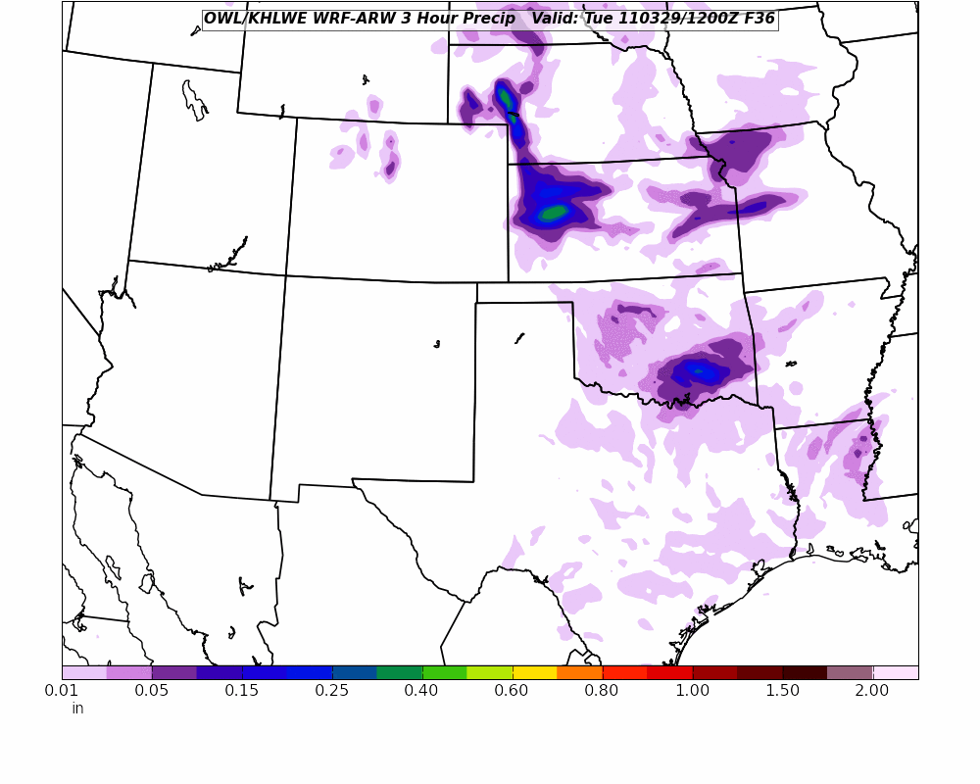
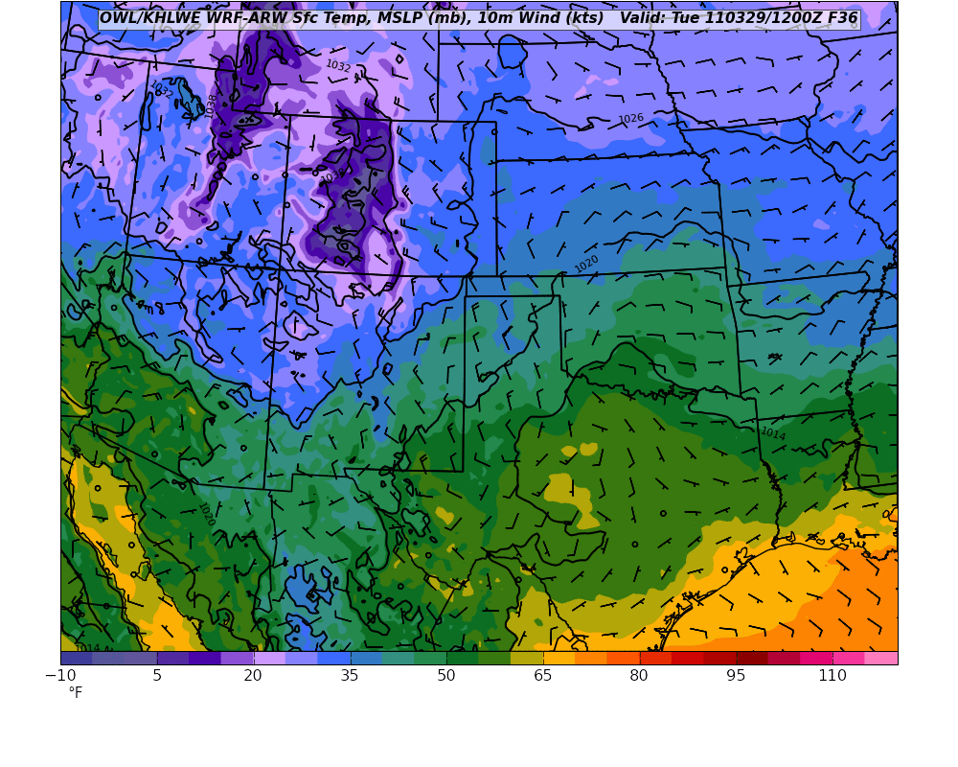
As of Monday Morning…. WRF (OU) 00Z +36, Valid Tuesday 12 UTC, 7 AM

Slide 5
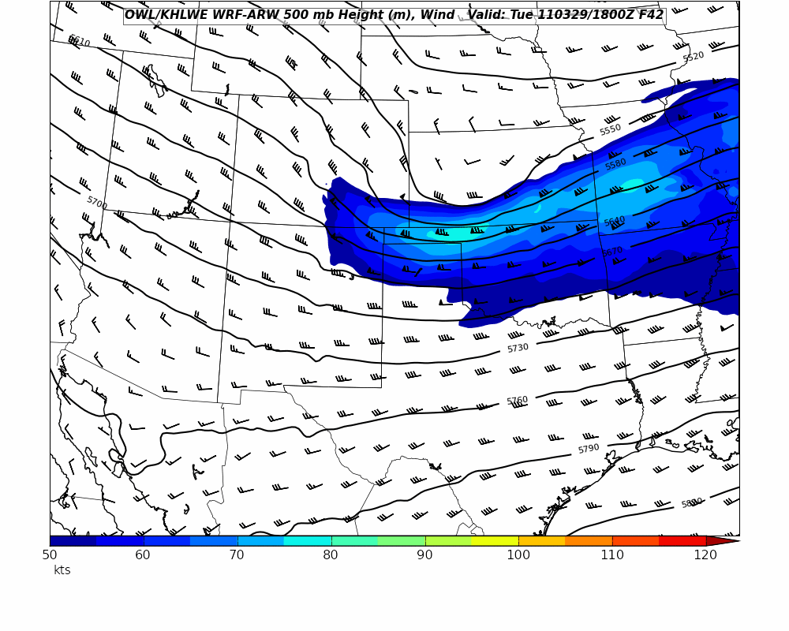
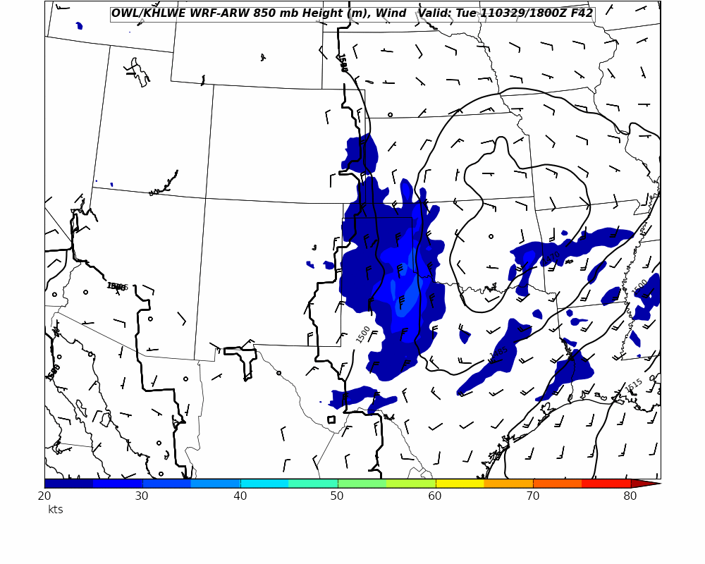
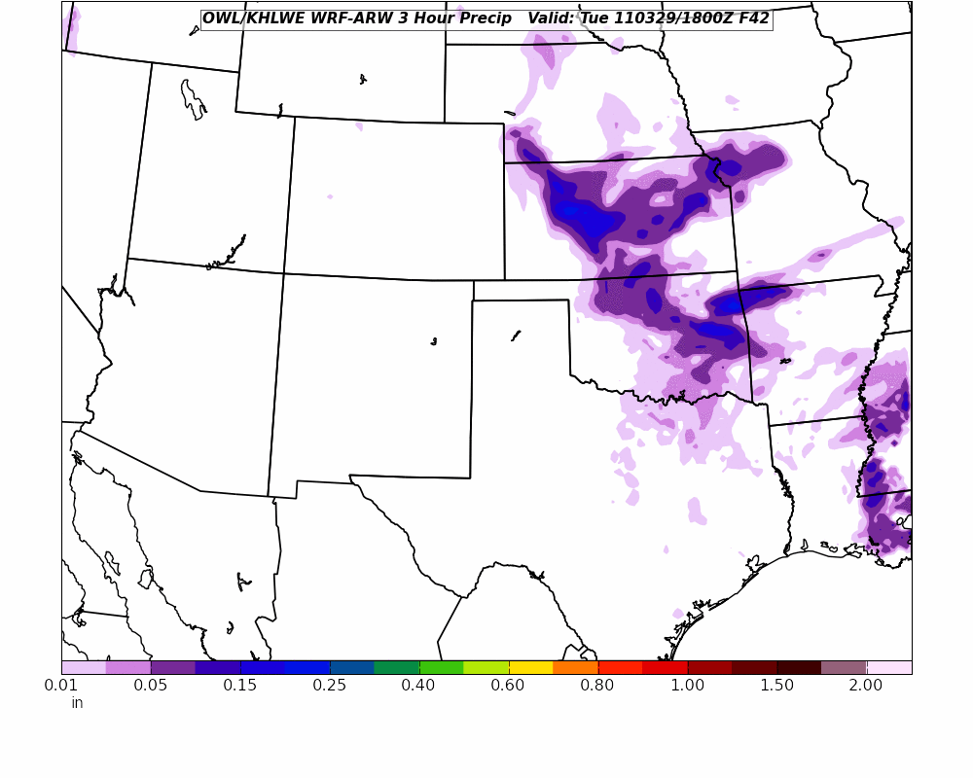
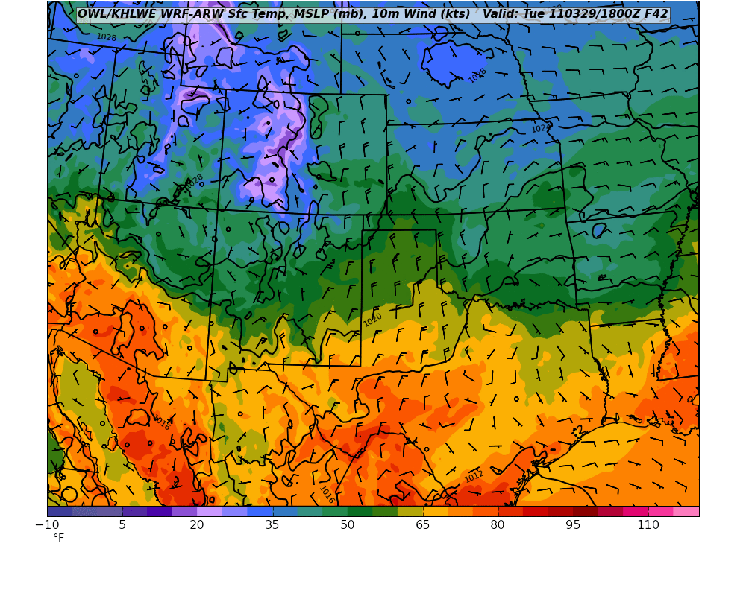
As of Monday Morning… WRF (OU) 00Z + 42 , Valid Tuesday 18 UTC, 1 PM

Slide 6
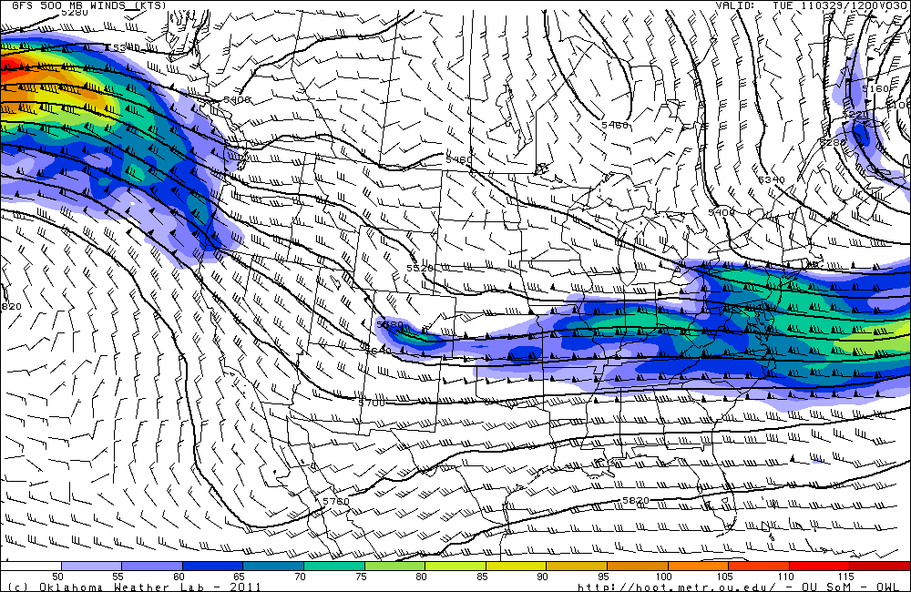
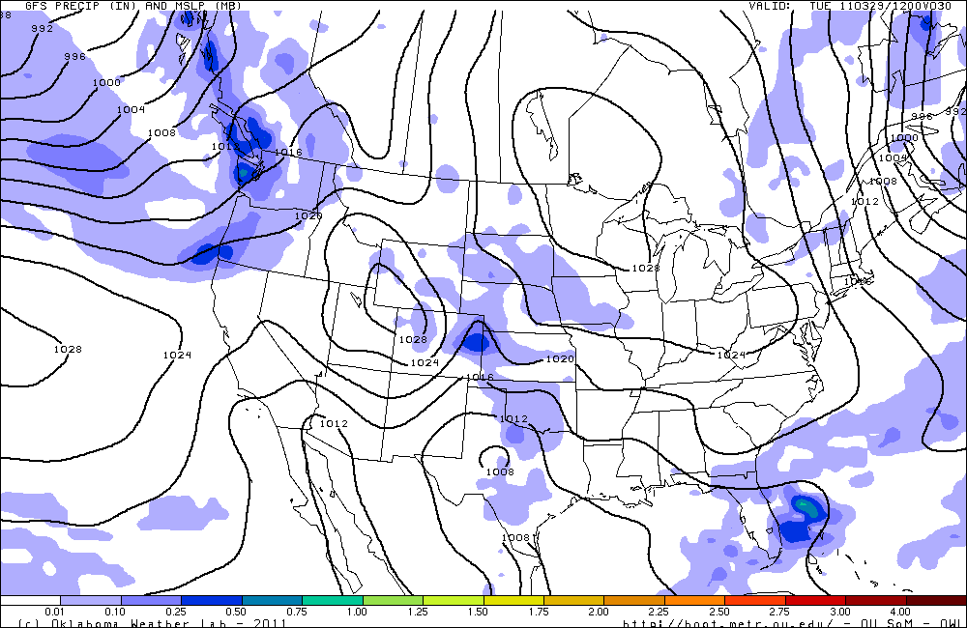
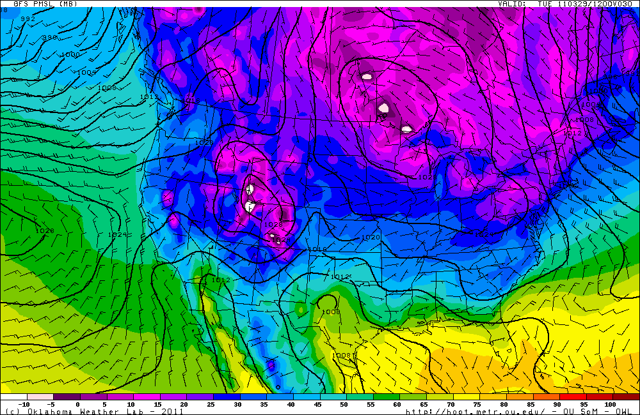
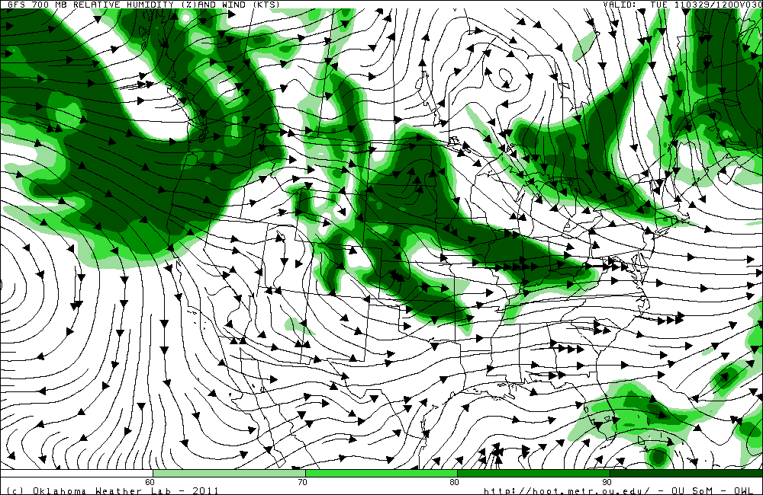
As of Monday Morning… GFS (06 UTZ + 30, Valid 12 UTC Tuesday, 7 AM)

Slide 7
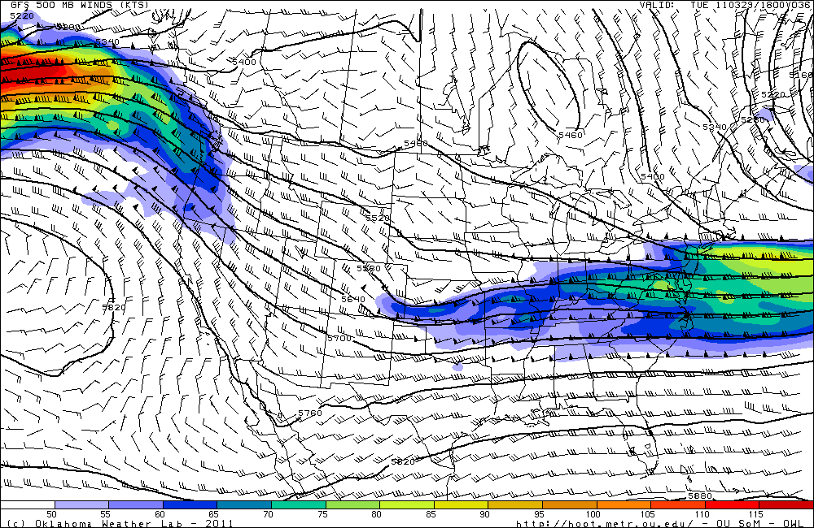
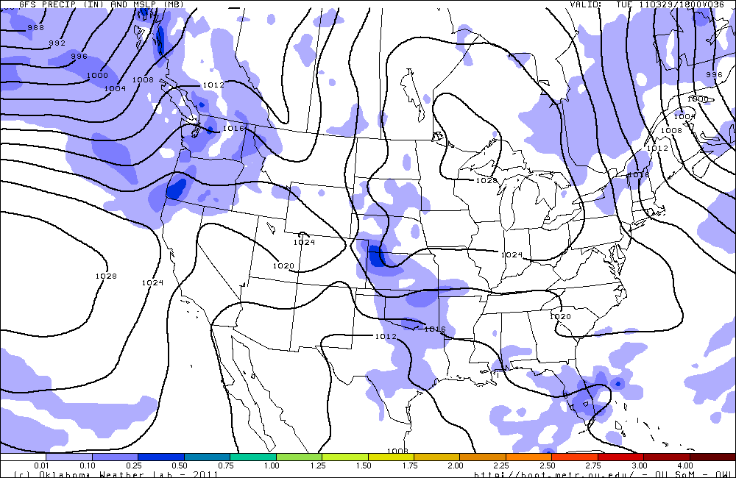
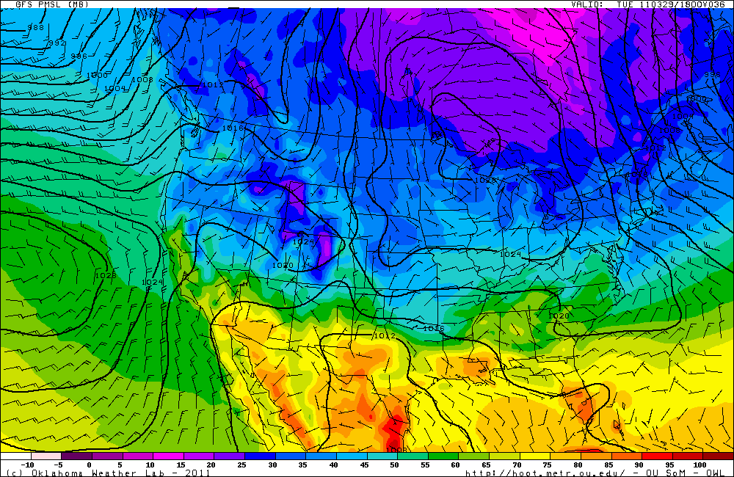
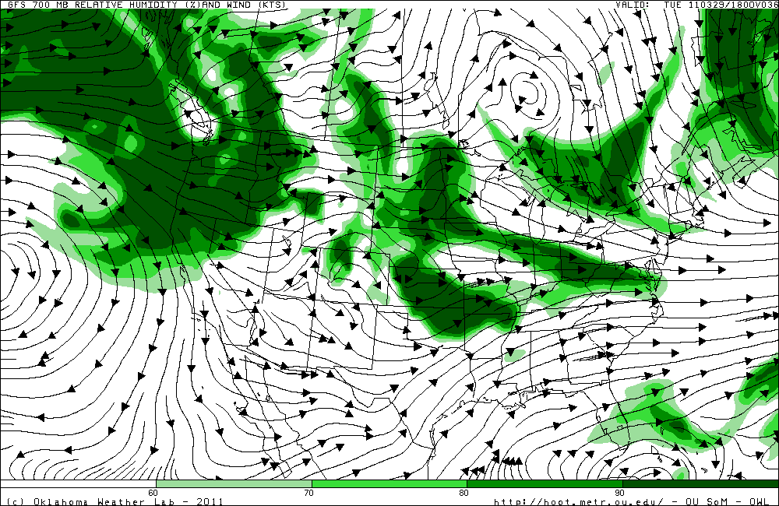
As of Monday Morning… GFS (06 UTZ + 36, Valid 18 UTC Tuesday, 1 PM)

Slide 8
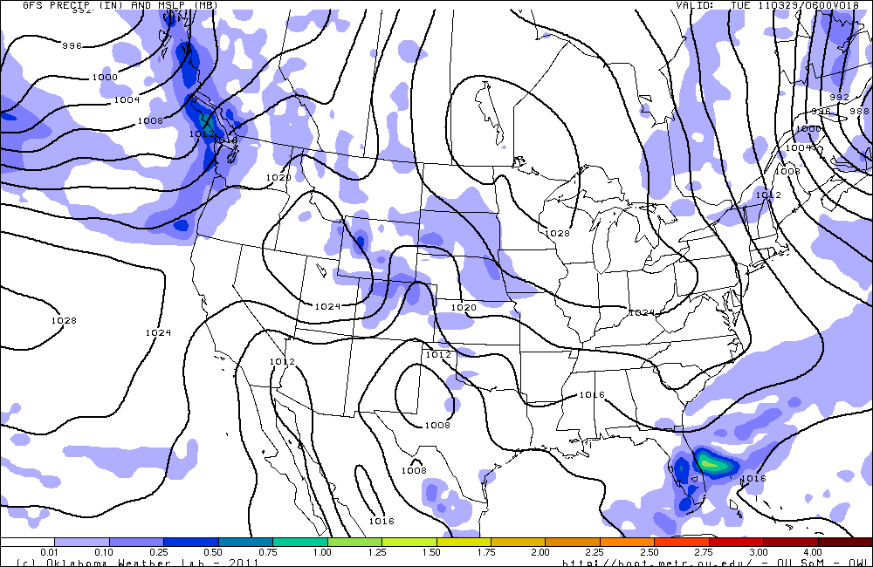
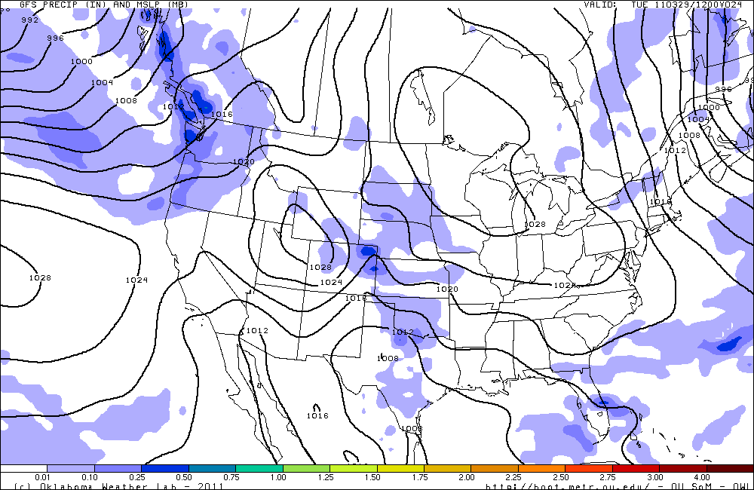
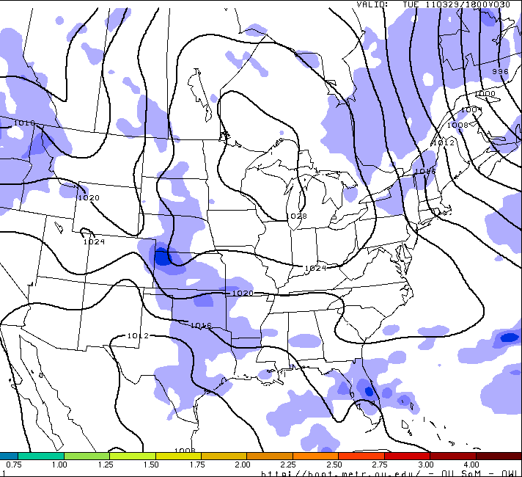
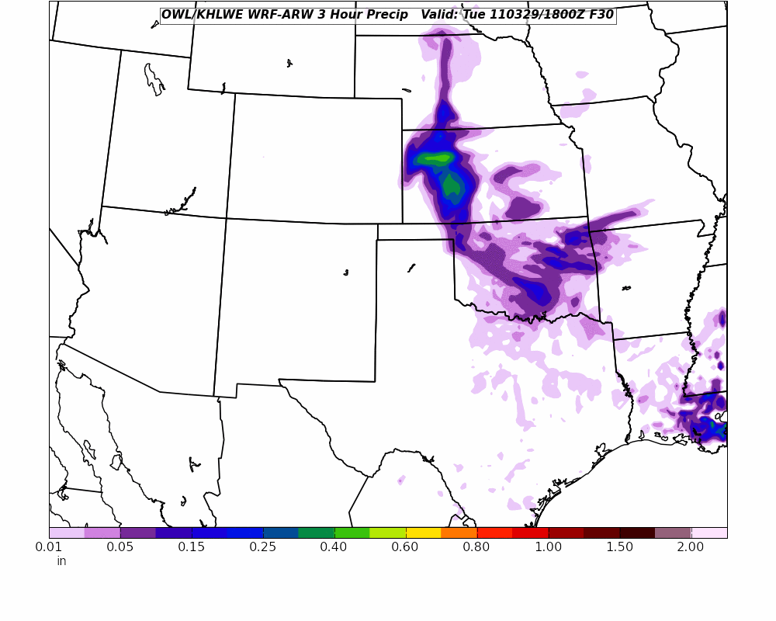
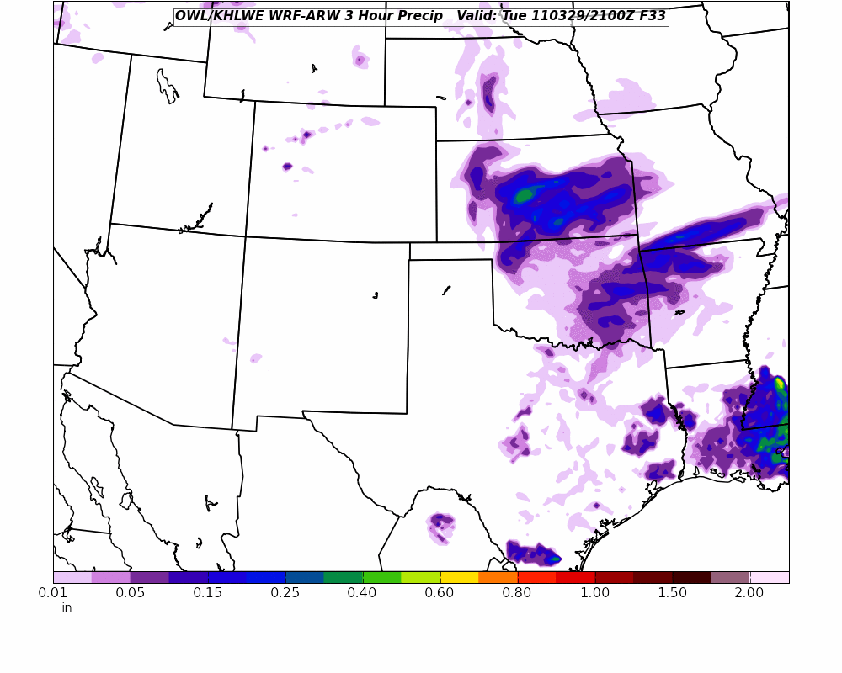
As of Monday Mid-Day… GFS (12 UTZ +, Valid Tuesday)
1 AM
7 AM
1 PM
4 PM
1 PM

Slide 9
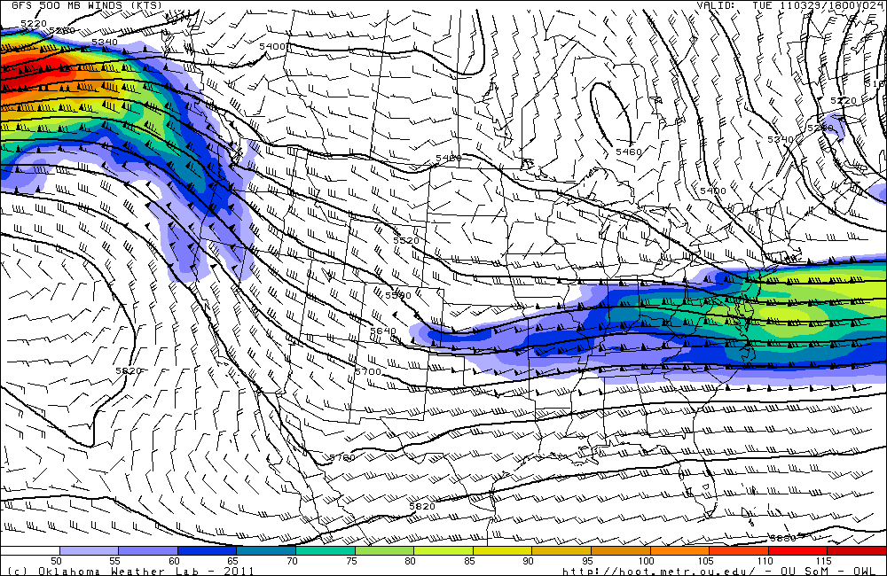
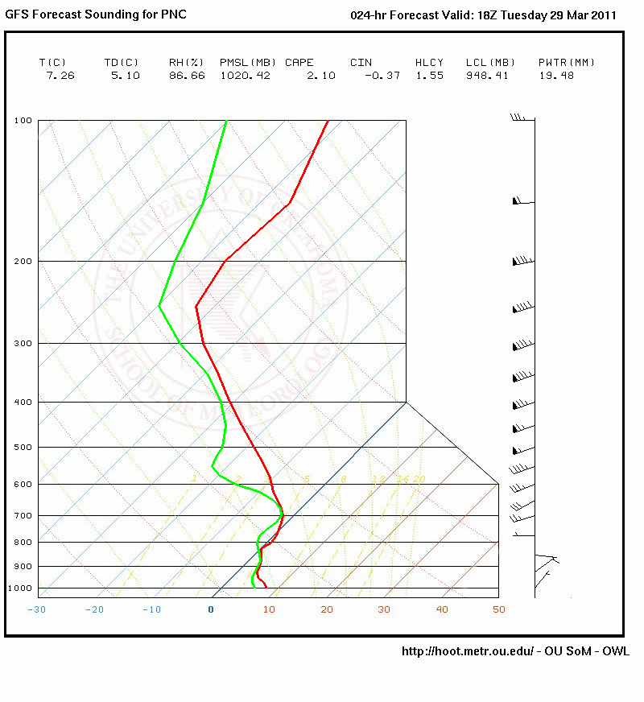
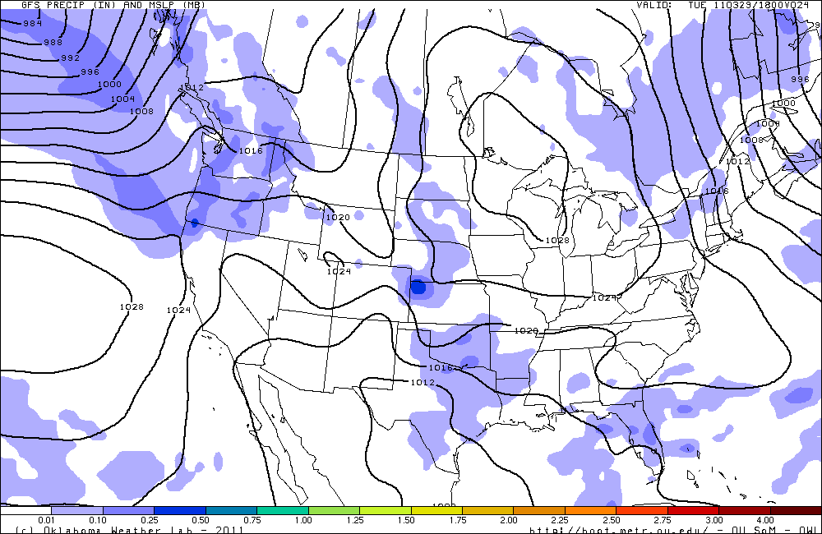
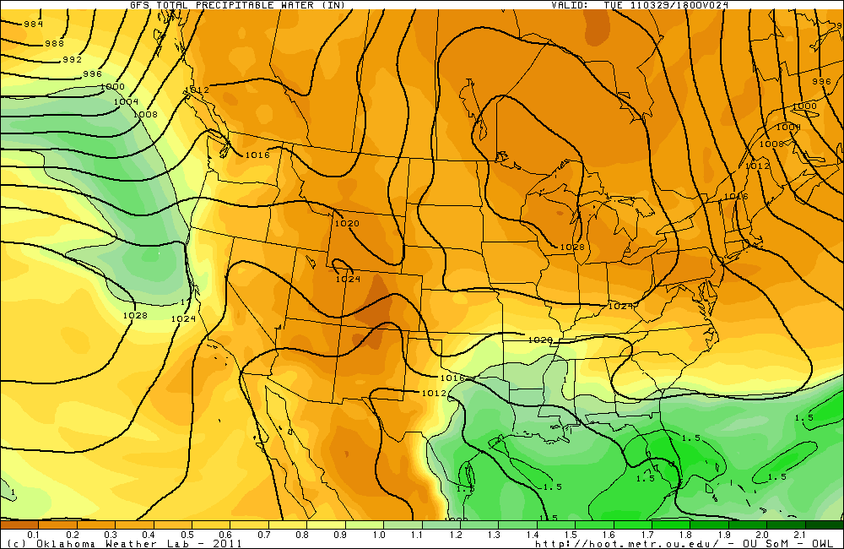
As of Monday Mid-Day… GFS (18 UTZ + 24, Valid Tuesday 1 PM)

Slide 10
NWS & MC3E Forecasting Highlights to Watch:
Showers/Thuderstorms to develop as moisture returns, early Tuesday (Low level jet over low level cold air).
Forecast Soundings over PNC more consistent with light stratiform rain, drizzle, not strong convective event (mid, upper level forcing, limited instability). Stronger cells more likely over Red River (southern Oklahoma/Texas border), eastern parts of state. “Hundredth is high, significant less likely”
Second, broad trough late Wed, early morning Thursday (00UTC+).
Quick moving.
Less moisture, confined to eastern half of state.
Low chance of precip, isolated.
Strong warming trend associated with longwave ridge into weekend.

Slide 11
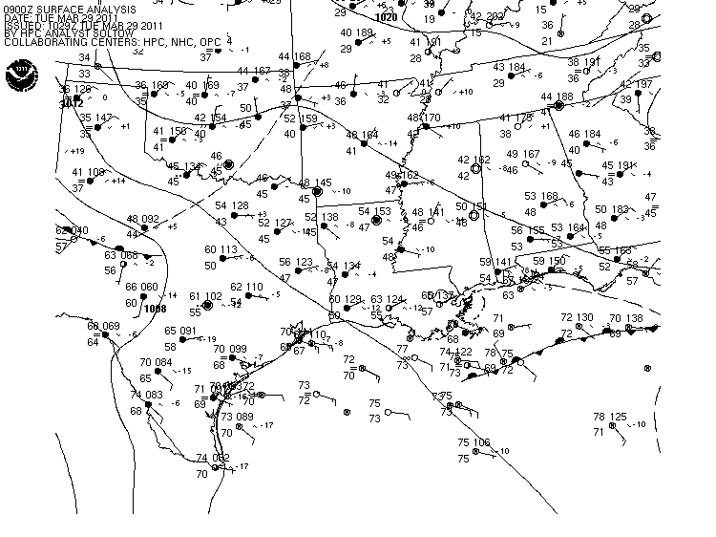
10 UTC

Slide 12
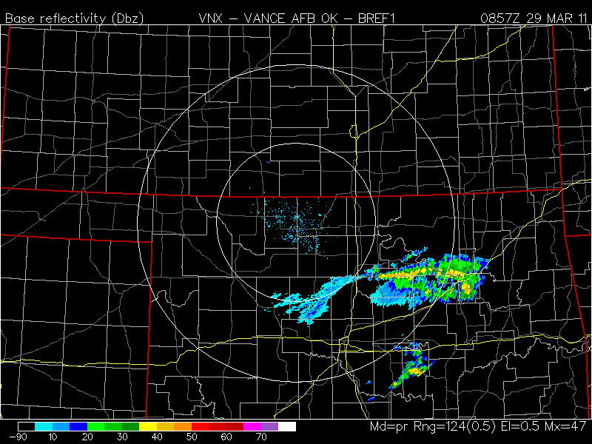
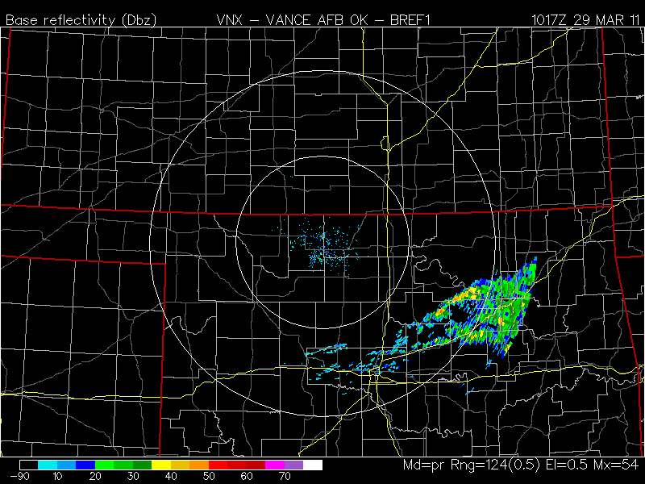
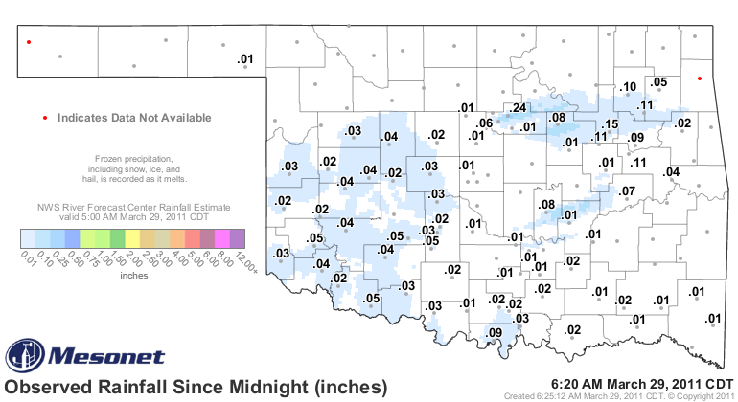
KVNX 9 UTC
KVNX 10 UTC

Slide 13
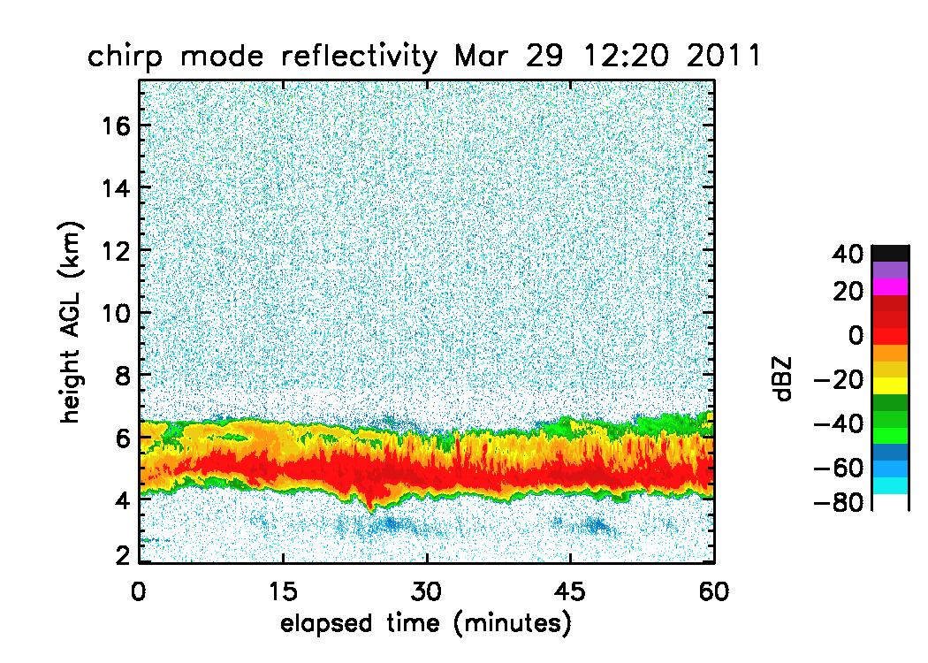
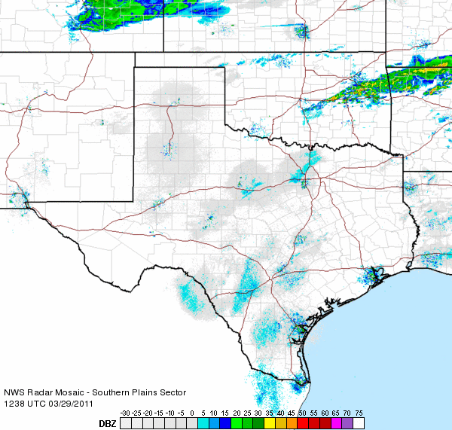
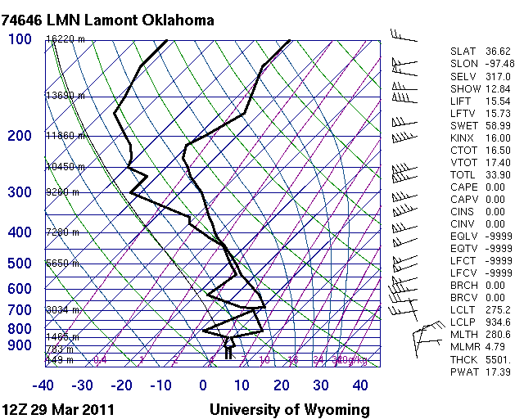
7:30 AM

Slide 14
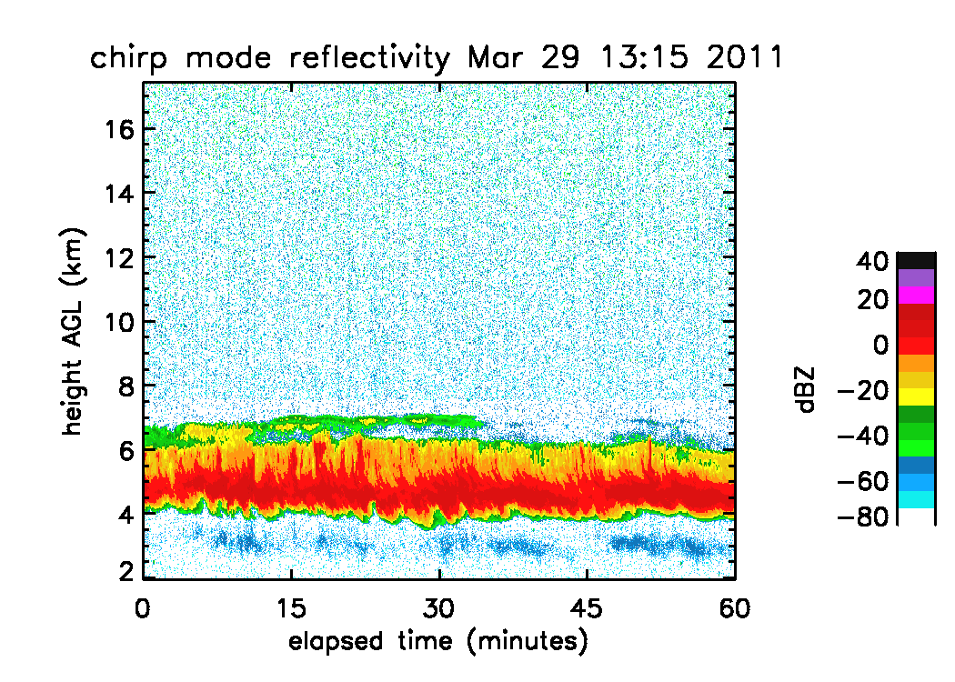
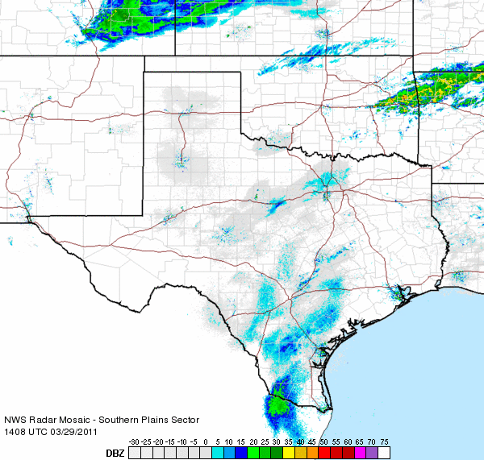
9 AM

Slide 15
Forecast Day 1
24-36 hours

Slide 16
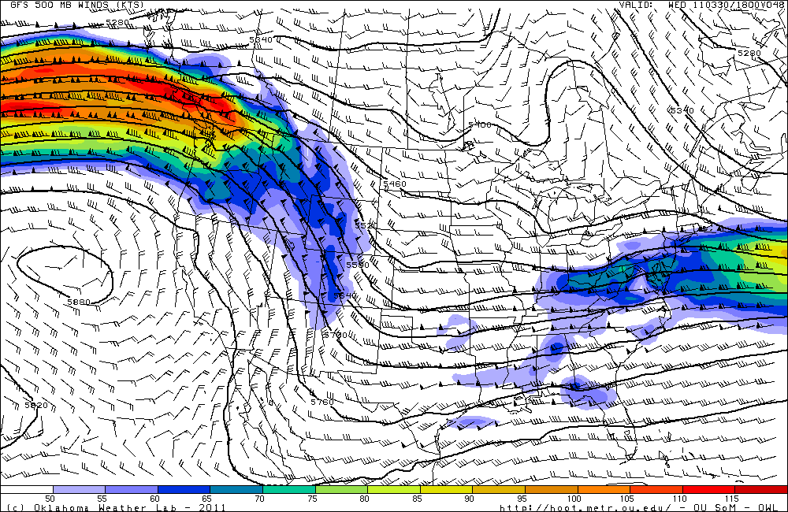
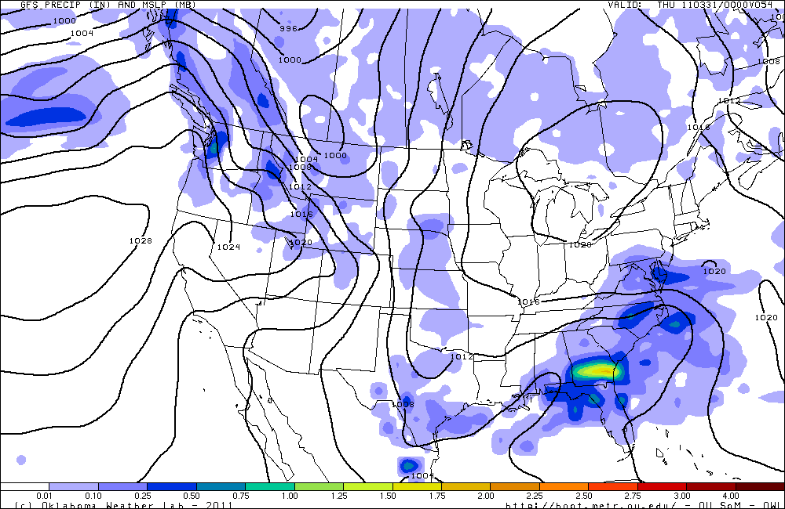
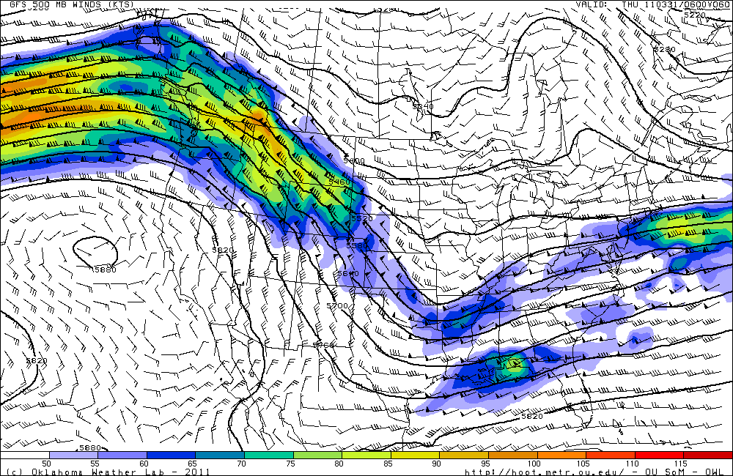
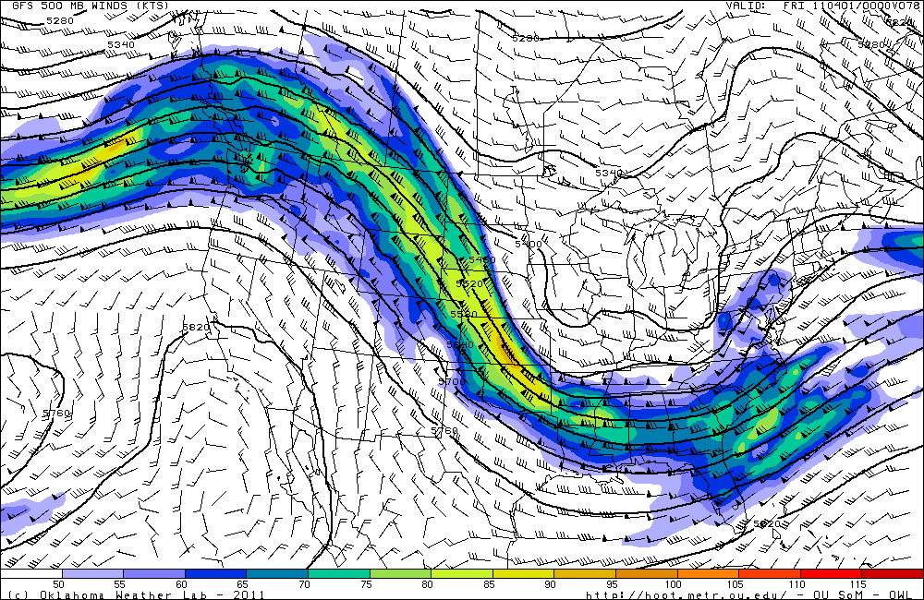
As of Monday Mid-Day… GFS (18 UTZ, Valid Wednesday into Thursday)
WED 18 UTC
THR 00 UTC
THR 6 UTC

Slide 17
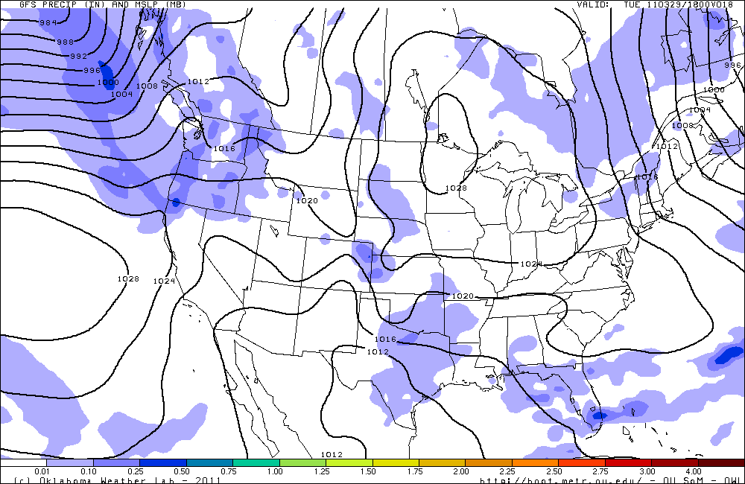
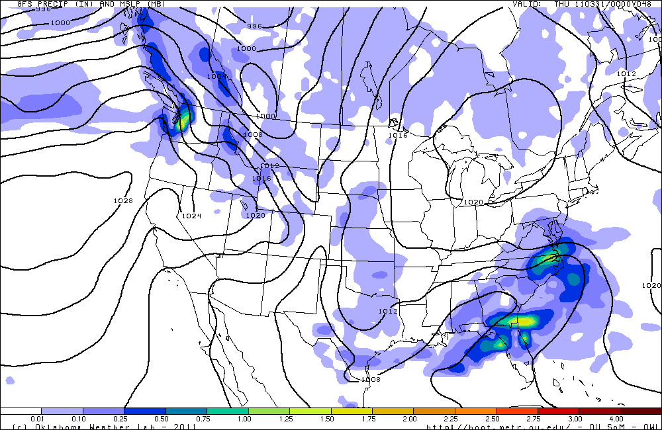
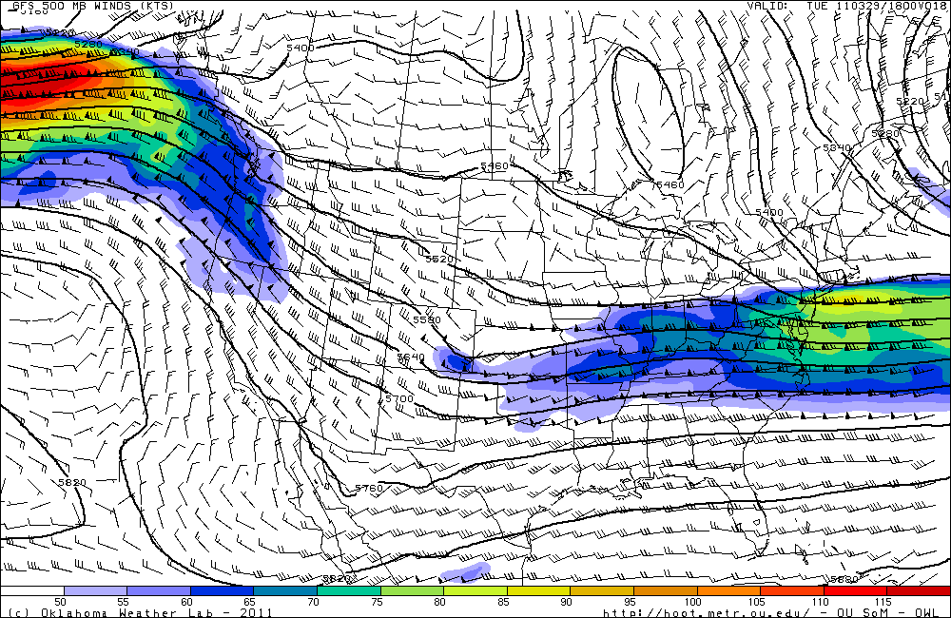
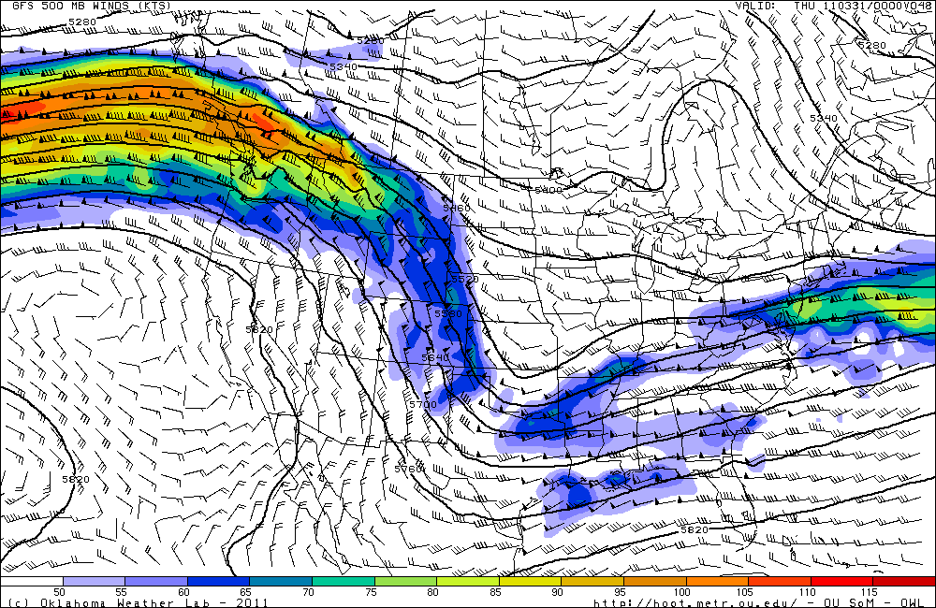
As of Monday Evening… GFS (00 UTZ)

Slide 18
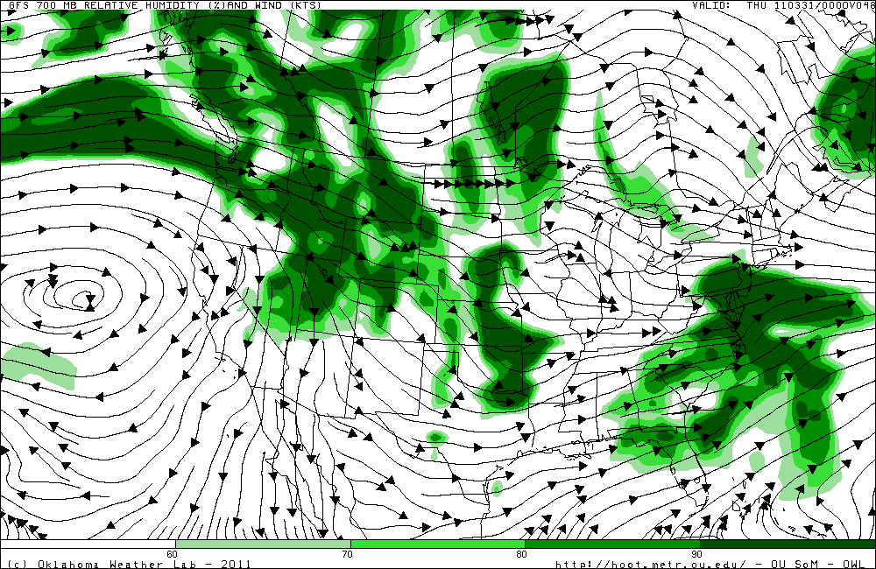
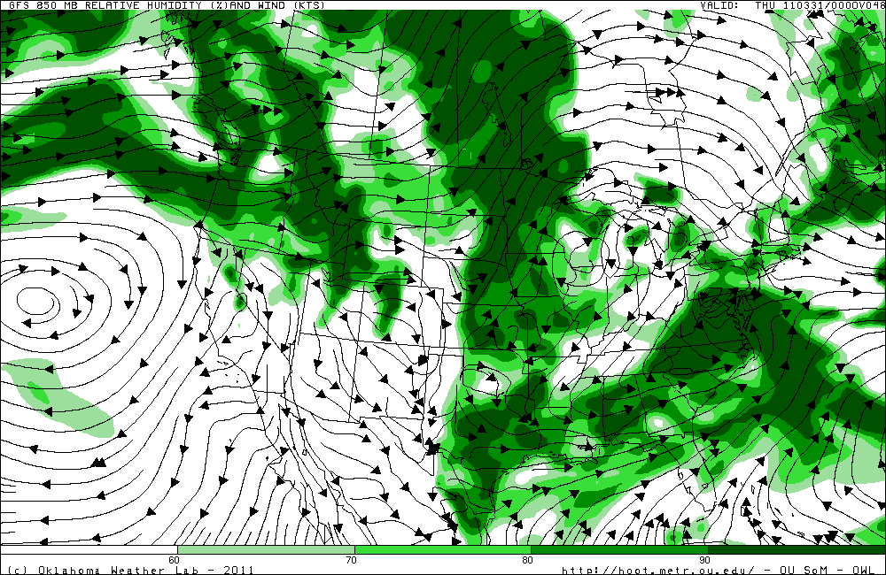
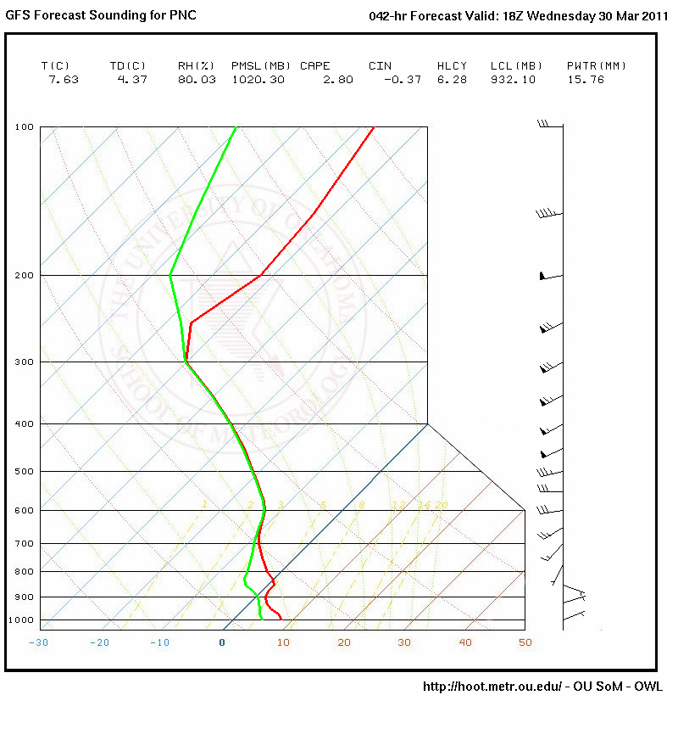
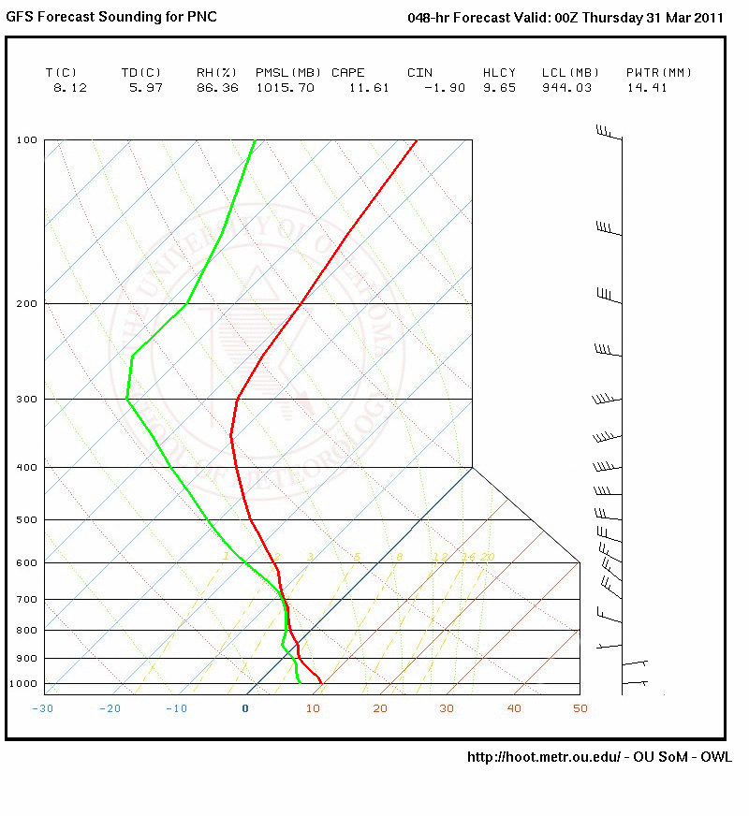
As of Monday Evening… GFS (00 UTZ)

Slide 19
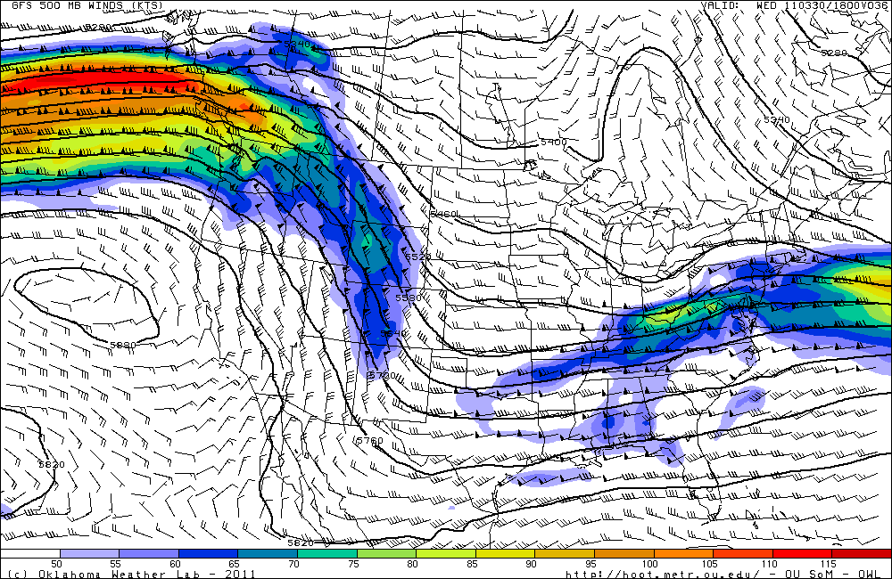
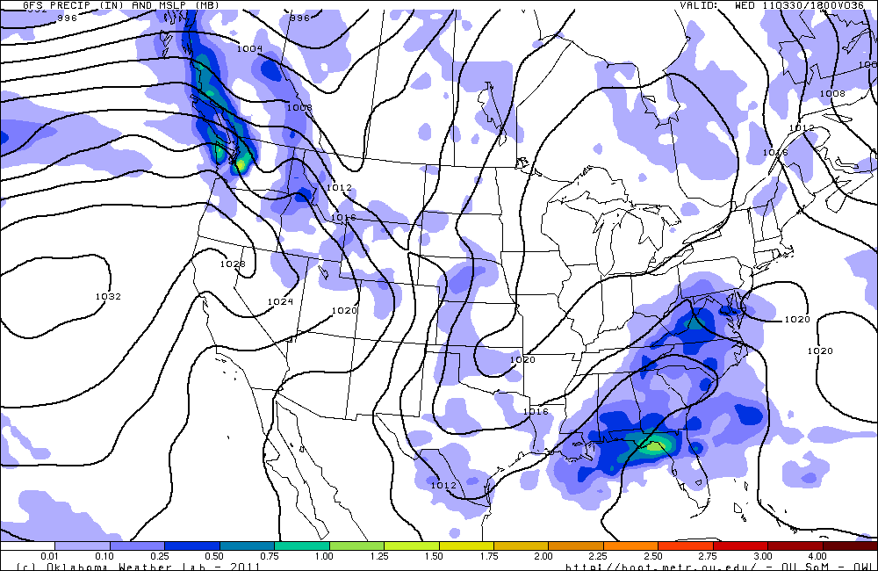
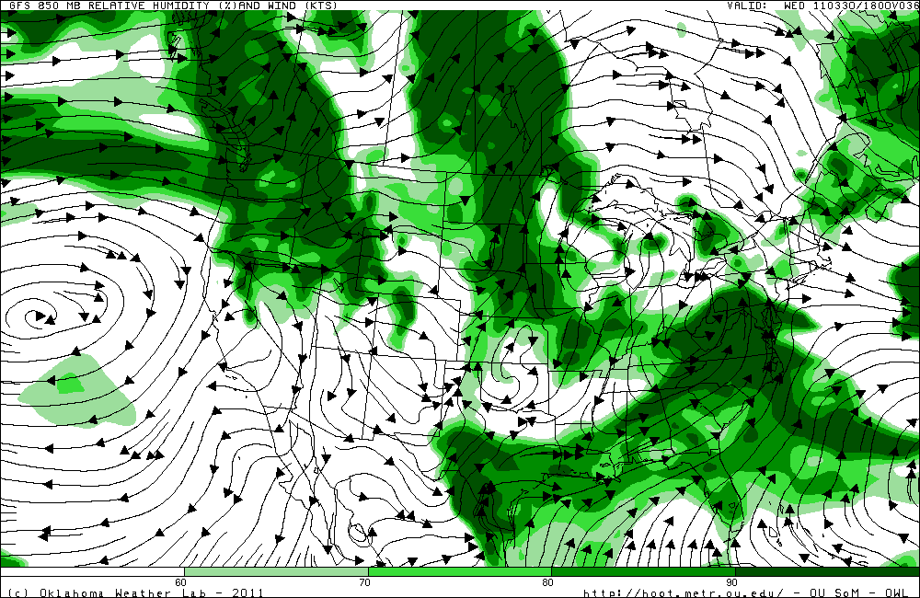
As of Tuesday Morning… GFS (06 UTZ)

Slide 20
NWS & MC3E Forecasting Highlights :
Second, broad trough late Wed, early morning Thursday (00UTC+).
Quick moving.
Less moisture, confined to eastern half of state.
Low chance of precip, isolated.
Strong warming trend associated with longwave ridge into weekend.
No overwhelming reason to update an already “difficult forecast”, aka patchy isolate showers and moisture, uncertain upper level support.

Slide 21
Extended Forecasts
Days 2-?

Slide 22
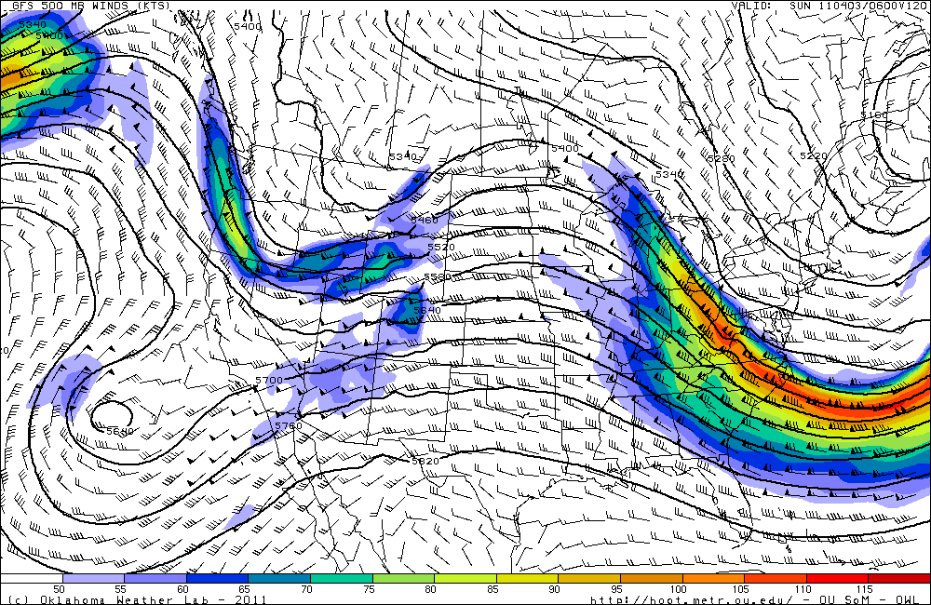
Stronger system from west over the weekend. Warmer.

