Slide 1
MC3E Weather Briefing
Wednesday March 30, 2011

Slide 2
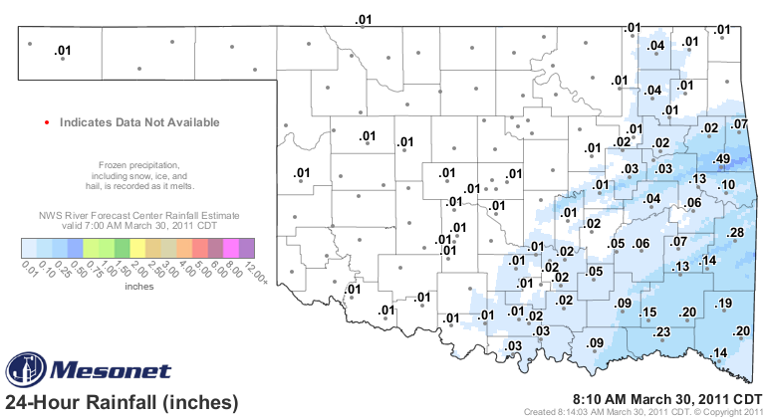
Validation
Rainfall over OK past 24 hours

Slide 3
Overview
Today – Low clouds/fog this morning. Small mid-level wave to clip northern OK very slight chance of showers < 20%
Thursday/Friday – Under an amplified ridge aloft
Weekend

Slide 4
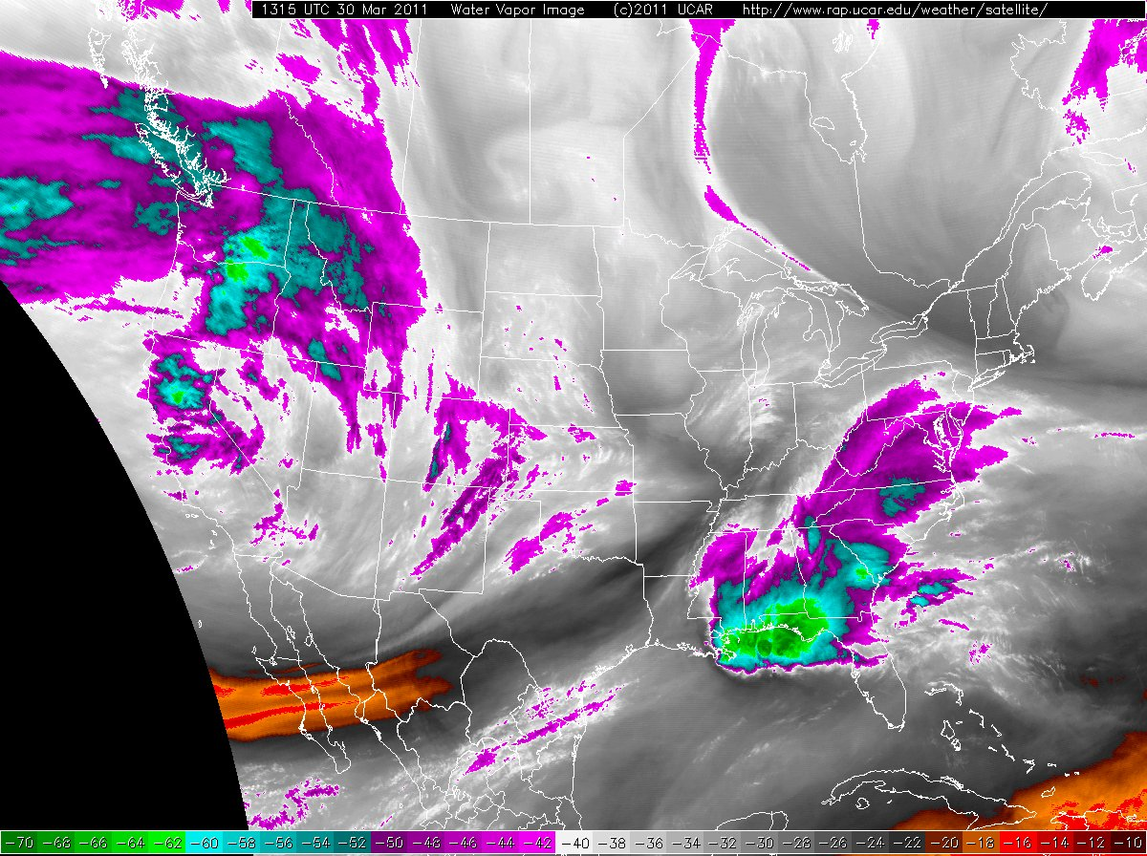
Water Vapor Satellite

Slide 5
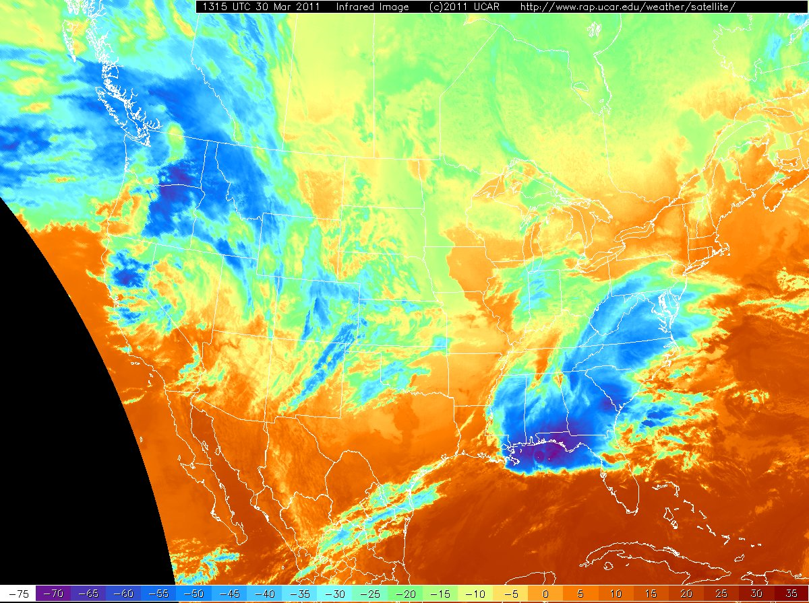
IR Satellite

Slide 6
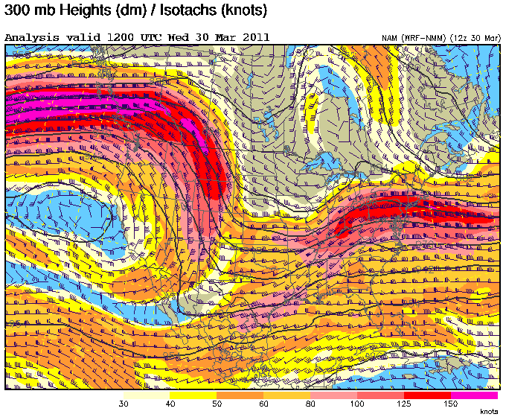
Large-Scale Dynamics

Slide 7
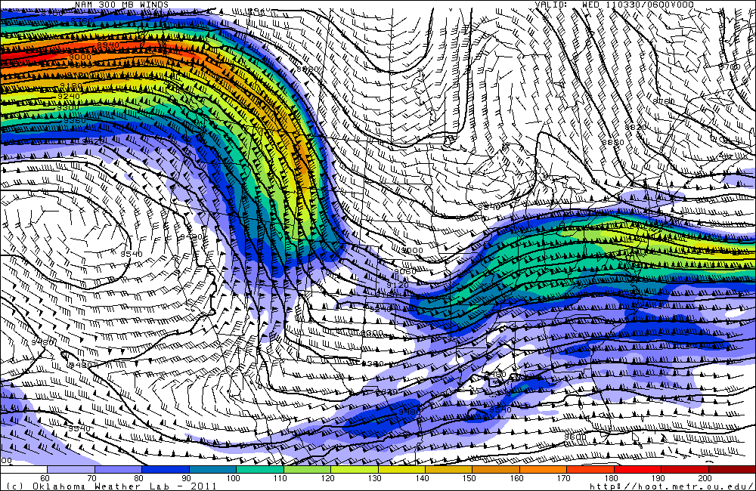
NAM 300mb Analysis

Slide 8
Surface Analysis/Radar

Slide 9
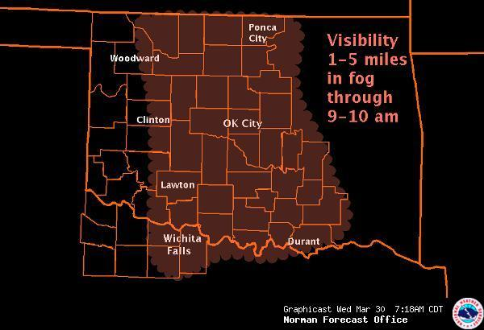
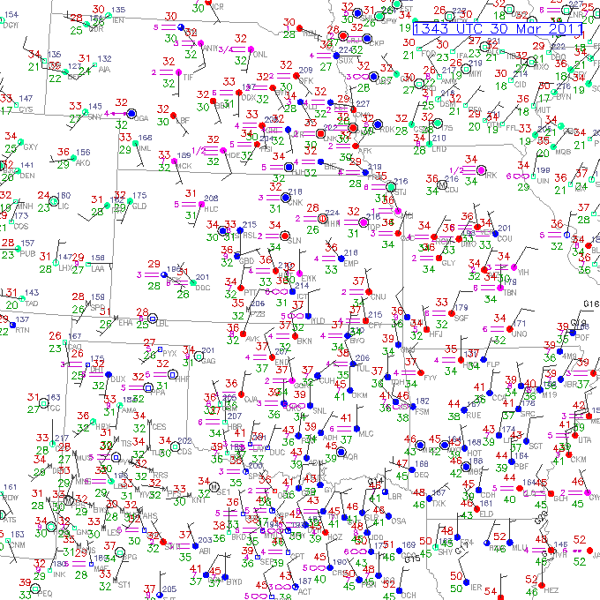
Surface

Slide 10
Surface Forecast

Slide 11
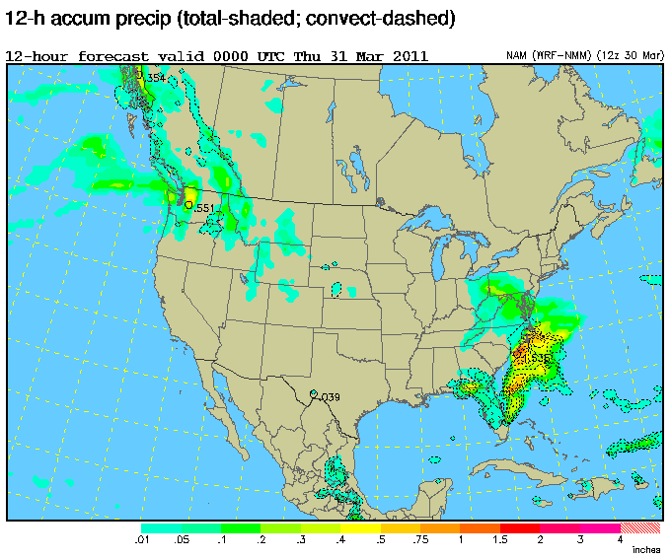
Forecast Day 0
Chance of Precipitation: < 20%

Slide 12
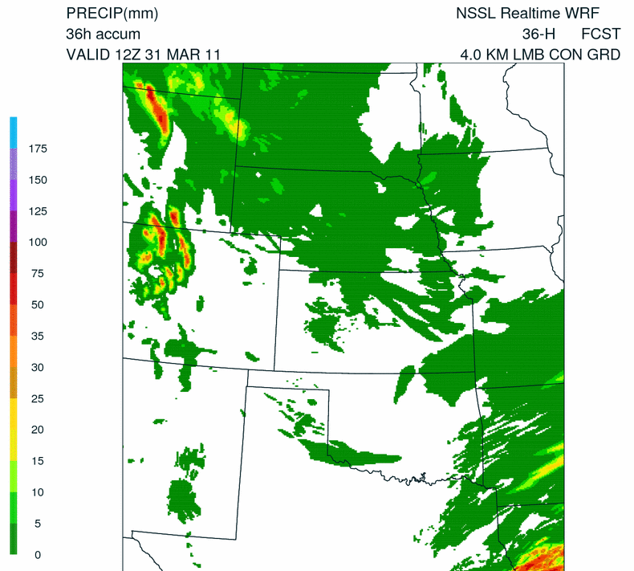
NSSL WRF

Slide 13
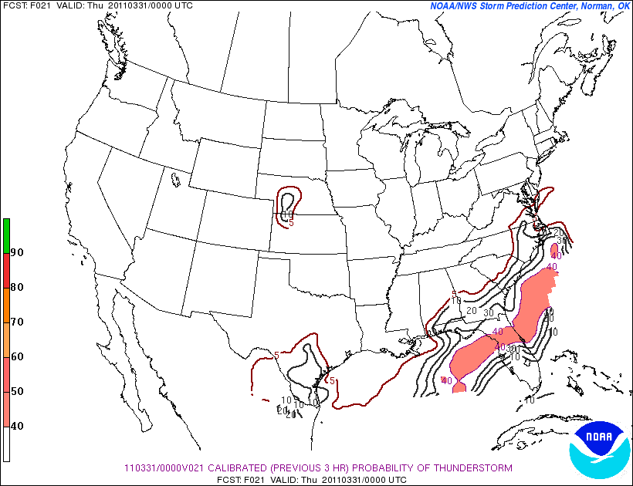
SPC SREF

Slide 14
Forecast Day 1
24-36 hours

Slide 15
Forecast Day 1

Slide 16
Model/Time

Slide 18
Forecast Soundings
“Link” to BUFKIT

Slide 19
Forecast Day 1
Chance of Precipitation: 0%
Type of Precip:
Timing
Initiation:
Duration:

Slide 20
Extended Forecasts
Days 2-?

Slide 21
Extended Forecast

Slide 22
Extended Forecast

Slide 23
Extended Forecast

Slide 24
BUFKIT

