Slide 1
MC3E Weather Briefing
Wednesday April 6, 2011

Slide 2
Overview
Today – A lack of low-level moisture will keep the region dry with some passing mid to upper-level clouds
Thursday – Storm chances increase with marginal moisture return. More likely high based cumulus development later evening
Friday – Better low-level moisture return bring chances of isolated storms late afternoon
Weekend – Storm chances persist with best chance of wide-spread precip SAT night as a strong upper-storm system approaches

Slide 3
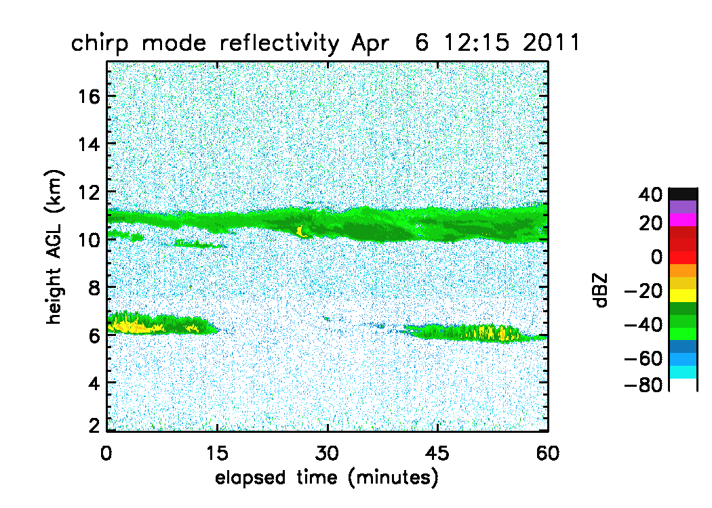

Slide 4
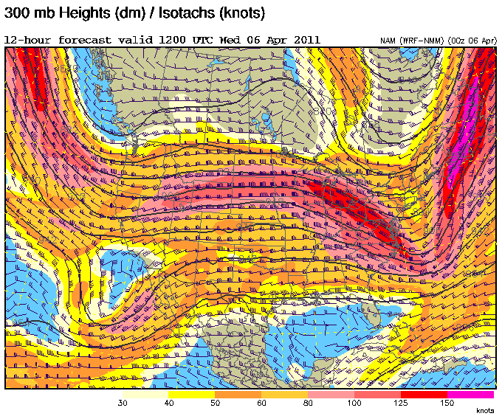

Slide 5
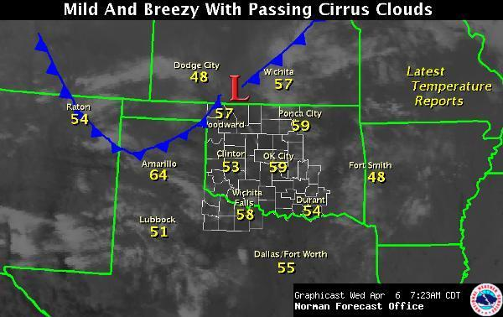
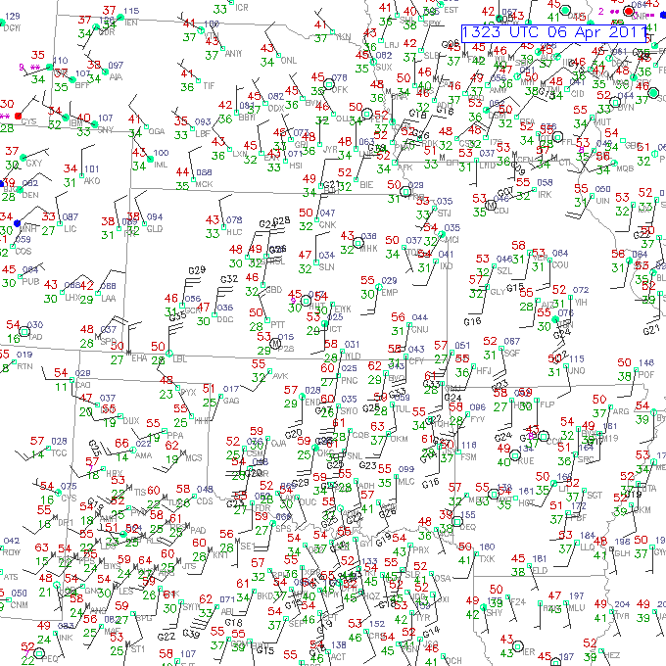
Surface front across the region today.
Low dewpoints will keep humidity values down today

Slide 6
Forecast Day 0

Slide 7
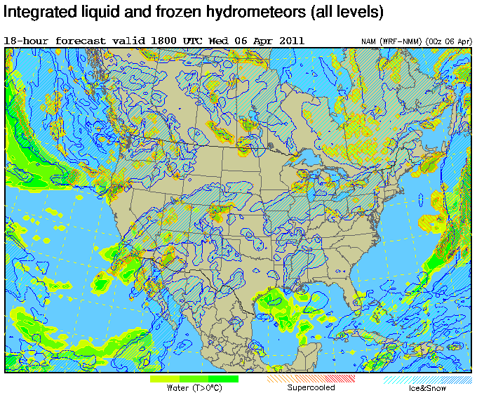

Slide 8
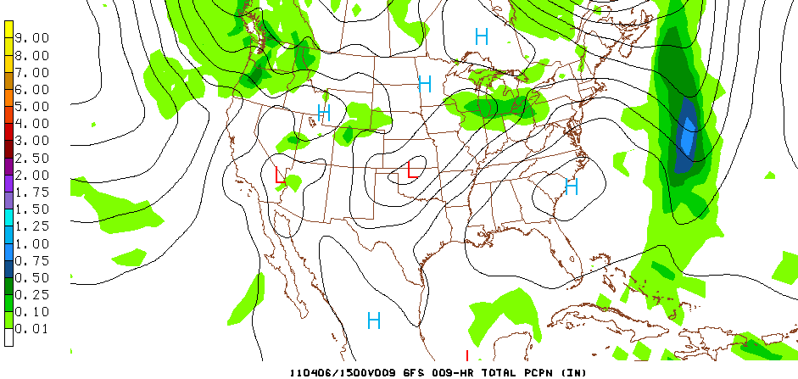
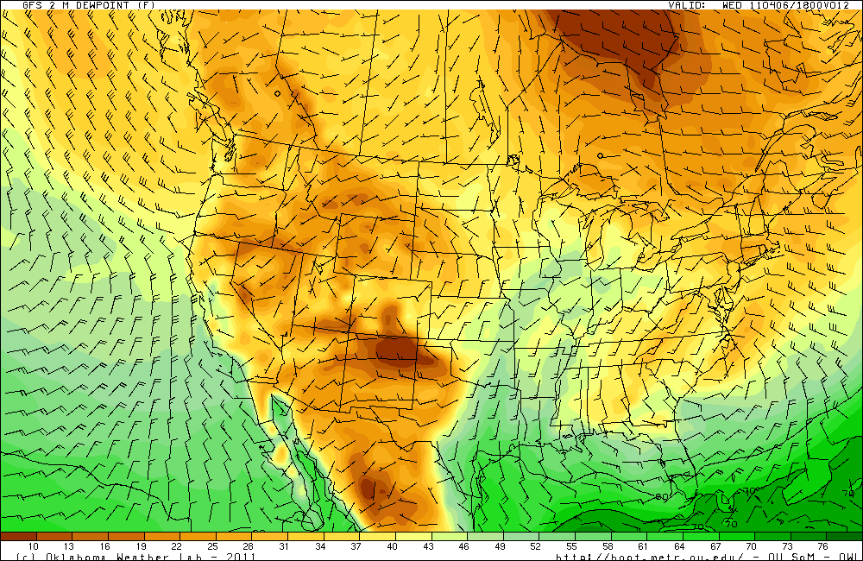
NWS noted that no models are handling low-level moisture very well (dewpoint forecast is tricky the next couple days)

Slide 9
Forecast Day 1 (Thursday) 12Z

Slide 10
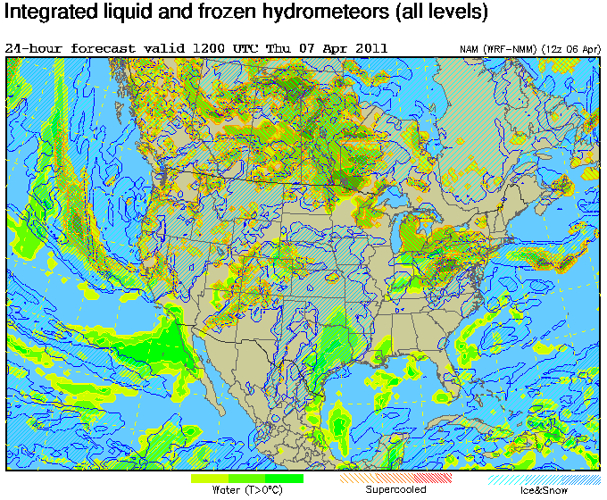
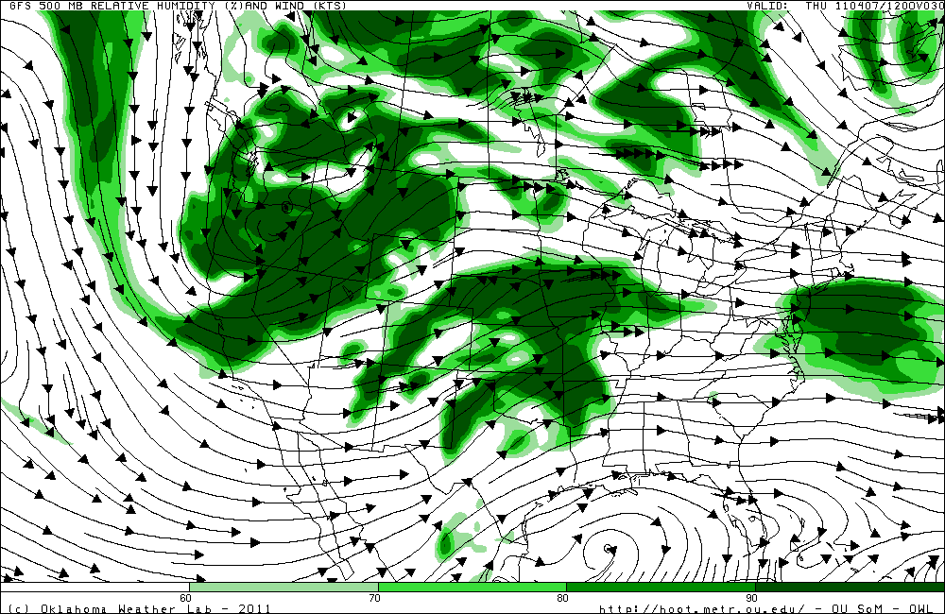
500mb RH (GFS) 12Z

Slide 11
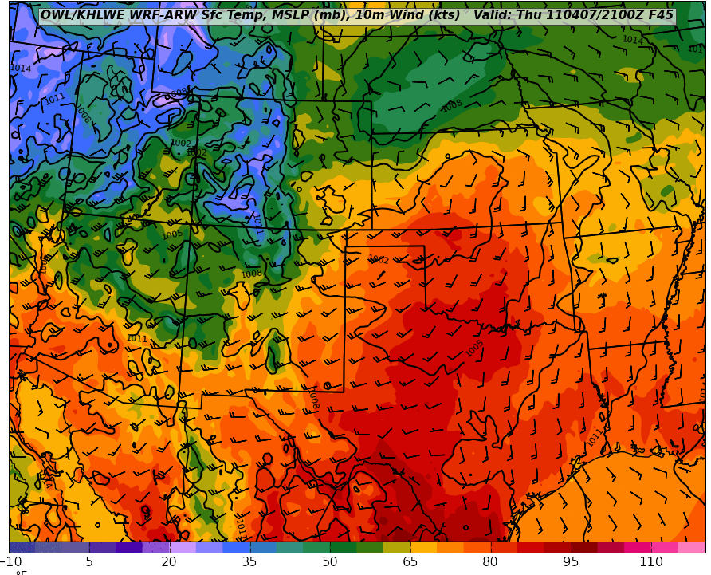

Slide 12
Forecast Day 1 (00Z)

Slide 13
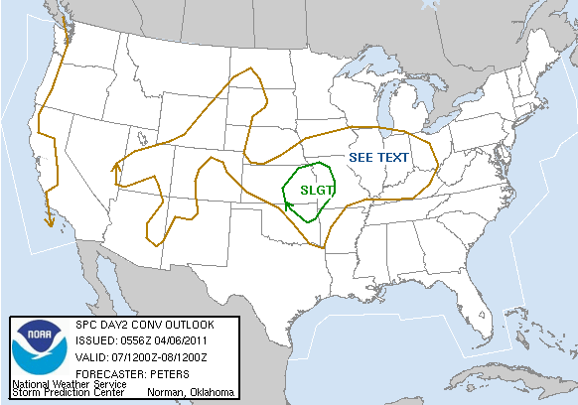
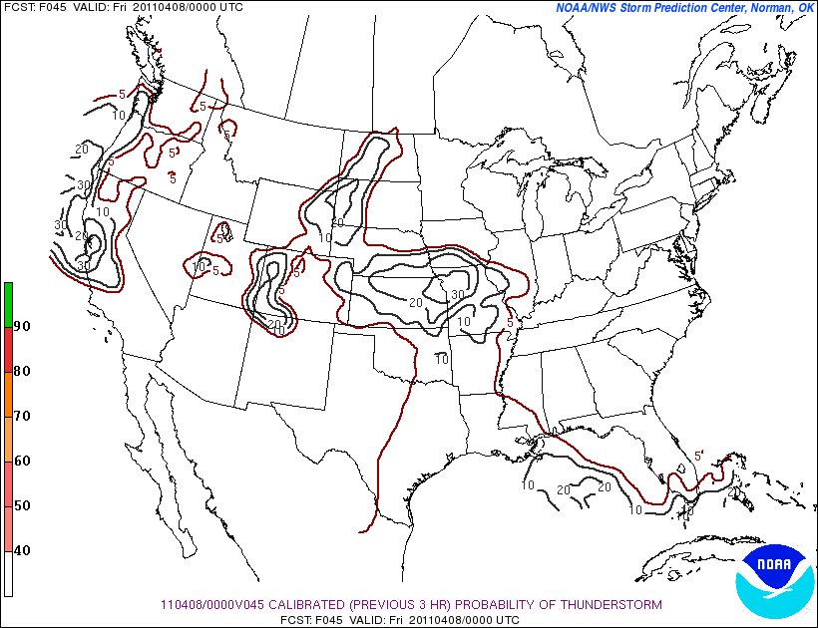

Slide 14
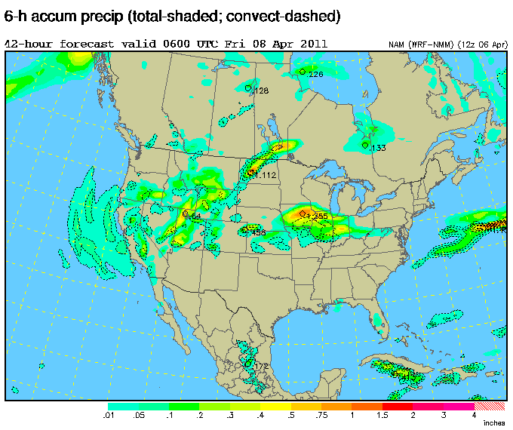
NAM (left) and GFS (below) 6-hour accumulated precip (starting at 00Z)

Slide 15
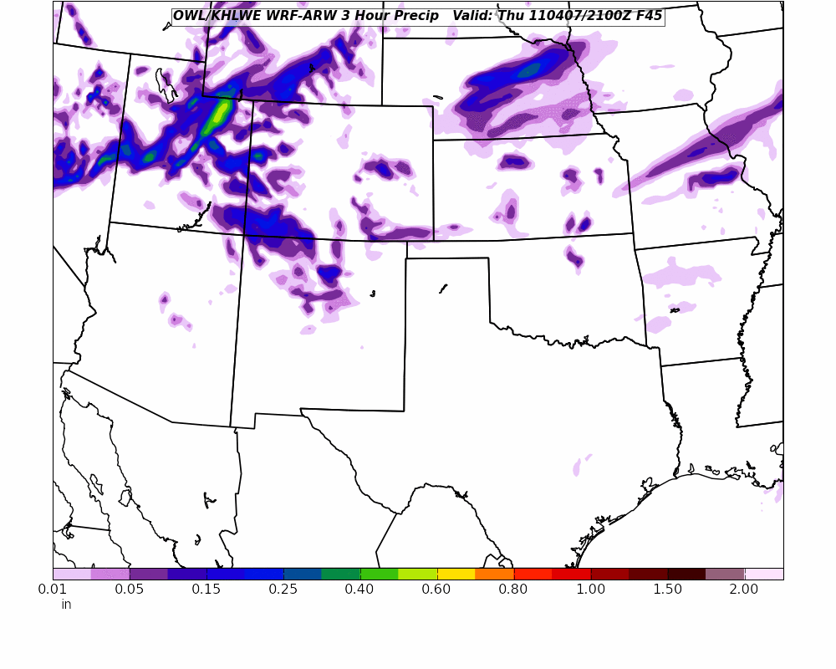
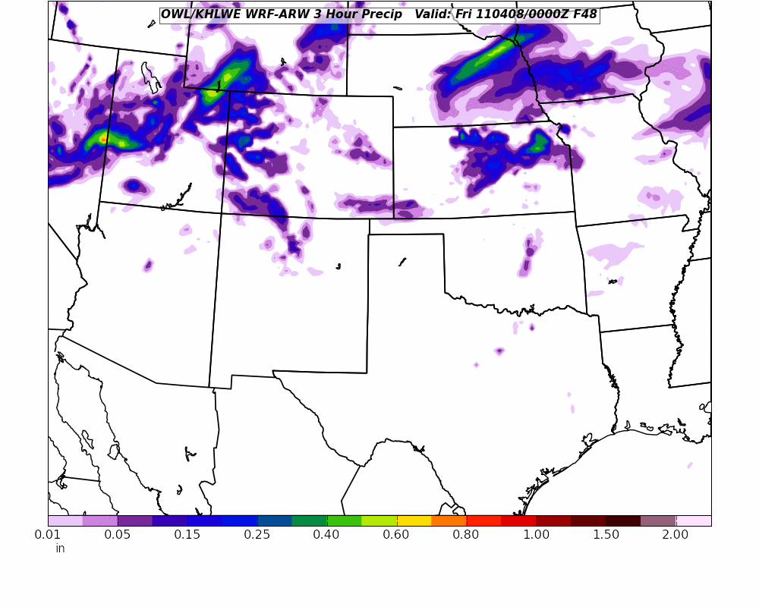
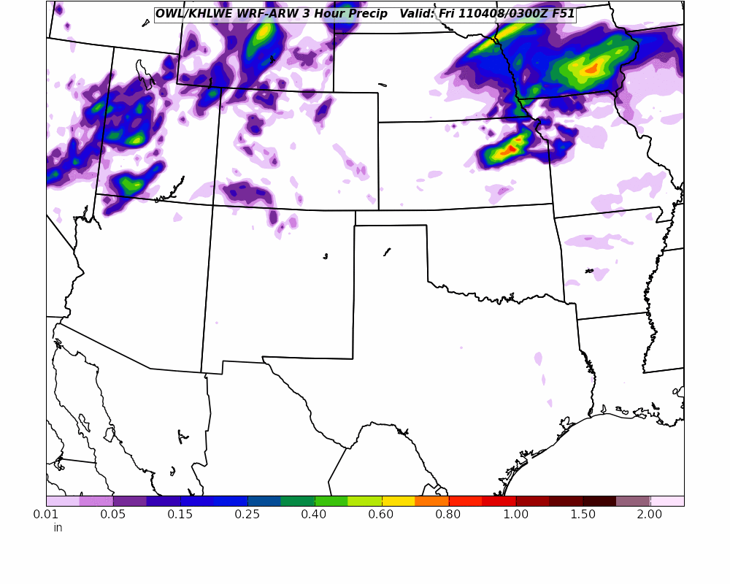
OWL WRF 21Z-00Z-03Z

Slide 17
Day 2 Forecast (Friday)

Slide 18
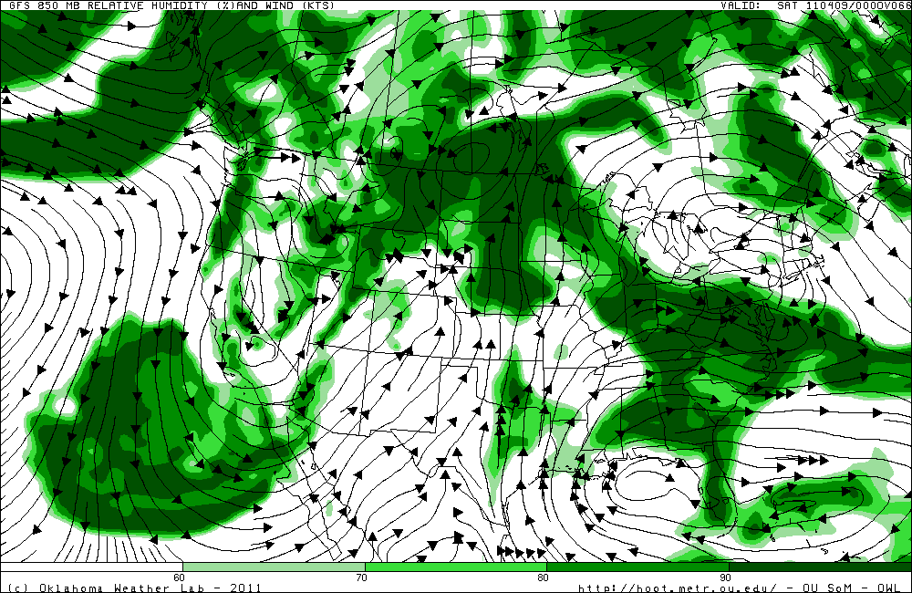
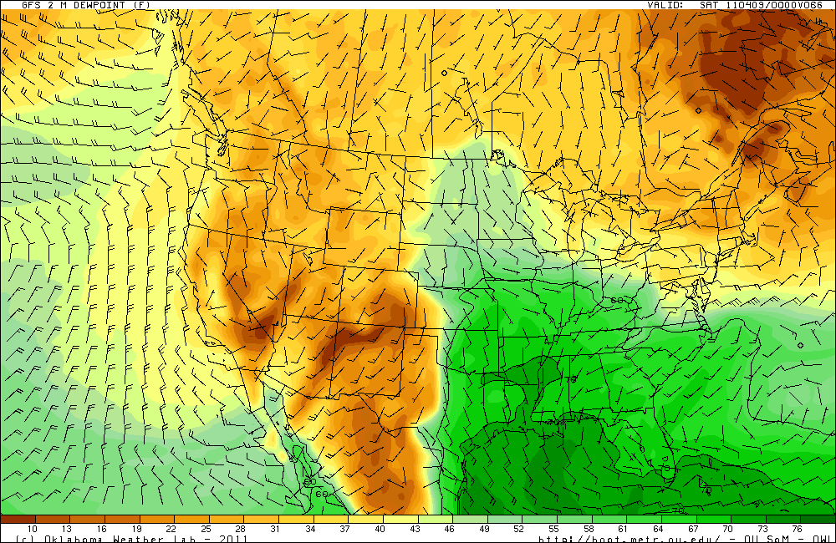

Slide 19
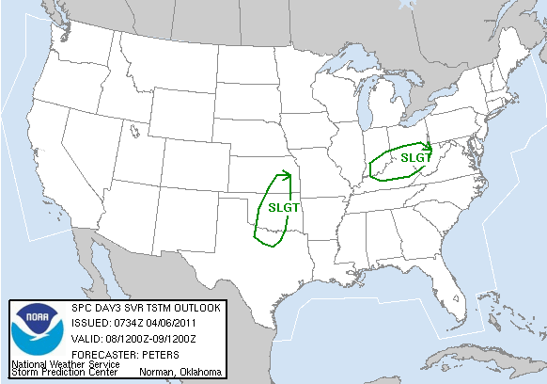
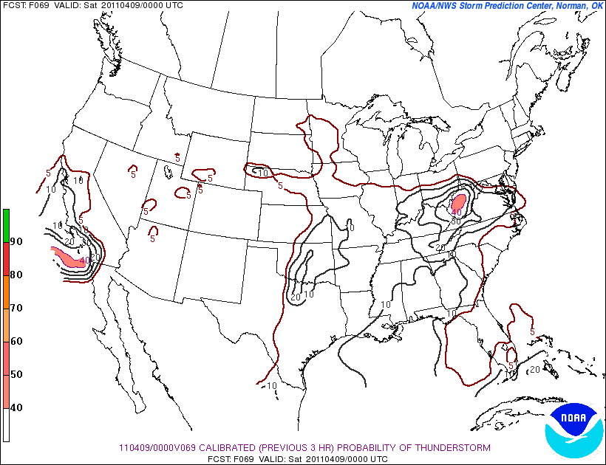
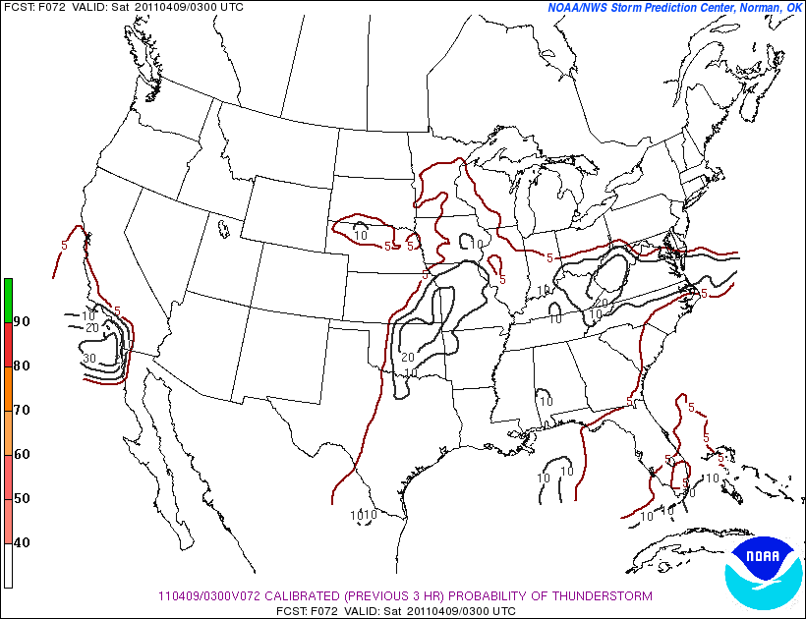

Slide 20
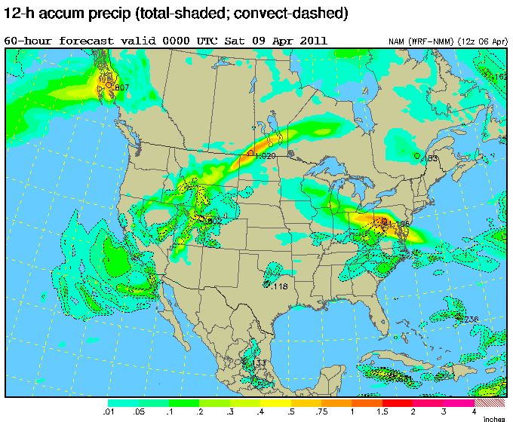

Slide 21
Extended Forecast

Slide 24
BUFKIT (GFS) Forecast Sounding Overview at SGP

