Slide 1
MC3E Weather Briefing
Monday April 11, 2011

Slide 2
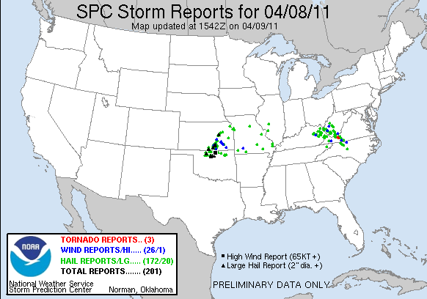
Weekend Validation
Friday Night Thunderstorms
Sat/Sunday: Oklahoma Remains Mostly Dry

Slide 3
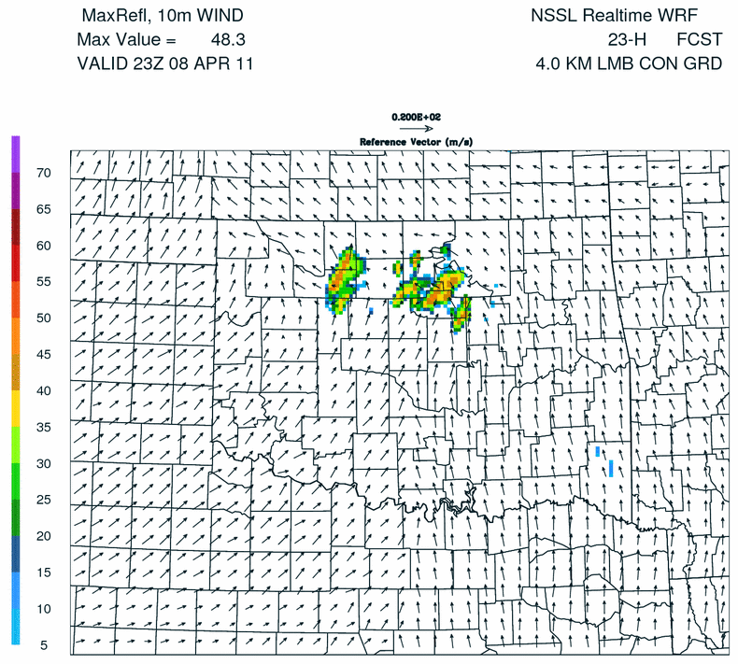
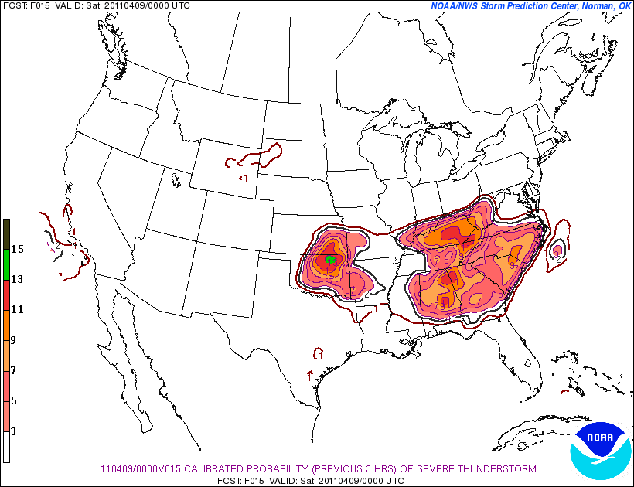
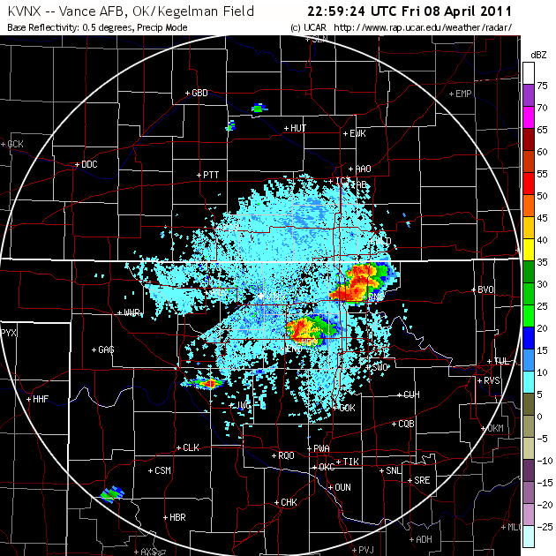
Convective Initiation Friday Night ~22-23Z

Slide 4
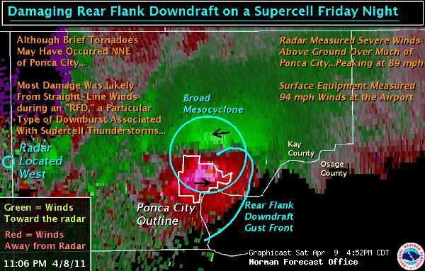
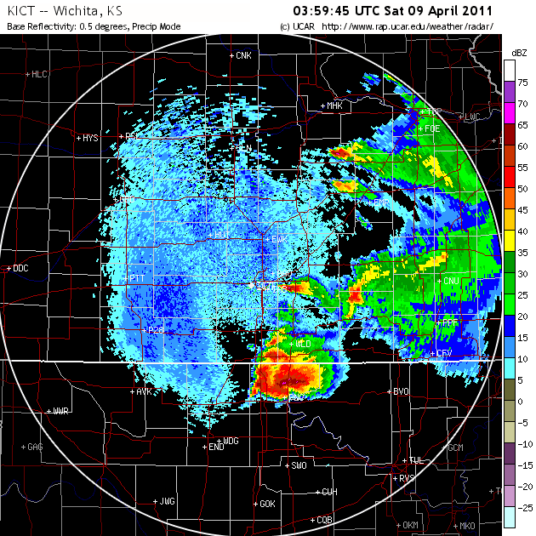
*Extensive damage was reported at the Ponca City Regional Airport. The glass cab in the tower at the terminal building was destroyed. The roof peeled off Hangar 6. Building 4, the Greenwood hangar, and two corporate hangars were heavily damaged. Three airplanes also were damaged. (The Ponca City News)

Slide 5
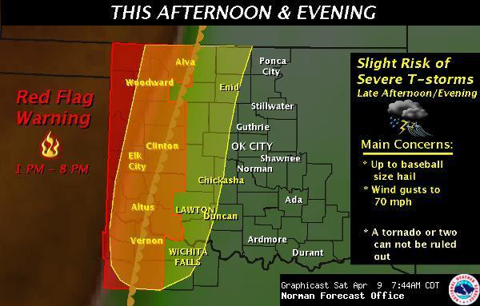
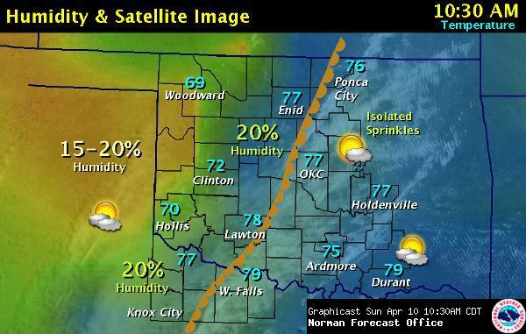
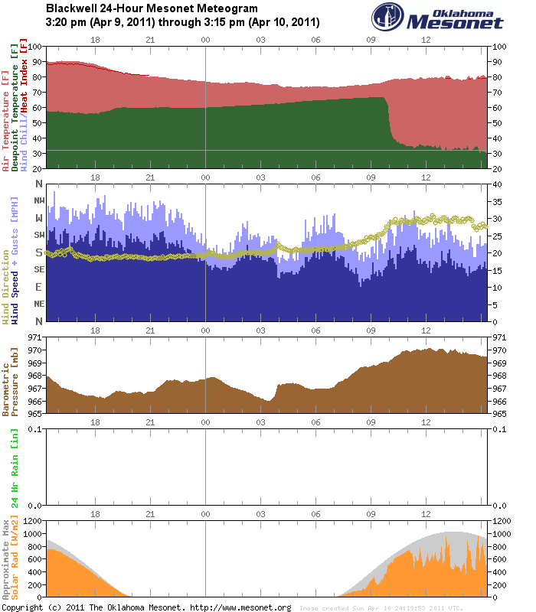
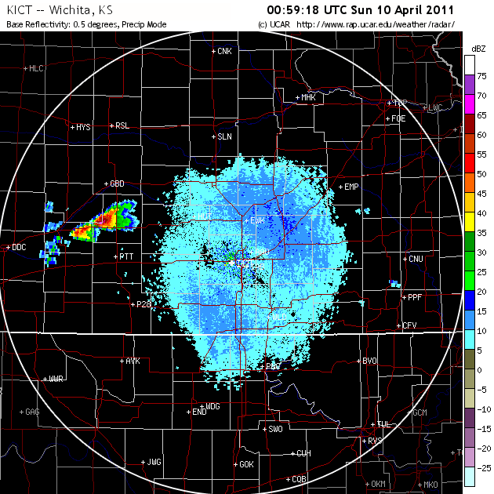
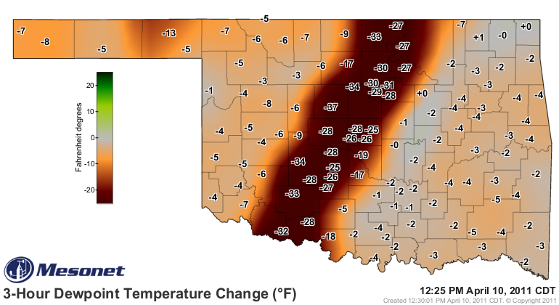
Saturday Sunday (am)

Slide 6
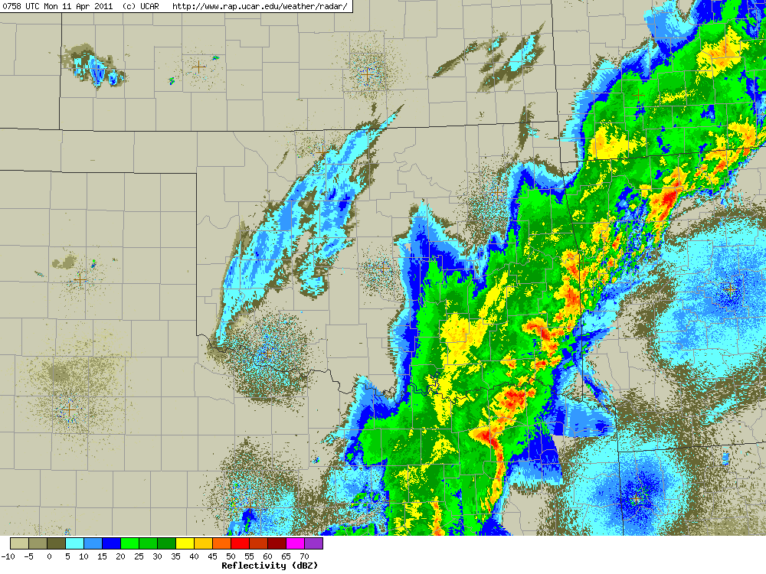
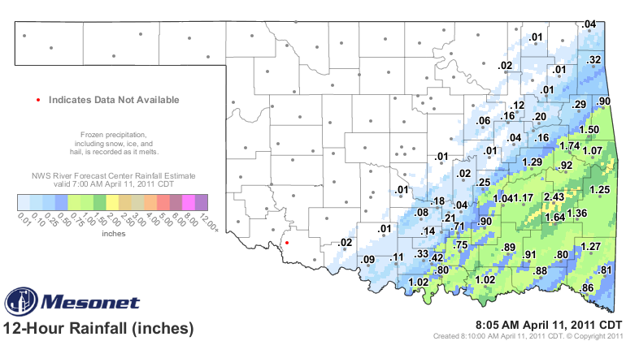
Late Sunday/Early Monday

Slide 7
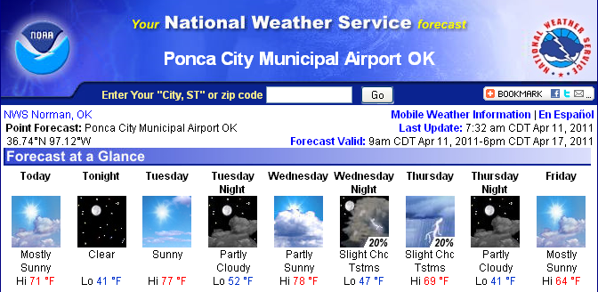
Overview
Today – A few passing clouds this morning, mostly clearing behind the front
Tuesday – Ridging aloft will lead to a mostly sunny day, with afternoon cirrus
Chance of rain (although low) Wednesday night into Thursday morning. In response to few upper short-waves and surface front
Extended – High Pressure builds back in until ??? (possibly late weekend)

Slide 8
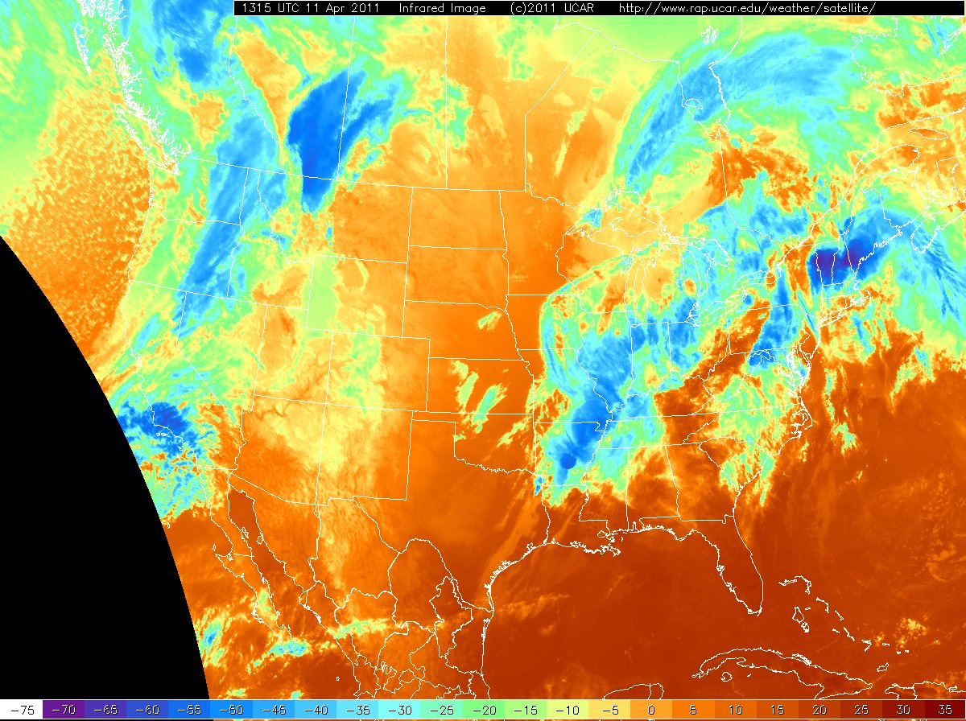
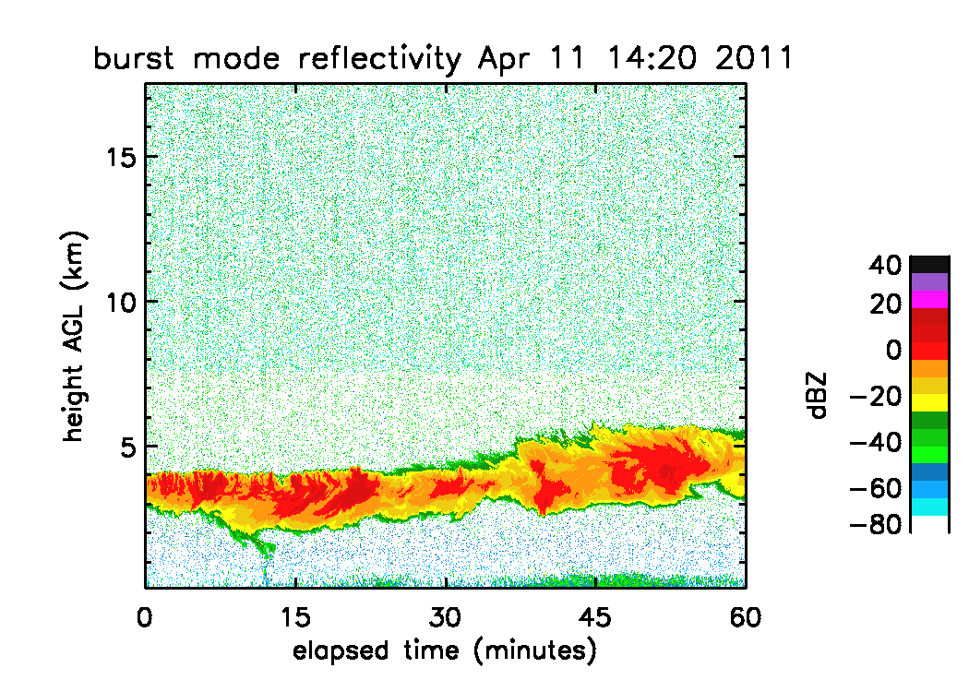

Slide 9
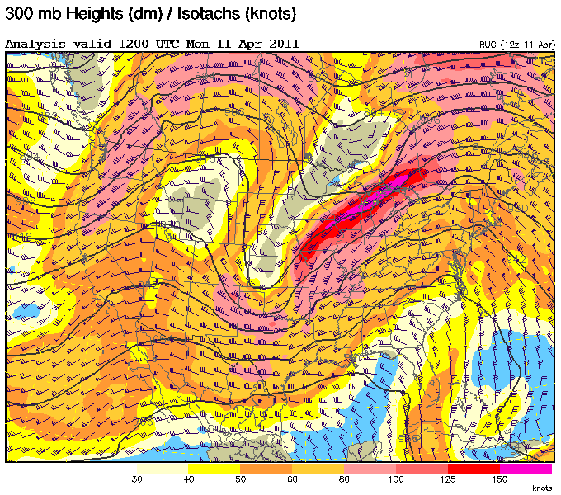

Slide 10
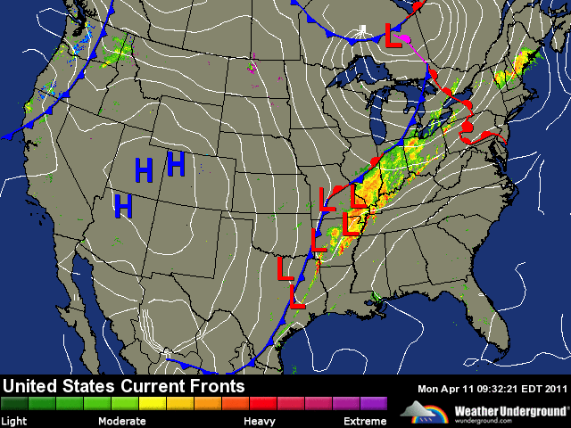
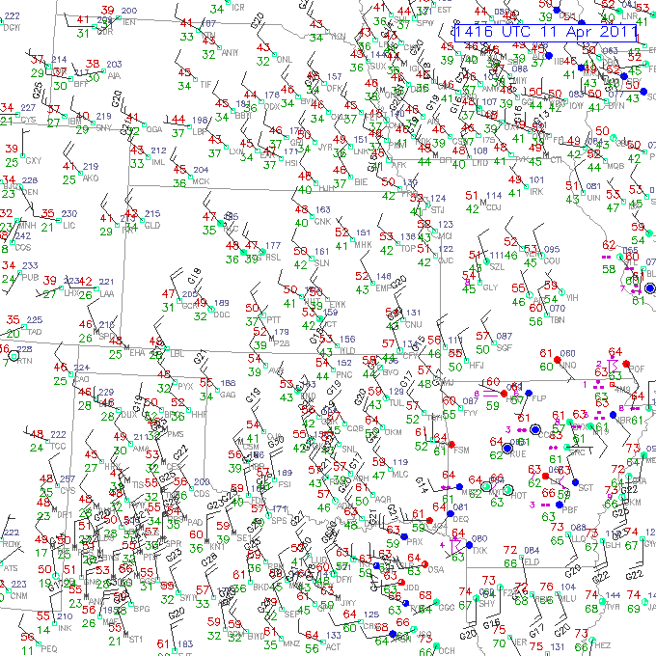
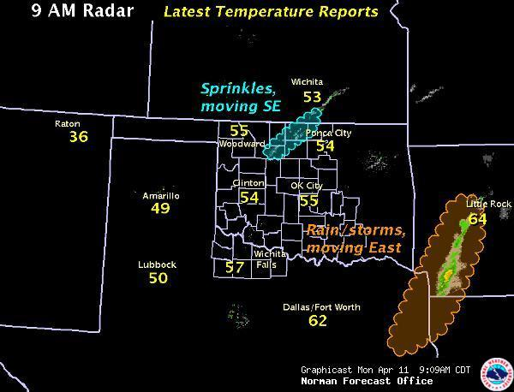

Slide 11
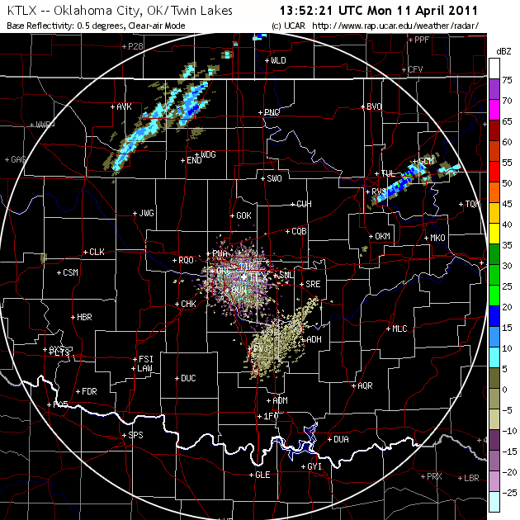
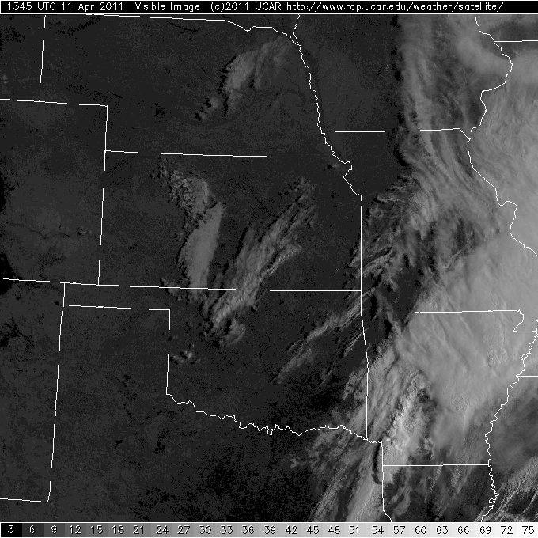
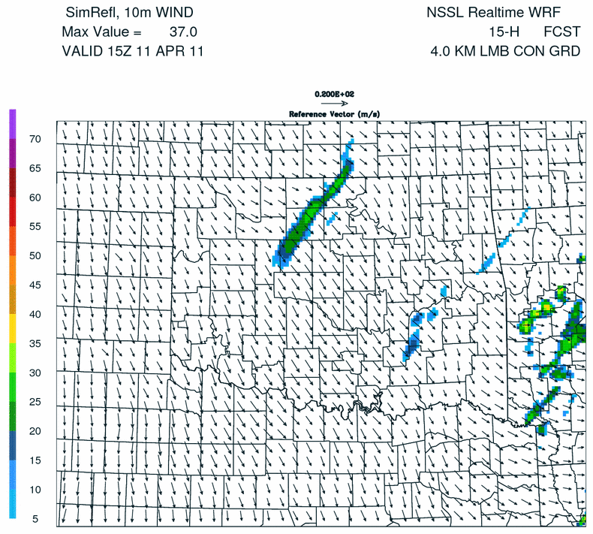
Sprinkles/Few Clouds ~10 am

Slide 12
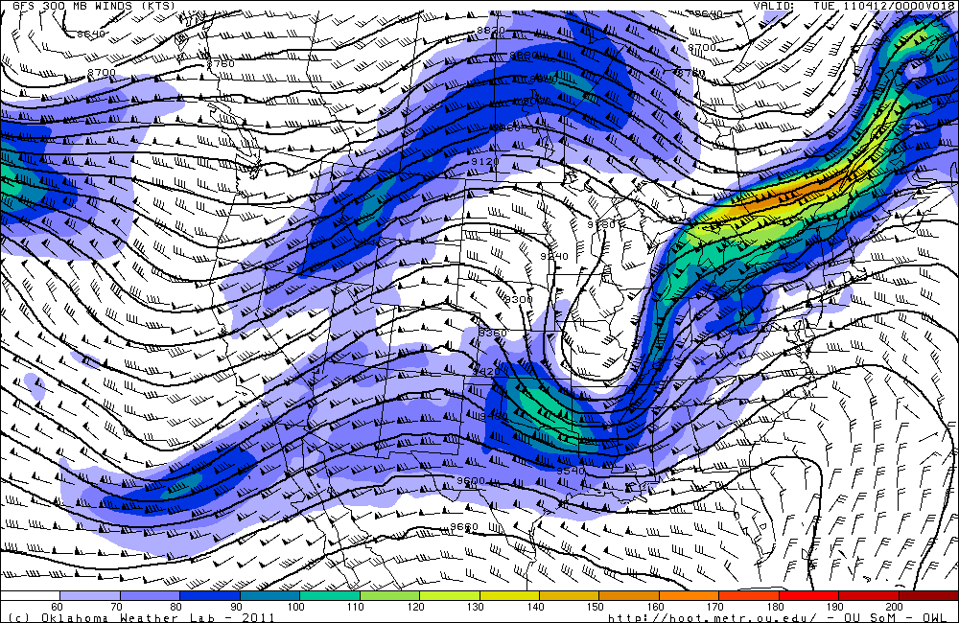
Forecast Day 0

Slide 13
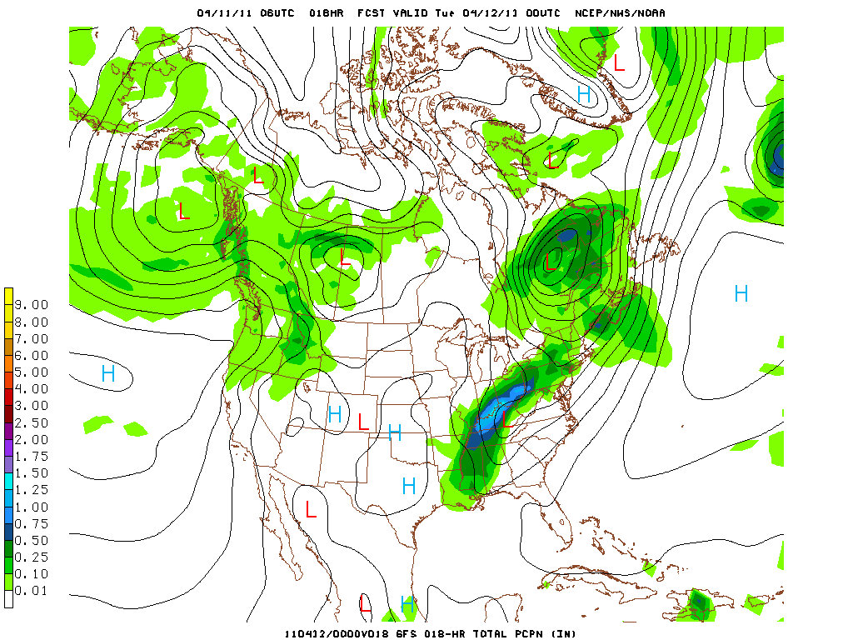

Slide 14
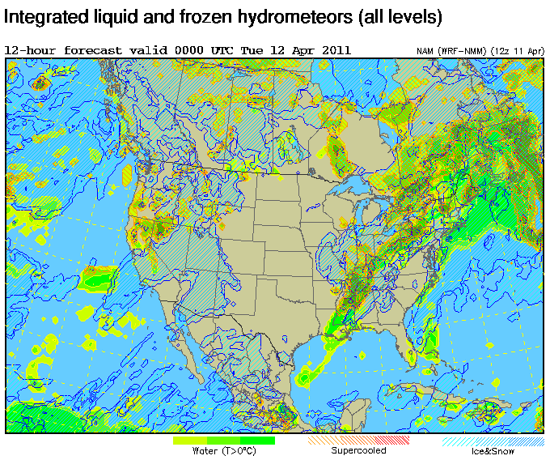

Slide 15
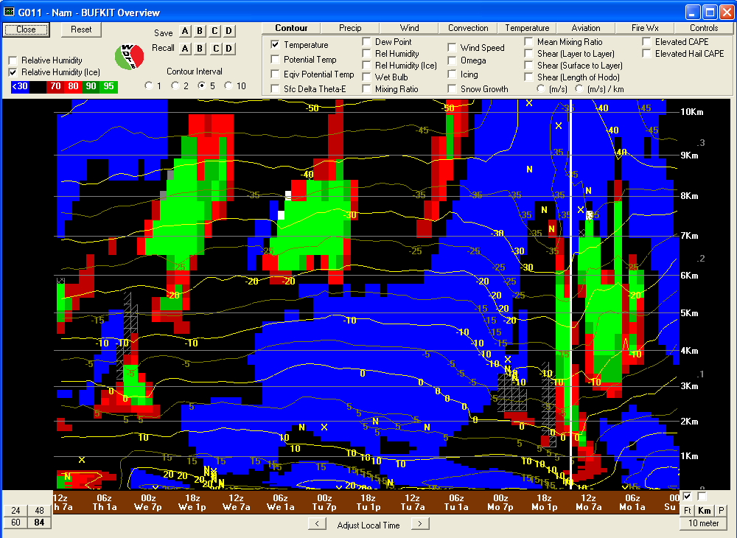
NAM Forecast Soundings at SGP + RH
Cumulus ~4pm (700mb)

Slide 16
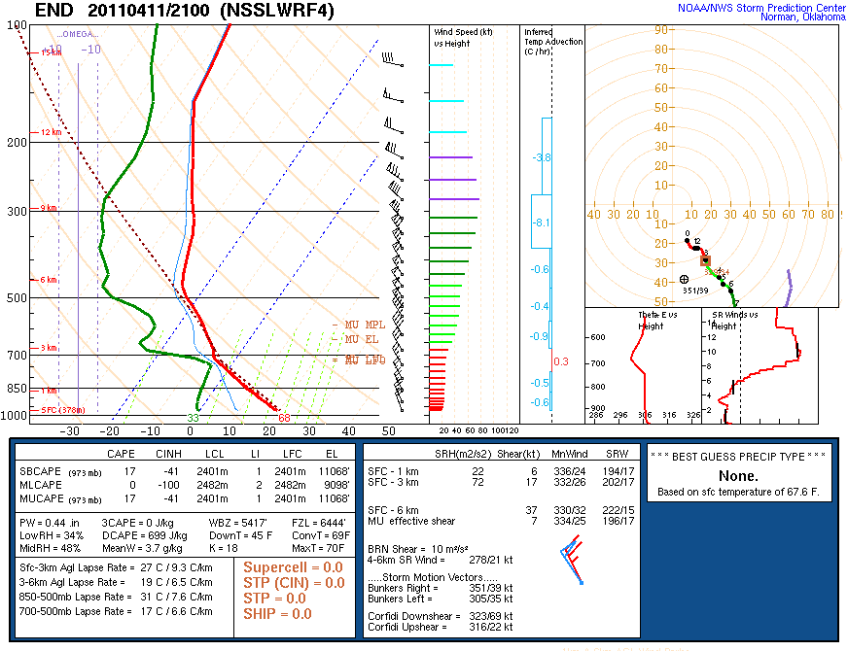

Slide 17
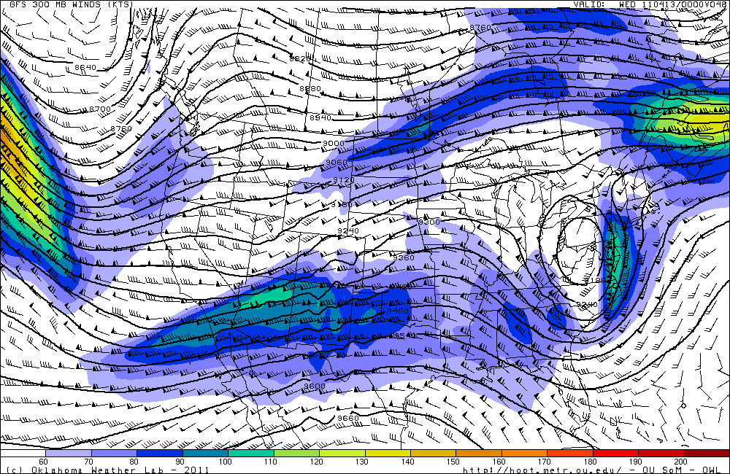
Forecast Day 1 (Tuesday)

Slide 18
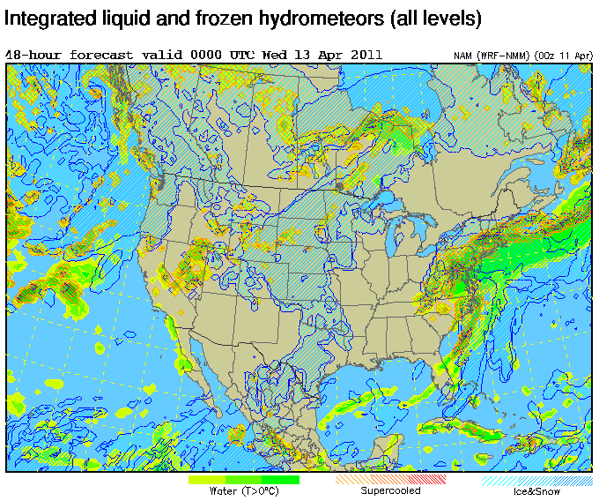

Slide 19
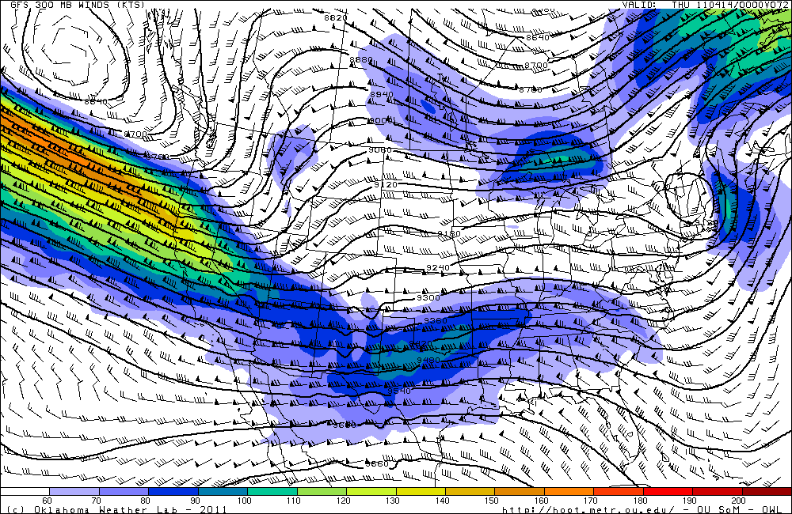
Day 2 Forecast (Wednesday)

Slide 20
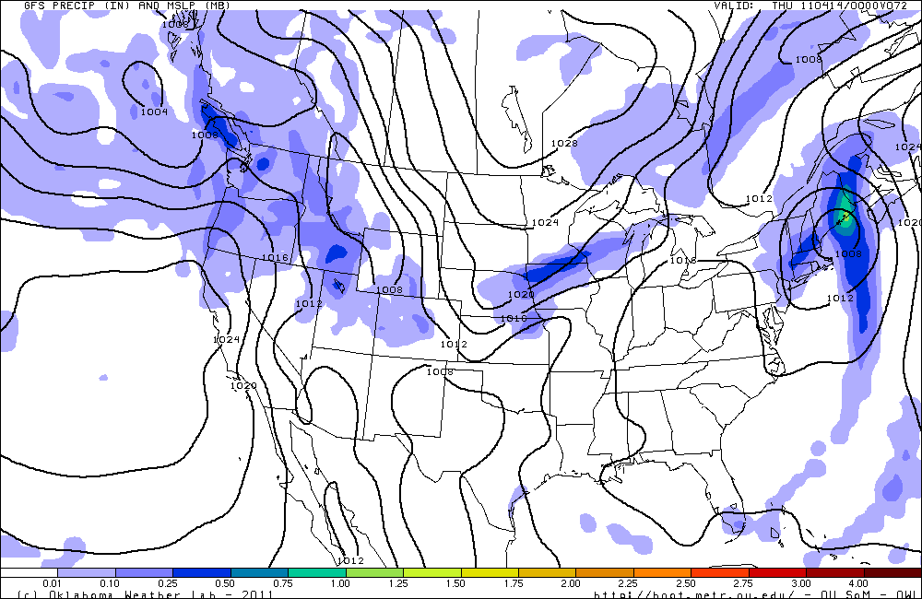

Slide 21
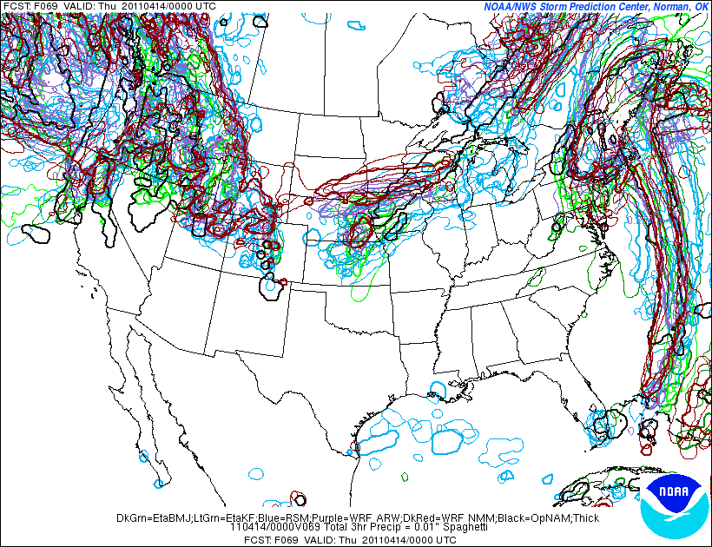
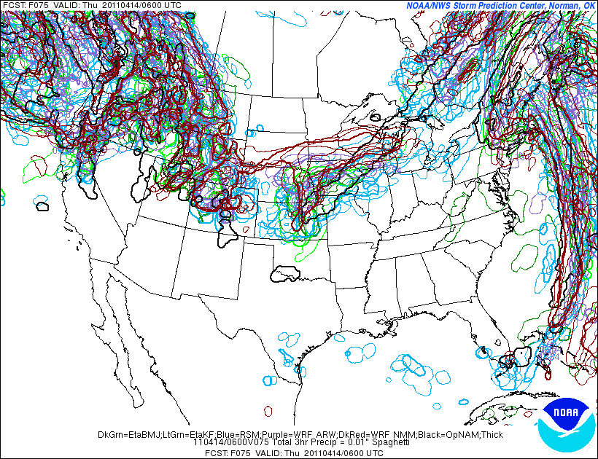
Wednesday Night 7pm-1am

Slide 22
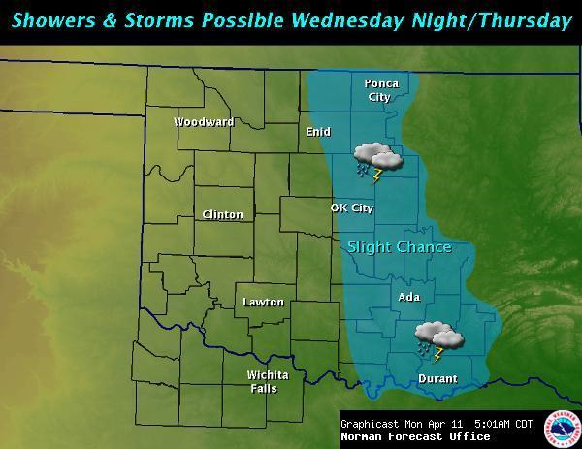
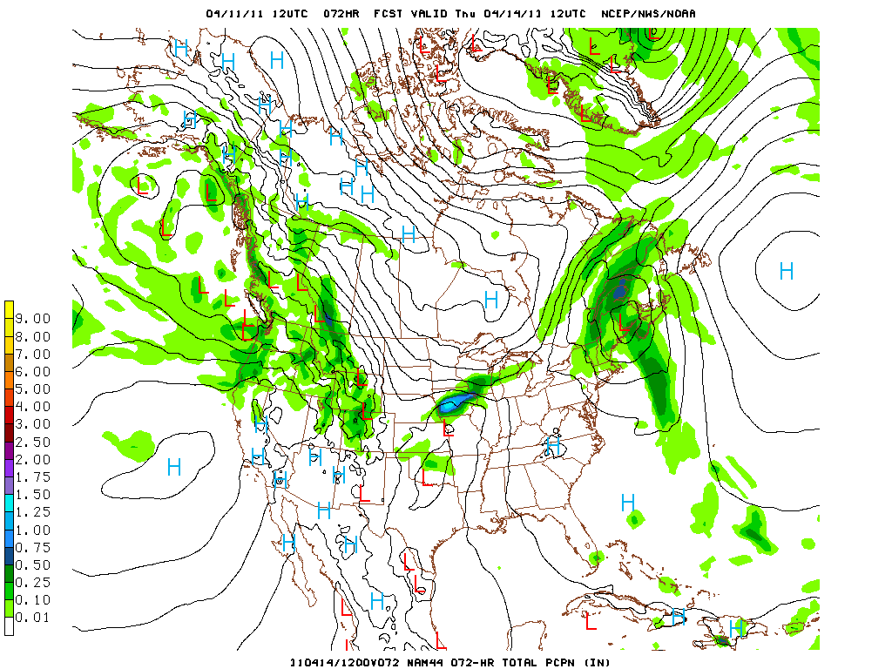
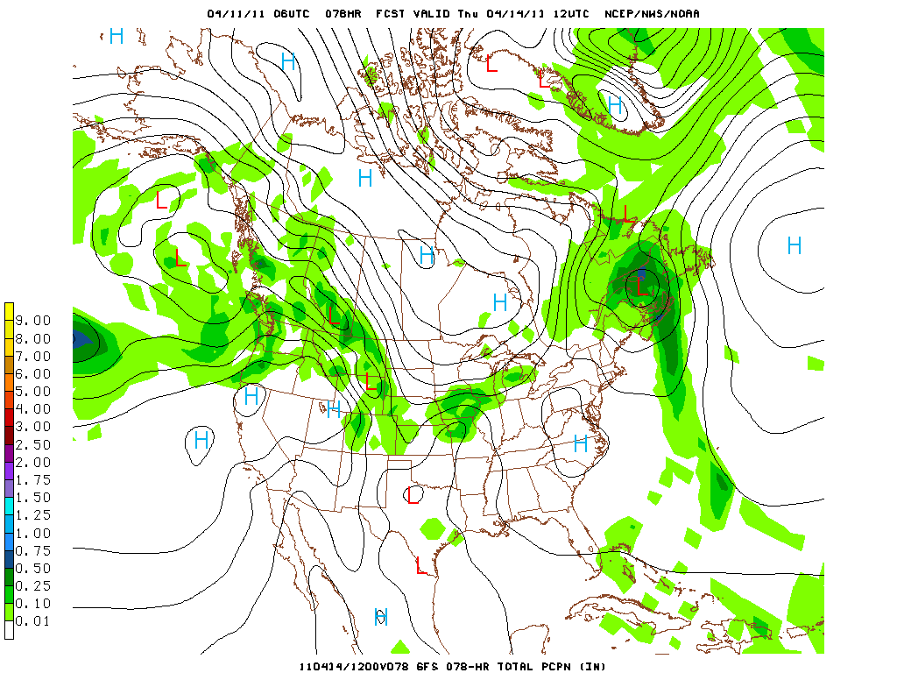
Extended Forecast

Slide 23
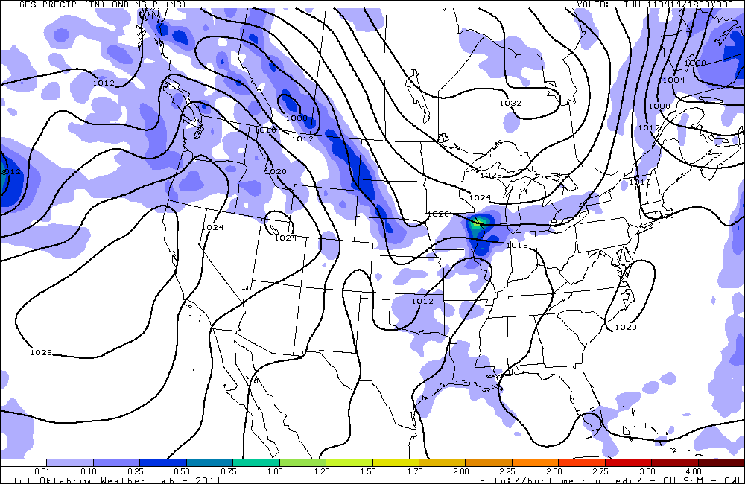
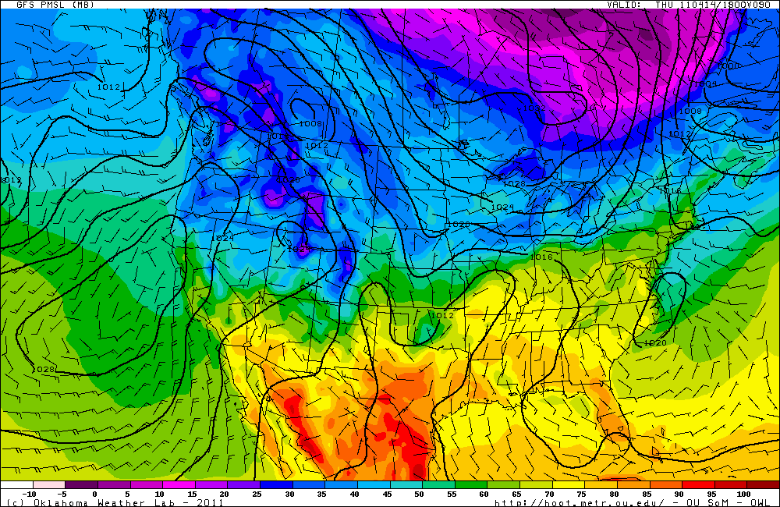
Thursday noon-ish
L

Slide 24
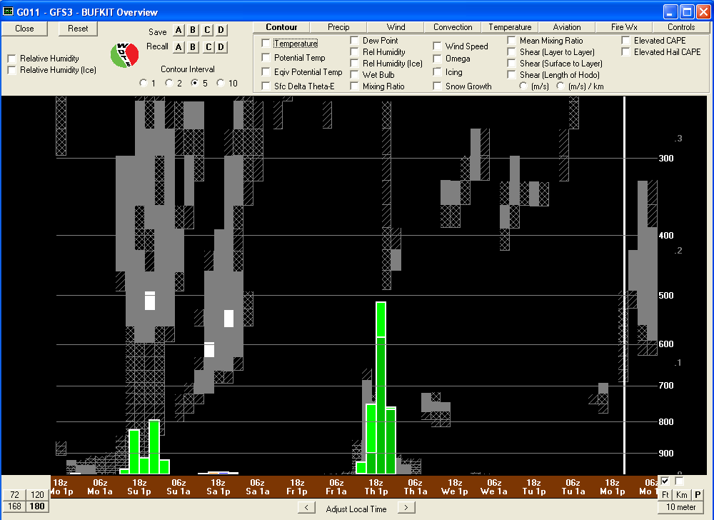
BUFKIT (GFS)
Forecast Sounding Overview at SGP

