Slide 1
MC3E Weather Briefing
Friday April 15, 2011

Slide 2
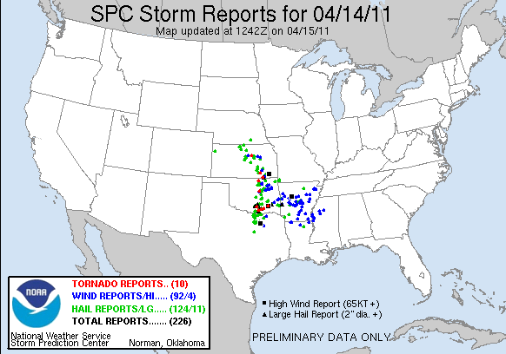
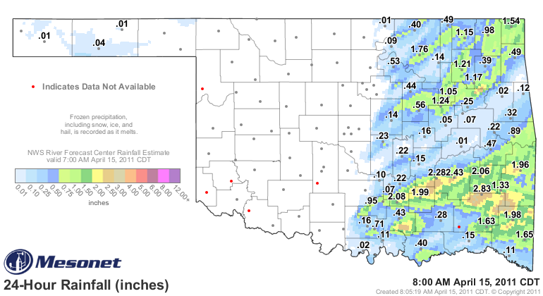
Thursday’s Thunderstorms

Slide 3
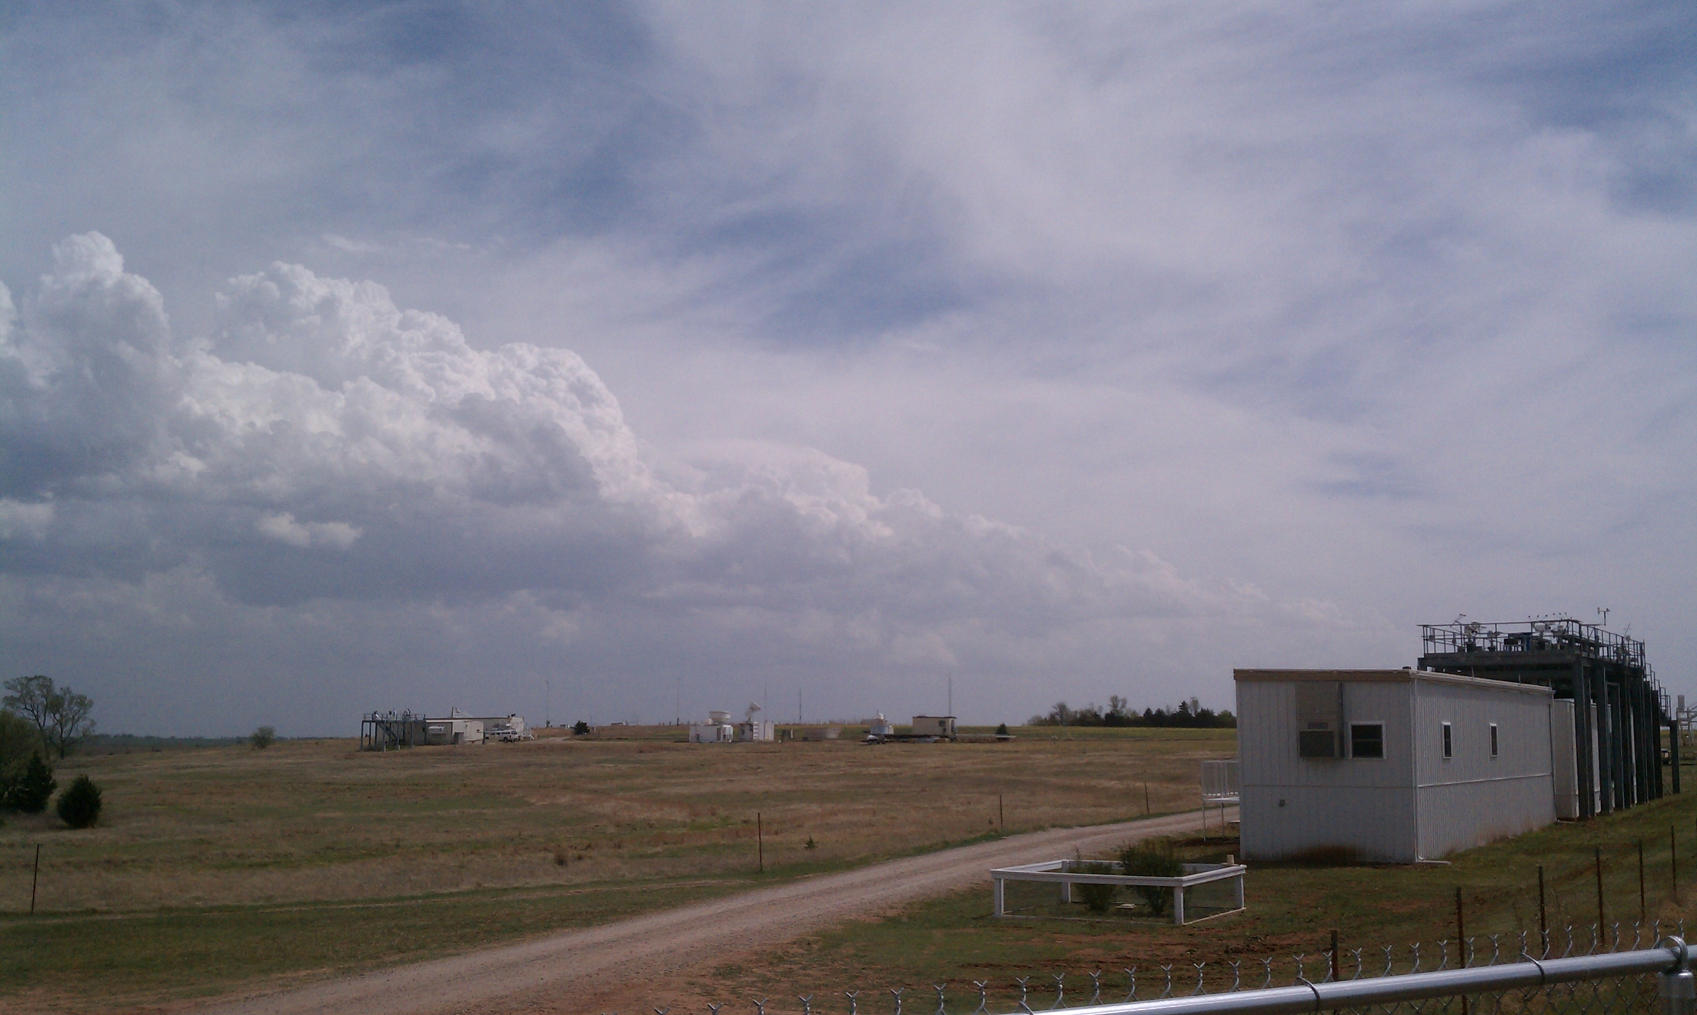
Storm Development Timeline
19Z – 20Z Cumulus towers began building just east of the SGP along the dryline, as the CIN had disappeared (SPC MesoAnalysis)

Slide 4
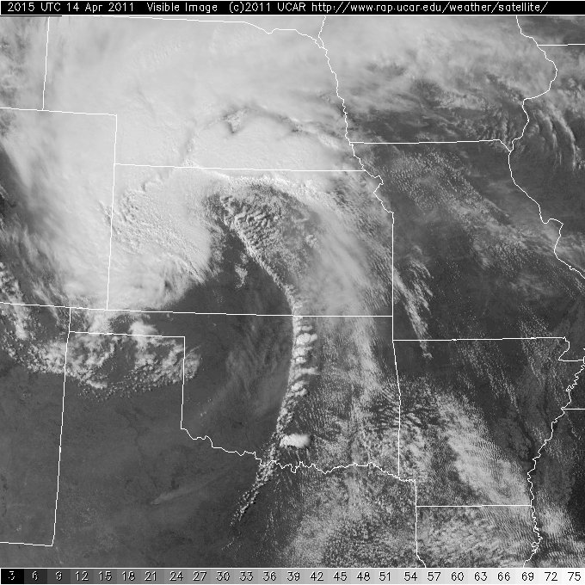
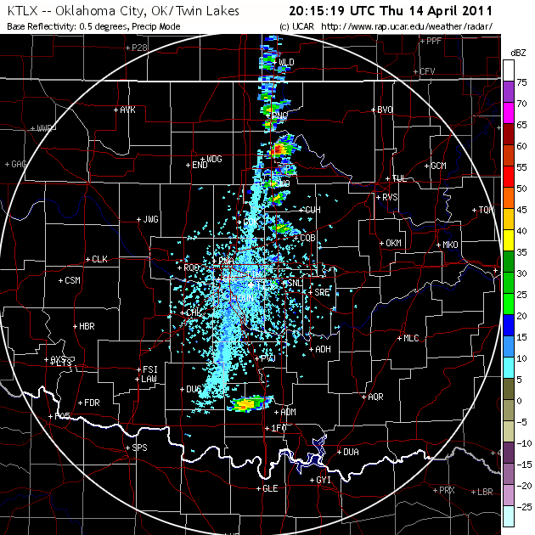
20Z Radar began indicating precipitation

Slide 5
2030Z Severe Storms Developed
21Z Tornado Warning East of Ponca

Slide 6
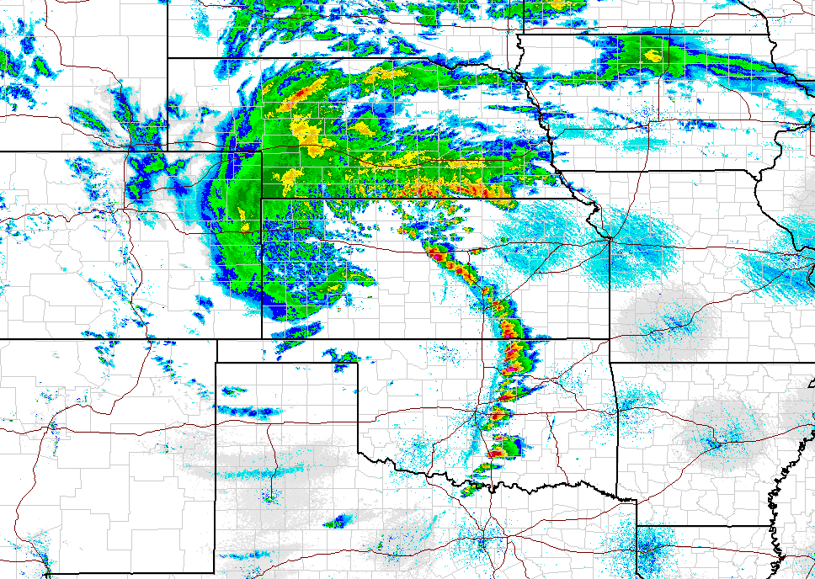
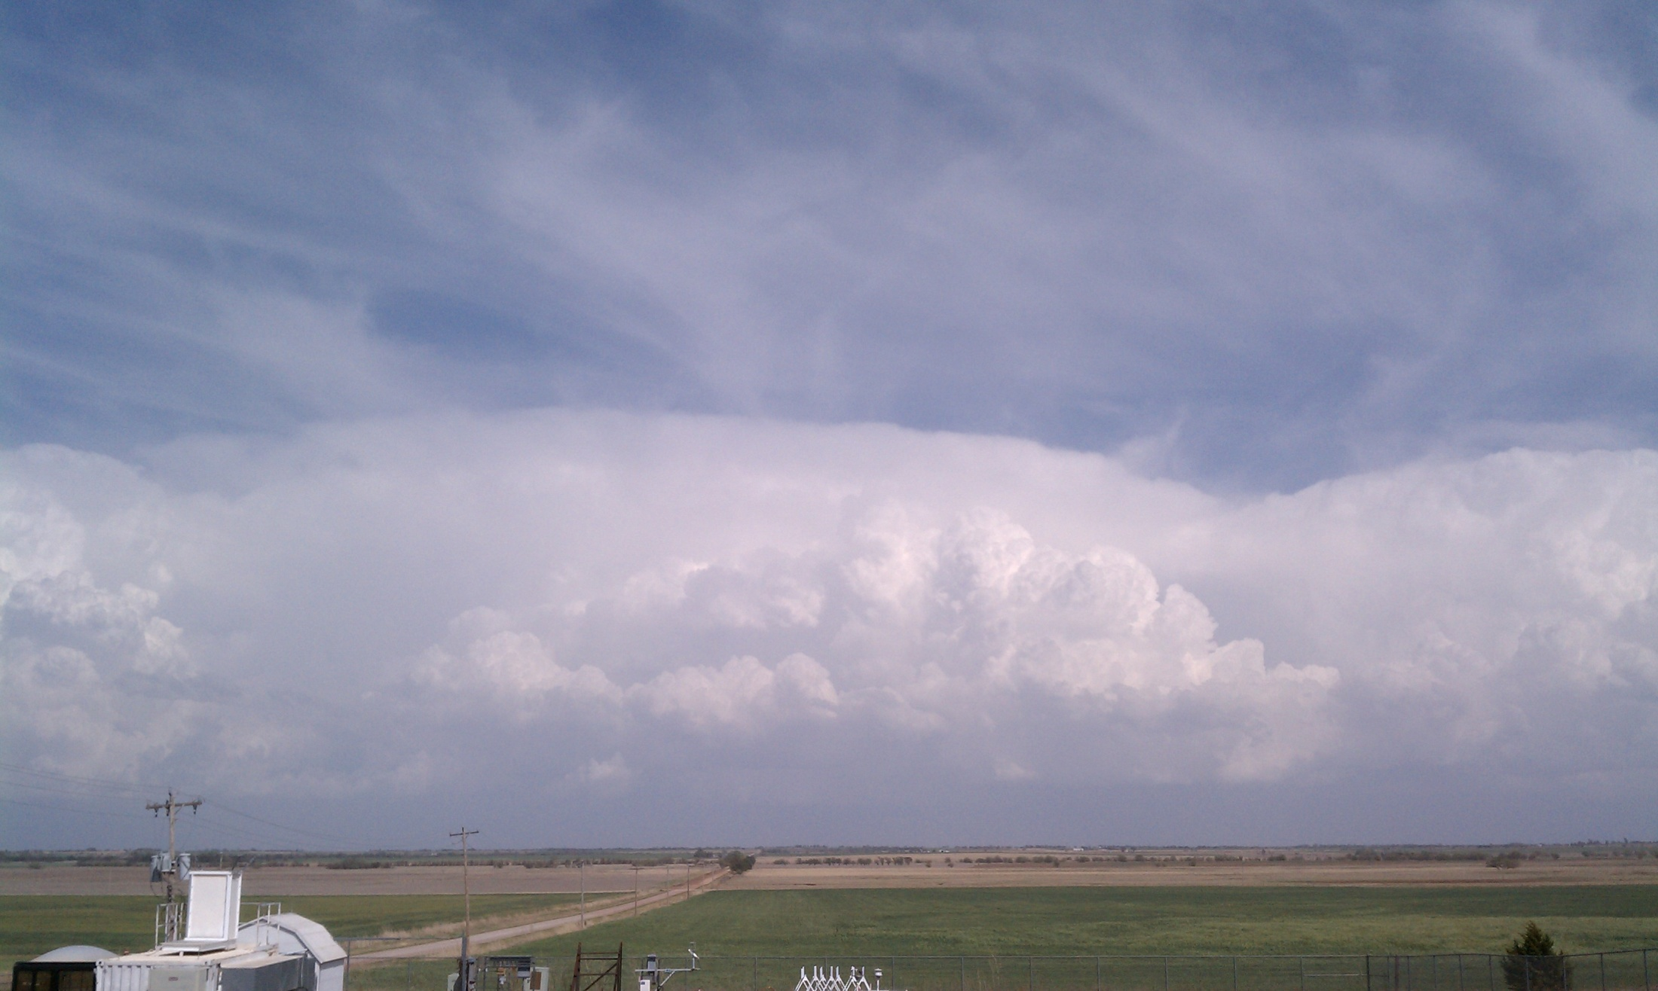
2130Z Mature Thunderstorms

Slide 7
Overview
Day 0 – Low clouds this morning with light precip through early afternoon with strong NW winds
Day 1 – Mostly Clear on Saturday
Day 2- Mostly Clear Sunday as well, with increasing Cirrus
Extended – Increasing clouds Monday and possible Tuesday T-storms

Slide 8
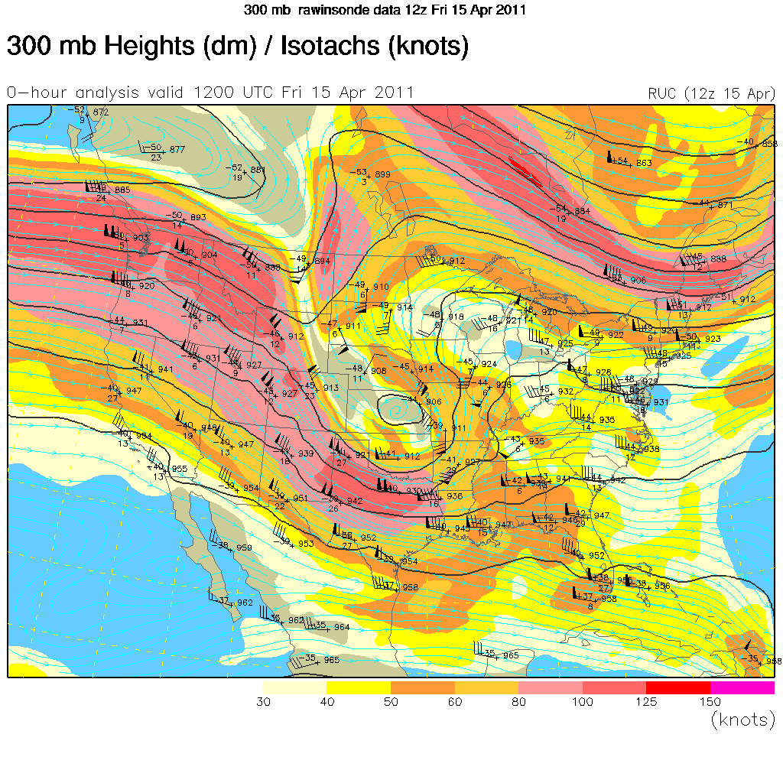

Slide 9
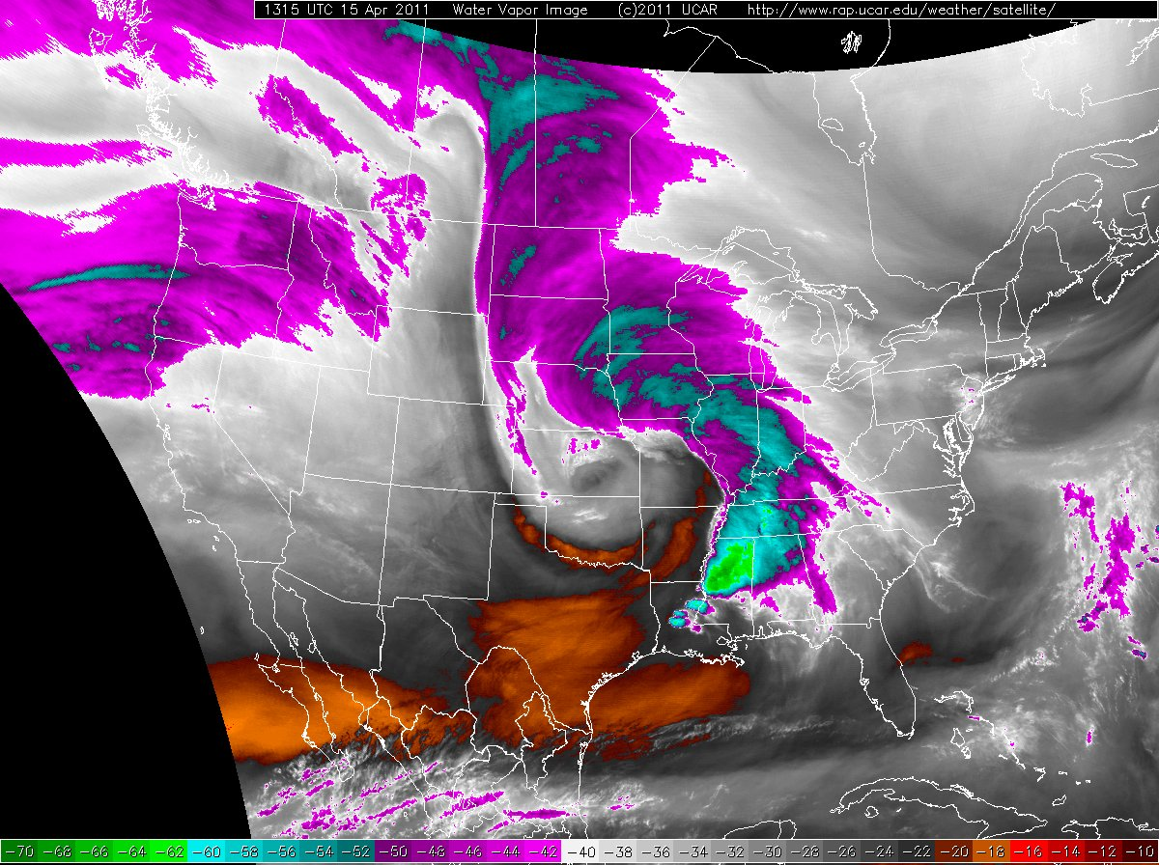

Slide 10
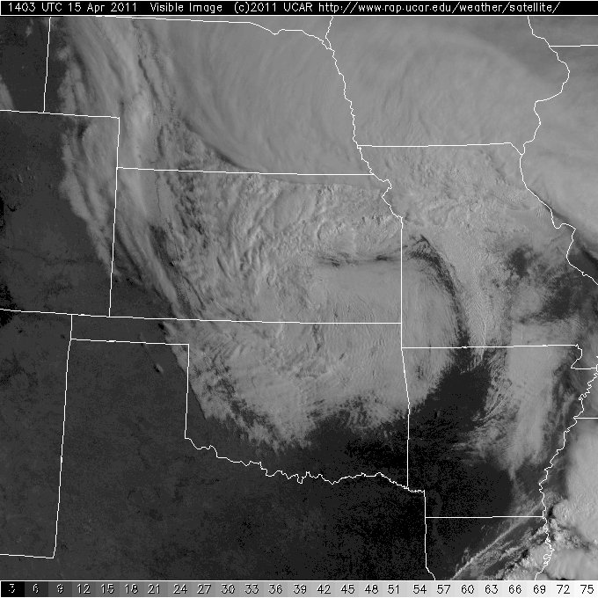
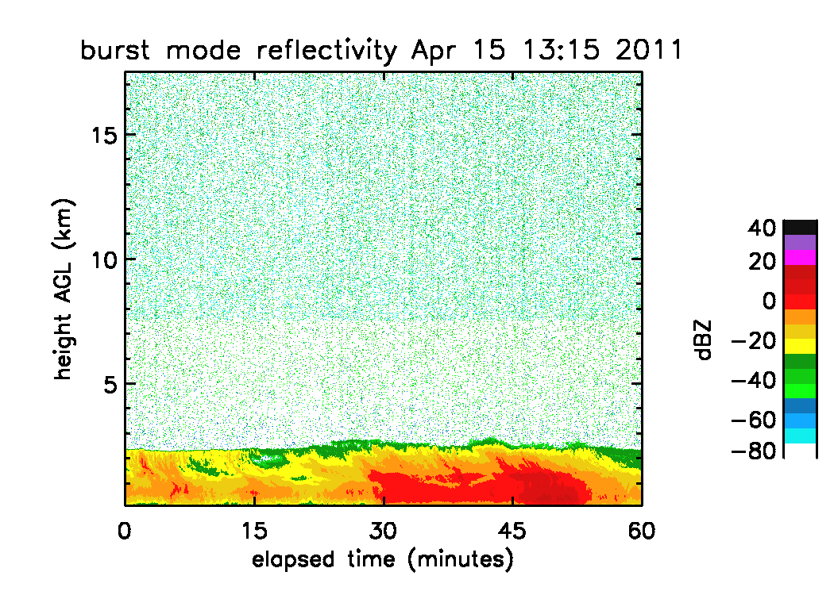

Slide 11
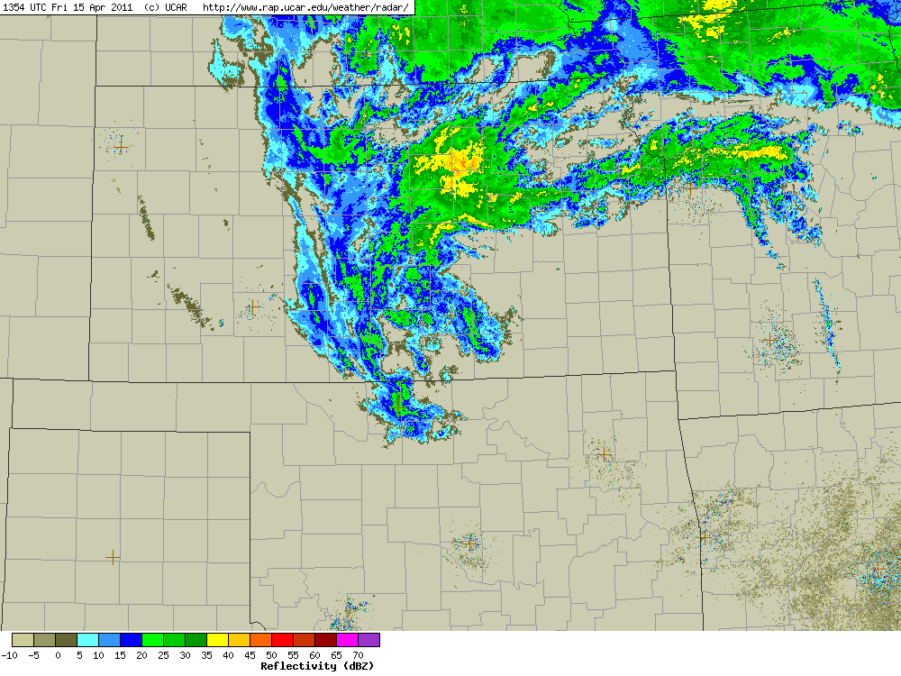

Slide 12
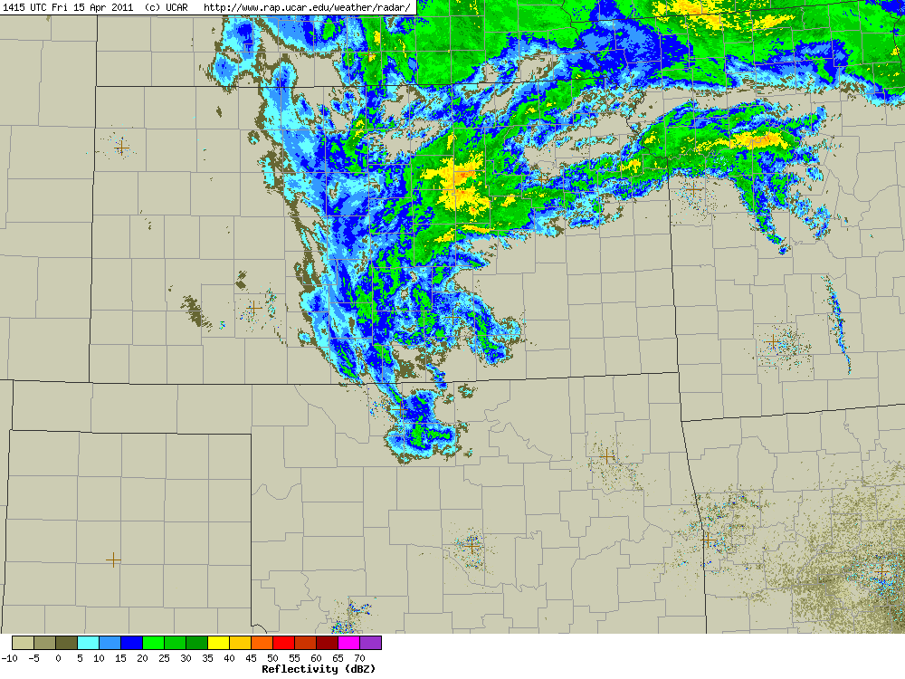

Slide 13
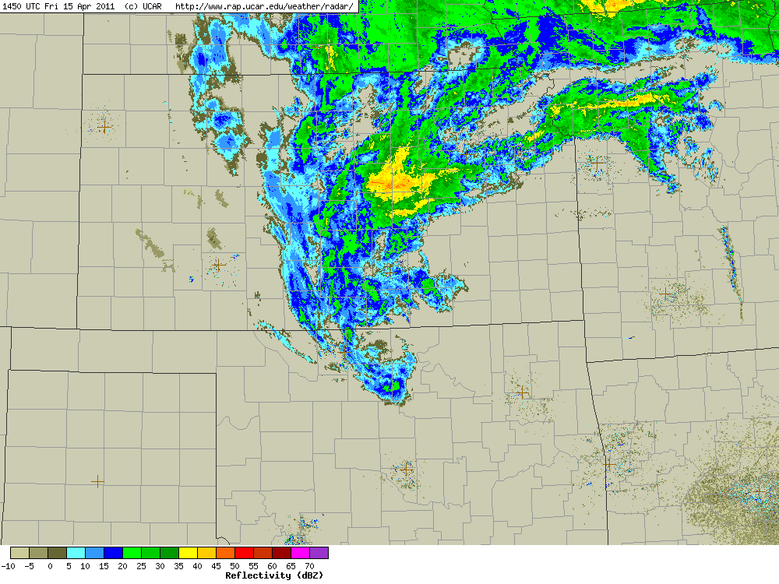

Slide 14
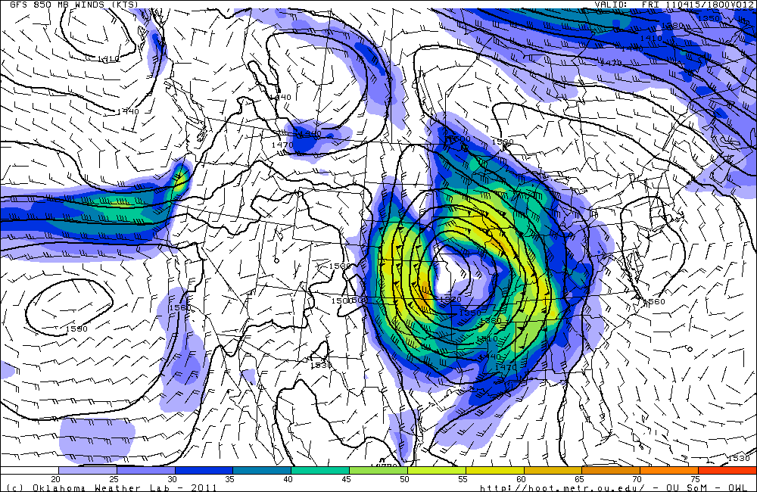
Nowcast Day 0 (850mb/1km)

Slide 15
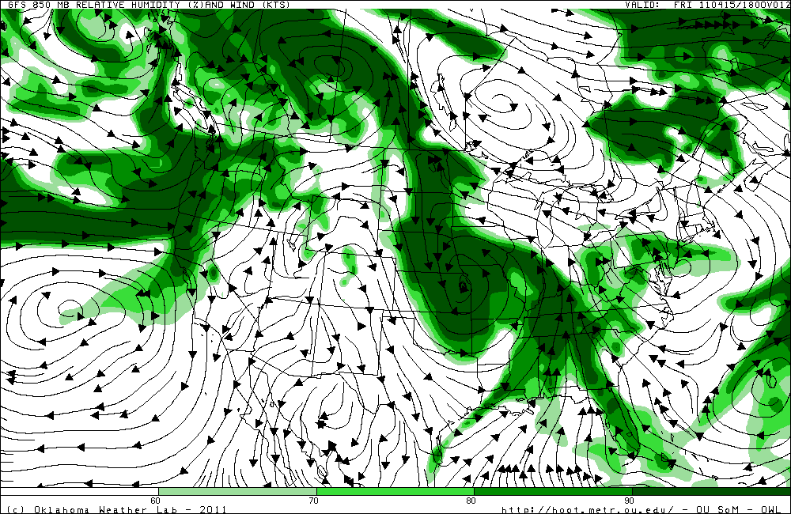
Nowcast Day 0 (850 mb RH)

Slide 16
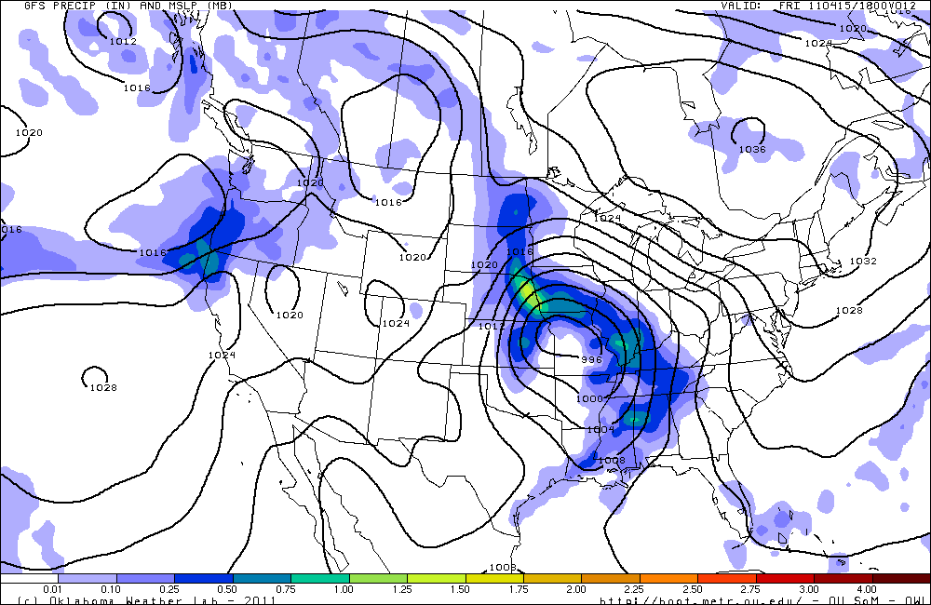
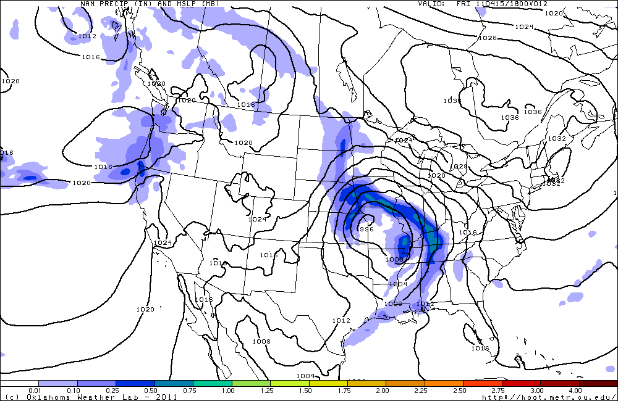
GFS (top) vs NAM (bottom) (06Z run) precip forecast at 18Z

Slide 17
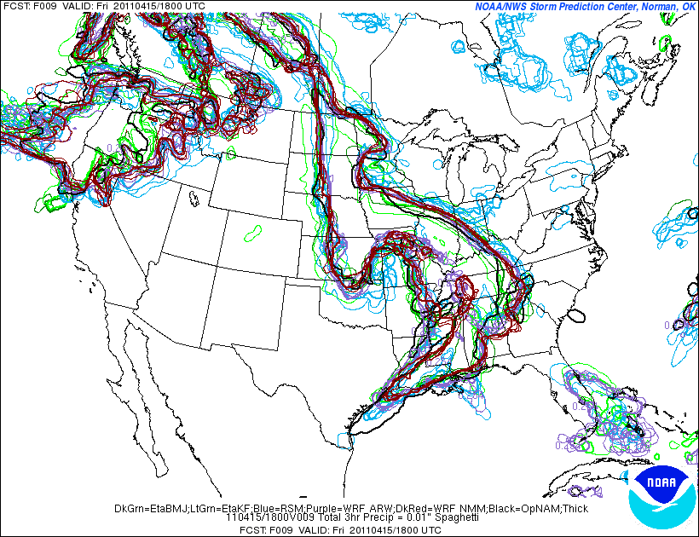
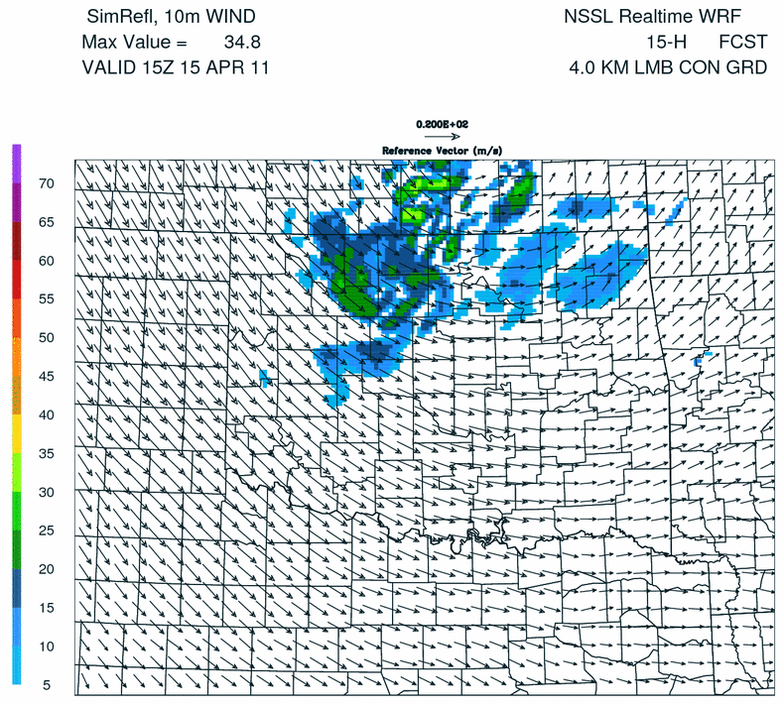

Slide 18
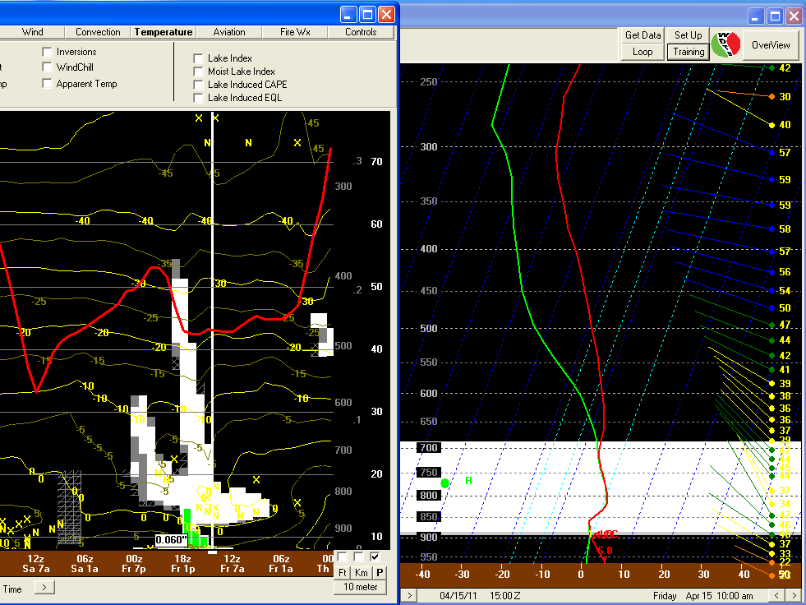
NAM 00Z Forecast Sounding

Slide 19
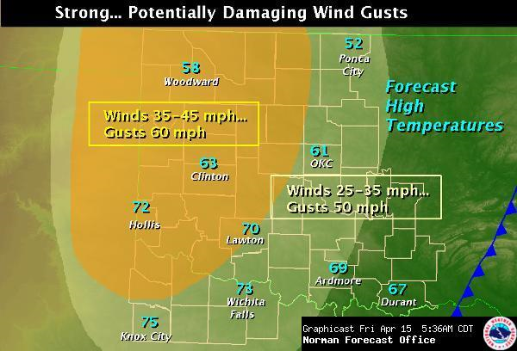
NWS

Slide 20
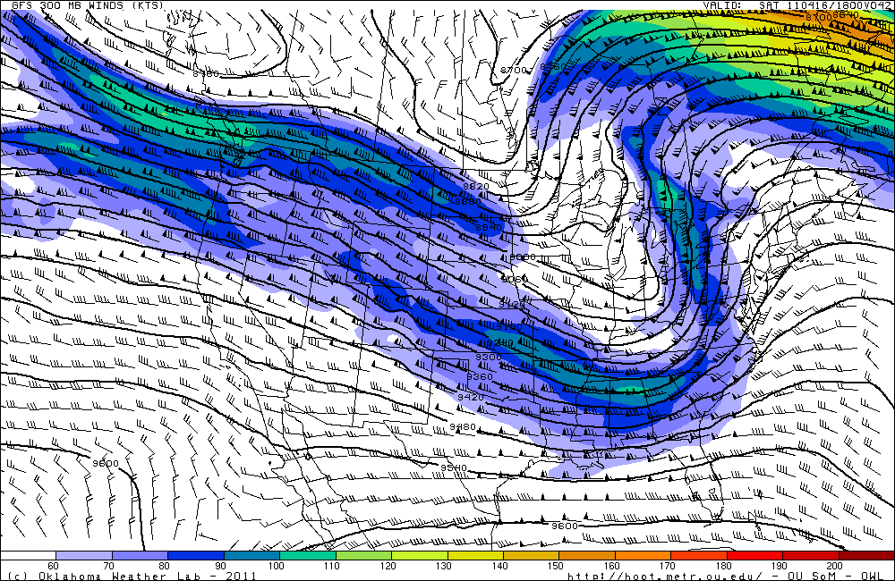
Forecast Day 1 (Saturday)

Slide 21
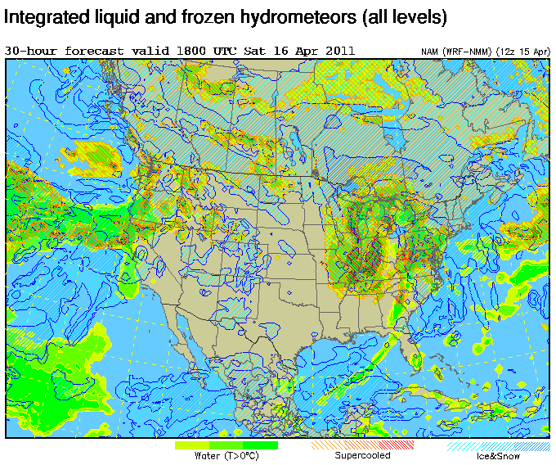
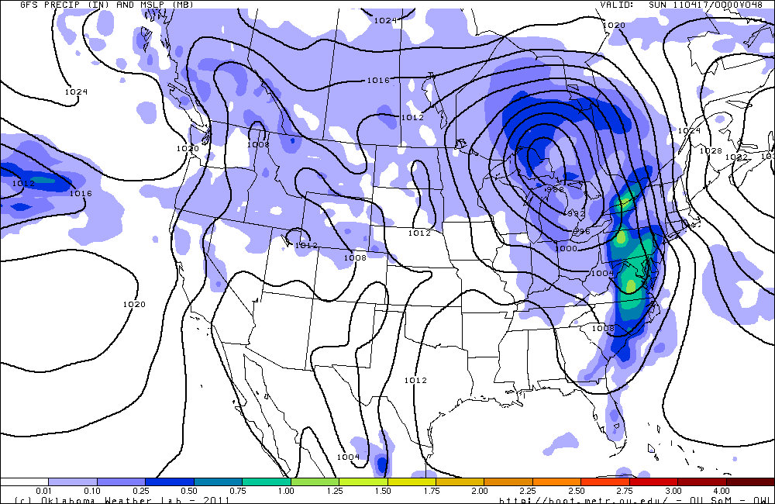

Slide 22
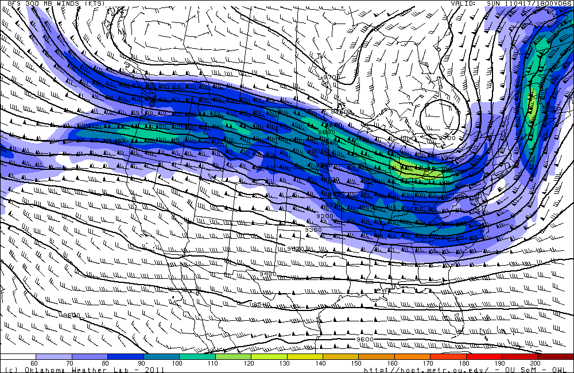
Day 2 Forecast (Sunday)

Slide 23
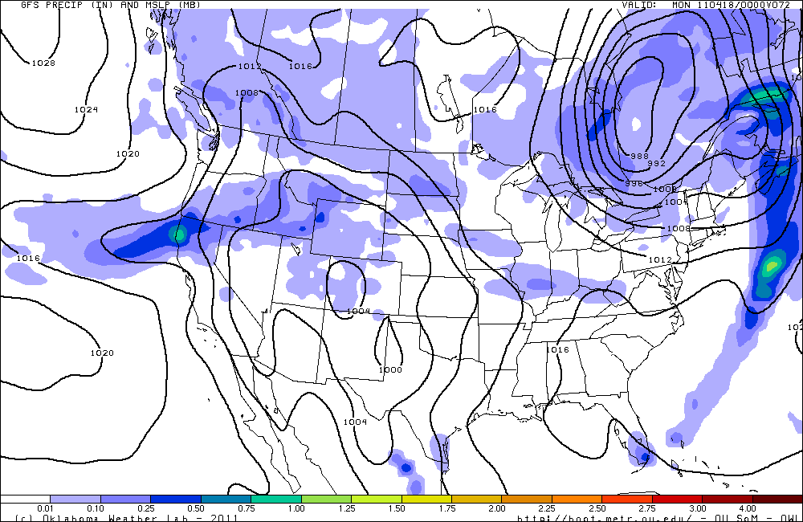

Slide 24
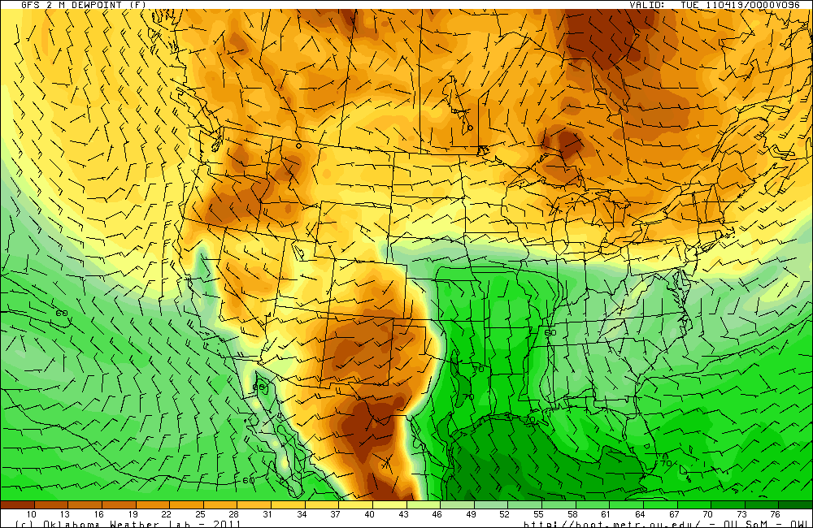
Moisture Return Monday

Slide 25
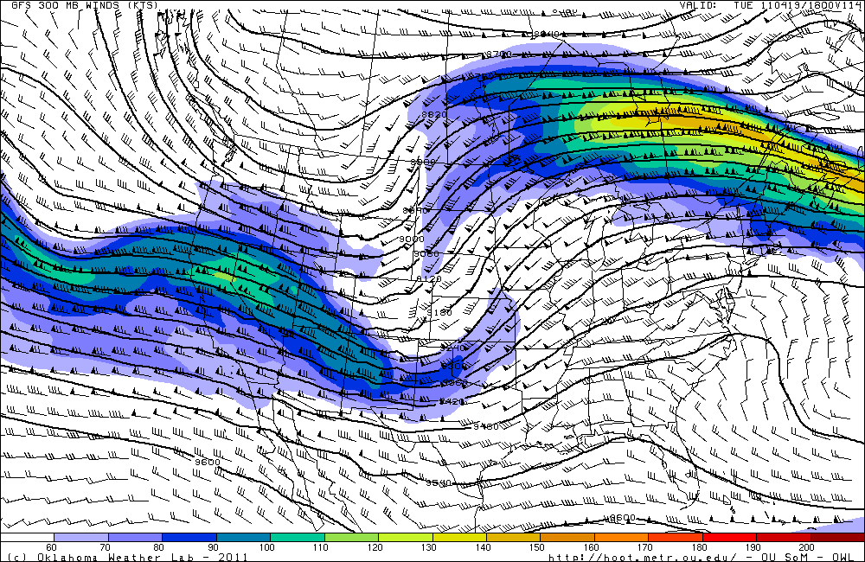
Extended Forecast

Slide 26
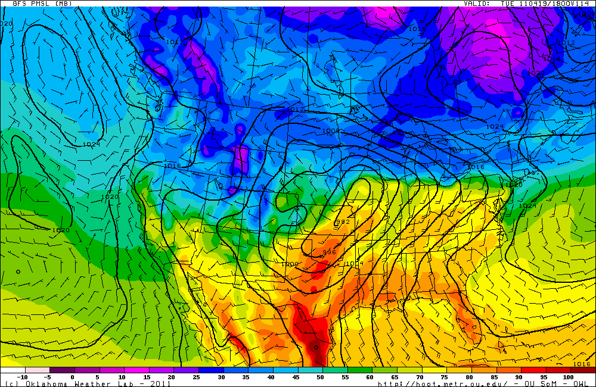
Surface Front Tuesday

Slide 27
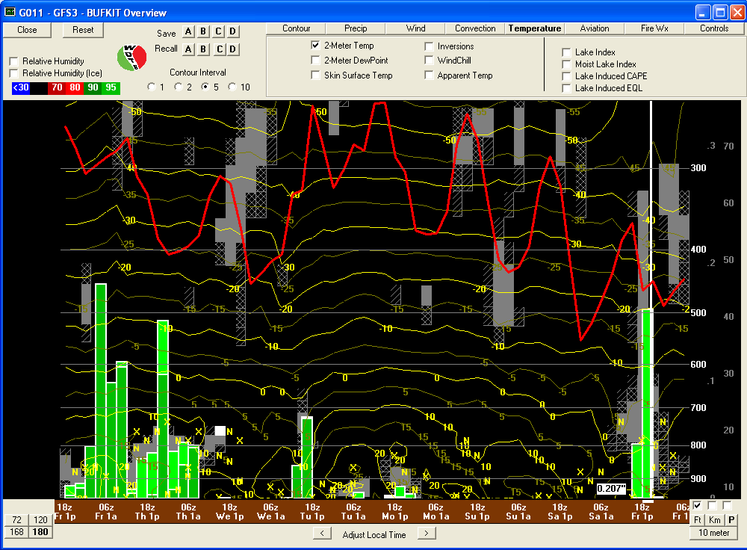
BUFKIT (GFS) Forecast Sounding Overview at SGP

Slide 28
