Slide 1
MC3E Weather Briefing
Monday April 18, 2011

Slide 2
Overview
Day 0 – Partly cloudy with moisture return, strong CAP
Day 1 – Tuesday gets interesting with many factors in play. Light precip possible behind the front
Day 2 – Wednesday cooler and sunny
Extended – Thursday into Friday “looks like one of the better rain chances in some time”

Slide 3
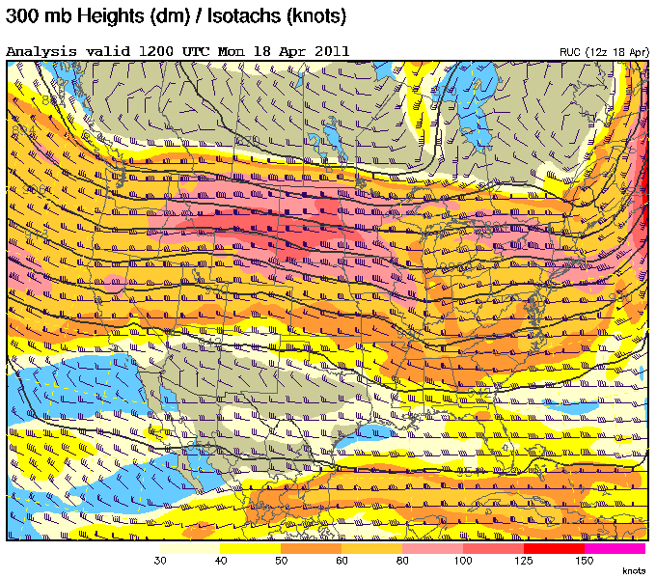

Slide 4
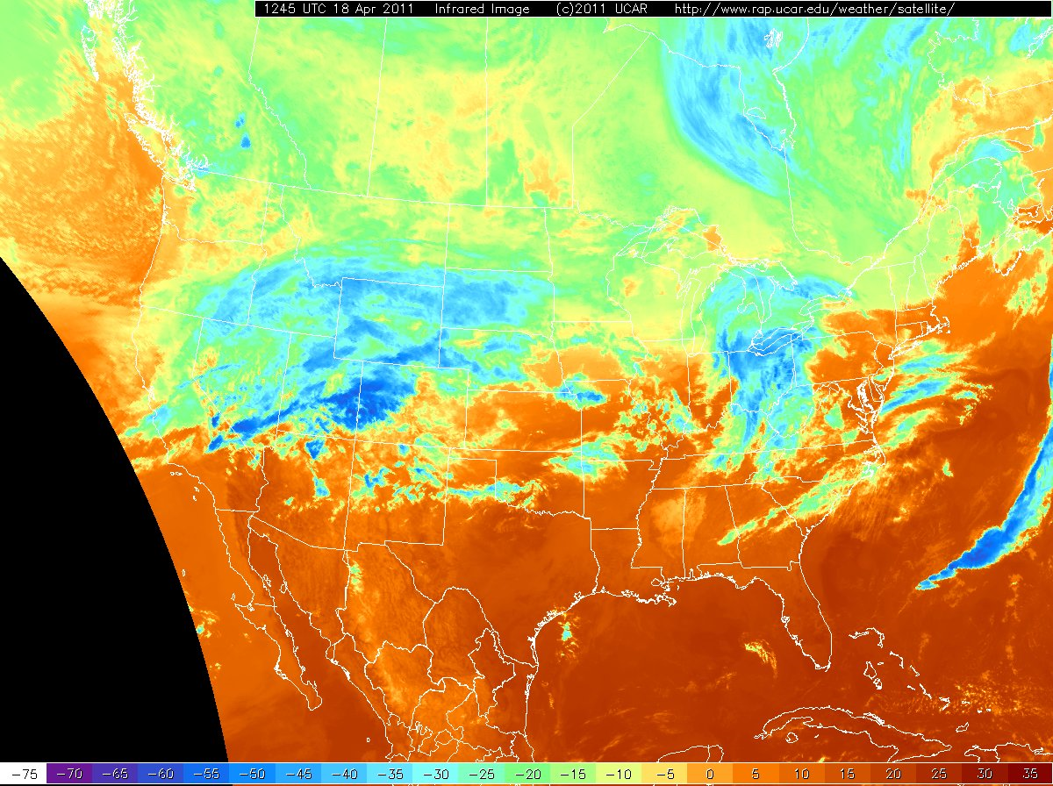

Slide 5
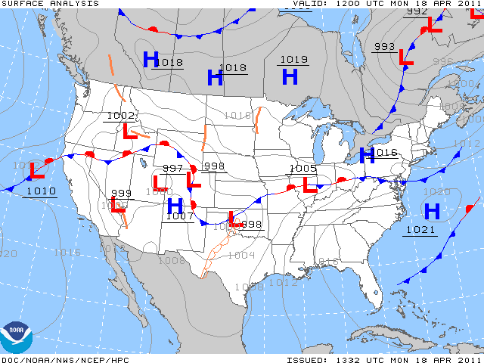
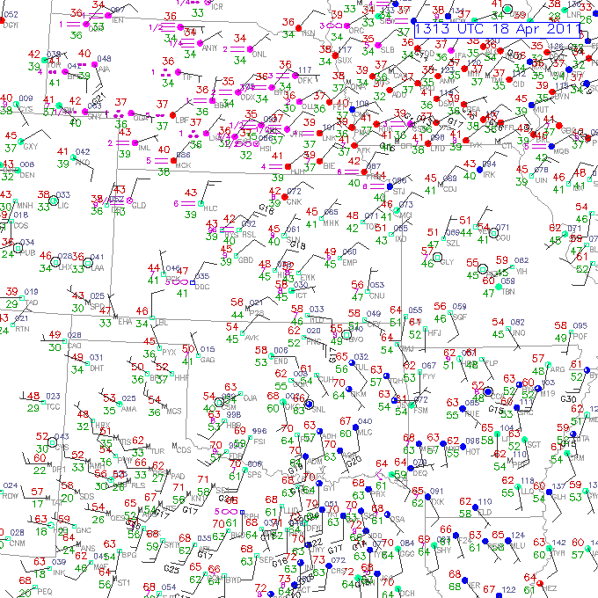

Slide 6
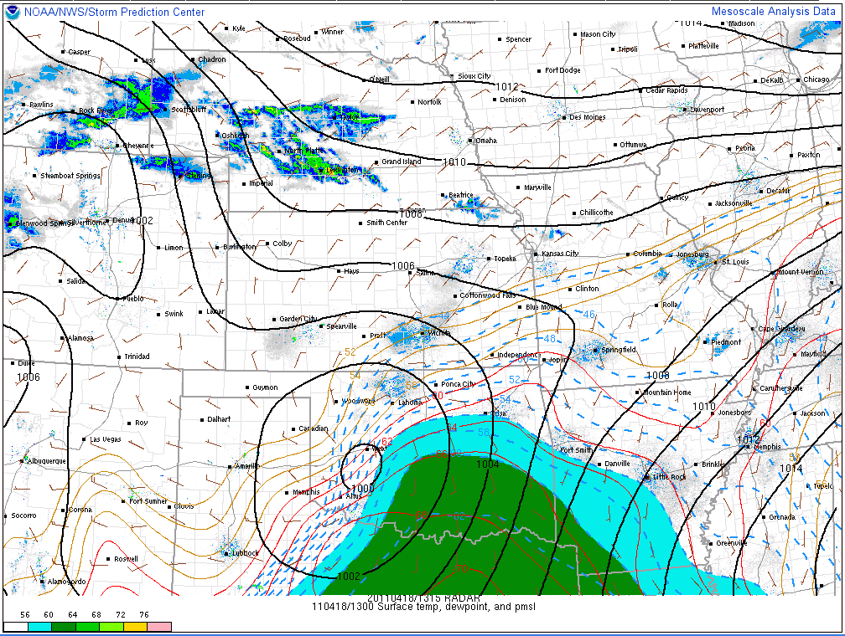

Slide 7
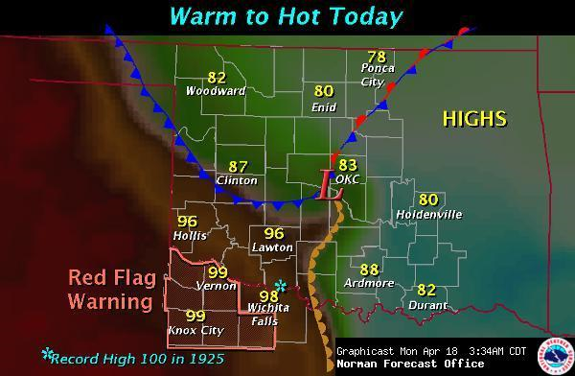
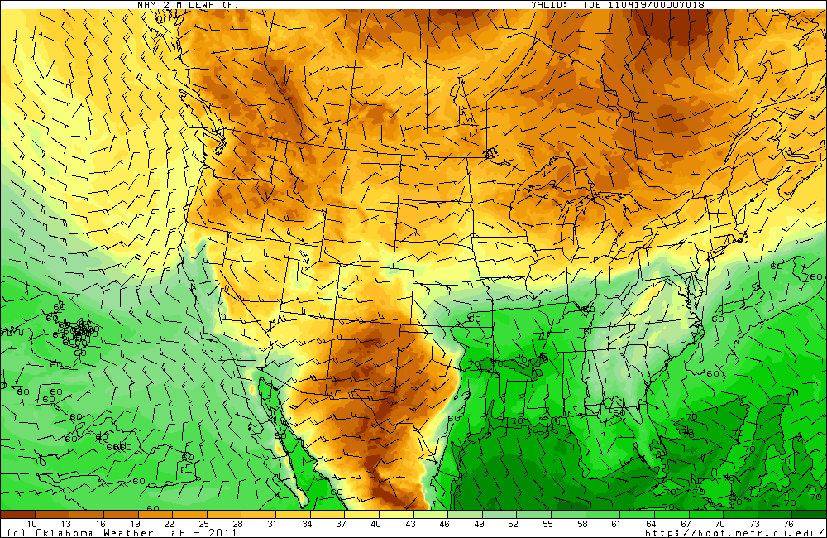

Slide 8
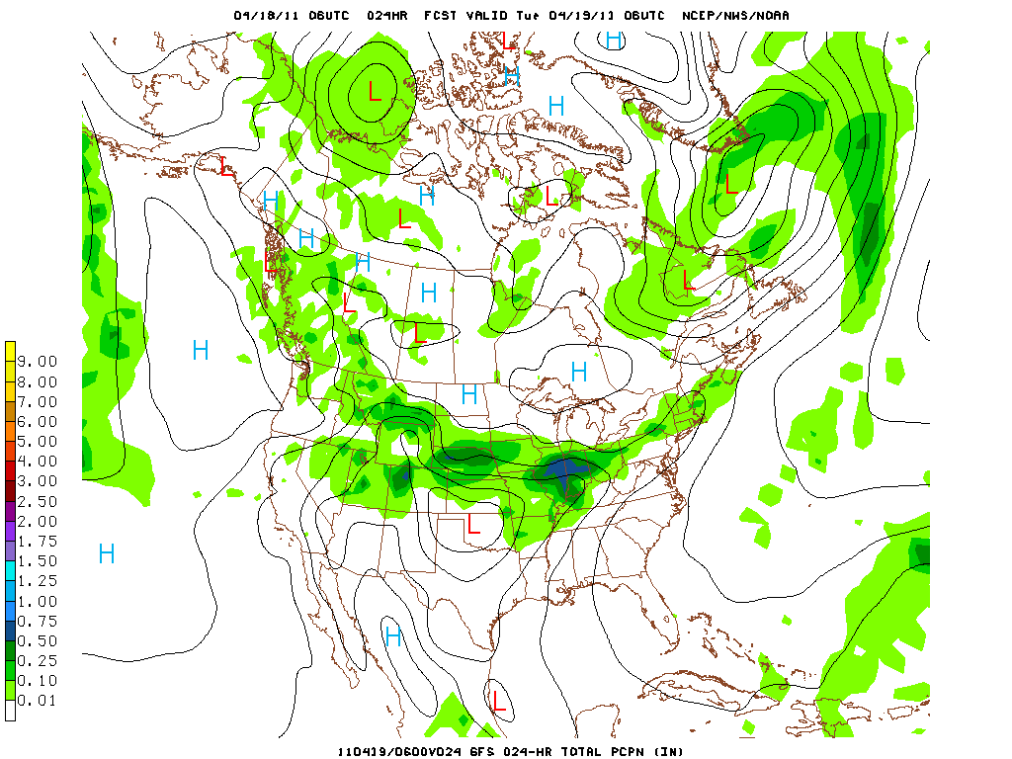
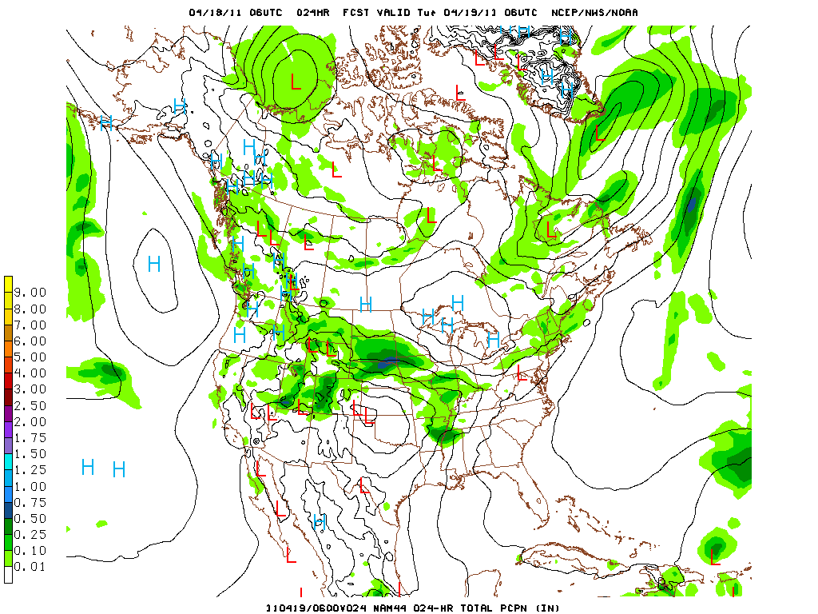
GFS (top) and NAM 6-hour precip forecasts for 00Z-06Z tonight

Slide 9
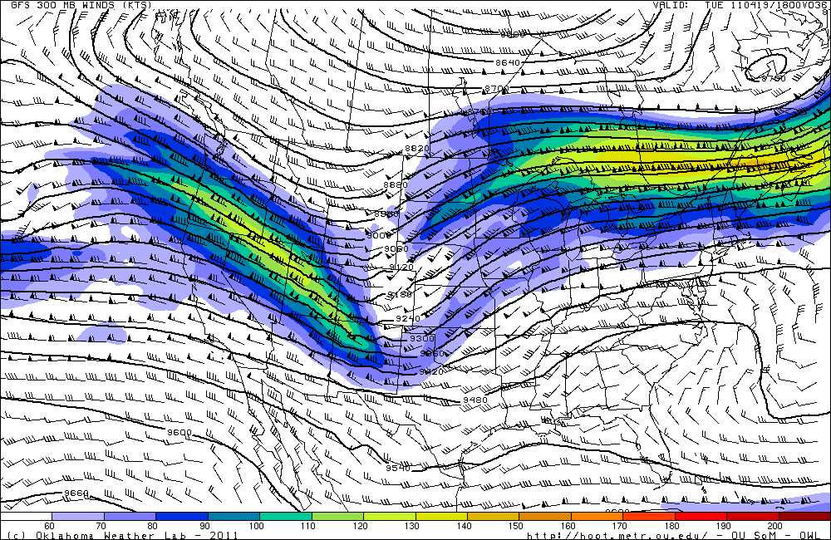
Forecast Day 1 (Tuesday)

Slide 10
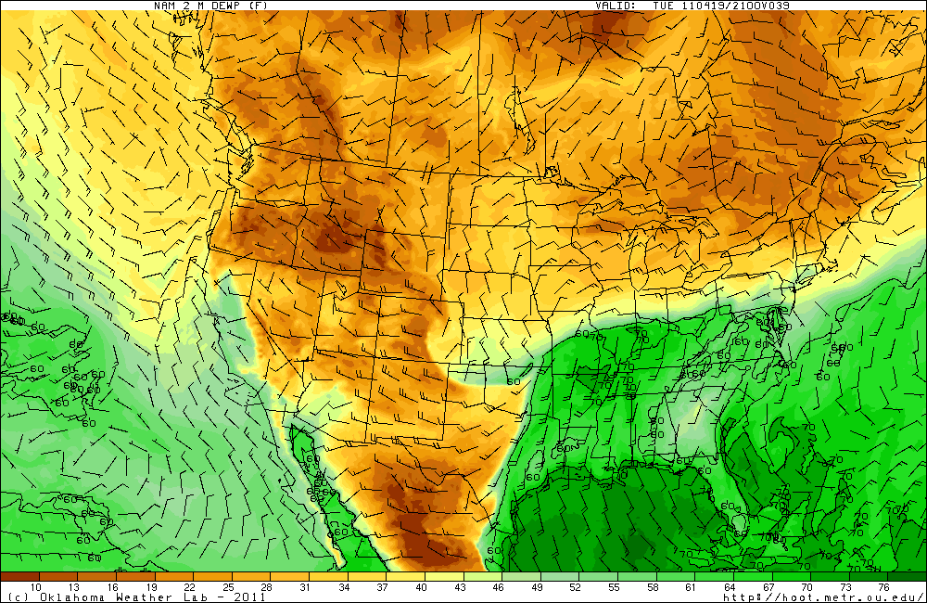
21Z Surface Dewpoints/Winds

Slide 11
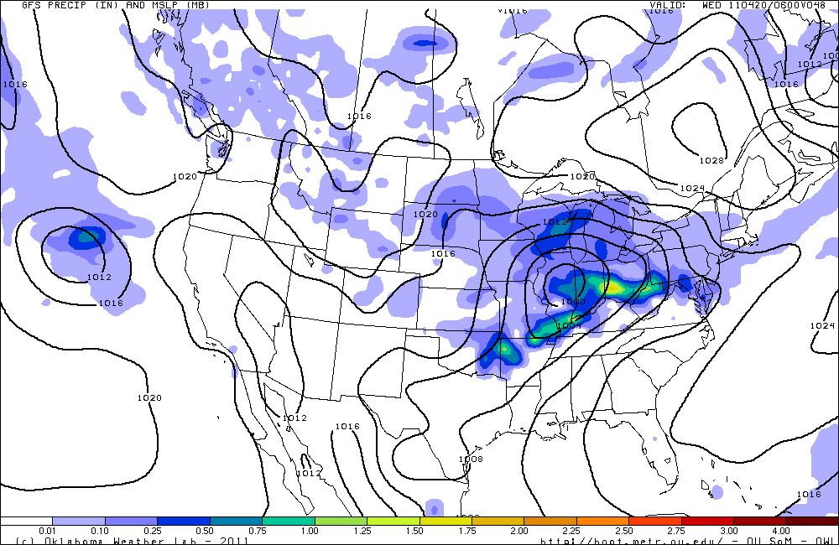
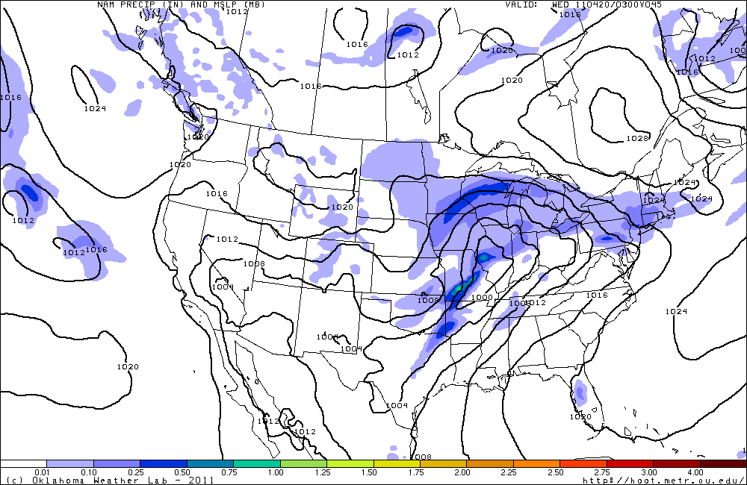
GFS (top) 6-hour precip forecast (00Z-06Z) and NAM 3-hour forecast (00-03Z)

Slide 12
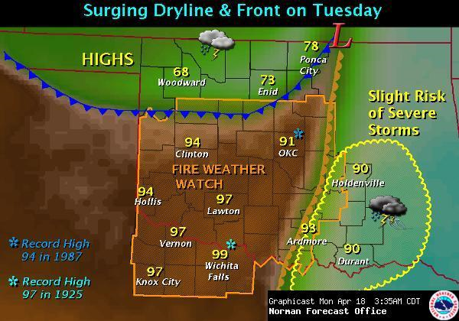
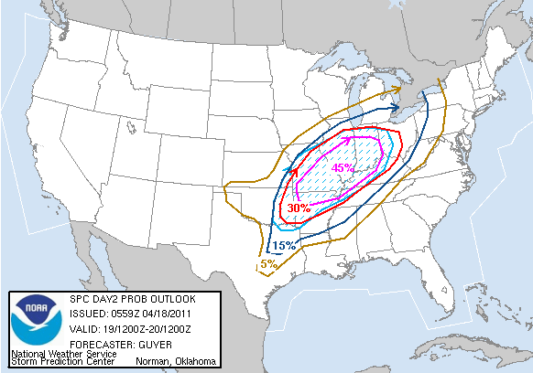

Slide 13
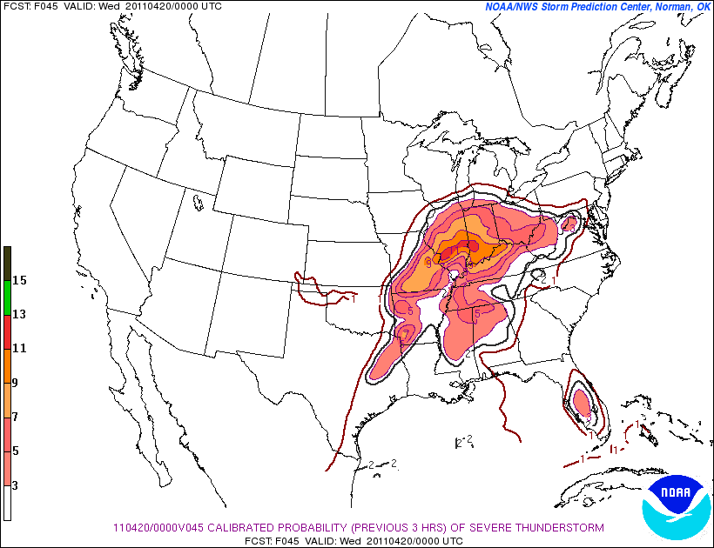

Slide 14
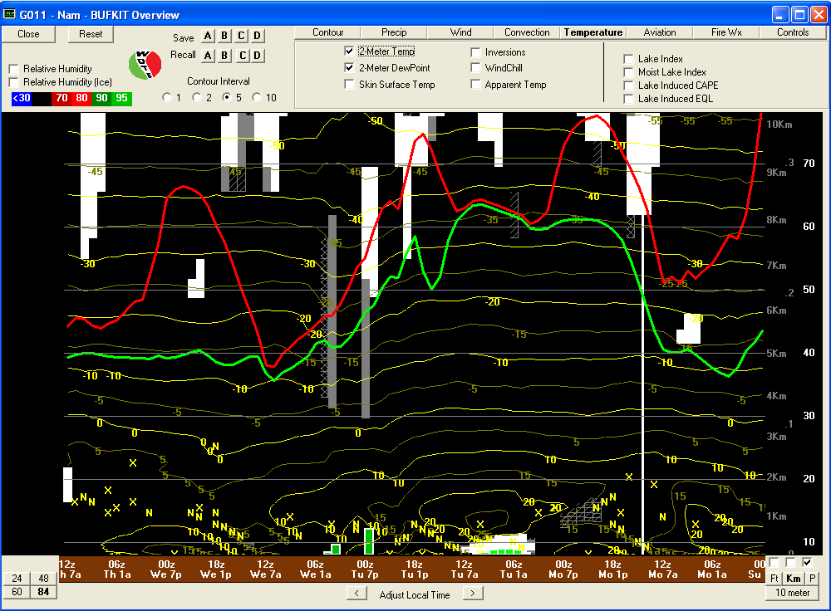

Slide 15
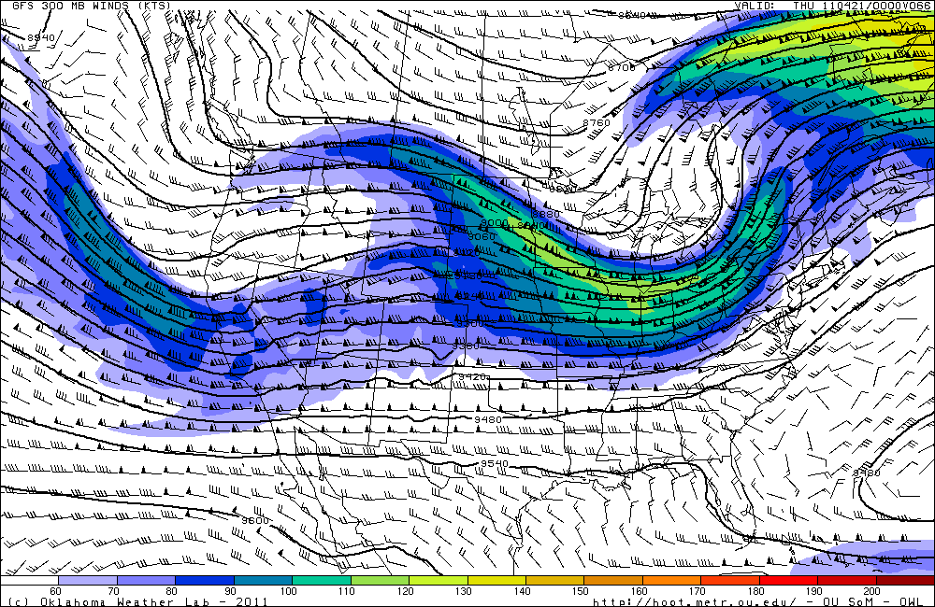
Day 2 Forecast (Wednesday)

Slide 16
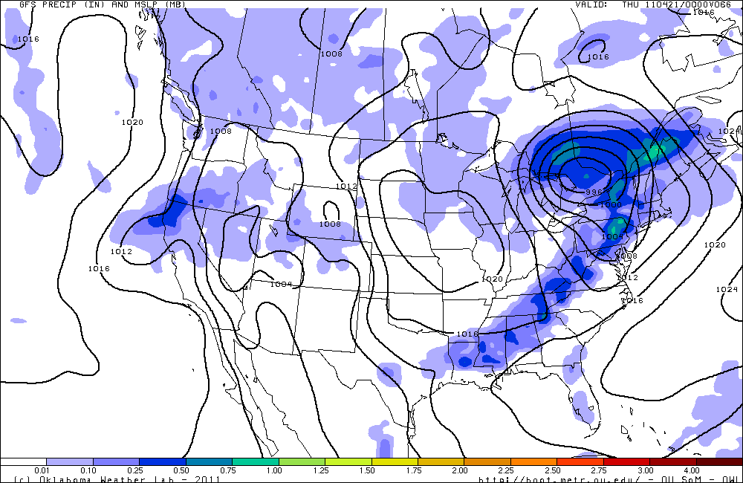

Slide 17
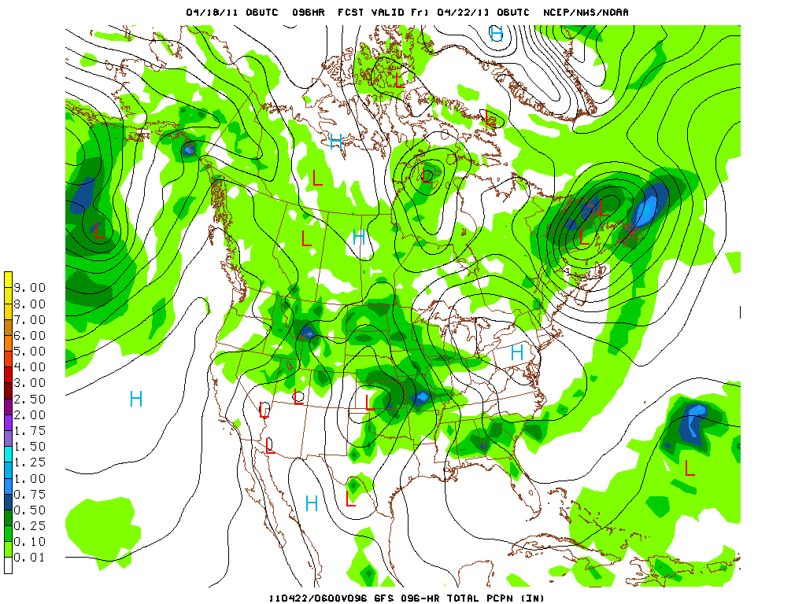
Extended Forecast

Slide 18
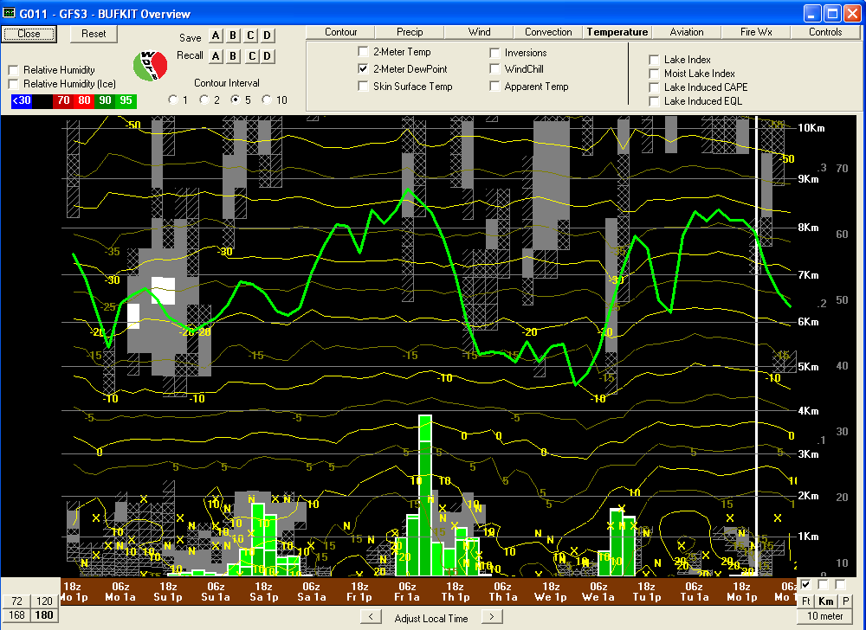
BUFKIT (GFS) Forecast Sounding Overview at SGP

Slide 19
