Slide 1
MC3E Weather Briefing
Monday April 19, 2011

Slide 2
Overview
Day 0 – The cold front pushed through ahead of schedule, leaving little-to-no chance of rain in our region today
Day 1 – Wednesday mostly clear
Day 2 – Thursday rain probable throughout the day, as a warm front pushes northward with moisture return and upper-level storm system moves across mountain west
Extended – Chances of storms remain Friday-Sunday

Slide 3
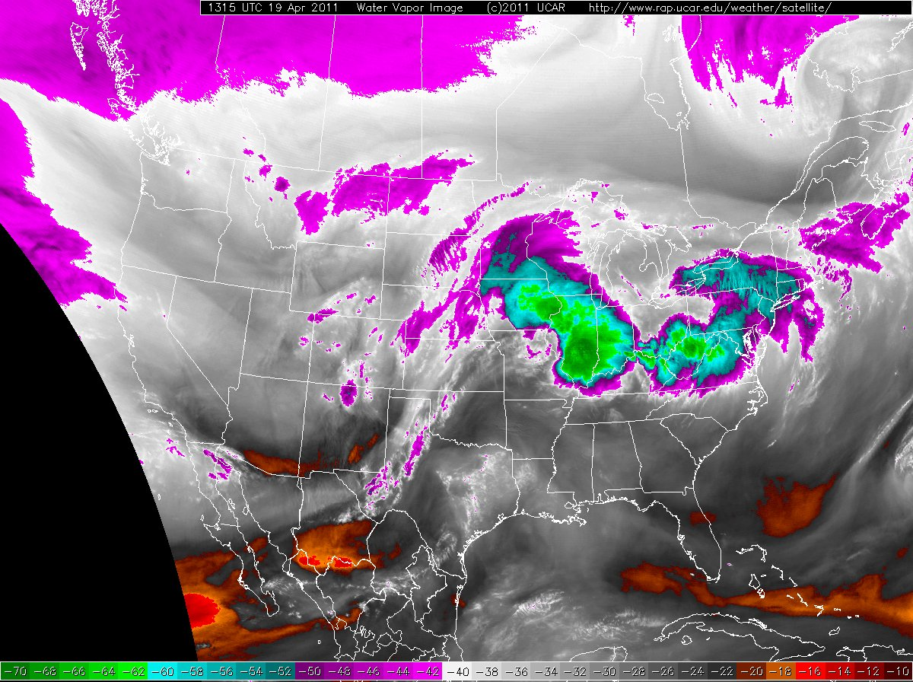

Slide 4
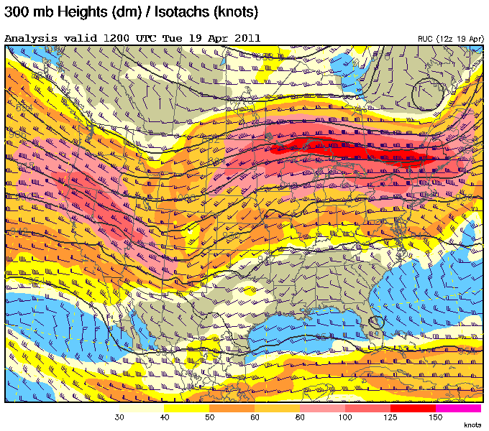

Slide 5
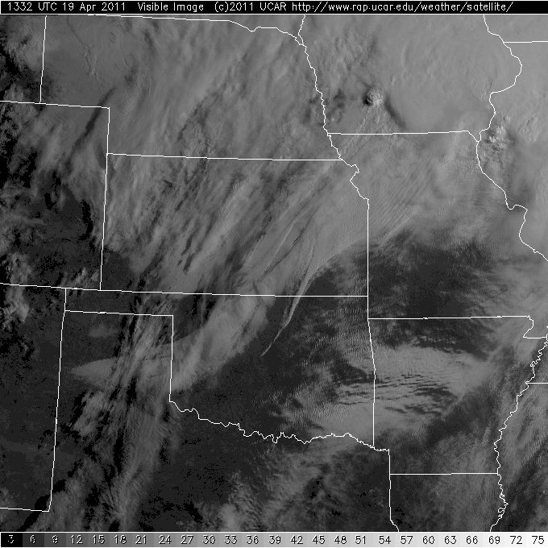

Slide 6
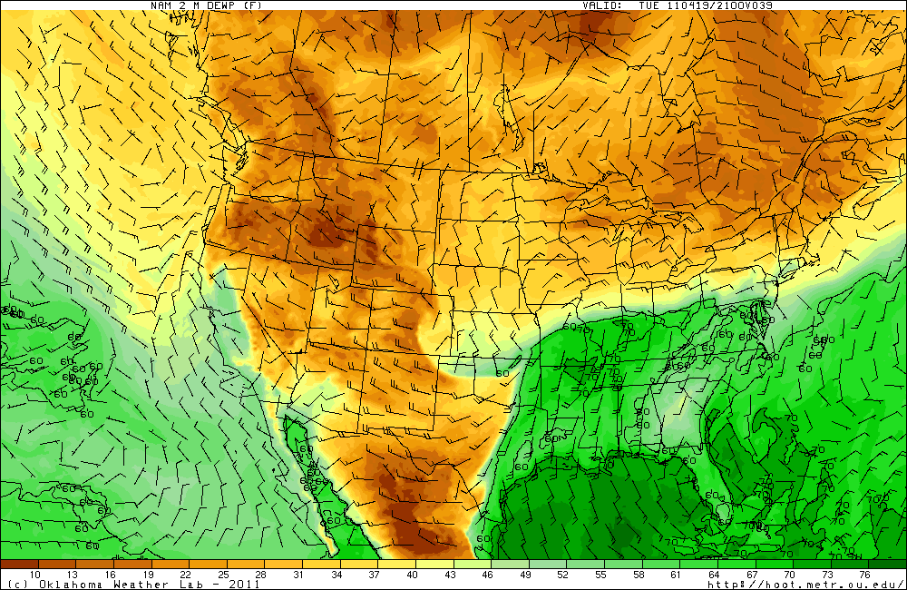
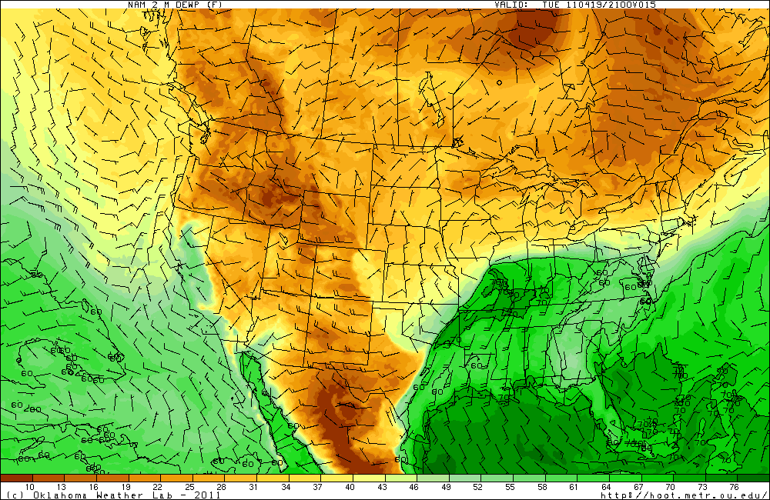
NAM 00Z forecasts from yesterday (top) and today (bottom) for 21Z today frontal passage

Slide 7
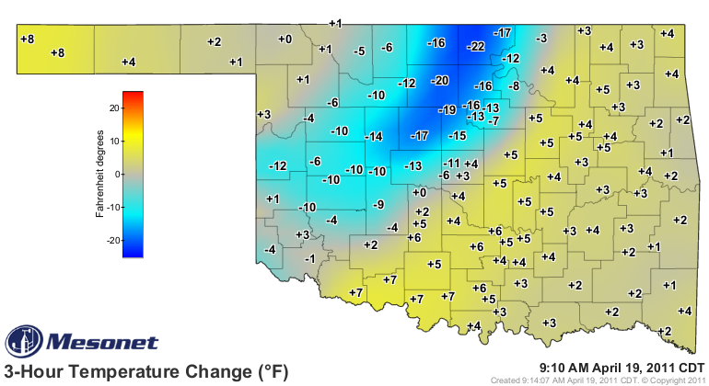
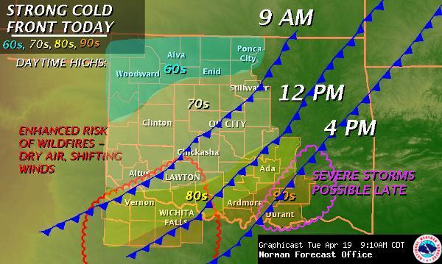

Slide 8
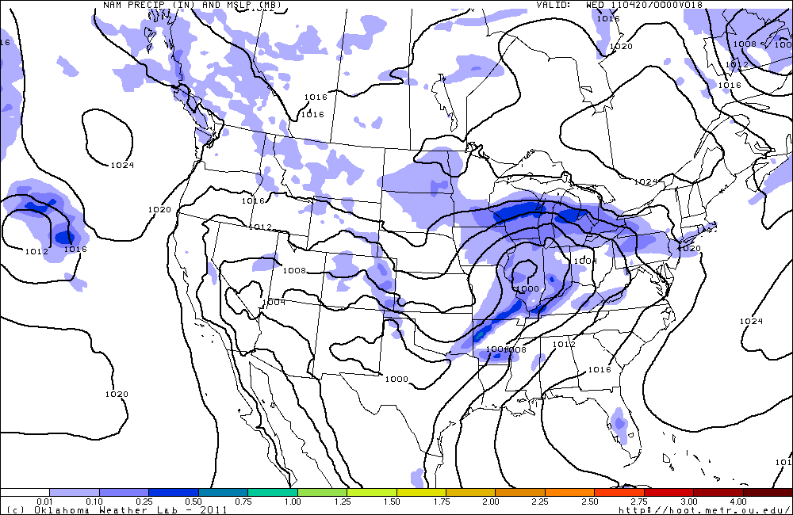
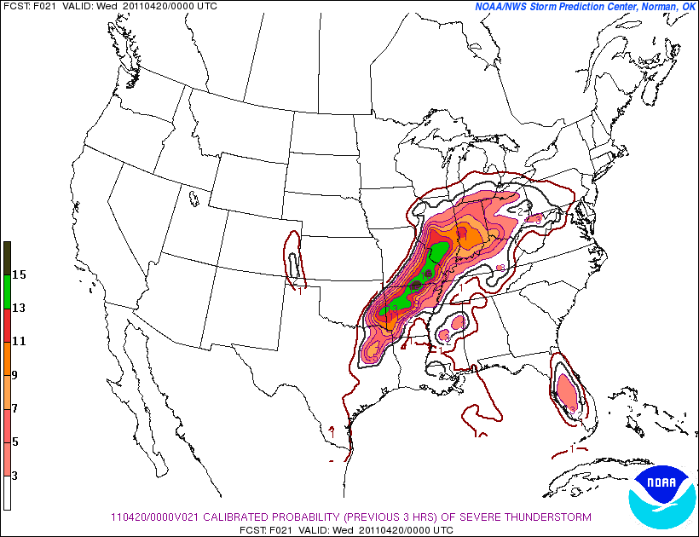

Slide 9
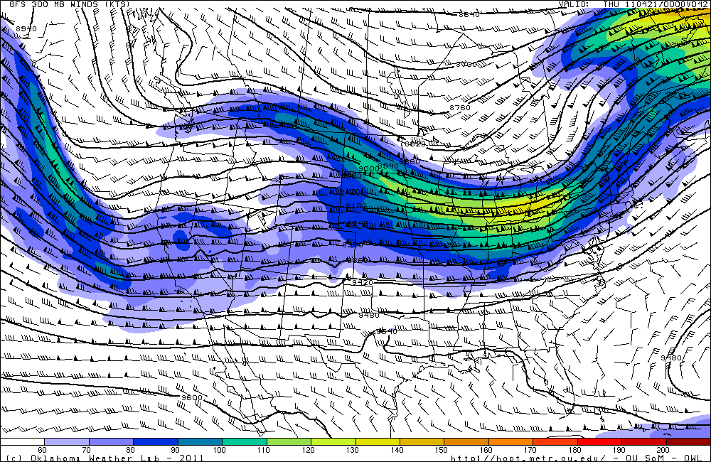
Forecast Day 1 (Wednesday)

Slide 10
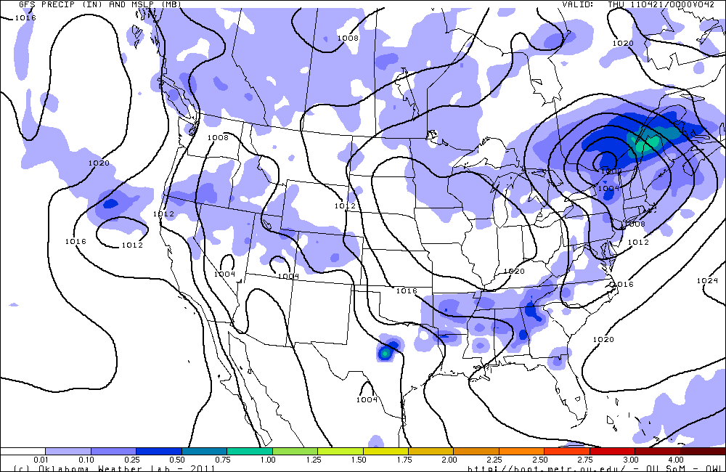
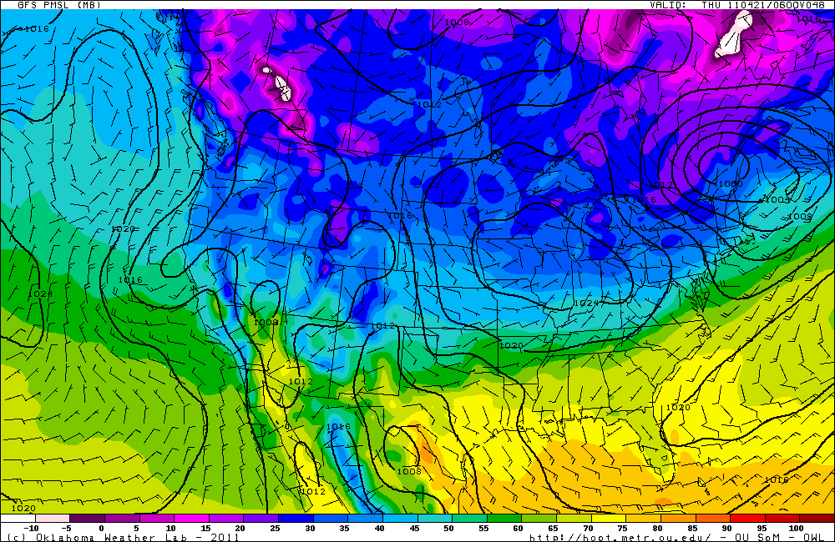

Slide 11
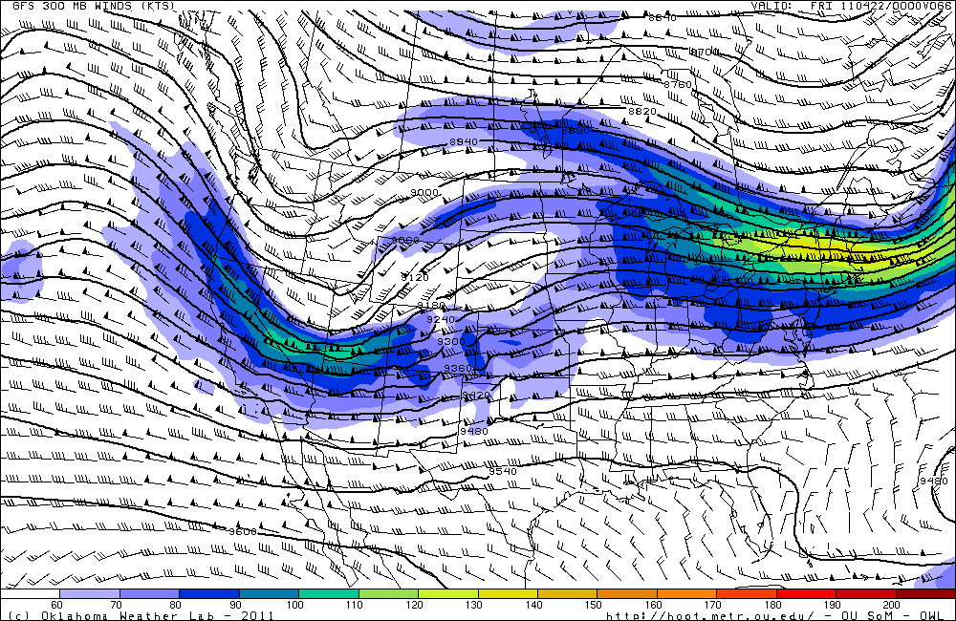
Day 2 Forecast (Thursday)

Slide 12
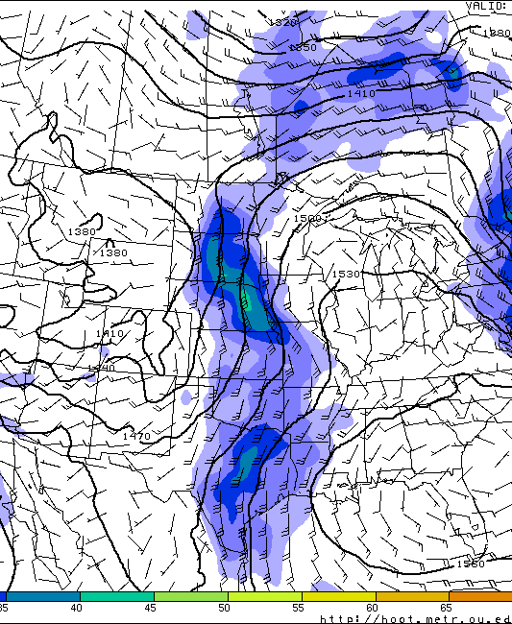
850 mb winds/RH

Slide 13
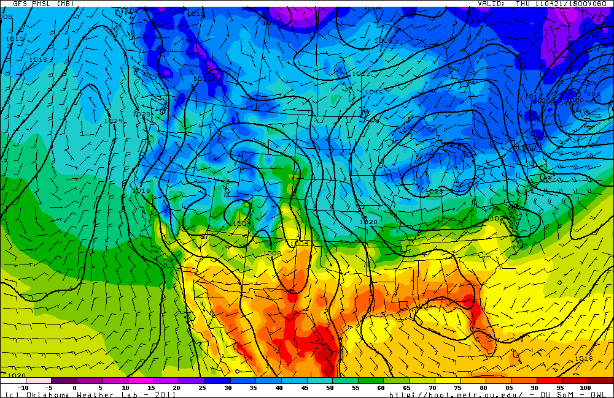
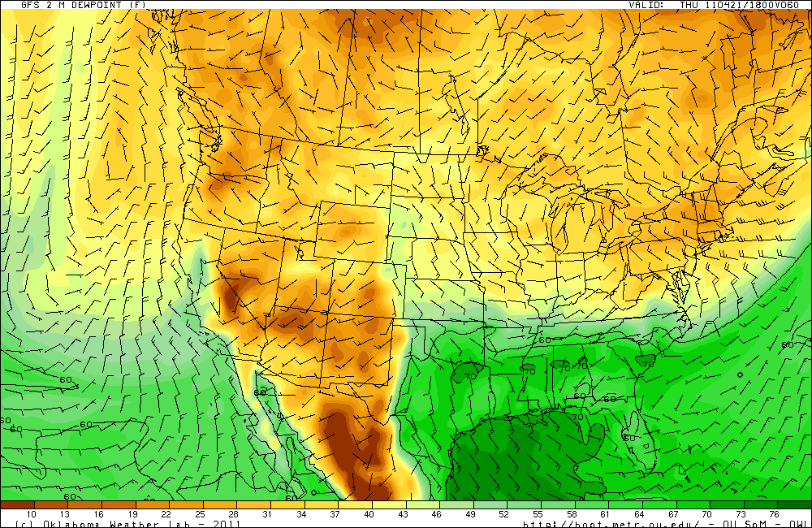

Slide 14
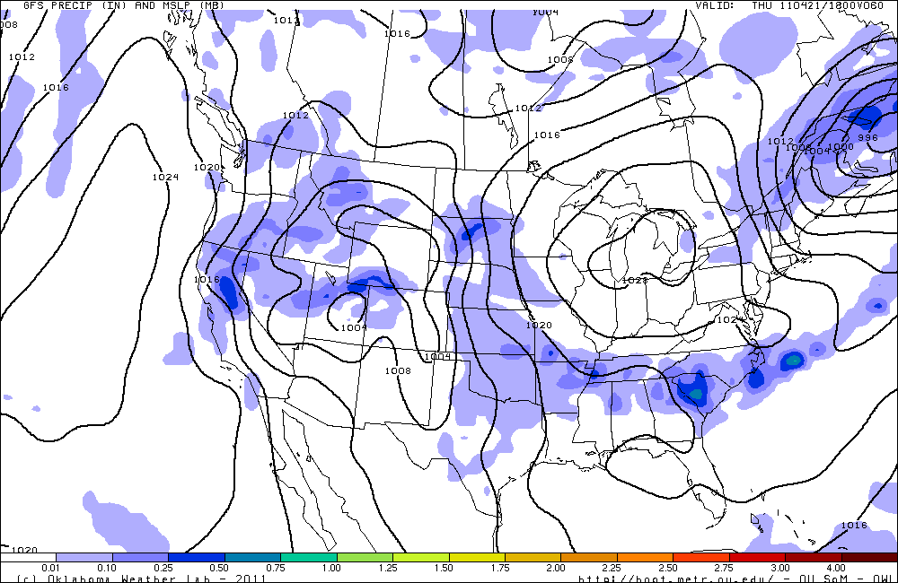
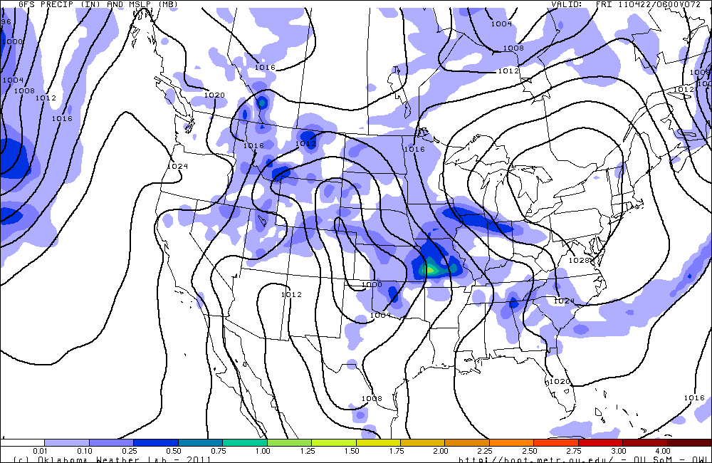

Slide 15
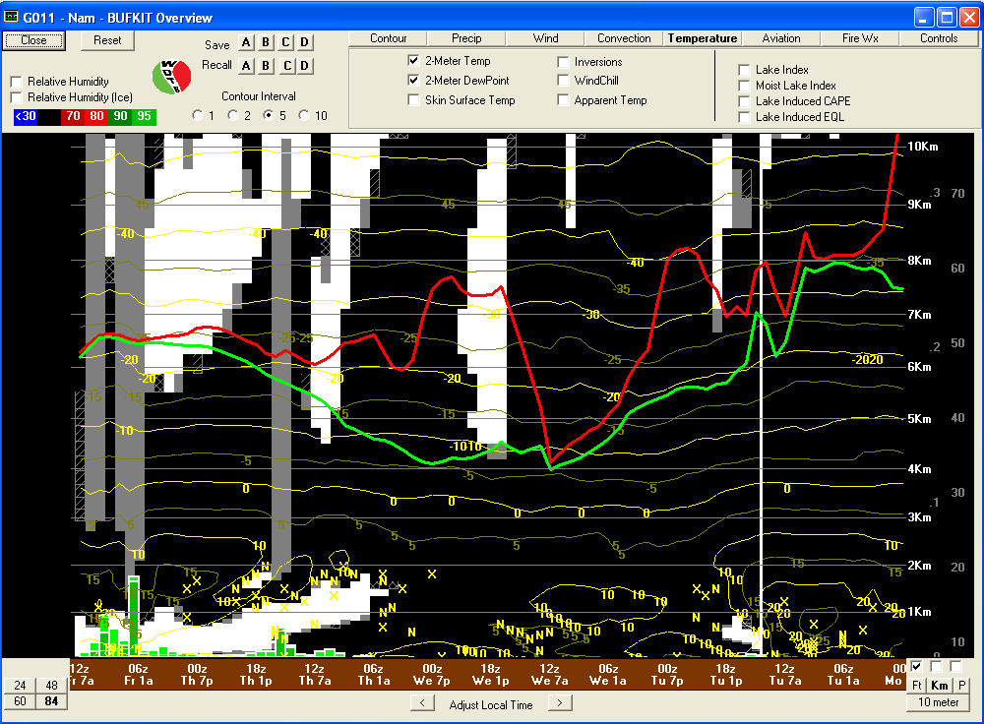

Slide 16
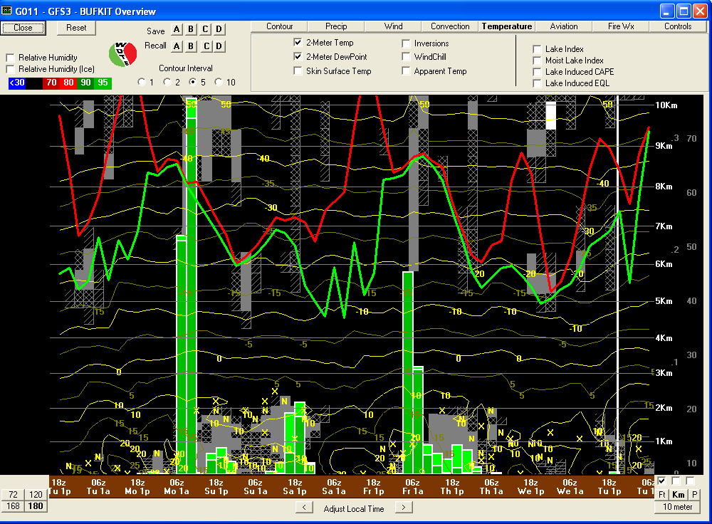
BUFKIT (GFS) Forecast Sounding Overview at SGP

Slide 17
Extended Forecast

Slide 19
