Slide 1
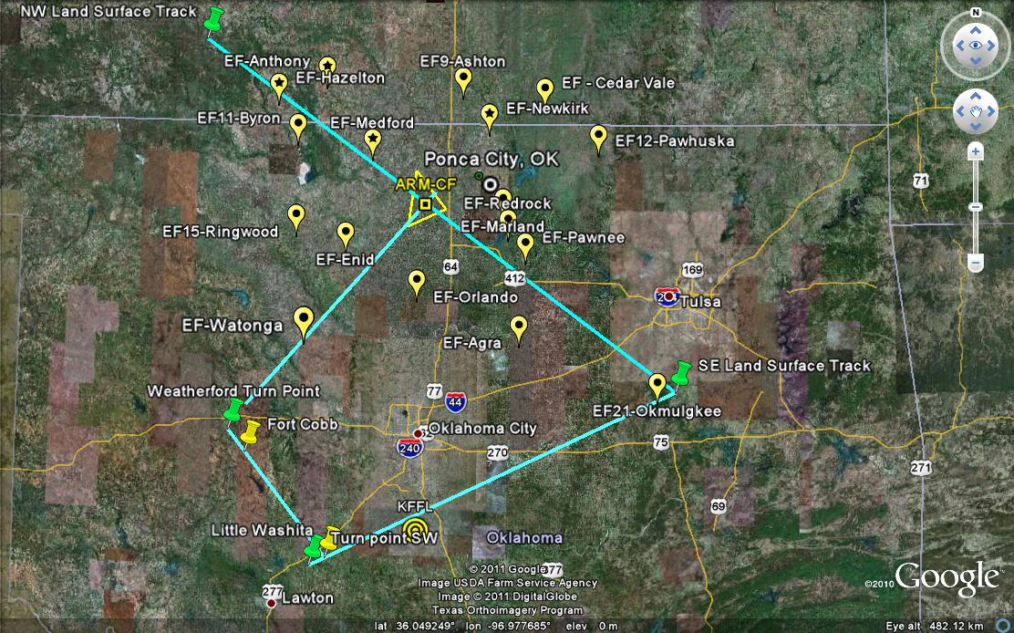
Illustration of desired track: See next slide for points and notes
START
HOME

Slide 2
Key Points:
37.407028° -98.871342° STARTING POINT (NW END)
35.677300° -95.953162° TURN POINT (SE END) Turn out to southeast and loop around to get back on new track toward the southwest and Little Washita
34.803571° -98.171096° TURN POINT (SW END) turn out to south and east, loop around for northwest track to Ft. Cobb
35.471109° -98.677029° TURN POINT (Weatherford area) Turn northeast and get onto leg to fly straight and level over EF Watonga and Central Facility- THEN HOME TO OFFUTT.
For refining takeoff time based on pattern completion: Prefer to have this particular pattern sampling centered on 2005 UTC
If flight will be under 3 hours, either widen the turns or deviate after hitting CF on way home to make it 3 hours (idea being to make sure we exercise the instruments for 3 hours).

