Slide 1
SPoRT GOES-R
Proving Ground Activities
Geoffrey Stano¹ and Matt Smith²
¹ ENSCO / SPoRT
² UAHuntsville / SPoRT
Huntsville, AL
GOES-R Risk Reduction Annual Meeting
22 September 2011, Huntsville, Alabama
Webpage: http://weather.msfc.nasa.gov/sport
Blog: http://weather.msfc.nasa.gov/sportblog

Slide 2

Short-term Prediction Research and Transition (SPoRT)
SPoRT is focused on transitioning unique NASA observations and research capabilities to the operational weather community to improve short-term weather forecasts on a regional and local scale.
  Mainly work with WFOs in Southern Region
  SPoRT activities began in 2002, first products to AWIPS in February 2003
SPoRT Paradigm
  Match observations to forecast challenges
  Develop and assess solution in “testbed” environment
  Transition solution to decision support system
  Develop/conduct training, product assessment and impact
Benefit
  Demonstrate capability of NASA experimental products to weather applications and societal benefit
  Prepares forecasters for use of data from next generation of operational satellites (NPP/JPSS, GOES-R)

Slide 3
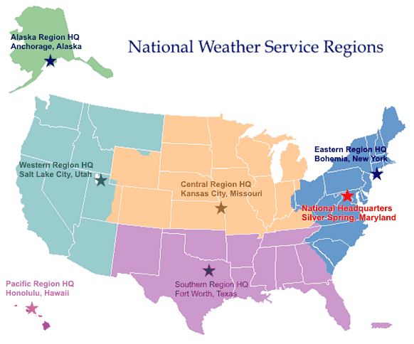
Partnerships and End Users
Partnered with NOAA / University community
  Access to real-time experimental
  data / products
  NASA instruments data and
  model products
  Collaborations with NOAA CIs
  for GOES-R proxy products
End users
  Regular interactions with 20 WFOs
  National Centers and “testbeds”
  Private sector users
Data / transition / dissemination
  Suite of over 30 satellite derived products, analyses, forecast products
  Public ftp, Local Data Manager (LDM), http server
  AWIPS, NAWIPS, AWIPS2, Google Earth
Collaborating WFO
Partner Regional HQ
Real-Time Data Source
Collaboration National Center

Slide 4
GOES-R Products
Pseudo Geostationary Lightning Mapper P-GLM Products
  Flash extent density and maximum density products derived from ground-based LMA data (4 networks), AWIPS and AWIPS II
  Similar to AWG optical proxy GLM product (not yet available)
GOES-MODIS Hybrid Product
  Replicates spatial resolution of selected ABI channels
  Derived from MODIS imagery combined with GOES-East 15 minute imagery for animation, AWIPS
  8 WFOs participating in comprehensive evaluation
Convective Initiation Product – obtained from AWG
  Reformat and disseminate to SPC/HWT/ Spring Experiment
  AWIPS and AWIPS II
ABI Quantitative Precipitation Estimate (QPE) Proxy Product
  OCONUS applications
  Available late Fall 2011 from Bob Kuligowski (NESDIS)

Slide 5
GOES-R Products Future Products
Red-Green-Blue (RGB) channel composites simulating ABI capabilities – more information than a single channel
  Collaboration with CIRA and CIMSS for product development
  Generated from MODIS, SEVIRI, GOES Sounder, simulated ABI radiance data
  SPoRT disseminates RGB products to NHC, SPC, HPC, OPC, others
  Focus on specific products and forecast problems
High-resolution SST Composite
  2-4x daily AMSR-E and MODIS derived SSTs combined contiguous field
  No planned proxy AWG product for ABI
  AWIPS, GRiB for model ingest, WFOs, SPoRT WRF for SPC/HWT Spring Experiment LFA
Lightning Forecast Algorithm (LFA)
  Total lightning forecast product
  Based on forecast model microphysics
  Aids in GOES-R GLM lightning data assimilation

Slide 6
Ongoing Demonstration Activities
GOES-MODIS Hybrid to WFOs - assessments
RGB products to National Centers for their Proving Ground activities – NHC, OPC, HPC, AWC
HWT/SPC /Proving Ground Spring Experiment participation
Training – variety training for end users, many in NWS Learning Management System
ABI QPE proxy product to Alaska and Pacific Regions – beginning 2012
Transition products to AWIPS II with custom plug-ins for SPoRT products

Slide 7
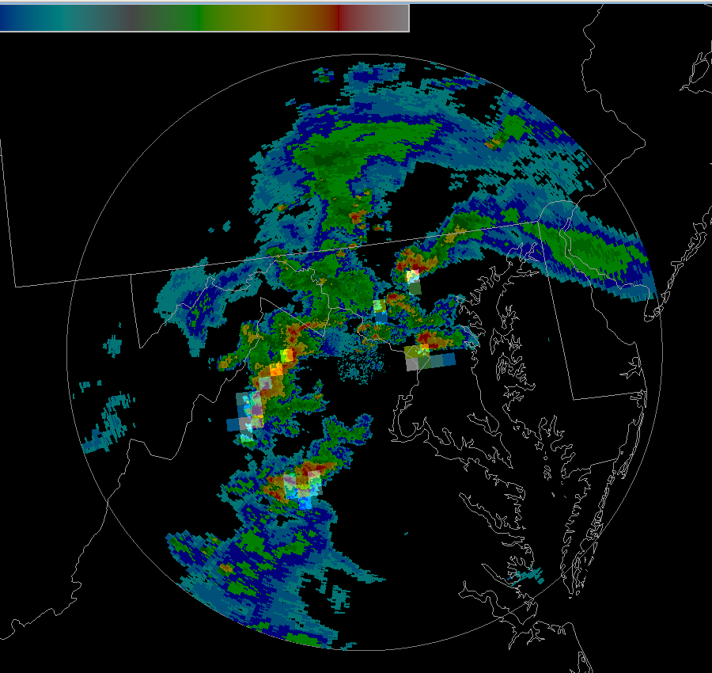
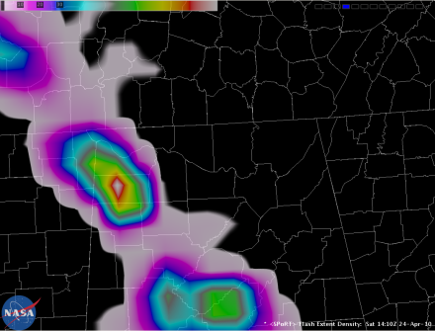
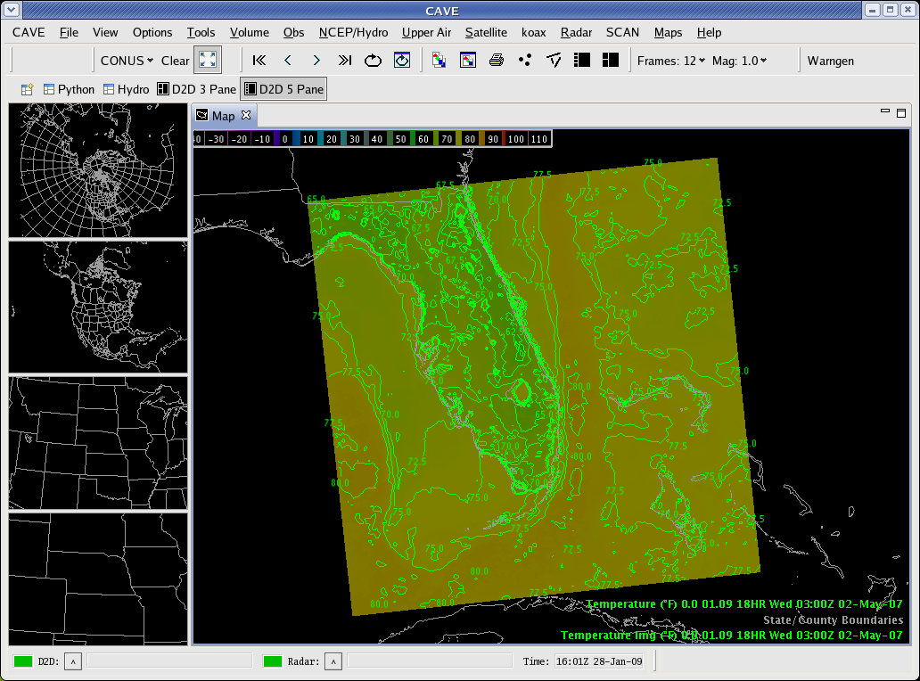
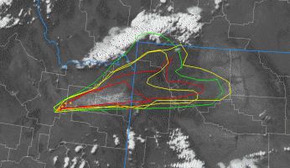
Integration of SPoRT Data into AWIPS2
Make all SPoRT products available with operational release of AWIPS2
Custom plug-ins to display data
Example datasets
  Total lightning products
  Models products and analyses (WRF, LIS, LFA, ADAS)
  SPoRT satellite imagery such as hybrid, SST composites, RGB products, etc.
  Proving ground products – PGLM, suite of proxy products

Slide 8
Example Slides for Backup

Slide 9
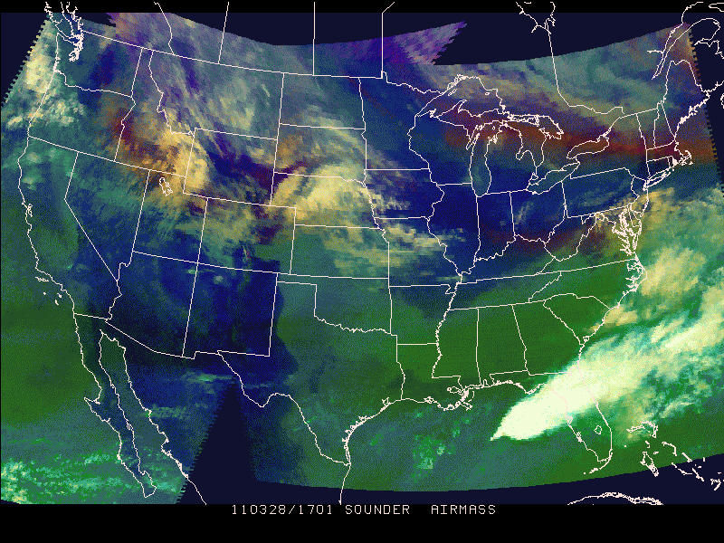
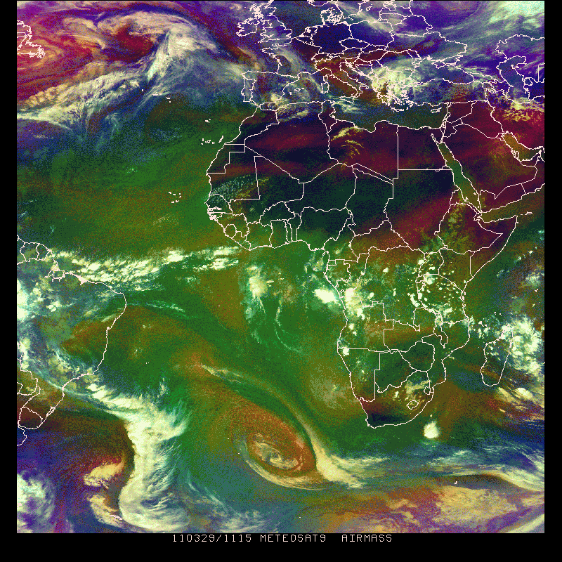
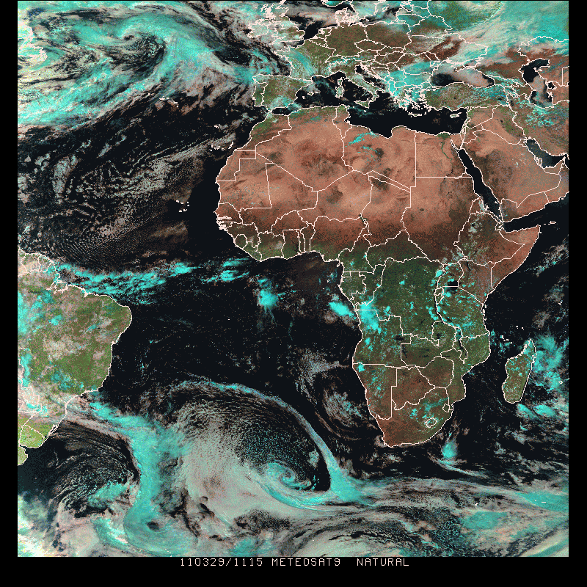
Multispectral Data as “RGB” Imagery
Products shown in 95-color NAWIPS
Suite of multispectral channel composites to enhance identify features not readily apparent in single channel imagery
based upon EUMETSAT guidelines for consistency with SEVIRI data
provided to partners in AWIPS and NAWIPS systems
collaborate with CIRA to demonstrate RGB products over CONUS using the GOES Sounder
product available for use in NAWIPS at NHC for Joint Hurricane Testbed activities
GOES Sounder “Air Mass” RGB from CIRA
SEVIRI Air Mass
SEVIRI Natural Color

Slide 10
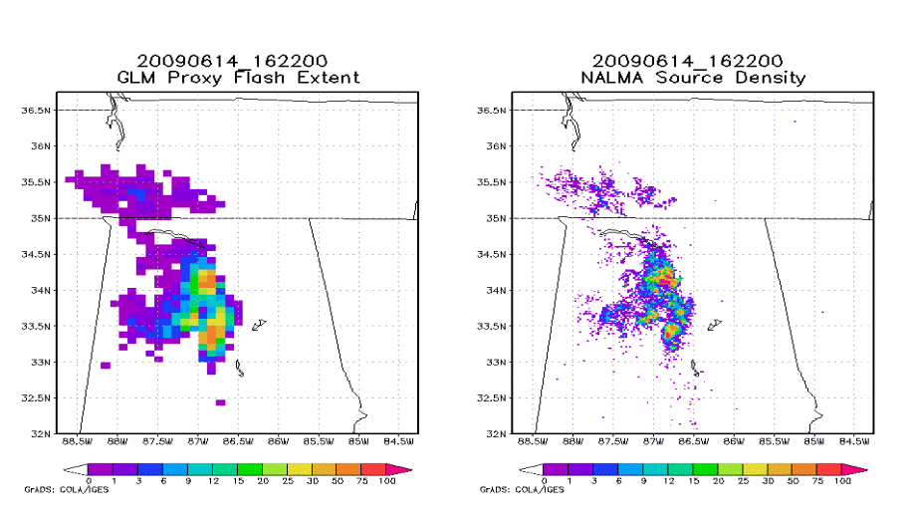
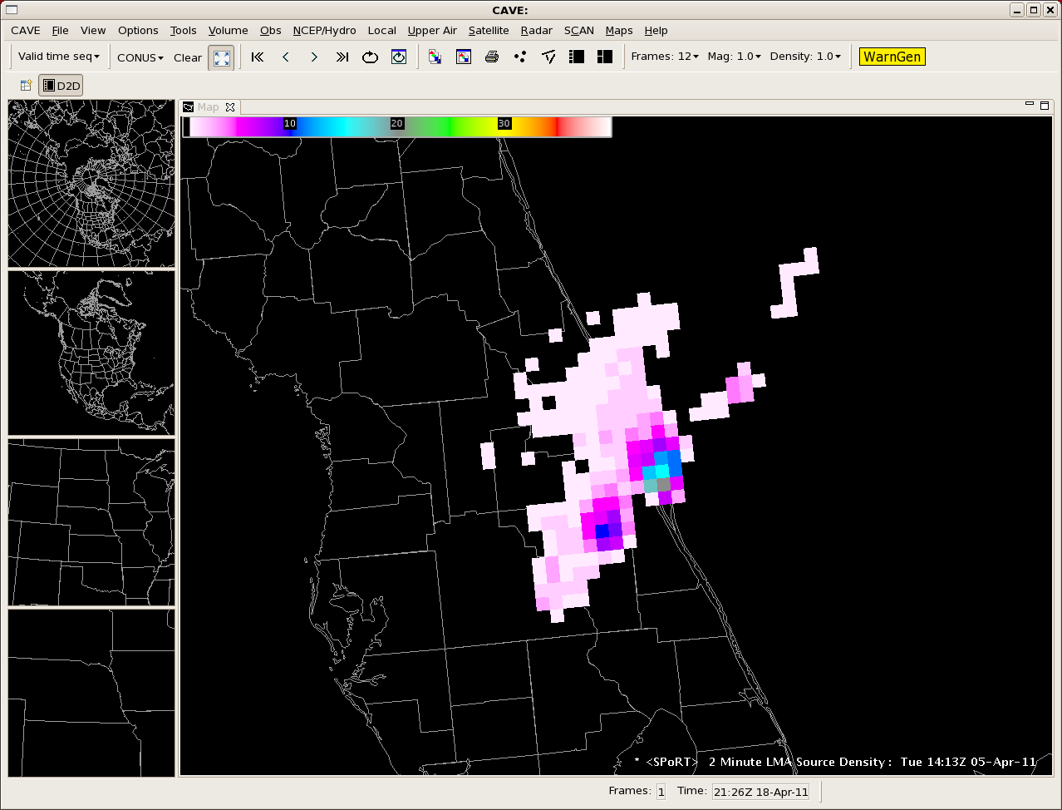
Spring Experiment: Pseudo-GLM
Pseudo GLM
Flash Extent
LMA Source Densities
SPoRT providing the Pseudo Geostationary Lightning Mapper
  Mimics future GOES-R GLM
  8-km resolution
  Flash extent density product
  produced from 4 LMAs
Provided to the Spring Program
  Emphasis on total lightning uses
    situational awareness and lightning safety
    improved warnings
  Educate forecasters on GLM
  Receive forecaster feedback on
  best visualization approaches
Pseudo GLM for the Kennedy Space Center LDAR

Slide 11
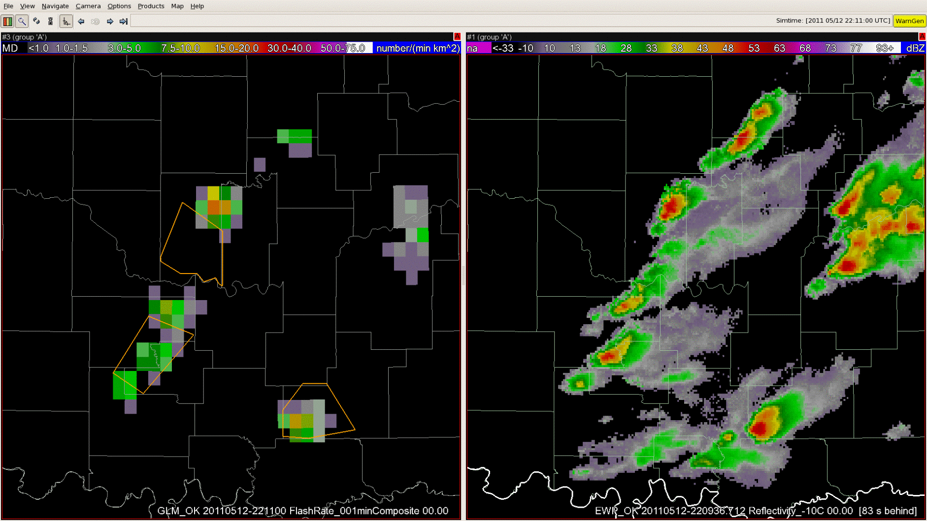
Lightning Jump Associated with Developing Severe Storm
Pseudo GLM
Radar Reflectivity

Slide 12
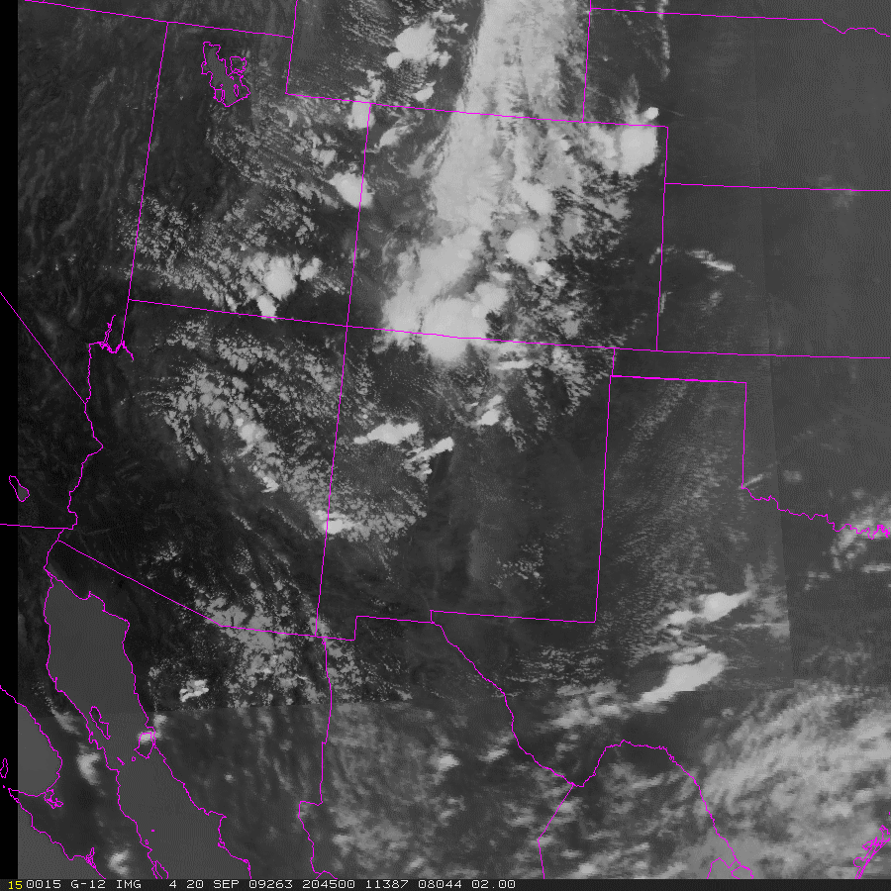
GOES-MODIS Hybrid
Product to simulate or serve as “proxy” for GOES- R ABI
ABI will have advanced imaging capabilities
16 multispectral channels similar to MODIS
Spatial and temporal resolution improvements over GOES Imager
While MODIS can be used to replicate spatial and spectral resolution of ABI, the polar orbit limits its temporal resolution
Combine MODIS and GOES to simulate GOES-R ABI capabilities

Slide 13
Hybrid Imagery Feedback Results 4/14 to 5/16
(8 day break due to loss of power from tornadic events)
30 total survey/ evals, 4 blog posts
  from 7 WFOs and SMG
2/3 of users providing feedback have high experience/knowledge regarding satellite imagery in operations.
IR, SW, WV, and Vis. imagery included in at least 10 assessments each (multiple products can be included in single assessment)
21 said the imagery had some to large impact, while 9 indicated little impact
  generally a normal distribution with most in the “some” category
  “expert” users mostly indicated some to little impact in cases examined with occasional high impact,
  less experienced users had ~equal amount of high and low impact cases
26 indicated that they recommended the product to other forecasters
21 indicated that they zoomed into features vs. using a large-scale view
  look at mesoscale features vs synoptic

Slide 14
User Feedback – Hybrid Impact

Slide 15
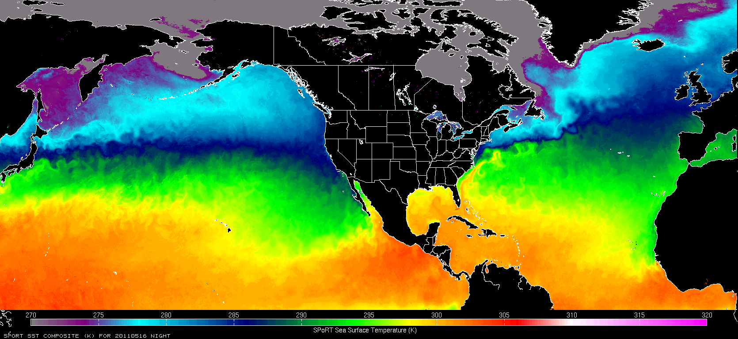
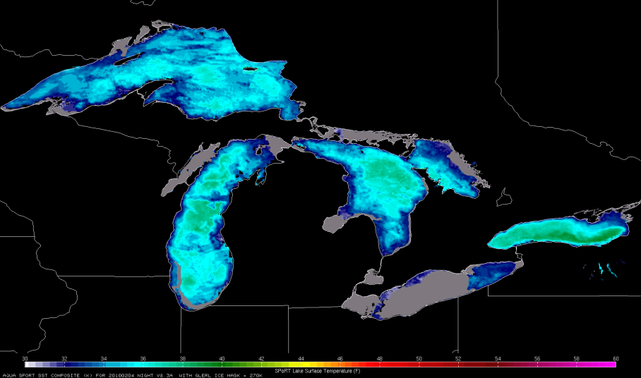
MODIS - AMSR-E Composite SST – ABI SST “Proxy”
NOAA/GLERL Ice Mask
Composite SST product from multi-day composite of MODIS and AMSR-E
1-2 km resolution, 2-4x a day based on Terra/Aqua
Great Lakes product includes GLERL ice mask
Available in AWIPS, NAWIPS, KML, GRIB

Slide 16
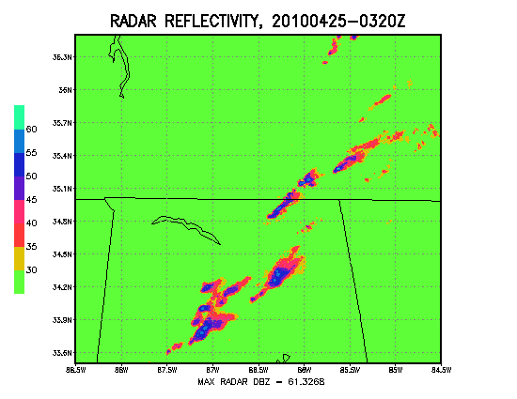
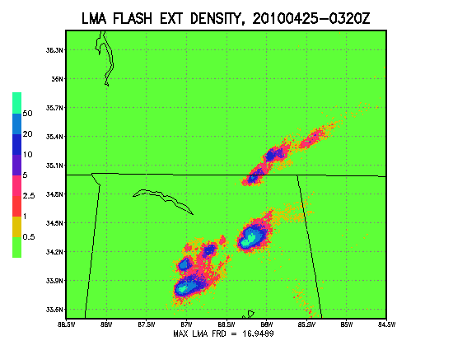
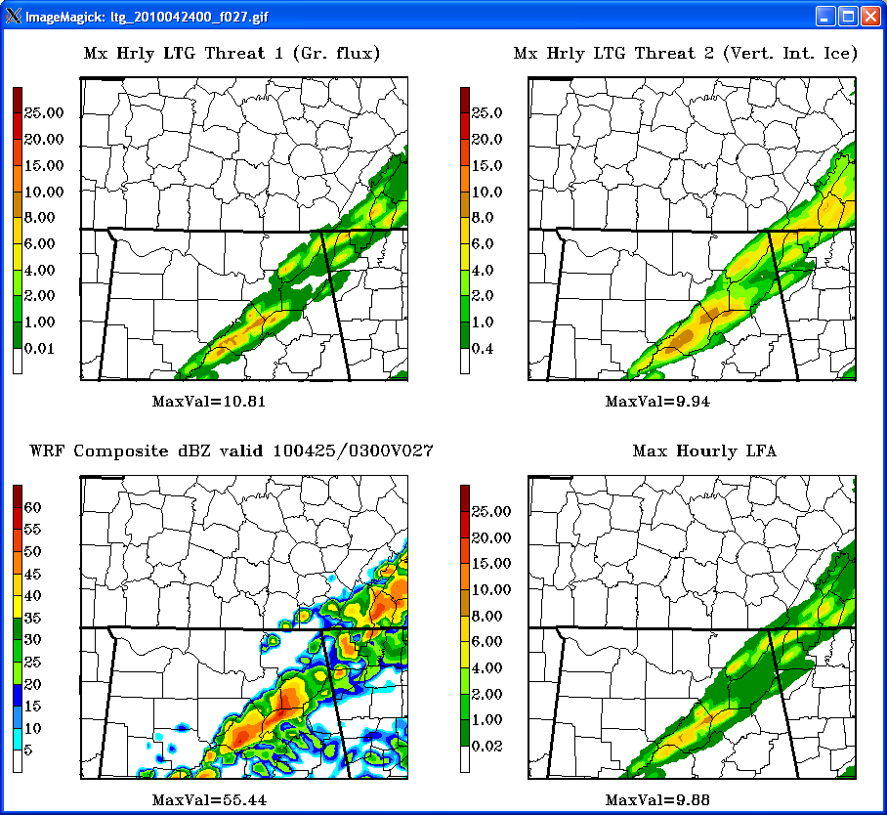
Spring Experiment Products:
Lightning Flash Algorithm (LFA)
LFA is forecast total lightning product
WRF model microphysics proxies
  Upward graupel flux at -15°C
  Vertically integrated ice
  Blend of these two fields
Aids in future GOES-R data
assimilation techniques
Incorporated in numerous models
4-km NSSL WRF runs
4-km SPoRT WRF runs
Storm Scale Ensemble
Forecast System (~40 members)
MaxVal=61.33
MaxVal=16.95

Slide 17
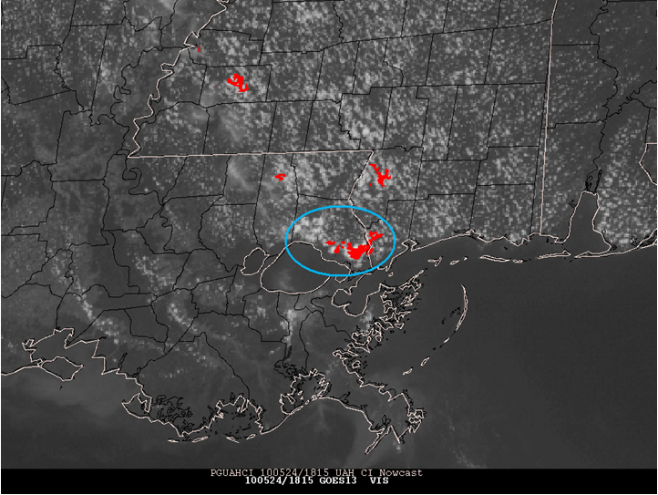
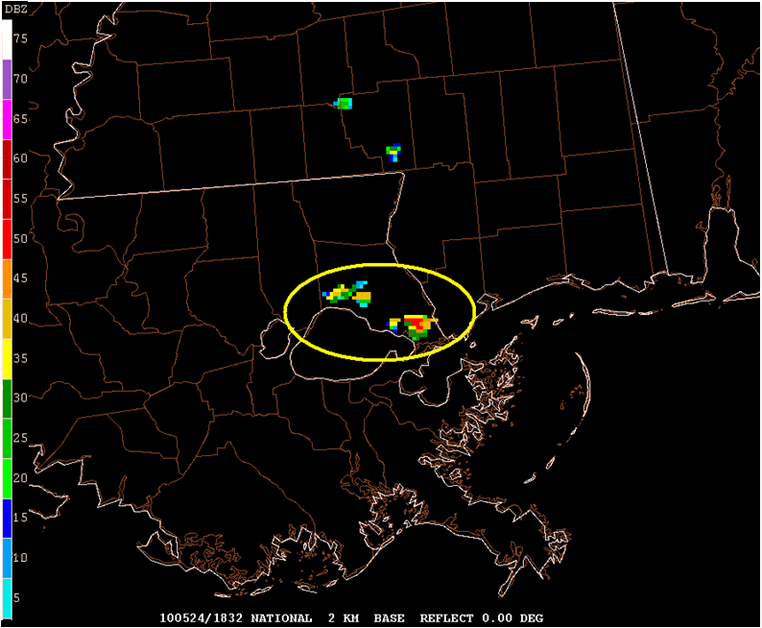
Spring Experiment: UAH CI Product
SATellite Convection AnalysiS and Tracking (SATCAST) – Dr. John Mecikalski, John Walker
Depicts clouds likely to initiate
convection within 2 hours
    Identifies potential convective-
    form clouds as “objects”
    Tracks select cloud objects
    between consecutive images
    Applies 6 spectral/time
    differencing tests on objects
Provides extended lead-time on CI
SPoRT disseminates AWG product and assists in training

