Slide 2
Atmospheric Electricity and Lightning Research at UAH
Large Group (>25) includes scientists, engineers and students. Capabilities include:
Instrument development –
Ground, airborne and space
Data analysis
Modeling
Theory
The only group with expertise ranging from fundamental lightning physics to space-based monitoring to meteorological applications.
a unique combination of physicists, meteorologists and engineers with years of experience is necessary for accomplishing our mission

Slide 3
Key Research Areas and Accomplishments
Space-based lightning observations
Developed the OTD/LIS: continuous operations since 1995. Expected to operate through 2014
GLM: instrument design and development (with Lockheed Martin); algorithms, risk reduction, verification and training
Unique verification capabilities: HAMMA and airborne simulator
Thunderstorm Electrification
Investigate how storms electrify, determine how lightning measurements can be used for monitoring storm development, etc.
Extensive use of ground observation capabilities:
LMA, multiple parameter, Doppler radars, ground electric field network (new)
Launch Safety
Serve on the NASA/Air Force Lightning Advisory Panel (revise LCC)
Developed the ground-based field mill network and conducted two Air-Borne Filed Mill (ABFM) programs
Developing an ABFM capability for the Japanese space program

Slide 4
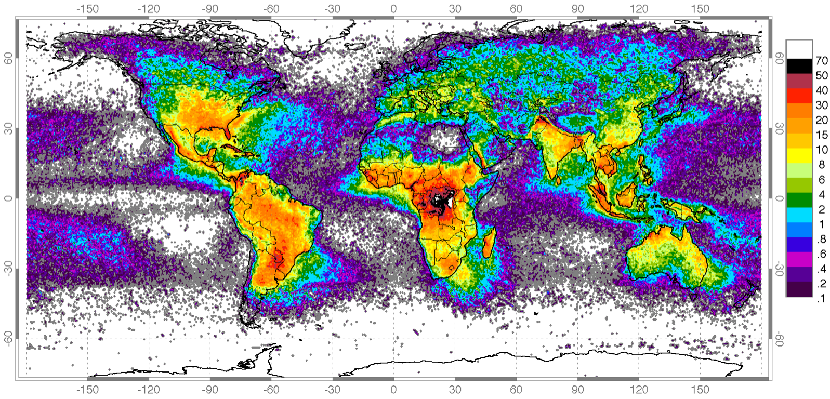
High Resolution Full Climatology Annual Flash Rate
Global distribution of lightning from a combined nine years of observations of the NASA OTD (4/95-3/00) and LIS (1/98-12/04) instruments

Slide 5
HAMMA Detections and Locations vs. LIS

Slide 6
Newer Initiatives
Lightning Physics
Lightning initiation and propagation
Remote measurements of thunderstorm electric fields
High-speed lightning spectroscopy
One microsecond lightning spectroscopy enabling the development of the first ever time resolved gas dynamic model of a lightning channel
Ice charging study
LIS-light as part of a proposed CHASER mission (UAH build)
Terrestrial Gamma Ray Burst investigation
High altitude airplane program to simultaneously measure gamma ray bursts and electric filed structure
Fly's Eye GLM Simulator (FEGS)
An optical sensor to be flown on NASA’s ER-2 or Global Hawk
Designed to simulate GLM observations of lightning from above cloud tops

