Slide 1
MC3E Daily Weather Briefing
April 13, 2011

Slide 2
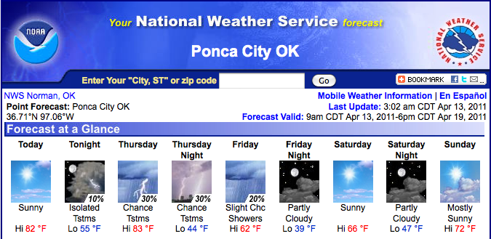
Overview
Day 0: Hot and Sunny
Day 1: Afternoon t’storms, mainly east?
Day 2: Possible morning precip/clouds
Day 3-6: Nice this weekend, possible event beginning next Monday

Slide 3
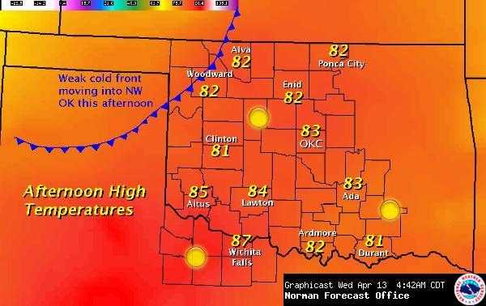
Day 0

Slide 4
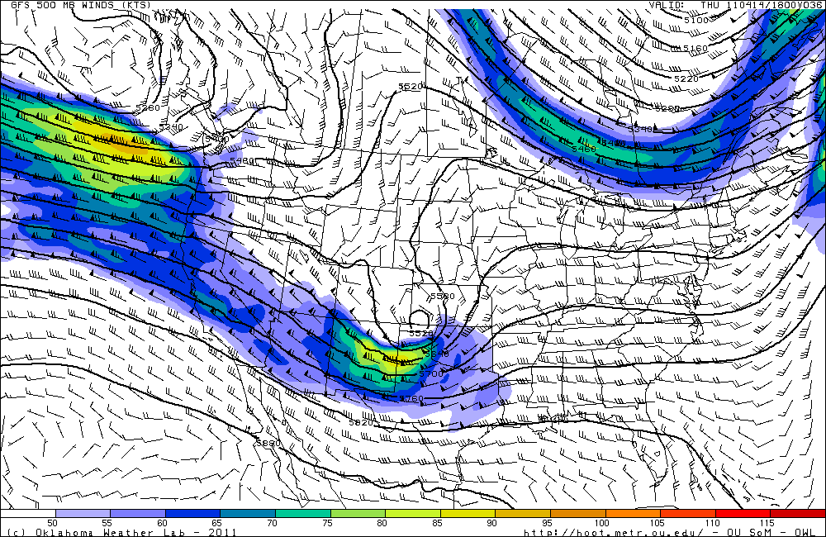
Day 1
4/14 1800 UTC GFS

Slide 5
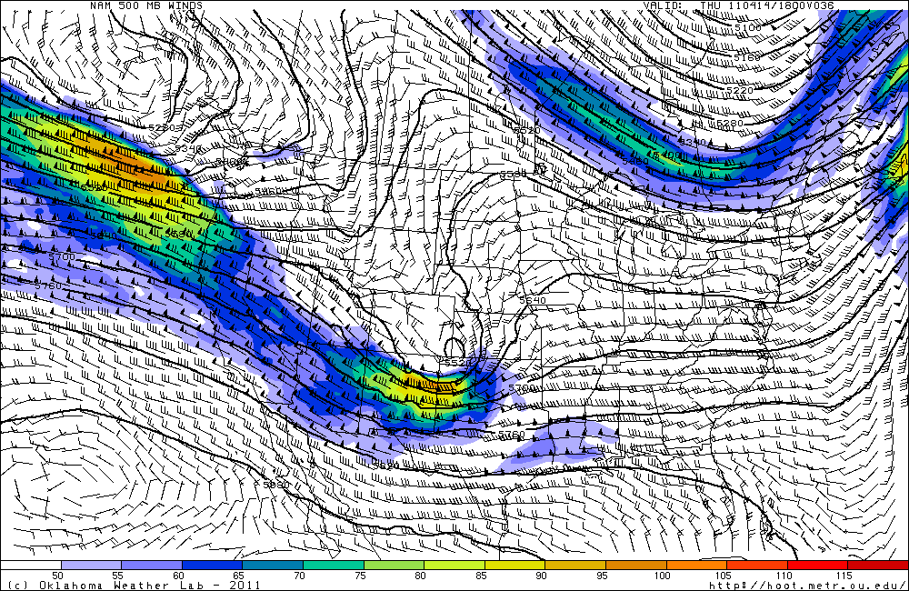
Day 1
4/14 1800 UTC NAM

Slide 6
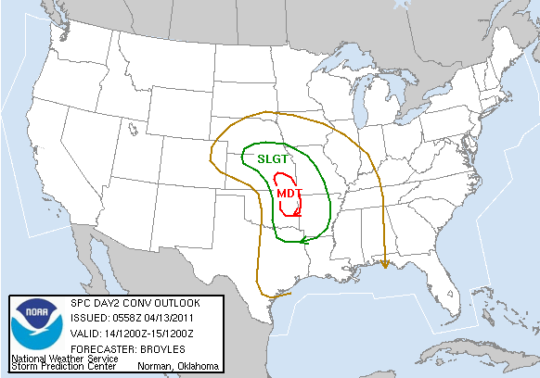
Day 1
“THE STORMS SHOULD INITIATE JUST TO THE EAST OF A DRYLINE ORIENTED NORTH TO SOUTH ALONG THE I-35 CORRIDOR. “

Slide 7
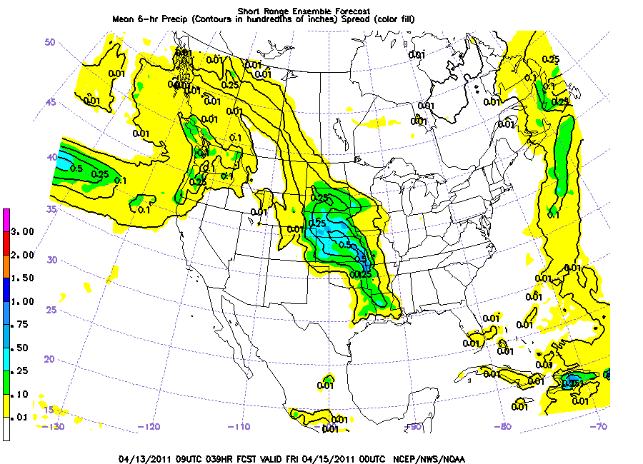
Day 1
4/15 (Thursday) 0000 UTC

Slide 8
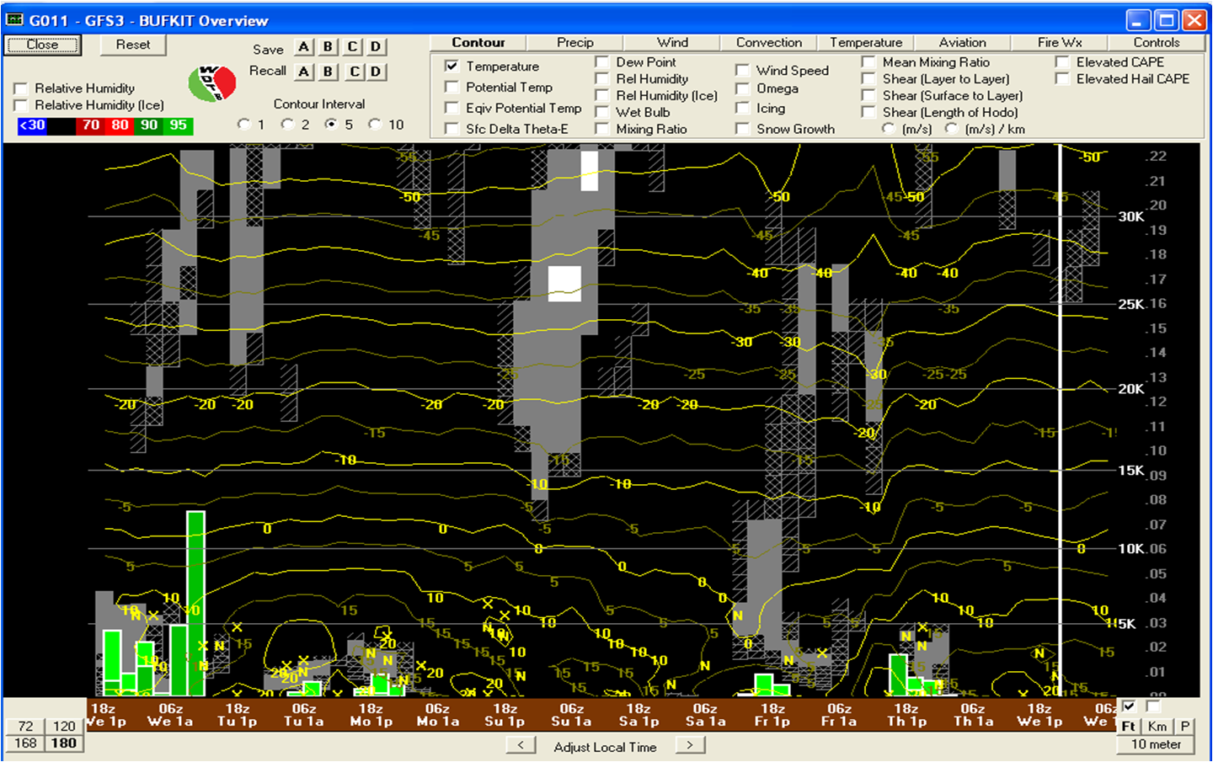
Day 1

Slide 9
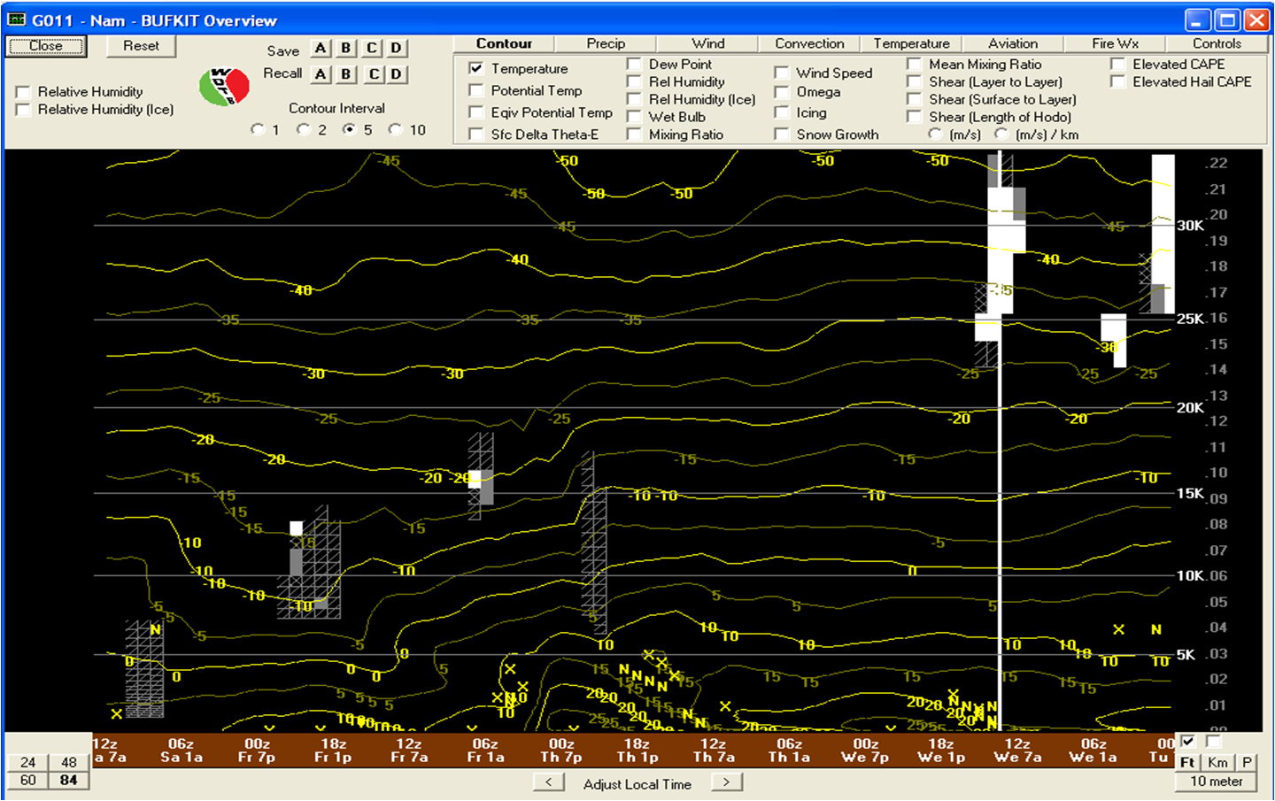
Day 1

Slide 10
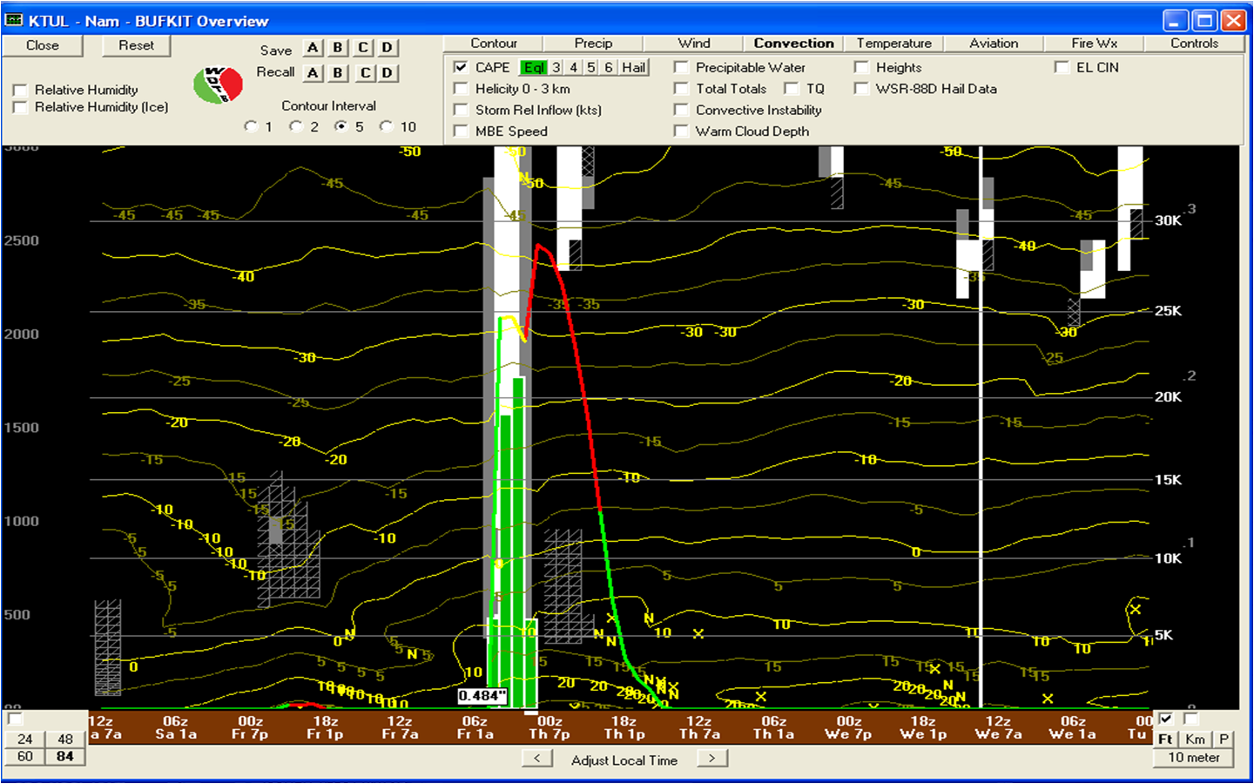
Day 1

Slide 11
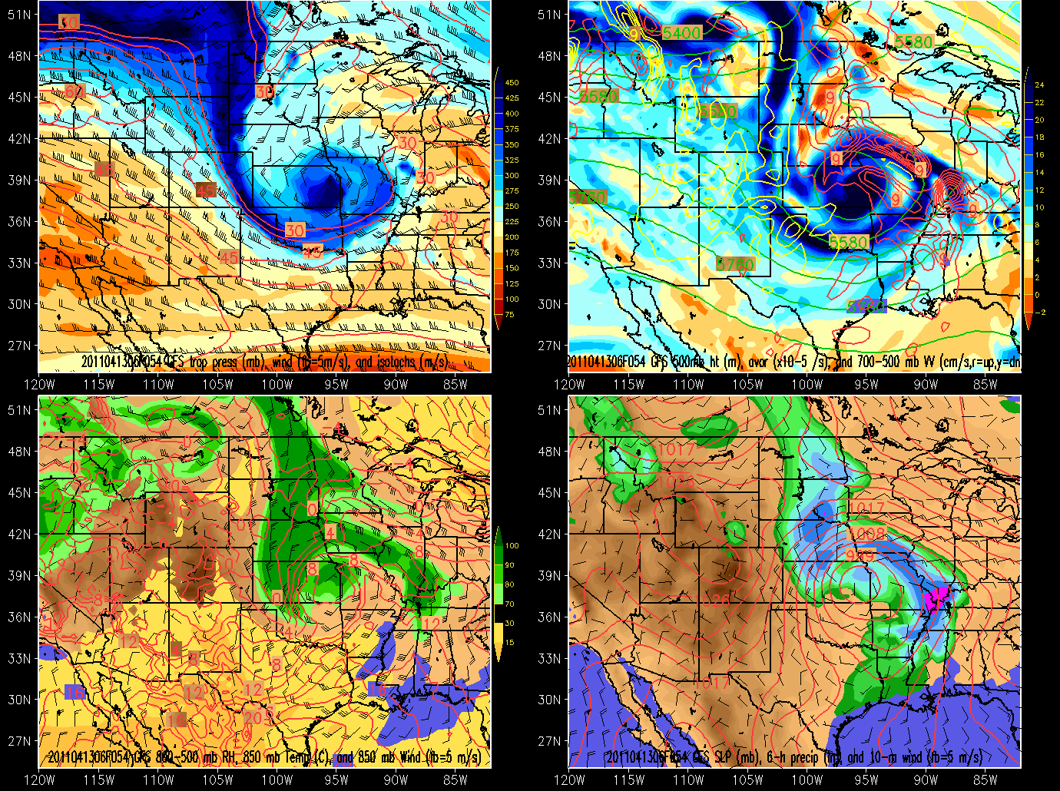
Day 2
GFS valid 1200 UTC Friday

Slide 12
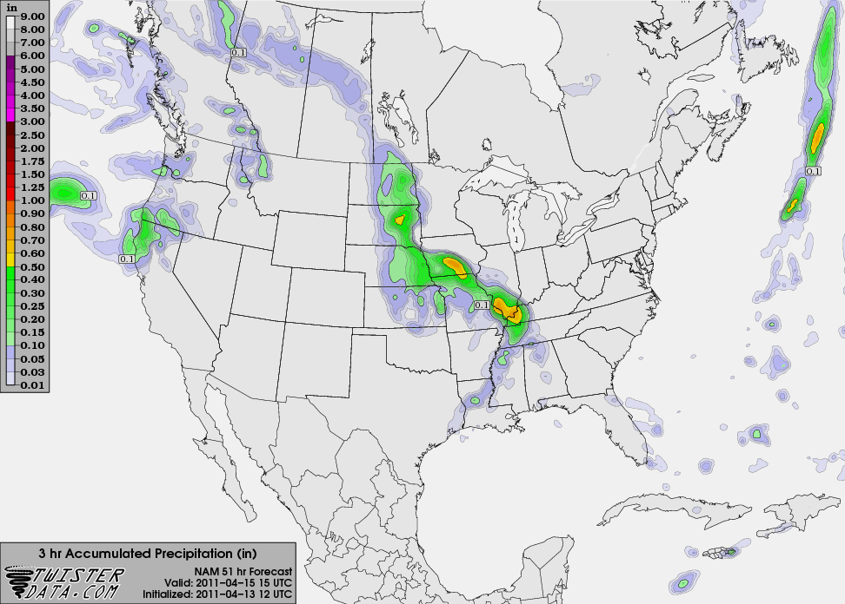
Day 2
NAM 3 hr precip 12-15 UTC Friday

Slide 13
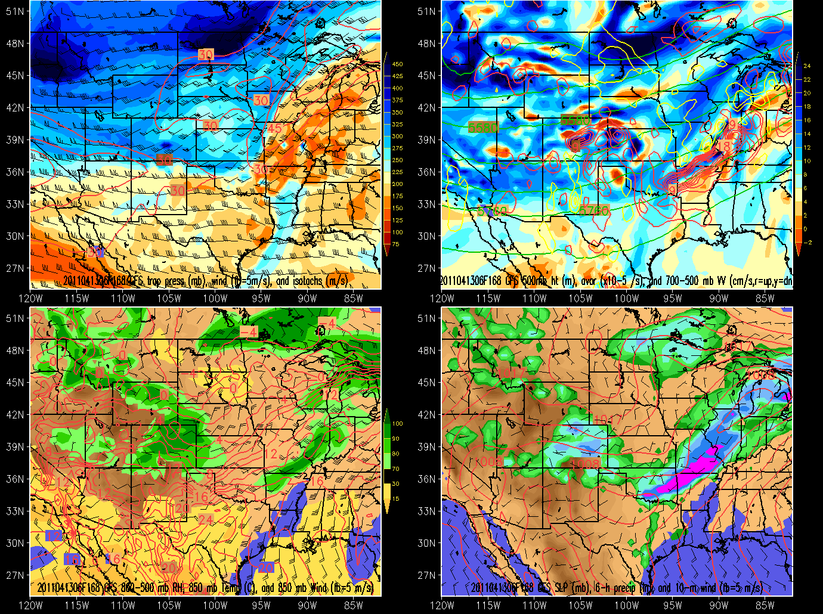
Day 3-6
GFS 0000 UTC next Wednesday

Slide 14
Summary
Convective precipitation Thursday afternoon-evening
Initiation midday, but organized precipitation farther to the east
Light stratiform precipitation Friday morning
Nothing this weekend
Keep an eye on early next week

