Slide 1
The National Hurricane Center GOES-R Proving Ground
Mark DeMaria
NOAA/NESDIS, Fort Collins, CO
GLM Science Meeting, Huntsville, AL
Sept 19-20, 2011

Slide 2
Outline
Overview of NHC Proving Ground
Lightning and tropical cyclone rapid intensity change (RIC)
Experimental RIC forecast algorithm
Results from 2010 NHC GOES-R Proving Ground
Preliminary results from the 2011 Proving Ground

Slide 3
The NHC Proving Ground
Purpose
Provide NHC forecasters with an advance look at GOES-R tropical cyclone forecast products for evaluation and feedback
Proxy data
ABI from SEVIRI, Current GOES, MODIS
GLM from WWLLN and GLD360
2010 Activities
6 products tested Aug 1 to Nov 30
Final report available
Modifications suggested for 2011 proving ground
2011 Activities
9 products being tested Aug 1 to Nov 30
Mid-project meeting at NHC Sept 13th
Participants:
Users - NHC
Providers - NESDIS, CIRA, CIMSS, SPoRT, HRD/CIMAS

Slide 4
2011 NHC Proving Ground Products
Baseline
Hurricane Intensity Estimate (HIE) from CIMSS
Super Rapid Scan Imagery coordinated by CIRA and NHC
Future Applications (formerly known as Option 2)
Tropical Overshooting Top (TOT) Detection Algorithm from CIMSS (new in 2011)
Additional Future Applications from GOES-R Risk Reduction
Red-Green-Blue (RGB) Air Mass Product from CIRA/SPoRT
RGB Dust Product from CIRA/SPoRT
Saharan Air Layer (SAL) Product from CIMSS
GOES-R Natural Color Imagery from CIRA (new)
Pseudo Natural Color Imagery from CIMSS (new)
Lightning based Rapid Intensification Index (RII) from CIRA

Slide 5
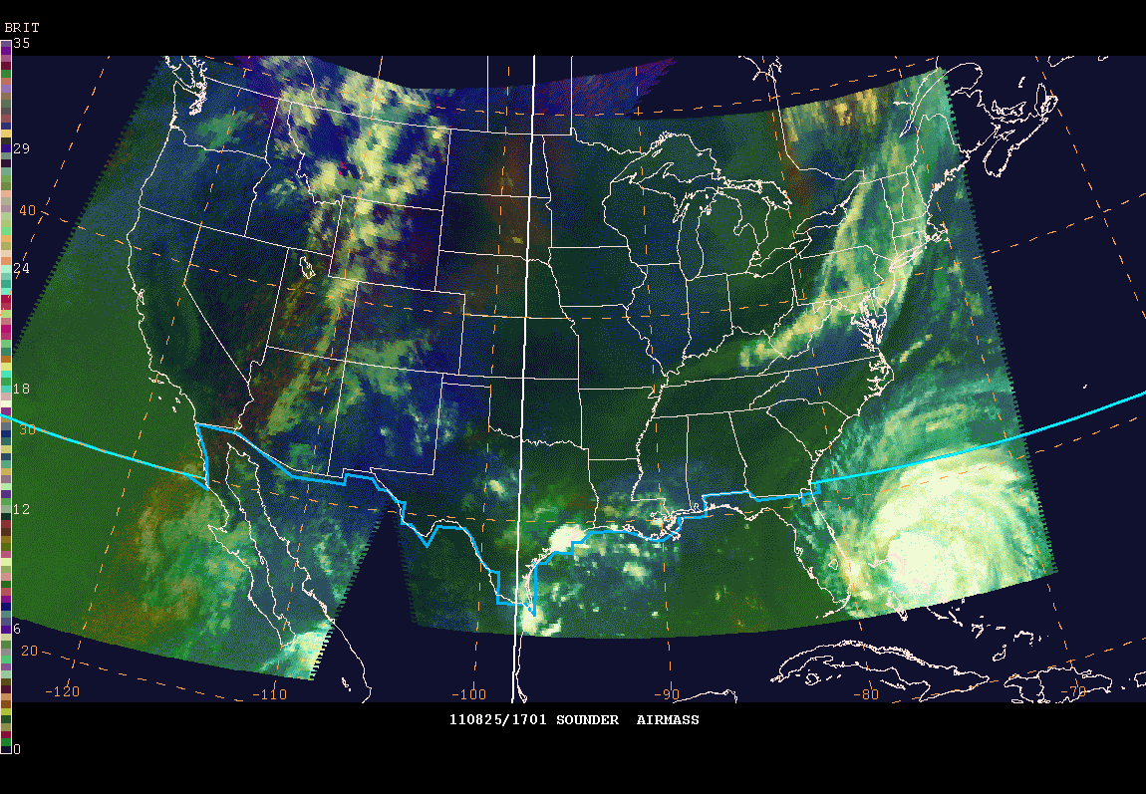
Sounder Air Mass Product for Irene

Slide 6
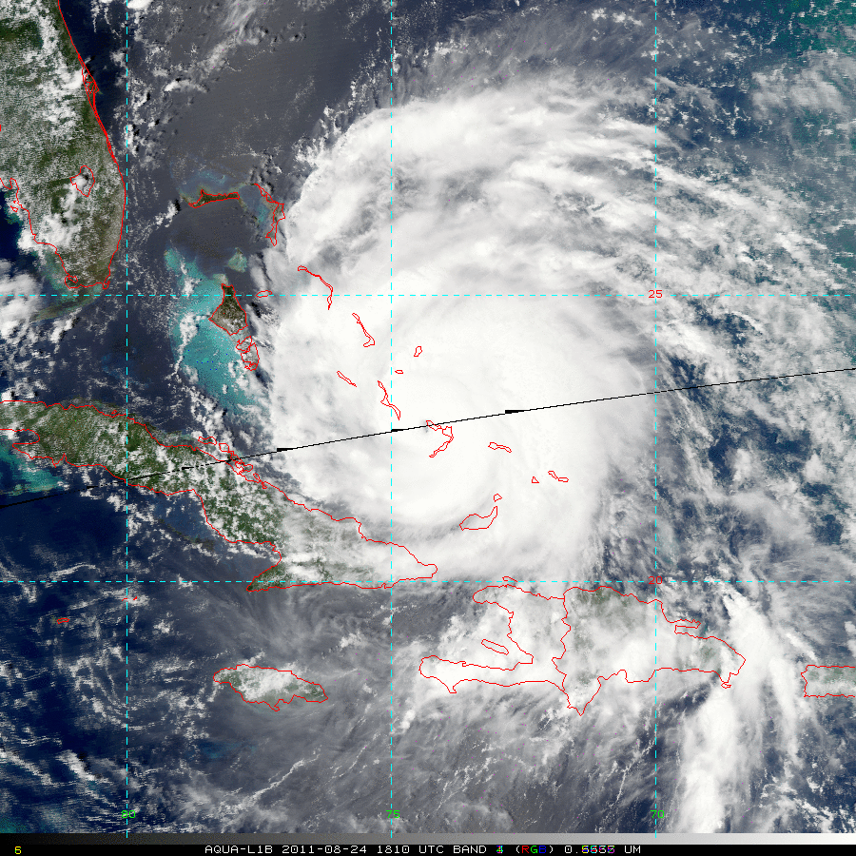
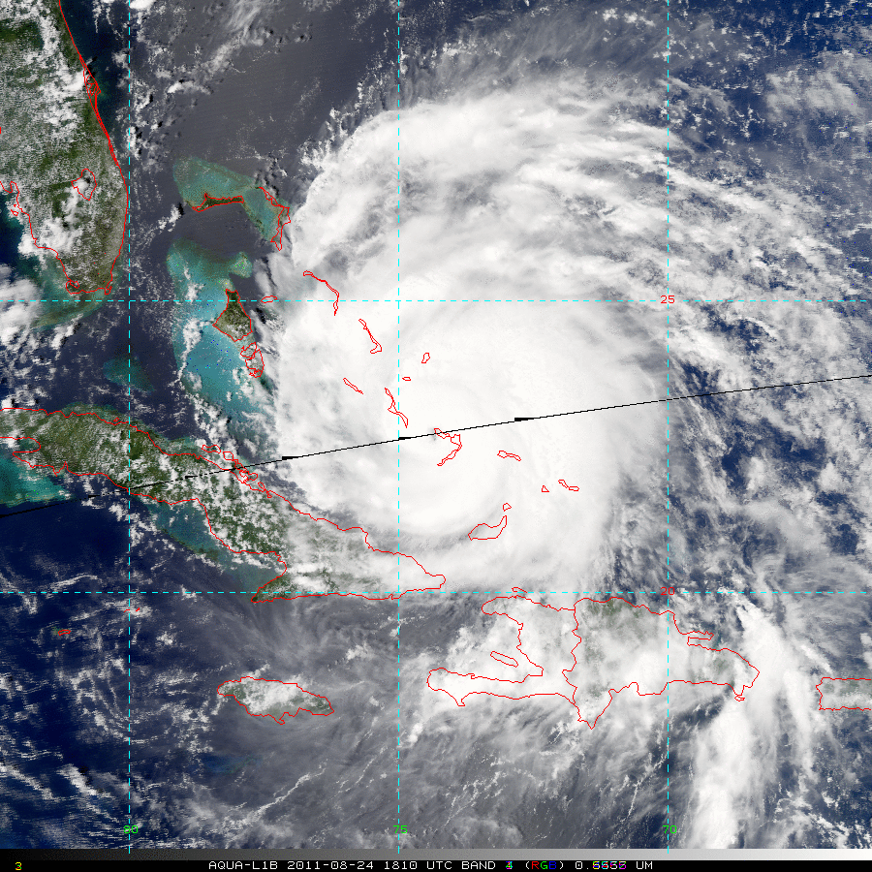
Natural Color Imagery from MODIS
Simulated Green Observed Green
Caption: GOES-R natural color (left) and true color (right) from MODIS. Storm was close to center of MODIS pass, so limb effects
Less obvious. Shows shallow water regions in western Bahamas.

Slide 7
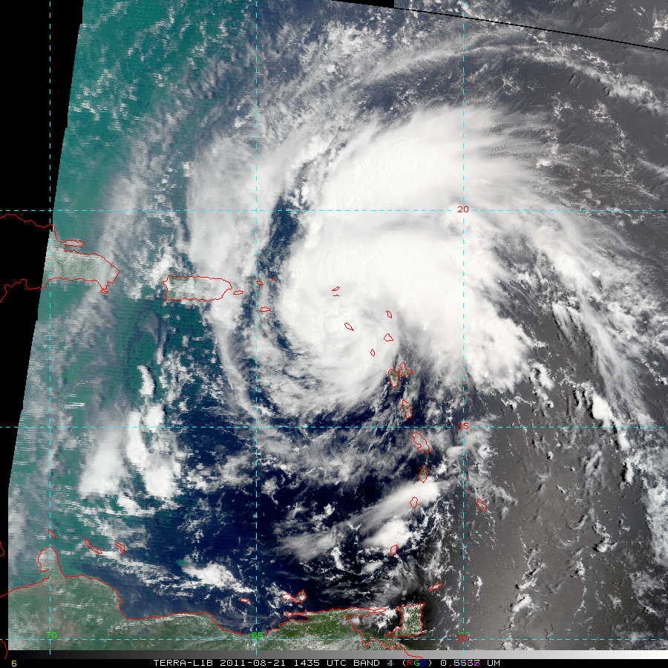
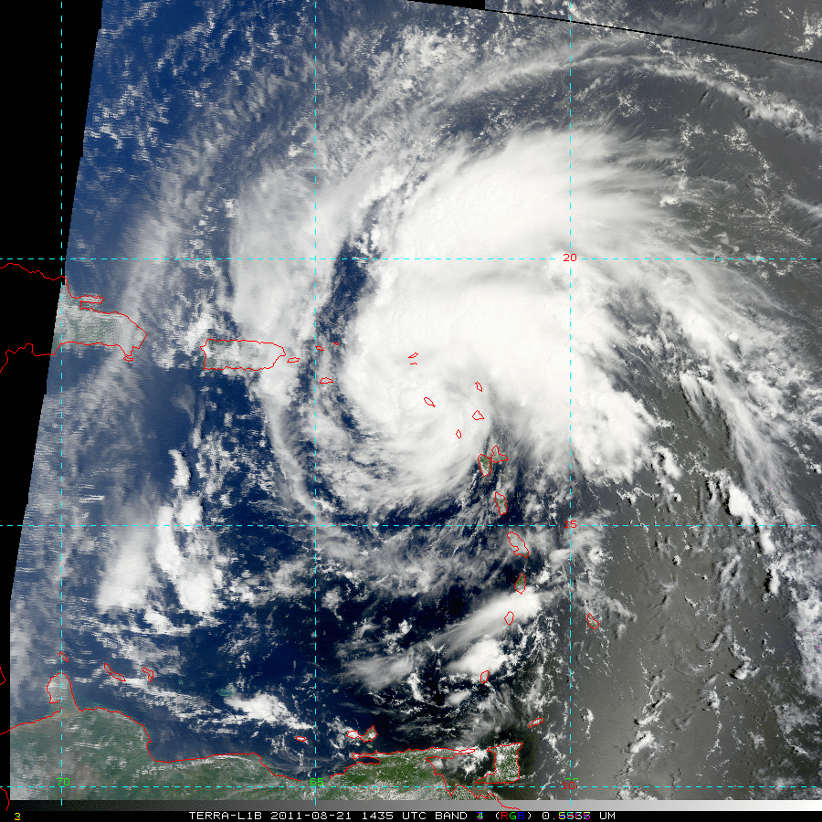
Natural Color Imagery from MODIS
Simulated Green Observed Green
Caption: GOES-R natural color (left) and true color (right) from MODIS. Limb effects evident on left side of image.
Algorithm correction developed by the imagery team

Slide 8
Forecasting Rapid Intensity Changes with Lightning Data
Use large sample of cases to develop statistical relationships with intensity change
Combine with SHIPS model database
SST, shear, etc
Full life cycle of Atlantic and east/central Pacific tropical cyclones 2005-2011
WWLLN data proxy for GLM
Annual basin wide correction for detection efficiency, conversion to total lightning
Normalize to OTD/LIS climatology

Slide 9
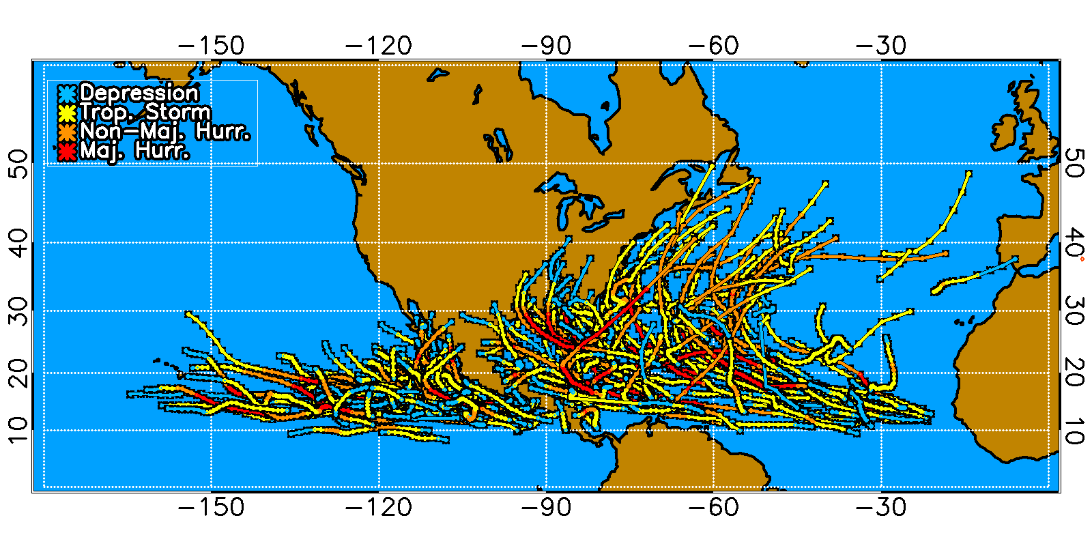
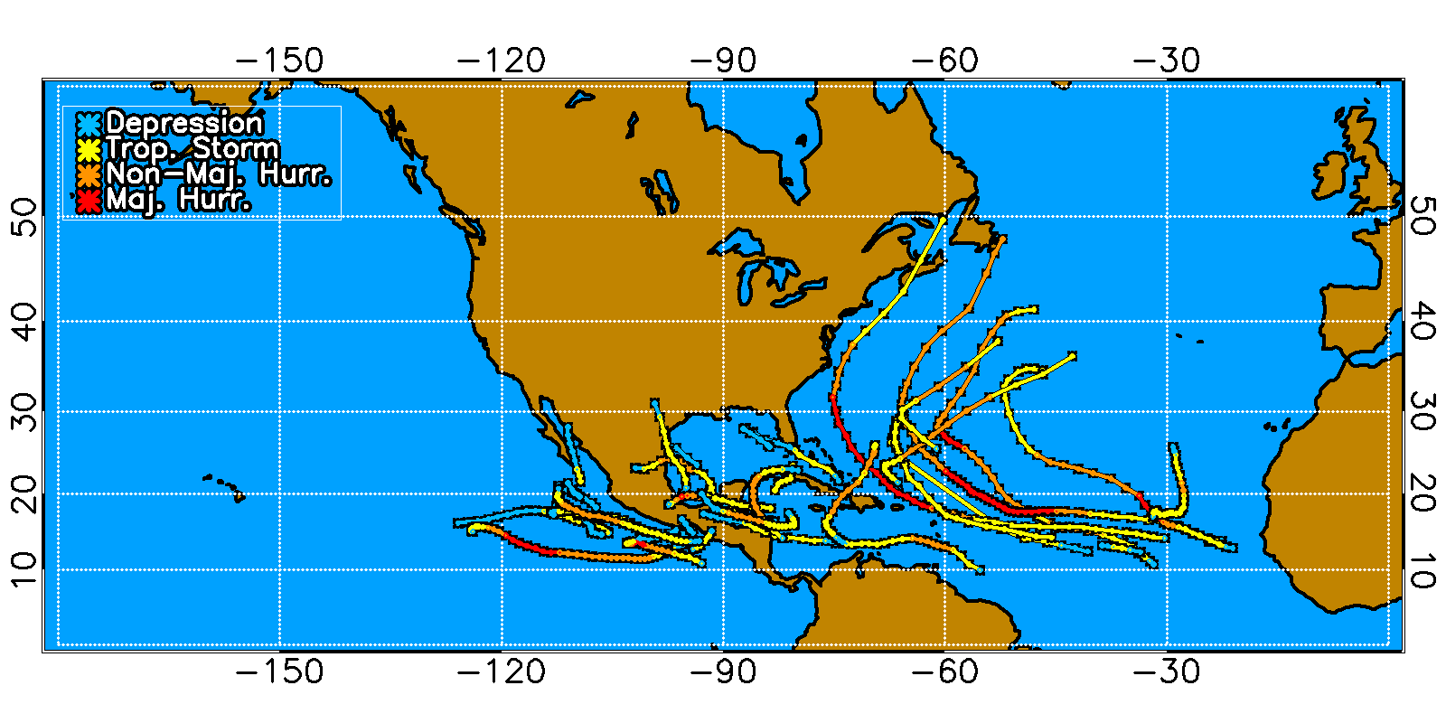
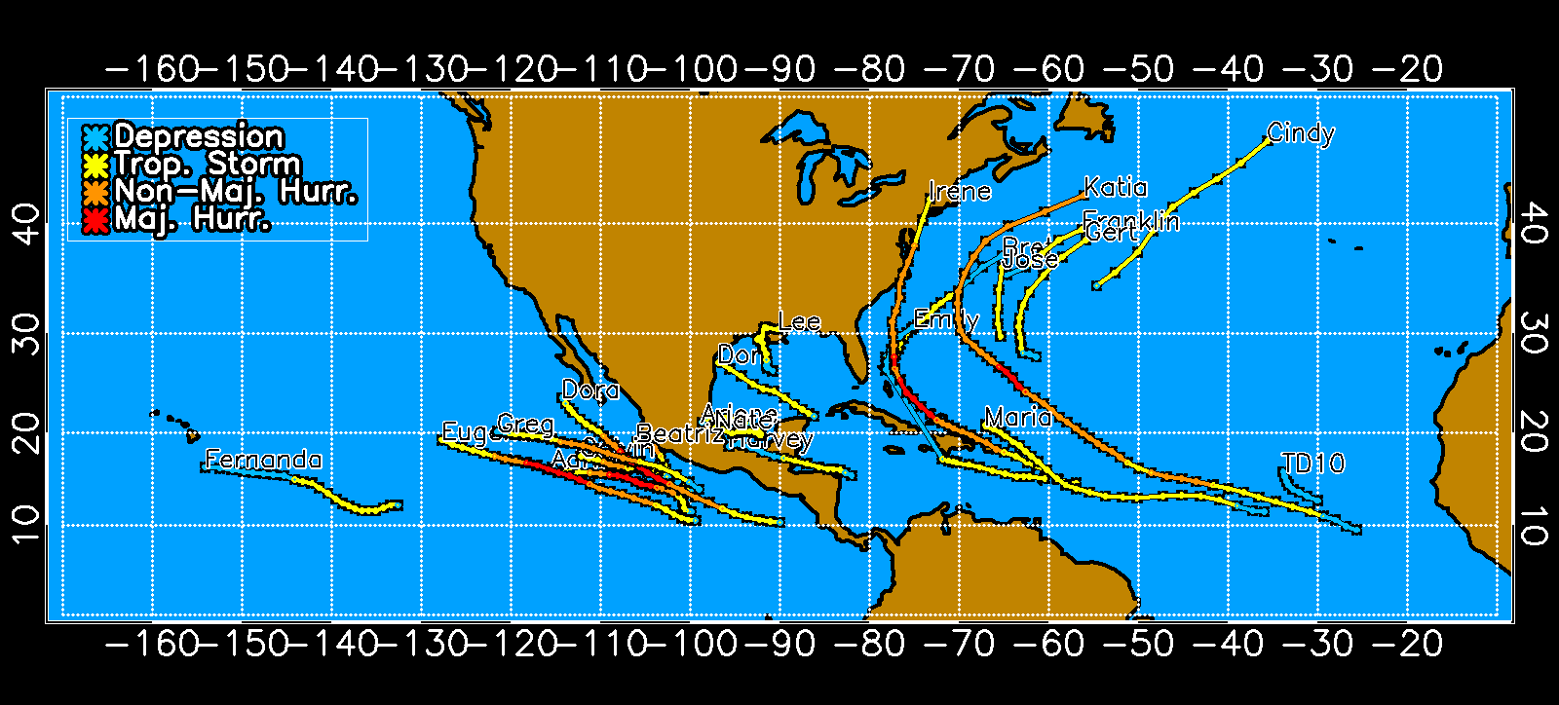
Tropical Cyclone Sample
2005-2009
2011 through
Sept 12
2010
2005-2010 sample = 2542 cases from 172 tropical cyclones

Slide 10
Lightning Analysis
Transform strike locations to storm-centered cylindrical grid
Composite data over 6 hour intervals
Compute lightning density in radial intervals
0-50, 50-100, 100-200 km, …
Adjust density using annual conversion factors
Hurricane Ike 2008

Slide 11
Lightning Density Normalization
Calculate annual average lightning density from WWLLN
Atlantic domain: 0-40ºN, 100 to 10ºW
East Pacific domain: 0-40ºN, 180 to 100ºW
Compare with 1998-2005 OTD/LIS climatology
Apply adjustment factor to WWLNN to make the values equal to OTD/LIS
Inverse of adjustment factor is estimate of WWLLN detection efficiency for total lighting

Slide 12
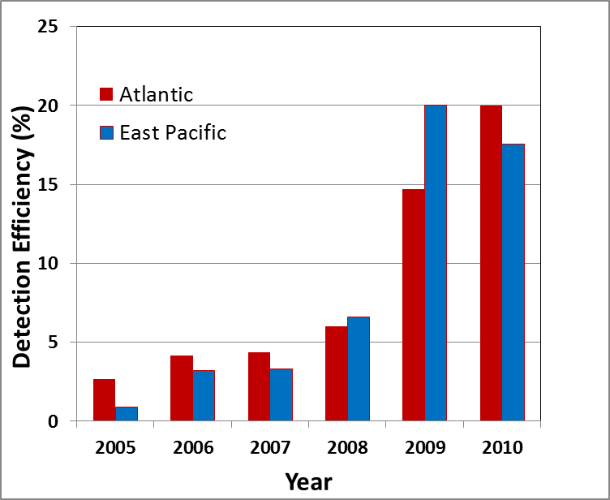
Detection Efficiency

Slide 13
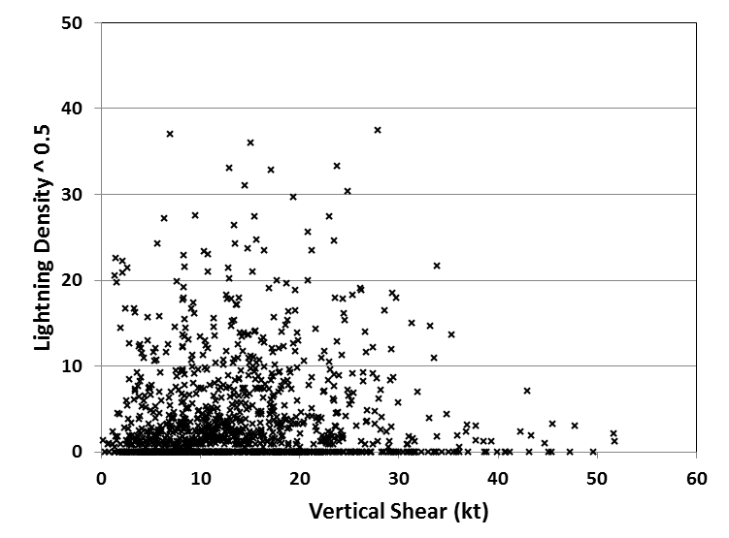
2005-2010 Atlantic Normalized Lightning Density Time Series

Slide 14
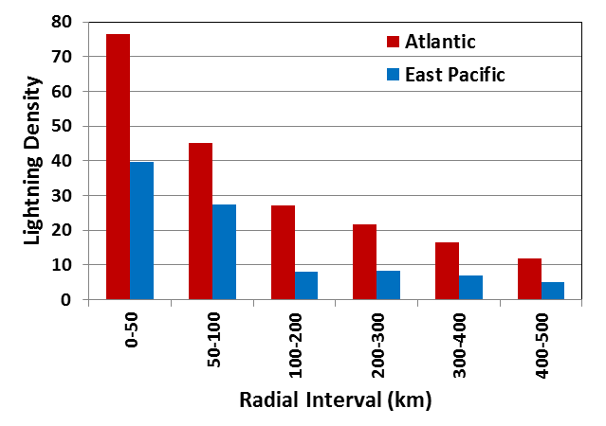
Radial Structure
Eye wall 0-50 km
Inner Core 0-100 km
Rain band 200-300 km

Slide 15
Rapid Intensity Change
Rapid Intensification (RI)
Increase in maximum wind of 30 kt or more in 24 hr
~95th percentile of Atlantic sample
Rapid Weakening (RW)
Decrease of maximum wind of 20 kt or more in 24hr
~5th percentile of Atlantic sample (over water)
Stratify lightning density by intensity change, RW and RI

Slide 16
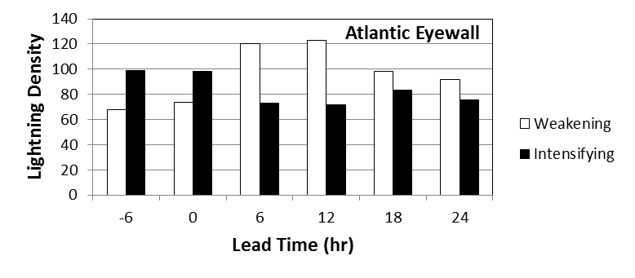
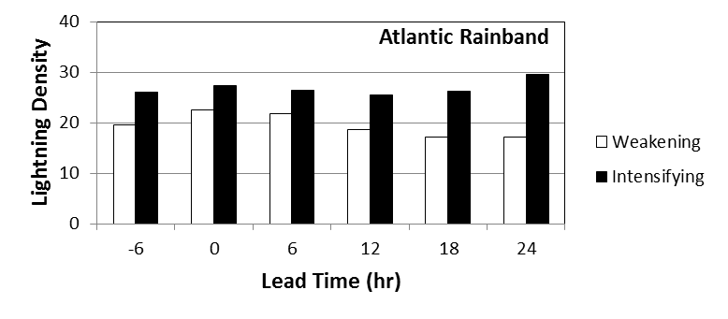
Stratification by Intensity Change at Various Time Lags

Slide 17
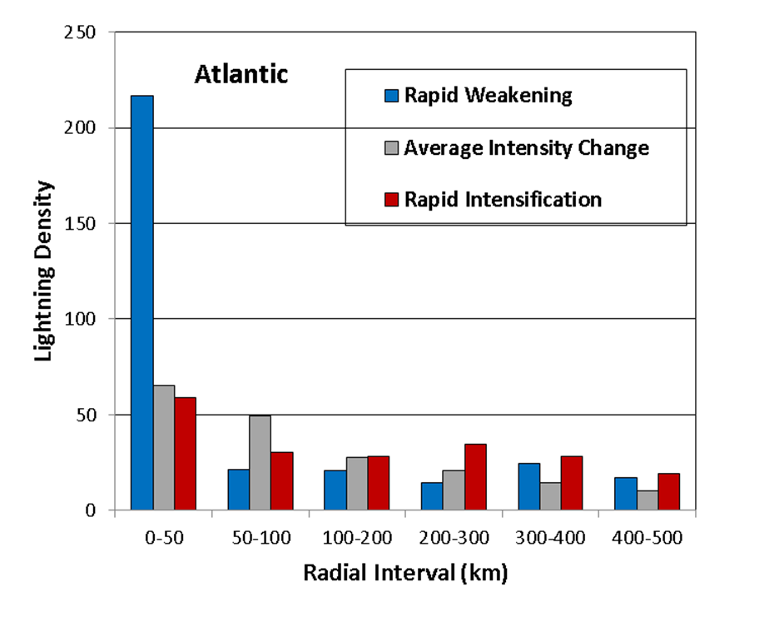
Stratification by Rapid Intensity Change in the following 24 hr

Slide 18
Experimental Algorithm in 2010 NHC Proving Ground
Operational Rapid Intensification Index modified to include lightning input
Inner core and rain band lightning density
Linear Discriminant Analysis technique used to to estimate probability of RI
Developed from 2005-2009 WWLLN sample
Lightning density from GLD360 data in real time
2010 Cases run with WWLLN input in post season for comparison

Slide 19
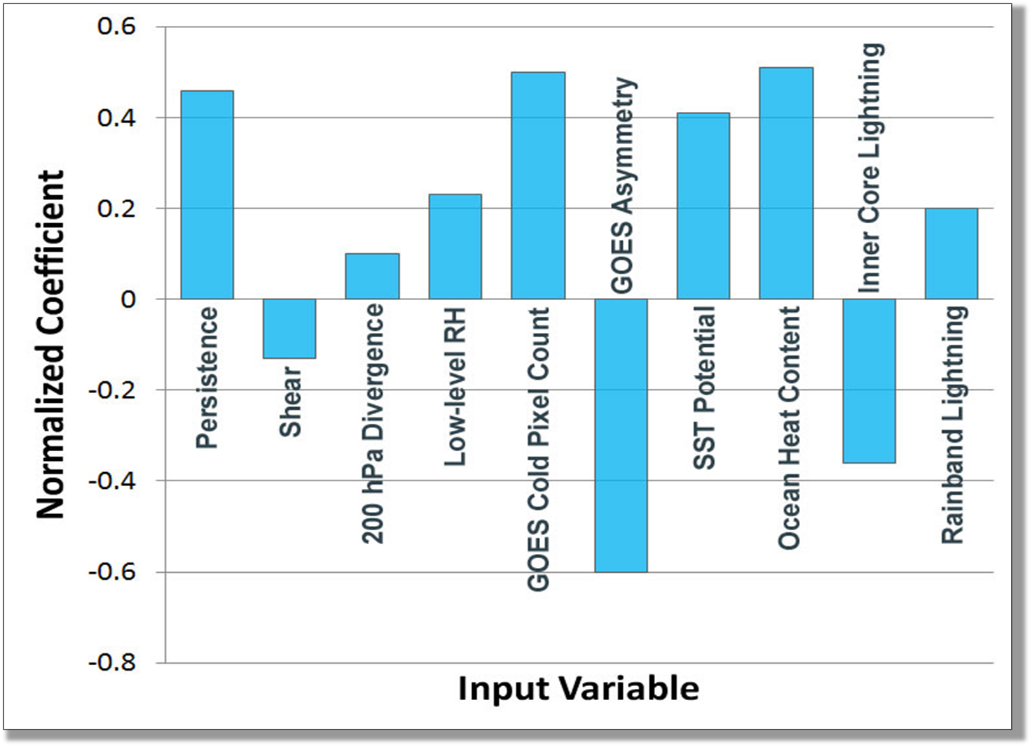
Normalized Discriminant Weights (Atlantic RII Algorithm)

Slide 20
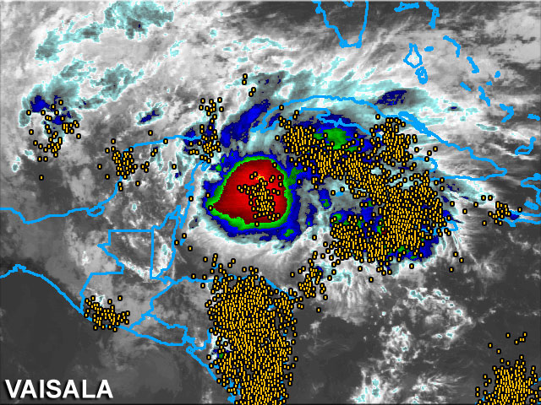
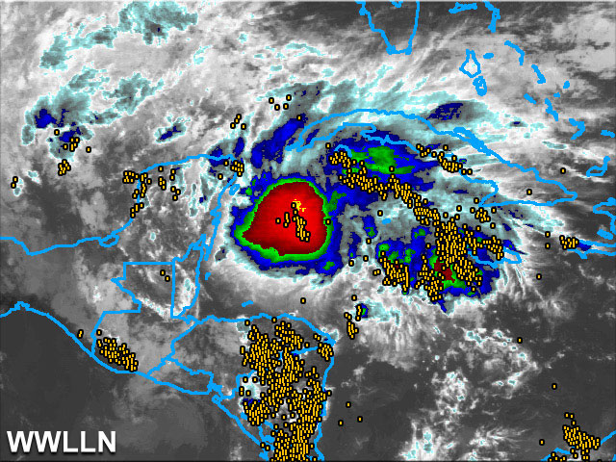
Normalization of GLD360 data
Spatially dependent adjustments to GLD360
Based on 3 month overlap of WWLLN, GLD-360
Oct-Dec 2009
Hurricane Ida Nov., 2009

Slide 21
RII Verification Metrics
Bias = ( ΣP_{f}/N_{obs} ) - 1
Brier Score = (1/N_{f})Σ[P_{f} – P_{obs}]²
Threat Score = a/(a+b+c) from 2 by 2 contingency table
Area of overlap between forecast and observations
Find max TS for range of probability thresholds

Slide 22
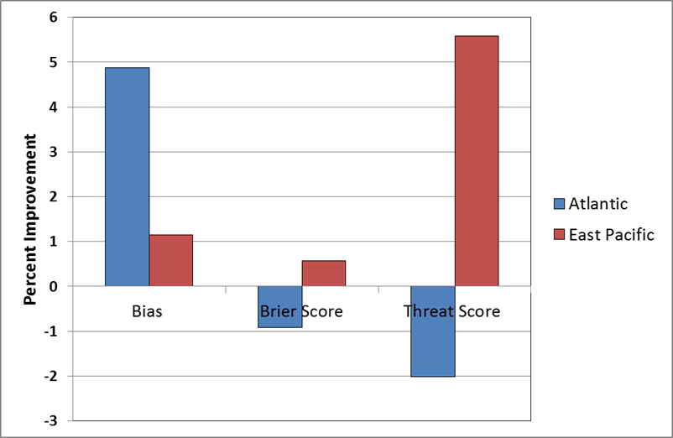
2010 Verification Results: Impact of Lightning Input (GLD360)

Slide 23
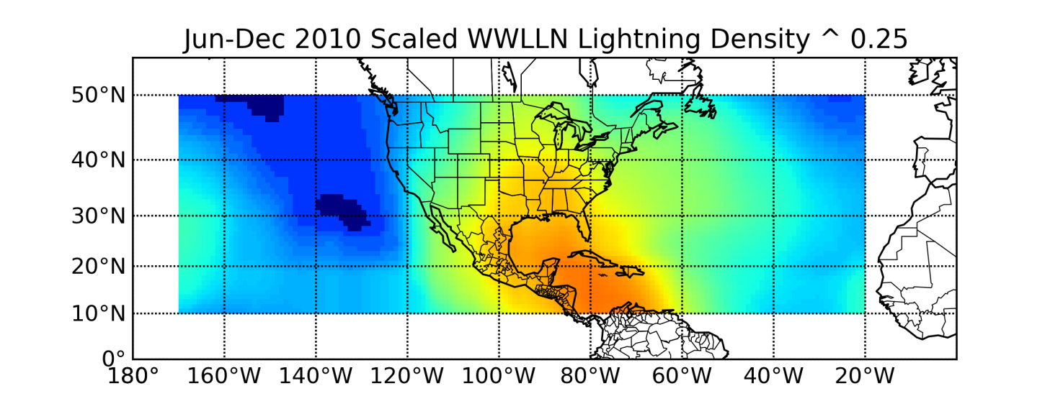
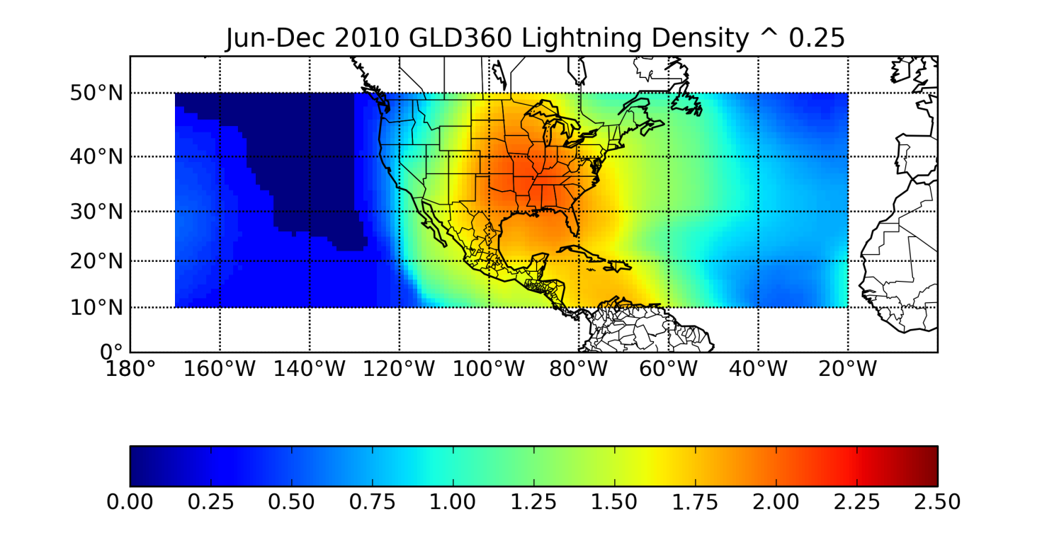
WWLLN and GLD360 Jun-Dec 2010

Slide 24
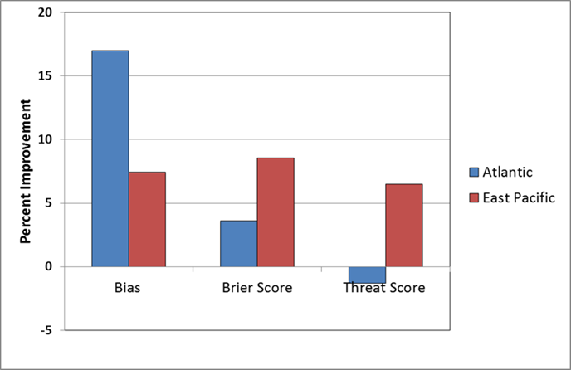
2010 Verification Results: Impact of Lightning Input (WWLLN)

Slide 25
Experimental Algorithm in 2011 NHC Proving Ground
2010 cases added to sample
2 class LDA generalized to 3 class LDA
Rapid weakening, average intensification, rapid intensification
WWLLN data obtained in real time
Not many RI cases in Atlantic so far
Several RW cases in east Pacific

Slide 26
Hurricane Lili 2002 120 to 80 kt in 18 hr before landfall

Slide 27
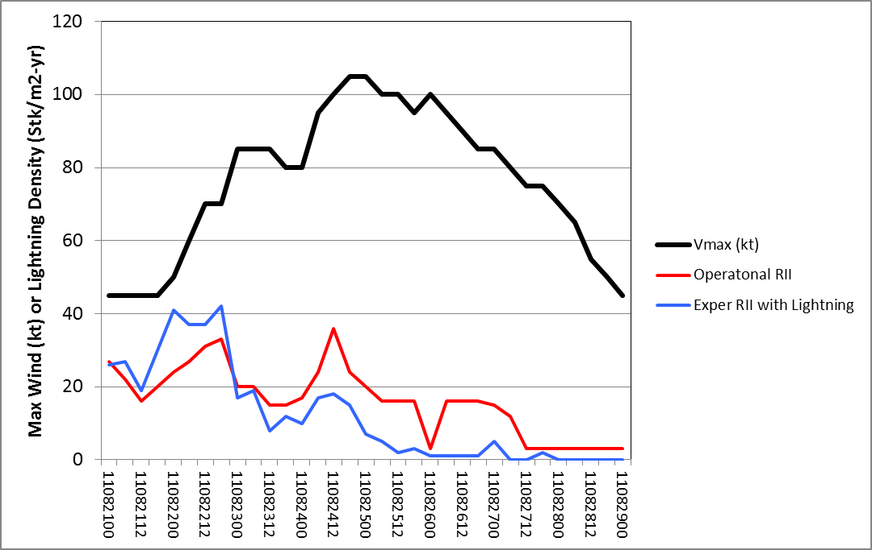
RI Probabilities For Irene (Operational and Experimental)

Slide 28
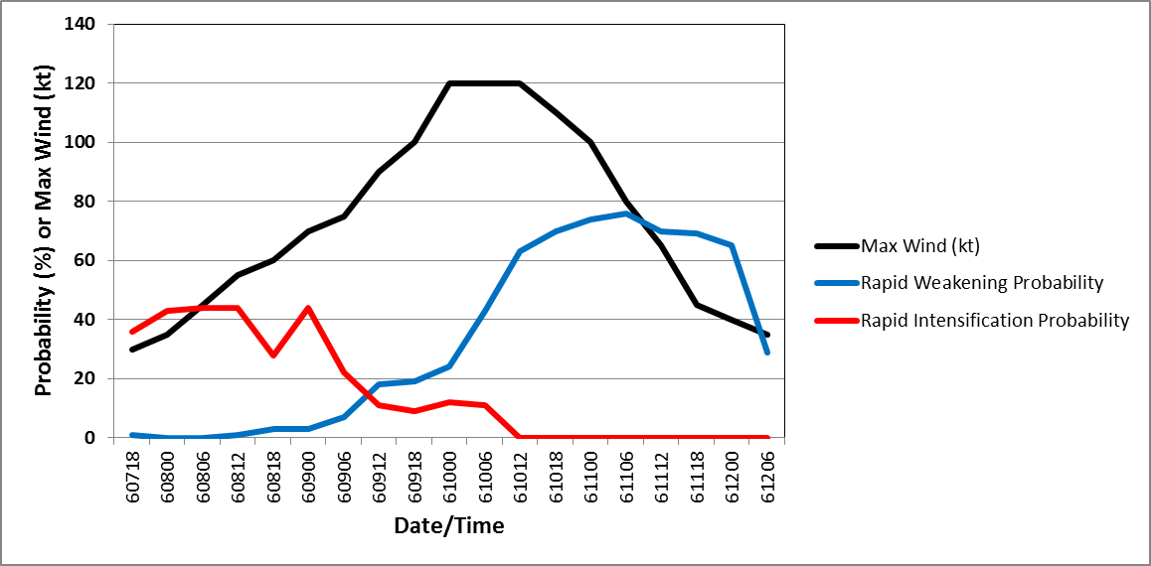
RW and RI Probabilities for East Pacific Hurricane Adrian (2011)
RI
RW

Slide 29
Conclusions
Large sample of lightning and large-scale data created for Atlantic and east Pacific tropical cyclones
Experimental rapid intensification forecast algorithm developed
Inner core and rain band lightning discriminators
Inner core lightning positively correlated with current intensification, but negatively correlated with future intensification
Independent cases from 2010 showed reduced bias, improved Brier Score in Atlantic and east Pacific
2011 algorithm also include rapid weakening probability
Quantitative evaluation following 2011 season

Slide 30
Back-Up Slides

Slide 31
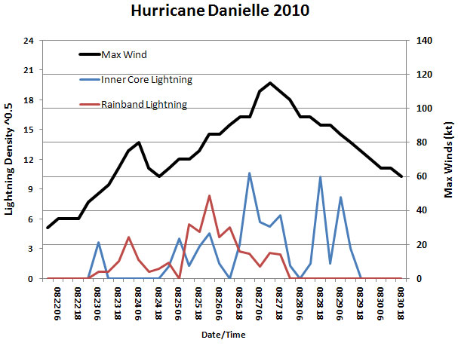
Qualitative Use of Lightning Time Series Hurricane Danielle (2010) example

Slide 32
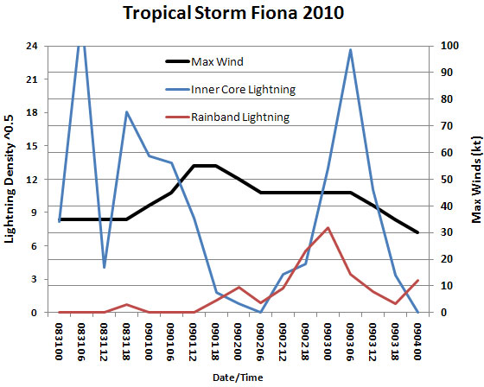
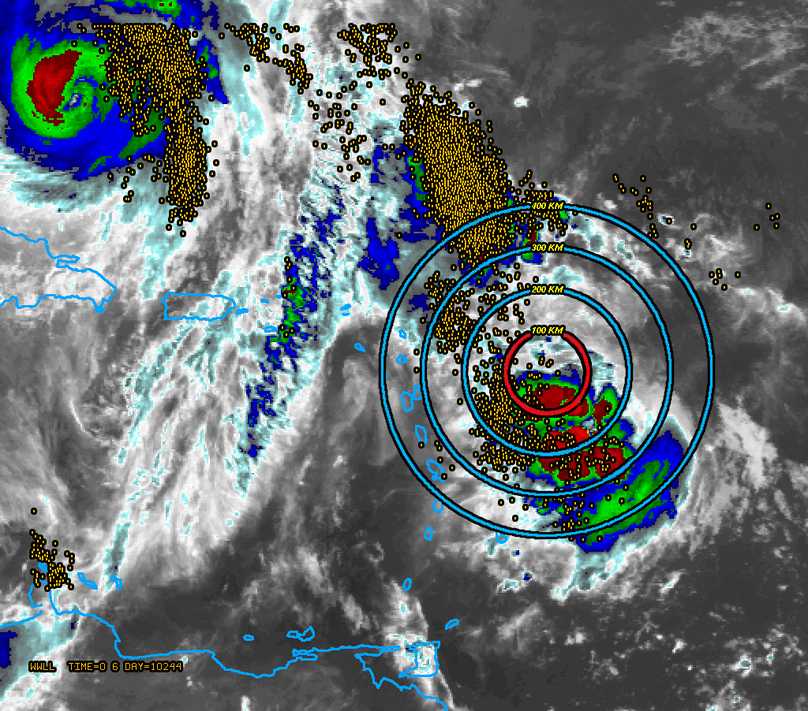
Qualitative Use of Lightning Time Series Tropical Storm Fiona (2010) example

Slide 33
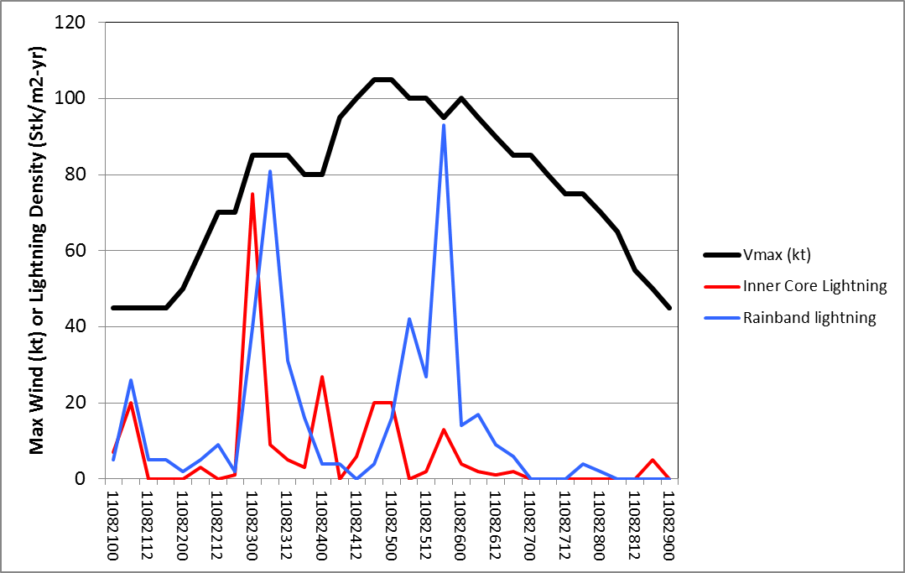
Irene Max Wind and Lightning Density
RI
Caption. Working best track shows just one 24 hr period with RI (30 kt increase). Lightning data showed two time periods (around 082306 and 082600) with best configuration for intensification (large rainband, less inner core lightning). In first period intensification may have been hindered by interaction with Hispaniola. In second period (north of the Bahamas) large pressure falls occurred, but wind increase was small.

Slide 34
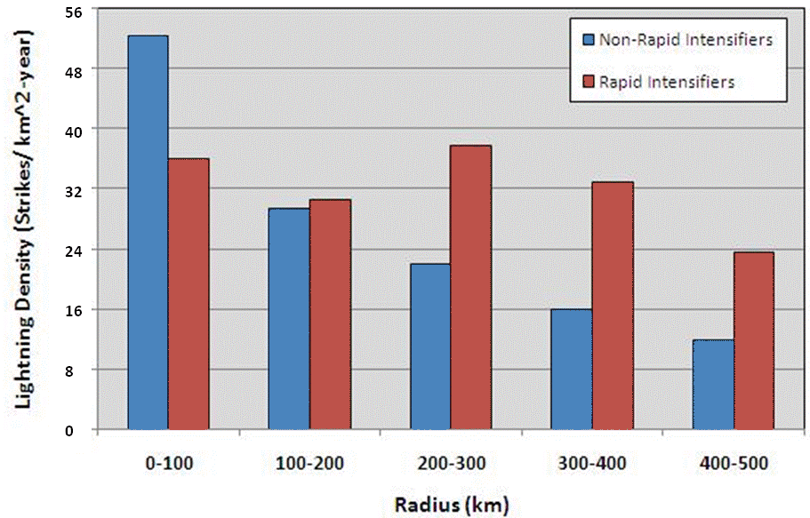
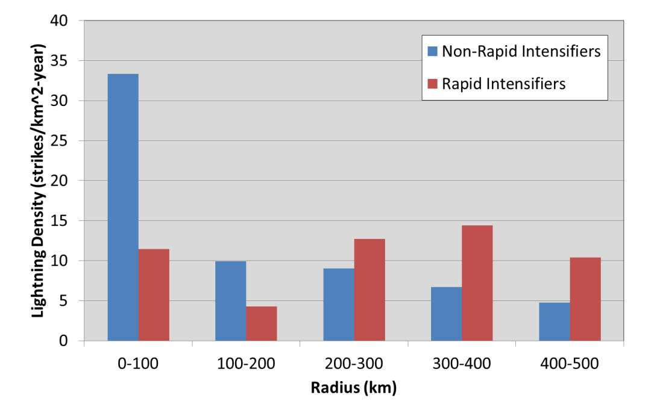
Lightning Density vs. Radius for RI and non-RI Cases
Atlantic East Pacific
Lightning density also function of vertical shear, SST, initial intensity, etc.

Slide 35
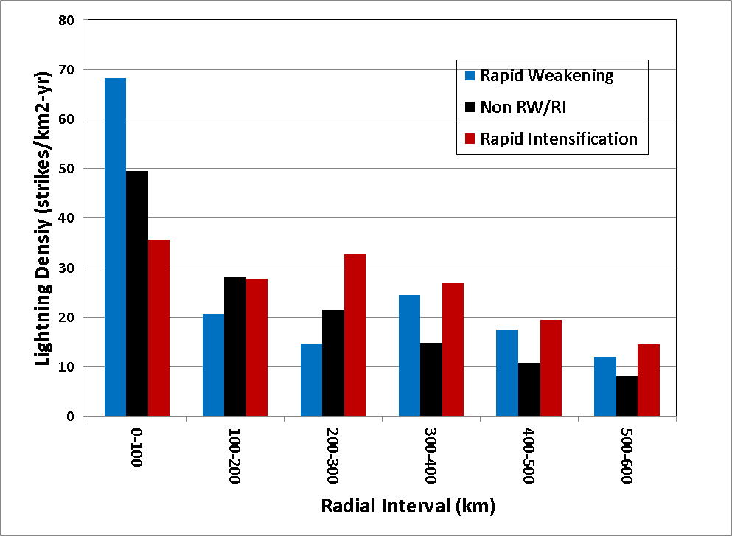
2005-2010 Atlantic Sample Lightning Density for RW, Avg, RI Cases

Slide 36
Evaluation of GLD360 to WWLLN Adjustment
2010 WWLLN data obtained in post season
Compare RII lightning parameters with GLD306 and WWLLN input
Rerun 2010 RII forecasts with WWLLN-based parameters

Slide 37
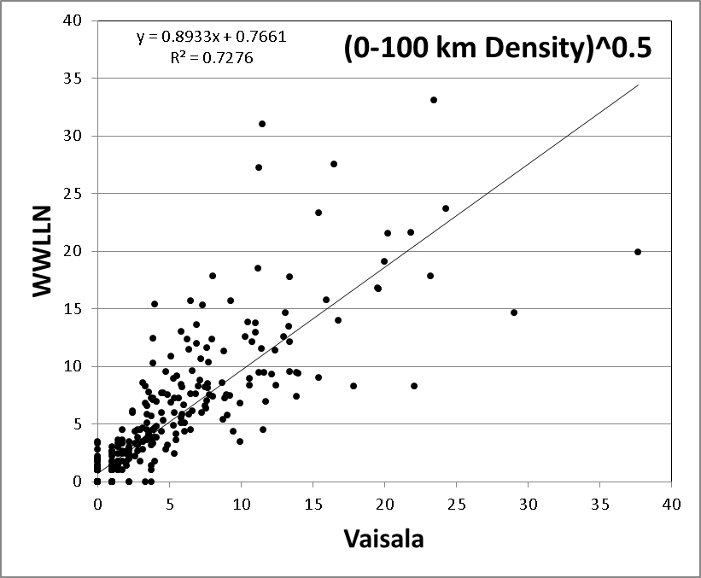
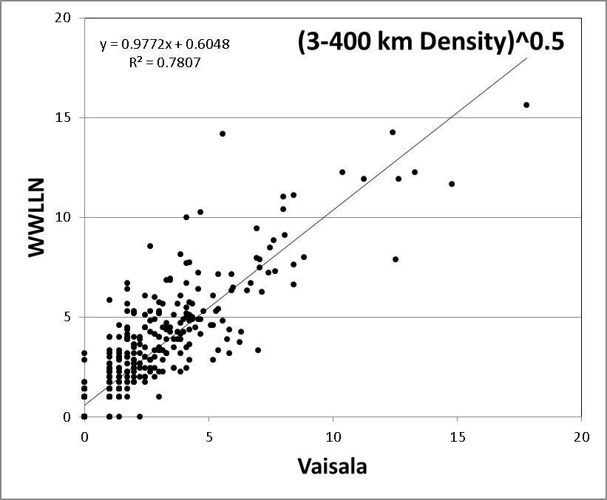
Comparison of RII Input Parameters with WWLLN and Vaisala

Slide 38
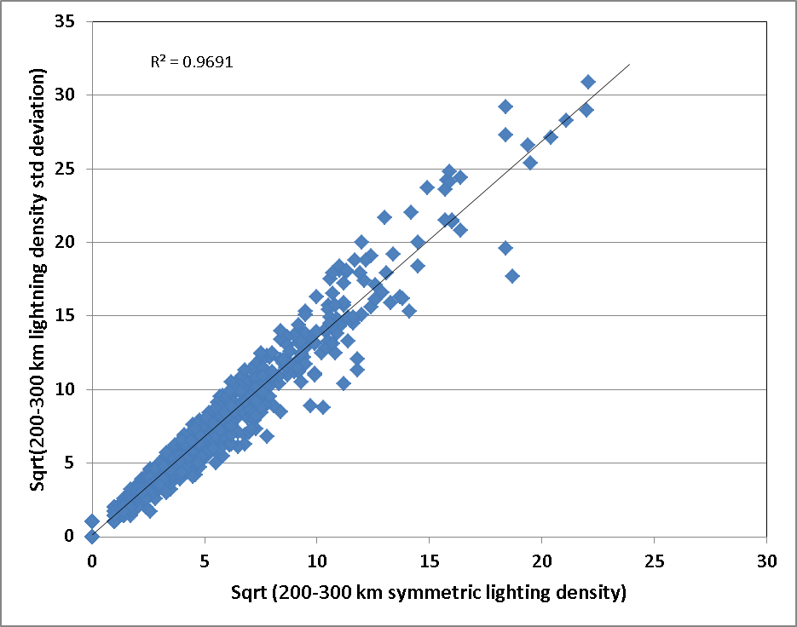
Use of Lightning Asymmetry
Mean and Standard Deviation are Highly Correlated

